Slide 1
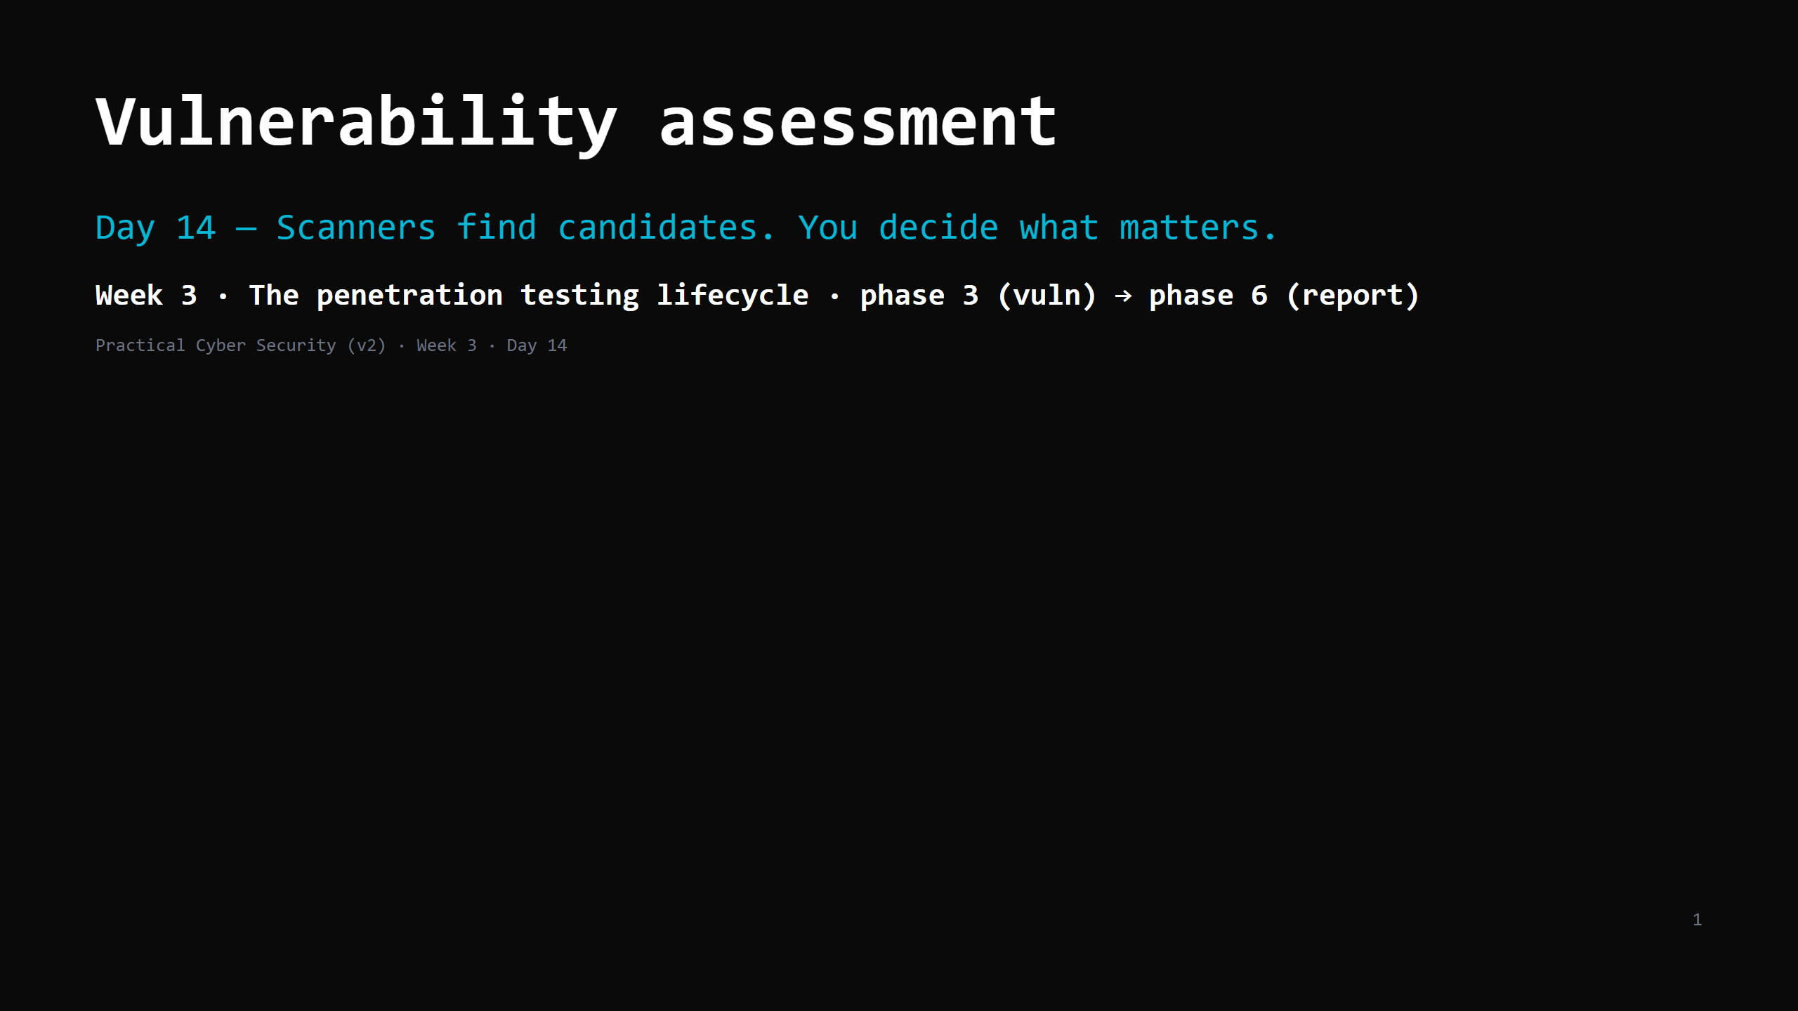
Notes:
RUN SHEET (~85 min).
00:00 Journey check + hook (two 9.8s, one matters) 4
00:04 The pipeline 5
00:09 CVE & the NVD 7
00:16 CVSS — reading the vector 10
00:26 DO: decode 2 CVSS vectors 5
00:31 "Is there a public exploit?" 7
00:38 DO: run a vuln scanner on the lab 16
00:54 From scan output to a ranked findings list 9
01:03 The report trap + writing a finding 6
01:09 Attack <-> defence 4
01:13 Wrap + artifact + homework 4
CUT FIRST IF SHORT: CVSS Scope/temporal detail; the report-writing slide to "a finding =
title + severity + evidence + repro + impact + fix".
NEVER CUT: the pipeline, CVSS AV/PR/UI basics, the exploitability question (KEV/Exploit-DB),
the ranked findings table, "more findings != better report".
ANALOGY (kitchen / inspector): the scanner = a junior who flags EVERYTHING on the checklist
("extinguisher expired! chipped plate! walk-in 1 degree warm!"). The assessor = the senior
who says "the expired extinguisher by the fryer could kill someone; the plate is a note."
ETHICS: scan only <LAB_HOST> (in the ROE). Metasploitable2 is the primary target; DVWA is the
web-side target for `nikto`. Own lab: MS2 `10.89.1.10`, DVWA `10.89.1.20`.

Slide 2
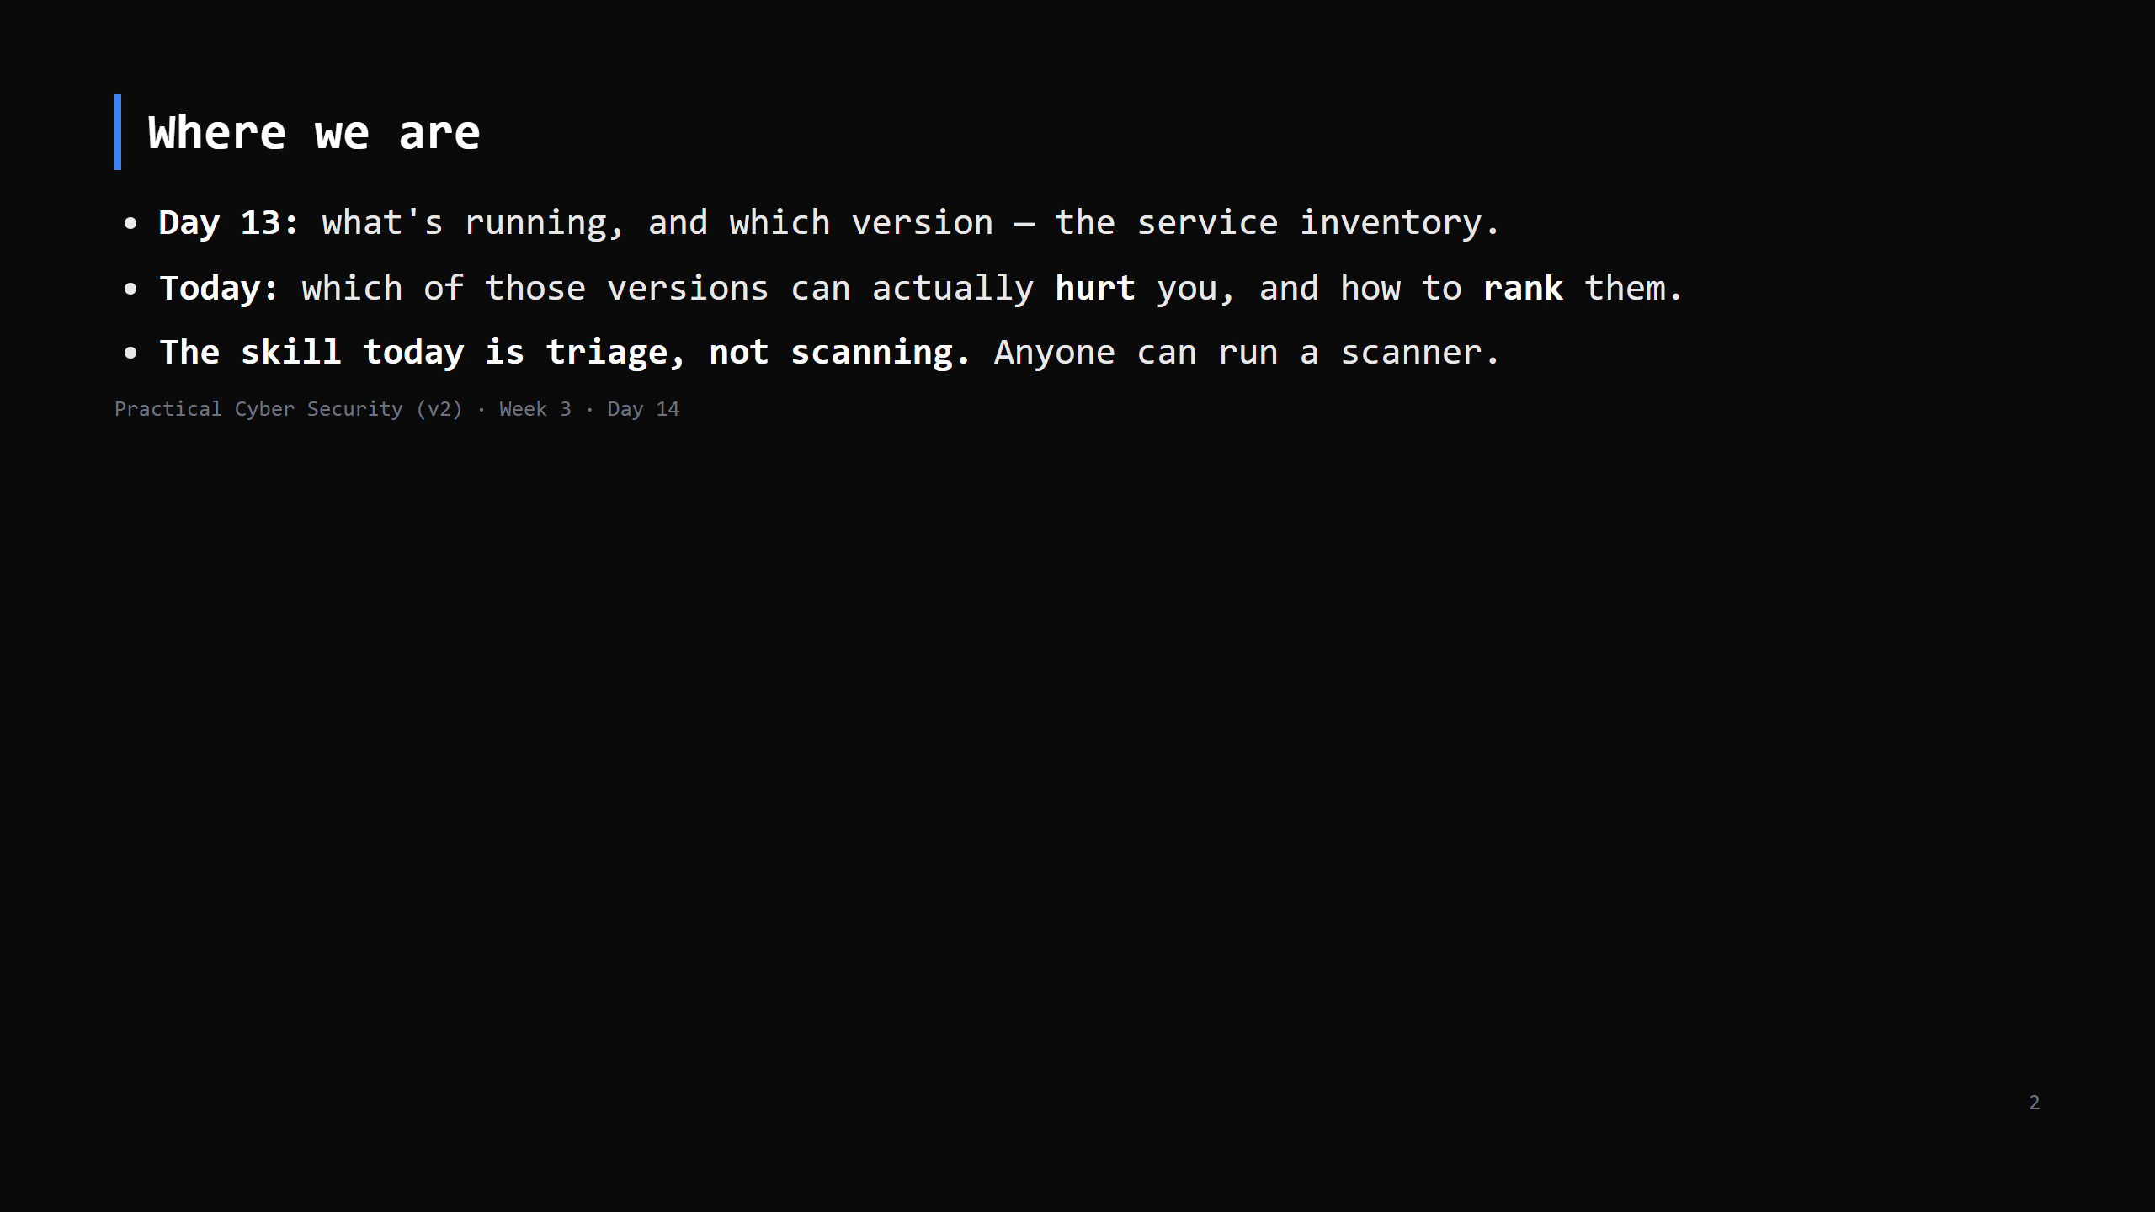
Notes:
Journey Check. This is the pivot from "I found things" to "here's what to fix first" — the
part a client actually pays for.

Slide 3
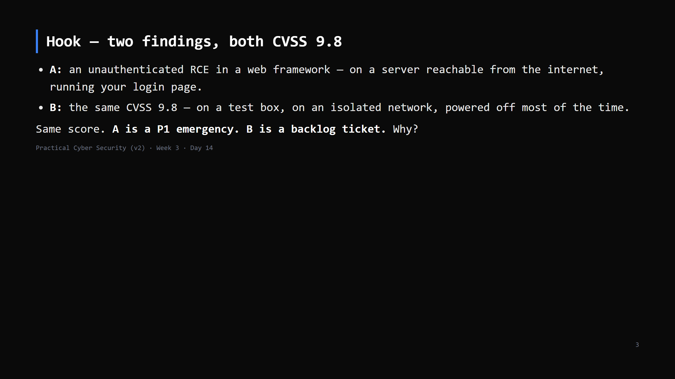
Notes:
The number is the same; the RISK is not. CVSS has no idea where the box is, whether it's
exposed, whether anyone's exploiting it, or what's behind it. That context is your job.

Slide 4
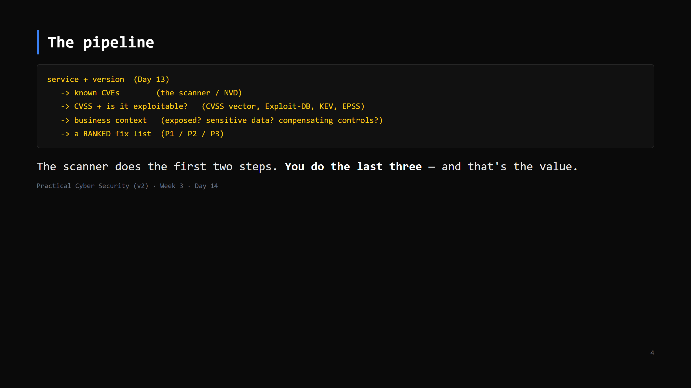
Notes:
Put this on the board. Every finding walks this path. A scanner that stops at step 2 gives you
a list; you turn it into a plan.

Slide 5
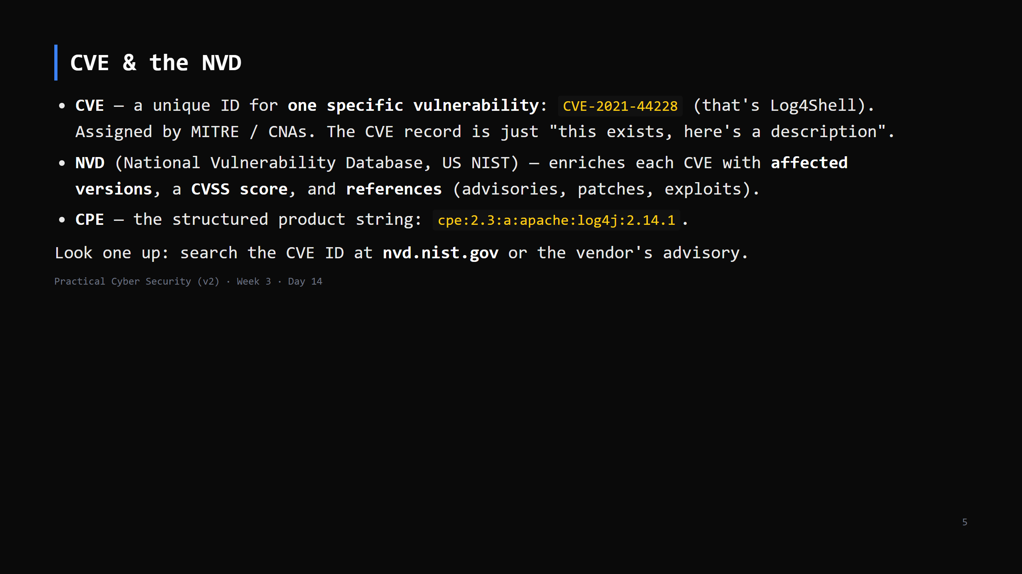
Notes:
Your Day 13 banner ("Apache httpd 2.4.49") -> search "Apache 2.4.49 CVE" -> CVE-2021-41773
(path traversal -> RCE). That lookup is the everyday move.
Vendor advisories are often more accurate than NVD on "are WE affected" (config matters).

Slide 6
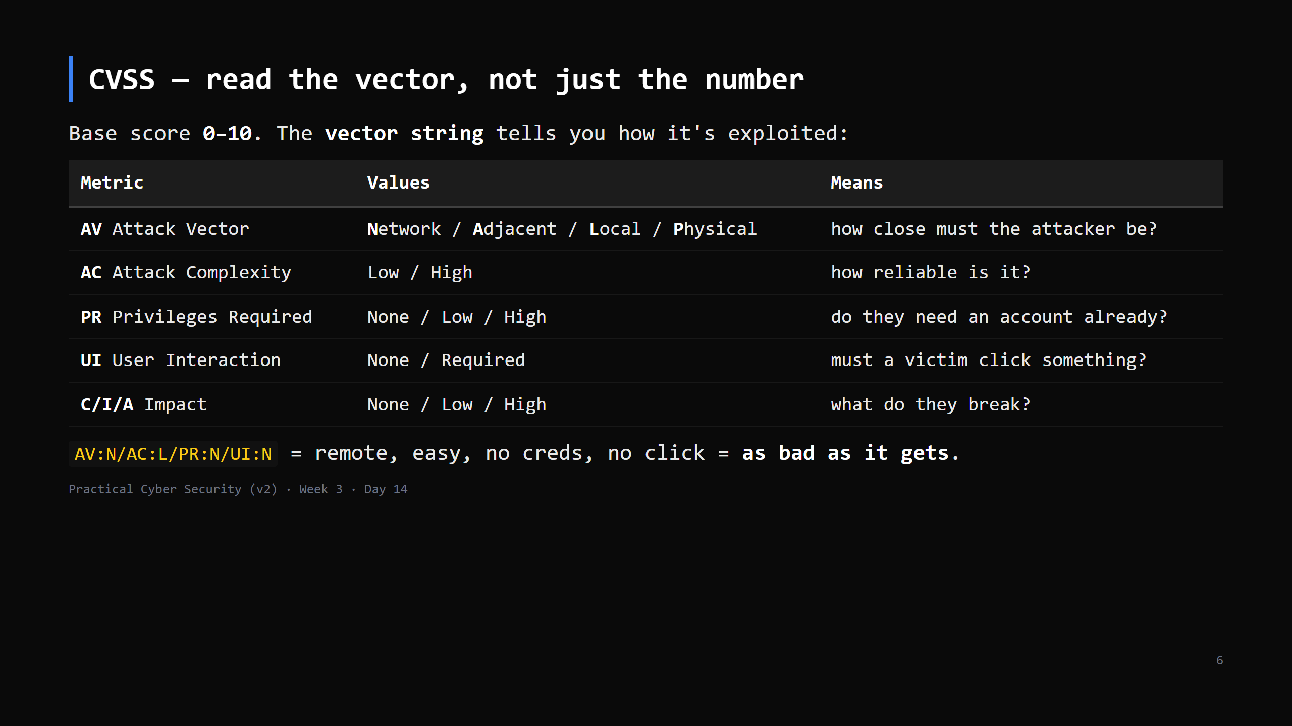
Notes:
Bands: 0.1-3.9 Low, 4.0-6.9 Medium, 7.0-8.9 High, 9.0-10.0 Critical.
The number is a rough triage aid. It is NOT risk: no exposure, no "exploited in the wild", no
asset value. Temporal/Environmental metrics exist to add some of that — most people ignore them.
CUT Scope + temporal detail first if short.

Slide 7
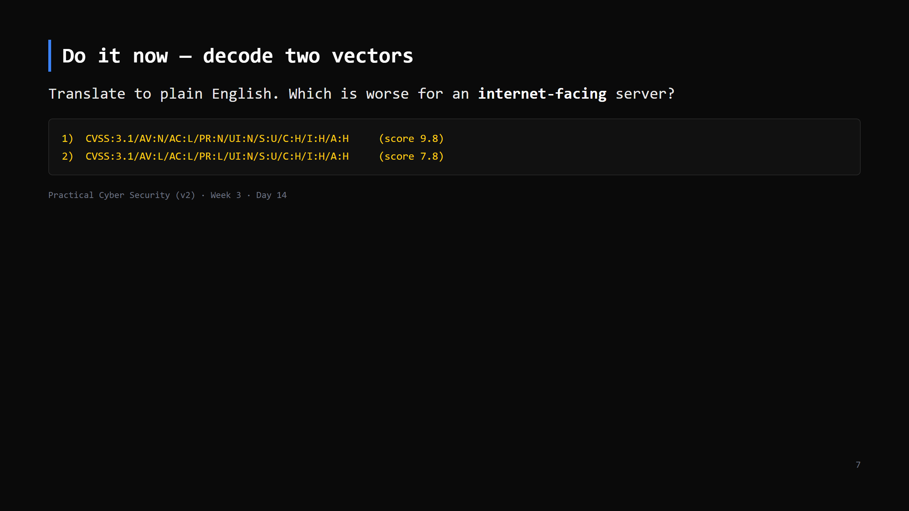
Notes:
5 min.
1) Network, low complexity, no privileges, no user interaction, full C/I/A impact -> a remote
unauthenticated attacker fully owns it. Critical everywhere.
2) LOCAL access, needs some privileges already -> the attacker must ALREADY be on the box with
an account. That's a privilege-escalation bug (Day 7). Bad, but not the front-door
emergency #1 is. For an internet-facing box, #1 is the fire.

Slide 8
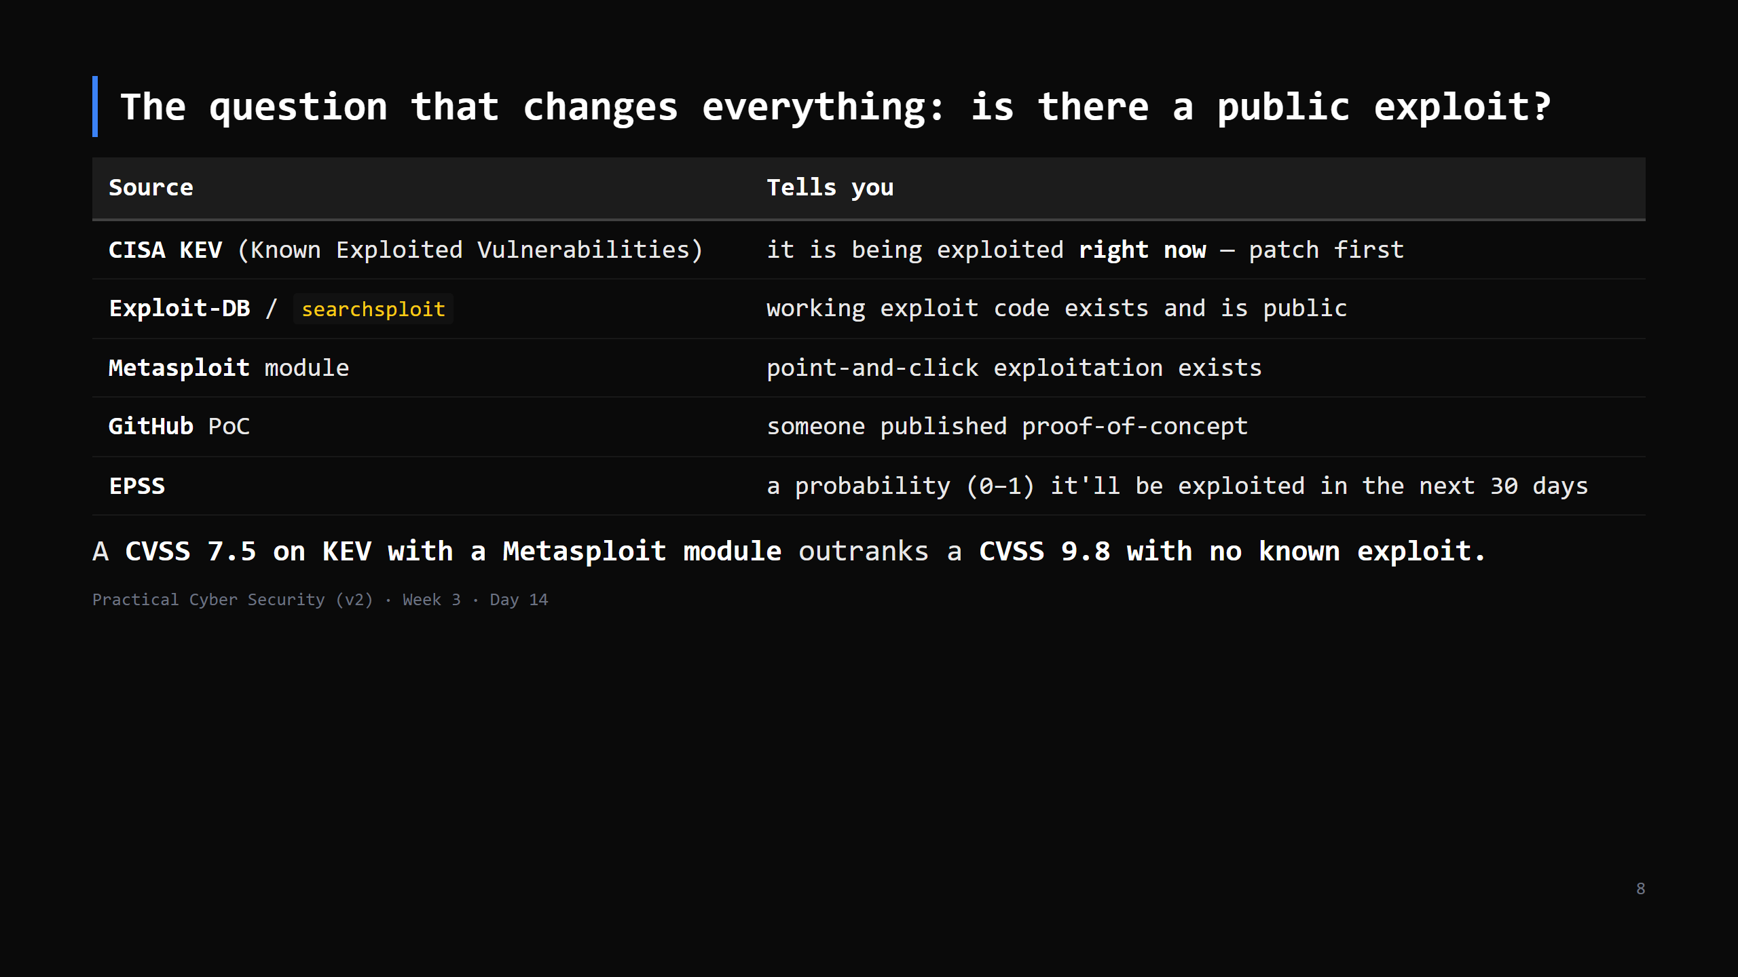
Notes:
KEV is the single best free prioritisation list — CISA only adds things with confirmed
in-the-wild exploitation. `searchsploit apache 2.4.49` on Kali is the everyday check.
"No public exploit yet" doesn't mean safe — it means less urgent than the ones that do.

Slide 9
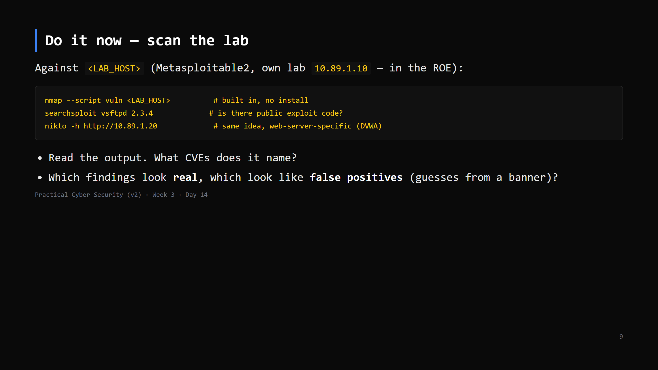
Notes:
16 min. `--script vuln` runs NSE vuln-category scripts — decent, noisy, and it WILL produce
false positives (it often flags things based on version alone without confirming). That's the
lesson: the scanner is a candidate generator.
If Nuclei is installed: `nuclei -u http://<LAB_HOST>` for the web side. OpenVAS is heavier -
optional, instructor demo. `nikto` above already covers the everyday web-scanner case.
No lab? assets/sample-vulnscan.txt.

Slide 10
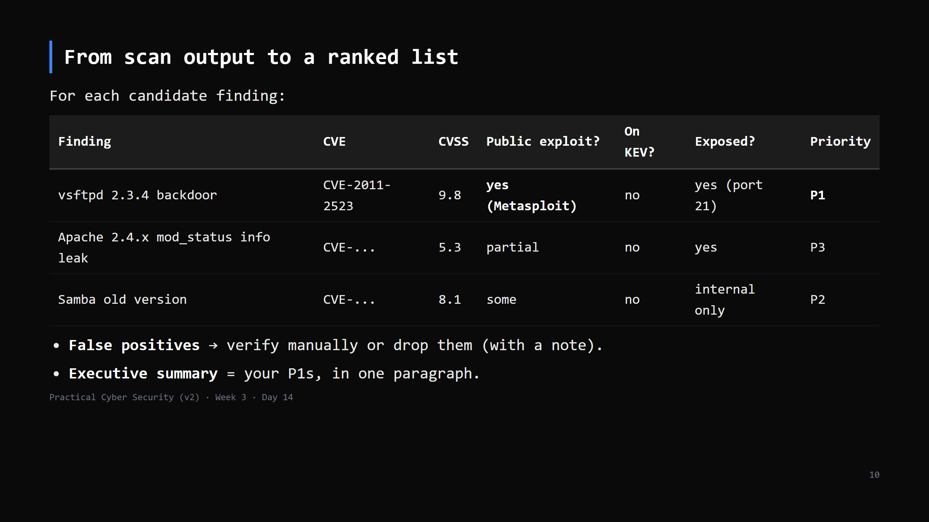
Notes:
This table is the artifact and the seed of the Week 3 assignment. The columns after "CVSS"
are what a scanner can't do for you.
Priority is a judgement: CVSS + exploit availability + exposure + what's behind it.

Slide 11
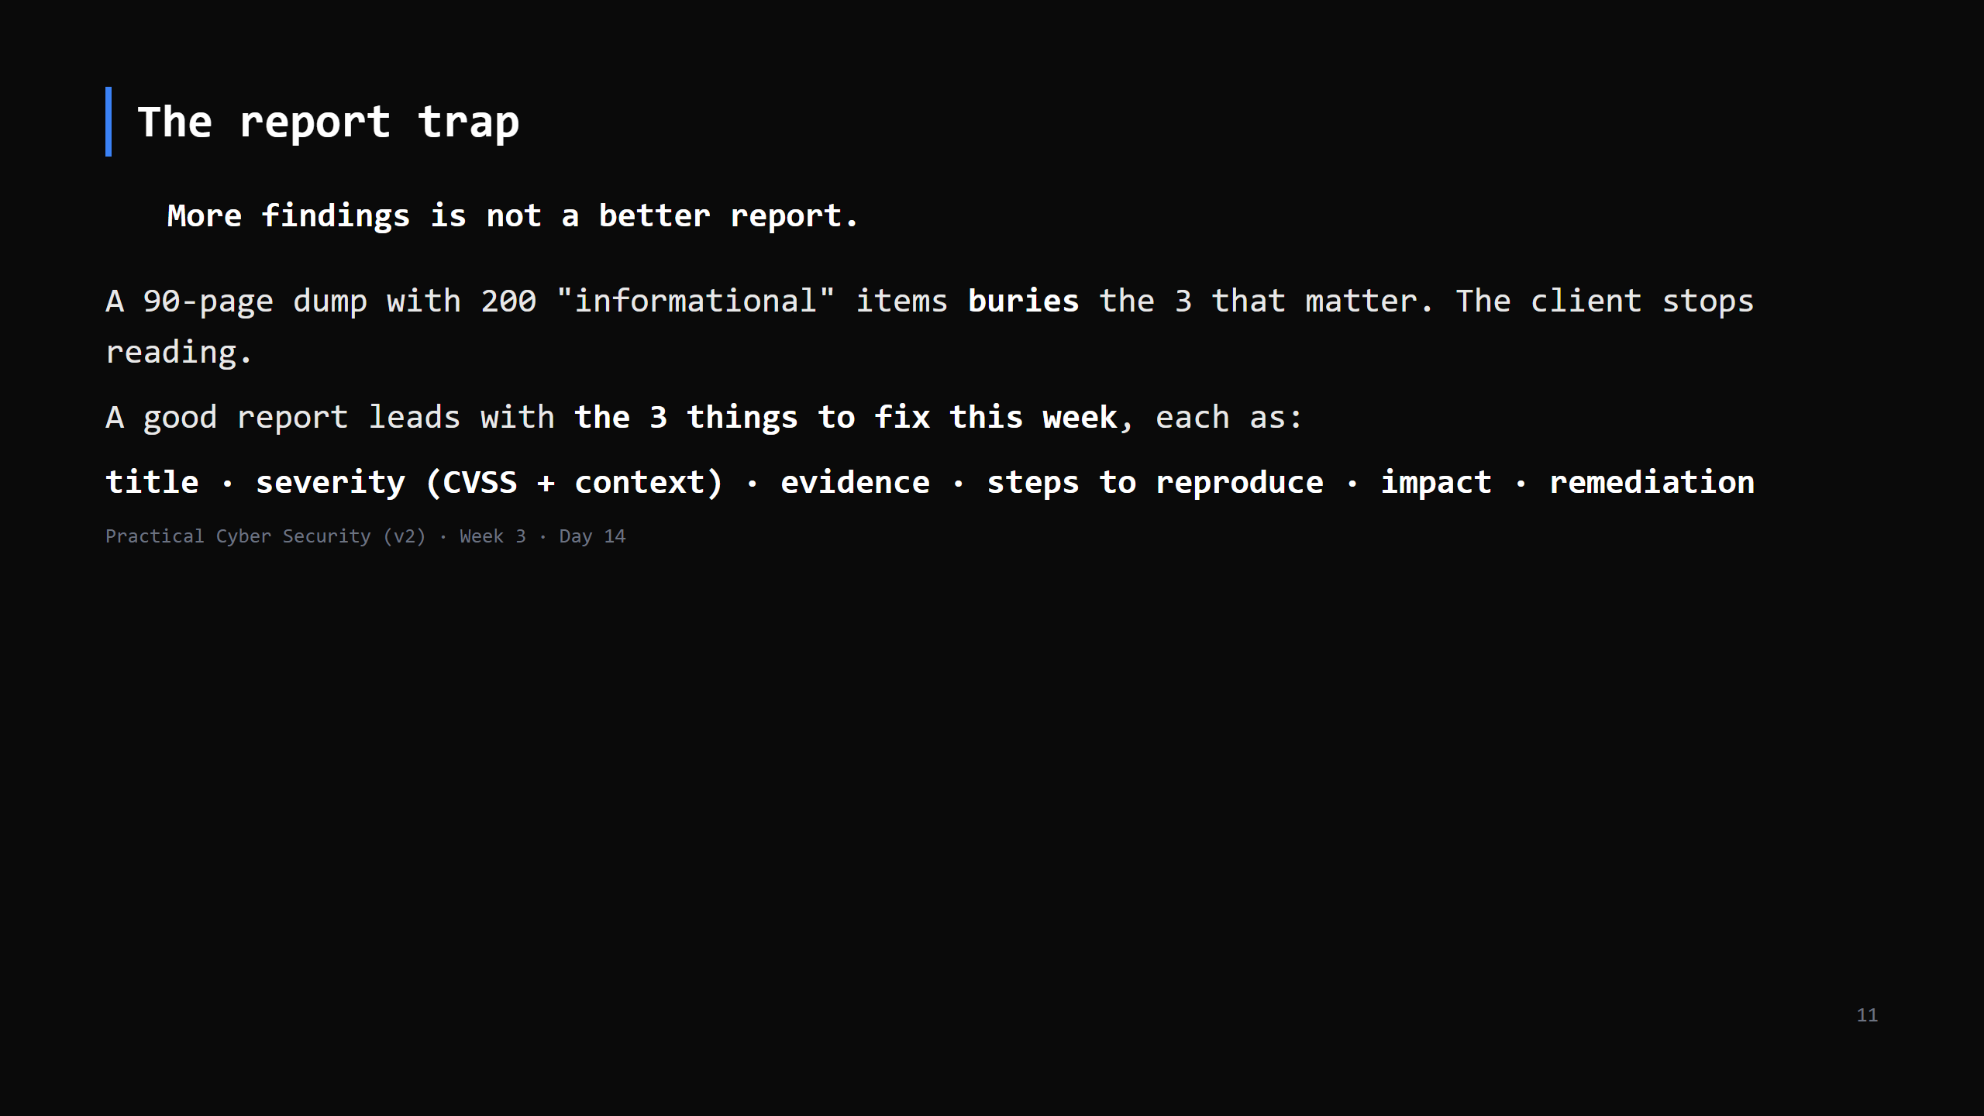
Notes:
The Day 14 trap. Junior testers pad reports to look thorough. Senior testers make the client's
decision easy: "fix these 3 now, these 5 this month, the rest is hygiene."
CUT this slide to the "a finding = ..." line if short.

Slide 12
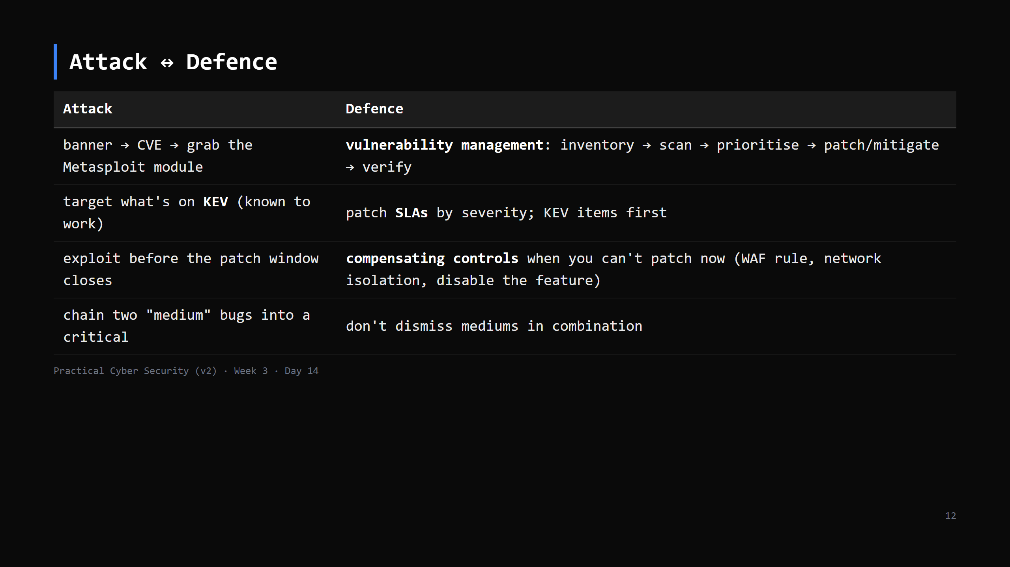
Notes:
Real orgs can't patch everything instantly - the discipline is a *program*: know what you
have, scan regularly, fix by risk, and verify the fix landed. KEV gives you the "do these
first" list for free.

Slide 13
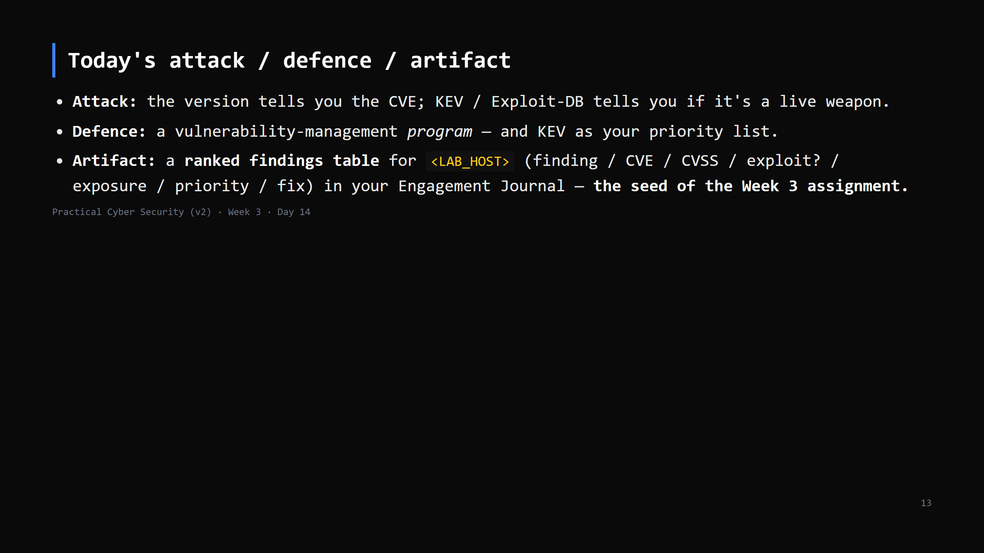

Slide 14
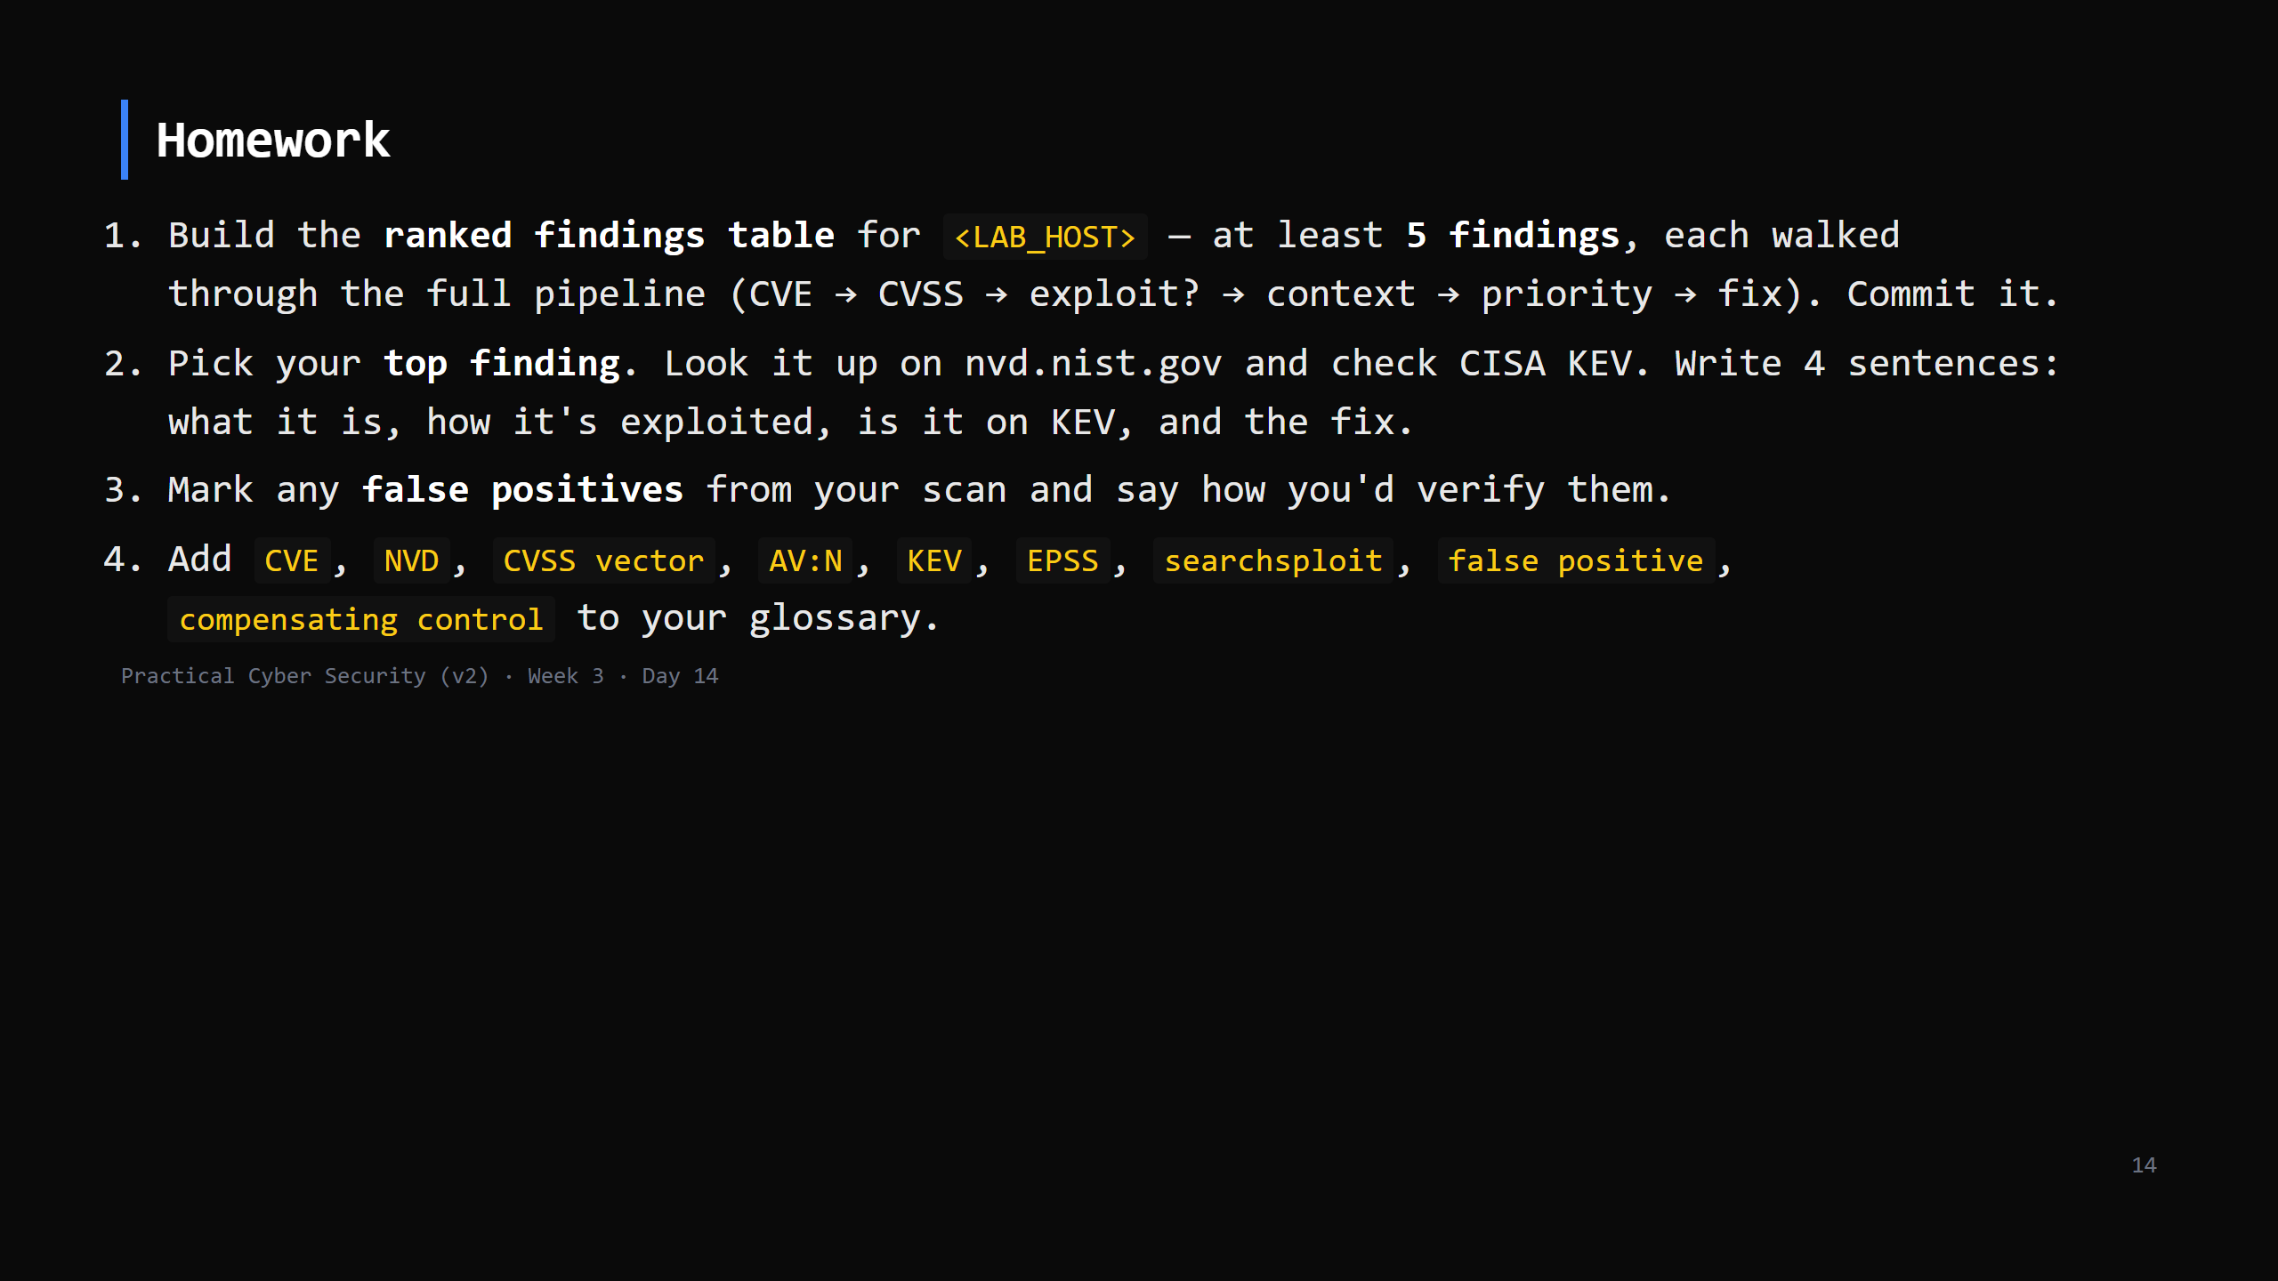
Notes:
Due start of Day 15 (the practice day). This table becomes Week 3 assignment Part A.

Slide 15
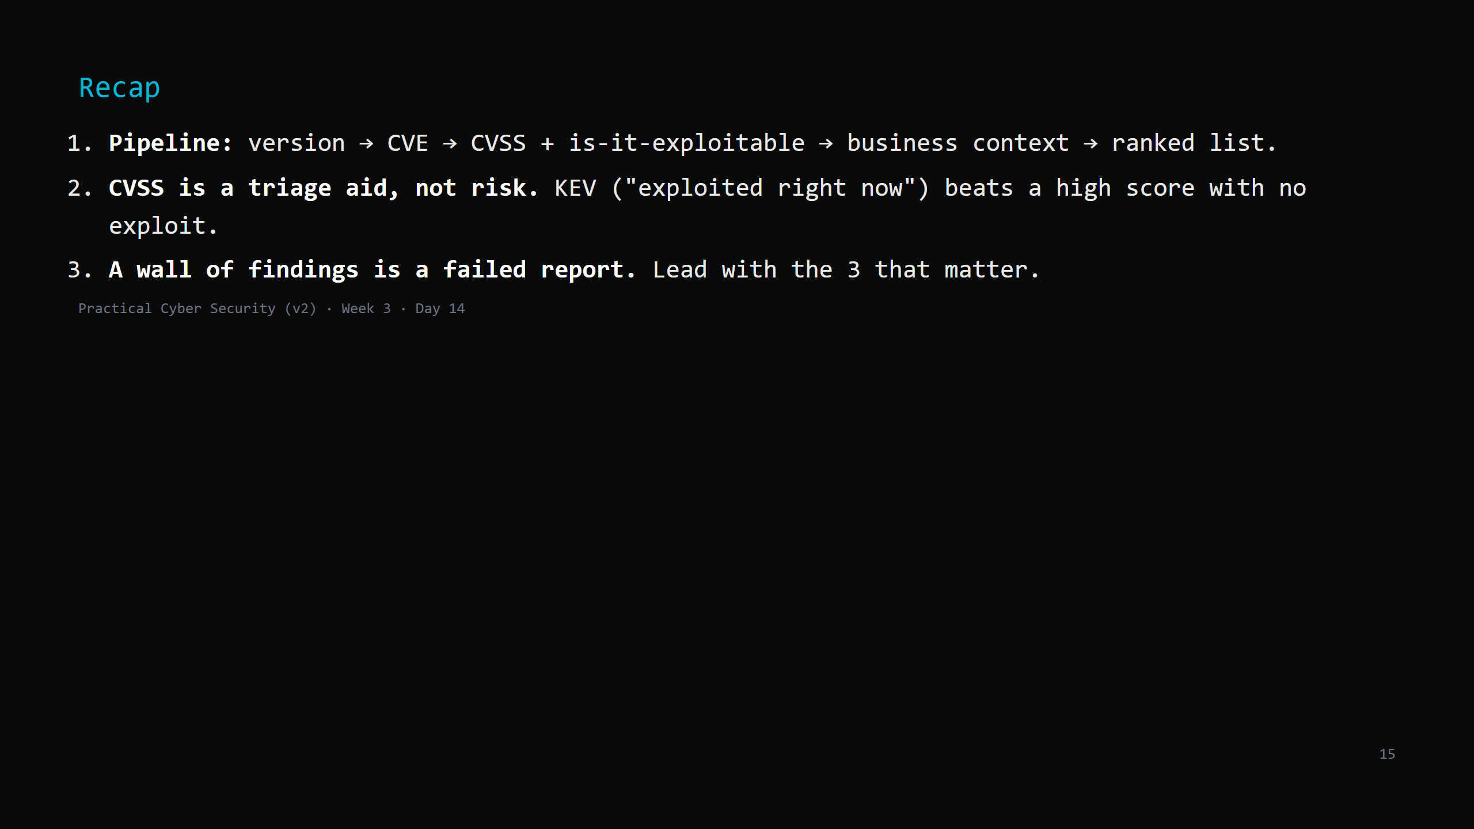
Notes:
Say the three lines. Tomorrow: the practice day - you run the whole lifecycle end to end
(recon -> scan -> vuln -> proof) on a fresh target, coached, and write it up. Plus the Week 3
assignment brief.

