Slide 1
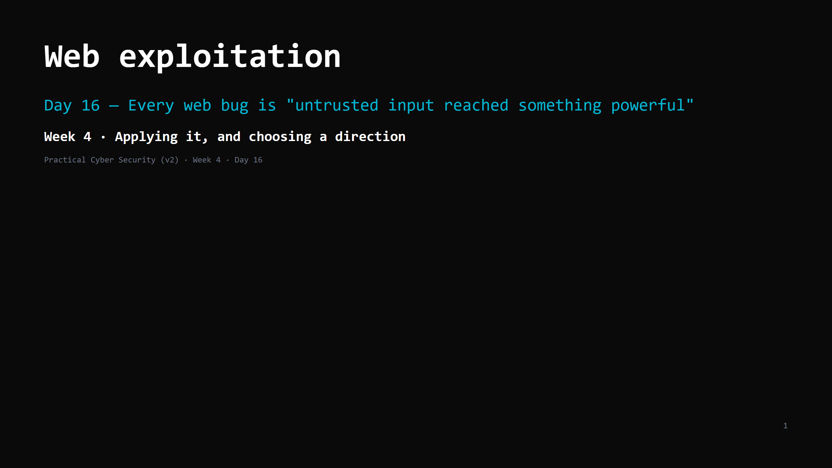
Notes:
RUN SHEET (~85 min). Hands-on heavy. DVWA at "low" then "medium"; Juice Shop.
00:00 Journey check + hook (SQLi login bypass, live) 4
00:04 How a web app works + the tools (DevTools / Burp) 7
00:11 The OWASP Top 10 — the shape 5
00:16 #1 Injection / SQLi — the mechanism 11
00:27 DO: SQLi — login bypass + UNION extract 12
00:39 #2 XSS — reflected / stored / DOM 10
00:49 DO: stored XSS 10
00:59 #3 Broken access control / IDOR 7
01:06 #4 & #5 — broken auth/session, SSRF 5
01:11 Attack <-> defence — the one pattern 4
01:15 Trap + wrap + homework 5
CUT FIRST IF SHORT: step 4 (sqlmap) of the SQLi DO — narrate/demo it yourself in 60s instead of
having everyone run it; the SSRF half of #4-5; the Burp demo to 2 min; DOM XSS detail.
NEVER CUT: the injection mechanism + the SQLi DO, XSS + the stored-XSS DO, IDOR, the
"parameterize don't filter" trap, the find/prove/fix artifact.
ANALOGY (kitchen): untrusted input = an order ticket. If the kitchen blindly does whatever the
ticket says ("table 4: two pastas AND unlock the safe"), that's injection. A parameterized
query = an order form with fixed fields — the customer fills VALUES, never instructions.
ETHICS: DVWA / Juice Shop on <LAB_HOST> only (the ROE). These apps are built to be attacked.
Own lab: DVWA `10.89.1.20`, Juice Shop `10.89.1.30` — see the Day 13 teacher-notes lab tool map.

Slide 2
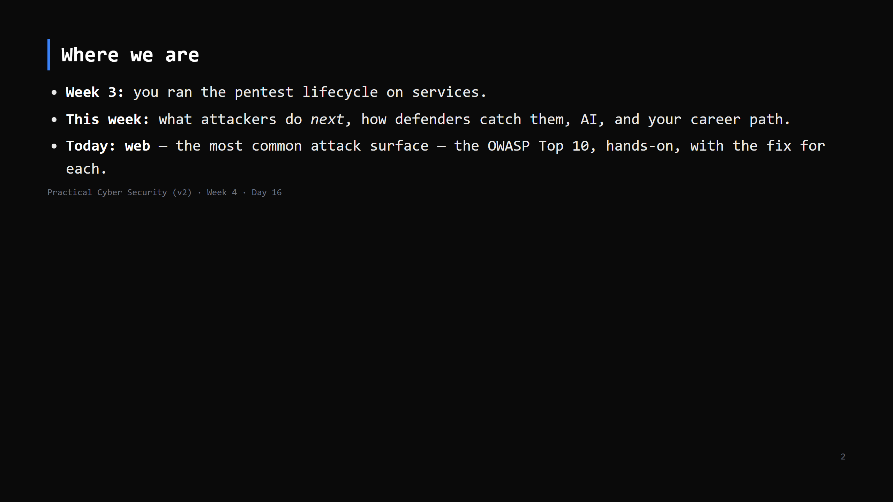
Notes:
Journey Check. Week 4 opens. Today is the most hands-on day of the course. Callback to Day 10:
"where does data from outside cross into somewhere powerful?" — today we walk through the door.

Slide 3
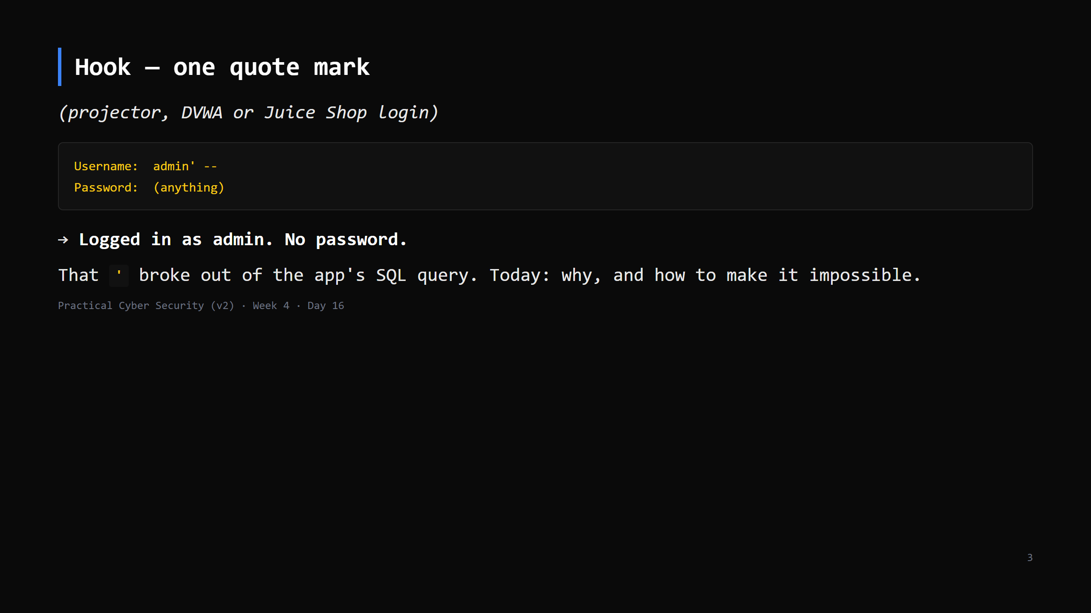
Notes:
Do it live. The `--` comments out the rest of the query (the password check). Let it land.
"The app trusted your input inside a command. That's the whole day."

Slide 4
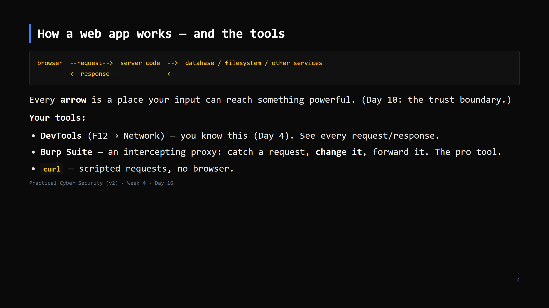
Notes:
Burp 2-min version: Proxy tab -> Intercept on -> browse -> the request pauses -> edit any
field -> Forward. Or "send to Repeater" to replay + tweak. That's 80% of web testing.
DVWA/Juice Shop are deliberately vulnerable training apps - attacking them is the point.

Slide 5
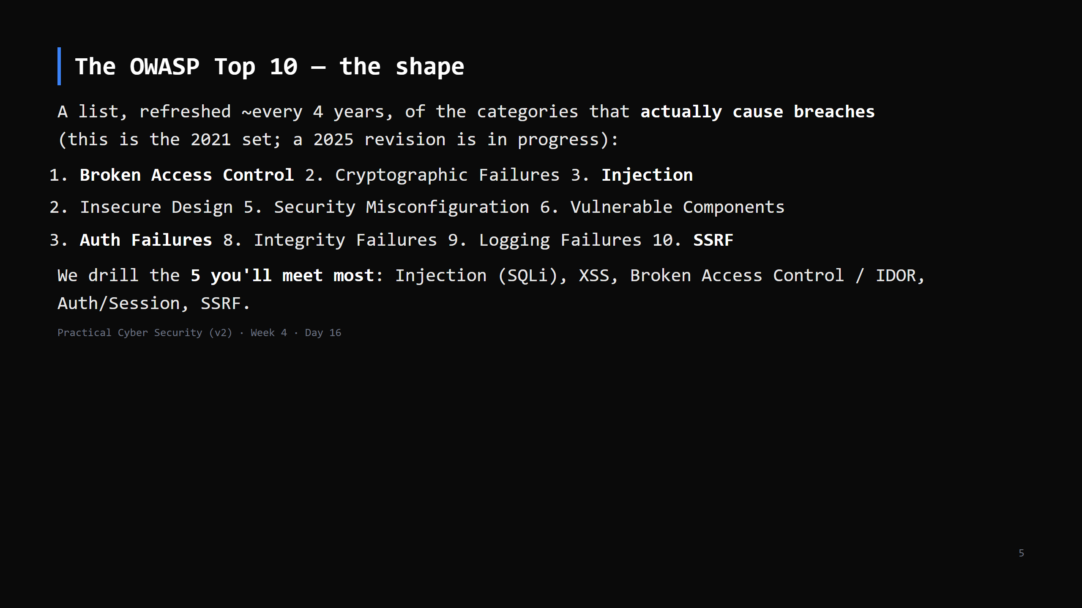
Notes:
It's not a checklist to memorise - it's "these are where the money is". Broken Access Control
is #1 because it's everywhere and scanners miss it (it needs logic understanding).
XSS lives under "Injection" in the current list but we teach it separately - it behaves differently.

Slide 6
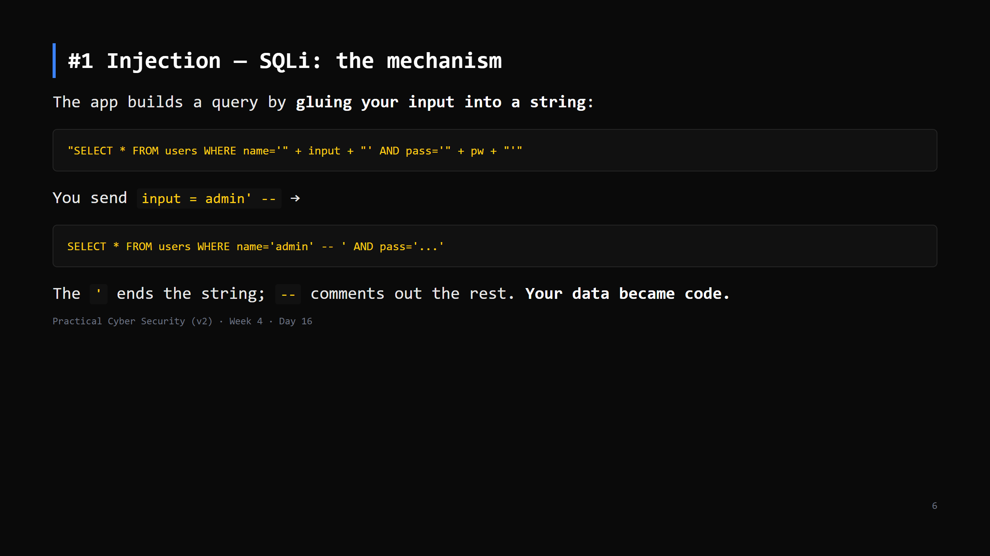
Notes:
Three flavours:
- Login bypass: `' OR '1'='1' -- `
- UNION extract: `' UNION SELECT username, password FROM users -- ` (pull data into the page)
- Blind: no output, but the page behaves differently for true vs false, or you time it
(`' OR SLEEP(5) -- `)

Slide 7
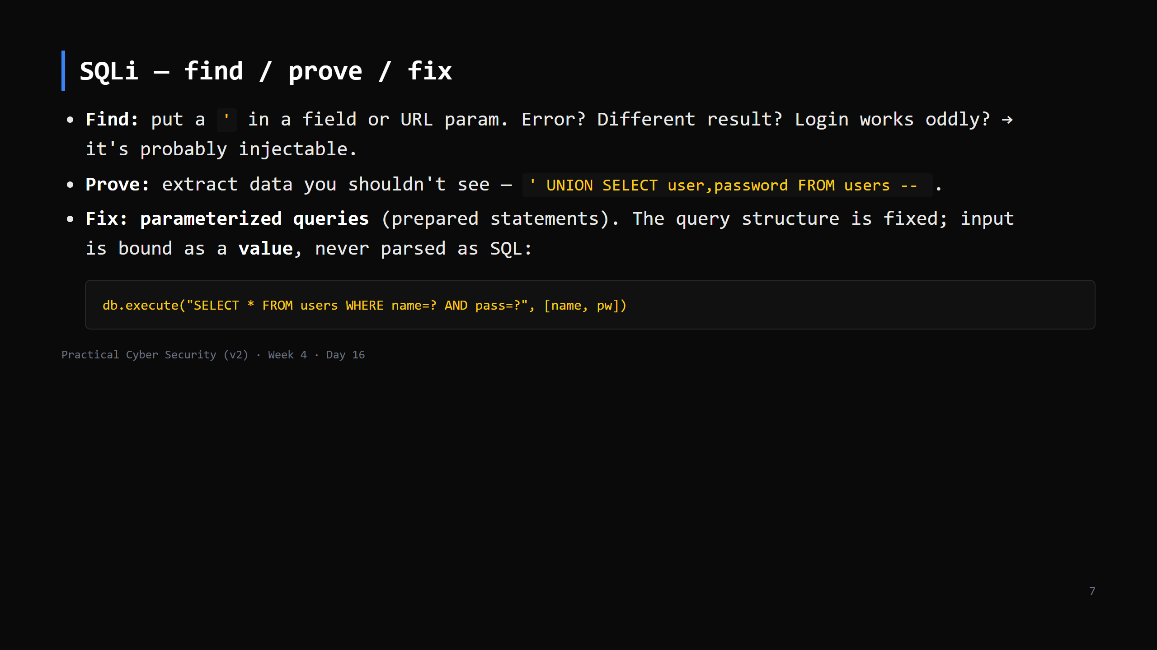
Notes:
The fix makes injection STRUCTURALLY IMPOSSIBLE - the DB driver keeps code and data separate.
This is the Day 16 trap, previewed: you do NOT fix injection by filtering out `'` and `--`.
ORMs parameterize by default. Stored procedures help but aren't automatic.

Slide 8
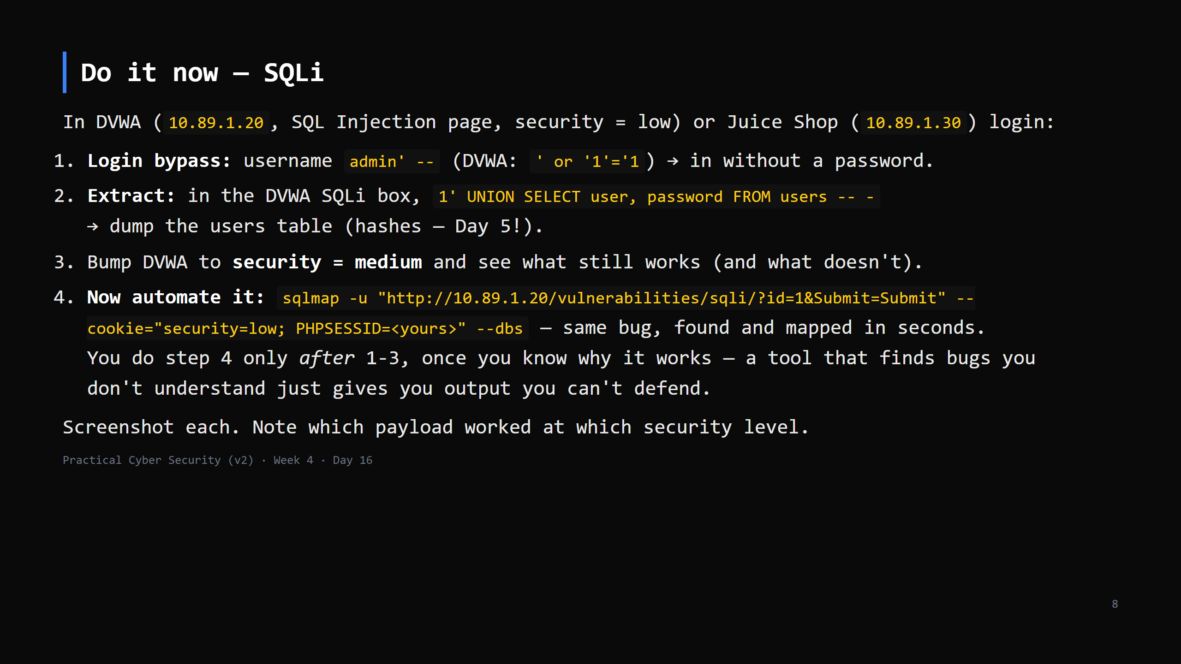
Notes:
12 min. Juice Shop login: email `' OR 1=1--`, any password -> admin. The password column is
MD5/bcrypt hashes -> callback to Day 5 (now go crack them with your Day 5 crack.py, optional).
"medium" adds some escaping - show that a determined payload still gets through, reinforcing
"filtering isn't the fix".

Slide 9
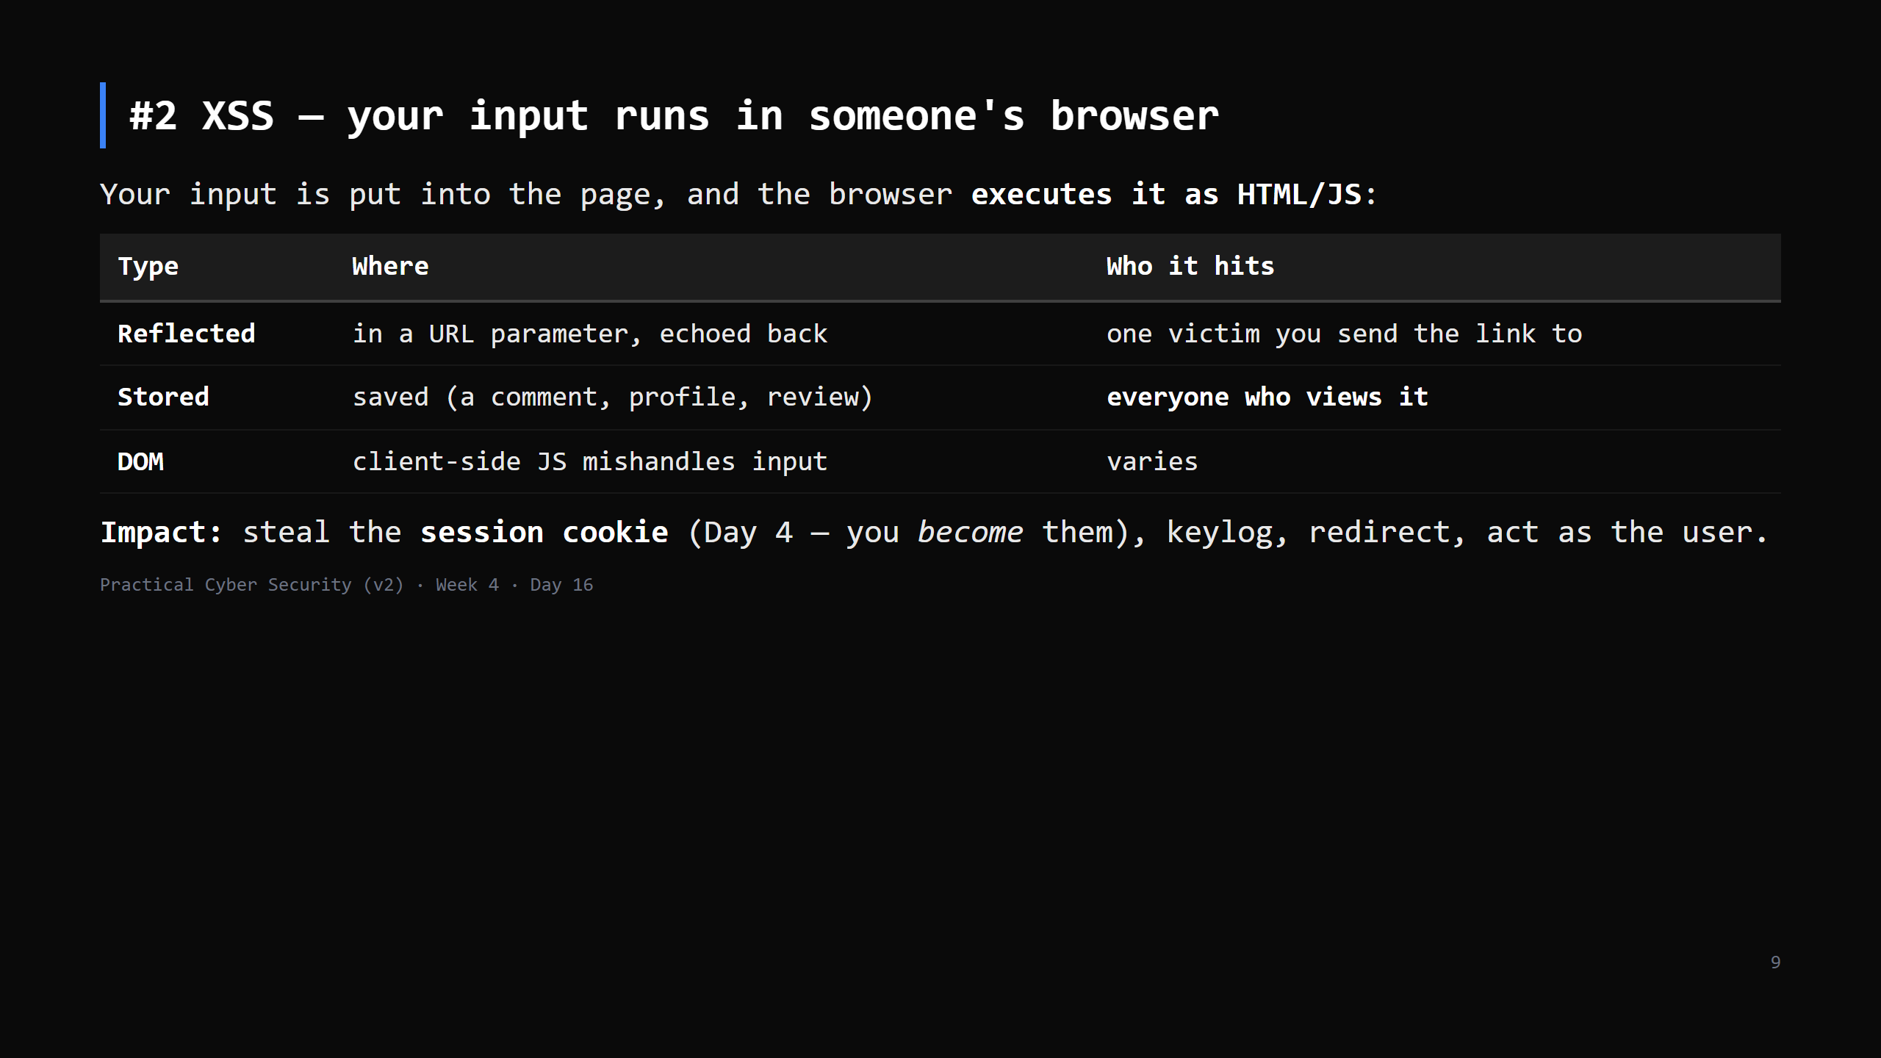
Notes:
"XSS is just alert() popups" is the trap here. alert() is the PROOF; the real payload steals
`document.cookie` and sends it to the attacker, or does actions as the logged-in user.
Stored XSS in an admin panel = game over.

Slide 10
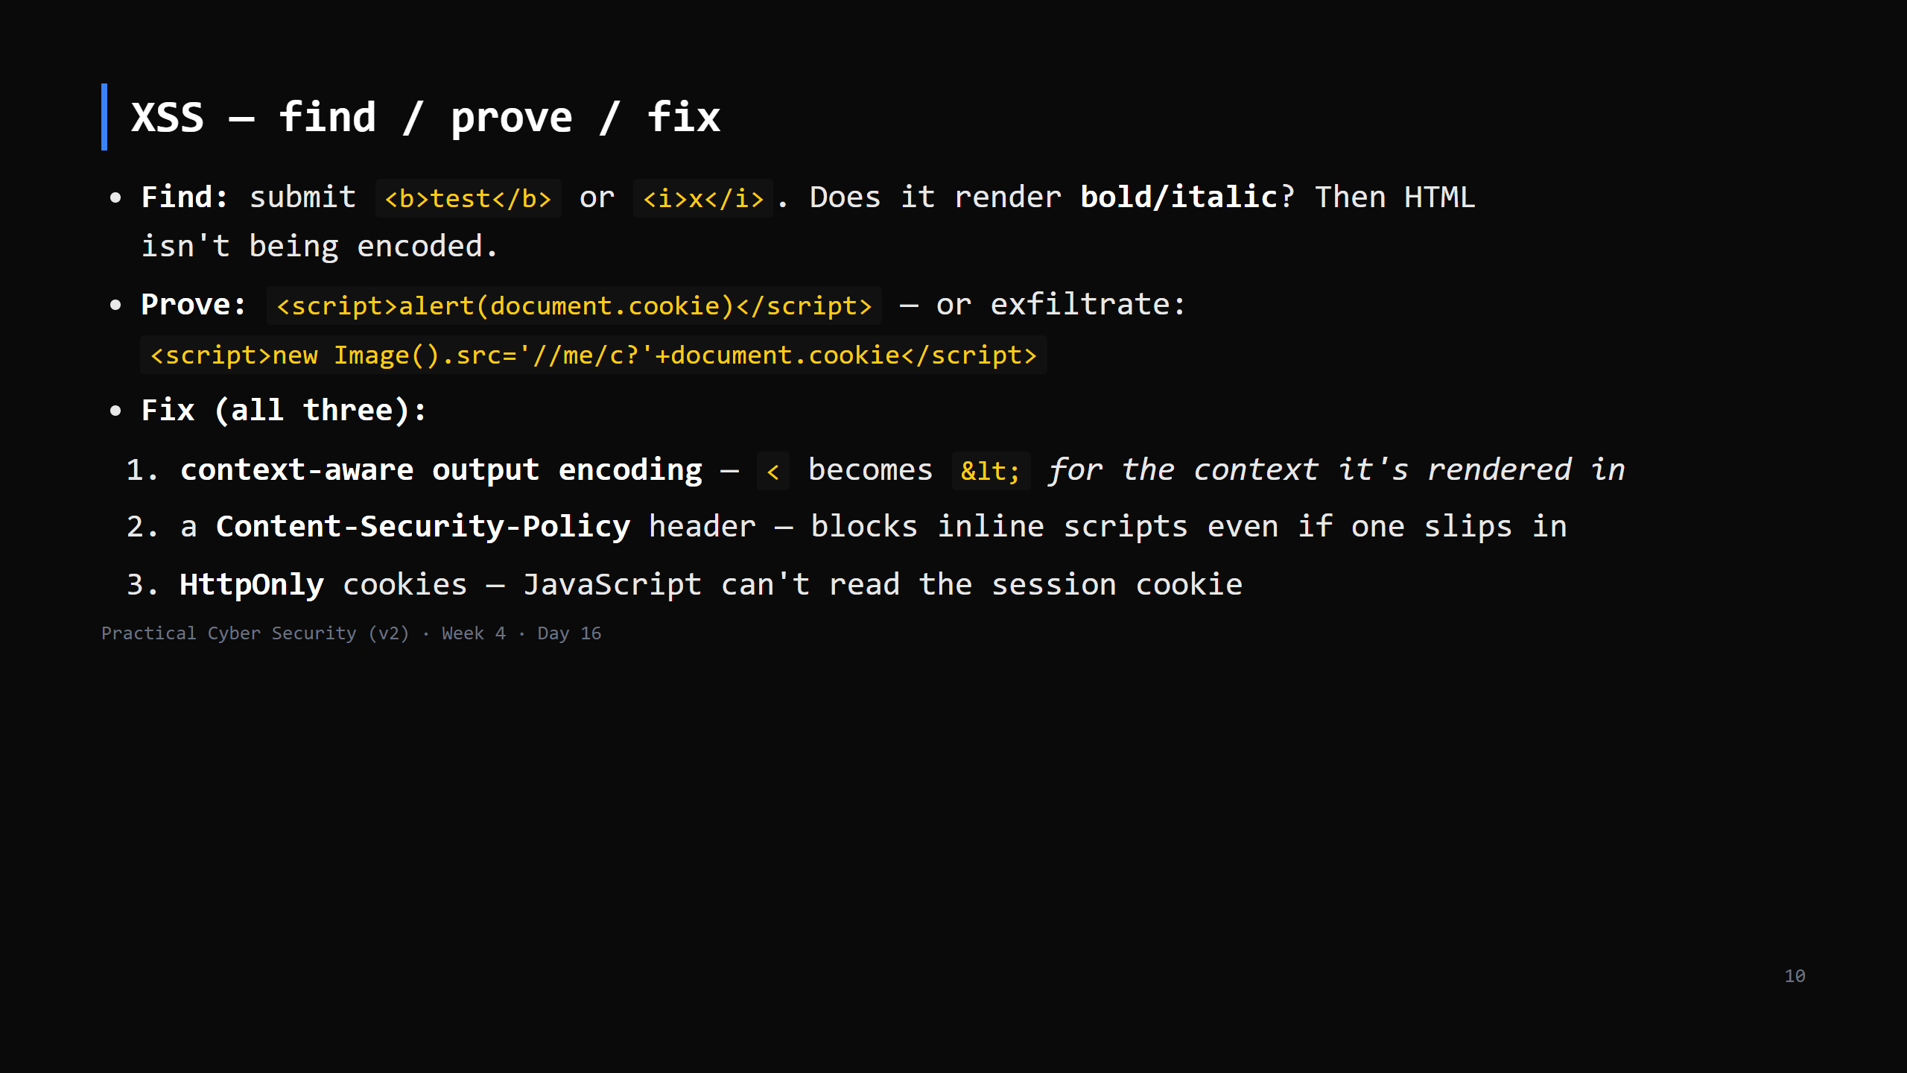
Notes:
Encoding is context-dependent: HTML body vs an attribute vs inside a <script> vs a URL each
need different encoding. Frameworks (React, Angular) auto-encode in templates - which is why
"just use the framework's templating" is good advice.

Slide 11
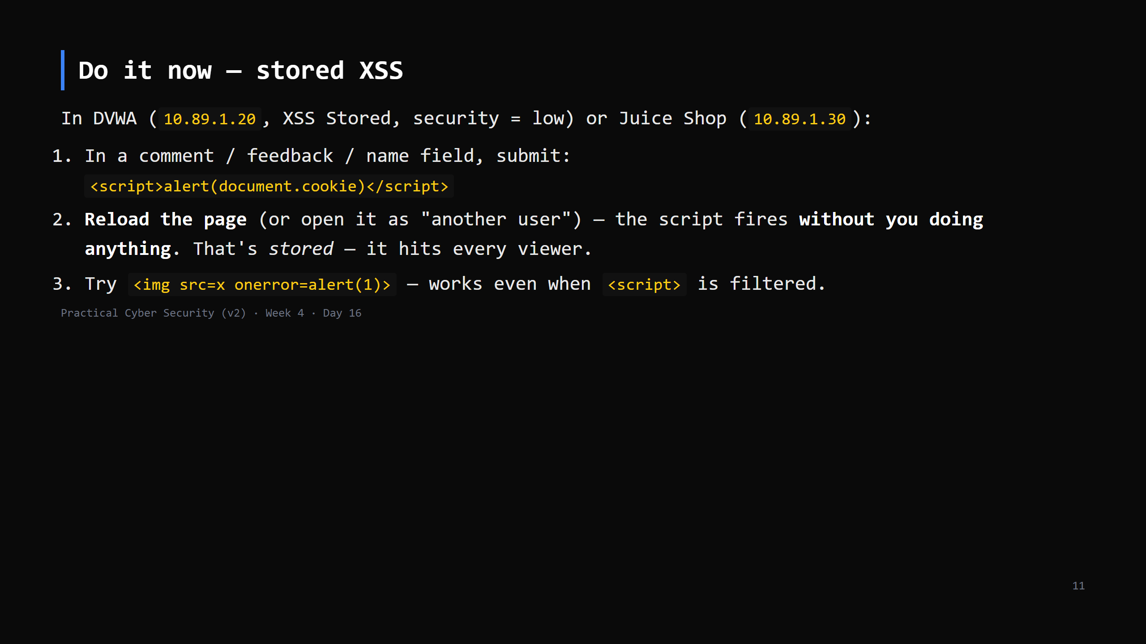
Notes:
10 min. The reload is the "aha" - the payload is now part of the page for everyone.
`<img onerror>` shows why blocklisting `<script>` doesn't work - there are dozens of ways to
run JS. Reinforces the trap again.

Slide 12
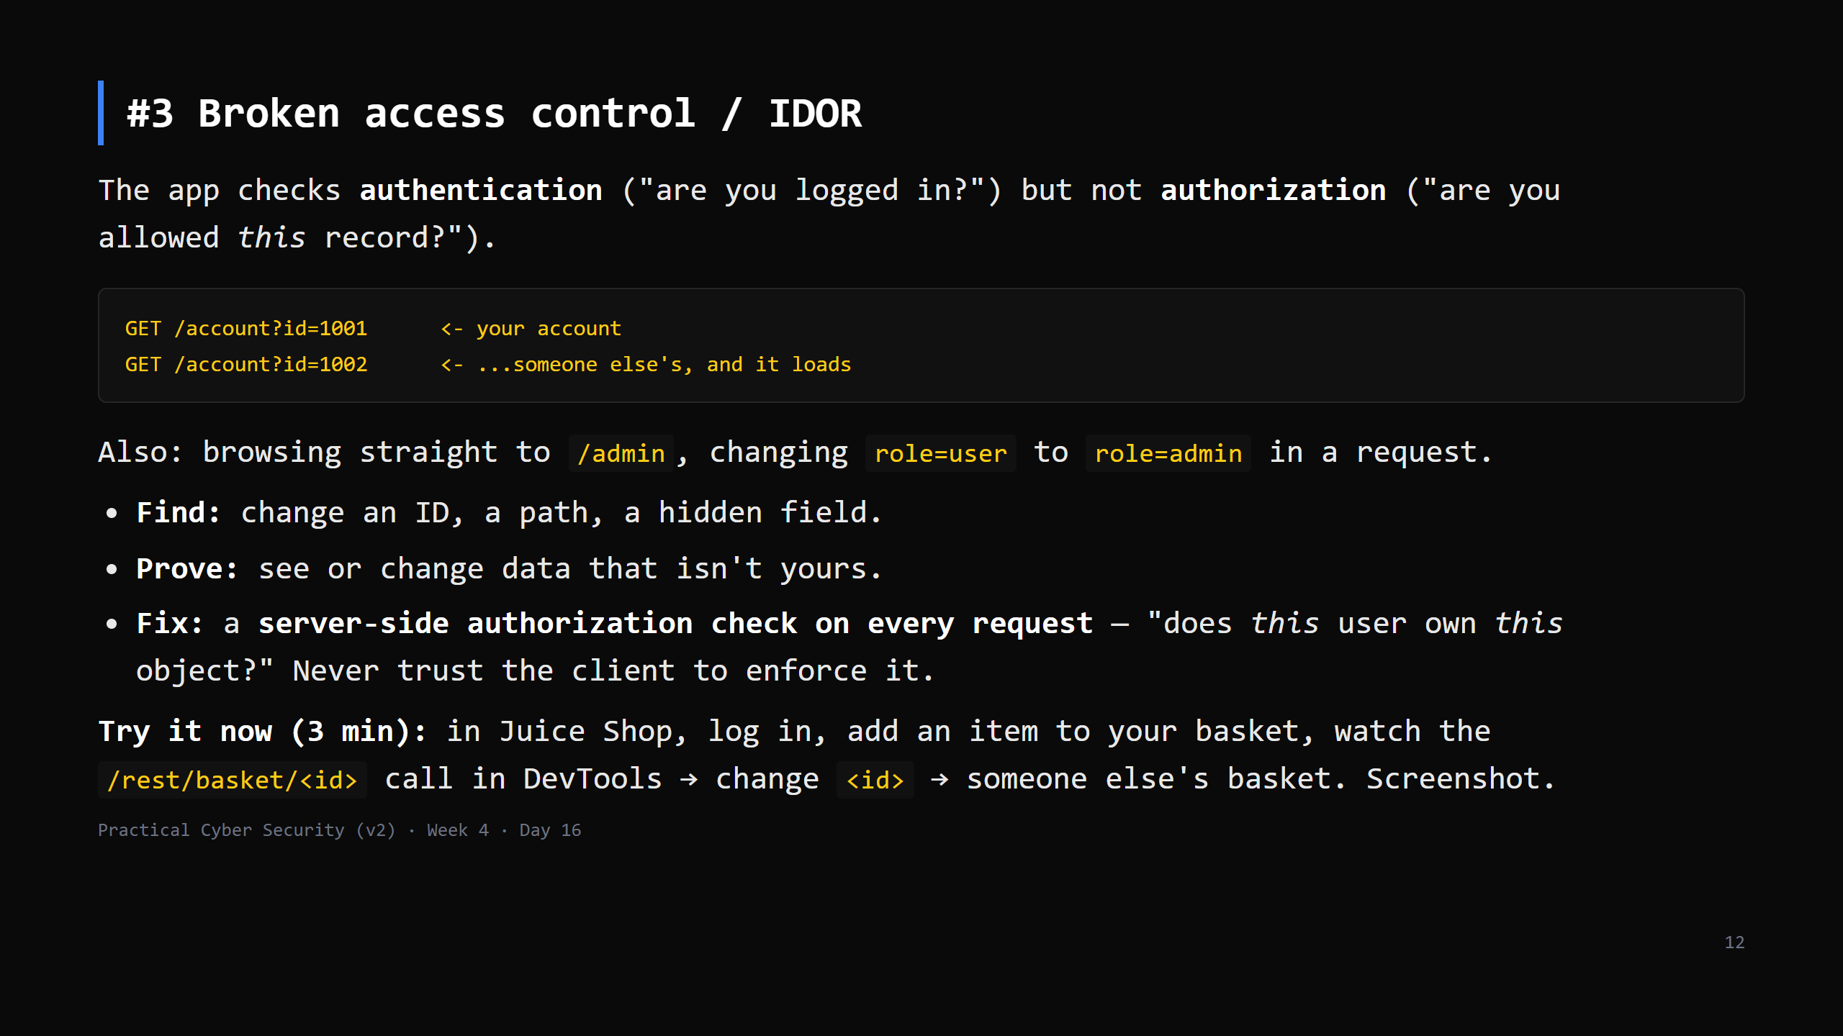
Notes:
This is OWASP #1 and scanners can't find it - it needs understanding of what SHOULD be allowed.
"It requires a login, so it's fine" is the trap: logged-in != authorised for that specific thing.
DVWA has little IDOR - Juice Shop is the target for this one. Borrow the 3 min from #4-5 if needed.

Slide 13
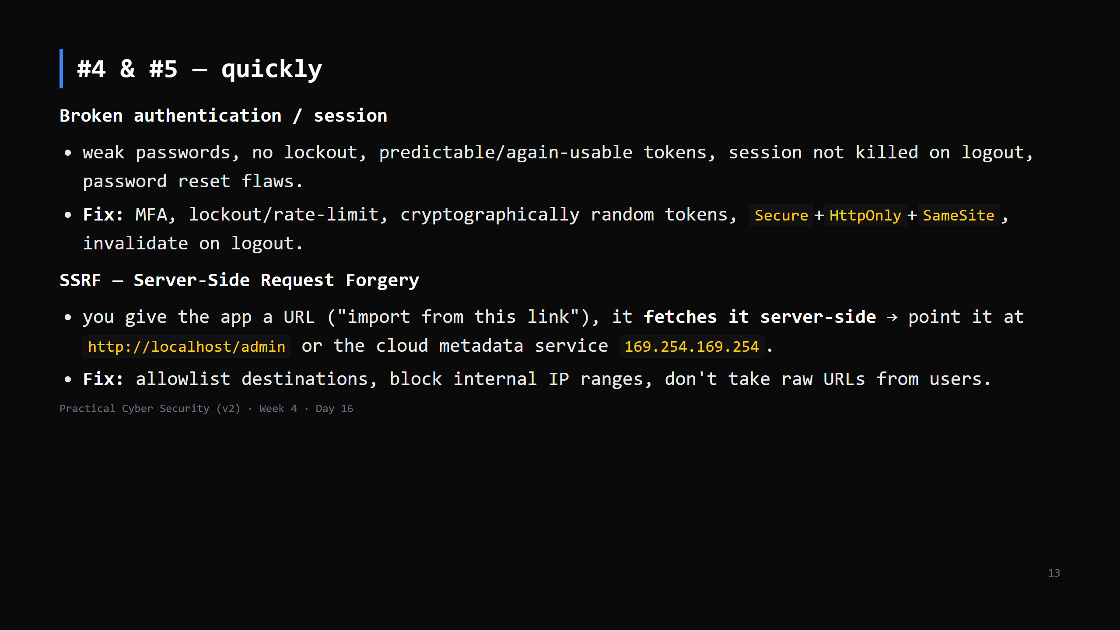
Notes:
5 min total. SSRF matters more in Week 4's cloud context (Day 17) - metadata endpoints hand
out credentials. CUT SSRF first if short.

Slide 14
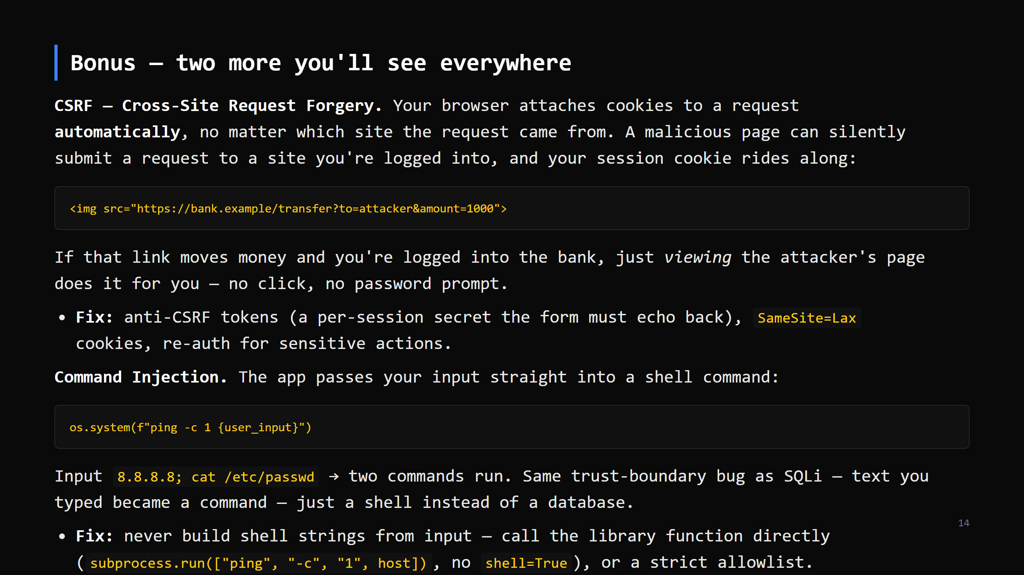
Notes:
OPTIONAL slide — cut first if short, or assign as homework reading. Same "your data became
code" pattern as the SQLi slide; students should recognise it immediately.
DVWA (`10.89.1.20`) has a Command Injection page and a CSRF page — good for extra practice
beyond today's three DOs. Command Injection there is also the door Day 17 walks through: a
shell via a web bug, then a backdoor for persistence — same target, later stage.

Slide 15
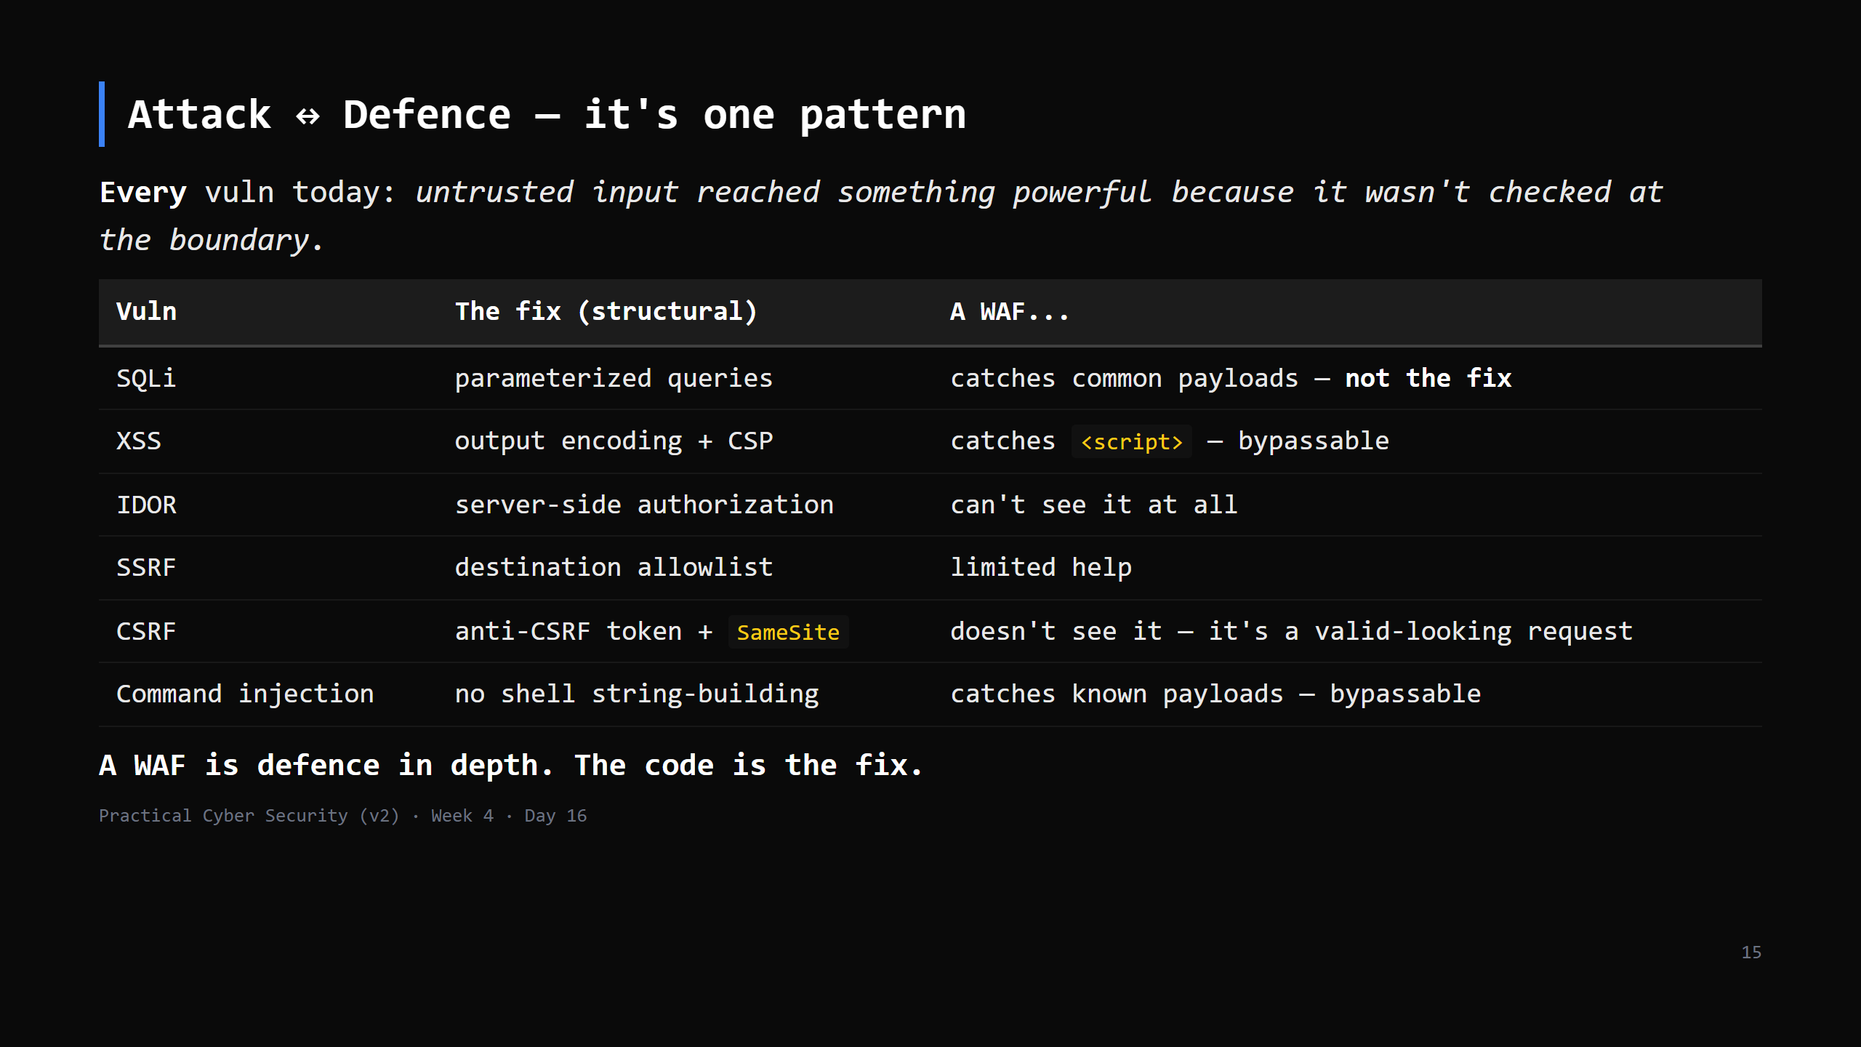
Notes:
Show a WAF/app log line for a blocked SQLi attempt next to the one-line code fix. The WAF buys
time; it doesn't remove the bug. Devs who "rely on the WAF" ship the vuln.

Slide 16
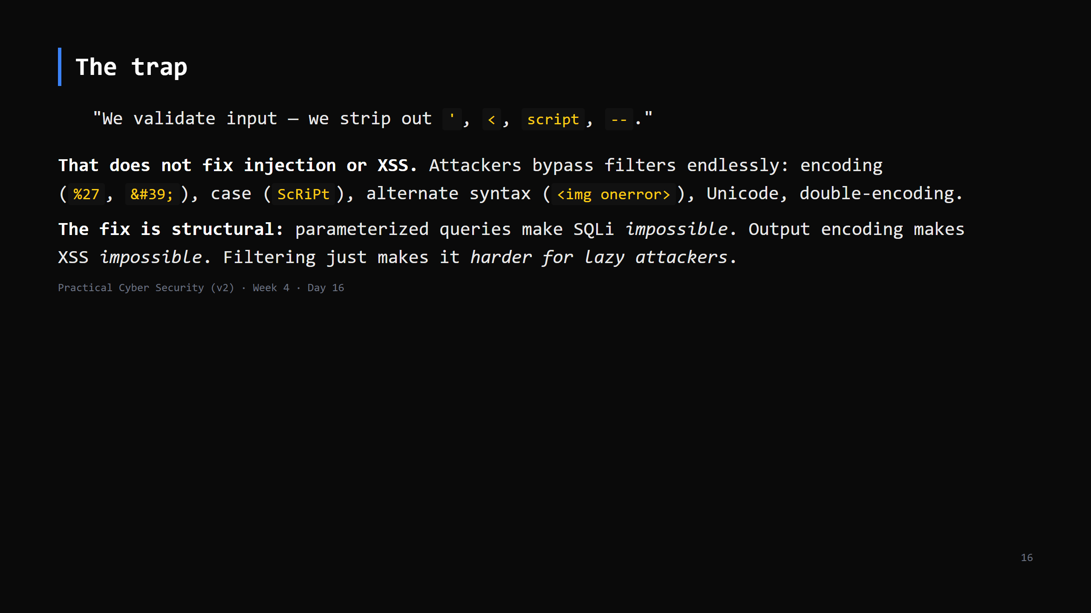
Notes:
Input validation is still good practice (reject a 5000-char "name") - just not as the security
control for injection. The structural fix + validation + a WAF = defence in depth.

Slide 17
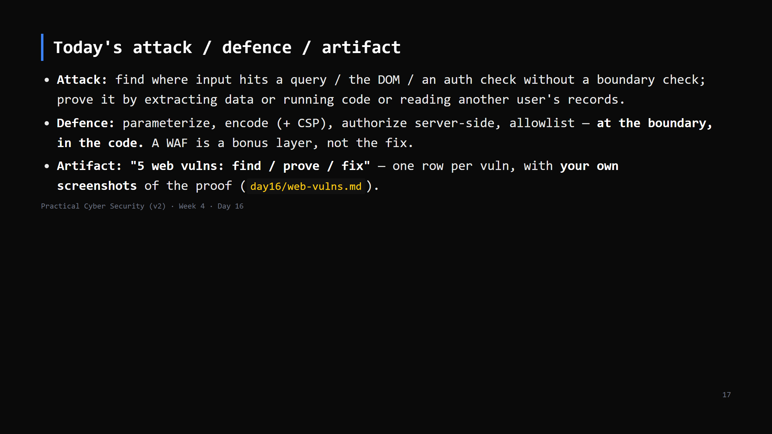

Slide 18
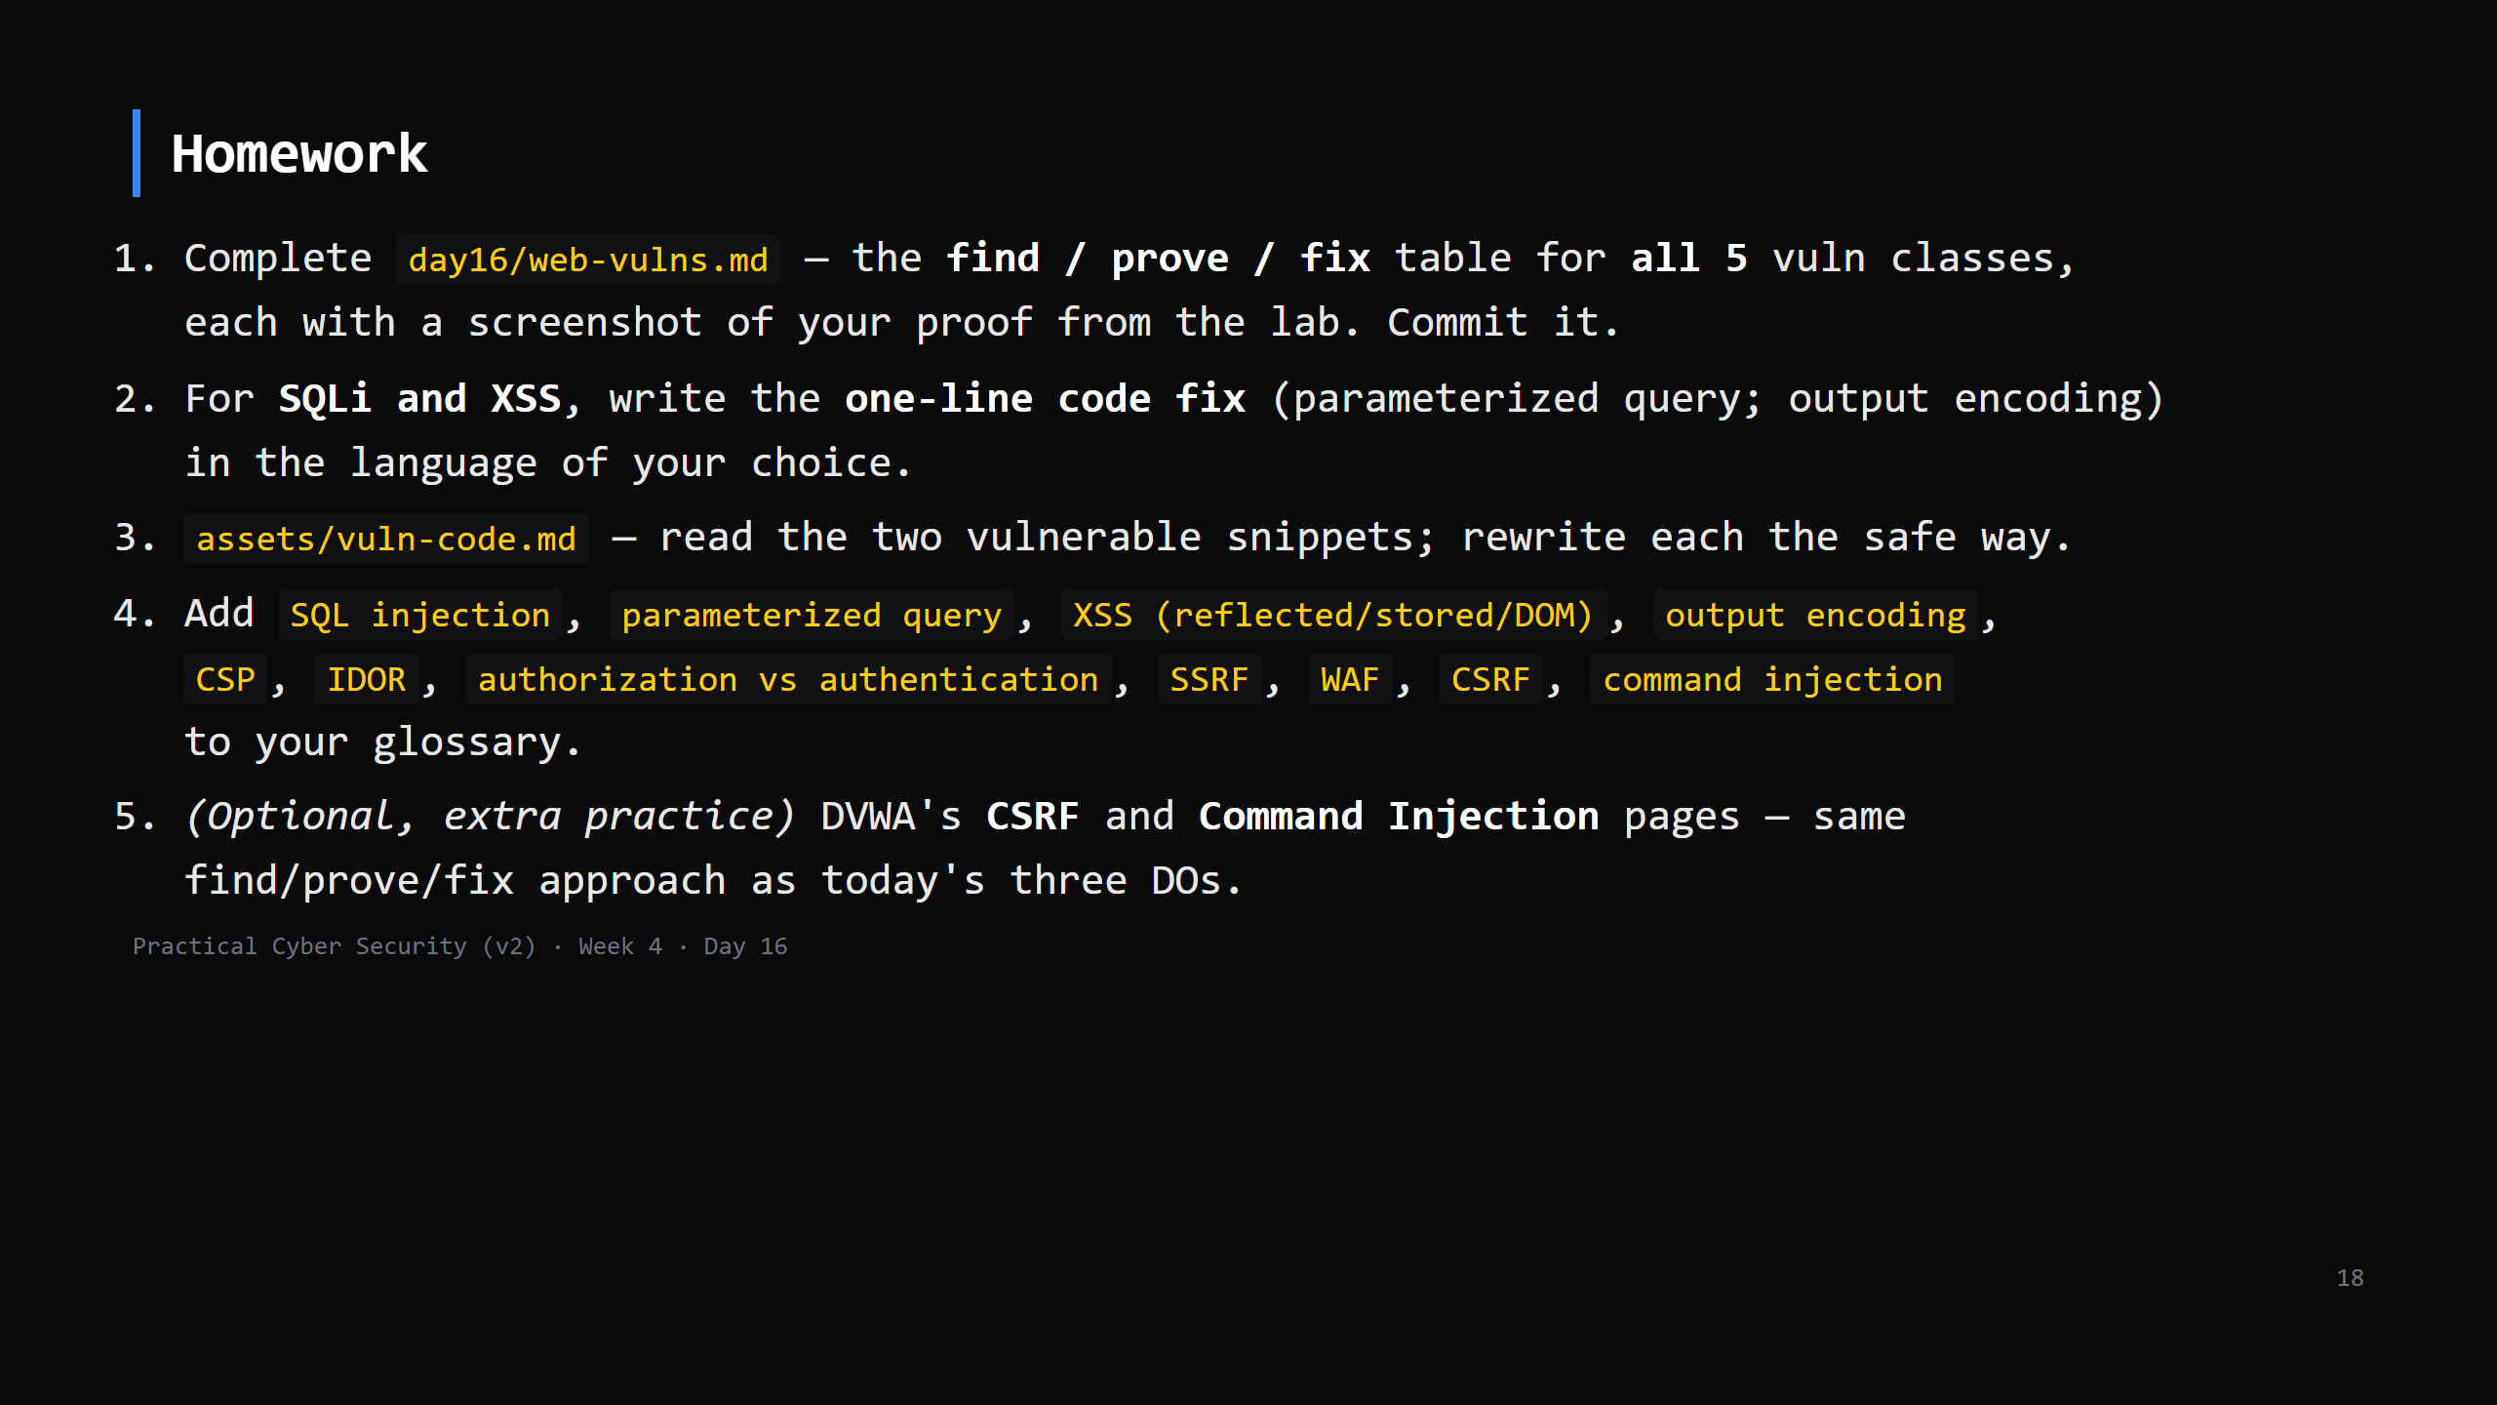
Notes:
Due start of Day 17.

Slide 19
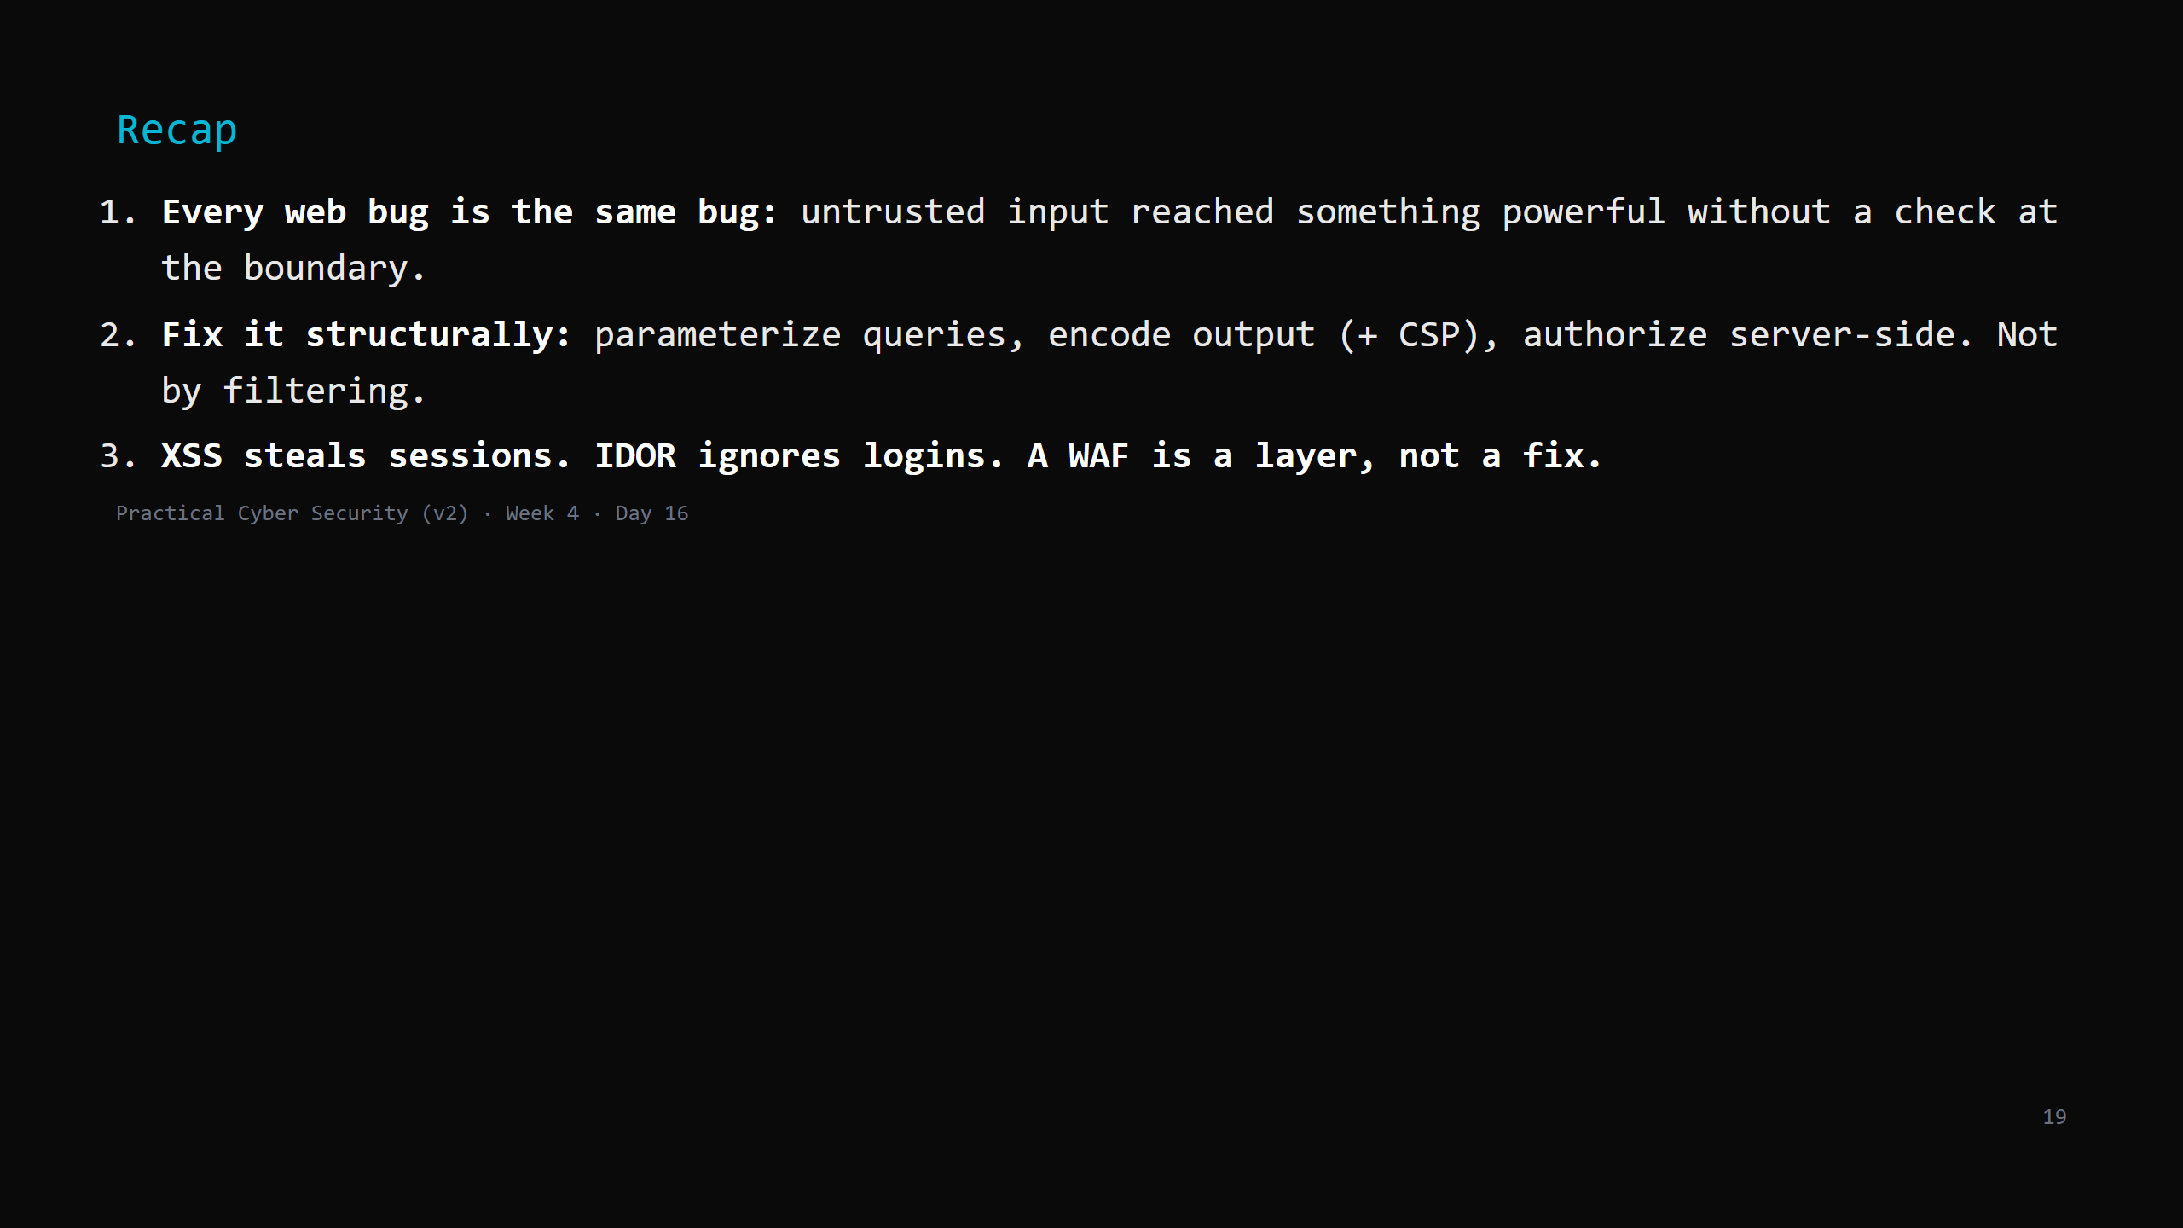
Notes:
Say the three lines. Tomorrow: what an attacker does AFTER getting in - post-exploitation,
privilege escalation, persistence, pivoting - and then the infrastructure and cloud side.

