Slide 1
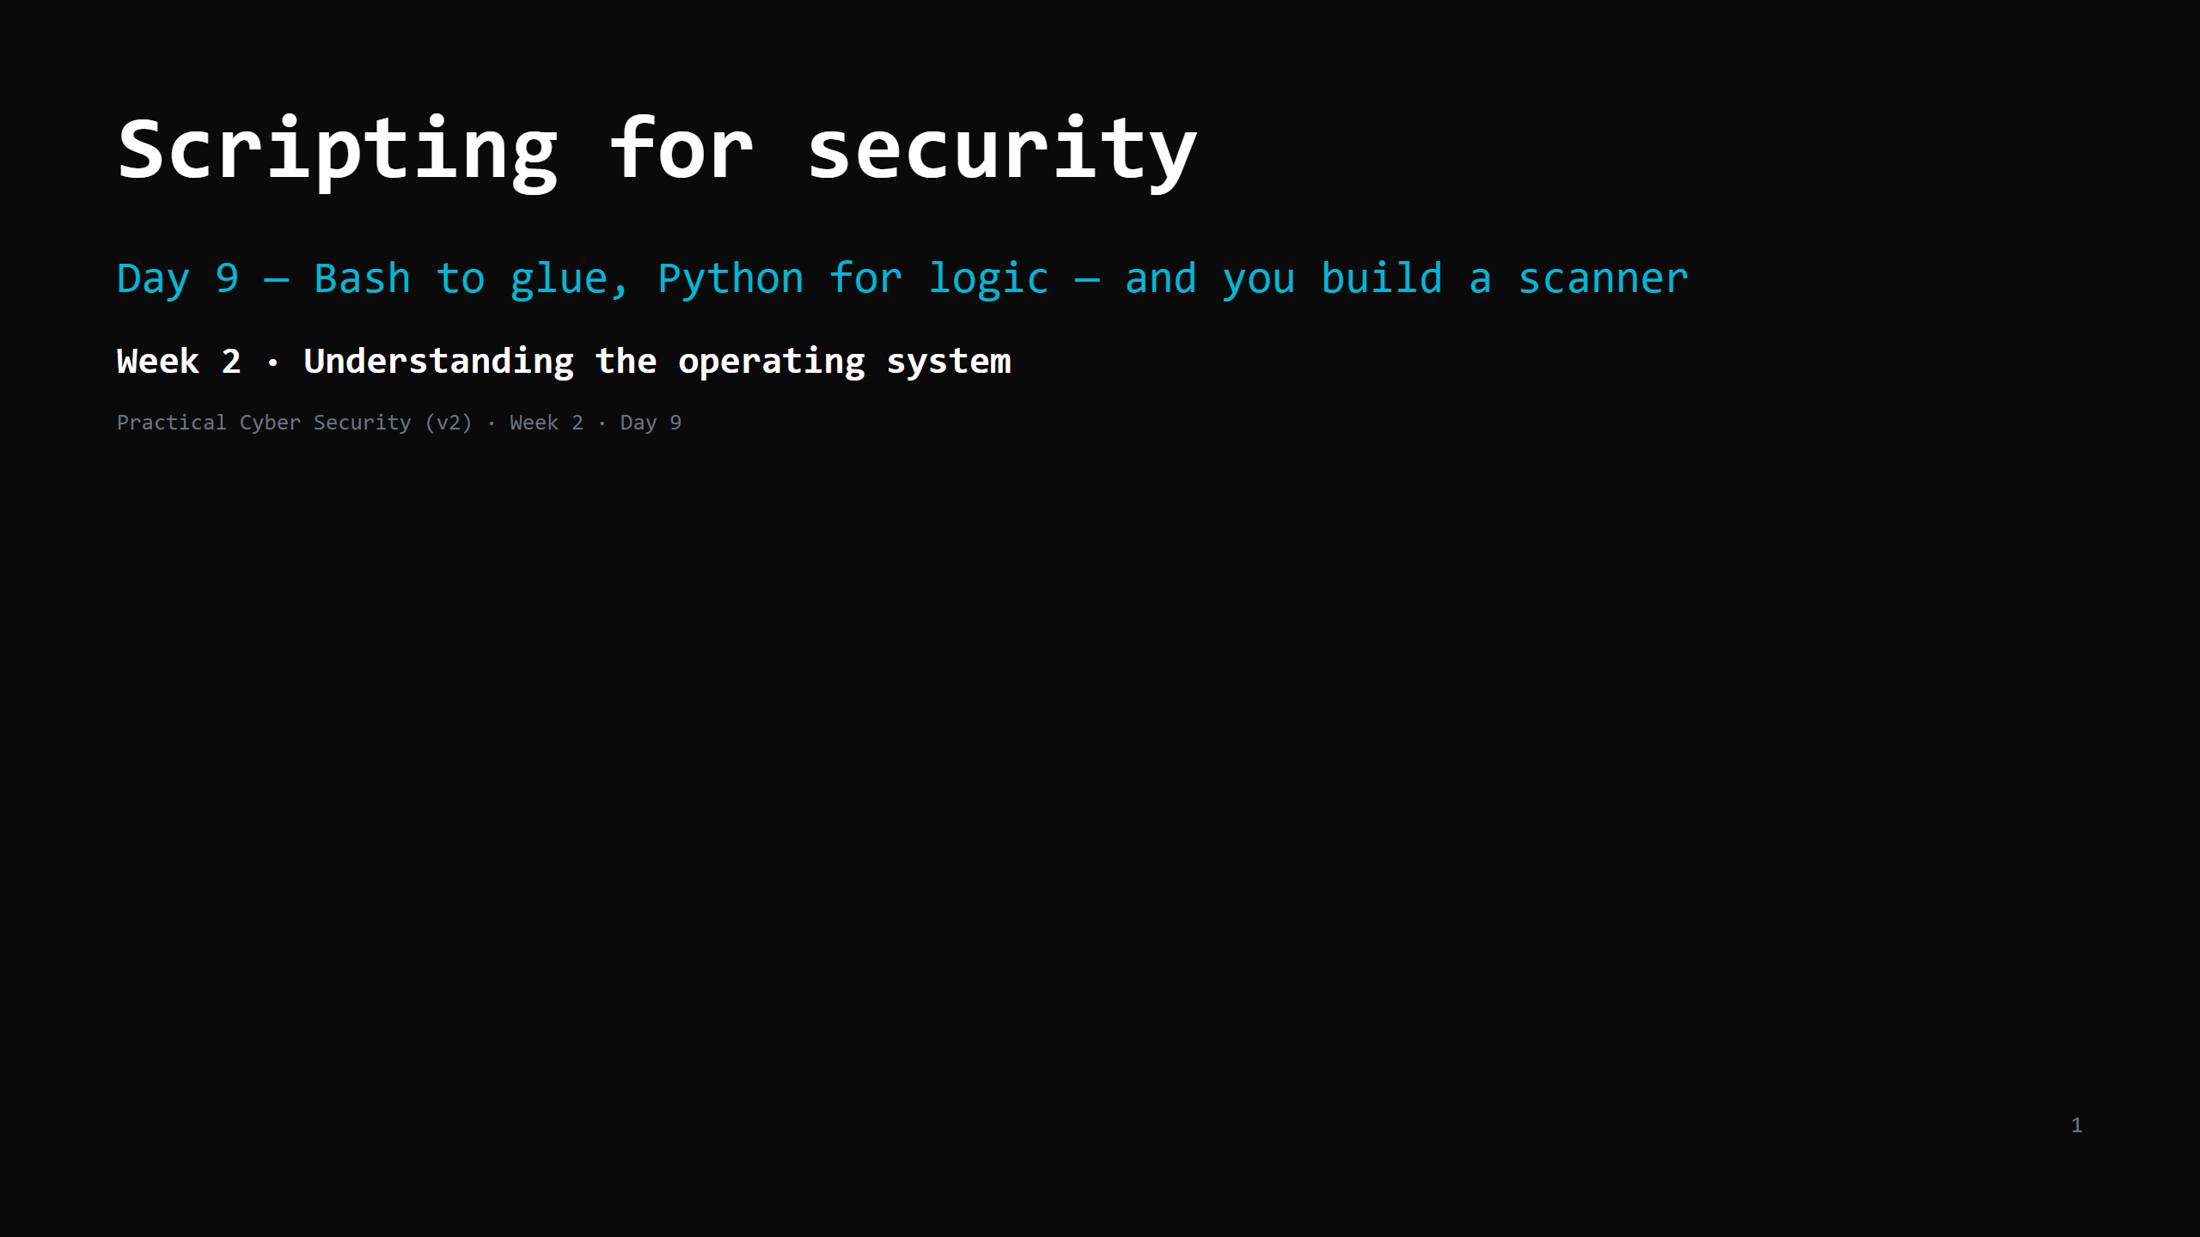
Notes:
RUN SHEET (~85 min). This is a BUILD day — hands-on is most of it. 00:00 Journey check + hook (sweep.sh running) 4 00:04 Why script + the 5 building blocks 7 00:11 Bash: your first script 8 00:19 DO: write a 5-line Bash script 7 00:26 Bash: the ping sweep, line by line 7 00:33 DO: run + adapt sweep.sh 8 00:41 Python: the same 5 blocks 9 00:50 DO: build scanner.py (socket port check) 11 01:01 Bash vs Python — when to use which 4 01:05 Reading code you didn't write (the LLM trap) 6 01:11 Attack <-> defence 5 01:16 Wrap + artifact + homework 4 CUT FIRST IF SHORT: the "first Bash script" DO (demo it instead); the bash-vs-python slide. NEVER CUT: the 5 building blocks, building scanner.py, the "read the code" exercise, the artifact. ANALOGY (kitchen): a script = a recipe card the kitchen follows without you standing there. Bash = quick notes to the line cooks. Python = a proper recipe with measurements and "if" logic. ETHICS: the scanner targets ONLY localhost / your own lab subnet / the class lab. No scope, no scan. PREREQ: Python 3 installed (set up as Day 8 homework); Linux shell from Day 6.

Slide 2
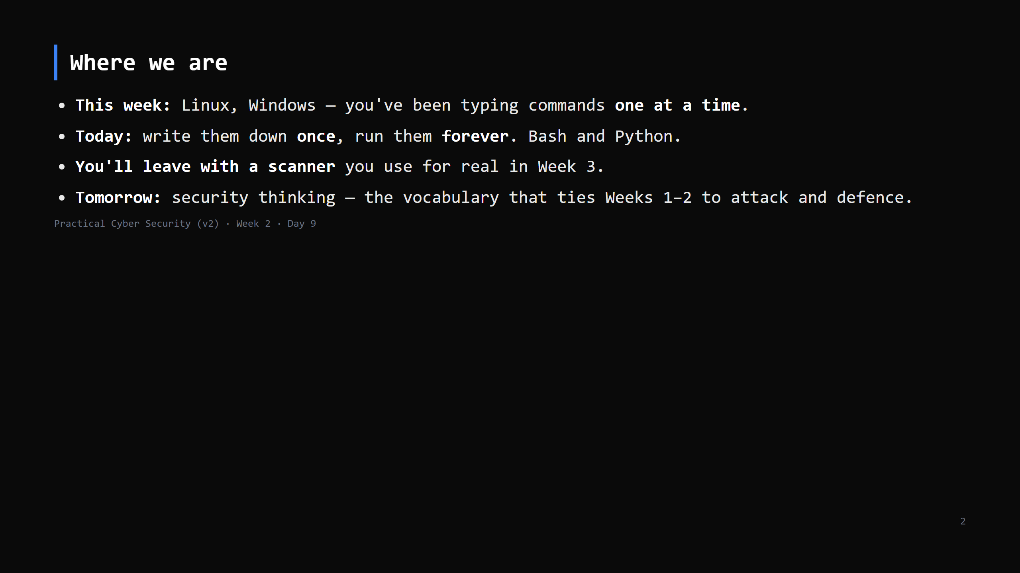
Notes:
Journey Check. Frame: today is a skill multiplier. Everything slow you did this week becomes one command you keep.

Slide 3
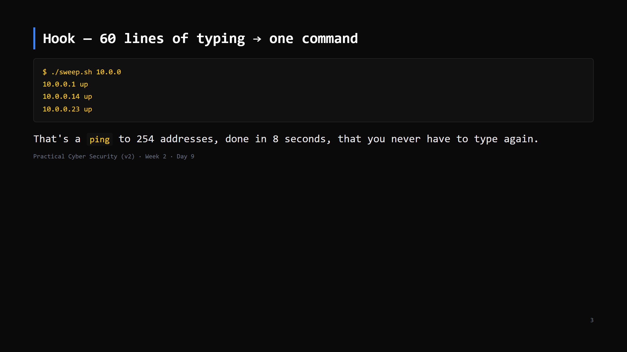
Notes:
Run the provided sweep.sh against the class lab subnet. Don't explain it yet — that's 3 slides away. "By the end of class this file is yours and you understand every line."

Slide 4
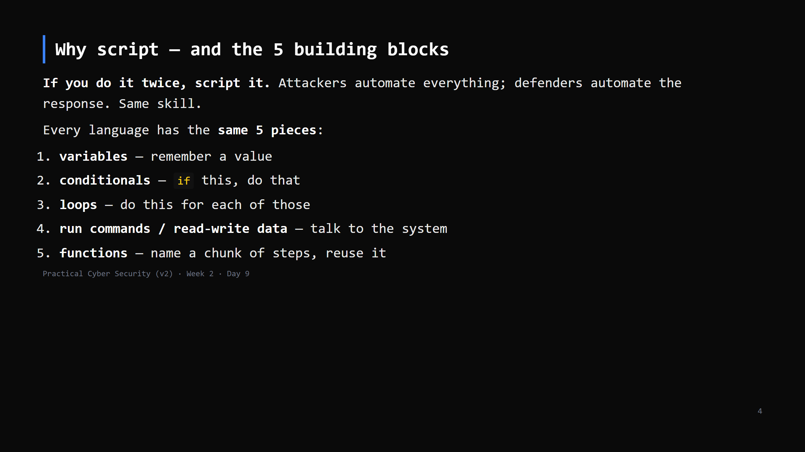
Notes:
This is the whole lesson's frame. Bash and Python are just two spellings of these 5 ideas. Don't teach "a language" — teach the 5 blocks, twice.

Slide 5
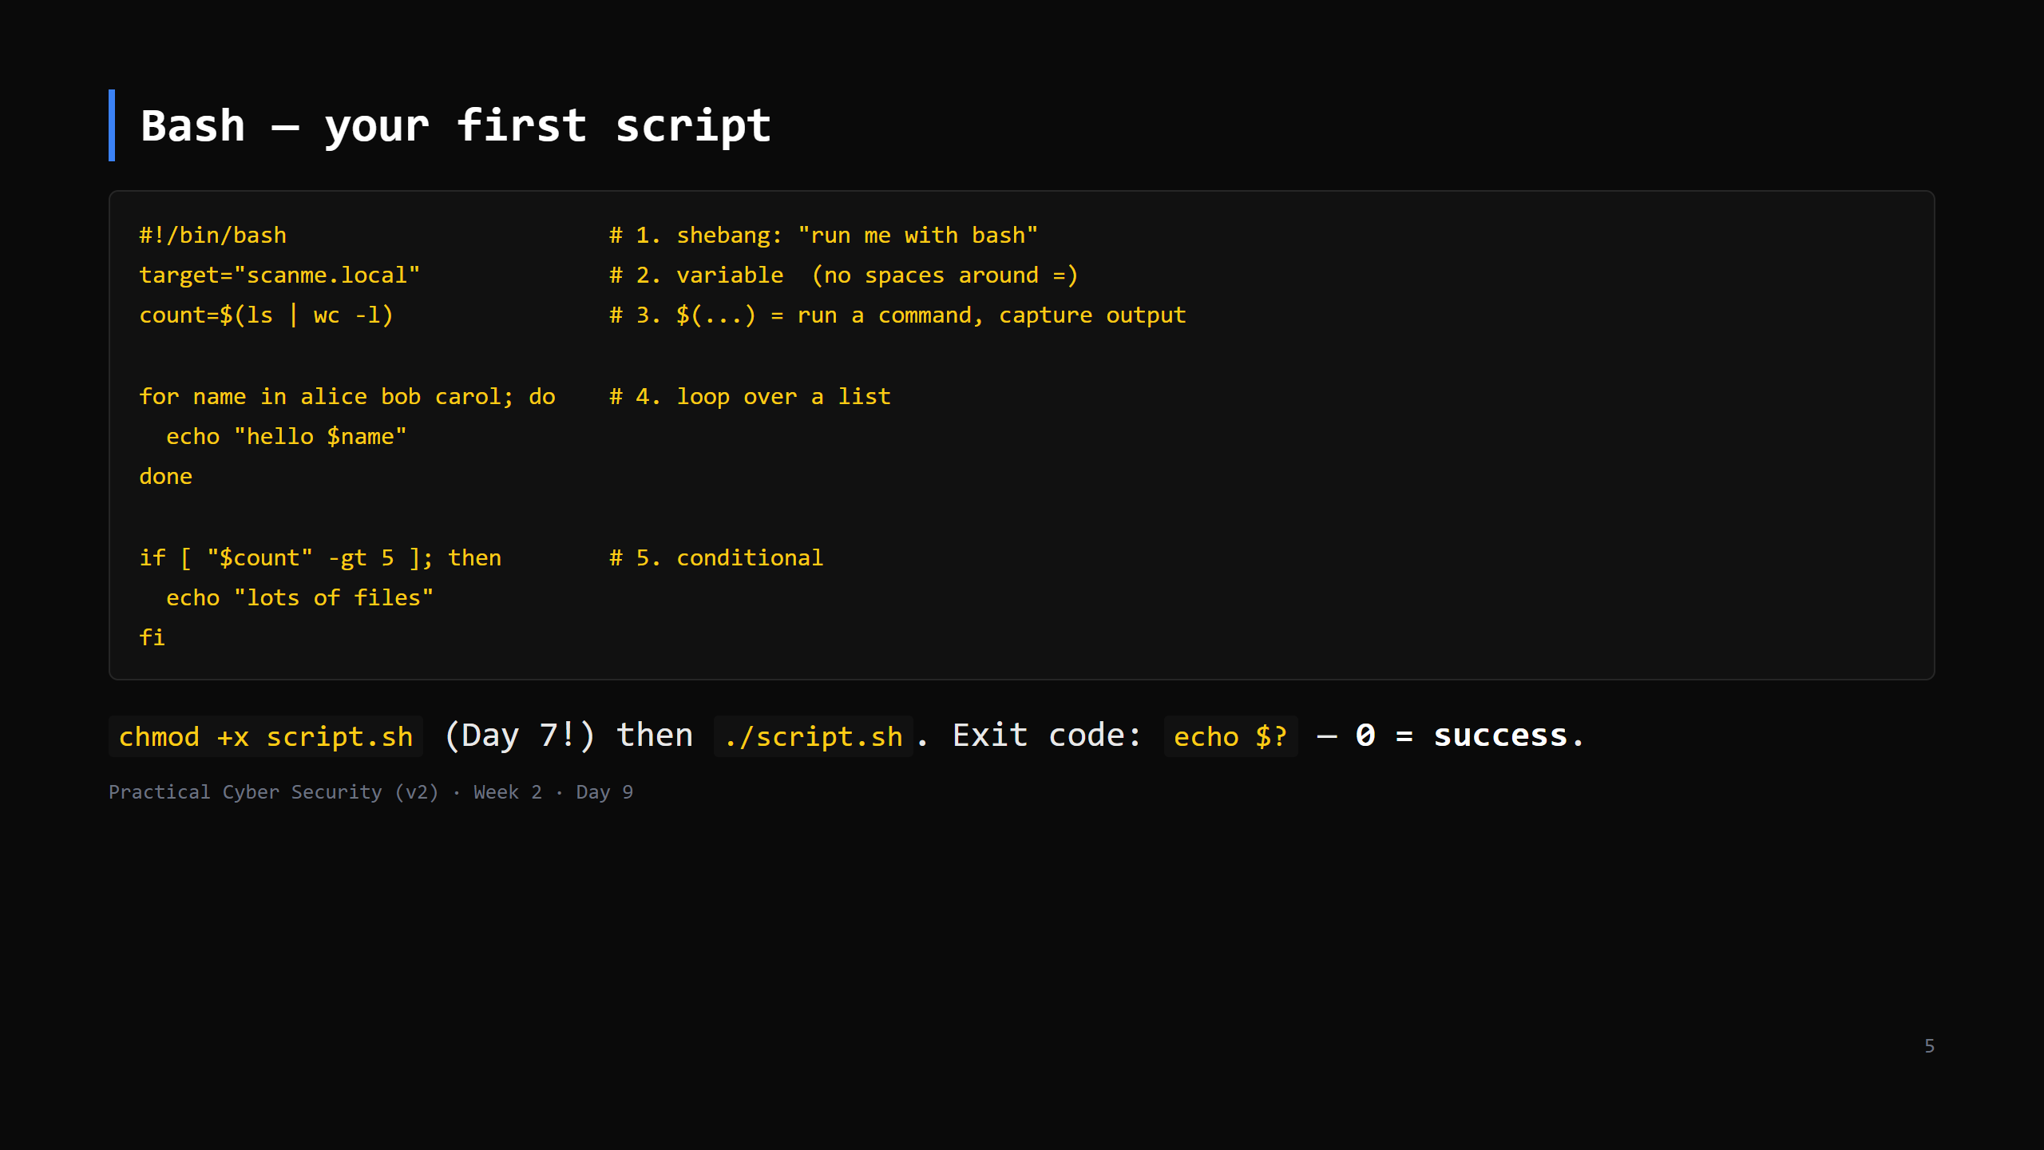
Notes:
Gotchas to say out loud: NO spaces around `=`. `$var` to read, `var=` to set. `[ ... ]` needs spaces inside. `$(...)` is the modern command substitution. Exit codes: every command returns one; 0 = ok, non-zero = failed. Scripts chain on this.

Slide 6
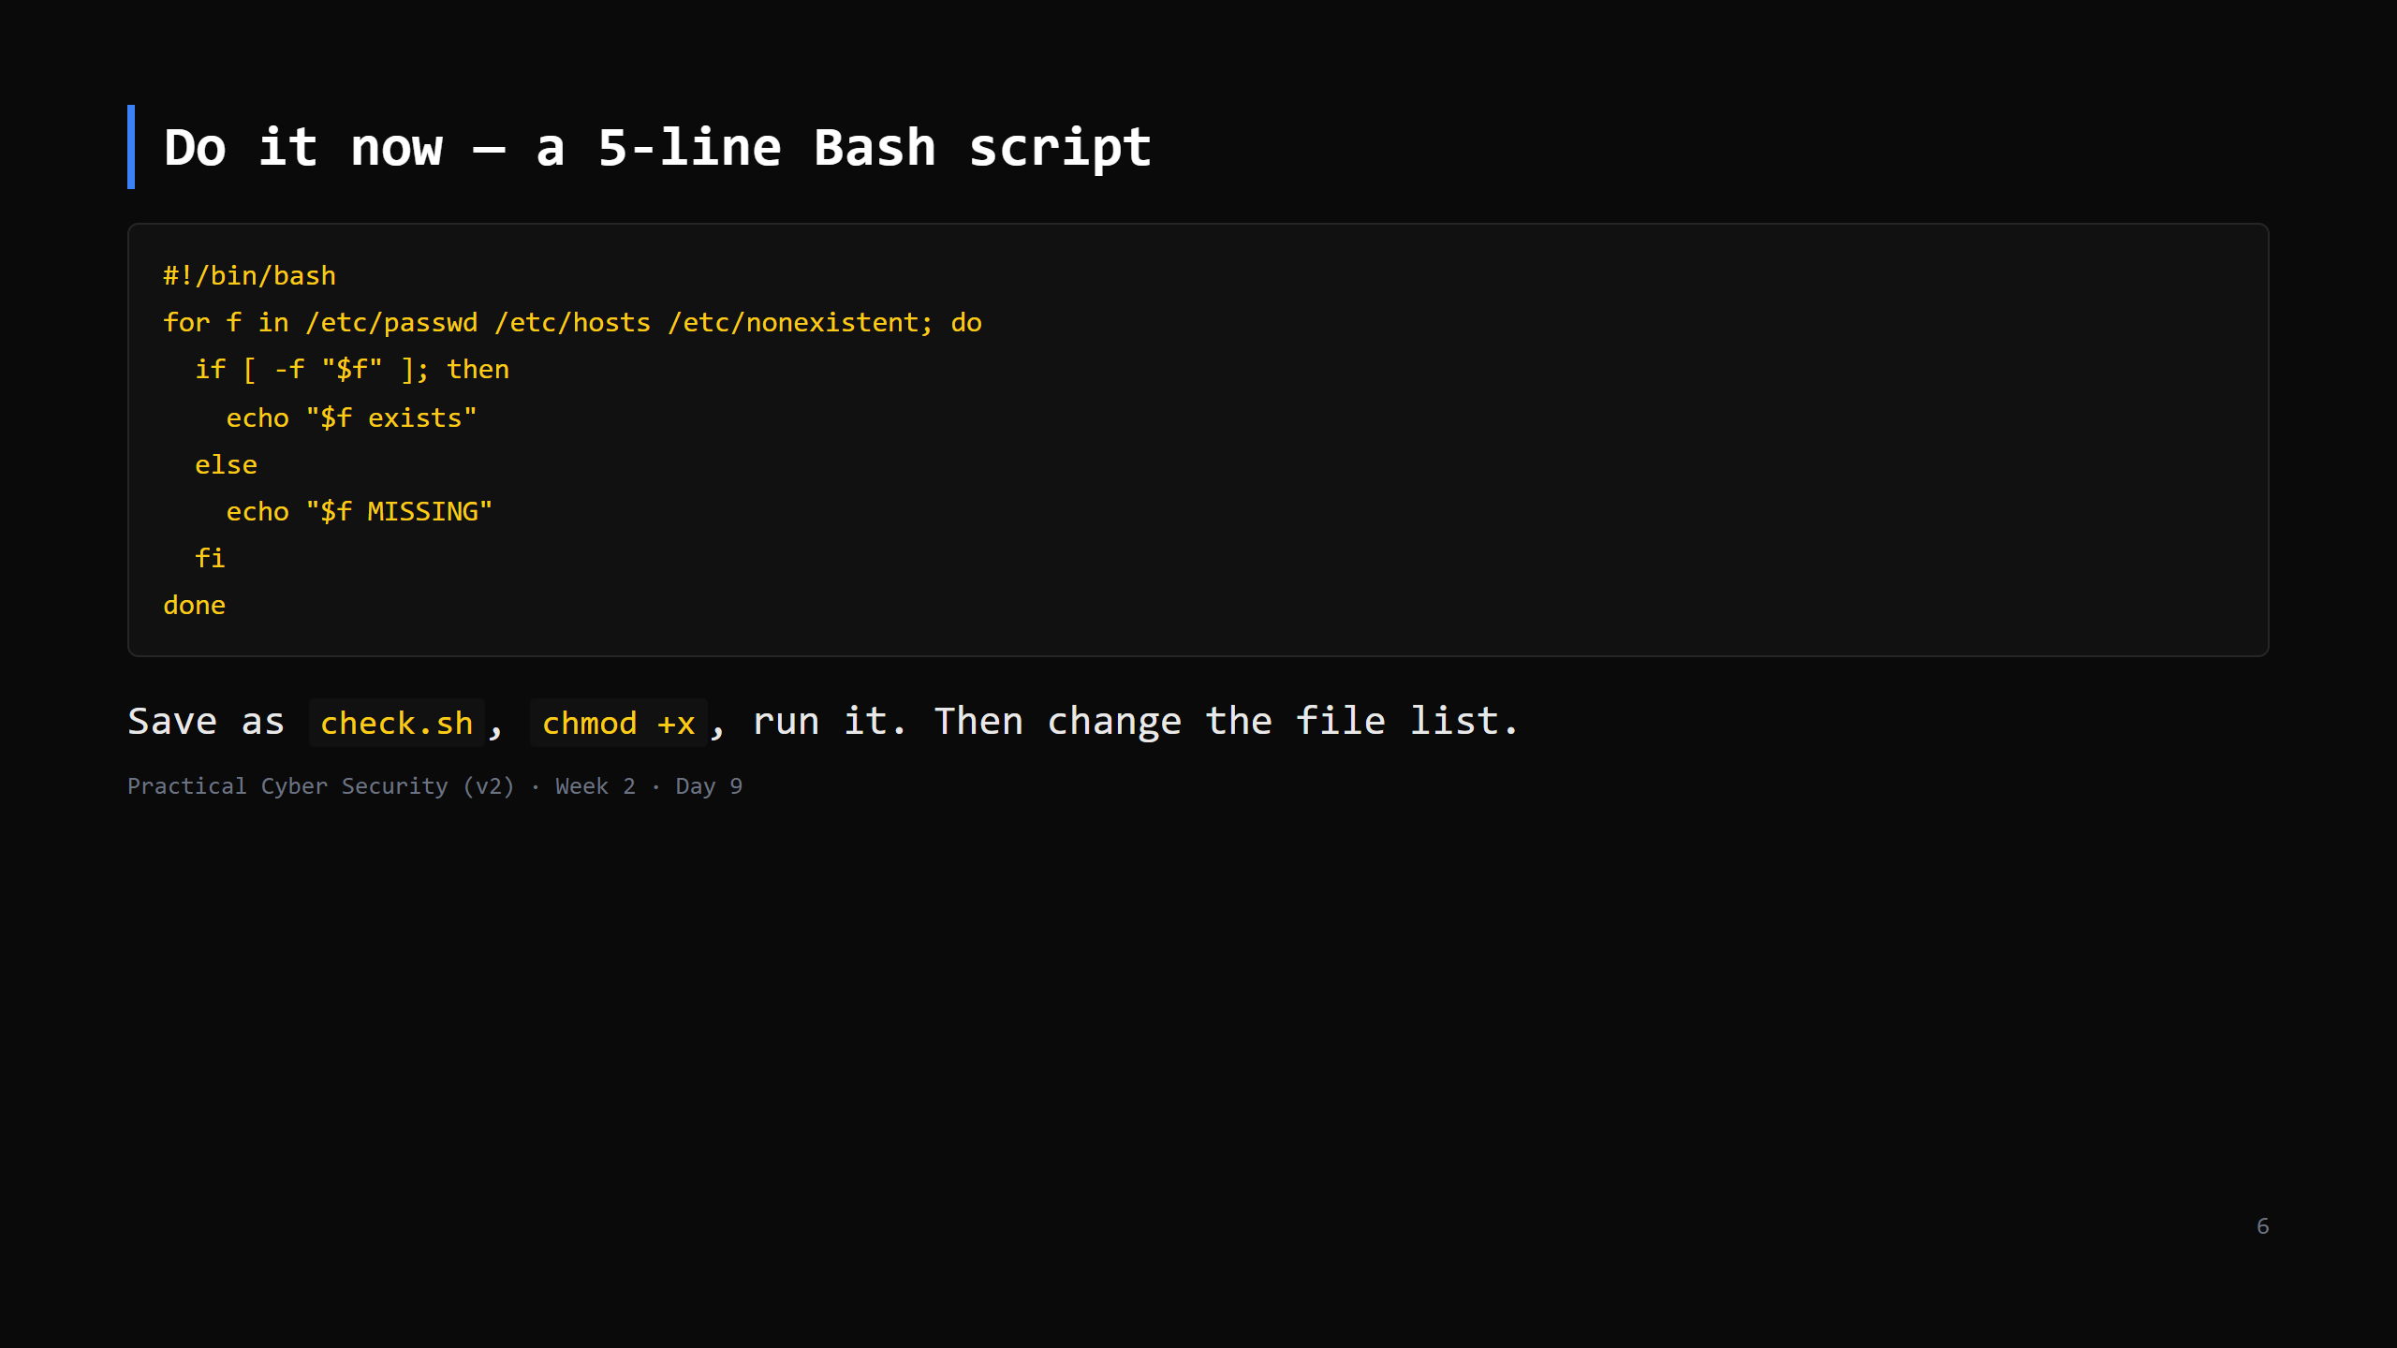
Notes:
7 min. `-f` = "is a regular file". Everyone should get this running. Common errors: forgot chmod +x; forgot ./ ; CRLF line endings on Windows (dos2unix / save as LF). CUT this DO first if short — demo it on the projector instead.

Slide 7
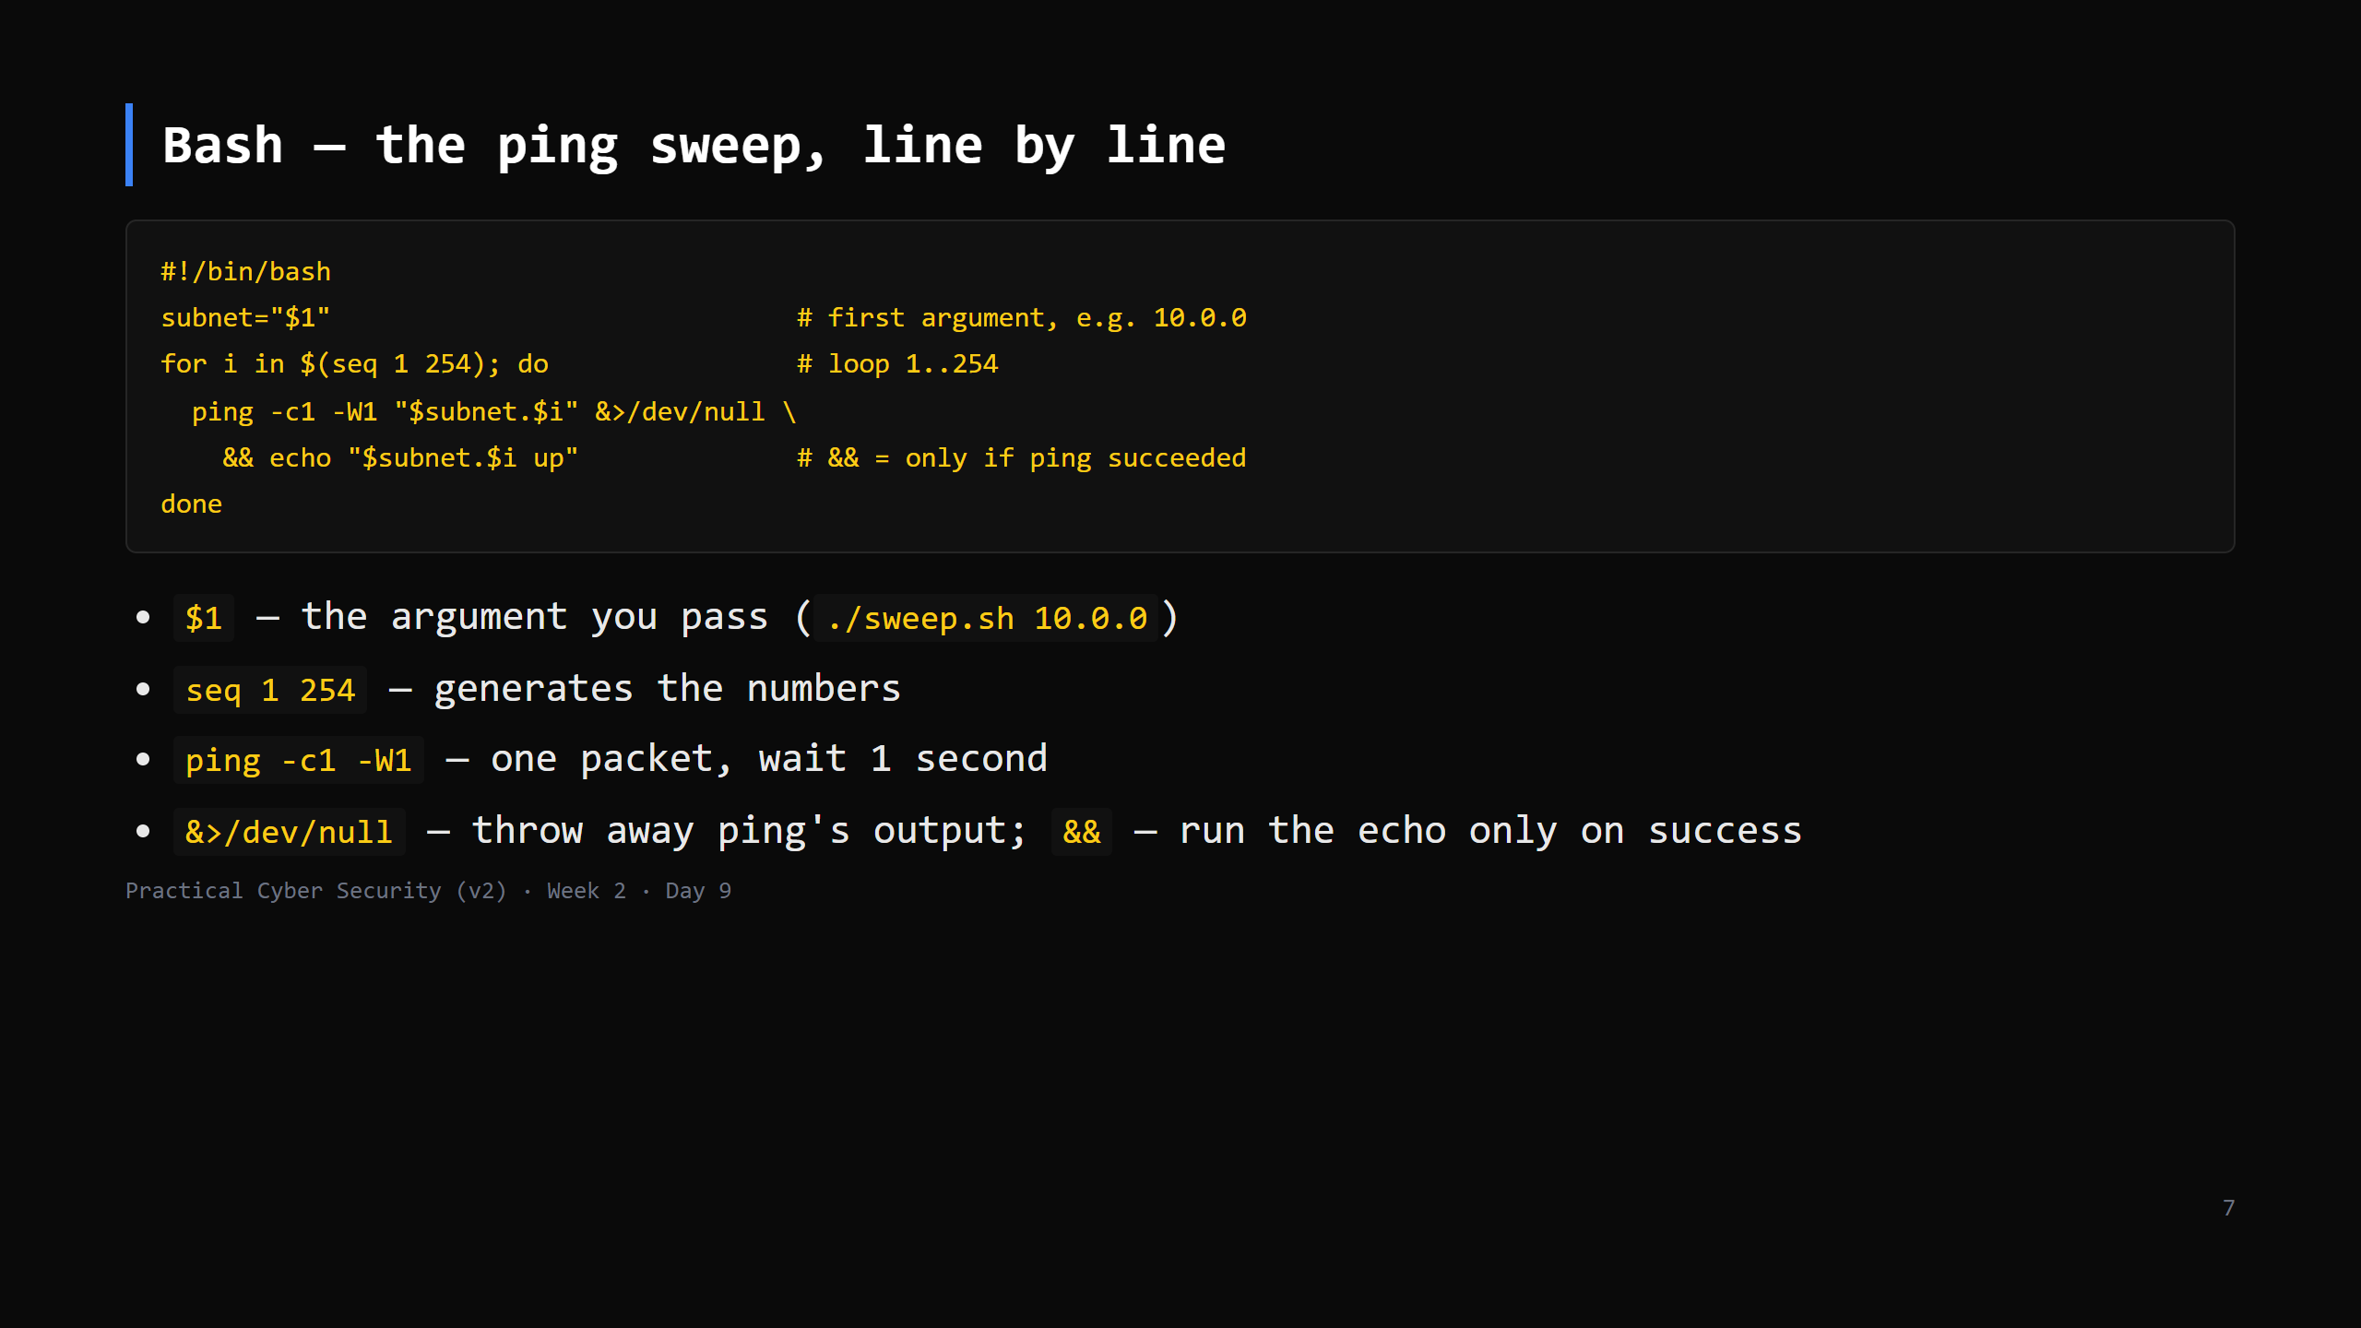
Notes:
This IS the hook script. Walk every token. The `&&` chaining on exit codes is the key idea. Note it's serial (slow-ish); a `&` after the ping backgrounds each = parallel = fast — mention, optional.

Slide 8
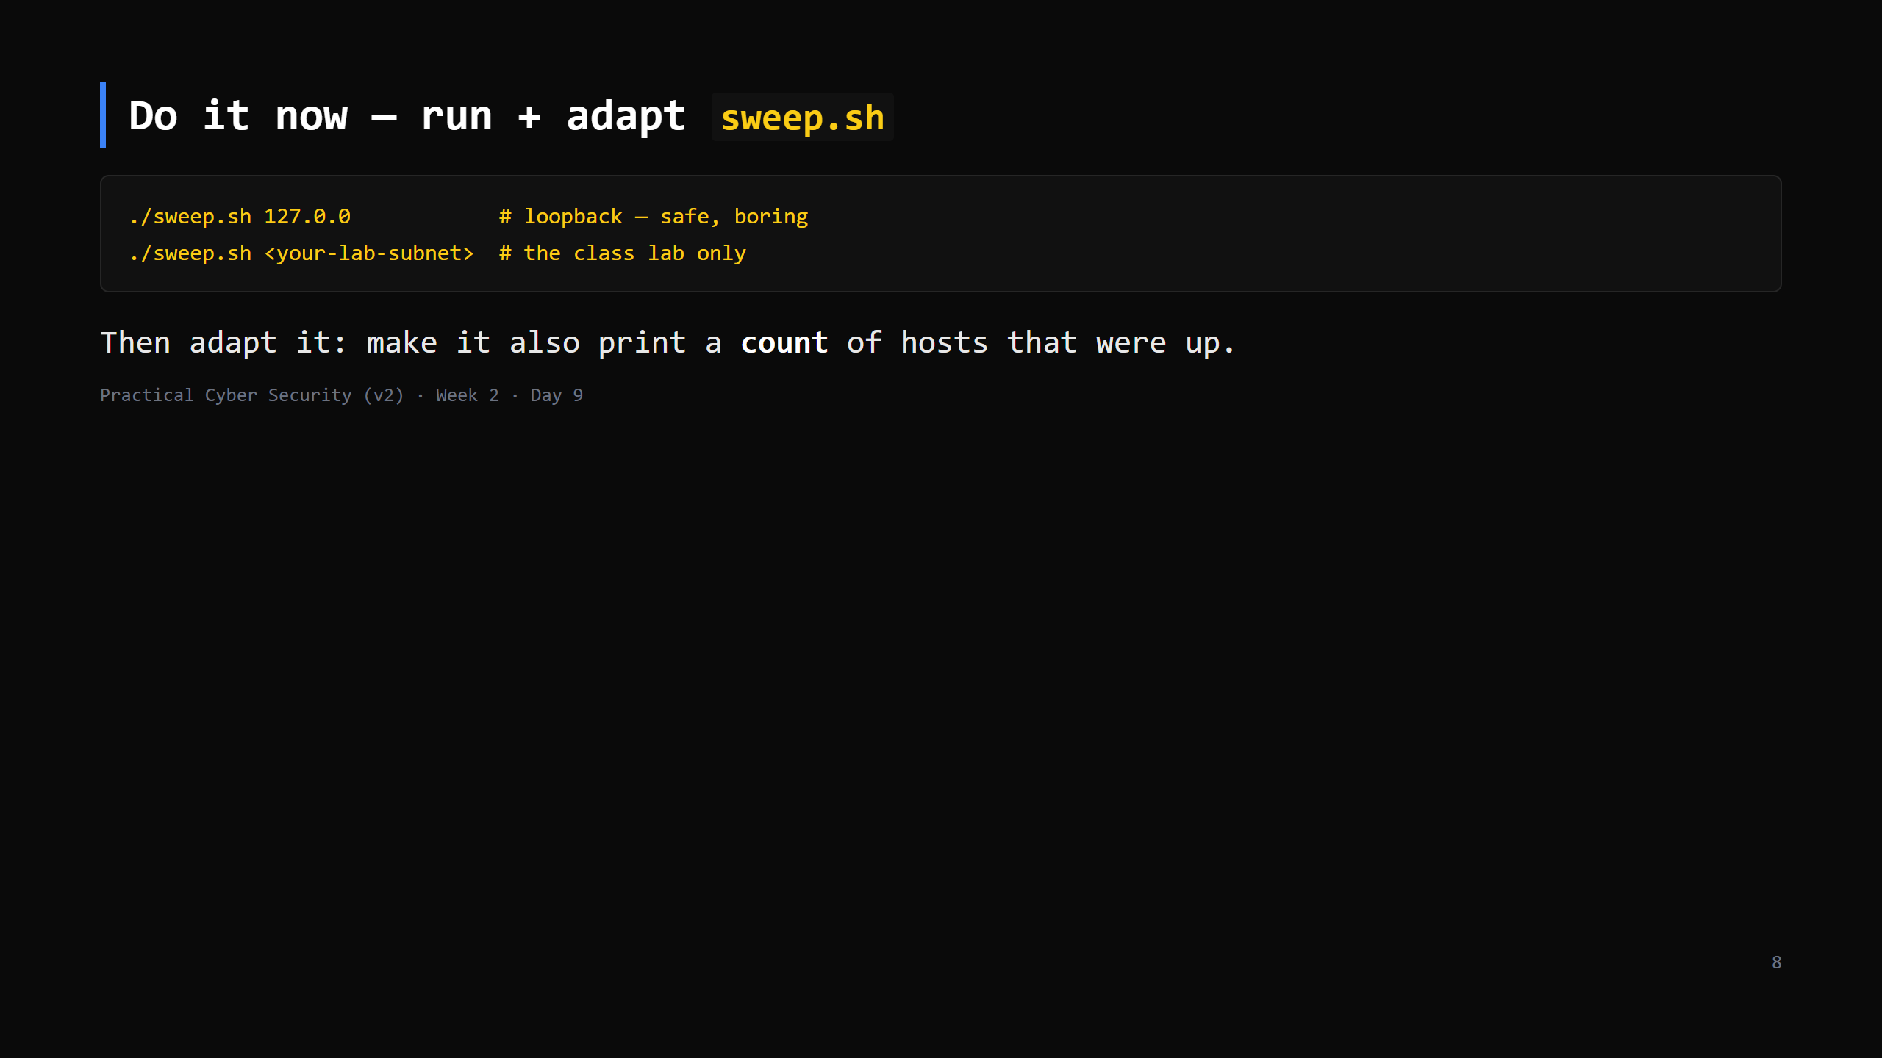
Notes:
8 min. ETHICS, say it: only scan your own machine or the class lab. Scanning networks you don't own is exactly the "no scope, no test" line from Day 1. The "count" tweak: add `up=0` before the loop, `up=$((up+1))` on success, `echo "$up hosts up"` after.

Slide 9
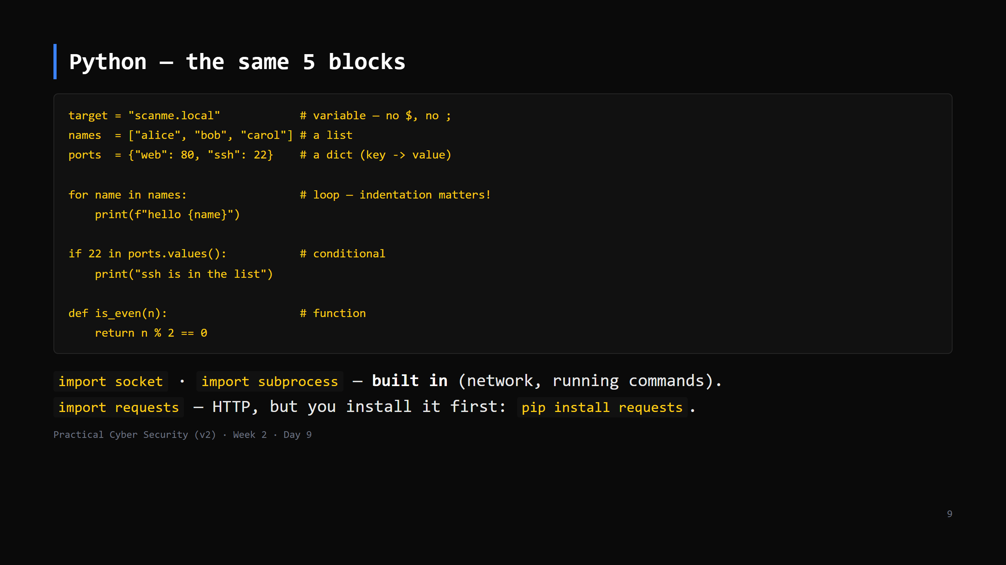
Notes:
The big Python gotcha: INDENTATION defines blocks (no braces, no `end`). 4 spaces. Mixing tabs/spaces = error. `f"...{x}..."` = f-string (formatting). `==` compares, `=` assigns. Don't teach classes/decorators/anything else. These 5 blocks + import.

Slide 10
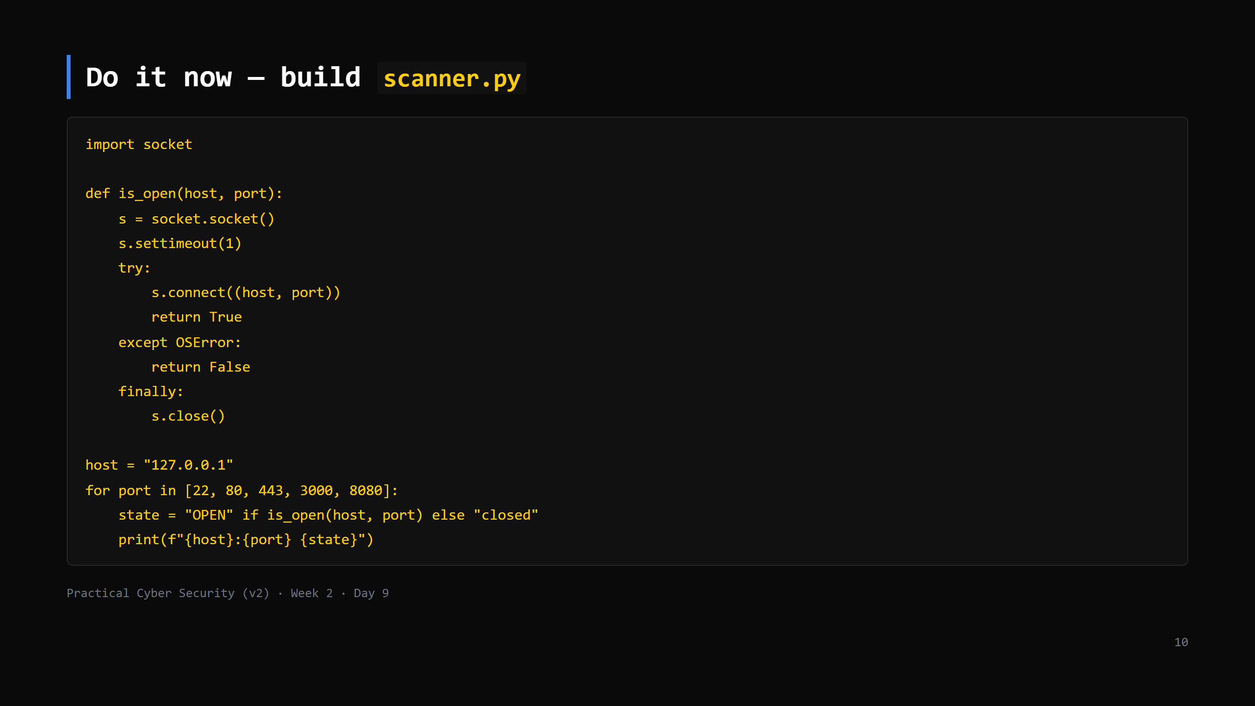
Notes:
11 min — the centrepiece. Build it up live: first the function, then the loop. socket.connect raises OSError if refused/filtered/timeout -> that's our "closed". Run against 127.0.0.1 (safe). Then the class lab host. NOT anything else. This file is the Week 3 scanner — they extend it Day 13.

Slide 11
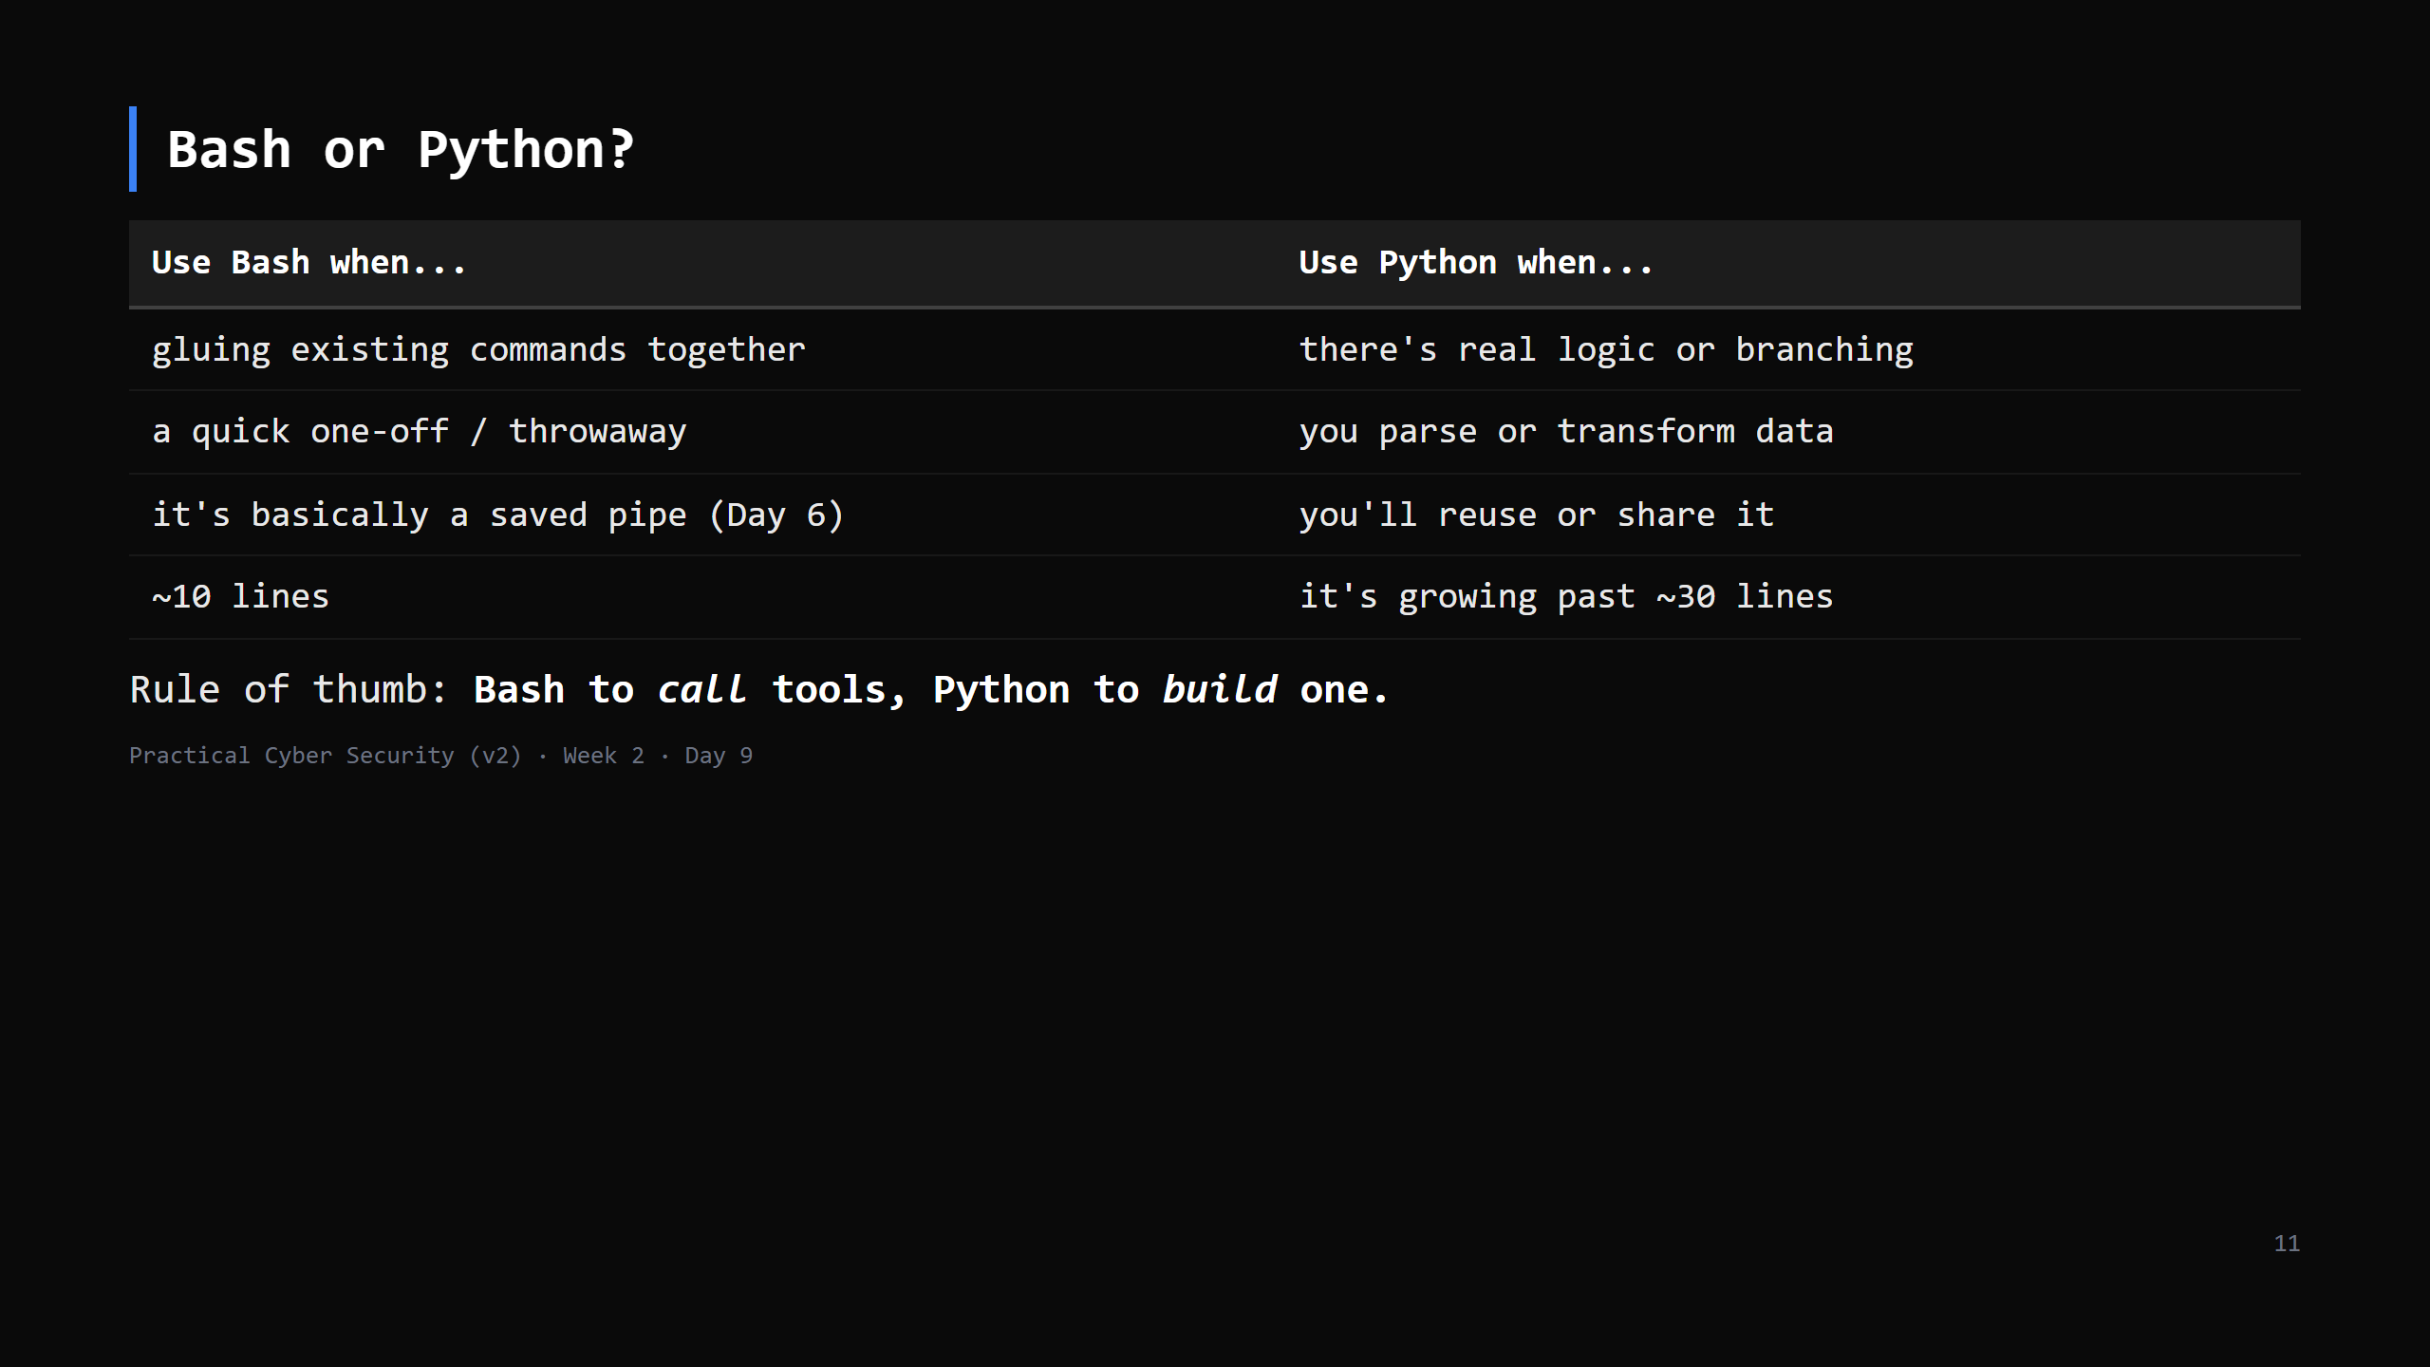
Notes:
CUT FIRST IF SHORT. The rule of thumb is the keeper.

Slide 12
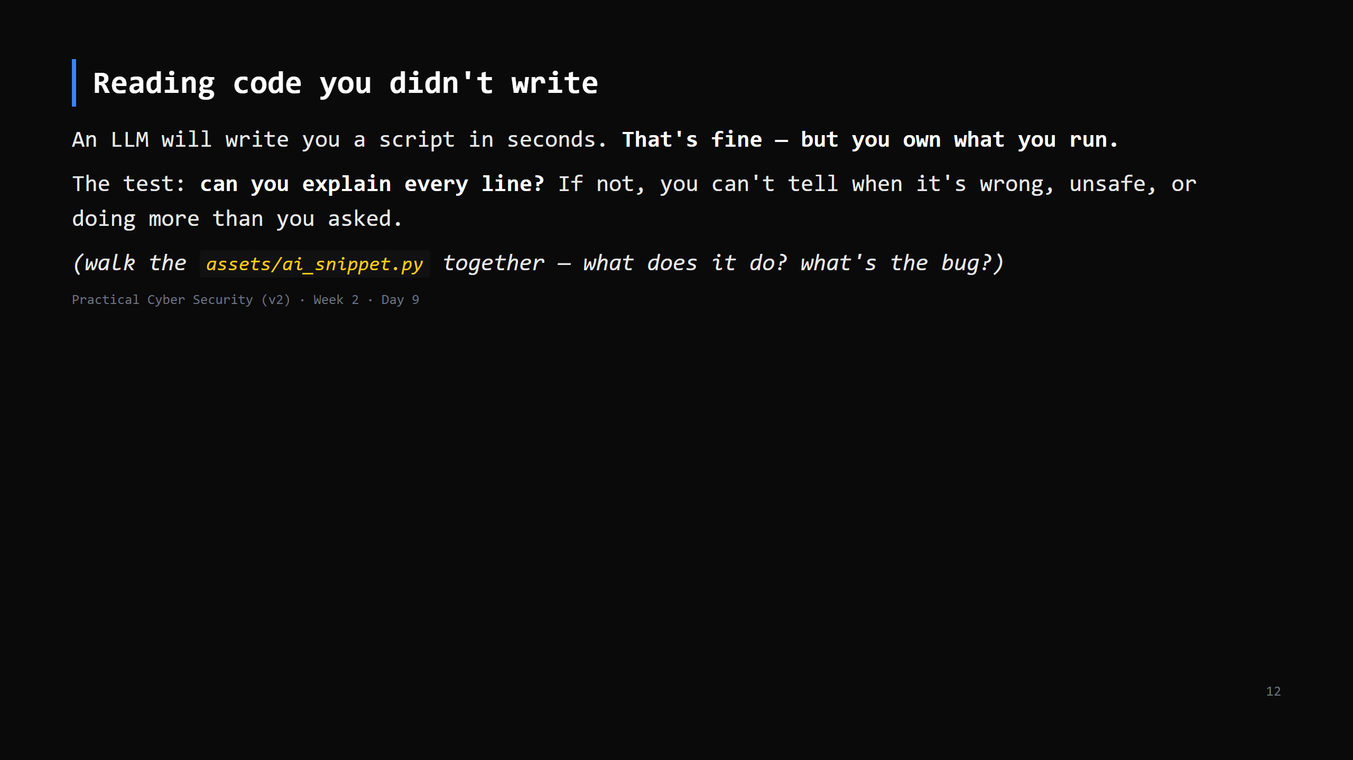
Notes:
6 min. This is the Day 9 trap. Generated code that "works" can still: hit the wrong host, have an off-by-one, swallow errors, or do something extra. The skill we're building is READING, not memorising syntax. ai_snippet.py: a plausible port scanner with a bug (e.g. range(1,1024) but never closes sockets / wrong variable / scans a hardcoded external IP). Find it together.

Slide 13
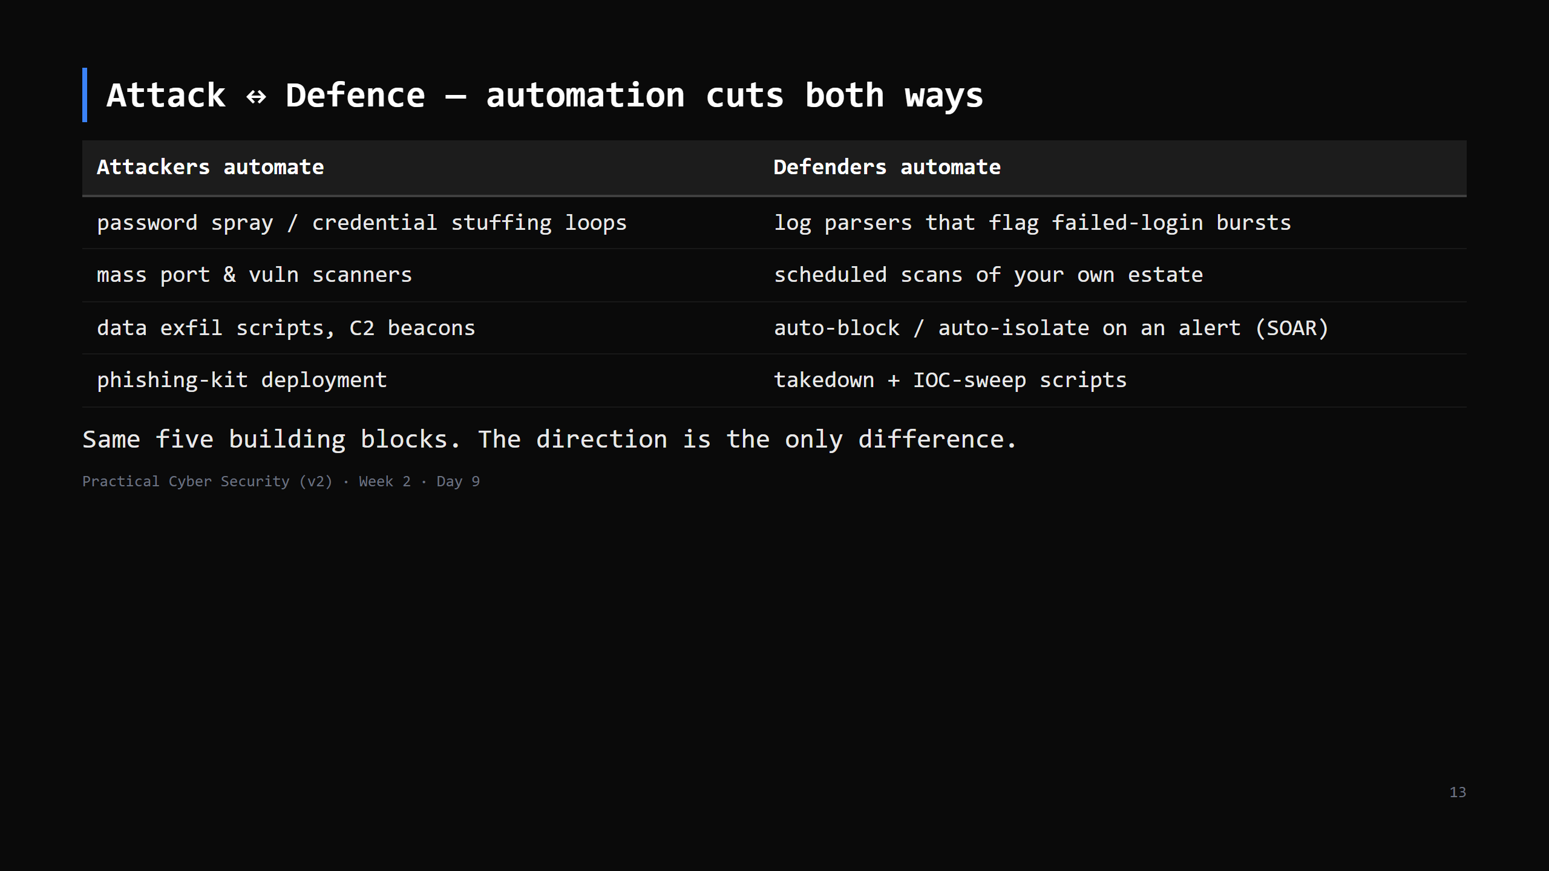
Notes:
Reinforce the course's spine: every offensive capability has a defensive mirror. Scripting is the clearest example — a SOC analyst and a pentester write very similar code.

Slide 14
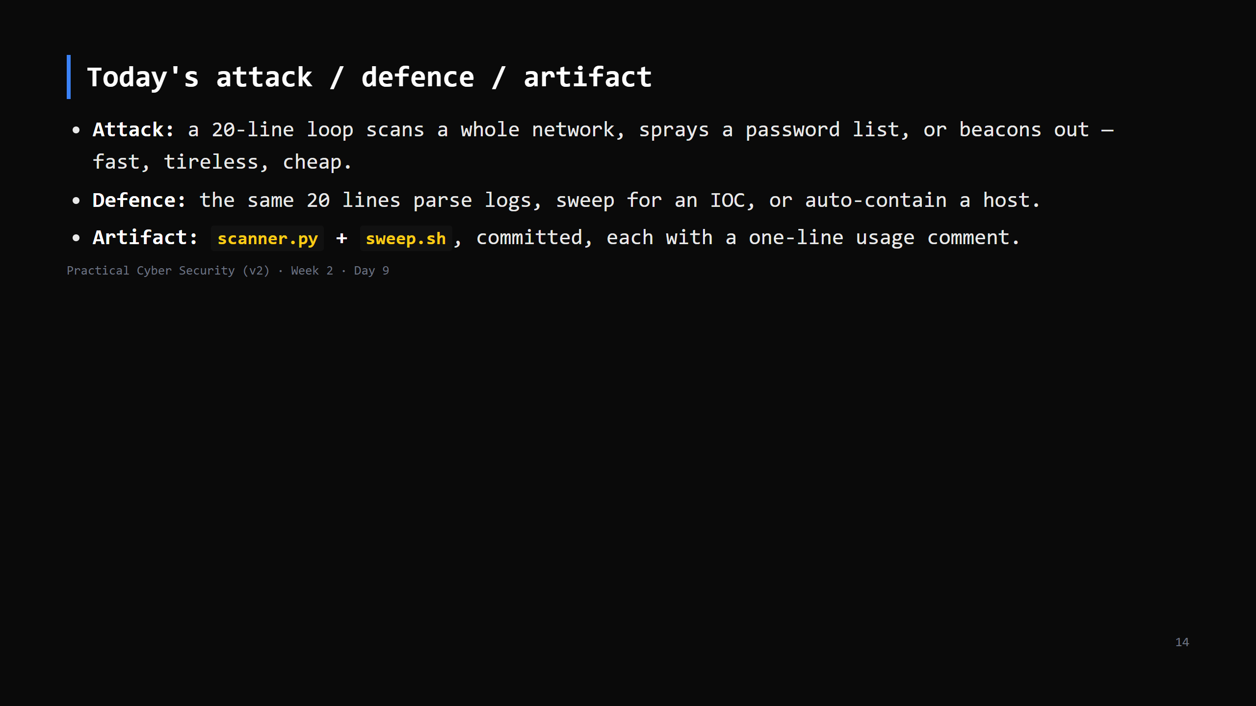

Slide 15
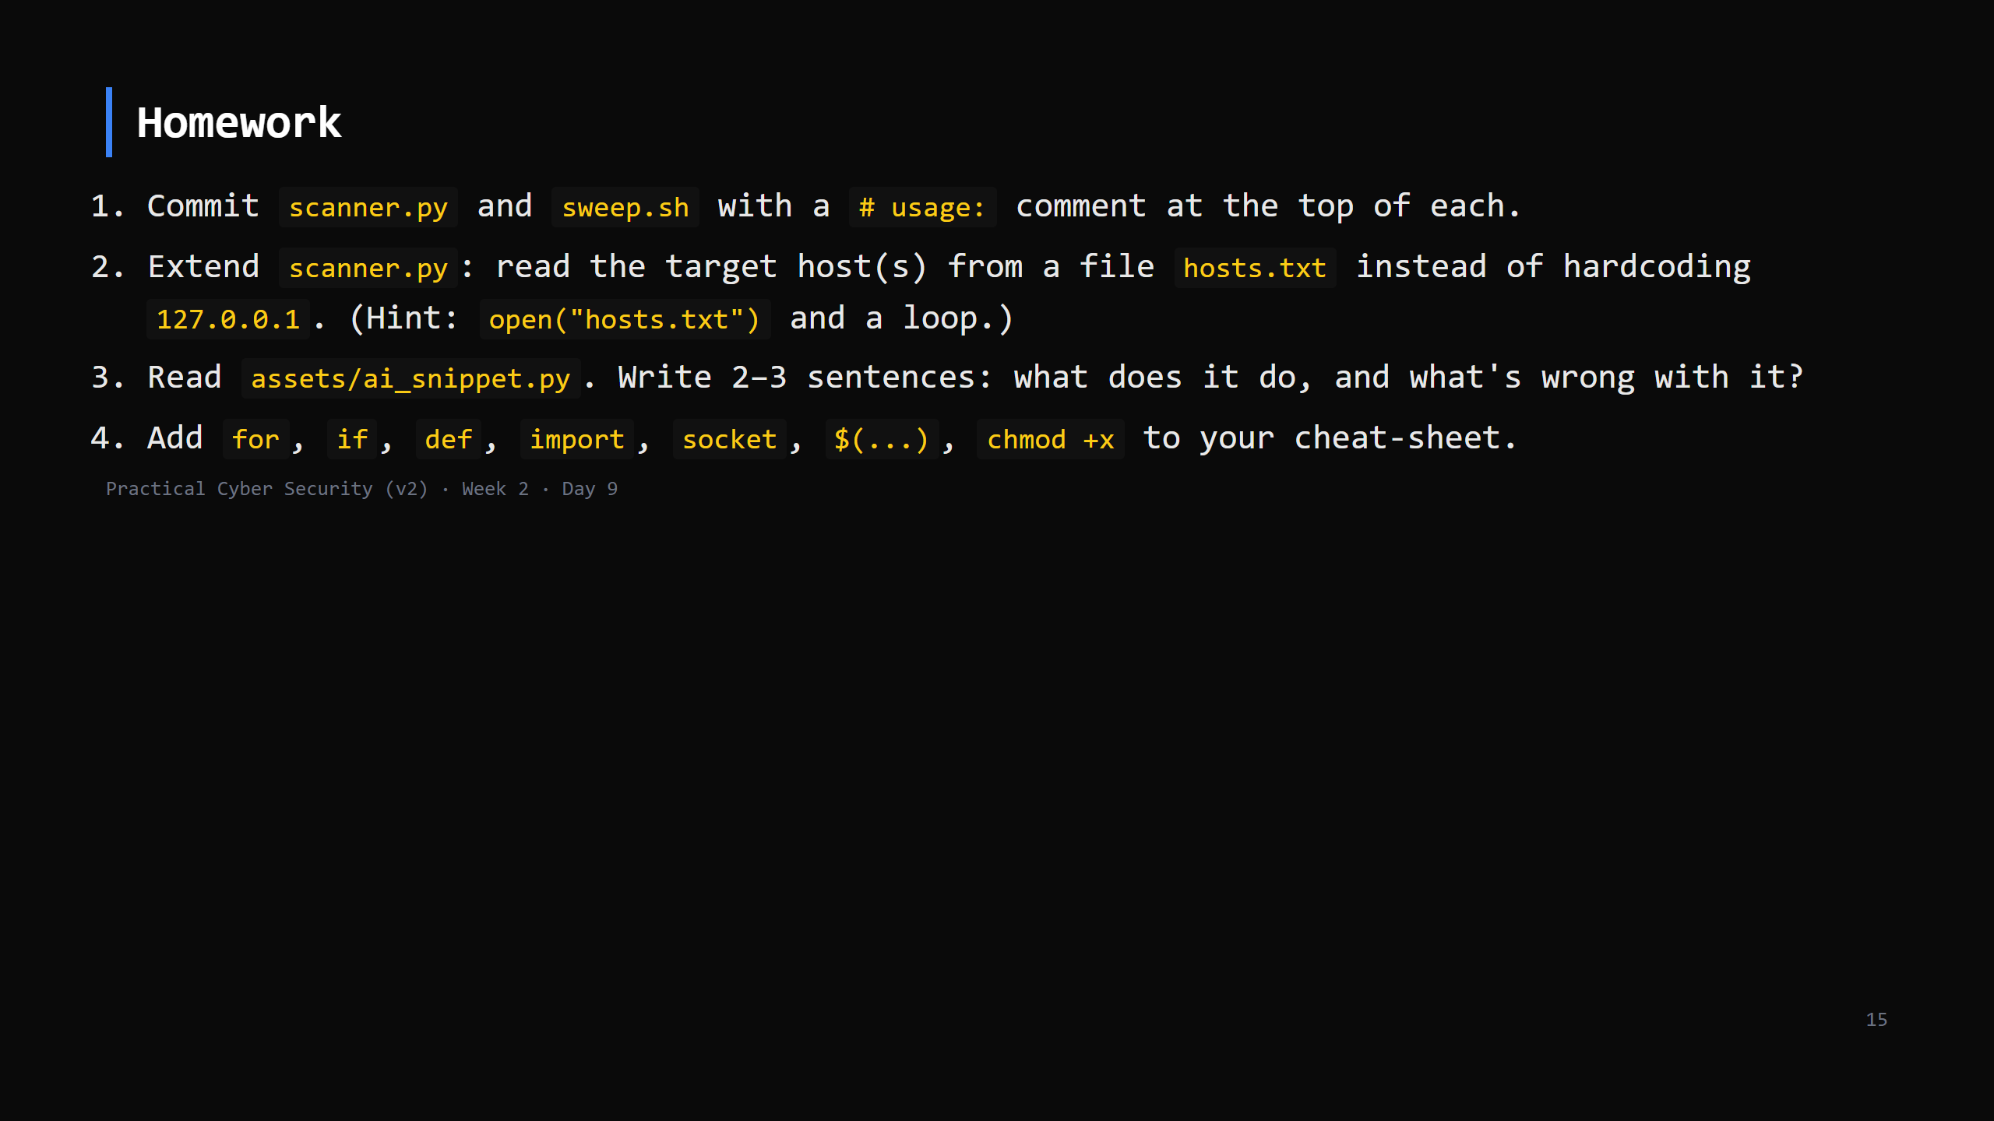
Notes:
Due start of Day 10. Only test against localhost / the class lab.

Slide 16
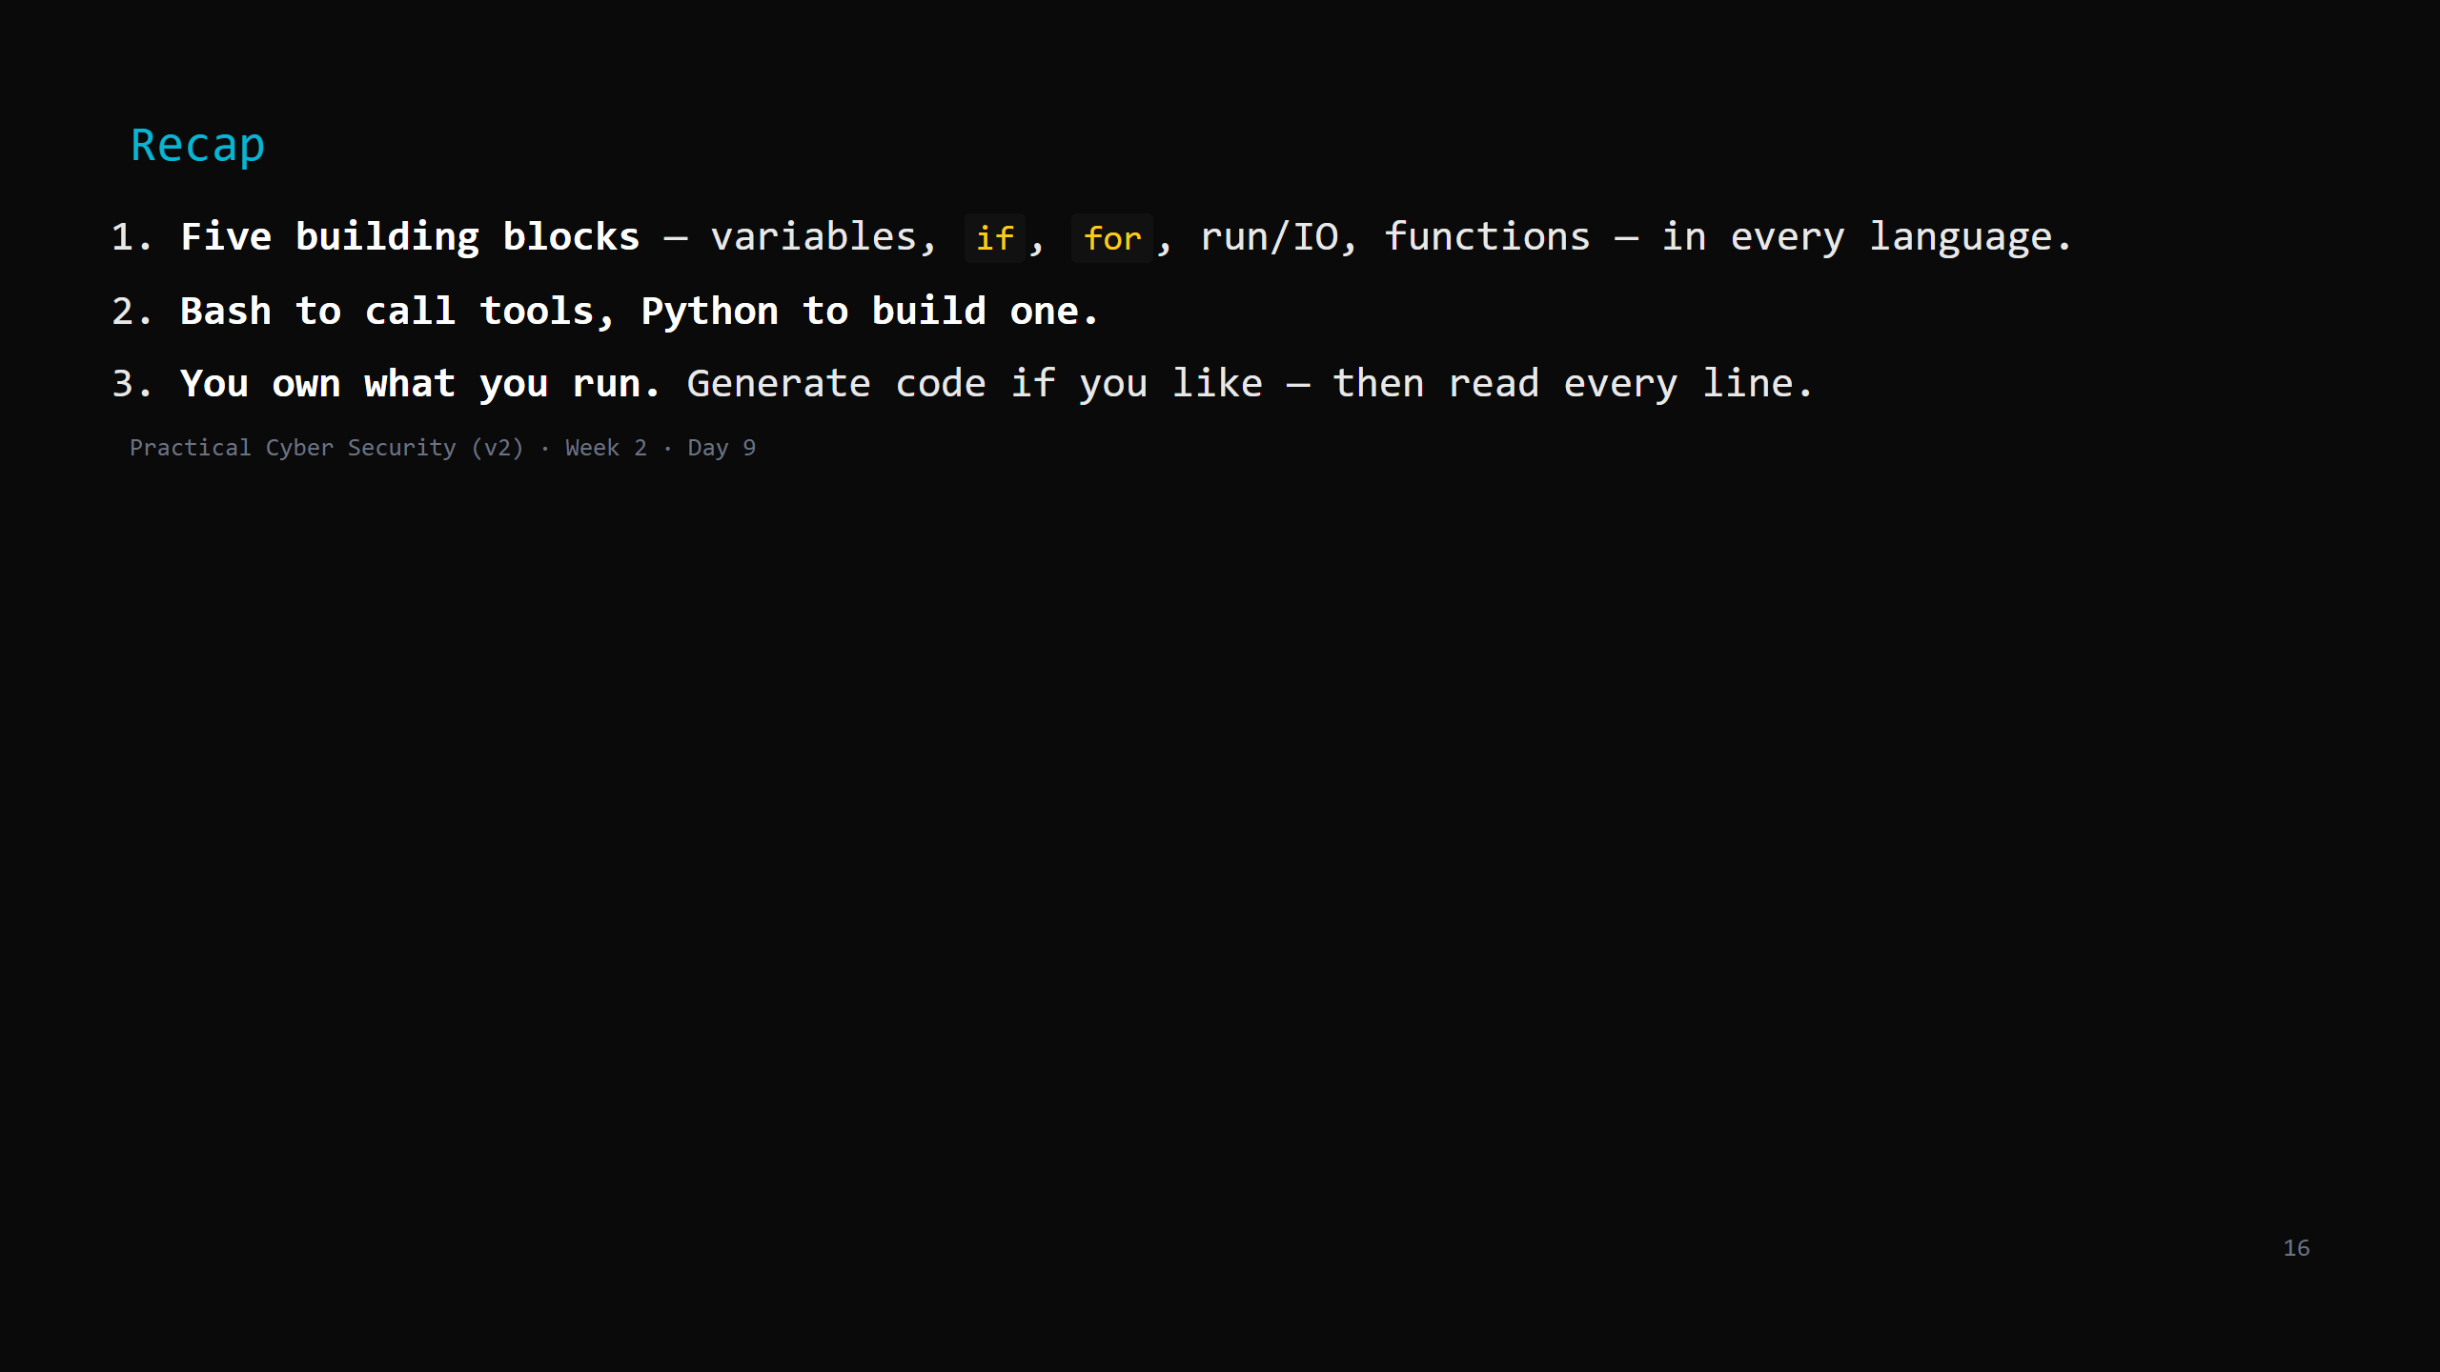
Notes:
Say the three lines. Tomorrow: security thinking — CIA revisited, threats/vulns/risk, threat actors, attack surface — the vocabulary that turns "I can use Linux" into "I can reason about what an attacker would do." + Week 2 assignment brief.

