Slide 1
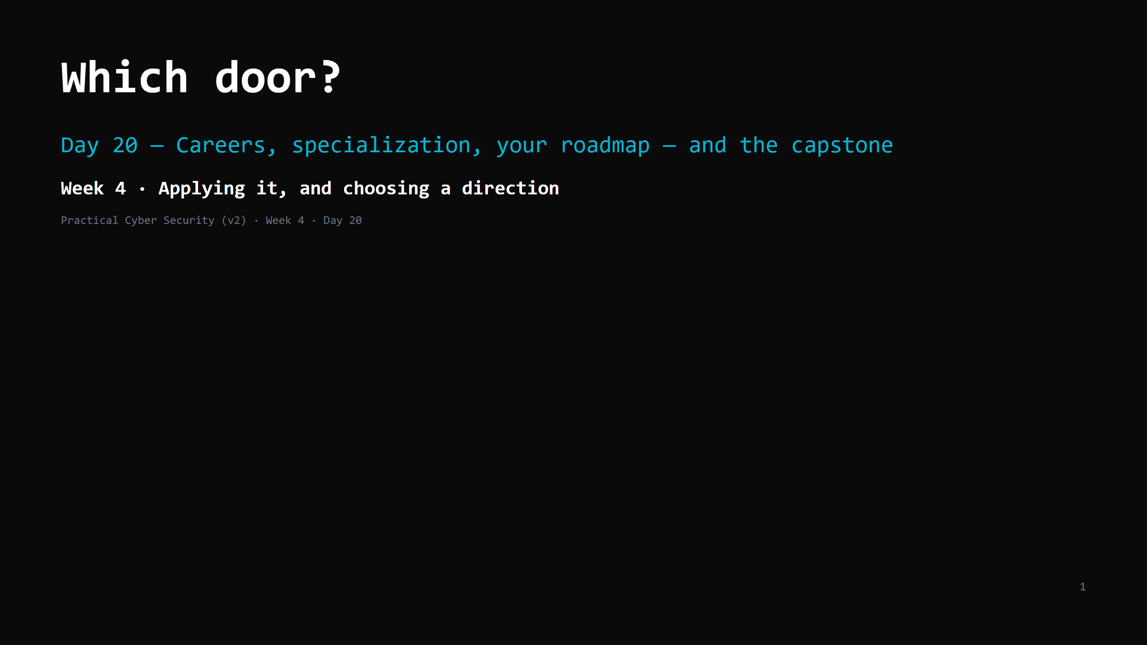
Notes:
RUN SHEET (~85 min). Light on new content — reflection, choosing, the capstone brief. 00:00 Journey check — the whole arc + look at your repo 5 00:05 The map of the field (Red / Blue / wings) 6 00:11 Red team roles — the actual day 8 00:19 Blue team roles — the actual day 8 00:27 The wings 6 00:33 DO: skills self-assessment 8 00:41 The Indian market — the honest version 8 00:49 Certs — the ladder, and what they're worth 6 00:55 DO: "which door and why" + next 3 steps + pitches 10 01:05 Finalise the portfolio repo 6 01:11 CAPSTONE BRIEF 10 01:21 Final recap — the course in 3 lines 4 CUT FIRST IF SHORT: the wings slide to 3 min; pitches to 2 volunteers. NEVER CUT: the self-assessment DO, "which door + 3 steps" DO, the portfolio finalisation, the capstone brief. ANALOGY (kitchen): you've now trained at every station — the line (offense), the pass and the security office (defense), front-of-house and the books (GRC), supplier relations (cloud), the new equipment (AI). Which station do you want to run? Your repo is your reference from the head chef.

Slide 2
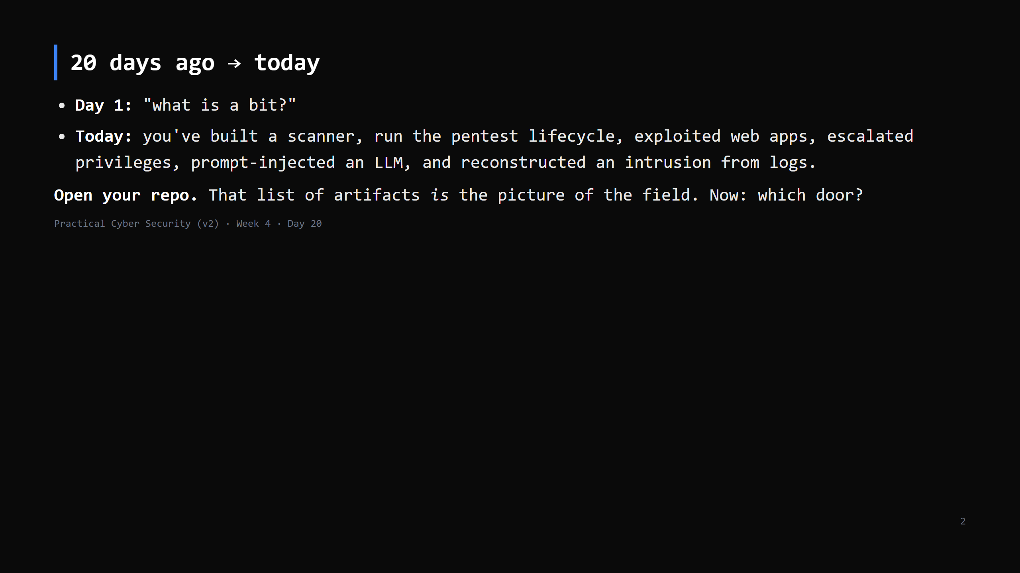
Notes:
Journey Check - the final one. Have them literally scroll their repo: scanner.py, the engagement journal, web-vulns.md, attack-chain.md, ai-attacks.md, timeline.md, ir-runbook.md. "You didn't learn ABOUT security. You did it. That's the difference on a CV."

Slide 3
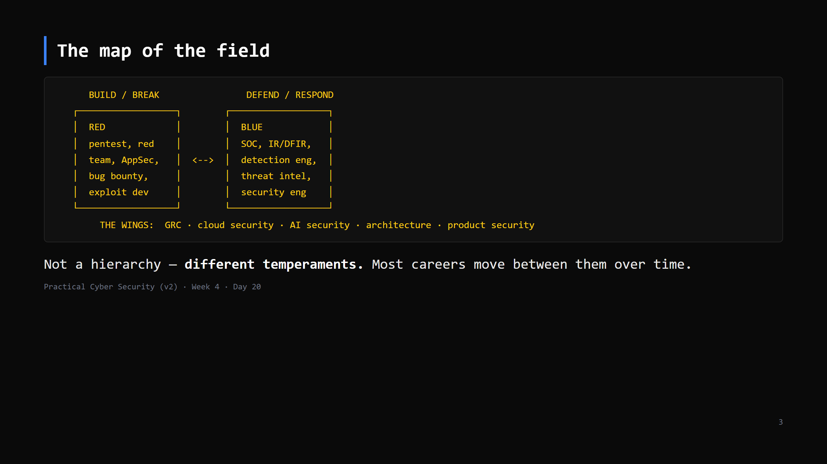
Notes:
Purple team = red + blue working together. "Full stack" security people exist. Nobody is locked in by their first job.

Slide 4
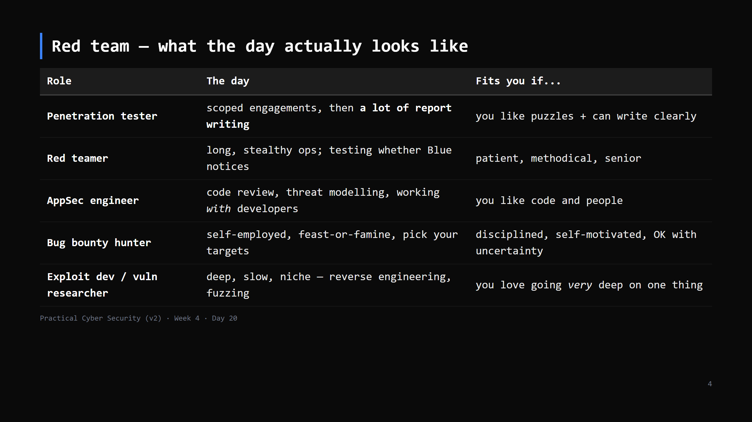
Notes:
The surprise for students: pentesting is ~40% writing. The report is the product (Day 12). AppSec is the fastest-growing and most dev-adjacent - good for CS students.

Slide 5
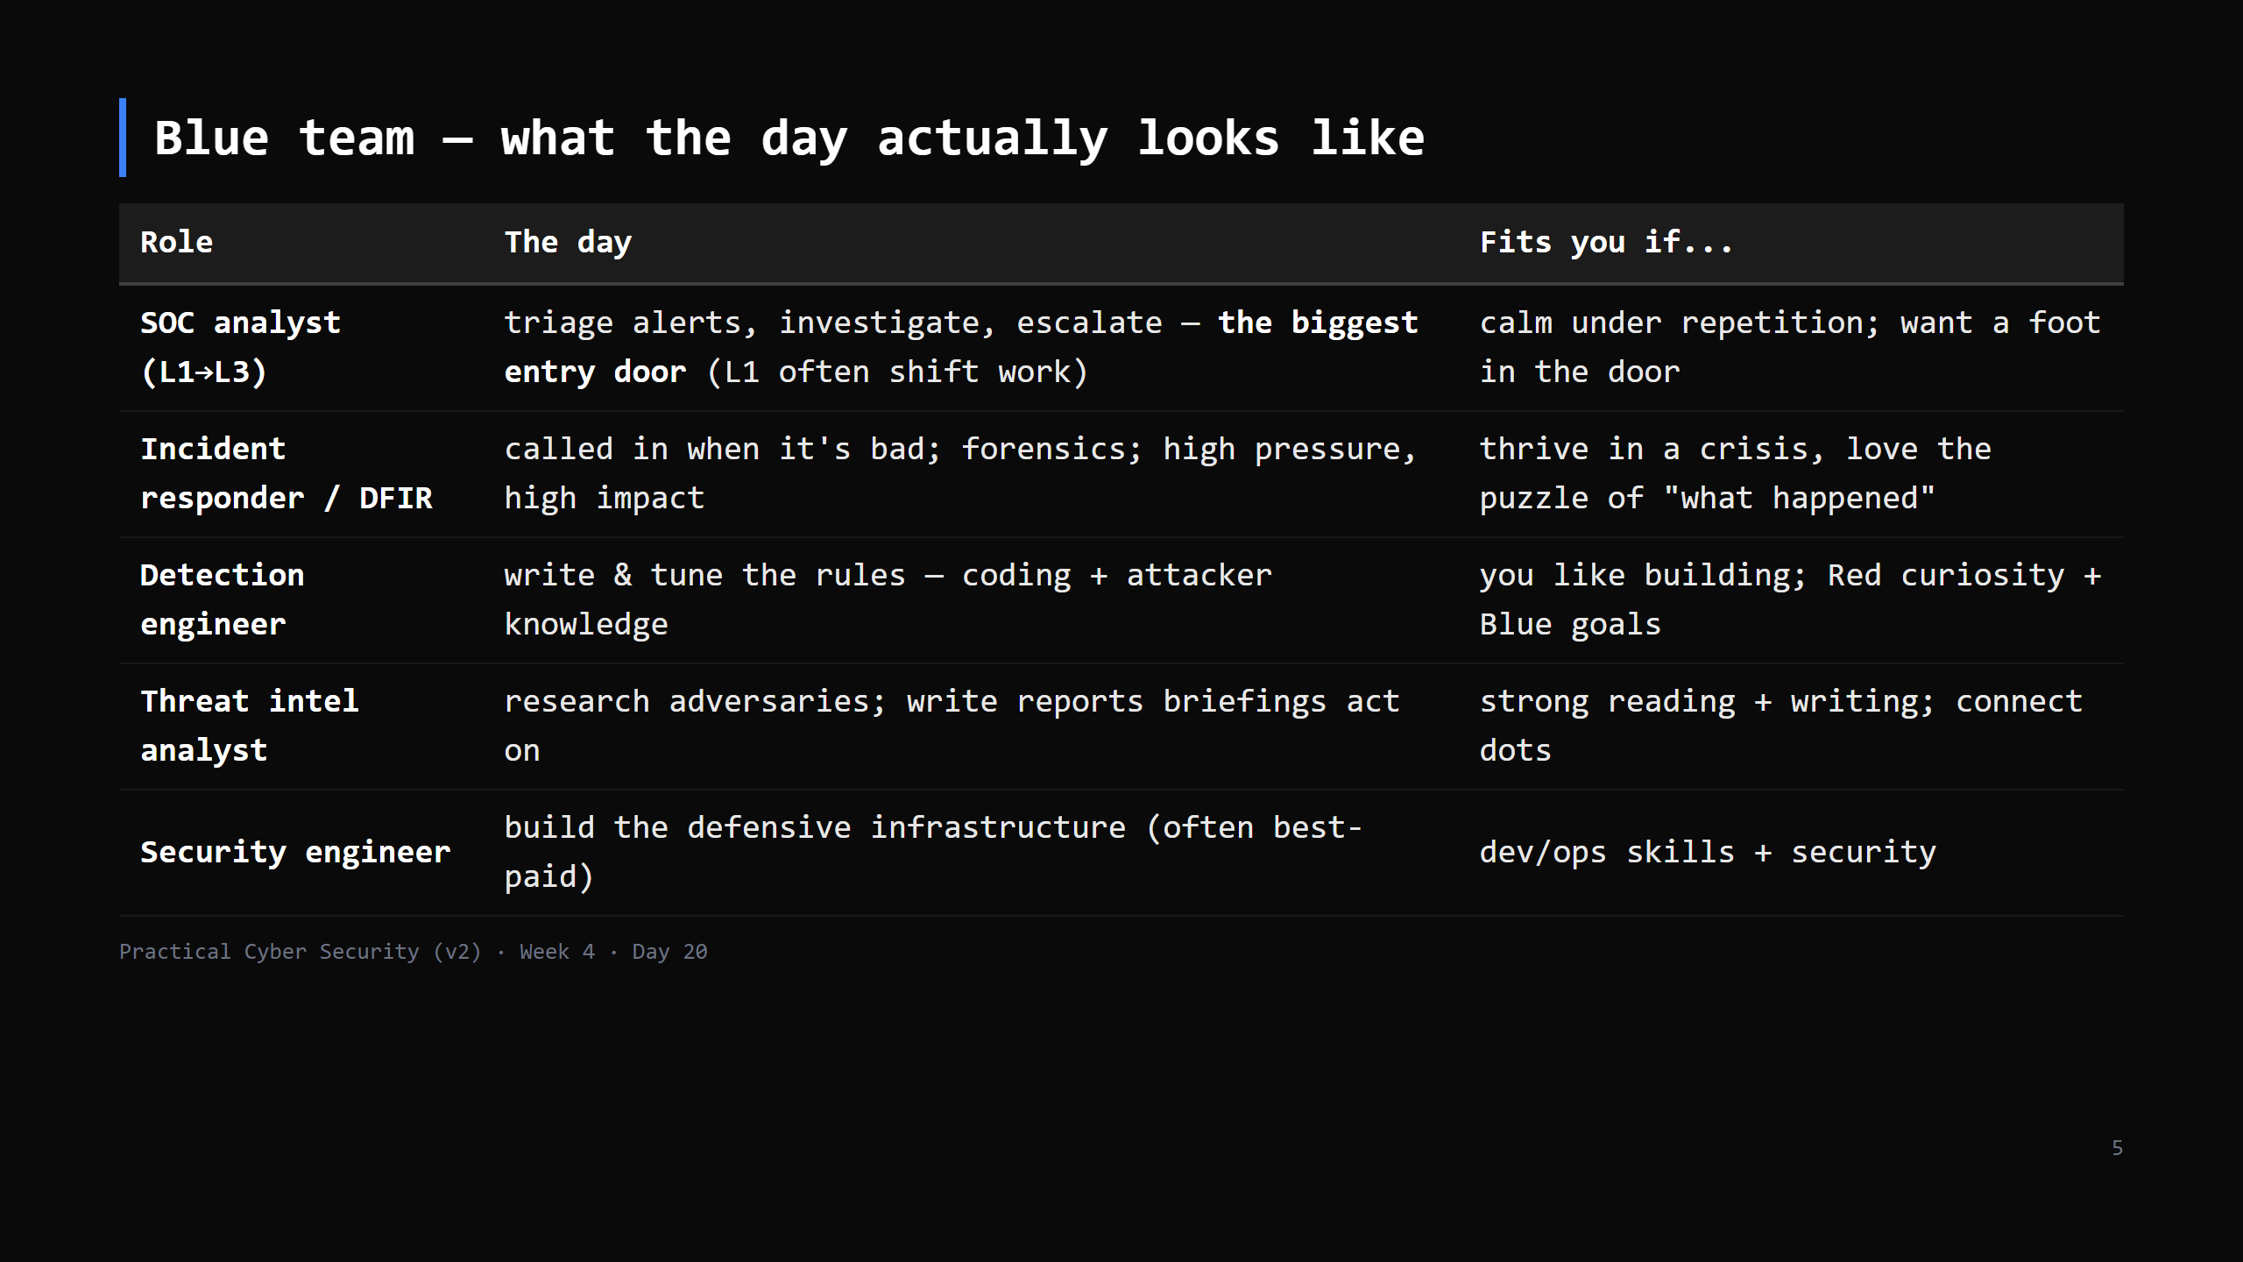
Notes:
SOC L1 is where most people start in India - high volume of openings, gets you experience. "Detection engineer" is the sweet spot for someone who enjoyed BOTH the Red days and Day 19.

Slide 6
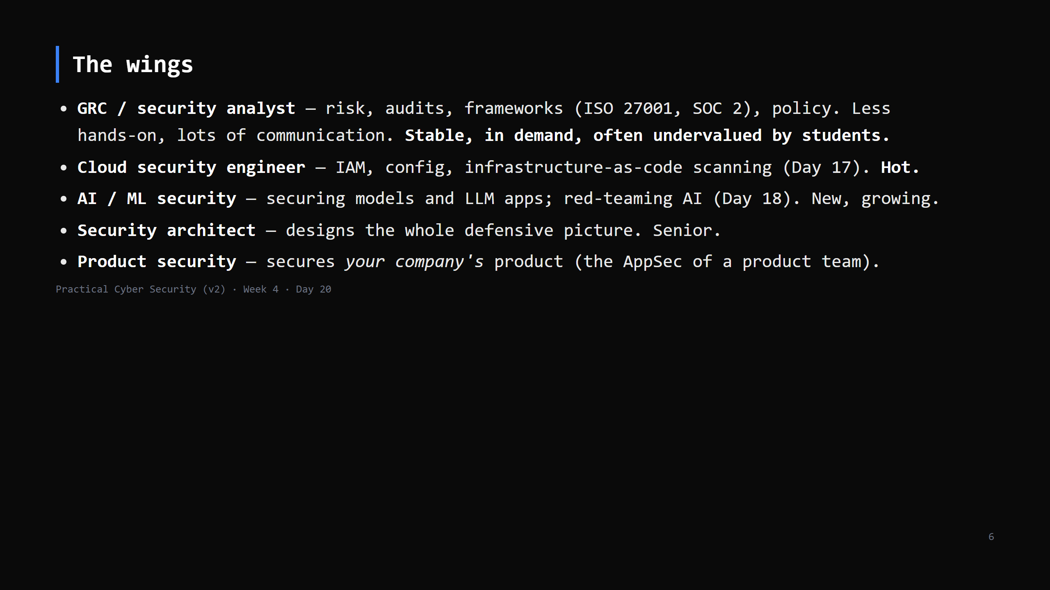
Notes:
Tell them plainly: GRC is a real, well-paid, less-gatekept path that suits people who are organised and communicate well but don't love the terminal. It's not "lesser". CUT to 3 min if behind.

Slide 7
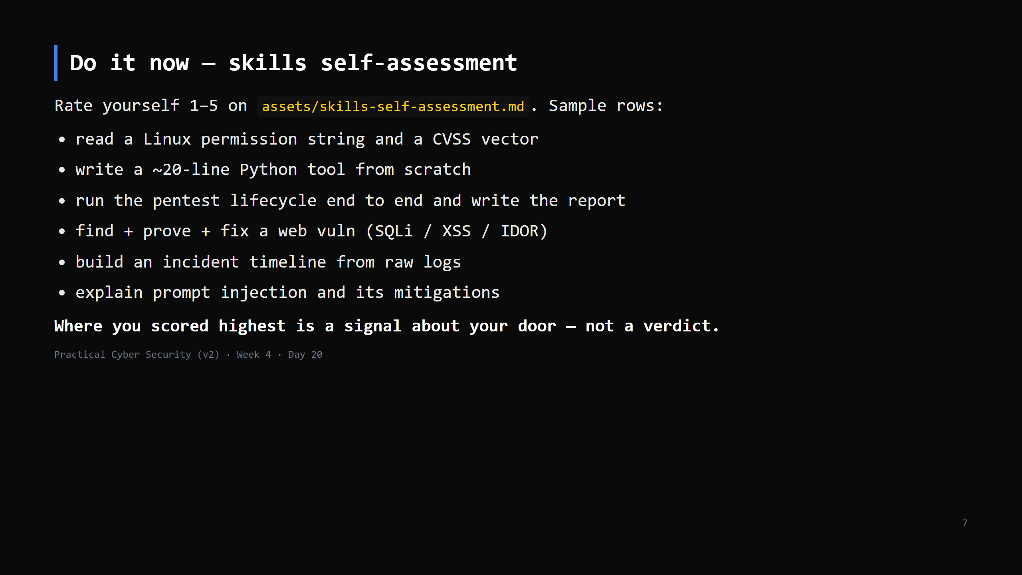
Notes:
8 min. The clusters map to doors: scripting+lifecycle+web = Red-lean; logs+timeline+IR = Blue-lean; "explain the risk to a non-technical person" = GRC-lean. It's a nudge, not destiny.

Slide 8
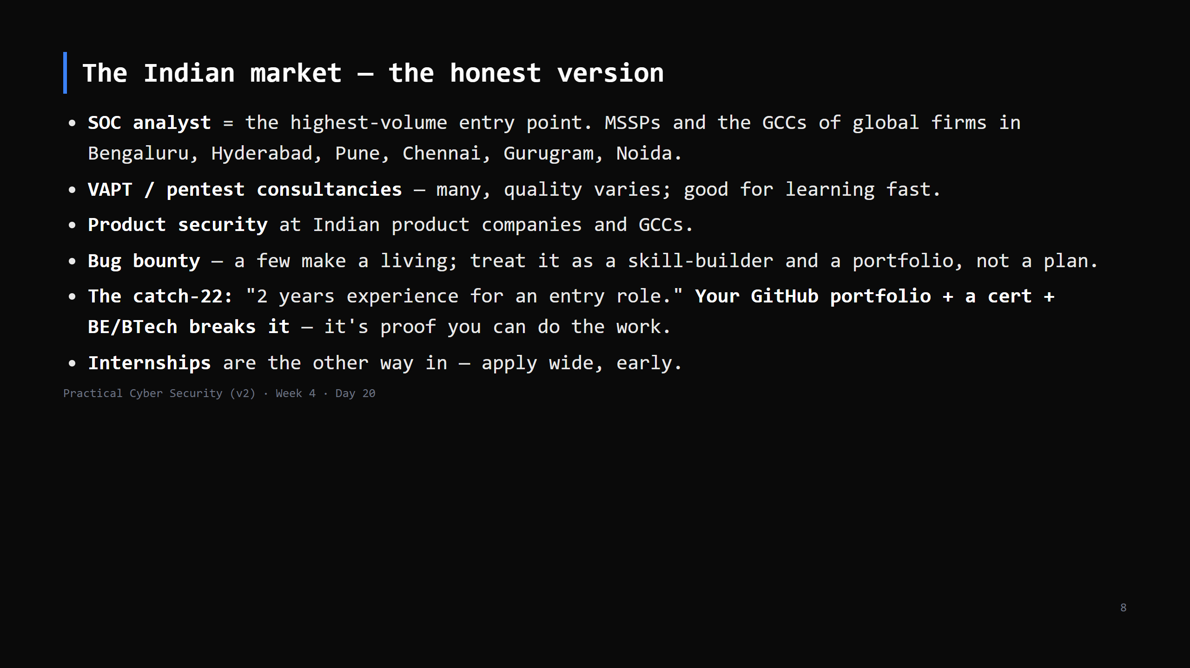
Notes:
Be real: freshers face a lot of "junior" roles asking for experience. The students who get past it have (1) a visible portfolio, (2) one relevant cert, (3) they can talk through a project in the interview. This course gave them (1). Certs and interviews are on them.

Slide 9
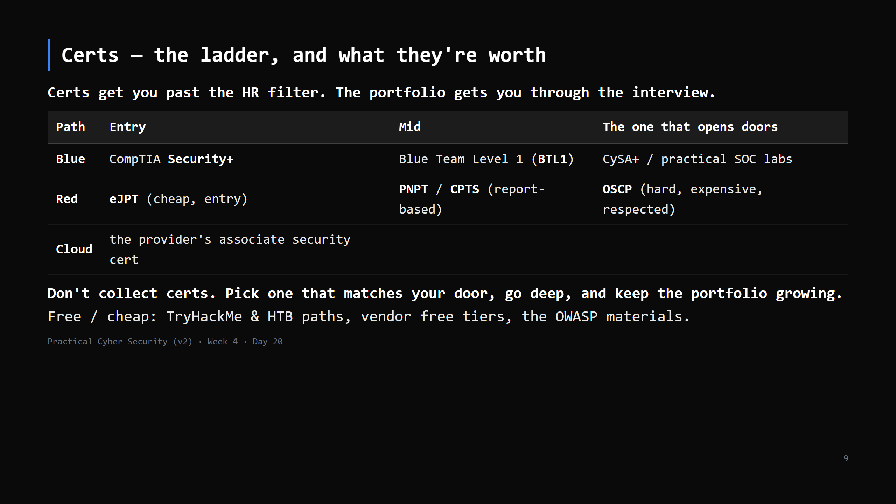
Notes:
CISSP is a management cert and needs ~5 years experience - not a fresher cert. Security+ is the realistic first one for most. For Red, TryHackMe/HTB + eJPT is a cheap strong start.

Slide 10
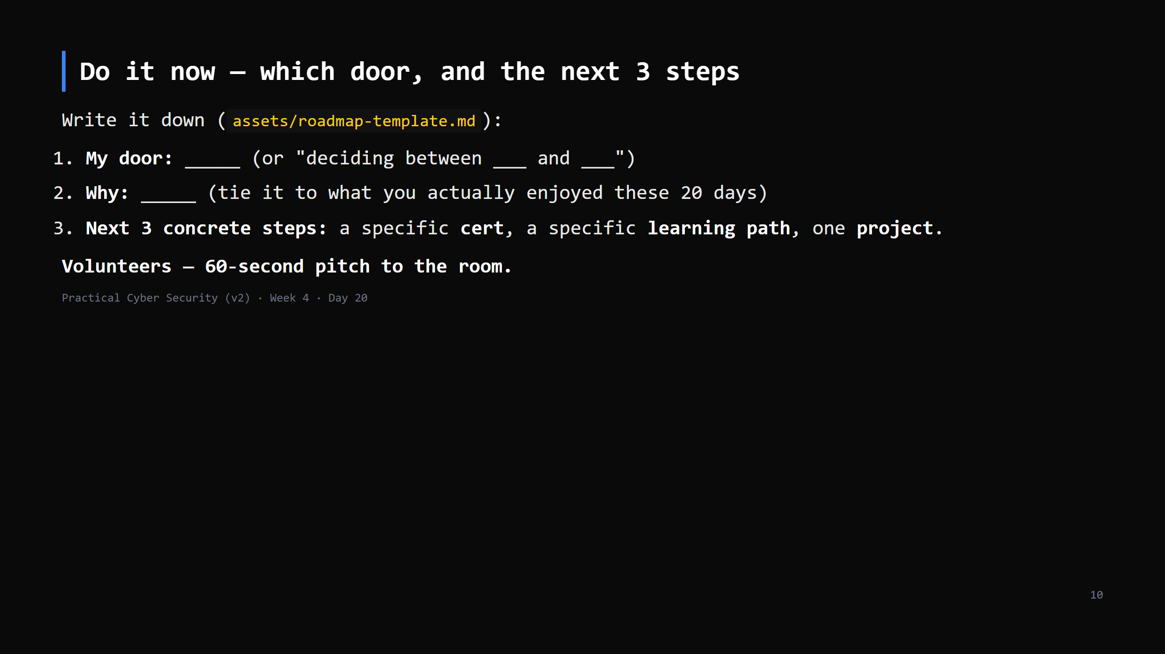
Notes:
10 min incl. 3-4 pitches. "Deciding between two" is a completely fine answer for now. The point is a CONCRETE next step, not a life plan. Push back on vague ("get better at hacking") -> "which HTB path, by when?"

Slide 11
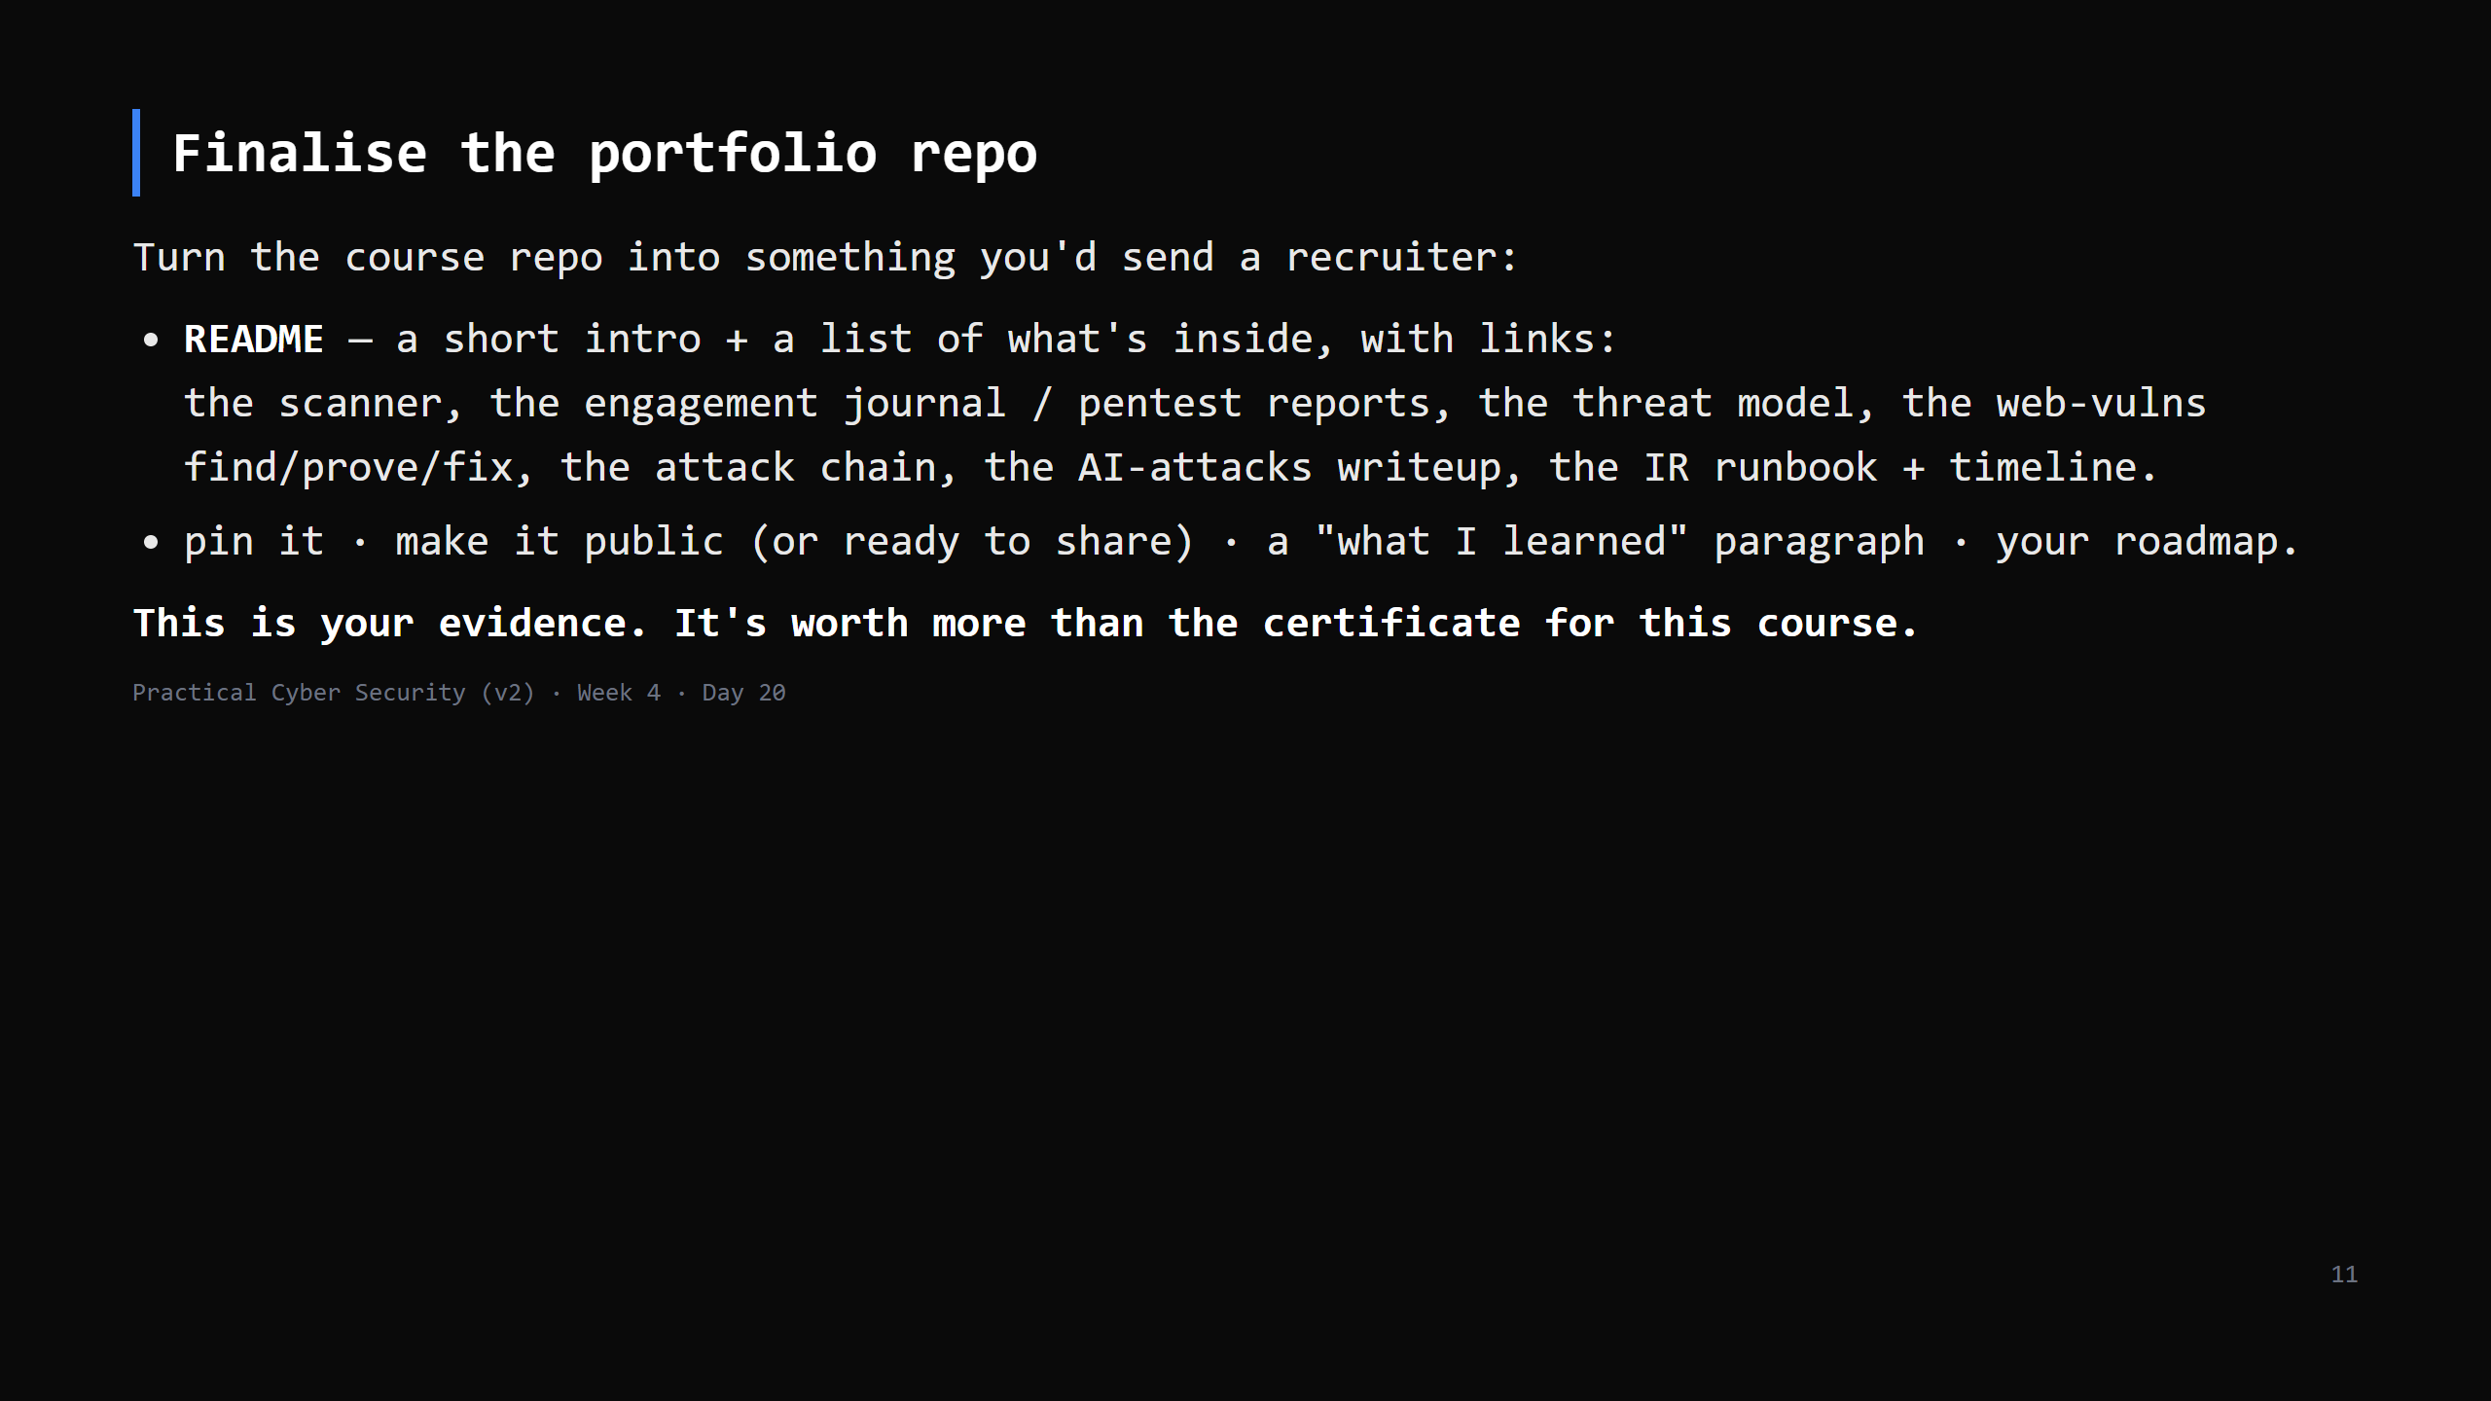
Notes:
6 min - get them to at least draft the README now. Template in assets/. A clean portfolio repo with 8 real artifacts genuinely stands out for a fresher.

Slide 12
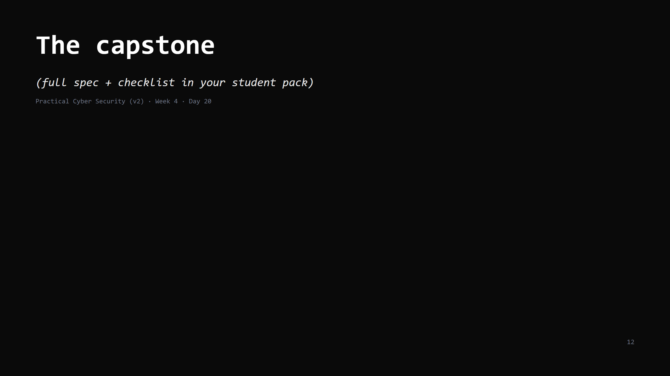

Slide 13
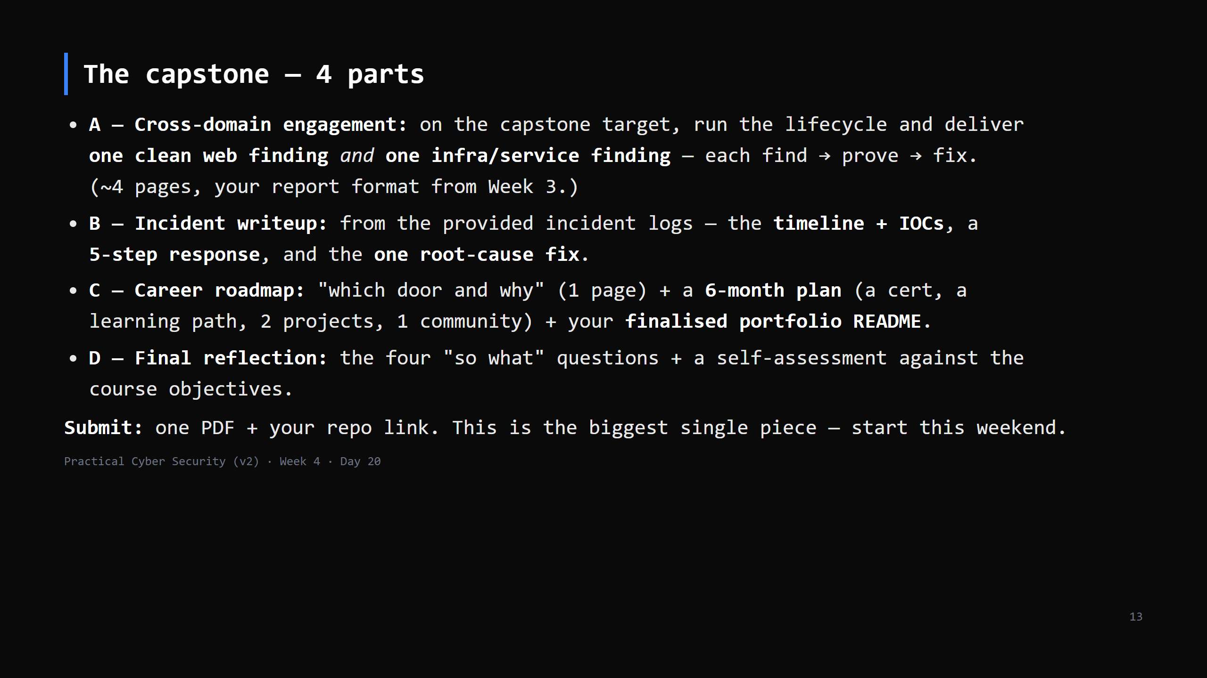
Notes:
Walk each part ~2 min. A = Weeks 3-4 combined. B = Day 19. C = today. D = the whole course. It's marked against the Definition of Success - "can you do the basics, and do you know your direction". Everyone who did the weekly assignments has 80% of this already.

Slide 14
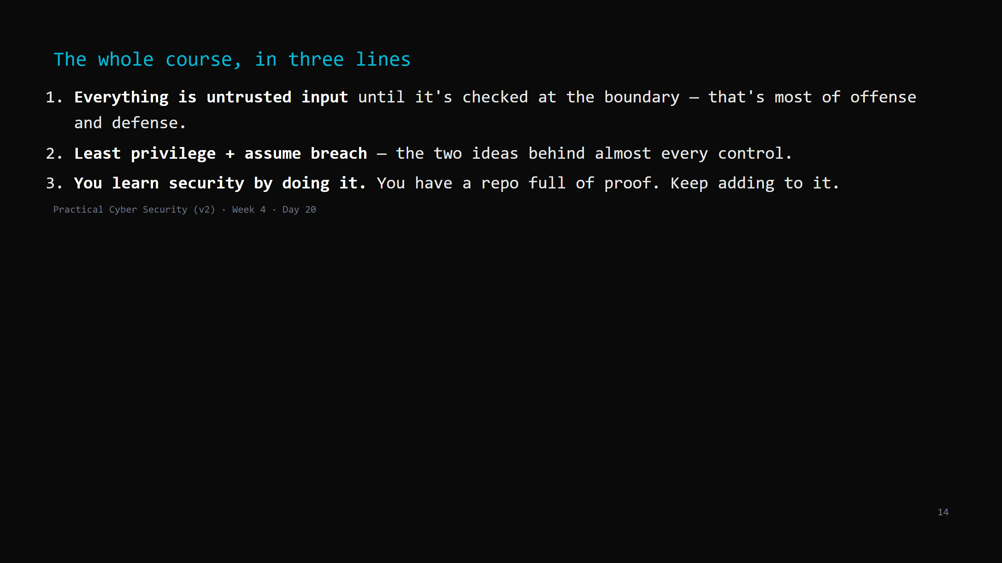
Notes:
The final recap. Then: "you came in 20 days ago asking 'what is a bit'. You leave knowing what the field is, what you can do, and which door you're walking toward. That was the whole point. Go build."

