Slide 1
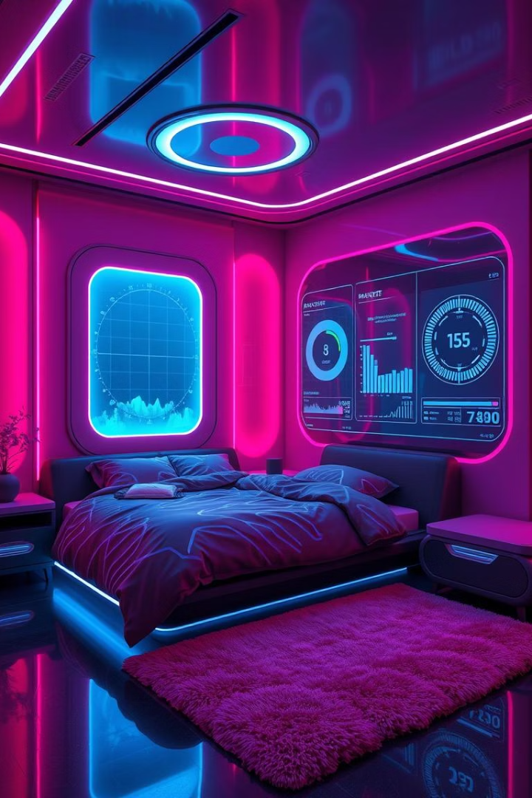
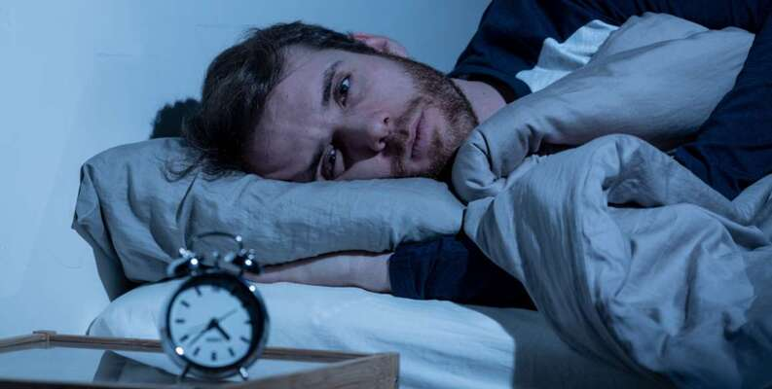
SleepWell
Predicting Sleep Disorders Using Machine Learning
By Group 57
AI-DeepThinkers / Sleep-Health-and-Lifestyle
https://www.kaggle.com/datasets/uom190346a/sleep-health-and-lifestyle-dataset

Slide 2
Promoting Good Health and Well-being
Our Mission
Aligned with SDG 3:
Good Health and Well-being.
The Challenge
One in three adults suffer from
poor sleep, often undiagnosed.

Slide 3



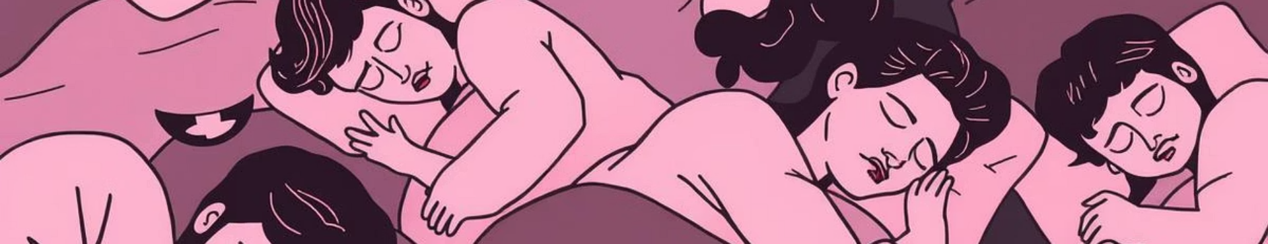
Understanding the Problem
Global Impact
Awareness Gap
Early Identification
Millions affected by undiagnosed sleep disorders.
Many are unaware of their condition.
Leveraging data for timely awareness.
Why sleep matters (mental + physical health)
2 common disorders: Insomnia & Sleep Apnea
Align with SDG 3: Good Health and Well-being

Slide 4

Dataset Overview
Source
Dimensions
Key Features
Kaggle:
Sleep Health and Lifestyle Dataset.
374 rows
10+ health/lifestyle features
Age, Gender, BMI,
Stress Level,
Sleep Duration.
Target: 3-class sleep disorder label

Slide 5




Our Machine Learning Workflow
Data Preprocessing
Classification Report:
precision recall f1-score support
Insomnia 0.80 0.86 0.83 14
Sleep Apnea 0.88 0.82 0.85 17
accuracy 0.84 31
macro avg 0.84 0.84 0.84 31
weighted avg 0.84 0.84 0.84 31
Cleaning and encoding raw data.
Exploratory Analysis
Uncovering data patterns.
Model Training
Developing the Random Forest model.
Performance Evaluation
Assessing model accuracy.

Slide 6
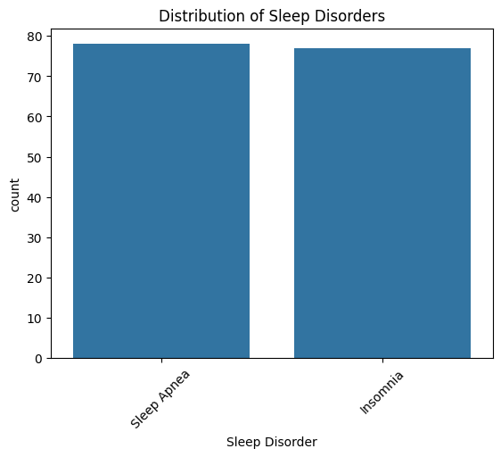
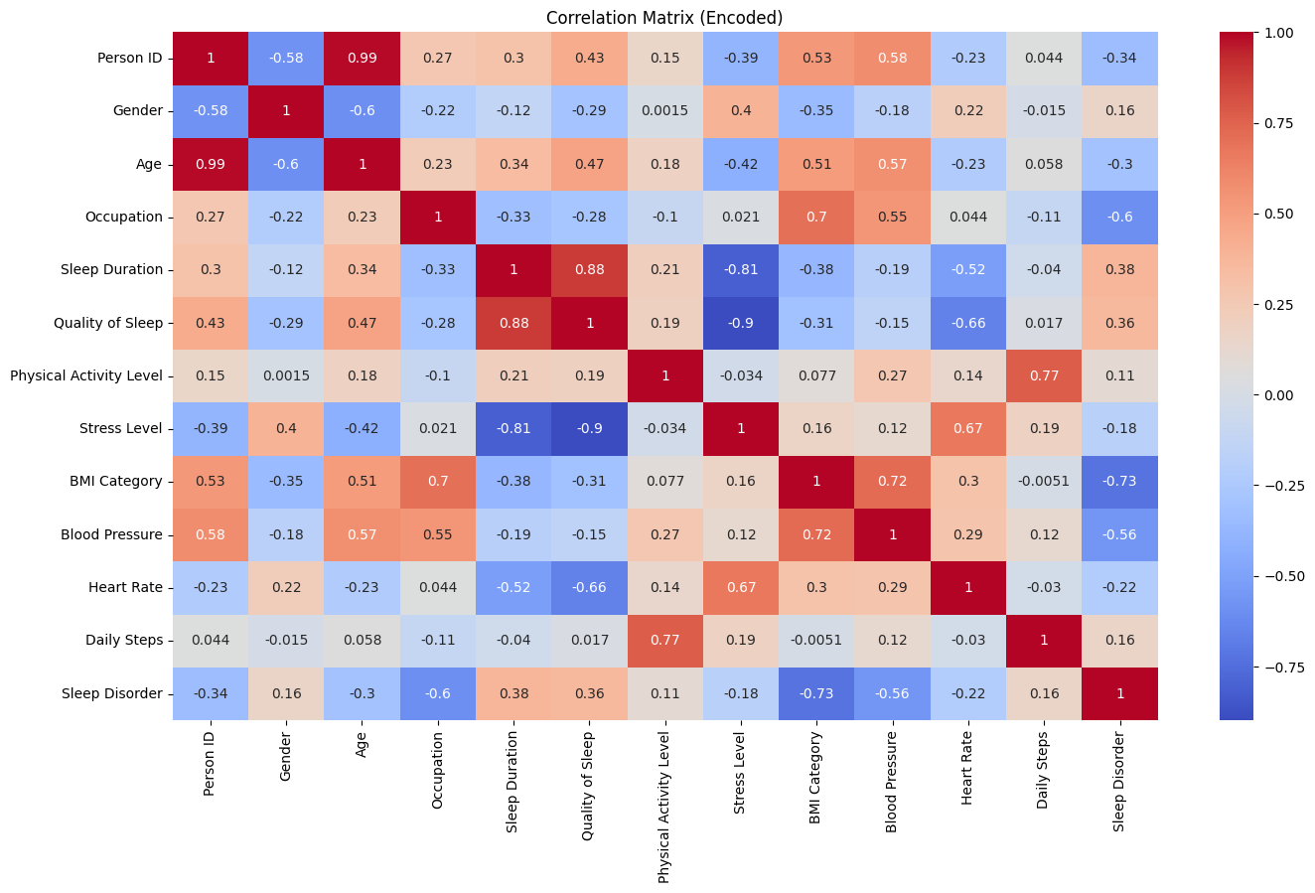
Exploratory Data Insights
Disorder Distribution
Key Correlations
Insomnia and Sleep Apnea balanced.
Stress Level and Sleep Duration.

Slide 7



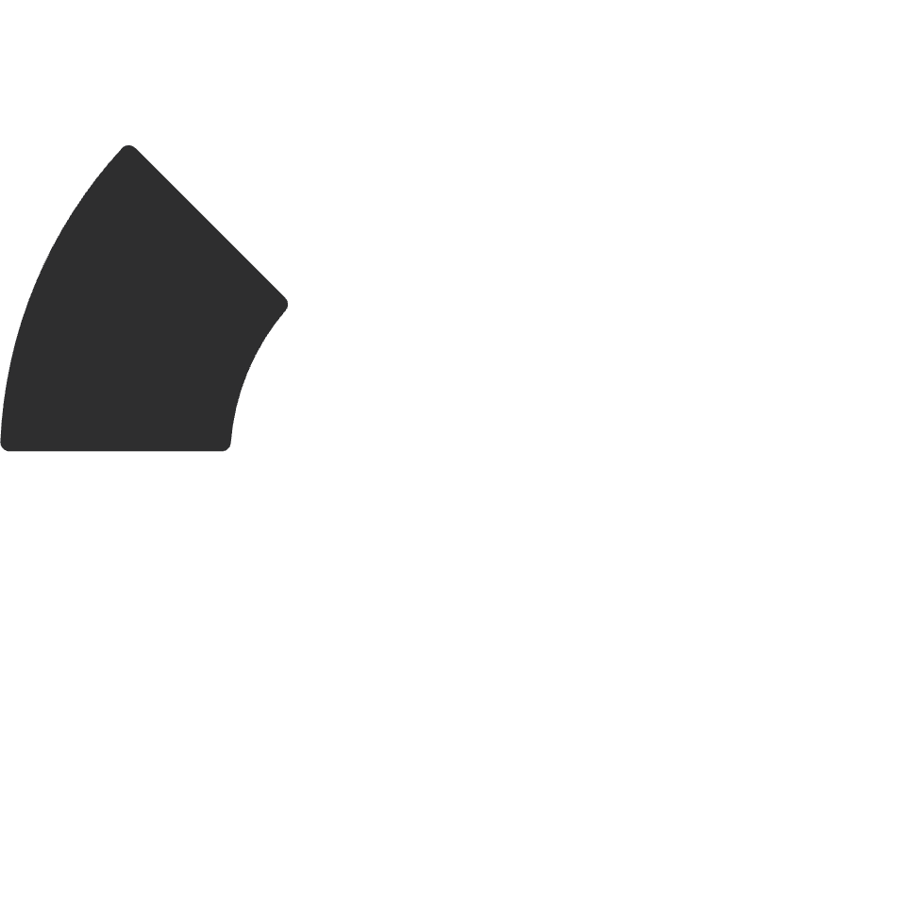
Model Selection: Random Forest Classifier
Data Split
Inputs
80% for training, 20% for testing.
Encoded lifestyle and health features.
2
3
Model Choice
Outputs
Random Forest for interpretability.
Predicted
sleep disorder type.
1
4

Slide 8
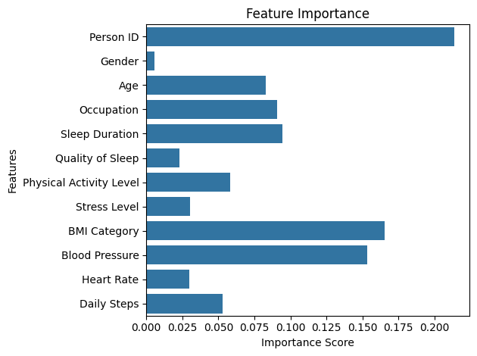
Model Results and Key Predictors
87%
Accuracy
Strong, balanced classification.
Top 3
Key Features
Stress, Sleep Duration, BMI.

Slide 9



Ethical Considerations and Limitations
Bias Awareness
Lifestyle data can reflect social inequities.
Fairness Measures
Label encoding for neutral representation.
Not Diagnostic
Tool for awareness, not medical diagnosis.

Slide 10






Future Impact and Directions
Data Expansion
Integrate wearables, survey data.
Healthier Habits
Encourages proactive lifestyle changes.
Real-time Support
Future app or chatbot integration.

