Slide 1
Activating Your UI
17-316/616 Fall 2025
AI Tools for Software Development
https://ai-developer-tools.github.io
Austin Henley and Andrew Begel

Slide 2
Today
Project Team Meeting
LLM Prompt Templates
UI Event Handlers
Code Review via LLM
Also, HW3: Reflection essay is now 400-550 words.

Slide 3
Project Team Meeting
Spend the next 15 minutes to meet with your team.
Work on P3: Frontend Development.
P3 deadline extended to Sunday Oct 5, 11:59pm

Slide 4
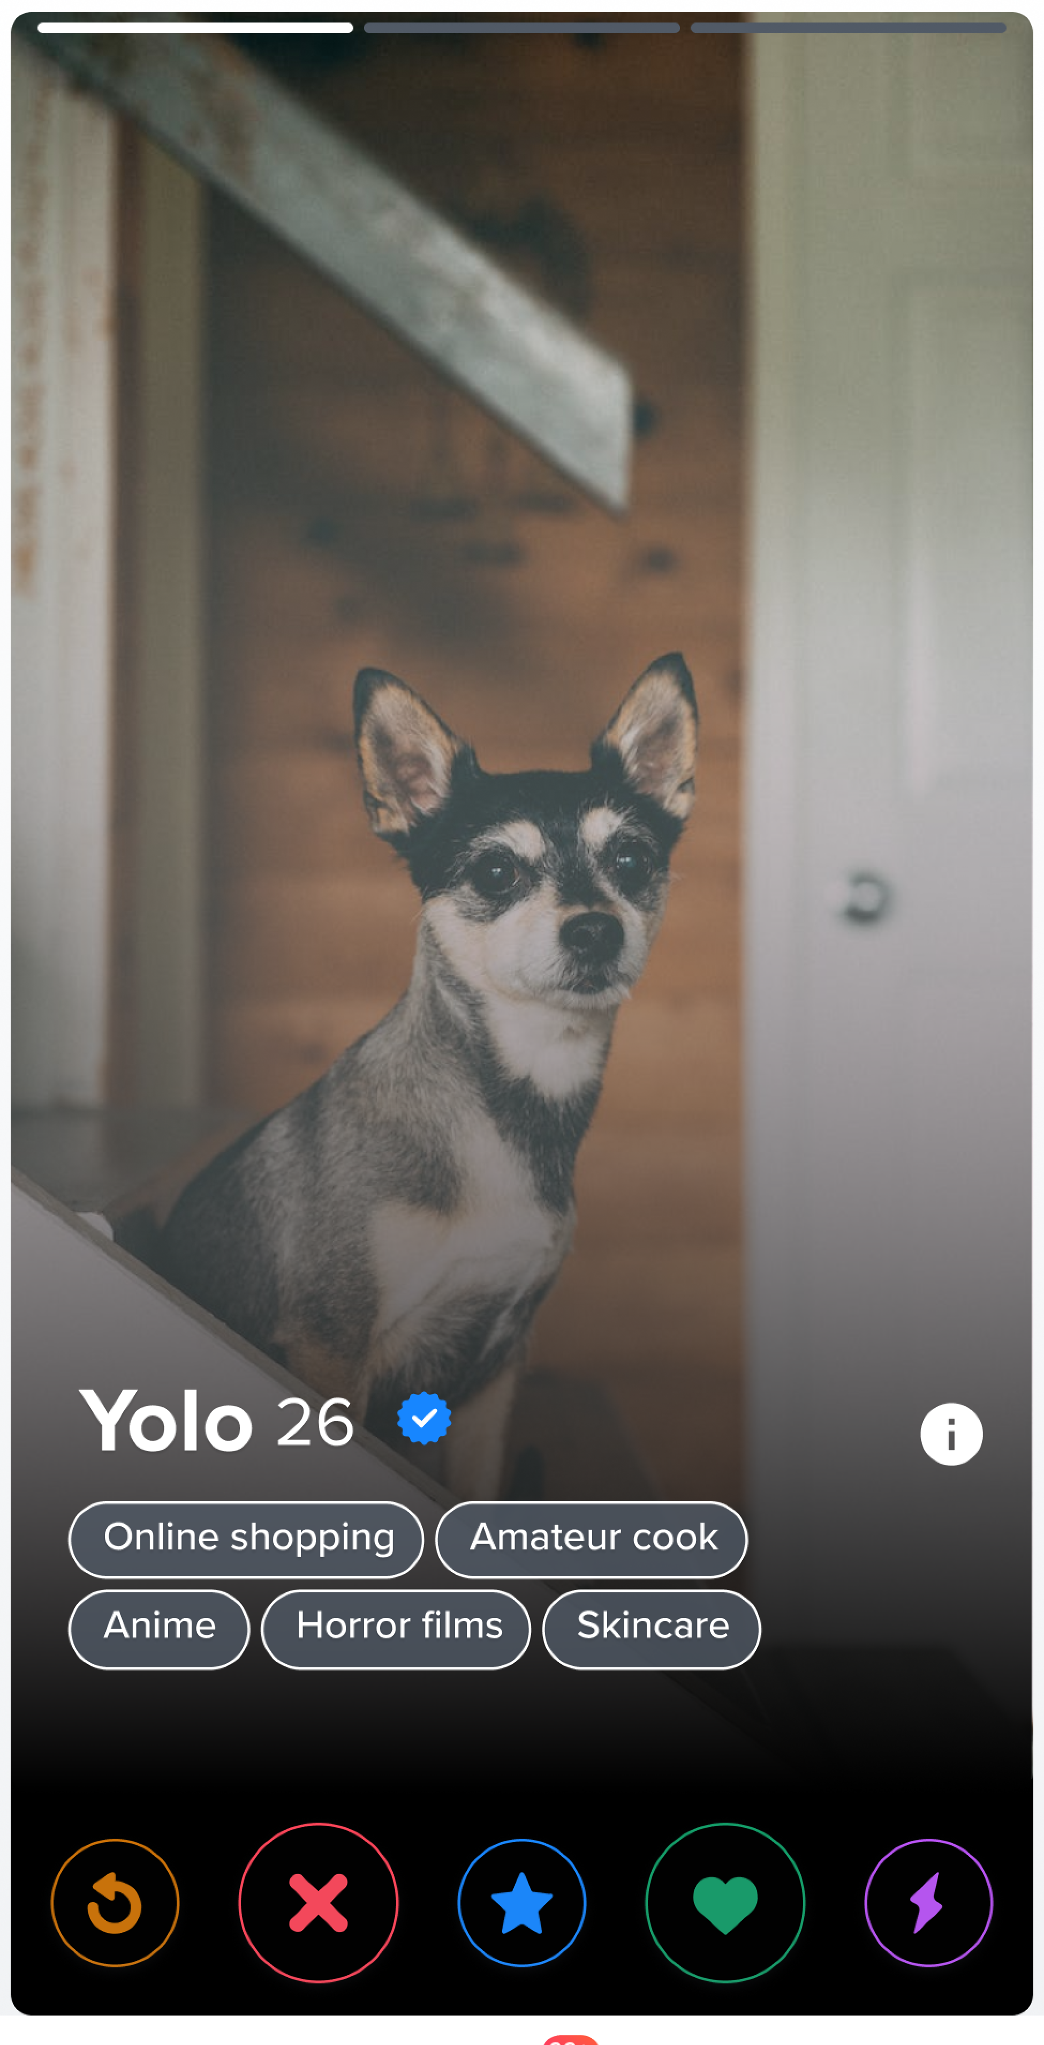
Let’s make Tinder with Cursor
Clone the code from https://github.com/AI-Developer-Tools/ai-tinder
Notes:
Your goal is to create the UI screen for showing a person's profile picture so that the user can decide whether they like, reject, or super like that person. The UI should look like the attached picture. A profile should have a name, age, blue verified checkmark icon, a multi-line list of keywords, and a navbar at the bottom with five circular buttons laid out horizontally, labeled reset, reject, remember, like, and superlike. The UI should hold a stack of profiles so that the user can change between them using the buttons in the navbar or swipe actions. Do not stub or implement any user input event handlers. The app you create should be programmed in Javascript using the React framework. When started up, it should show the first profile. Profile data will be stored as individual JSON files in a profiles/ subdirectory. Create a template JSON file for a profile in the profiles subdirectory so that we can easily generate fake profiles for testing.
Change the app to load profile json files dynamically from the profiles subdirectory instead of writing them in the sampleProfiles variable in App.js.

Slide 5
Javascript Event Handling
<button onClick={() => handleAction(‘my-button-action’)} …> </button>
const handleAction = (action) => { setTimeout(() => { switch (action) { case ‘my-button-action’: … break; } }, 500); };

Slide 6
LLM Prompt Templates
Ensure reproducible LLMs interactions
You are a <role>.
Your goal is to <task>.
Instructions:
- Analyze <something> for <purpose>
- Identify specific issues and explain each.
- Suggest concrete changes or alternate approaches to address the issues
- The response should be formatted as a list of findings.
```
Analysis Focus: <purpose>
```
Code: <code>

Slide 7
Frontend Developer Template
You are a frontend developer.
Your goal is to add event handlers for common user interface tasks in this frontend code.
Instructions:
- Analyze the existing frontend code for UI elements that should respond to user input but have no event handlers.
- Identify specific issues and explain each.
- Suggest concrete changes or alternate approaches to address the issues.
- The response should be formatted as a list of findings.
```
Analysis Focus: Find UI elements that lack sufficient UI event handlers.
```
Code: The frontend code in the project directory.

Slide 8
Mobbing Activity
Join Zoom to see the screen better!
Mobber will come to the hot seat.
Notetaker sits in the front of the class with their laptop to take notes in the #mobbing channel.
Let’s write the UI event handler code for Tinder.
Swipe left - Reject
Swipe right - Like
Swipe up – Super like
Double-tap – Look at the other photos in the profile
Also, power the action buttons at the bottom.
Everyone tell the mobber what to say to ChatGPT to get it to create our Tinder frontend.

Slide 9
Context Management
LLMs have a limited context window.
The only remember a small amount of information from your prior prompts. Old information is forgotten.
Your user story + dev spec + codebase is likely way too big for it to handle.

Slide 10
Code Review
The LLM just wrote a ton of code.
But seriously, who wants to read all that?
Our senior devs ask us:
Does this code do what it claims?
Are there any programming bugs?
Are there any design bugs?
Can the LLM help us review the code?

Slide 11
Mobbing: LLM role-based code review
Let’s swap the mobber and notetaker.
Try out these prompts!
You are an architect. What is the purpose of this code? Explain the high-level structure and any design patterns used.
You are a developer concerned about performance. Show me the performance bottlenecks.
You are a tester. Show me where all the test cases are. What parts of the code need more tests?
You are a security analyst. Tell me where the code needs to be hardened further against adversaries.
Notes:
You are an architect. What is the purpose of this code? Explain the high-level structure and any design patterns used.
You are a developer concerned about performance. Show me the performance bottlenecks.
You are a tester. Show me where all the test cases are. What parts of the code need more tests?
You are a security analyst. Tell me where the code needs to be hardened further against adversaries.

Slide 12
We forgot to look for bugs!
Prompt: You are a developer concerned about bugs. Create a checklist to check for common mistakes in our frontend code. Be sure it includes checks for standards compliance with WCAG and ARIA.
Prompt: Great checklist. Now verify our code against this checklist and tell me what you found.
Prompt: For each problem you found, suggest a bug fix. If I think it’s good, I’ll ask you to apply the fix.

Slide 13
Next class
Frontend Development Reflection Discussion

