Slide 1
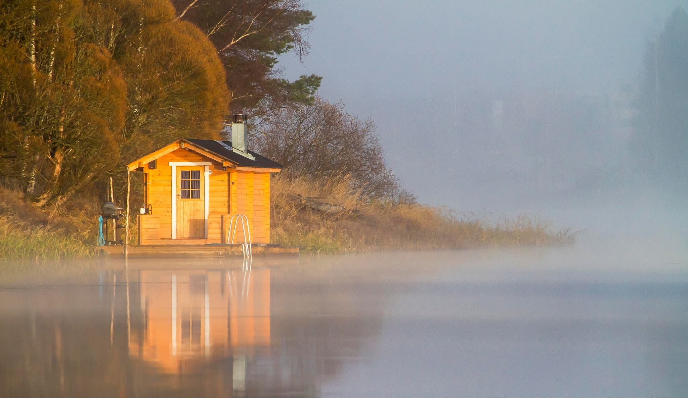
Your First Neural Network
Sauna Satisfaction Predictor

Slide 2
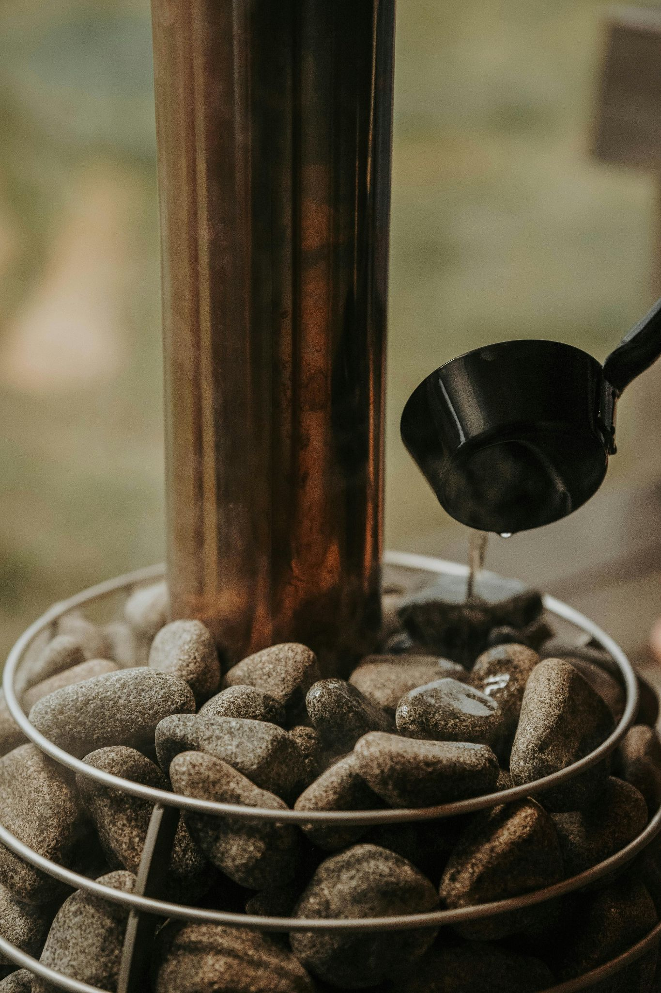
In a Nutshell
In an alternate universe, the Geological Survey of Finland maintains sauna visitor logs. For each visit, three inputs are recorded:
Sauna temperature (°C)
Outside temperature (°C)
Minutes since last coffee
After the visit, the visitor gives a Satisfaction Score between 0 and 1. We will train a small neural network to predict what the score will be based on these inputs.

Slide 3
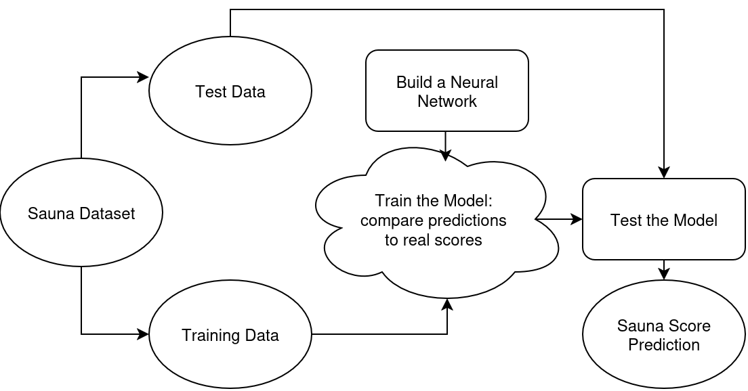
Workflow

