Slide 1
Three-dimensional inversion of gravity data using implicit neural representations and scientific machine learning
Sanni Laaksonen
In collaboration with Pankaj K Mishra, Jochen Kamm, Anad Singh

Slide 2
The Inverse Problem
Gravity surveys measure surface variations in Earth's gravitational field, resulting from subsurface density variations.
The inversion is ill-posed: many different density distributions can produce the same surface measurements.
Conventional voxel-based methods face several challenges:
Grid cells rarely align with real geological boundaries > geometric artefacts.
Gravity signal sensitivity decays with depth > estimated density concentrates near the surface.
Refining the model grid increases the number of unknowns > explosive parameter growth.

Slide 3
Why Choose Implicit Neural Representations?
The INR encodes the density as a continuous function, evaluated at any coordinate.
Geological boundaries can fall outside grid edges.
Structures emerge where the physics demand them, without explicit depth-weighting or pre-computed training examples.
Implicit regulariser: shared weights, limited capacity, and early stopping favour geologically plausible solutions without manual tuning of smoothness penalties.
The number of unknowns is determined by network size > increasing grid cell count not tied to parameter growth.

Slide 4
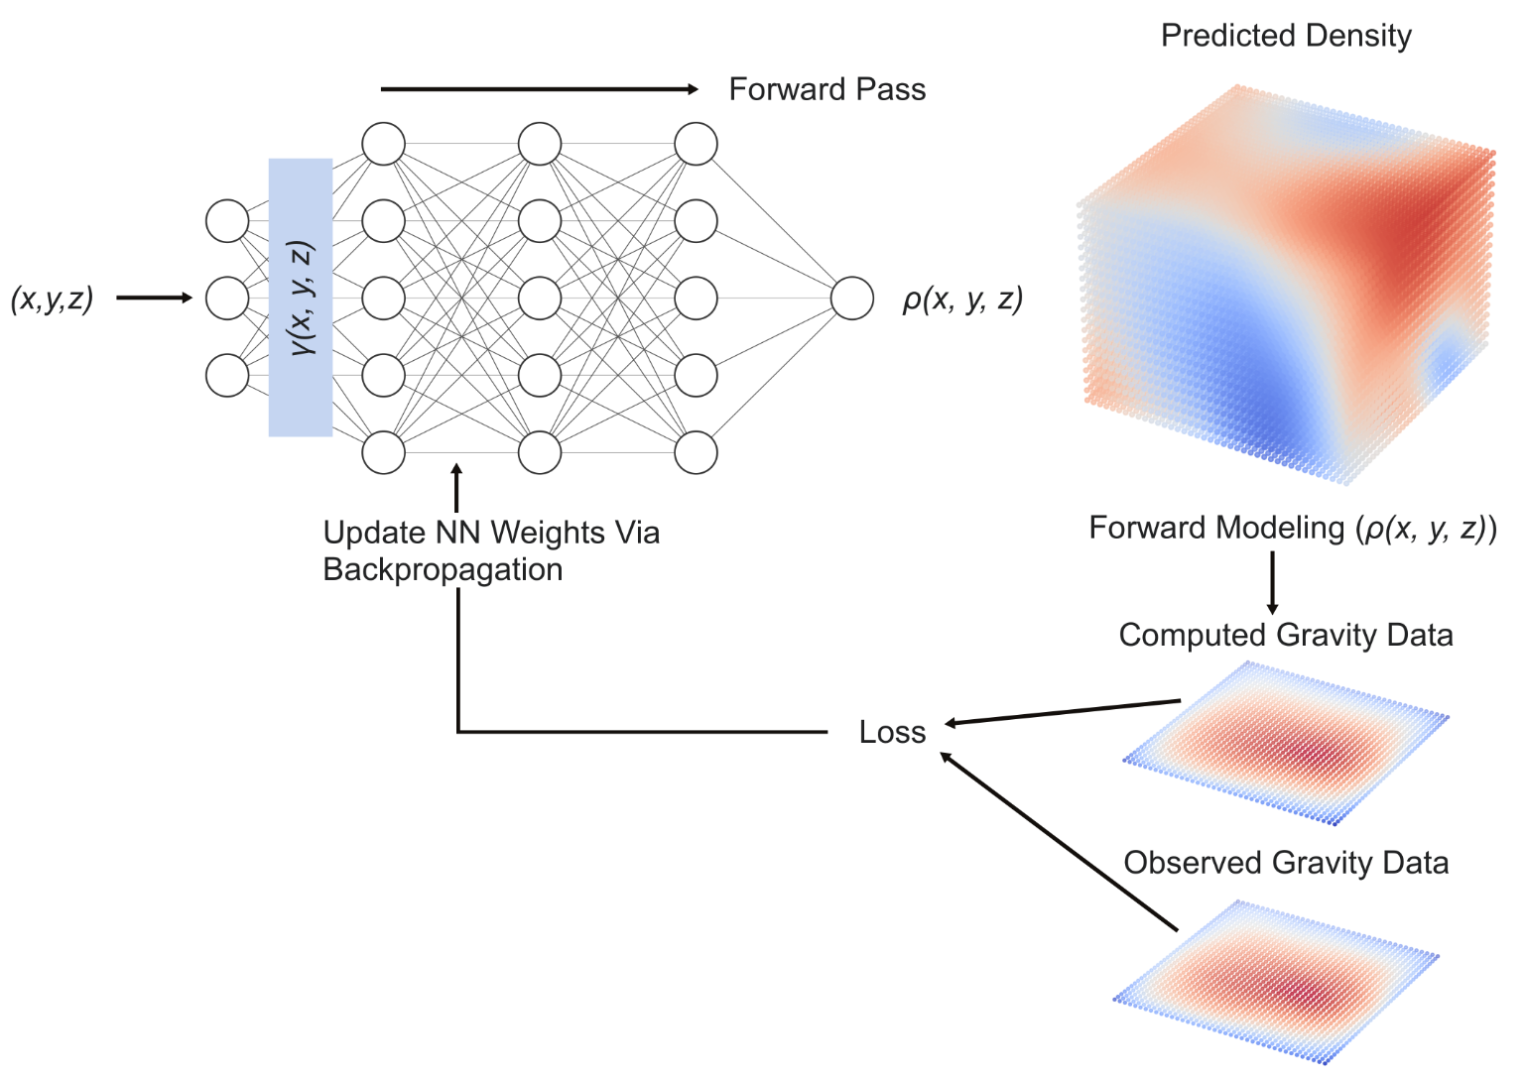
Architecture
Input: (x, y, z) coordinates.
+ Positional Encoding: Pass coordinates through sin/cos functions to represent sharp geological boundaries.
MLP network with LeakyReLU (non-linearity for complex patterns) & Tanh (squash the output to a plausible density range) activation.
Loss: observed vs. predicted gravity
Output: Trained parameters 𝜃★; density contrast 𝜌_{𝜃★}; predicted gravity 𝑔_{pred}

Slide 5
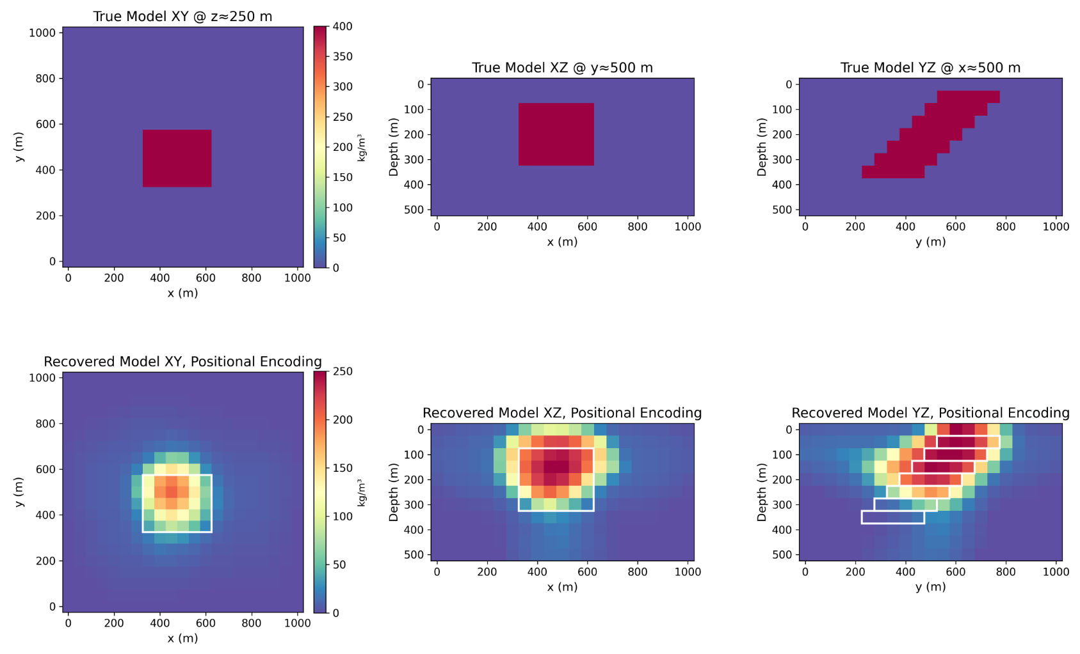
True & Predicted Model Comparison

Slide 6
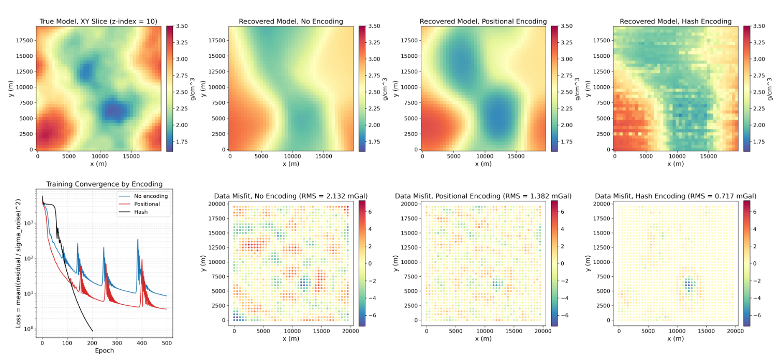
Encoding Comparisons & Spectral Bias

Slide 7
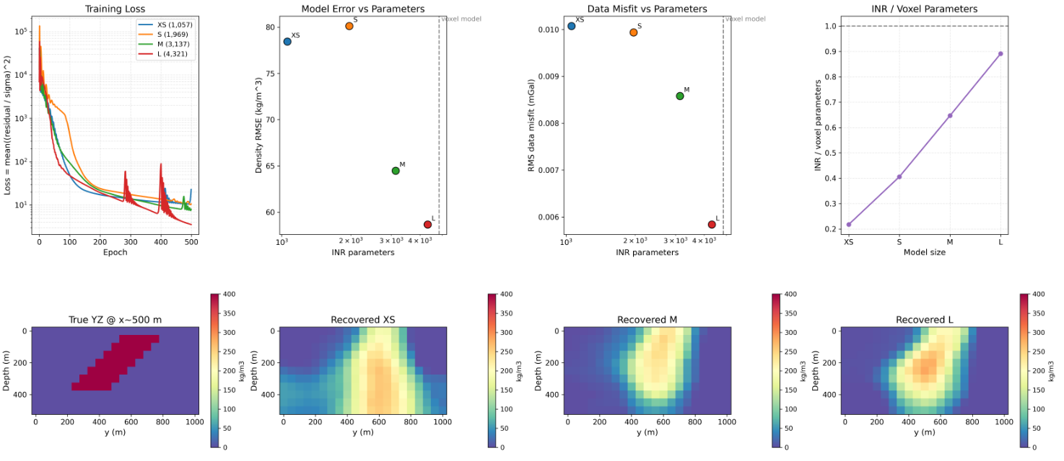
Network Capacity Comparison

Slide 8
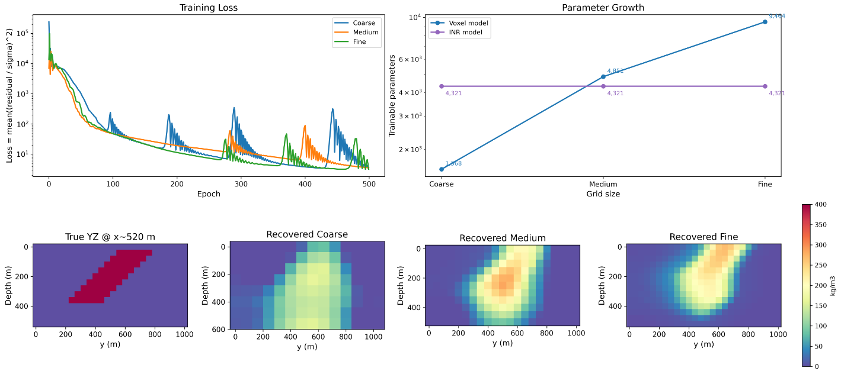
Grid Refinement Comparison

Slide 9
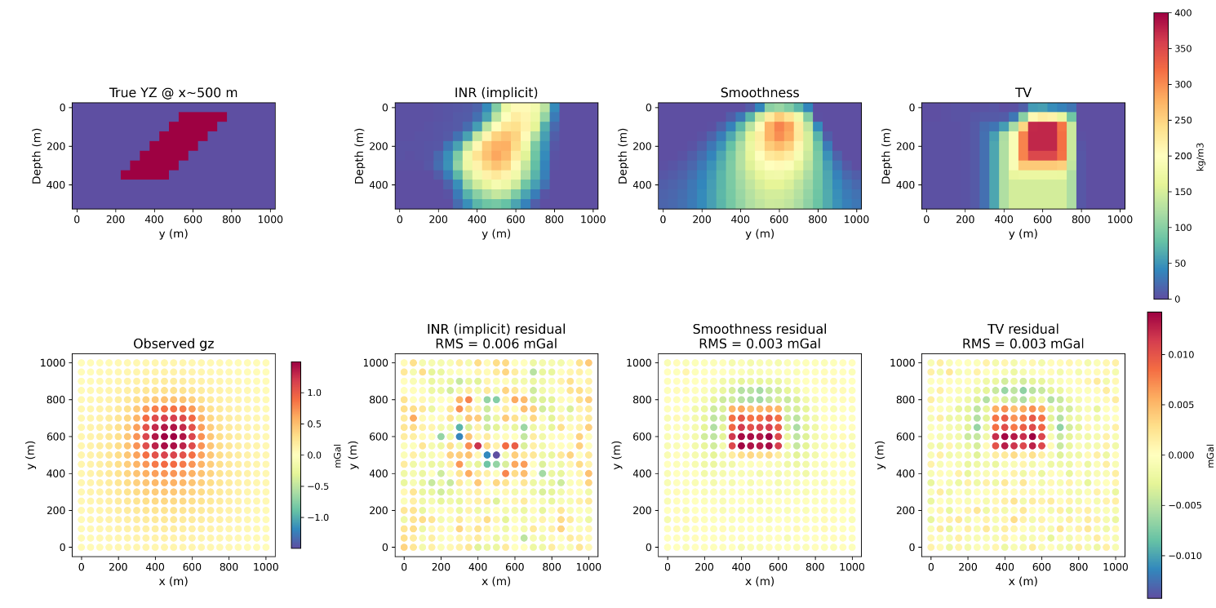
Implicit vs. Popular Explicit Regularisation

Slide 10
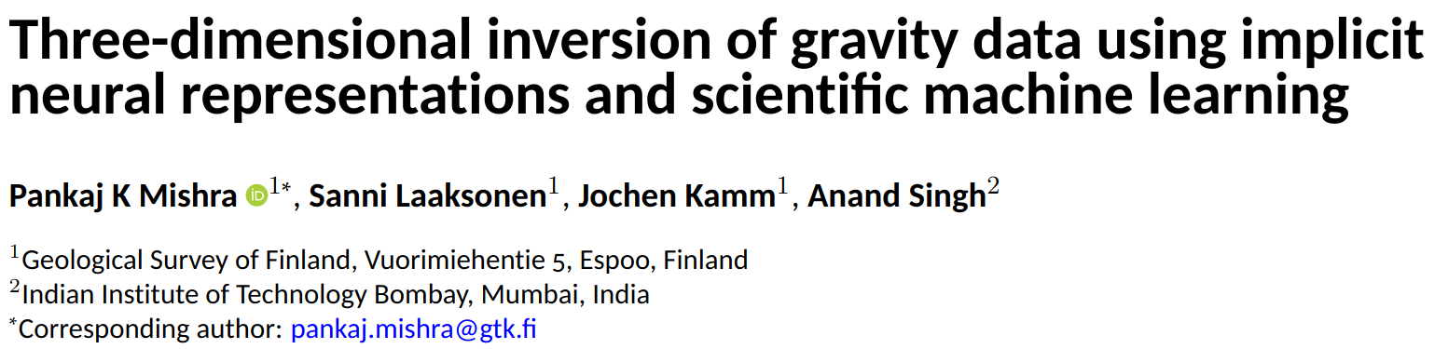
Thank you!
Further technical details, potential limitations and future work can be found in the paper published open-access in Scientific Reports: https://arxiv.org/pdf/2510.17876

