Slide 1

Getting started with Geoscientific Machine Learning
2026 Workshop on AI in Earth & Planetary Sciences
Download workshop materials
https://tinyurl.com/3p2v9rrp

Slide 2

https://tinyurl.com/3p2v9rrp
Target Audience & learning objectives
Primary target audience is someone with no previous machine learning or programming experience
Set up a machine learning environment from scratch
Basic utility programming tasks
Train your first neural network
How to continue learning after this workshop

Slide 3
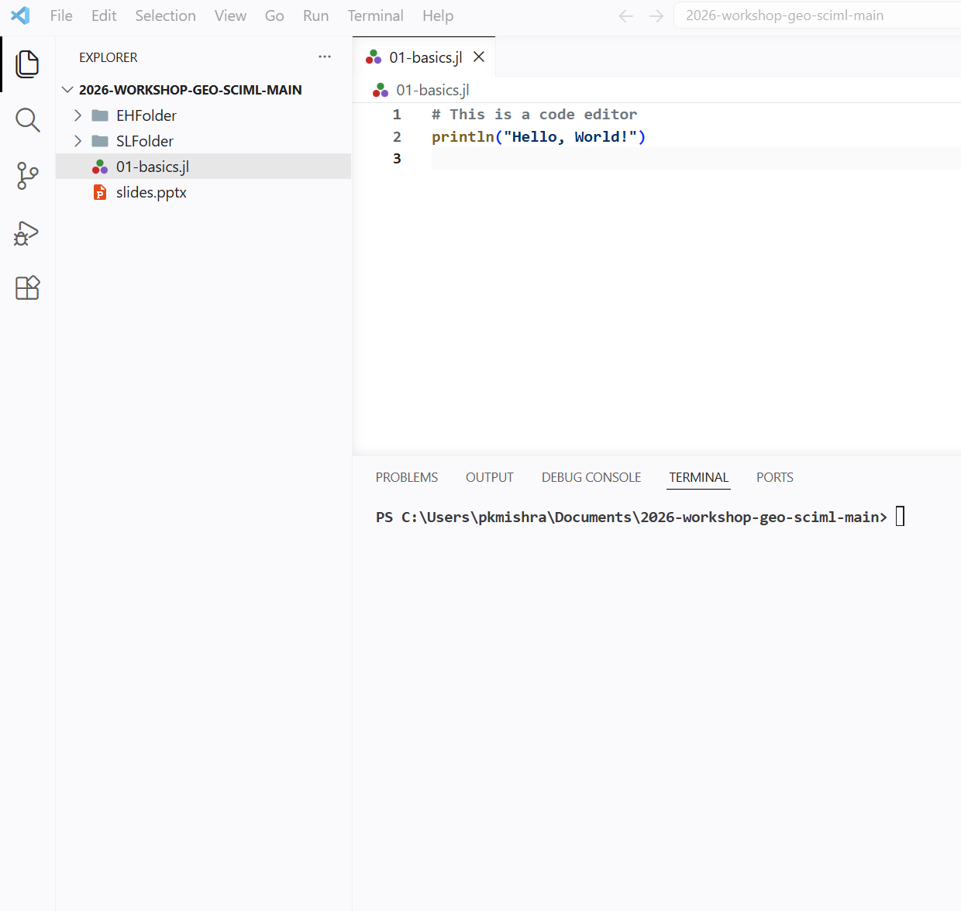
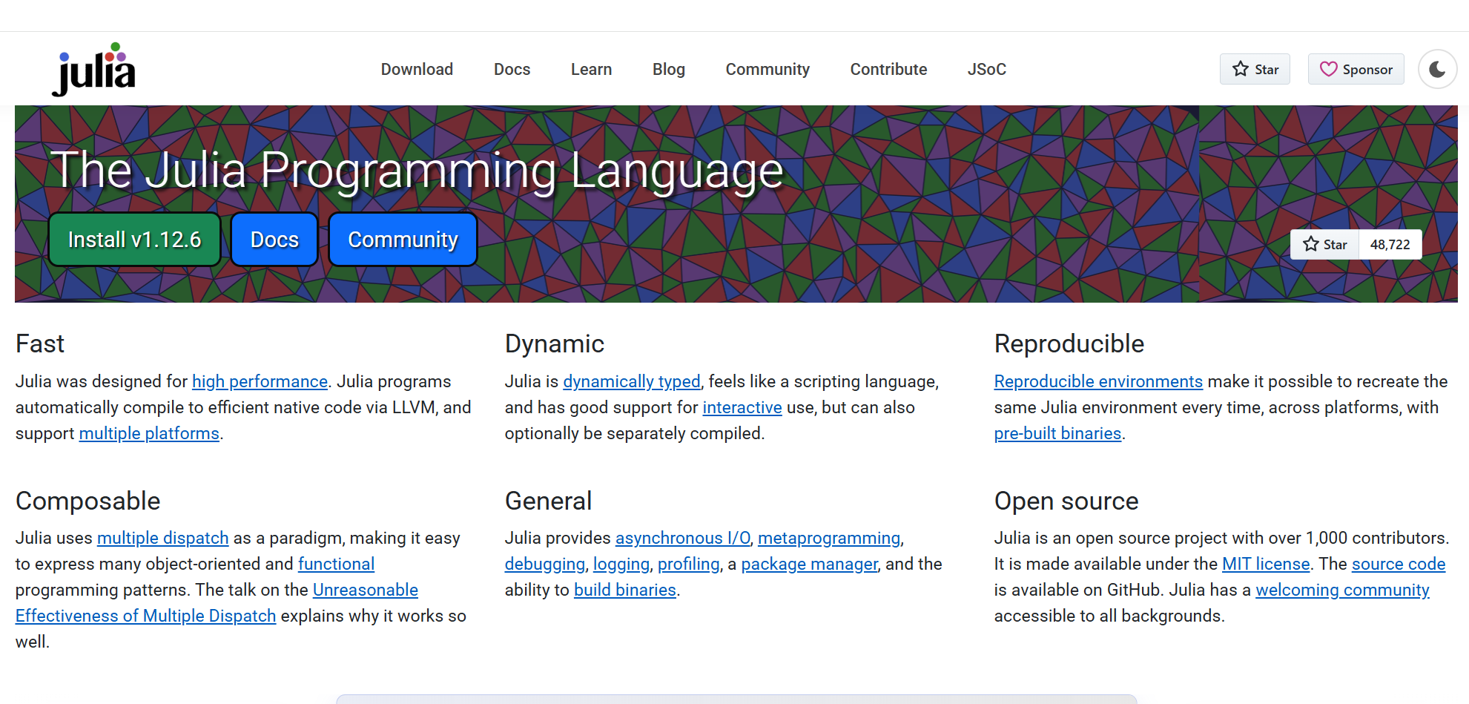
https://tinyurl.com/3p2v9rrp
Things we need
A code editor
A programming language
workshop materials
https://tinyurl.com/3p2v9rrp

Slide 4
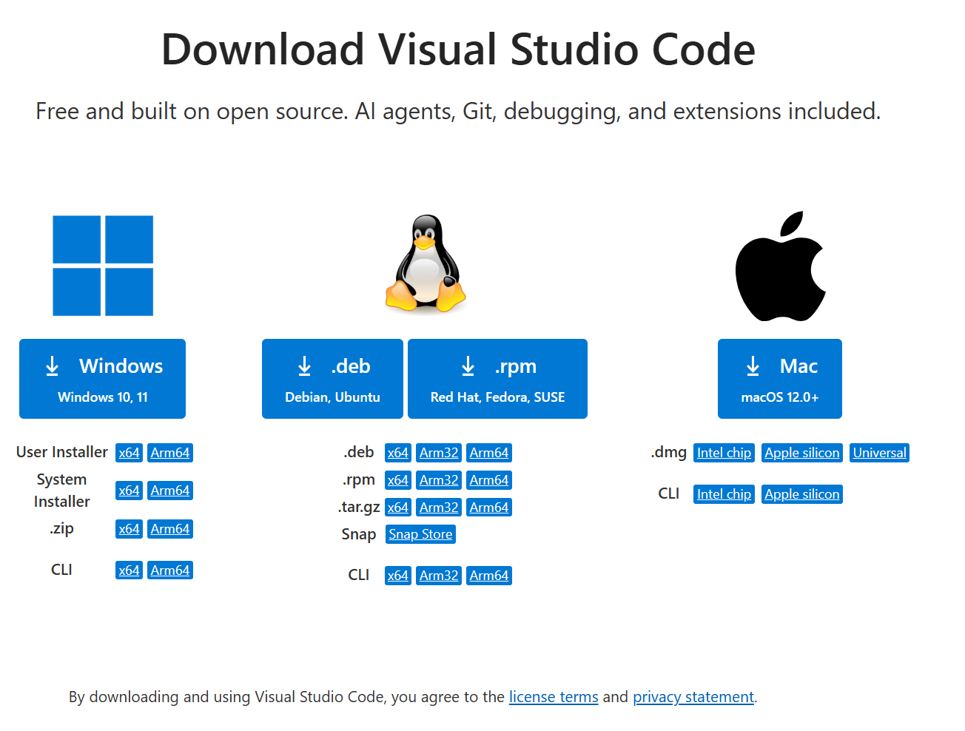
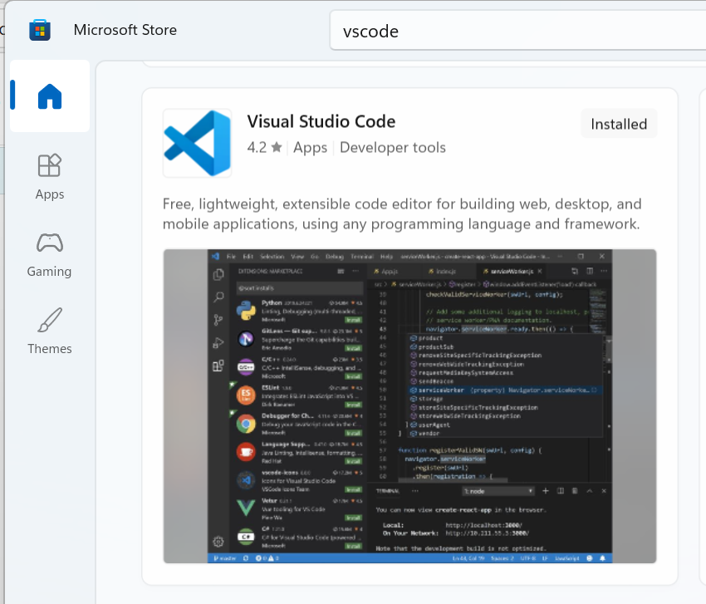
https://tinyurl.com/3p2v9rrp
https://code.visualstudio.com/download
Via Microsoft software centre
workshop materials
https://tinyurl.com/3p2v9rrp

Slide 5
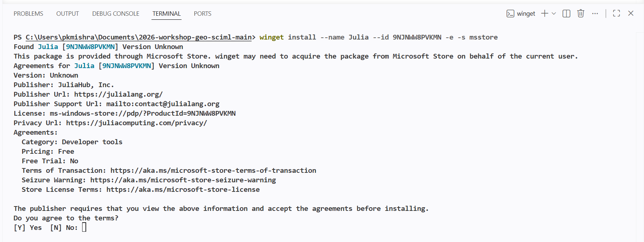
https://tinyurl.com/3p2v9rrp
Install Julia via VSCode
Powershell (Windows)
winget install --name Julia --id 9NJNWW8PVKMN -e -s msstore
Terminal (Linux/MacOS)
curl -fsSL https://install.julialang.org | sh

Slide 6
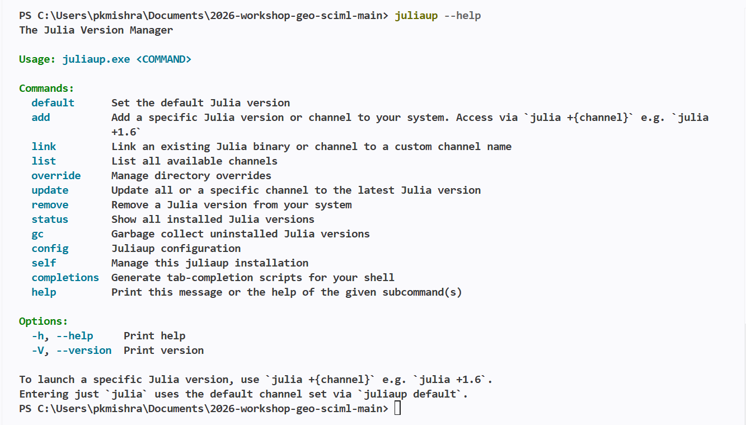
https://tinyurl.com/3p2v9rrp
We’ll manage Julia installations via juliaup

Slide 7
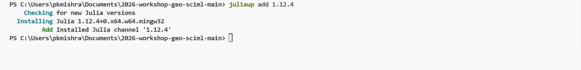
https://tinyurl.com/3p2v9rrp
Install a specific version of Julia

Slide 8
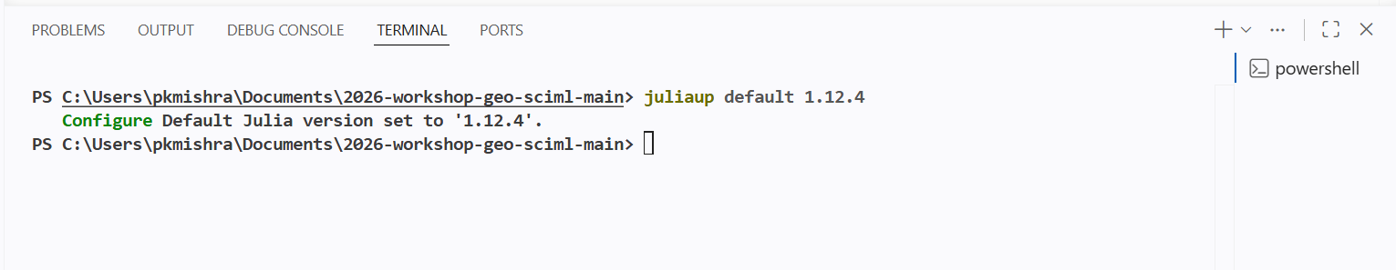
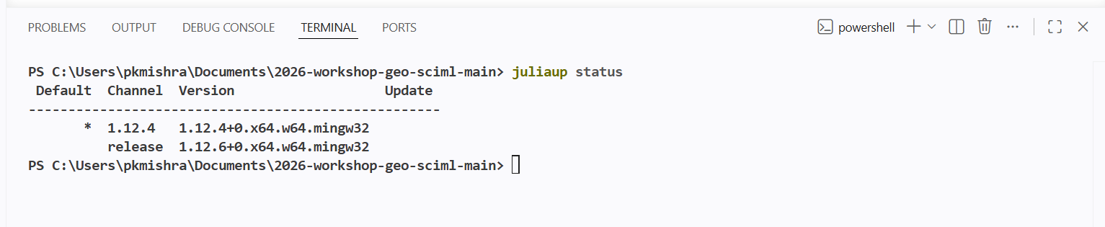
https://tinyurl.com/3p2v9rrp
Making a specific version of Julia as your default

Slide 9
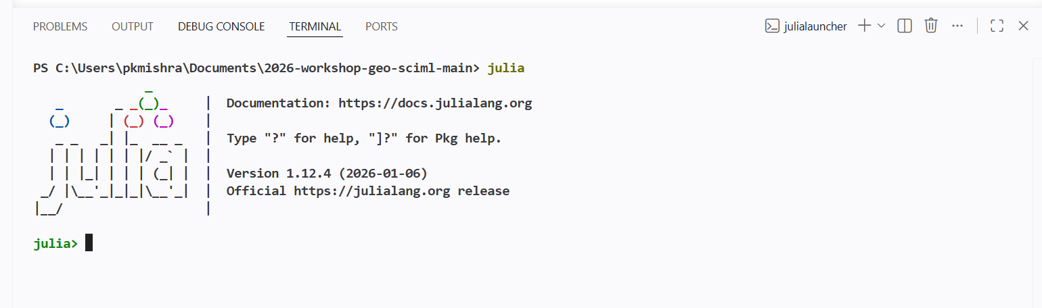
https://tinyurl.com/3p2v9rrp
Let’s start programming

Slide 10

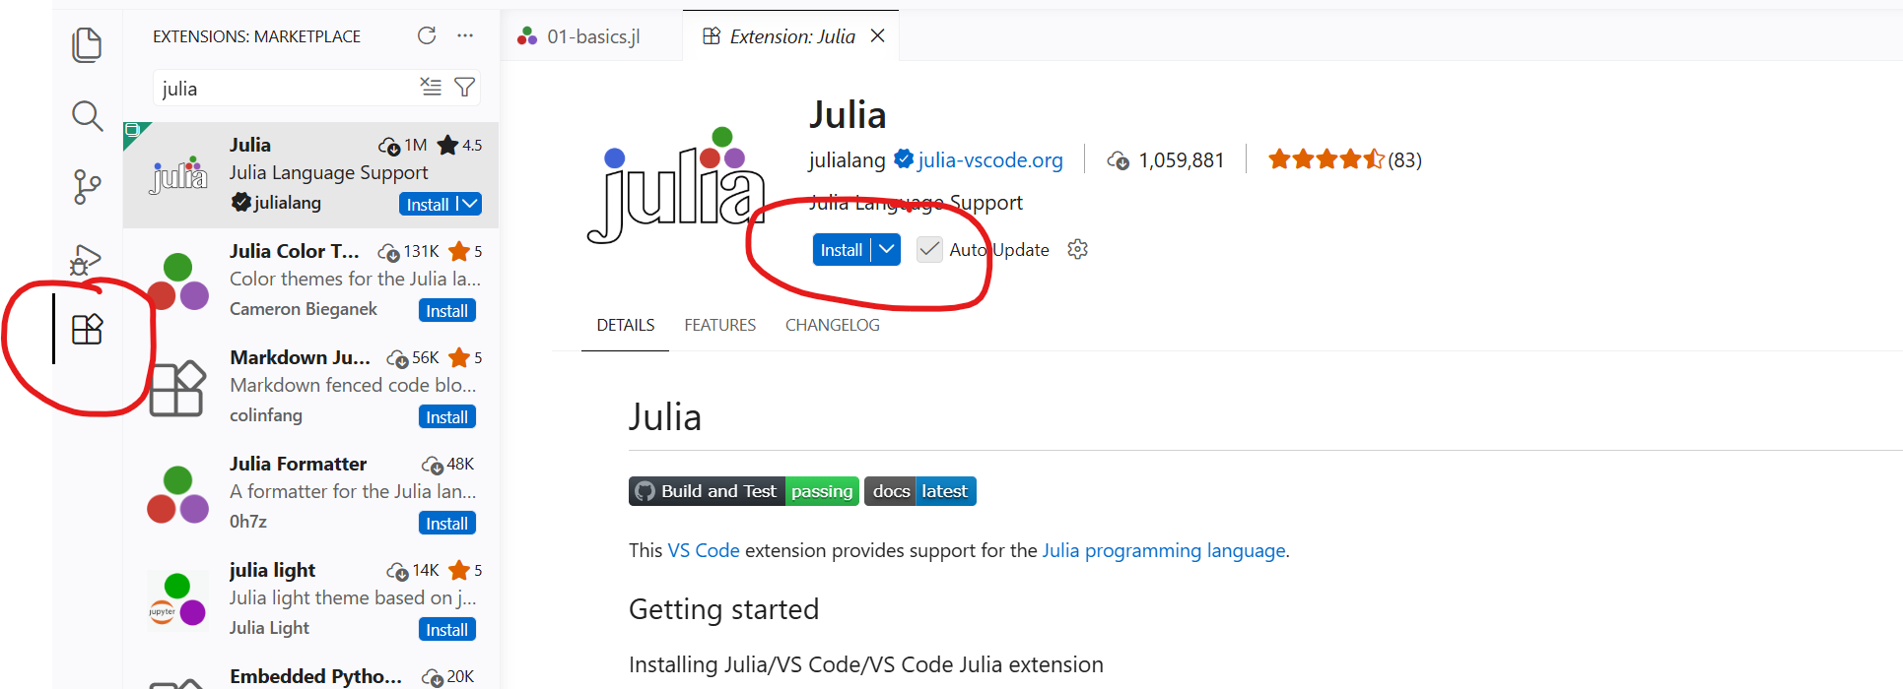
(optional) Install Julia language support extension inside VSCode
If you’re using GTK WORK Laptop, don’t install this for now because in it maybe blocked by IT

Slide 11
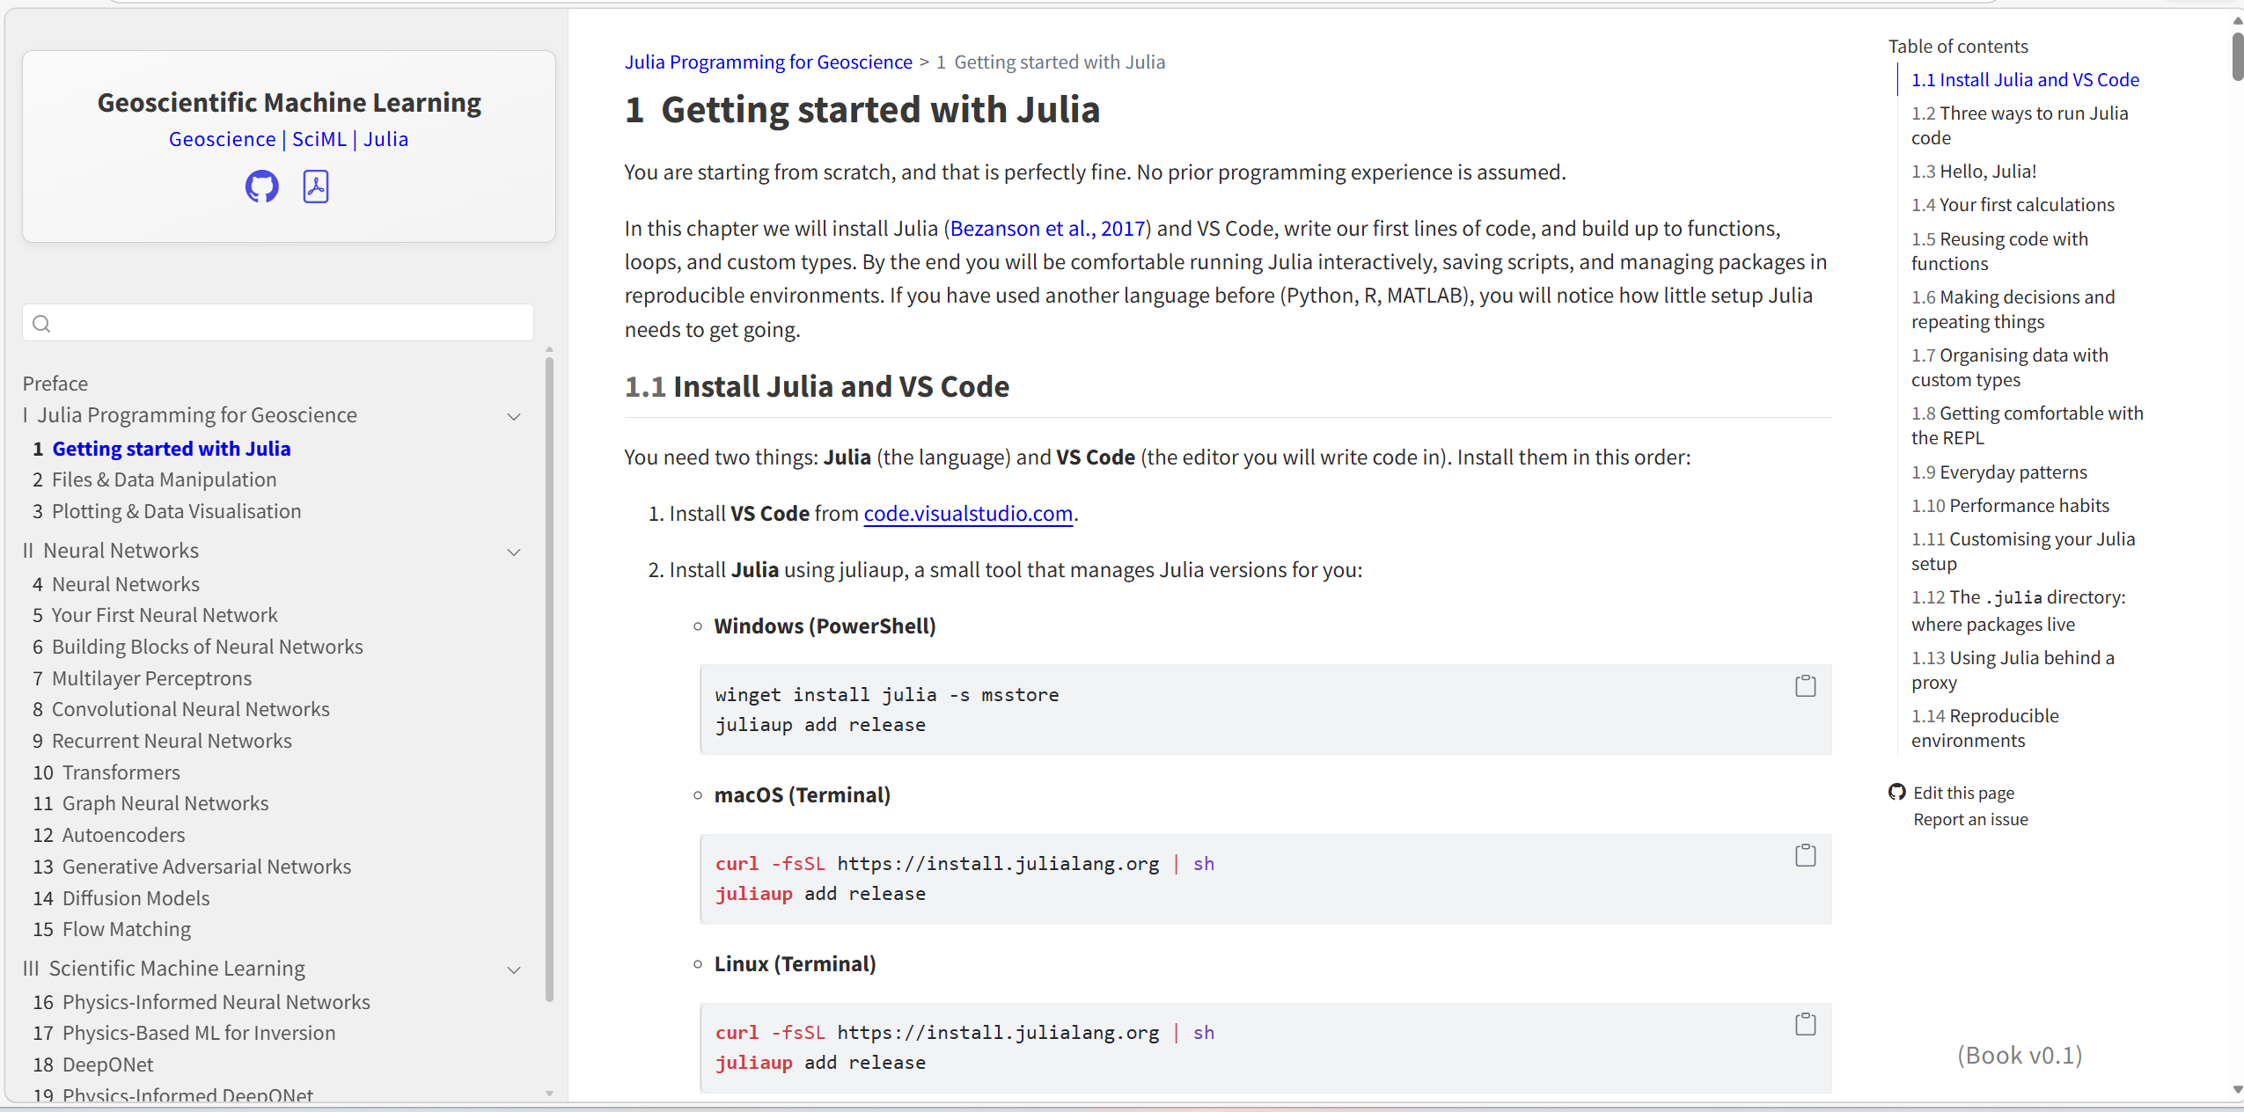
Continue learning after this session
https://geo-sciml.com/

Slide 12
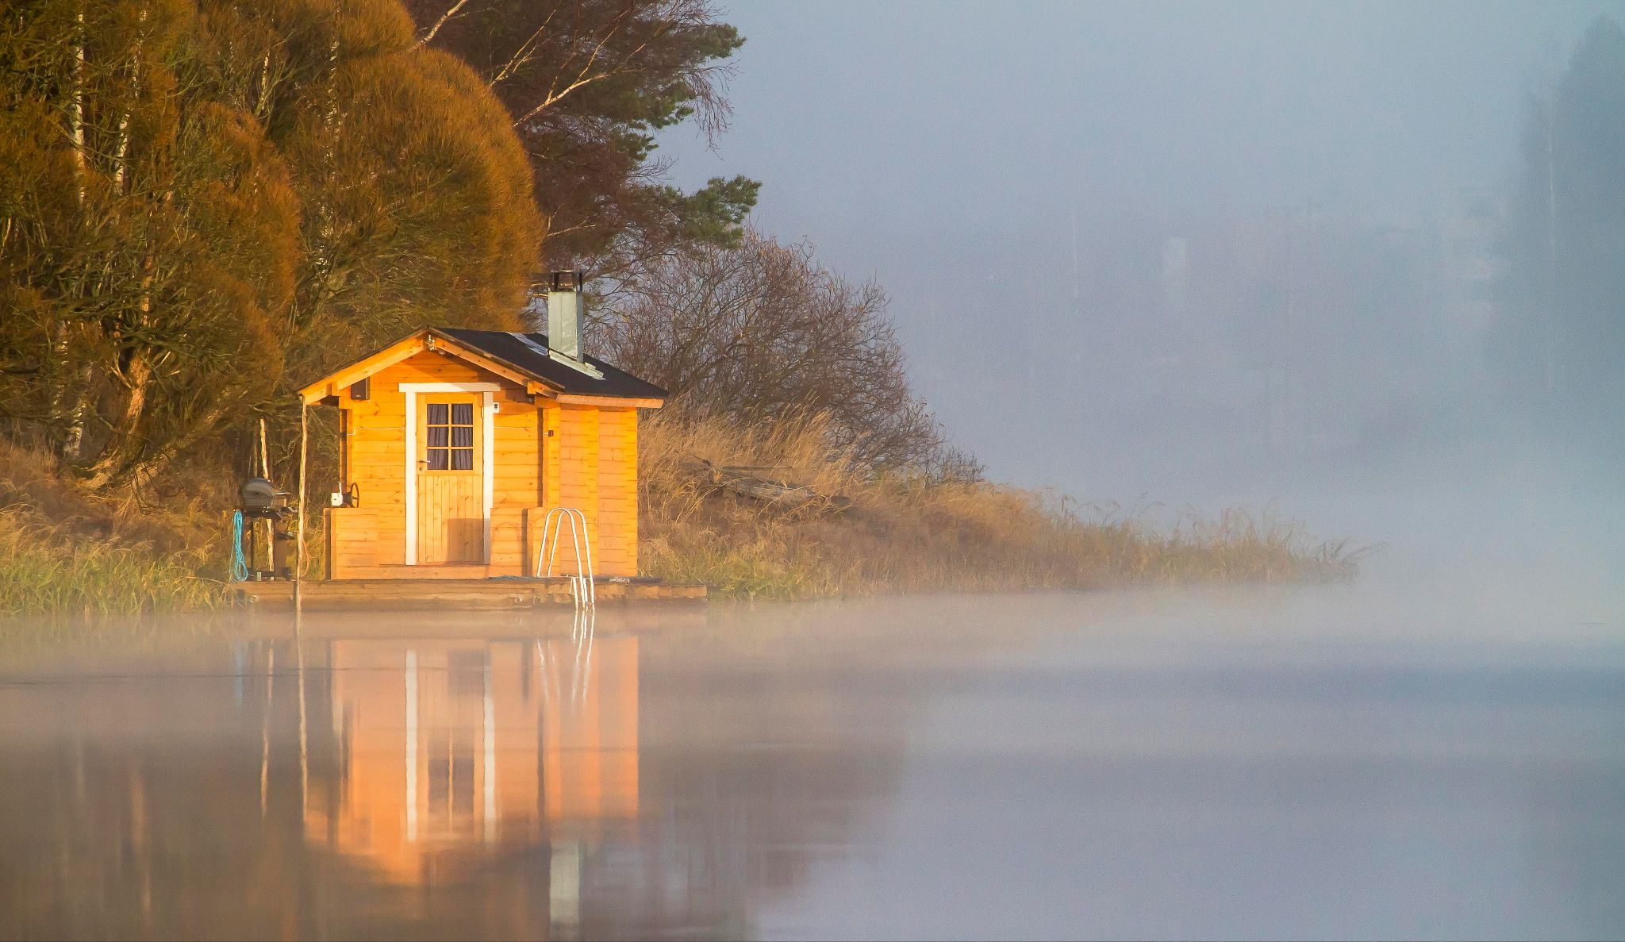
Your First Neural Network
Sauna Satisfaction Predictor

Slide 13
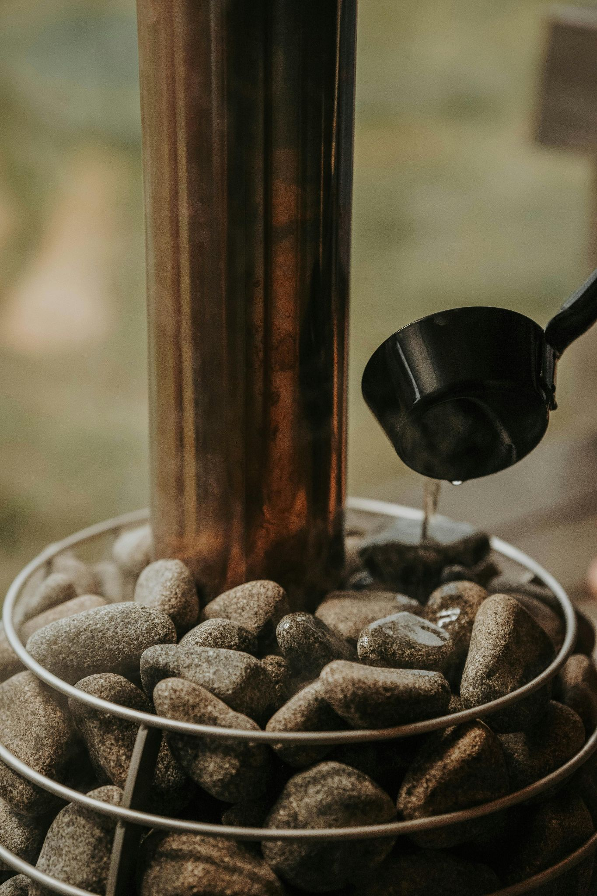
In a Nutshell
In an alternate universe, the Geological Survey of Finland maintains sauna visitor logs for employees. For each visit, three inputs are recorded:
Sauna temperature (°C)
Outside temperature (°C)
Minutes since last coffee
After the visit, the visitor gives a Satisfaction Score between 0 and 1. We will train a small neural network to predict what the score will be based on these inputs.

Slide 14
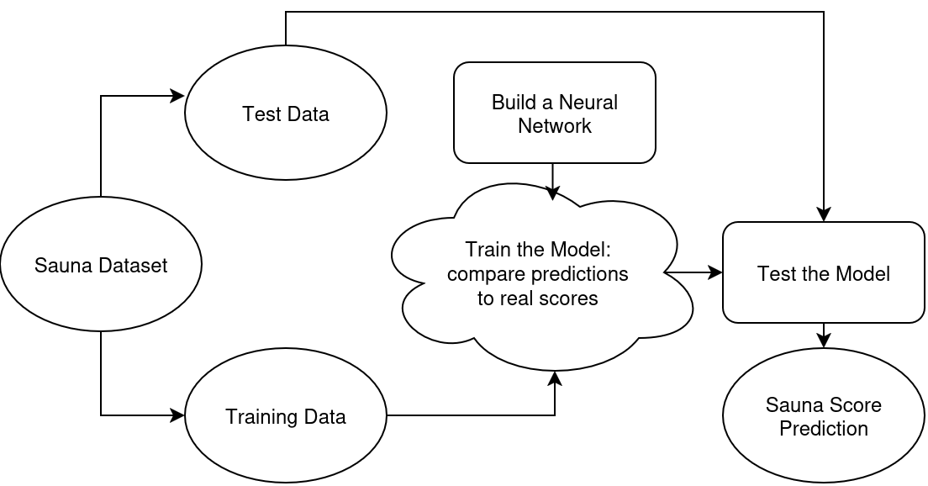
Workflow

