Slide 1
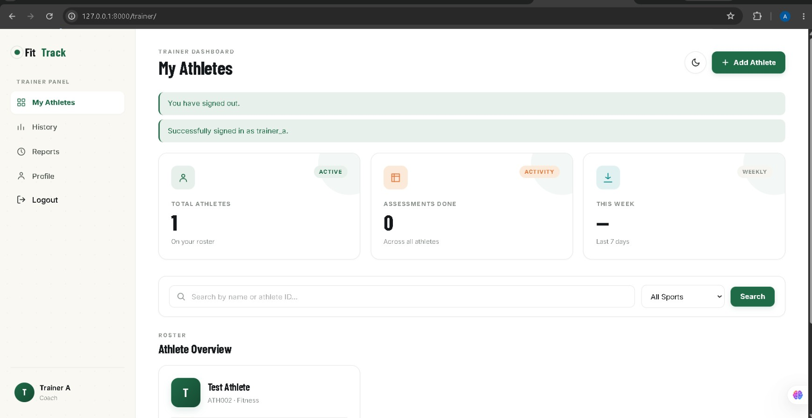
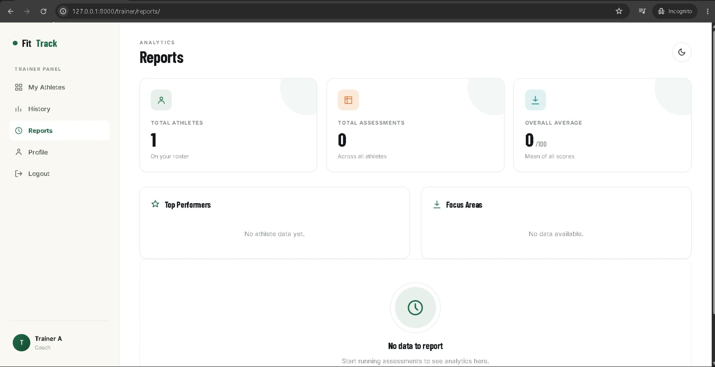
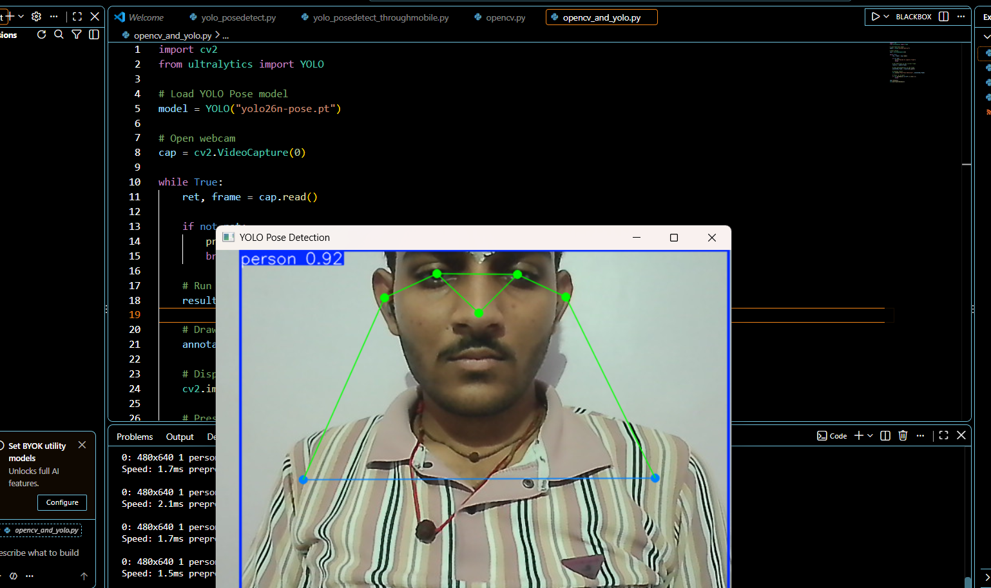
MITS
GWALIOR
माधव प्रौद्योगिकी एवं विज्ञान संस्थान, ग्वालियर (म.प्र.), भारत
MADHAV INSTITUTE OF TECHNOLOGY & SCIENCE, GWALIOR (M.P.), INDIA
(Deemed to be University · Declared under Distinct Category by Ministry of Education, Govt. of India) · NAAC A++ GRADE
GWALIOR VIGYAN MAHOTSAV 2026
ABV-IIITM Gwalior · Vigyan Bharati
AI-POWERED FITNESS ASSESSMENT PLATFORM
Real-Time Movement Analysis and Automated Fitness Assessment using Computer Vision
Presented by: Aakanksha Vidushi Pandey (BTAI21O1001) & Dhruv Urmaliya (BTAI21O1042)
Under the Guidance of: Dr. Neelam Arya · Centre for Artificial Intelligence, MITS Gwalior
01 — INTRODUCTION & OVERVIEW
02 — PROBLEM STATEMENT & MOTIVATION
The AI-Powered Fitness Assessment Platform is an automated, computer-vision system designed to assist athletic trainers, academies, and coaches in conducting objective physical evaluations.
• Replaces subjective human counting with real-time YOLO26-Pose estimation.
• Extracts 17 full-body keypoints from a standard webcam video feed (4 FPS / 250ms).
• Calculates joint angles and spatial displacement via vector dot product mathematics.
• Combines real-time movement tracking with multi-athlete management and digital records.
Traditional physical fitness testing in sporting academies, schools, and armed forces relies on manual stopwatches, visual counting, and paper scorecards.
• Subjective Observation Bias: Human fatigue leads to missed repetitions and inconsistent judging.
• No Angle Verification: Incomplete movement (e.g. shallow sit-ups) is falsely counted as valid reps.
• Data Fragmentation: Paper-based records make longitudinal tracking and cohort comparison slow.
• High Equipment Cost: High-end optical motion capture labs are unaffordable for grassroots centres.
⭐ END-TO-END SYSTEM WORKFLOW (THE 8-STEP OPERATIONAL PIPELINE)
STEP 01 — TRAINER SIGN IN
Secure login with credentials/OAuth. Enforces strict multi-trainer data isolation (trainer=request.user).
STEP 02 — ATHLETE SELECTION
Trainer registers a new athlete or selects an existing profile with sport, age, height, and weight baseline.
STEP 03 — EXERCISE SELECTION
Trainer chooses one of the 8 physical fitness tests (Vertical Jump, Broad Jump, Sit-ups, Sprint, etc.).
STEP 04 — MOVEMENT CAPTURE
Standard webcam captures video frames at 4 FPS (250ms interval) balancing responsiveness with CPU load.
STEP 05 — POSE DETECTION
YOLO26-Pose extracts 17 body keypoints (shoulders, elbows, wrists, hips, knees, ankles) with confidence > 0.5.
STEP 06 — MOVEMENT ANALYSIS
Vector dot product computes joint angles. Dual-threshold state machine verifies reps and displacements.
STEP 07 — REAL-TIME RESULTS
Canvas displays skeleton overlay, live joint angles, completed repetitions, peak metrics & score (0-100).
STEP 08 — SAVE & REVIEW
Completed assessment persisted to SQLite/PostgreSQL. Instant updates to athlete history, charts & team analytics.
03 — EIGHT FITNESS EXERCISE MODULES
04 — BIOMECHANICAL MOVEMENT ANALYSIS
✔ Vertical Jump
Ankle Y-displacement from standing baseline (cm)
✔ Broad Jump
Takeoff-to-landing ankle X-displacement (cm)
HOW AI UNDERSTANDS BODY MOVEMENT:
1. Keypoint Detection: Extracts 17 COCO landmarks (nose, eyes, ears, shoulders, elbows, wrists, hips, knees, ankles).
2. Vector Joint Angle Formula:
θ = arccos( (BA · BC) / (|BA| × |BC|) )
Calculates angle at joint B using dot product between vectors BA and BC.
3. State Machine Hysteresis:
Prevents false repetition counts near the threshold boundary.
• Sit-up Start: Torso angle > 140°
• Up Stage: Torso angle < 100°
• Count Rep: Return to > 140°
✔ Sit-ups
Hip angle (Shoulder-Hip-Knee); full UP/DOWN cycles
✔ Sit & Reach
Maximum forward wrist reach past toe baseline (cm)
✔ Sprint Test
Line crossing detection & precision digital stopwatch (sec)
✔ Medicine Ball Throw
Upper-body power via wrist release proxy tracking (cm)
✔ Shuttle Run
Directional agility boundary crossings via hip position
✔ Endurance Run
Stamina cadence monitoring through completed laps
05 — PRODUCTION APPLICATION INTERFACES & ASSESSMENT RESULTS
FIGURE 1: TRAINER DASHBOARD
Multi-athlete roster with live search, sport filtering, completed exercise count, and team assessment summaries.
FIGURE 2: TEAM PERFORMANCE REPORTS
Team average scores, top 5 athletes, exercise-wise score distribution bars, and weakest fitness module identification.
FIGURE 3: REAL-TIME POSE ESTIMATION & EXERCISE ANALYSIS
Live webcam capture displaying YOLO26-Pose 17-keypoint skeleton extraction, joint-angle calculation, and real-time movement state analysis.
06 — REAL-WORLD APPLICATIONS
07 — FUTURE SCOPE
08 — CONCLUSION
✔ Sports Academies: Objective athletic grading and talent identification.
✔ Schools & Colleges: Standardized annual physical education fitness reports.
✔ Armed Forces / Police: Fatigue-free, automated physical eligibility tests.
✔ Physiotherapy Clinics: Rehabilitation recovery tracking & range of motion.
✦ Edge Device Acceleration: On-device mobile inference using WebAssembly/ONNX.
✦ Real-Time Voice Coaching: Live audio cues (e.g. 'Keep your back straight').
✦ Multi-Camera Triangulation: Dual-angle 3D skeletal tracking for rotational sports.
✦ National Database Integration: Export compliant with SAI / Khelo India standards.
The AI-Powered Fitness Assessment Platform bridges sports science and artificial intelligence.
By replacing manual counting with YOLO-based 17-keypoint pose estimation, joint-angle mathematics, and Celery asynchronous queuing, the platform eliminates human error and fatigue. The system delivers an objective, accessible, and production-ready solution for coaches and athletes.
MADHAV INSTITUTE OF TECHNOLOGY & SCIENCE, GWALIOR · GWALIOR VIGYAN MAHOTSAV 2026 · ABV-IIITM GWALIOR

