Slide 1
BuLLM BAM Workbench: UI repair
16 screens, diffs, certification evidence, locked-state actions
28 captures from the running app (localhost:5174) after the 7 Oct 2026 review fixes · simulated demo run

Slide 2
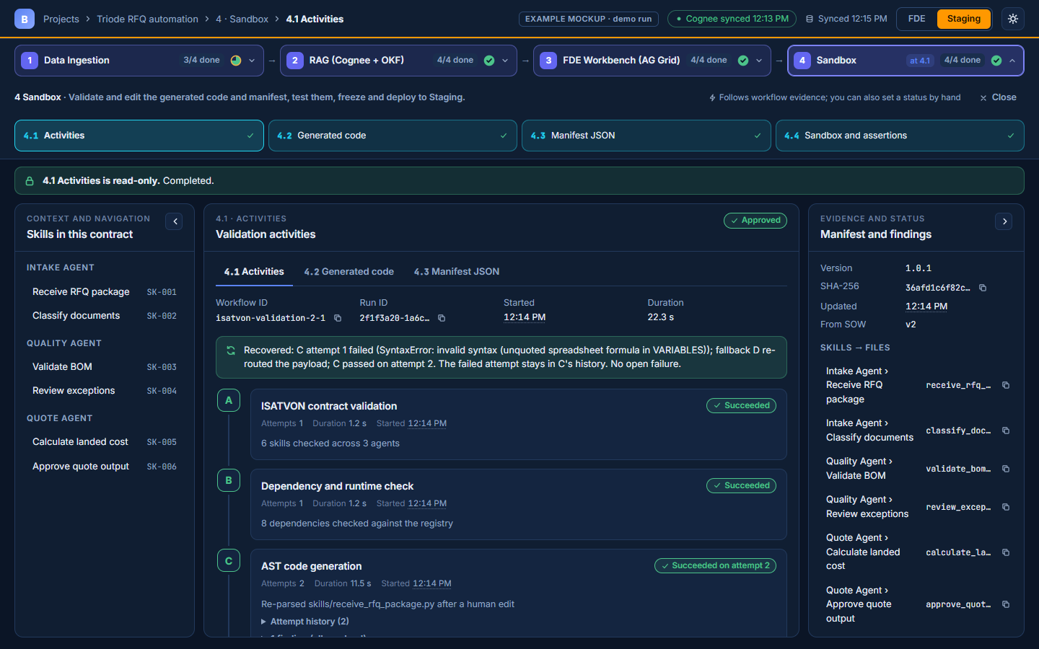
NAVIGATION
01 / 28
16 screens: 4 stages x 4
One registry; counters are n/4 done, with the current position ("at 4.1") shown separately. Back/forward work.

Slide 3
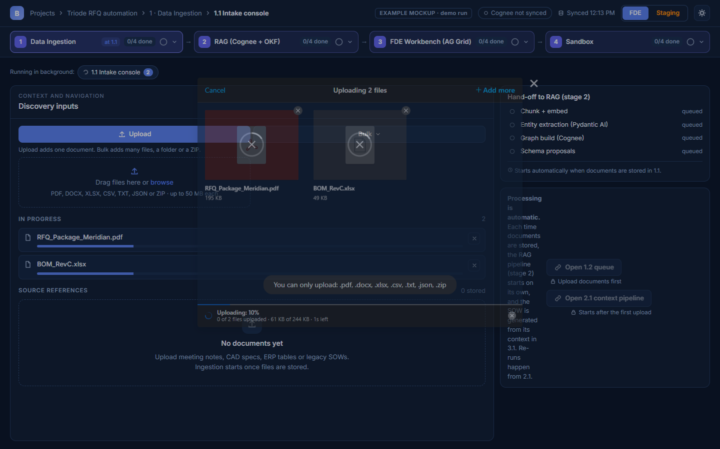
1 · DATA INGESTION
02 / 28
1.1 Intake console
Upload / Bulk plus a "Drag files here or browse" dropzone. Processing after upload is automatic.

Slide 4
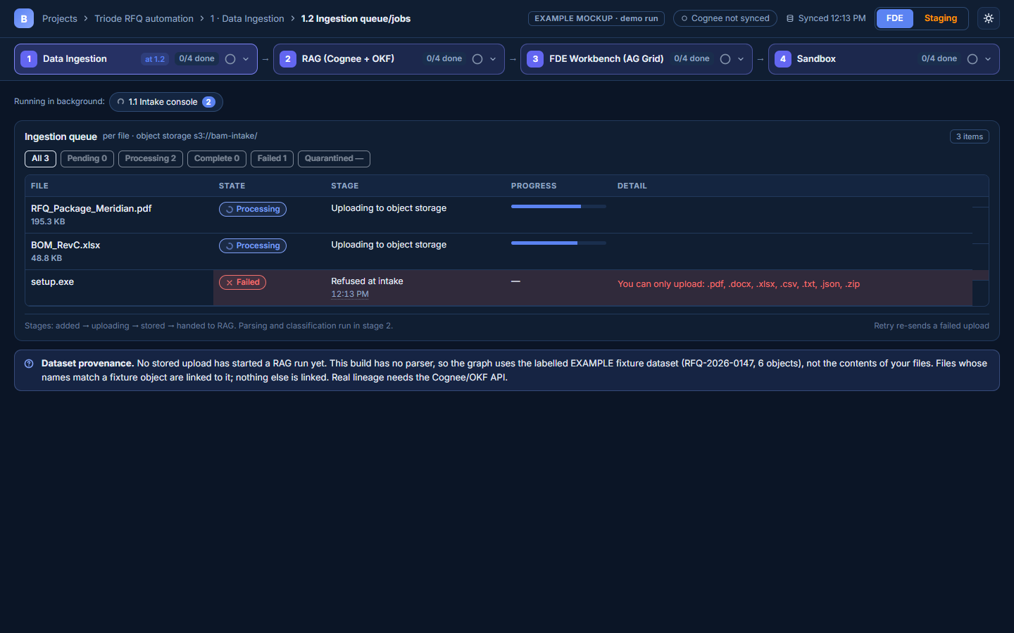
1 · DATA INGESTION
03 / 28
1.2 Ingestion queue/jobs
Per-file state, stage, progress and errors; refused files keep their reason. Quarantine is shown as not implemented.

Slide 5
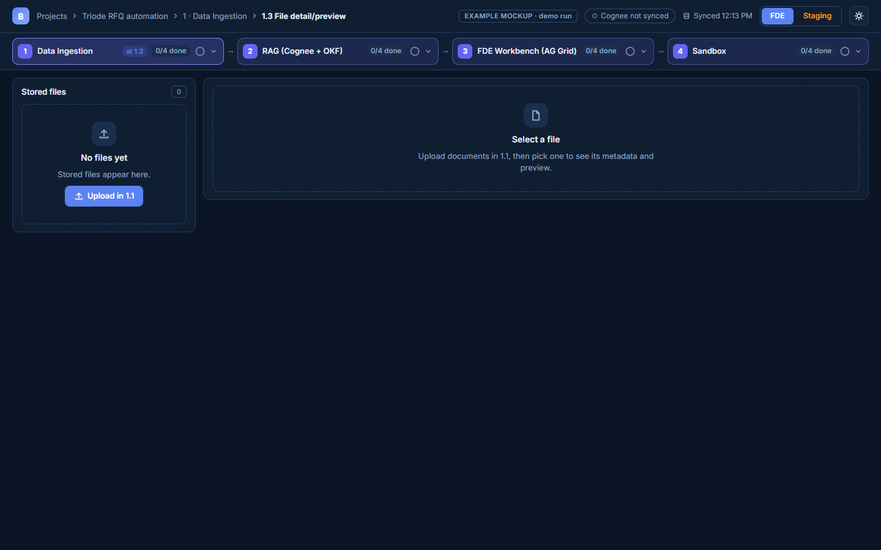
1 · DATA INGESTION
04 / 28
1.3 File detail/preview
Metadata with copyable keys. Parse preview says "Not available" (no parse service); fixture lineage is labelled.

Slide 6
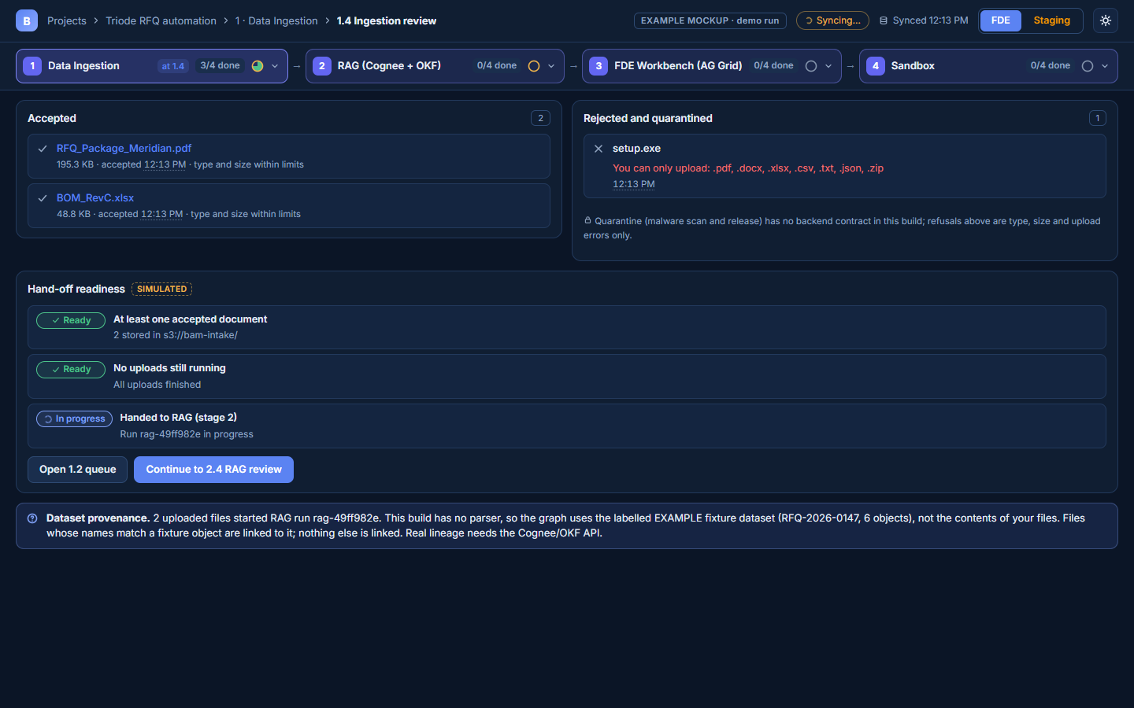
1 · DATA INGESTION
05 / 28
1.4 Ingestion review
Accepted vs rejected items with reasons, and hand-off readiness to RAG.

Slide 7
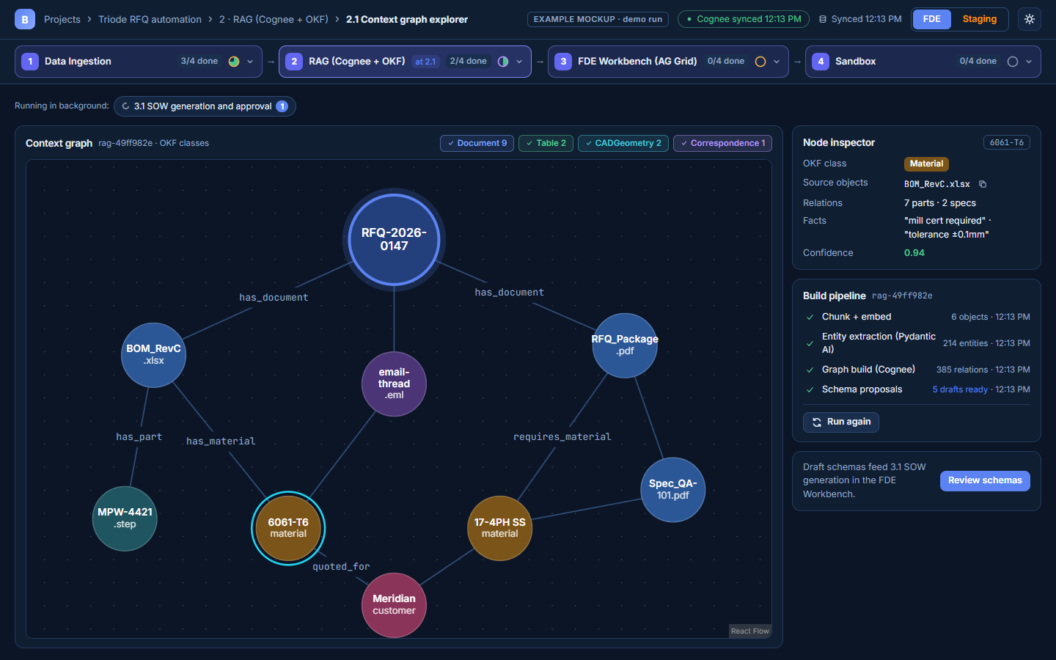
2 · RAG
06 / 28
2.1 Context graph: selected entity
Inspector shows OKF class, source objects (copyable URIs), relations, facts and confidence. Failure simulator hidden.

Slide 8
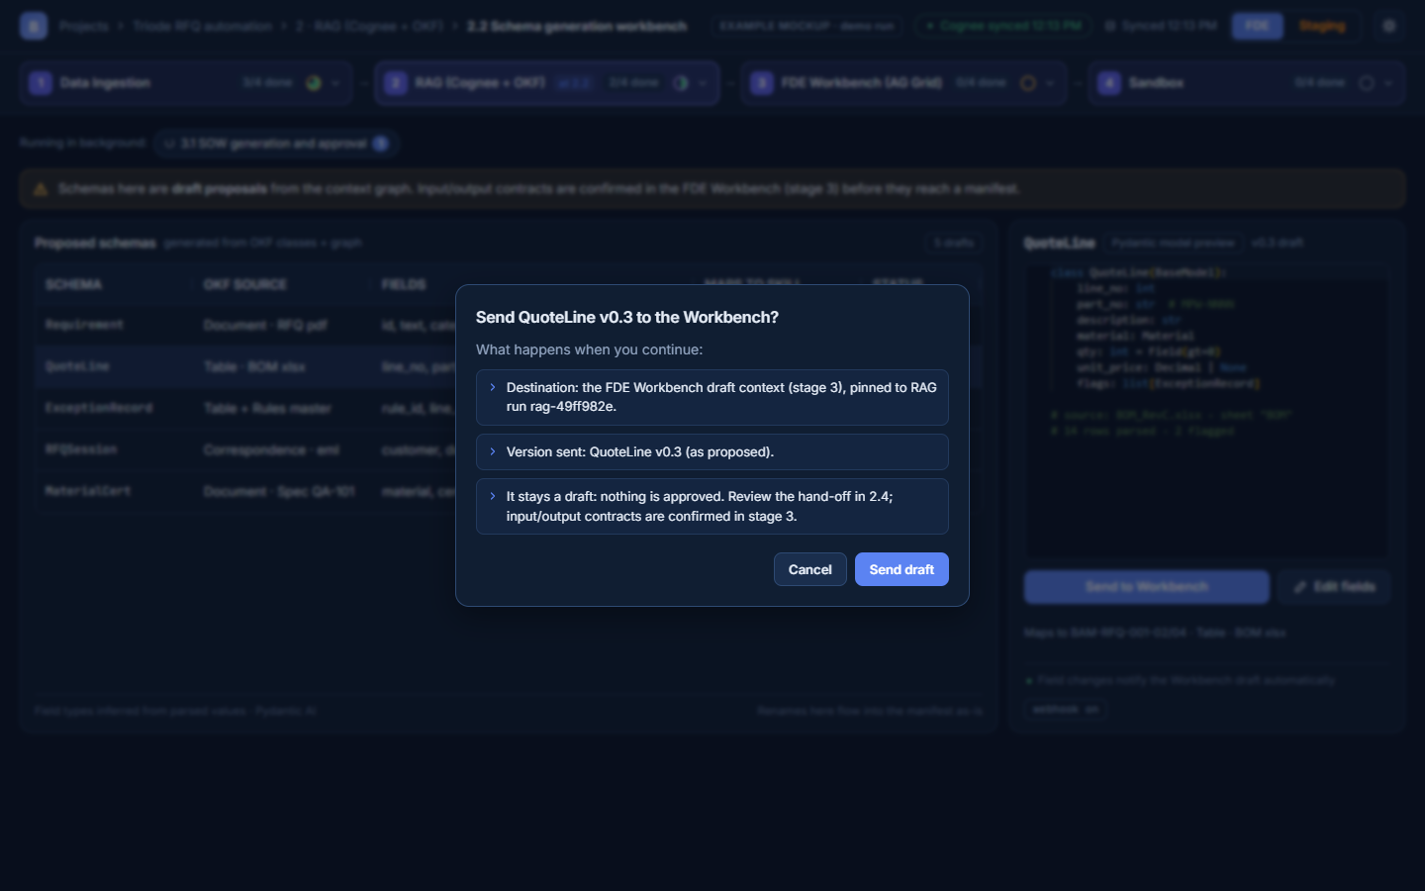
2 · RAG
07 / 28
2.2 Send to Workbench confirmation
Destination, version and run are confirmed before a draft hand-off; nothing is approved.

Slide 9
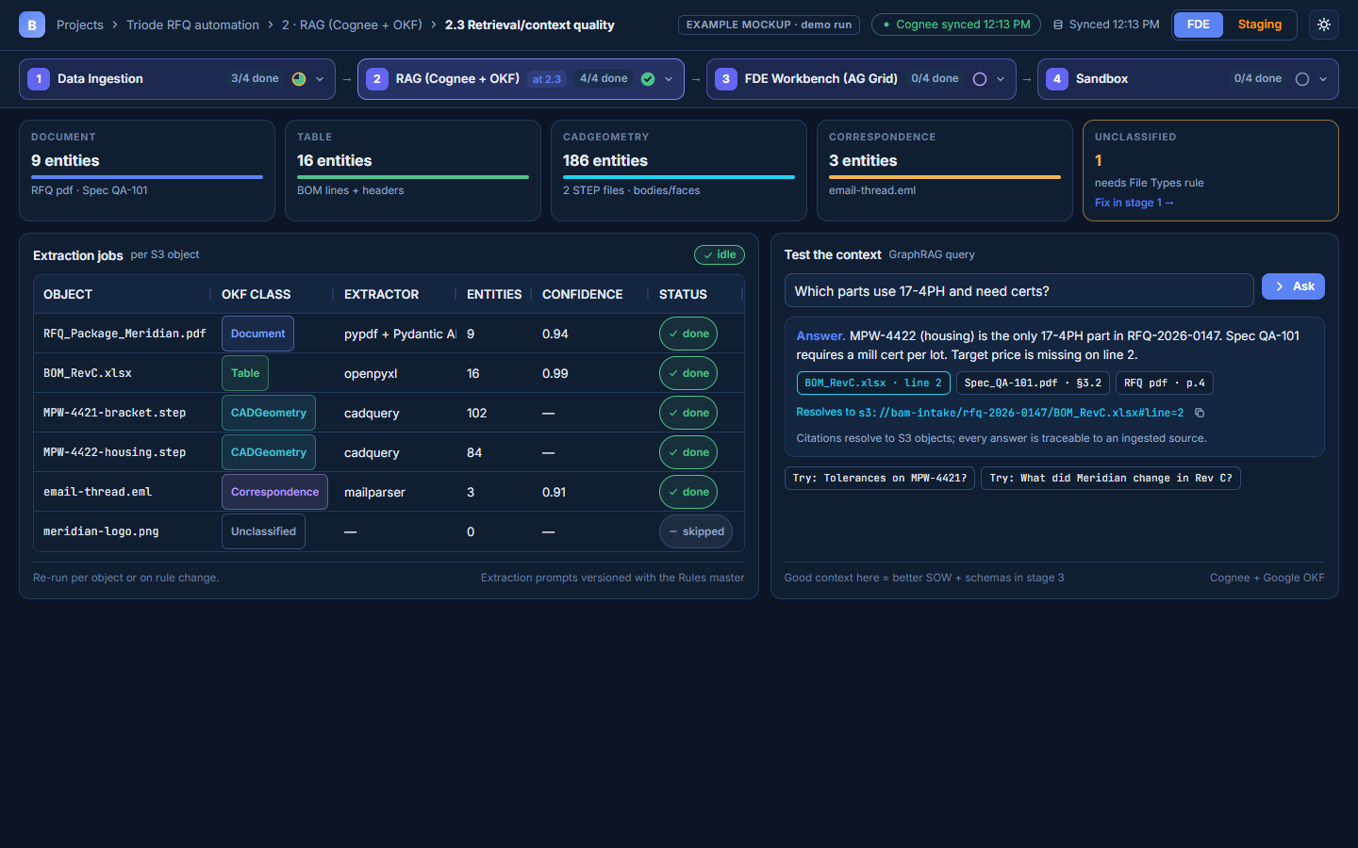
2 · RAG
08 / 28
2.3 Retrieval quality: answer and citations
Full CONFIDENCE header; cited answer with a copyable S3 URI; loading, error and no-answer states.

Slide 10
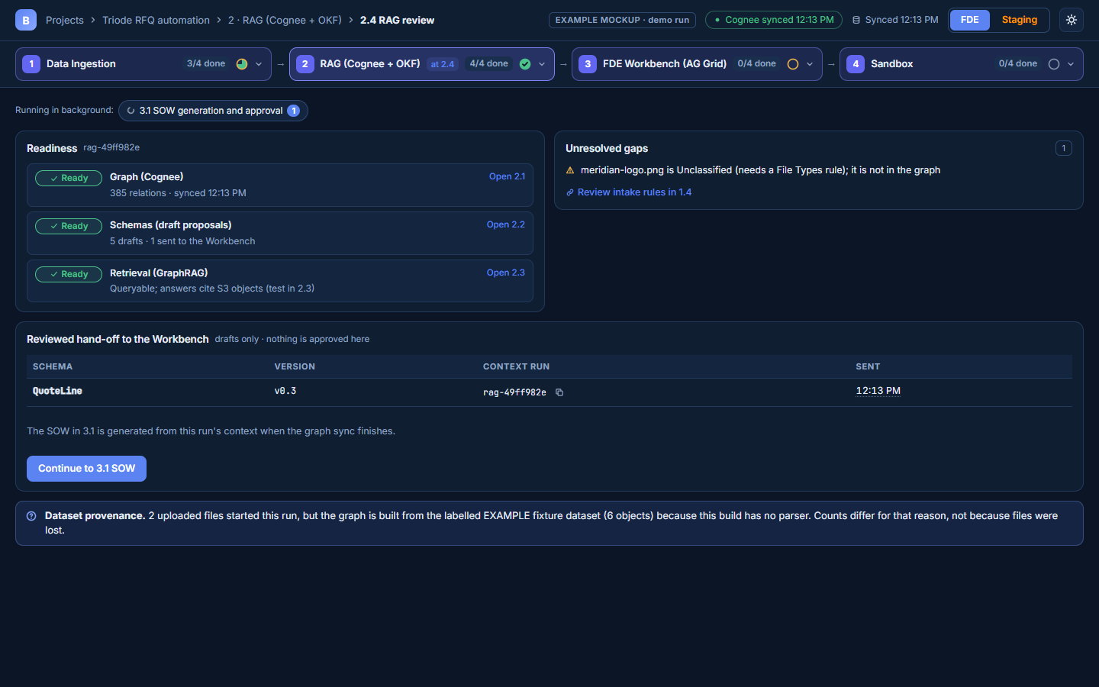
2 · RAG
09 / 28
2.4 RAG review
Graph/schema/retrieval readiness, open gaps, the reviewed hand-off, and dataset provenance.

Slide 11
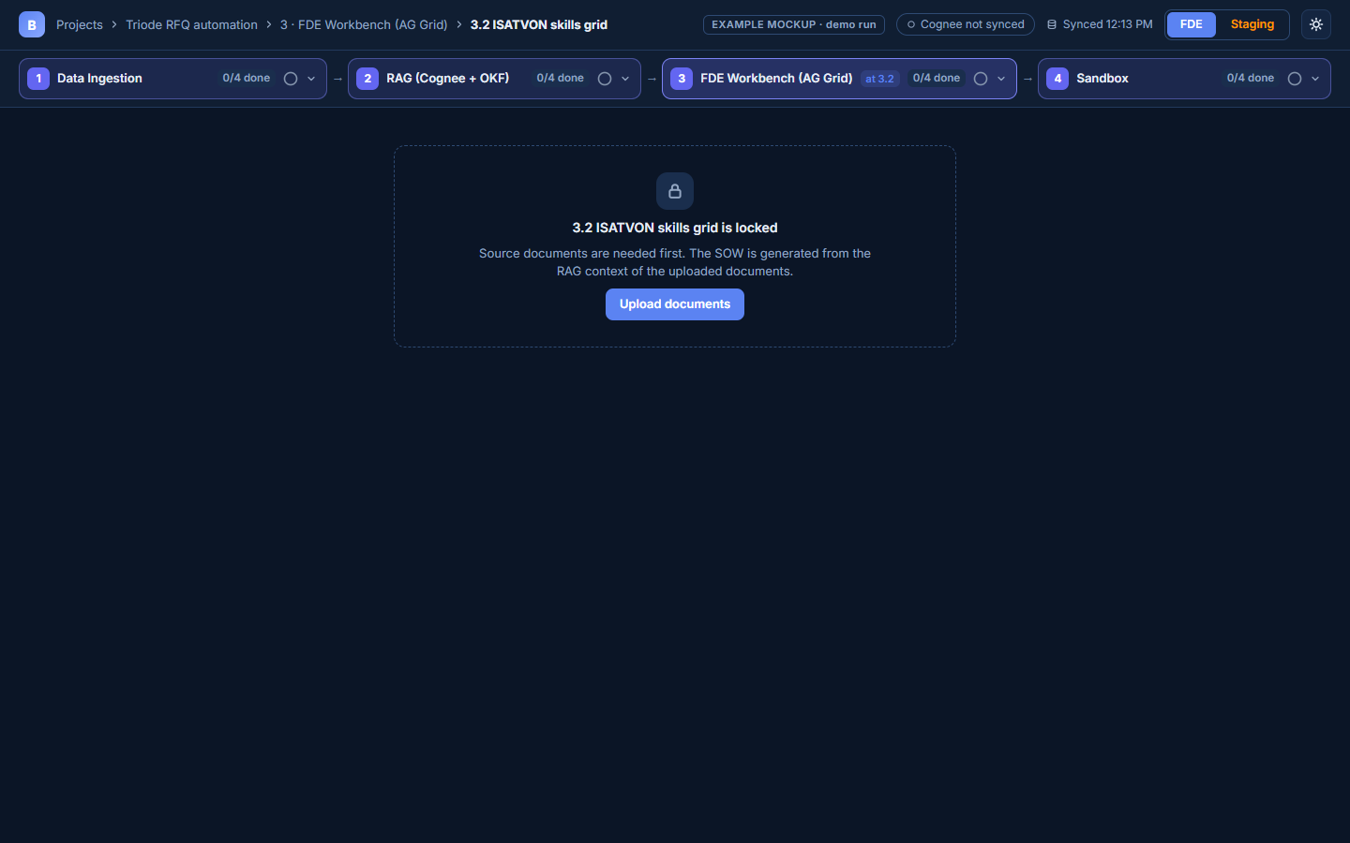
3 · FDE WORKBENCH
10 / 28
3.2 locked: no source documents
Reason and action come from the same prerequisite: Upload documents opens 1.1.

Slide 12
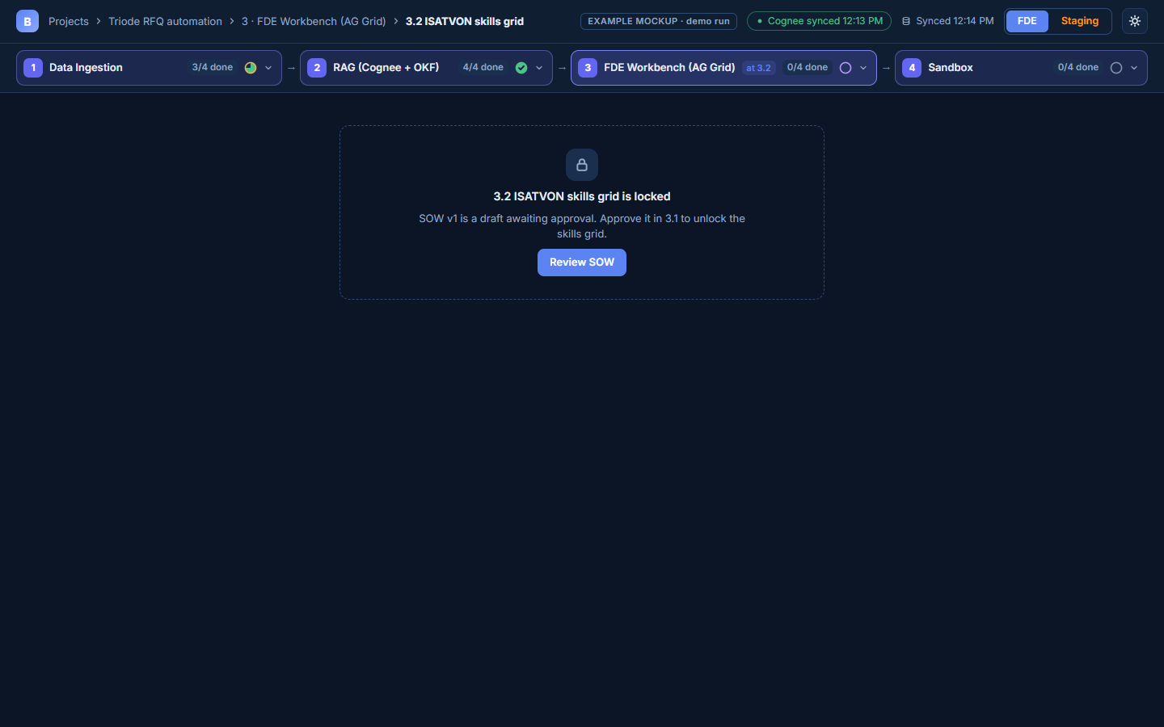
3 · FDE WORKBENCH
11 / 28
3.2 locked: SOW draft awaiting approval
SOW v1 is a draft awaiting approval; Review SOW opens 3.1.

Slide 13
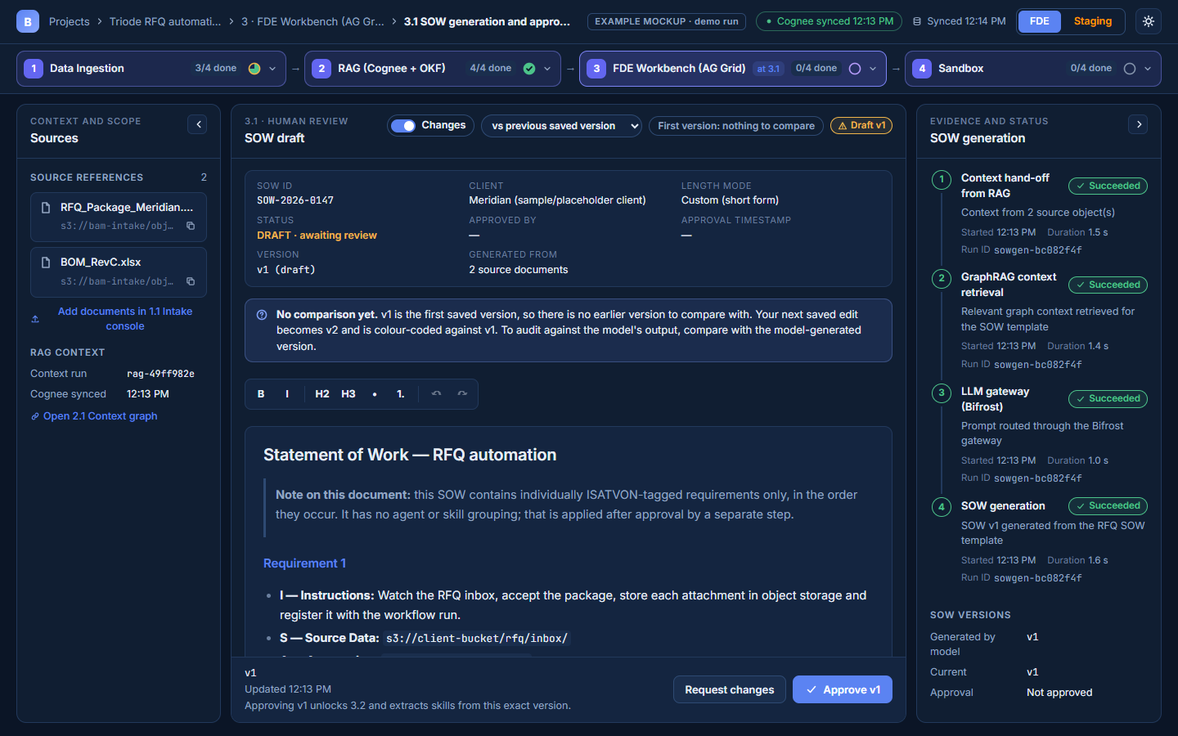
3 · FDE WORKBENCH
12 / 28
3.1 first version
With no earlier saved version the screen says so instead of showing a fake diff.

Slide 14
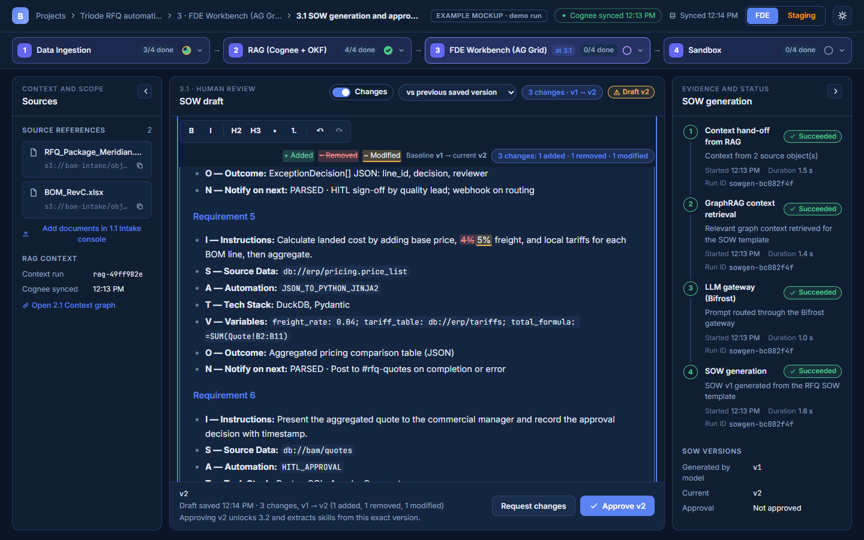
3 · FDE WORKBENCH
13 / 28
3.1 SOW v1 → v2 diff
Real edits: 1 added, 1 removed, 1 modified; legend, baseline → current, one change count.

Slide 15
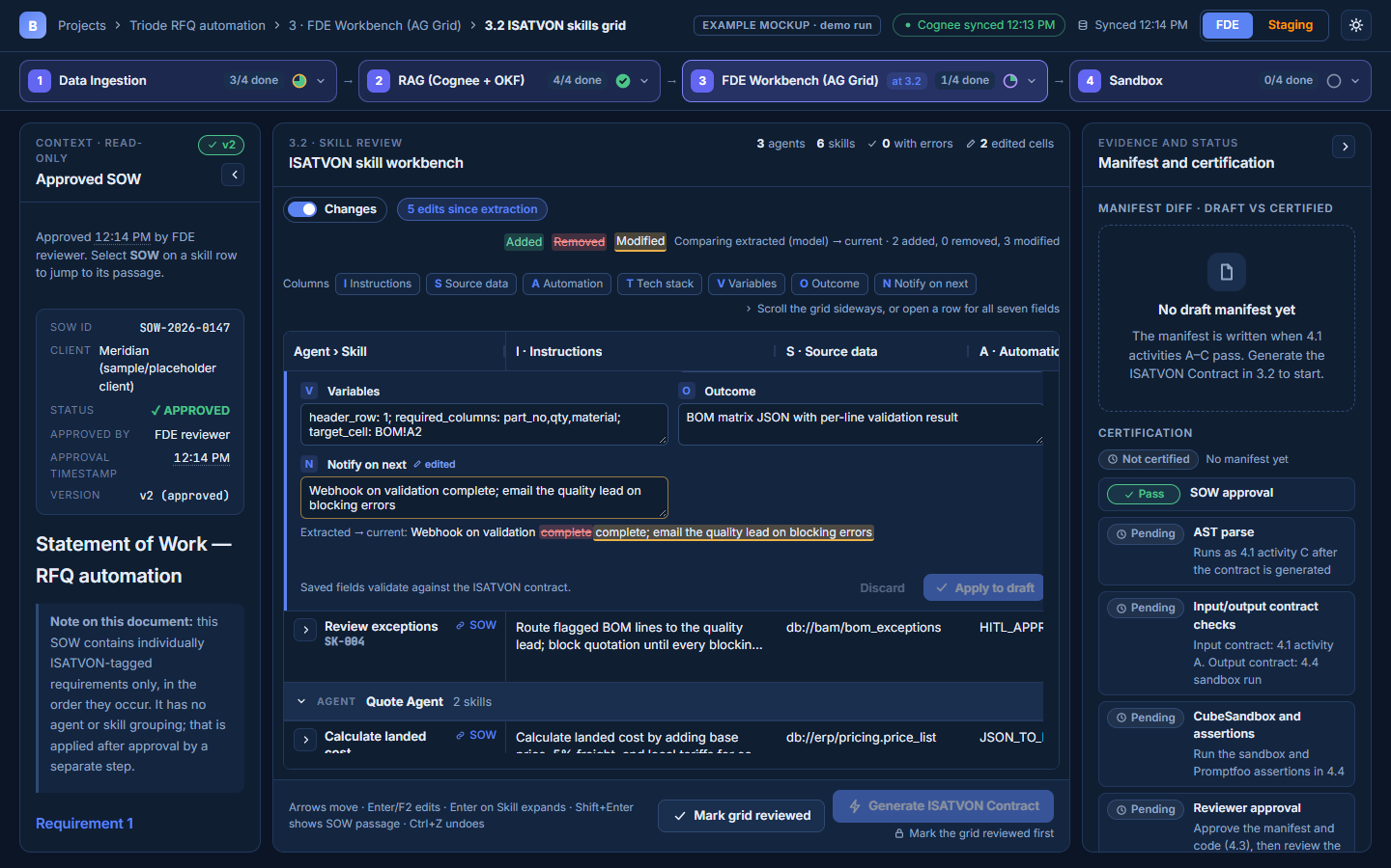
3 · FDE WORKBENCH
14 / 28
3.2 edited row and right rail
Column jump chips, changed-row badge, inline 7-field editor with before/after; rail = manifest diff + certification.

Slide 16
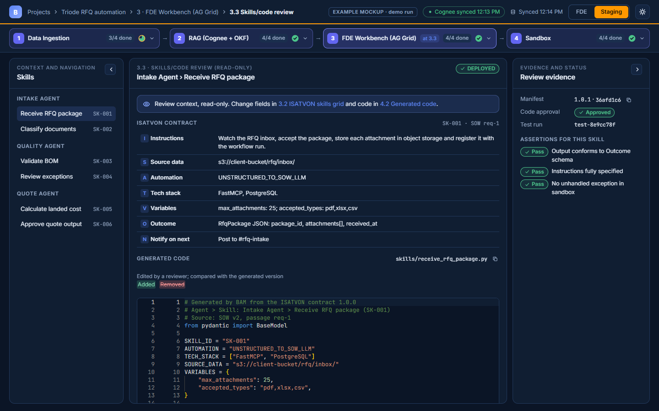
3 · FDE WORKBENCH
15 / 28
3.3 Skills/code review
Read-only review of one skill: contract, code diff vs generated, findings and its assertions.

Slide 17
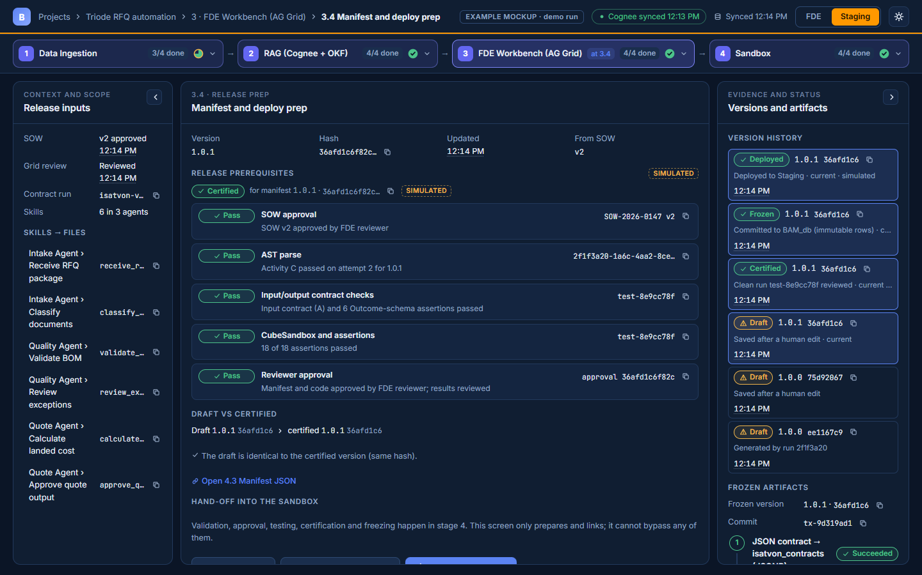
3 · FDE WORKBENCH
16 / 28
3.4 Manifest and deploy prep
Release prerequisites, draft vs certified, version history (draft/certified/frozen/deployed), frozen artifacts.

Slide 18
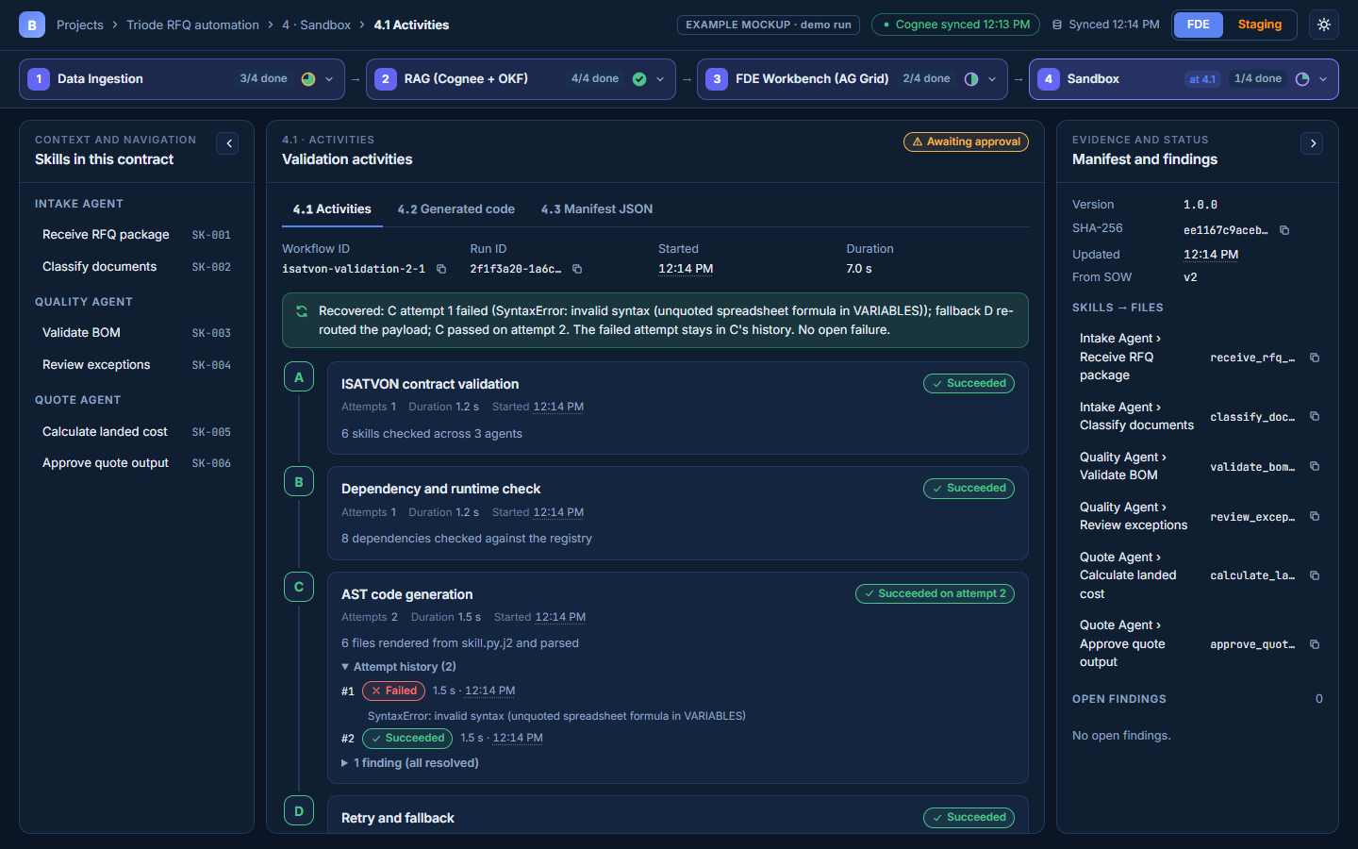
4 · SANDBOX
17 / 28
4.1 Activities: recovered run
One narrative: C attempt 1 failed (kept in history), D fallback, C passed on attempt 2.

Slide 19
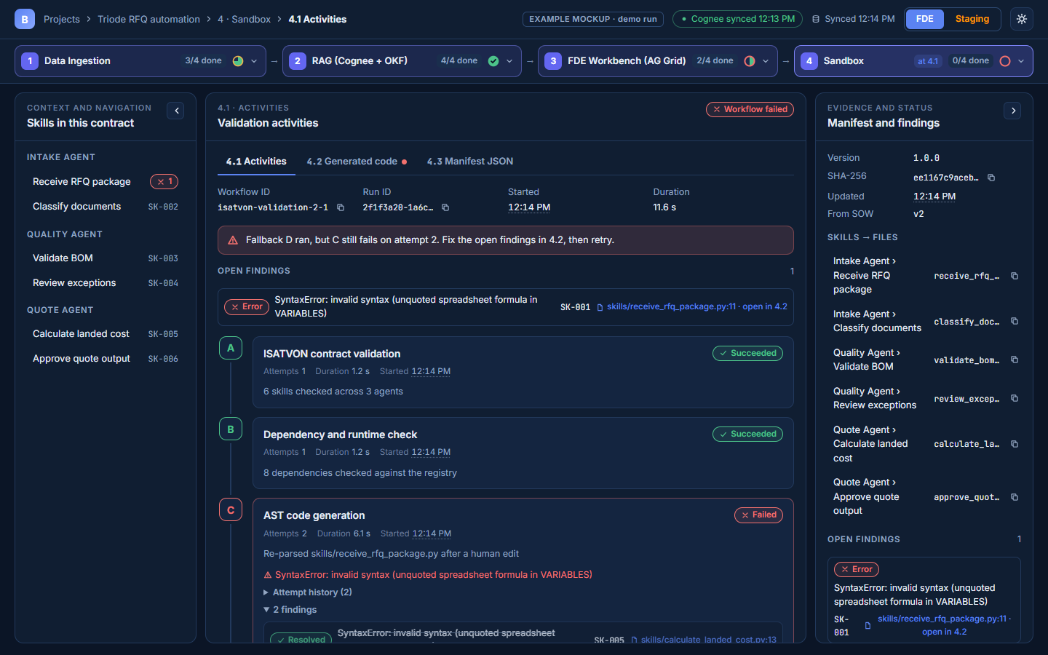
4 · SANDBOX
18 / 28
4.1 Activities: open finding
Open finding with severity, file:line and a jump to 4.2.

Slide 20
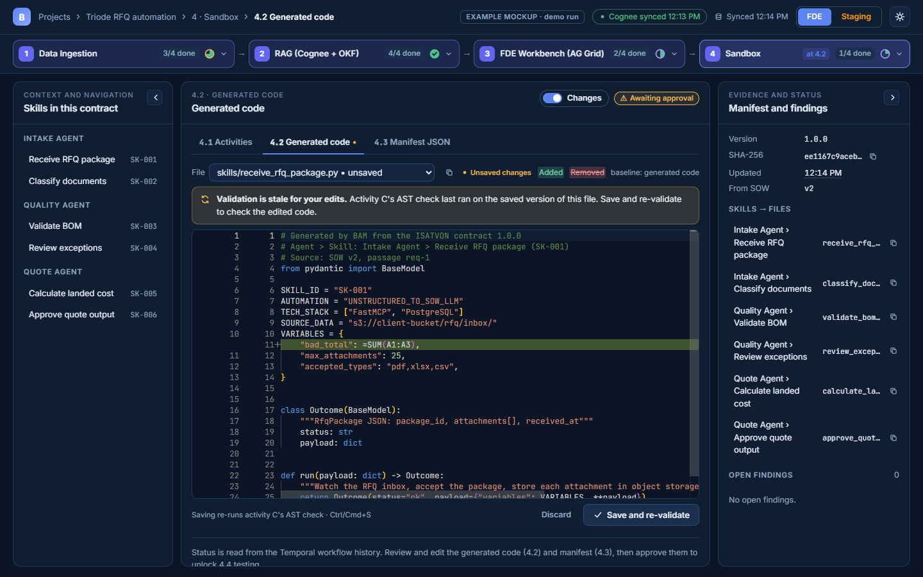
4 · SANDBOX
19 / 28
4.2 Generated code: stale validation
Unsaved edits are flagged as not yet validated; actions never overlap the editor.

Slide 21
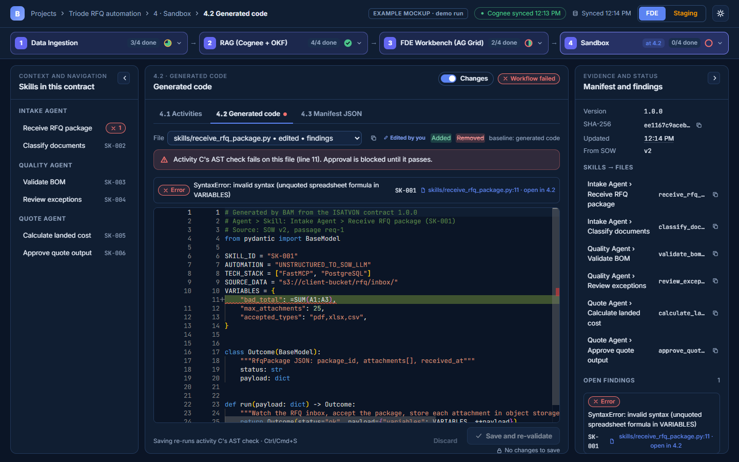
4 · SANDBOX
20 / 28
4.2 Generated code: invalid code
AST check fails on line 11; edits are kept; approval blocked until it passes.

Slide 22
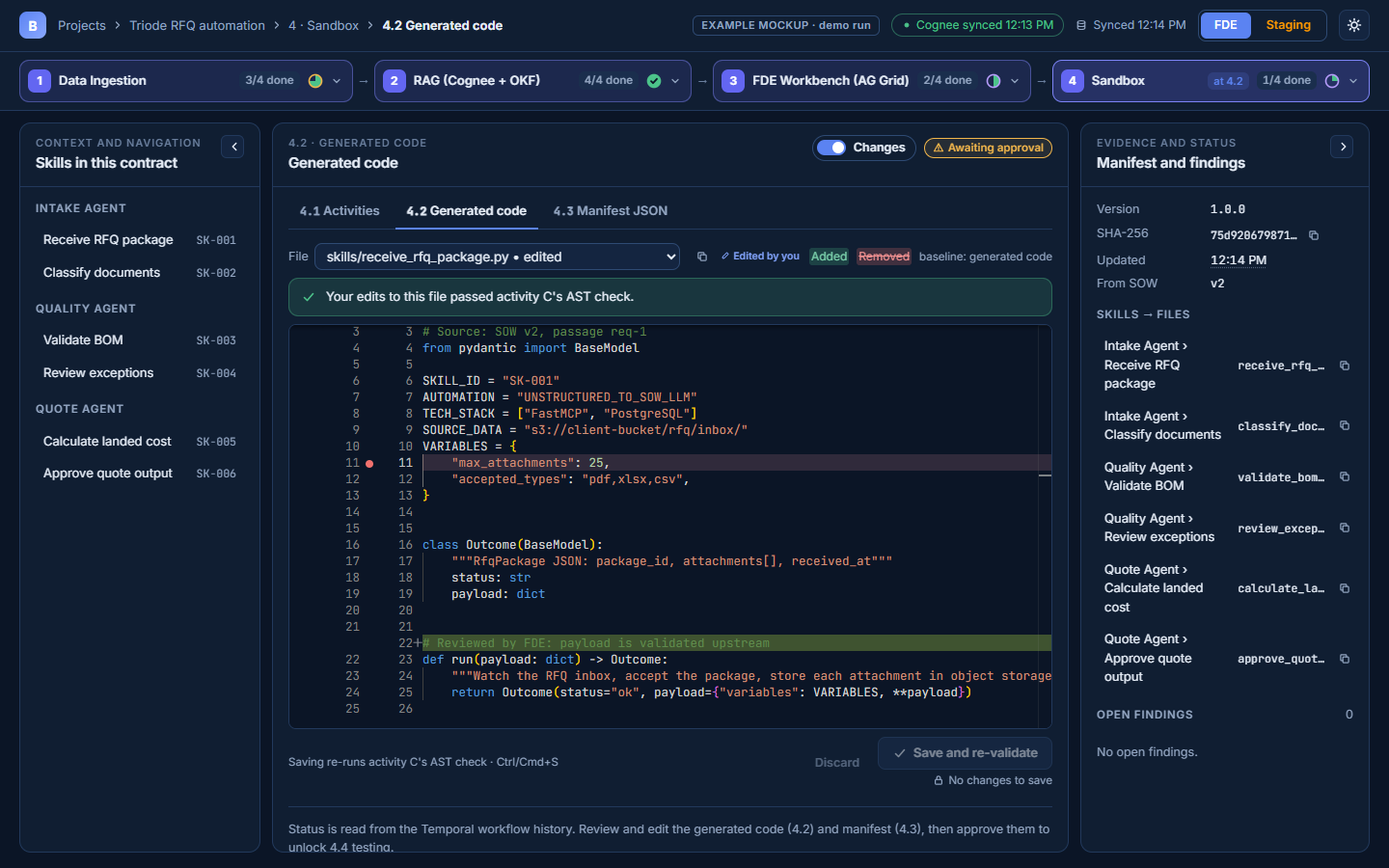
4 · SANDBOX
21 / 28
4.2 Generated code: edited and passing
Inline diff against the generated code after a valid reviewed edit.

Slide 23
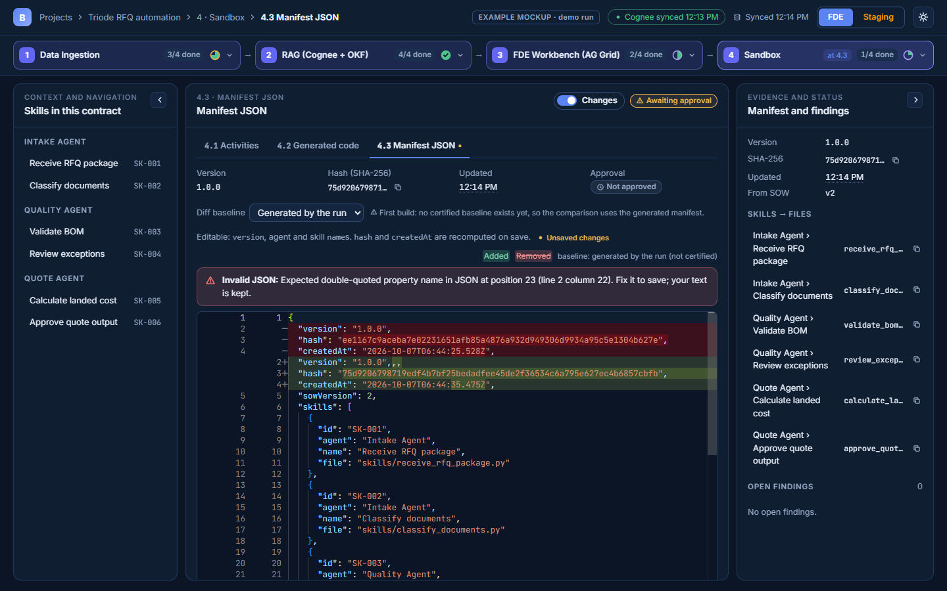
4 · SANDBOX
22 / 28
4.3 Manifest JSON: invalid JSON
Inline JSON error; Save disabled with the reason; text kept.

Slide 24
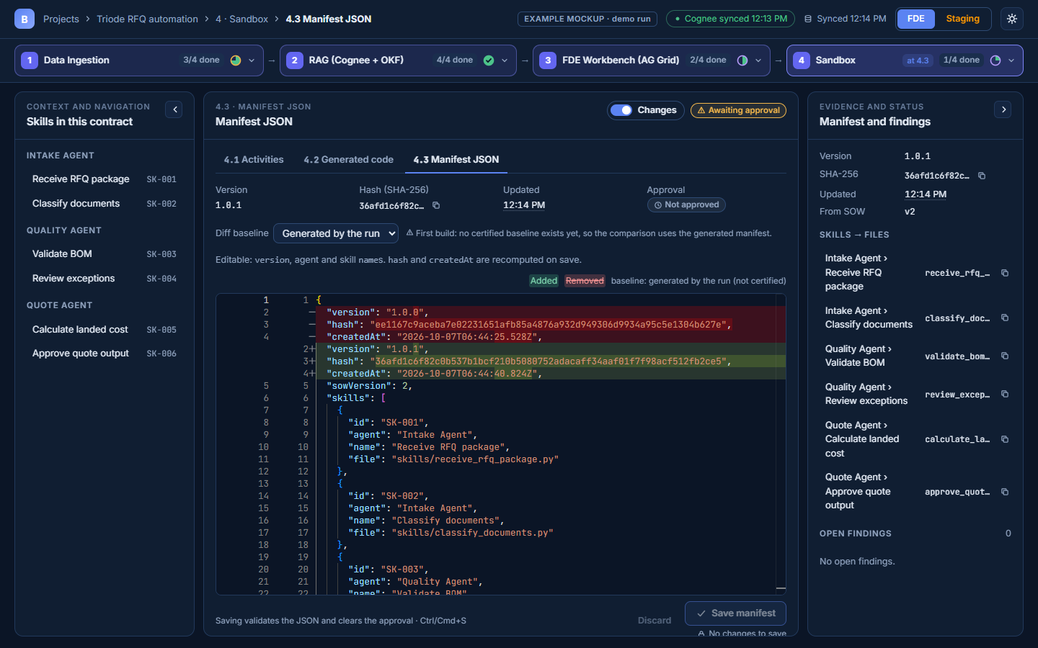
4 · SANDBOX
23 / 28
4.3 Manifest JSON: saved, new hash
Version 1.0.1, hash recomputed, approval cleared; baseline labelled (first build: no certified version).

Slide 25
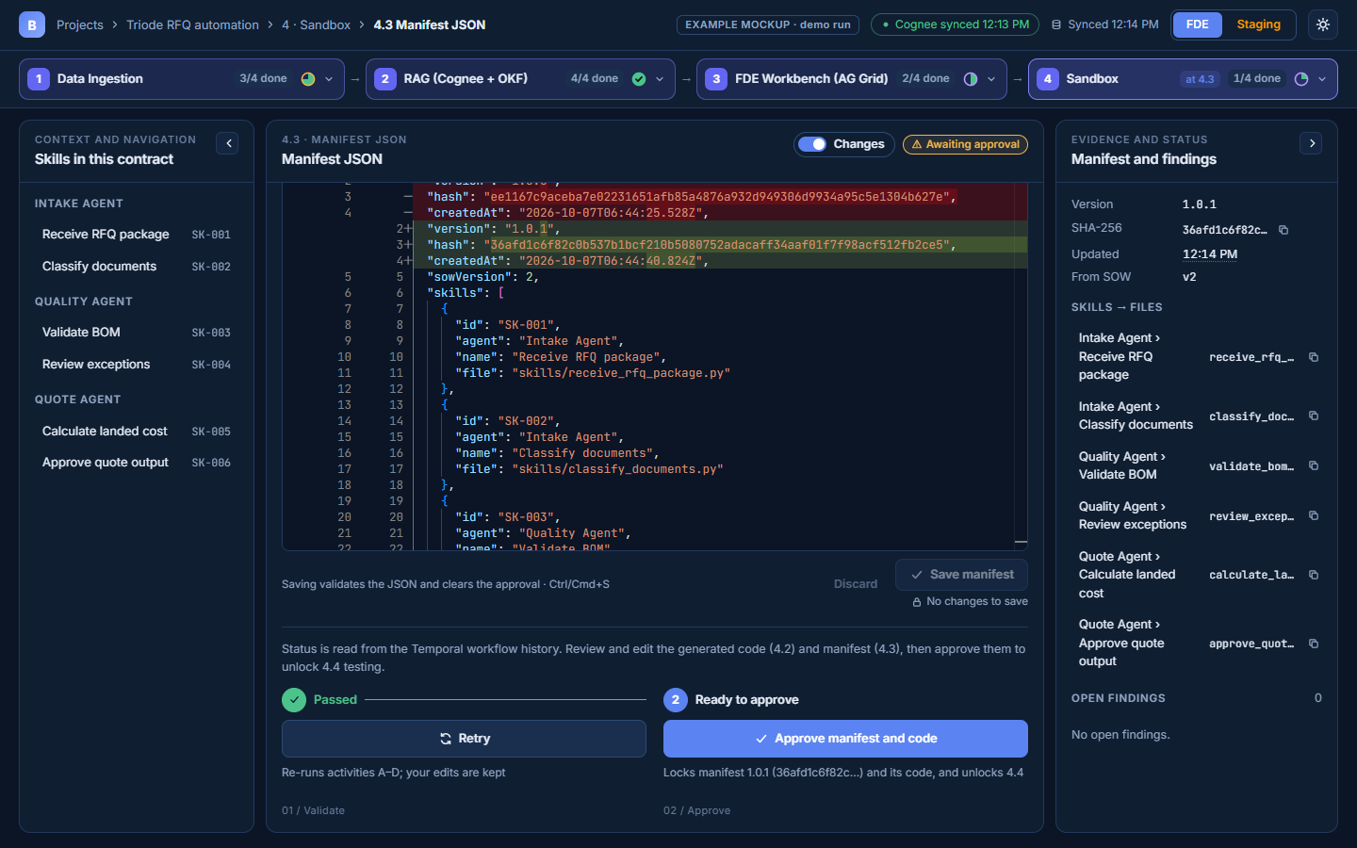
4 · SANDBOX
24 / 28
4.3 Approve manifest and code
Retry and Approve with helper text fully visible at the end of the content.

Slide 26
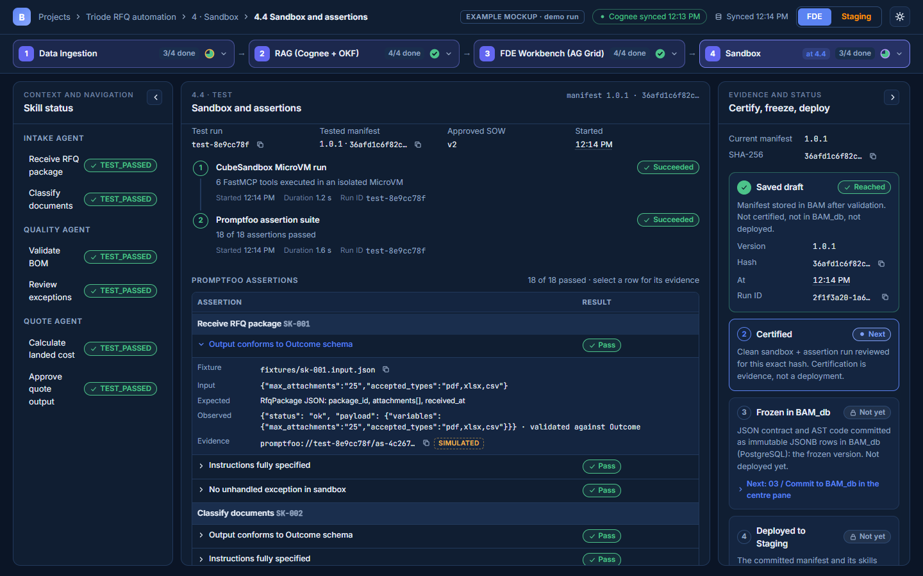
4 · SANDBOX
25 / 28
4.4 Certification checklist and evidence
Checklist bound to the tested hash; an assertion expanded into fixture, input, expected, observed and evidence.

Slide 27
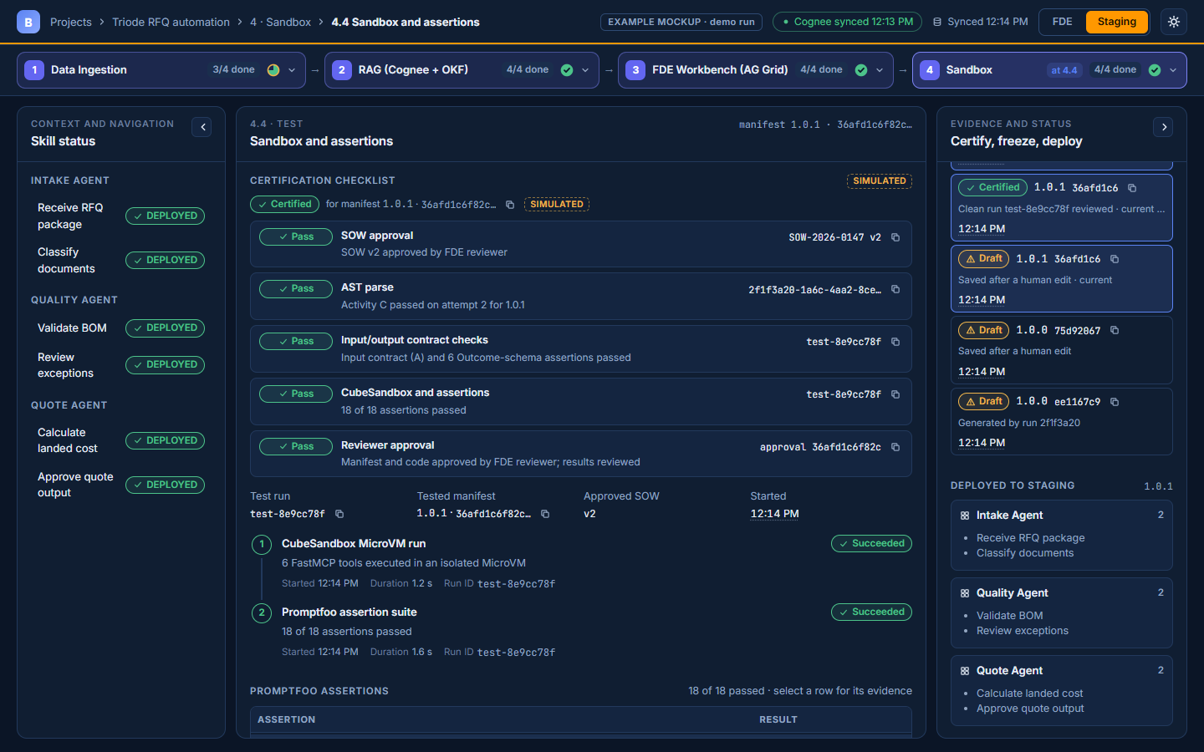
4 · SANDBOX
26 / 28
4.4 Certified, frozen, deployed
All five items pass for 1.0.1; certified and frozen evidence separate from Deployed to Staging (simulated).

Slide 28
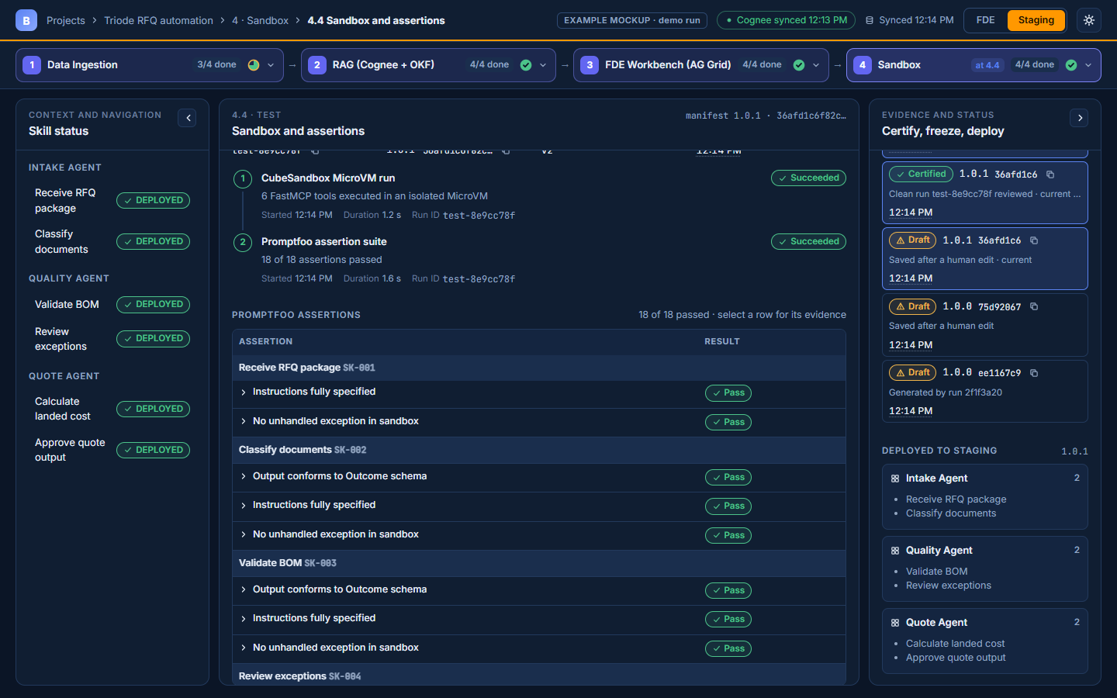
4 · SANDBOX
27 / 28
4.4 Sticky skill label
The skill label stays visible while its assertion rows scroll.

Slide 29
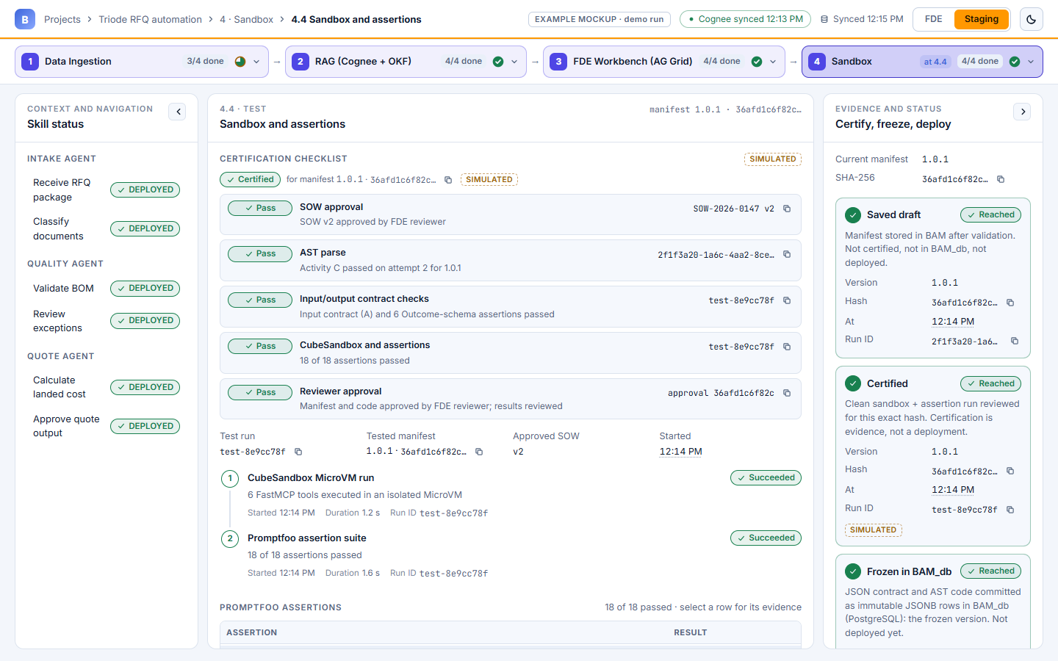
THEMES
28 / 28
4.4 in light theme
Same tokens drive both themes.

