Slide 1
BuLLM BAM Workbench
UI screens: Data Ingestion → RAG → FDE Workbench → Sandbox
16 screens in 20 views · captured from the running app (localhost:5174), dark theme, 1440×900 · updated 8 Oct 2026

Slide 2
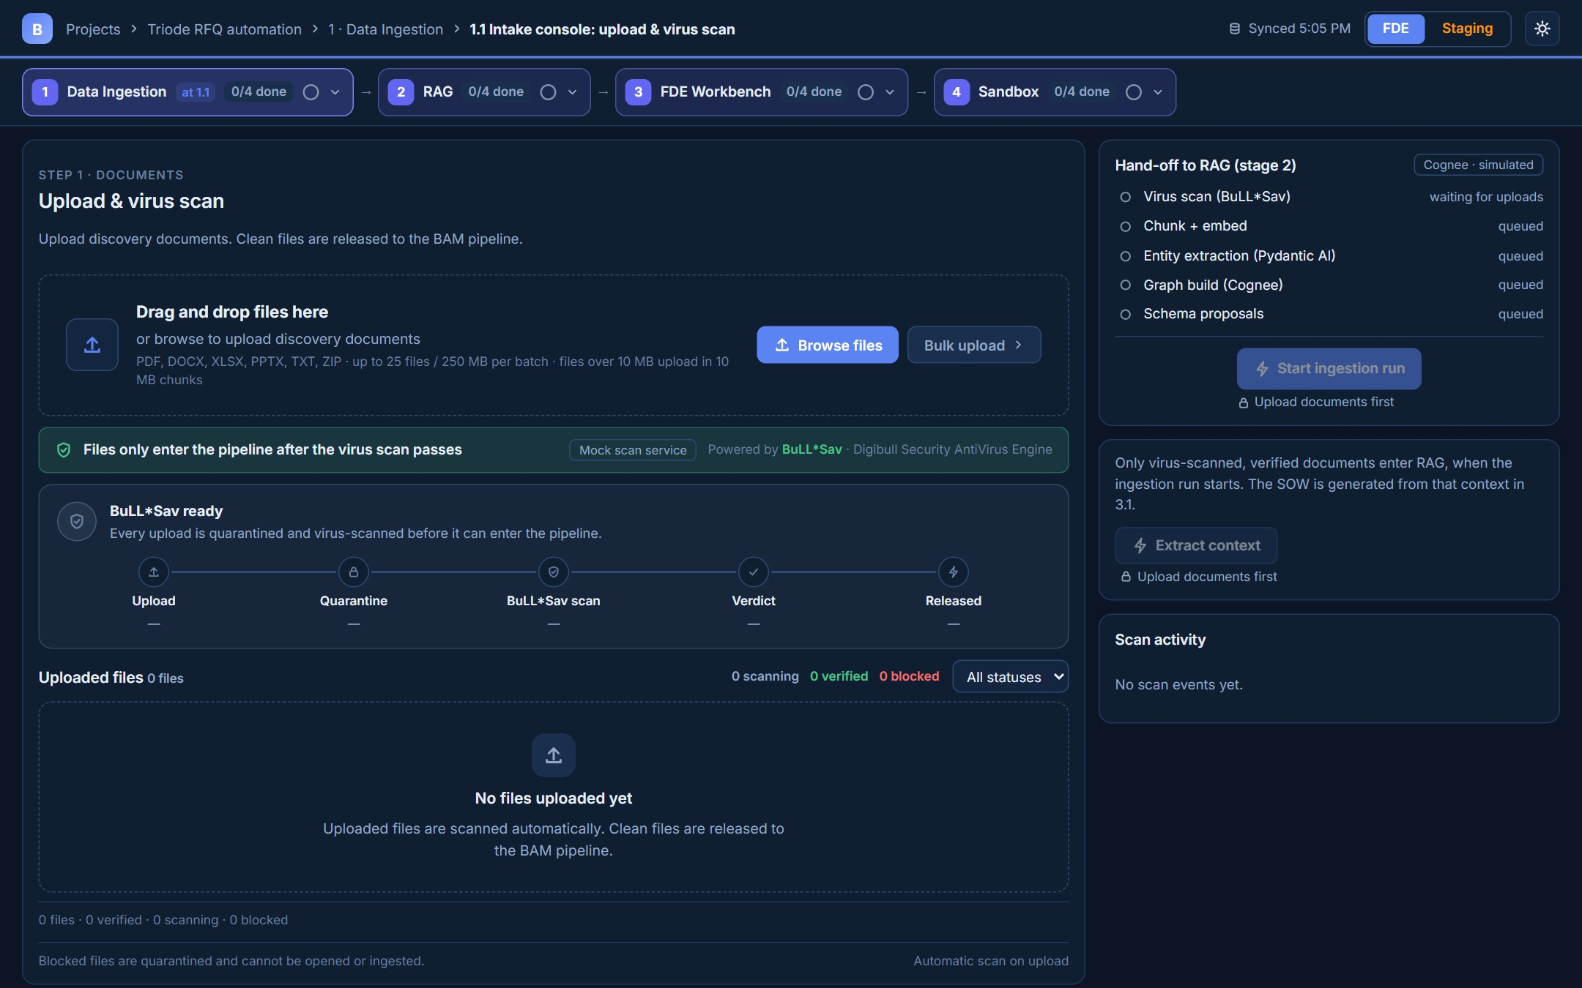
1 · DATA INGESTION
01 / 20
1.1 Intake console: upload & virus scan
Drag and drop, Browse files or Bulk upload. Every file passes BuLL*Sav (Digibull Security AntiVirus Engine) before it can enter the pipeline.

Slide 3
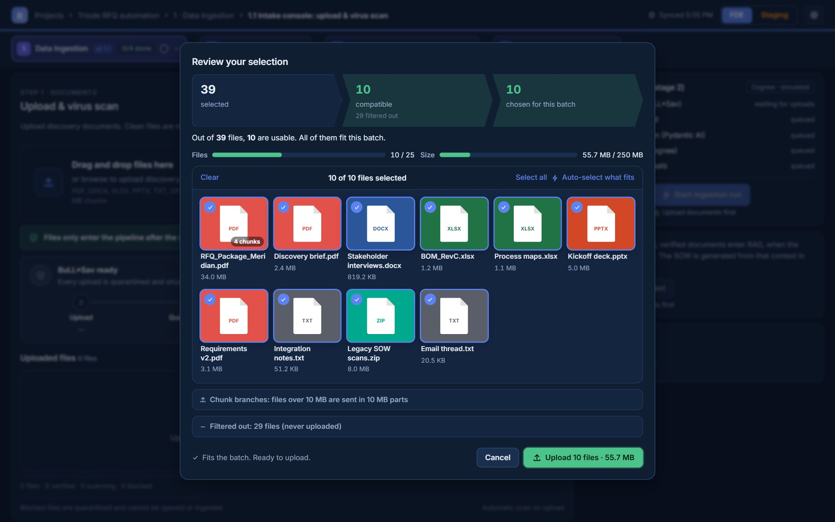
1 · DATA INGESTION
02 / 20
1.1 Review your selection
Incompatible files are filtered out first (39 picked, 10 usable); Upload turns green only when the choice fits 25 files / 250 MB.

Slide 4
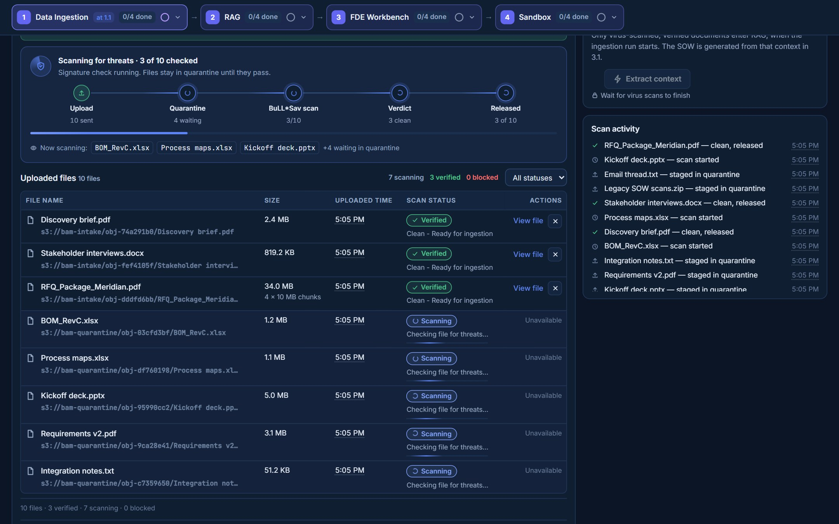
1 · DATA INGESTION
03 / 20
1.1 Live virus scan
Upload → Quarantine → BuLL*Sav scan → Verdict → Released, three files at a time. Files stay in quarantine until they are clean.

Slide 5
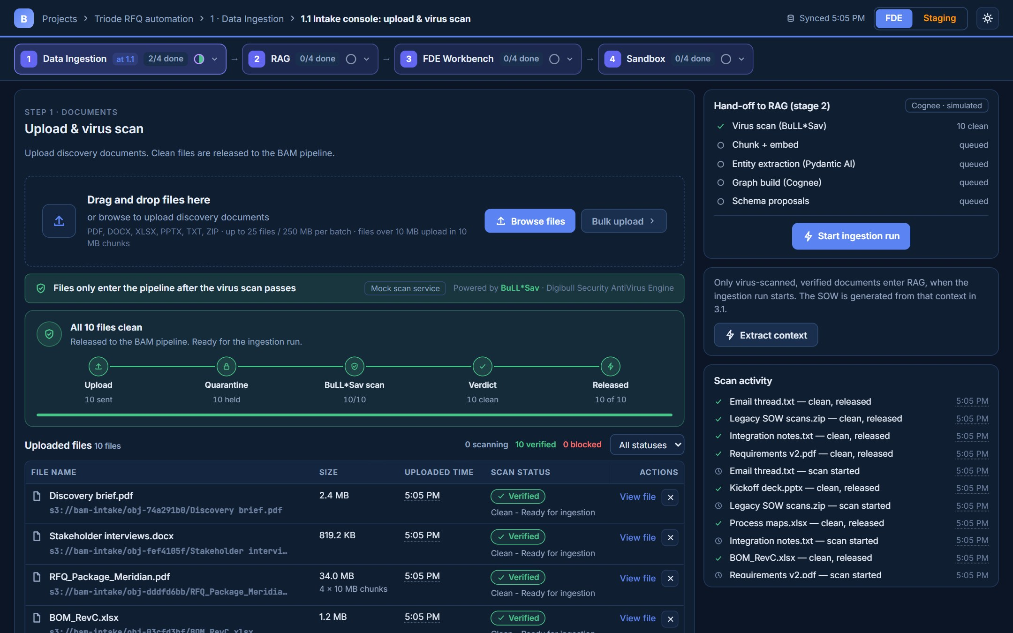
1 · DATA INGESTION
04 / 20
1.1 All files clean: ready for RAG
Start ingestion run hands only verified, released files to RAG. Nothing starts on upload alone.

Slide 6
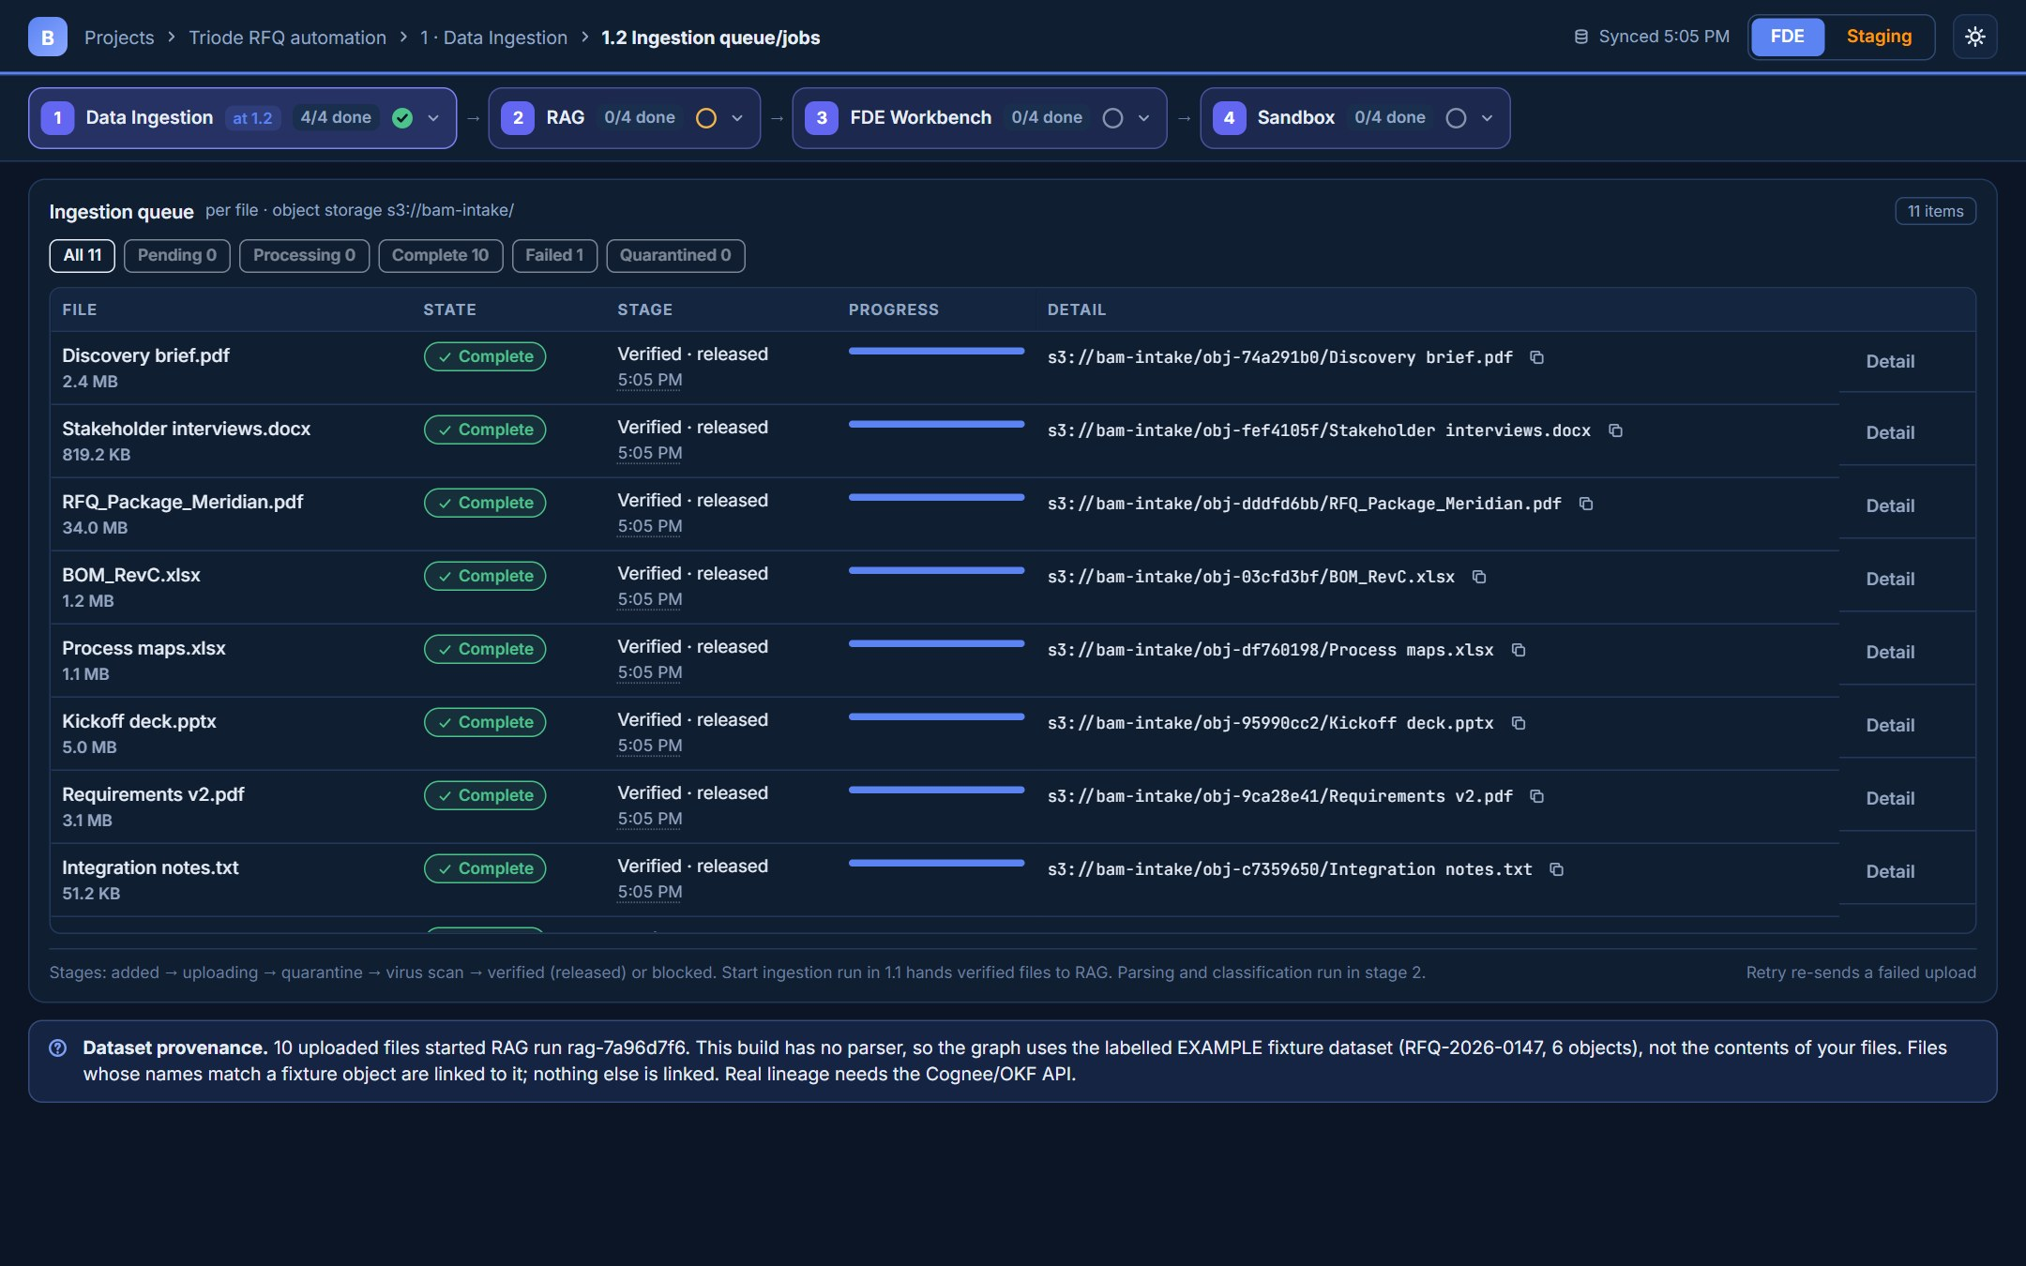
1 · DATA INGESTION
05 / 20
1.2 Ingestion queue/jobs
Per-file state, stage, progress and storage path, filterable by state.

Slide 7
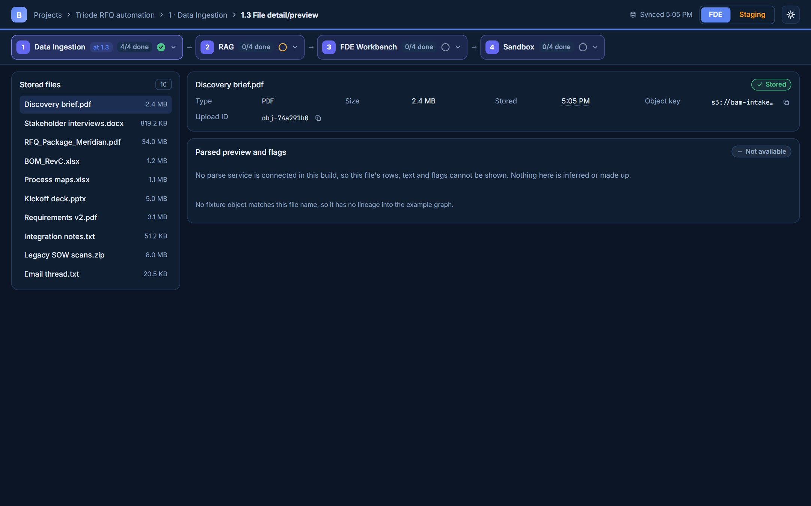
1 · DATA INGESTION
06 / 20
1.3 File detail/preview
Metadata for each stored file. The parse preview says Not available: there is no parser contract yet.

Slide 8
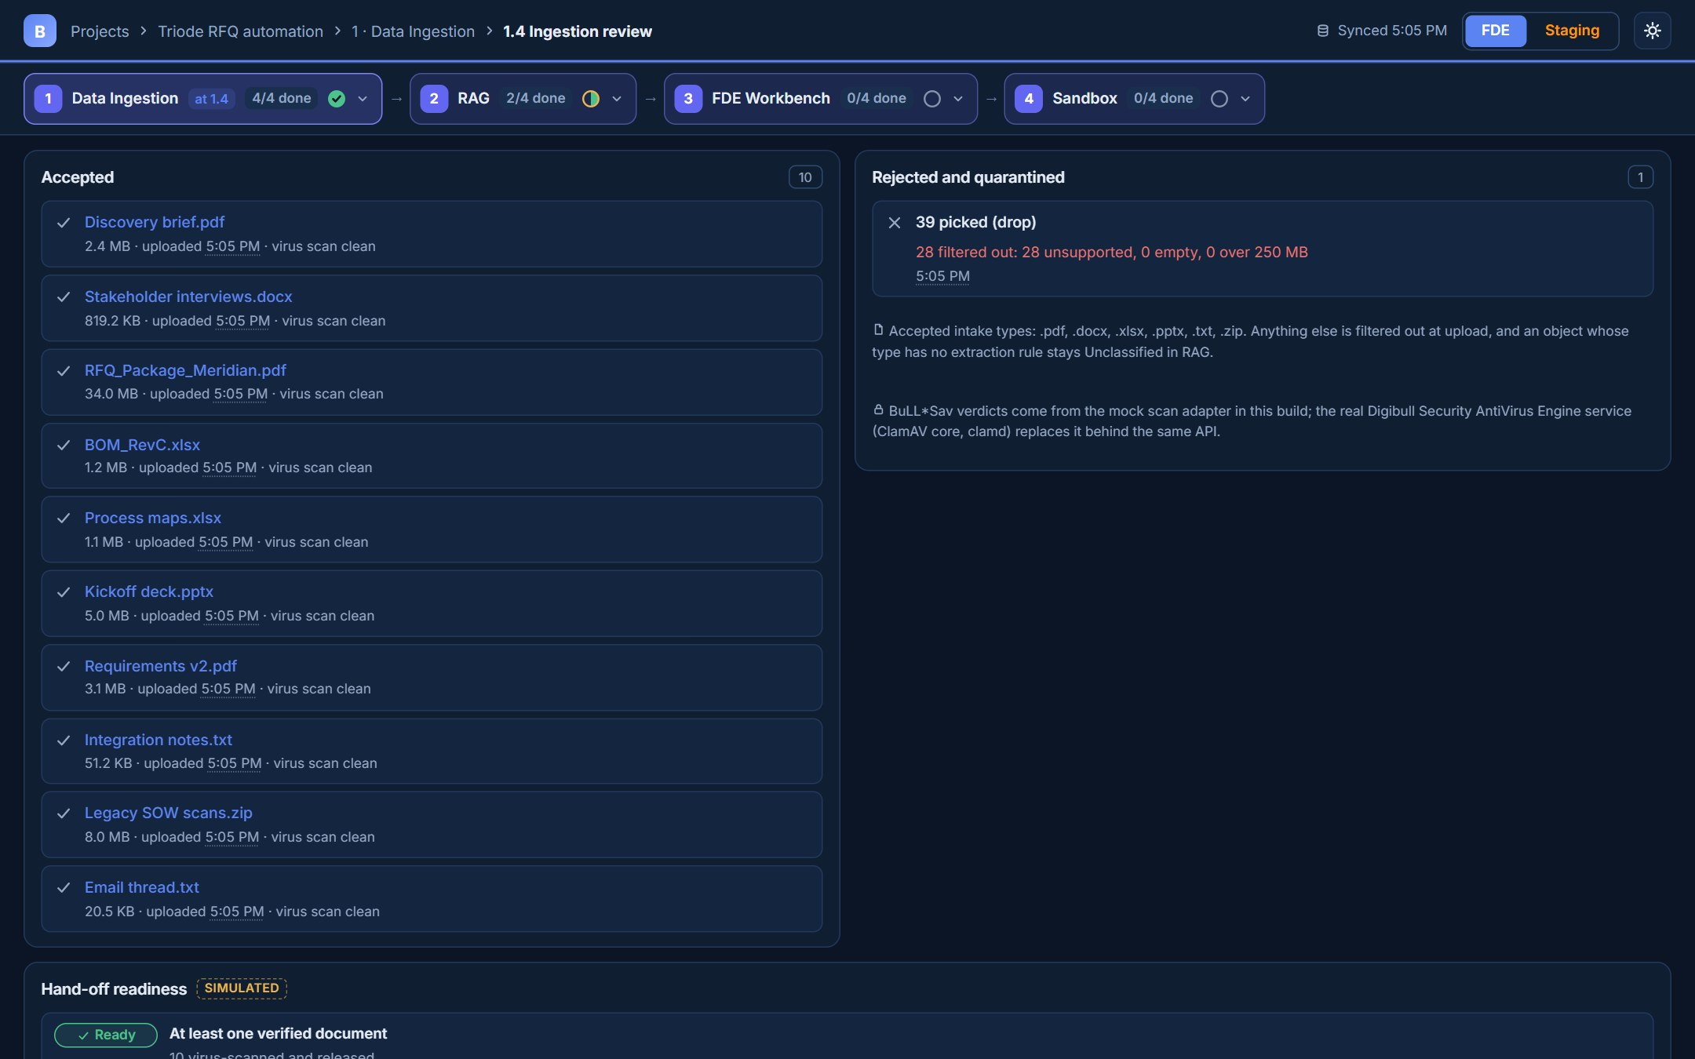
1 · DATA INGESTION
07 / 20
1.4 Ingestion review
Accepted files and what was filtered out, with reasons. Stage 1 completes 4/4 automatically after the hand-off.

Slide 9
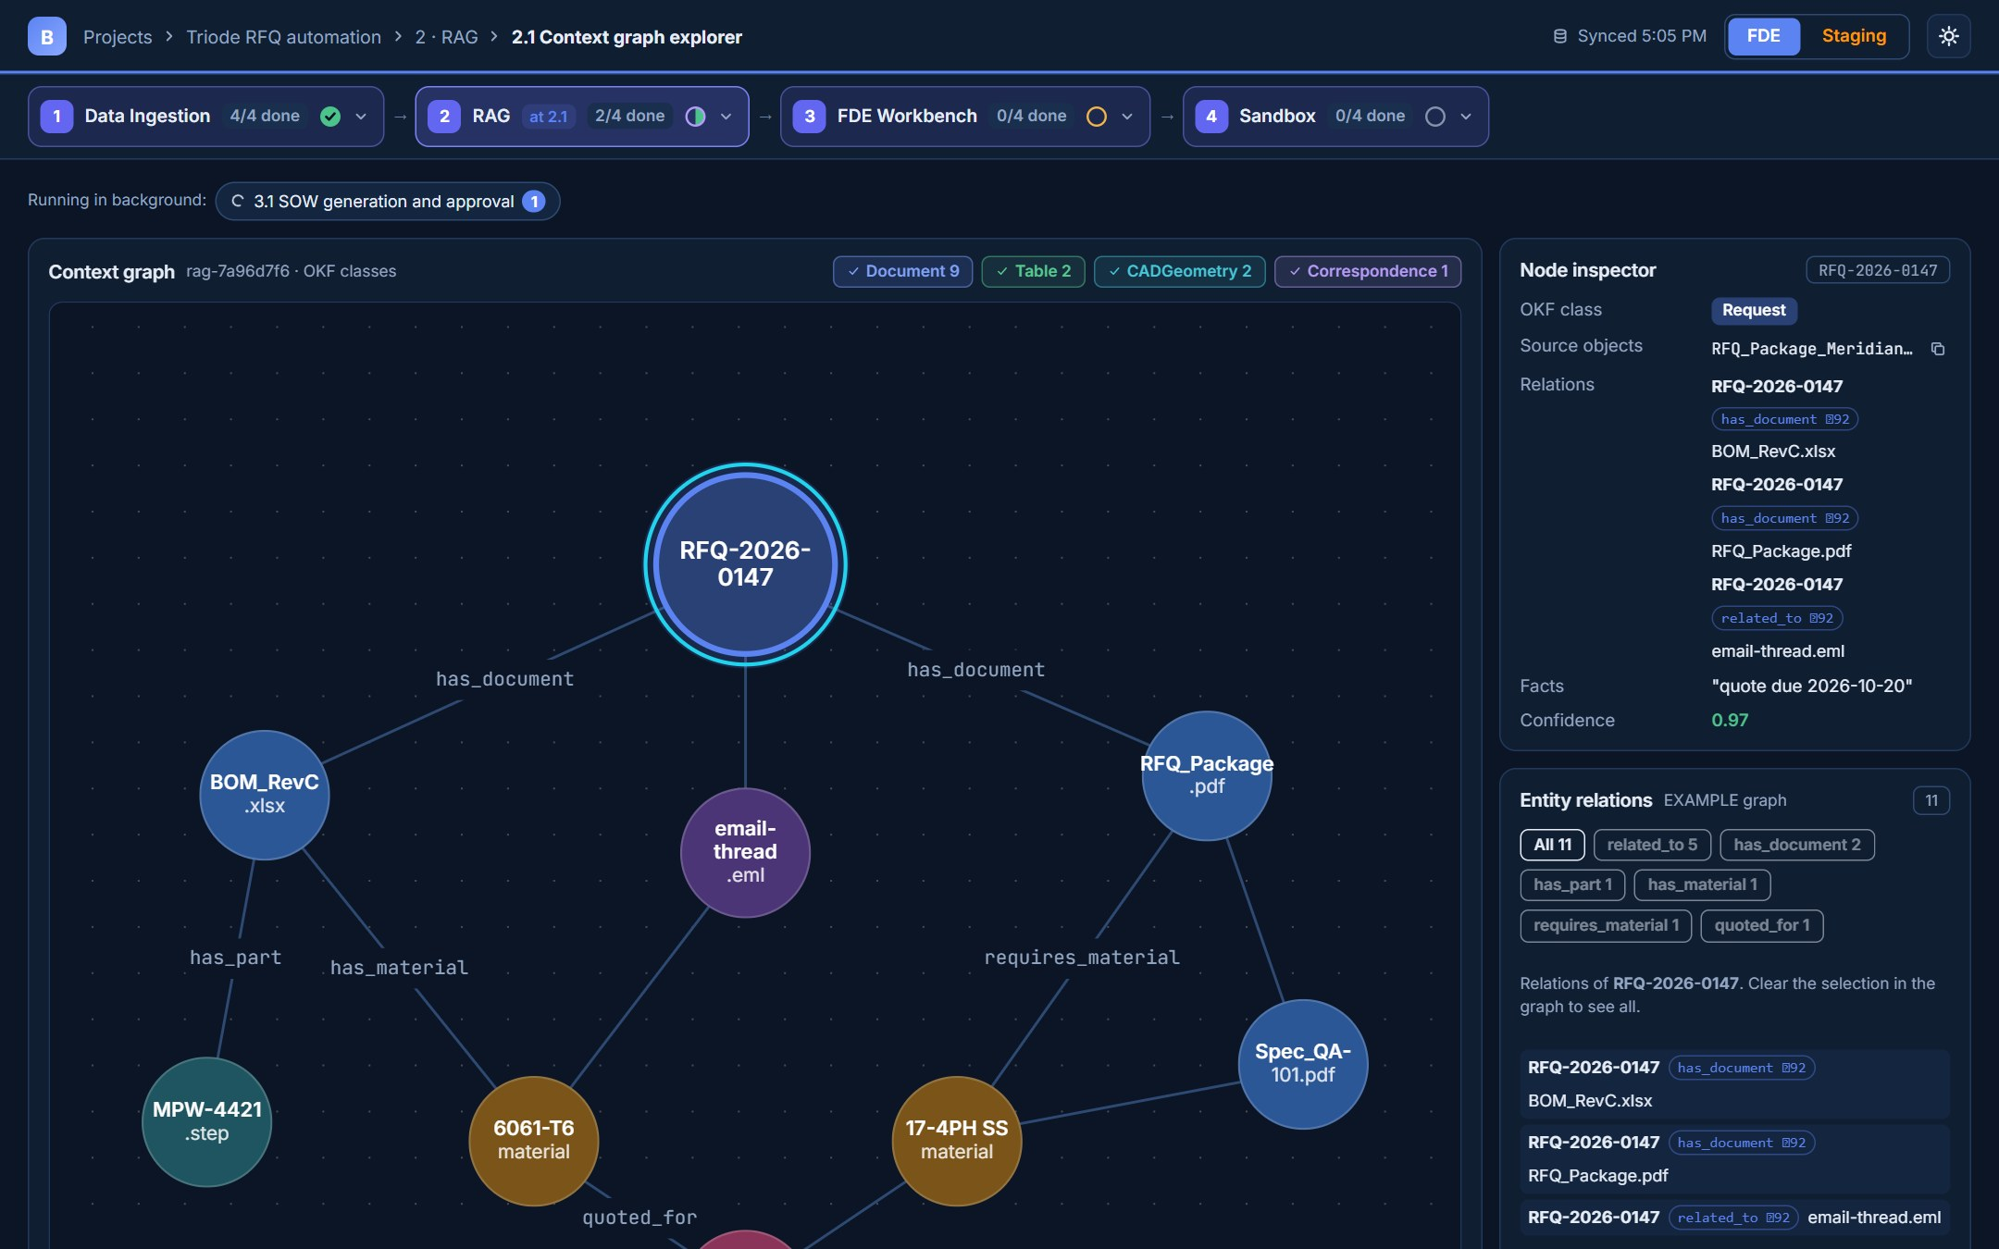
2 · RAG (COGNEE + OKF)
08 / 20
2.1 Context graph explorer
Cognee knowledge graph with labelled relations, a node inspector and the Entity relations card.

Slide 10
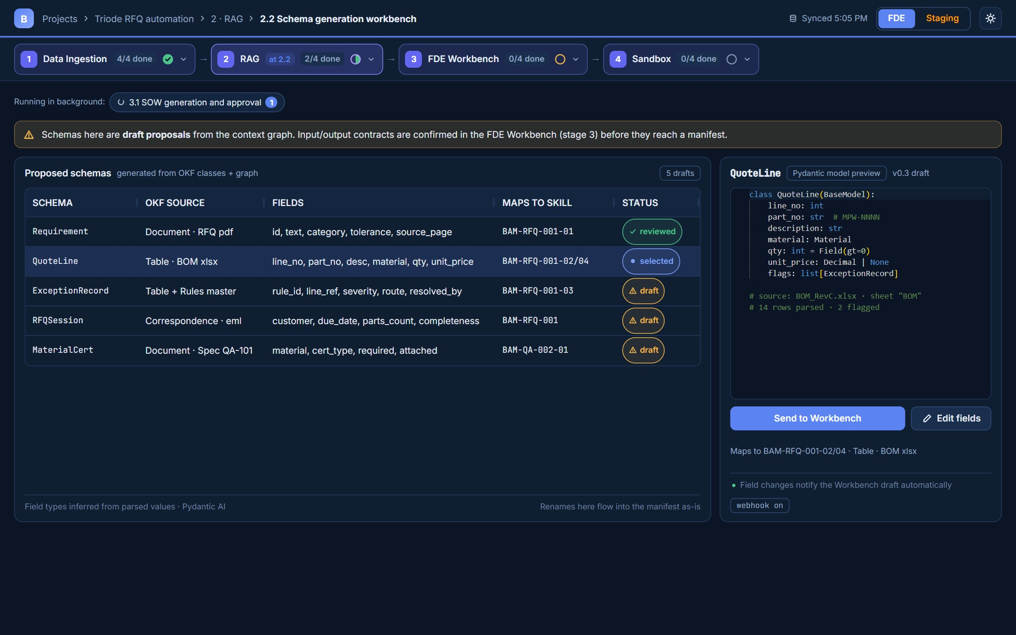
2 · RAG (COGNEE + OKF)
09 / 20
2.2 Schema generation workbench
Draft Pydantic schemas from the OKF classes. Send to Workbench creates a draft hand-off; nothing is approved here.

Slide 11
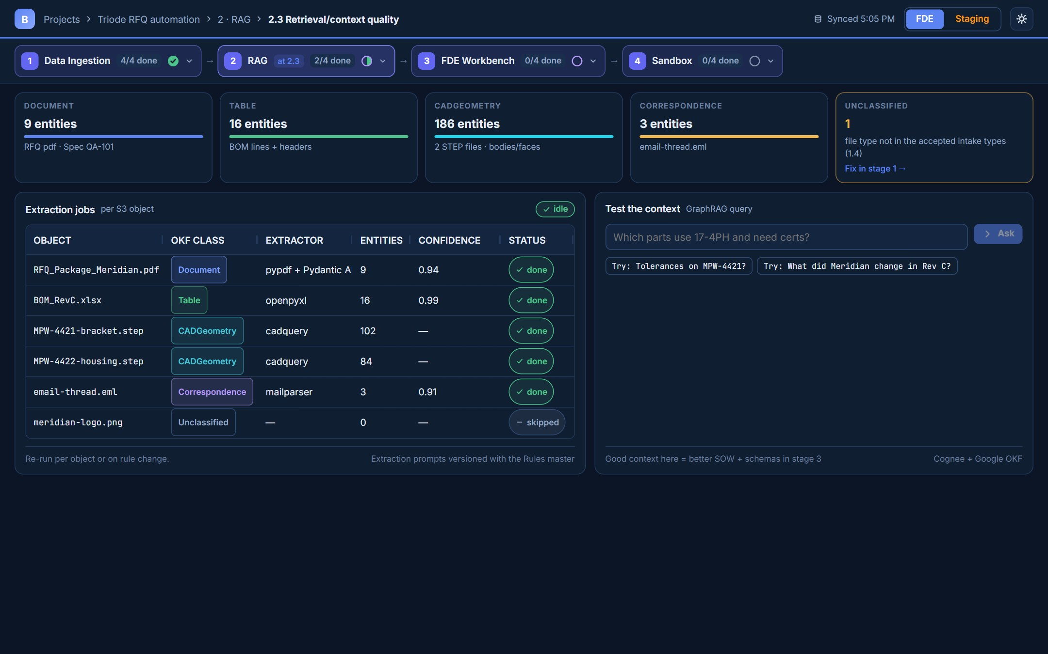
2 · RAG (COGNEE + OKF)
10 / 20
2.3 Retrieval/context quality
Coverage per OKF class, extraction jobs and GraphRAG answers with S3-resolvable citations.

Slide 12
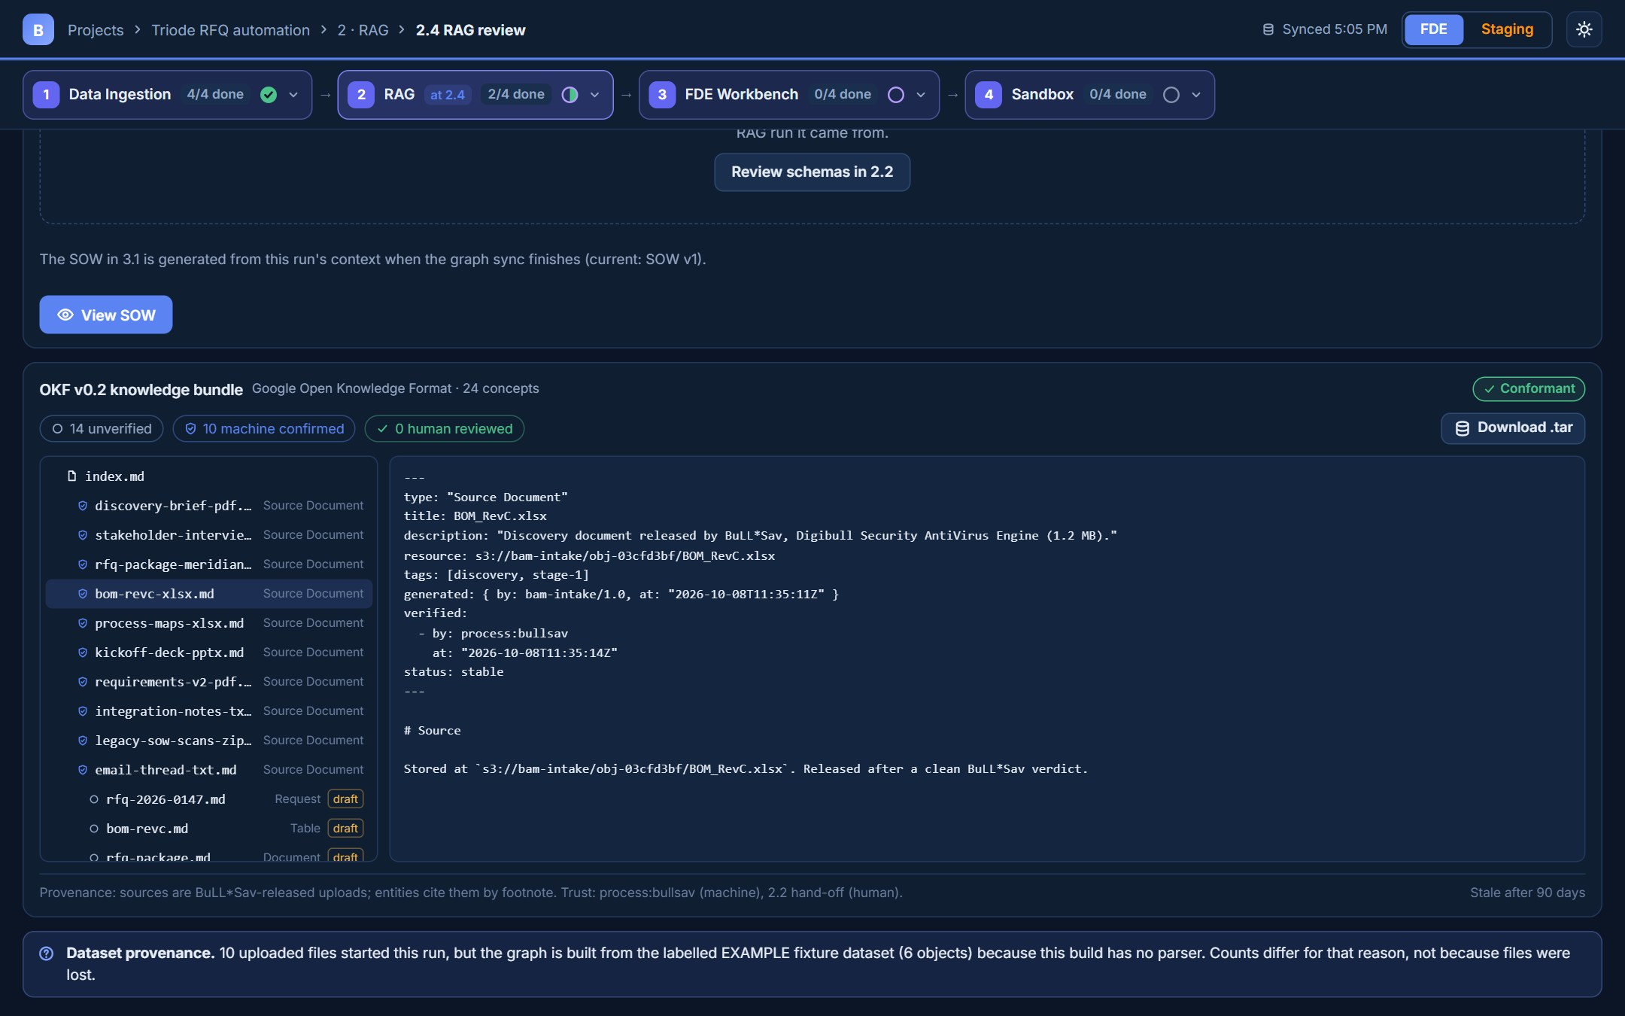
2 · RAG (COGNEE + OKF)
11 / 20
2.4 RAG review: OKF v0.2 bundle
The RAG context as a Google Open Knowledge Format v0.2 bundle: provenance, trust tiers, conformance check and .tar export.

Slide 13
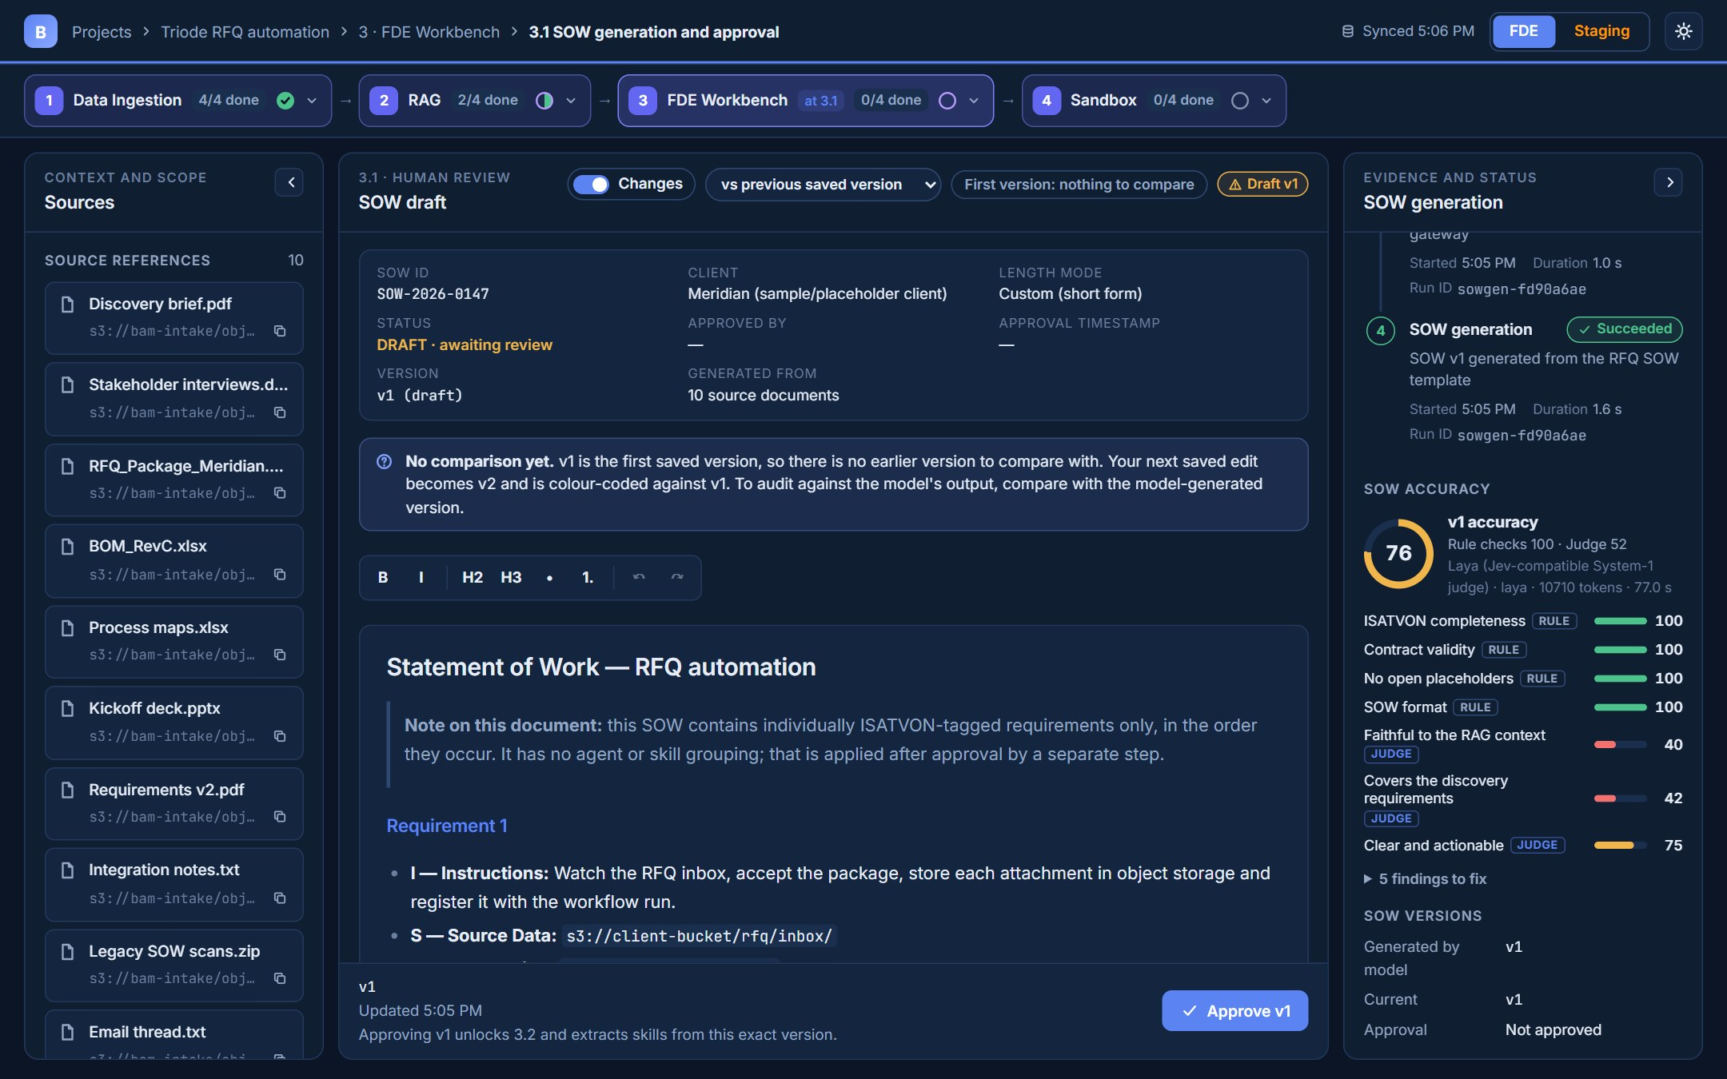
3 · FDE WORKBENCH
12 / 20
3.1 SOW generation and approval
ISATVON SOW in TipTap. SOW accuracy = rule checks + Laya judge (v1 scored 76). Edit directly, then approve.

Slide 14
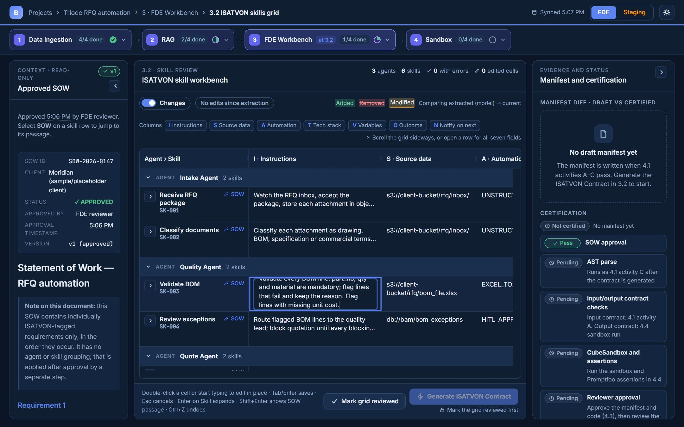
3 · FDE WORKBENCH
13 / 20
3.2 ISATVON skills grid
AG Grid grouped Agent > Skill with inline cell editing: double-click, Enter or just type in the cell.

Slide 15
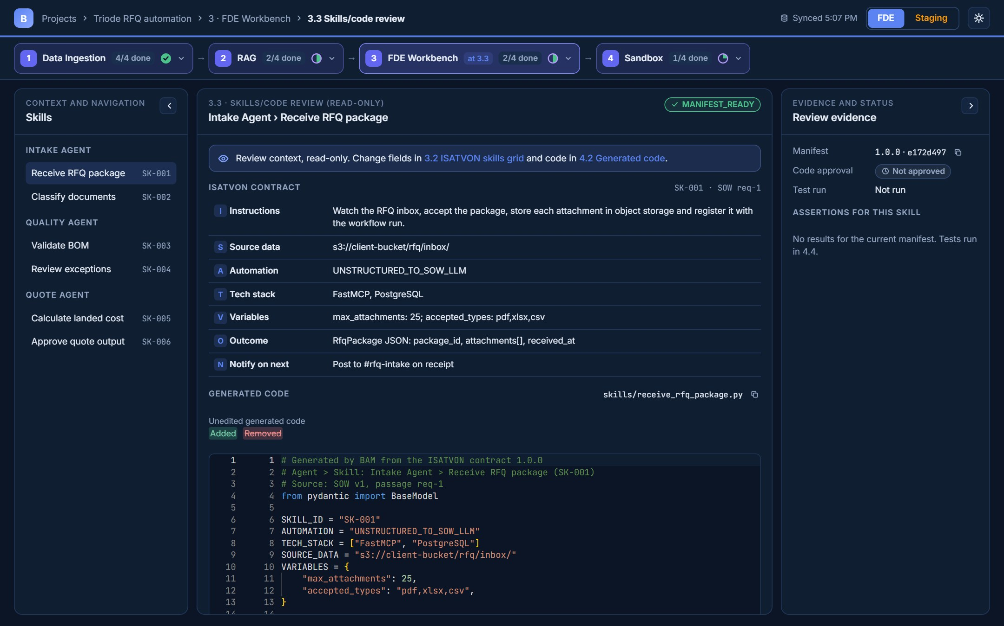
3 · FDE WORKBENCH
14 / 20
3.3 Skills/code review
Read-only view of one skill: its ISATVON contract and the code generated from it.

Slide 16
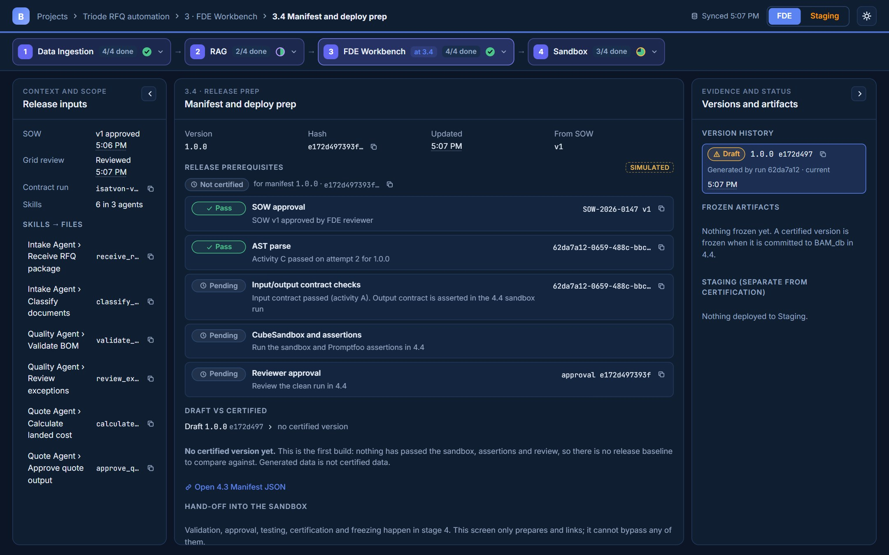
3 · FDE WORKBENCH
15 / 20
3.4 Manifest and deploy prep
Release prerequisites, draft vs certified manifest, version history and frozen artifacts.

Slide 17
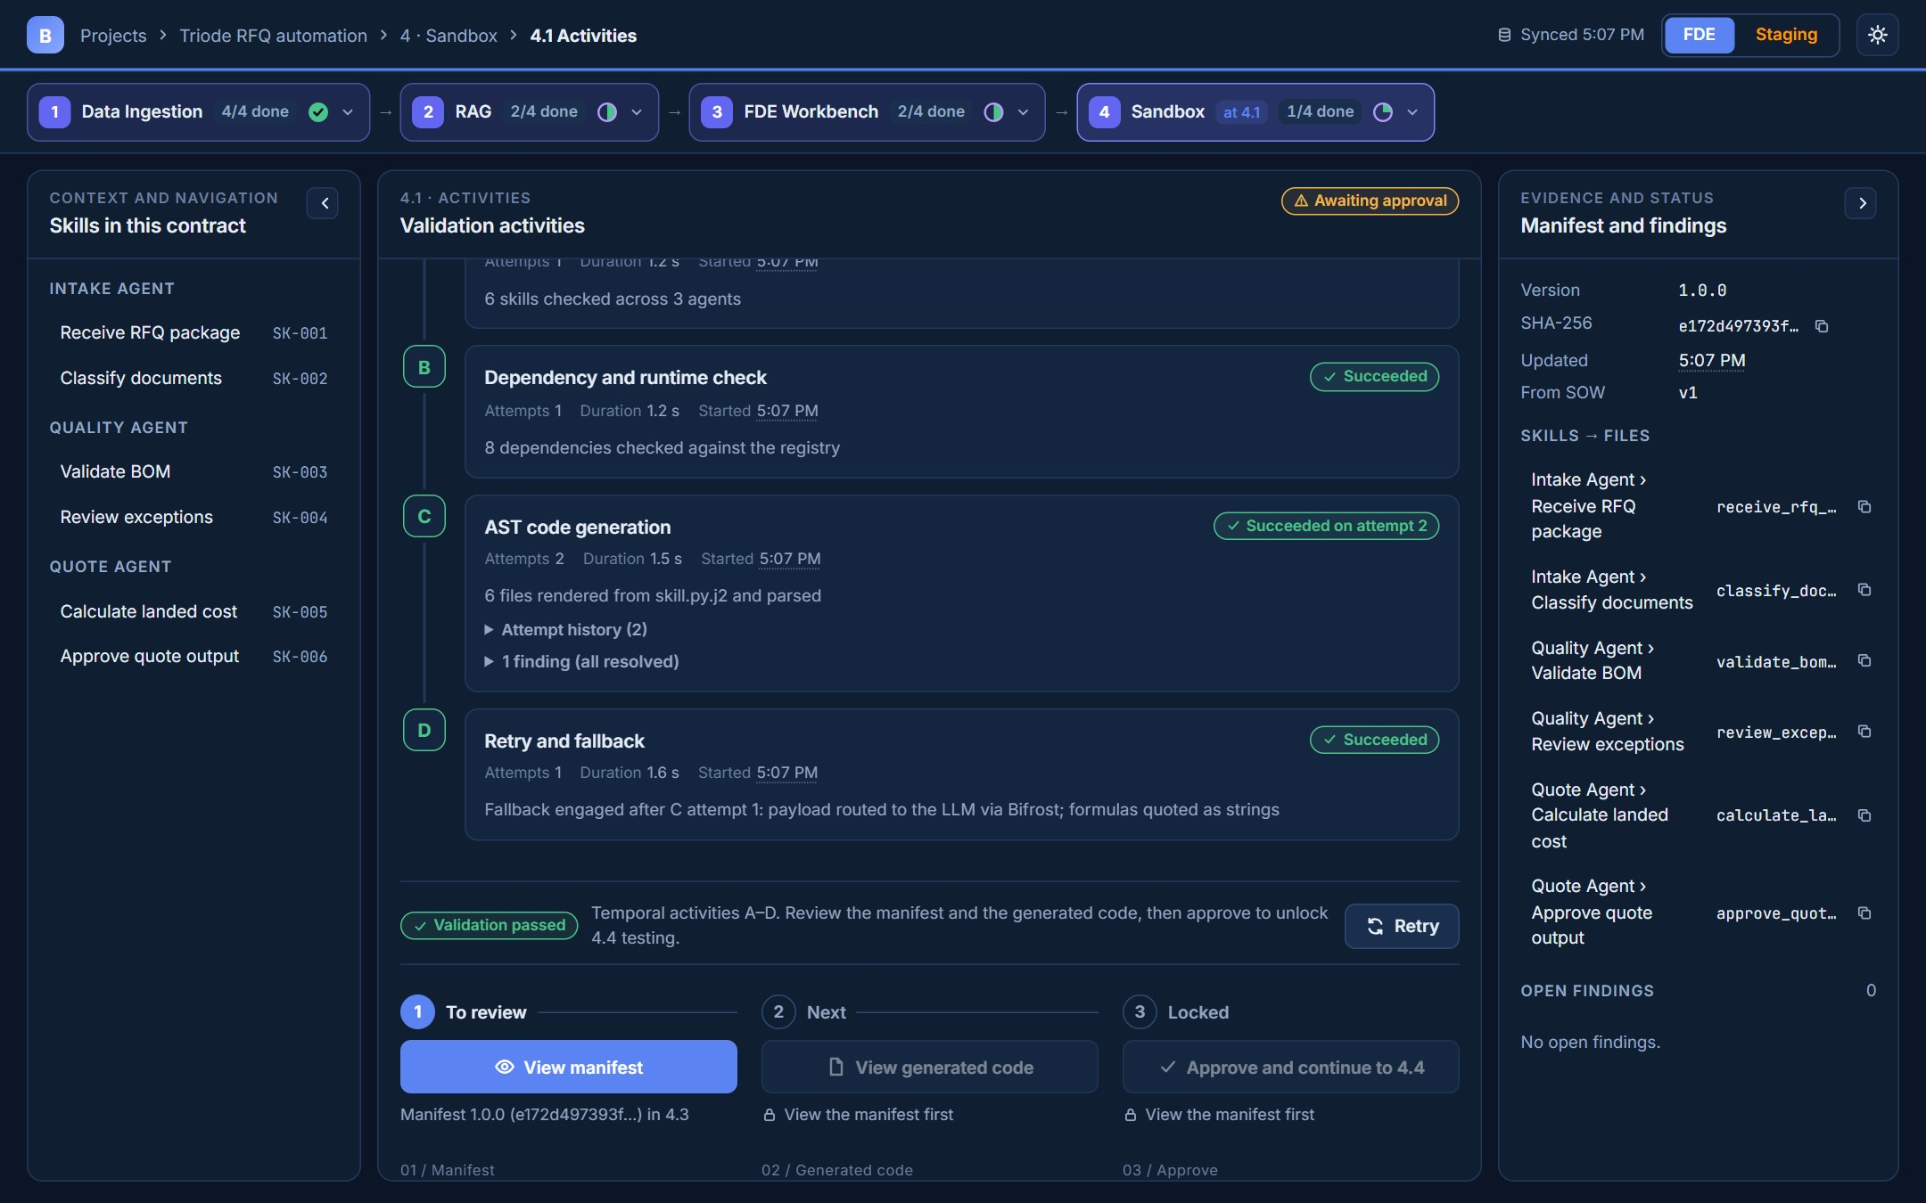
4 · SANDBOX
16 / 20
4.1 Activities
Temporal activities A–D, then the review gate: View manifest → View generated code → Approve and continue to 4.4.

Slide 18
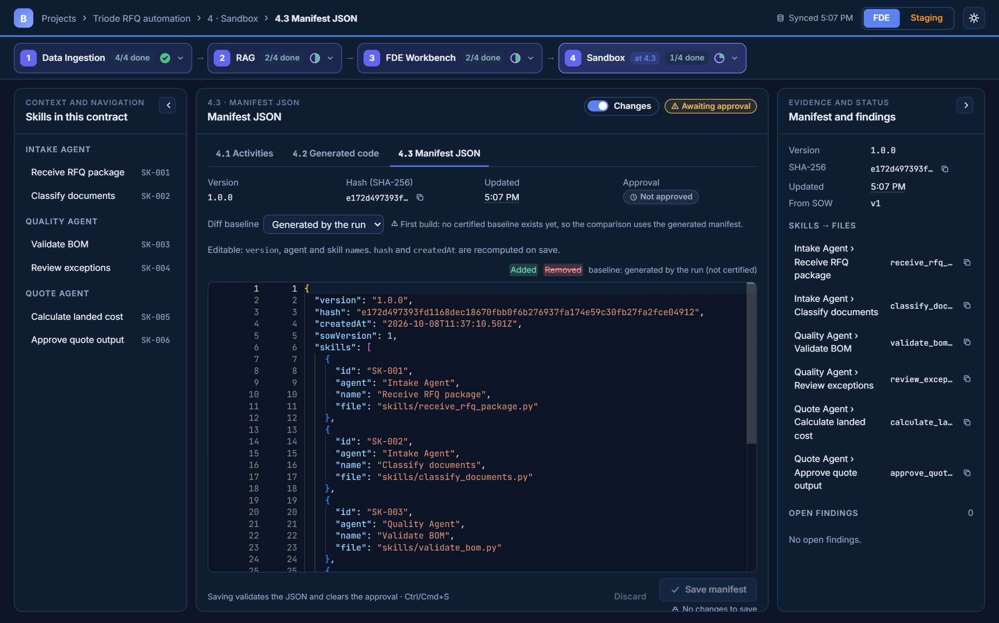
4 · SANDBOX
17 / 20
4.3 Manifest JSON
Editable Monaco diff against the generated manifest. Opening it completes step 01 of the gate.

Slide 19
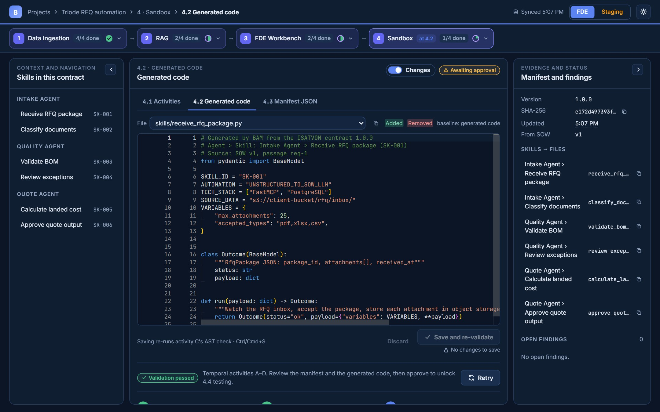
4 · SANDBOX
18 / 20
4.2 Generated code
Editable code diff per skill; saving re-runs the AST check. Opening it completes step 02 of the gate.

Slide 20
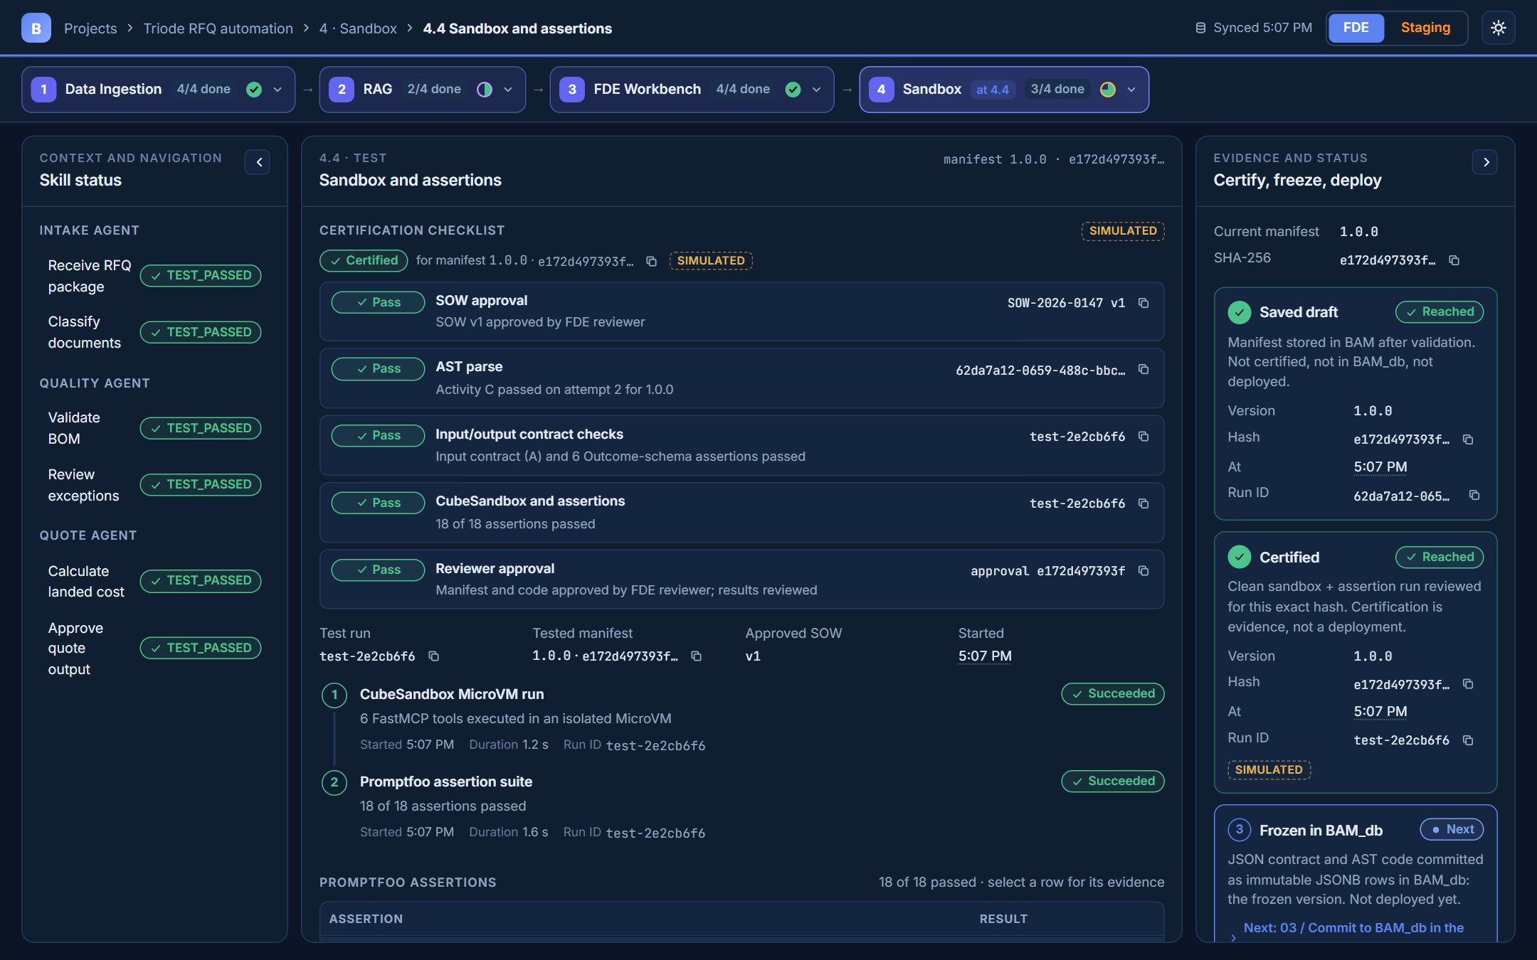
4 · SANDBOX
19 / 20
4.4 Sandbox and assertions
Certification checklist, CubeSandbox run and Promptfoo assertions: Test → Review → Commit to BAM_db → Deploy to Staging.

Slide 21
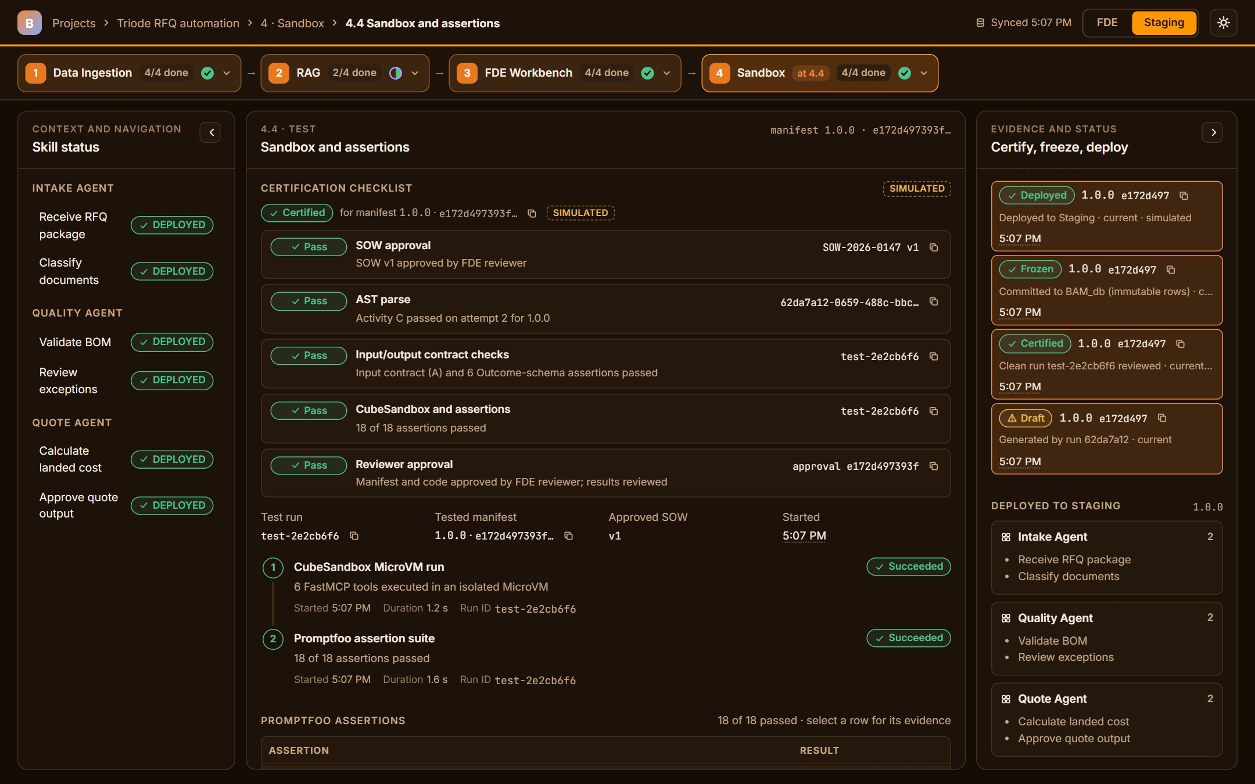
4 · SANDBOX
20 / 20
4.4 Deployed to Staging
After the deploy the Staging view switches the whole UI to the orange palette (FDE stays blue).

