Slide 1

Ai Engineering 2025
An overview

Slide 2

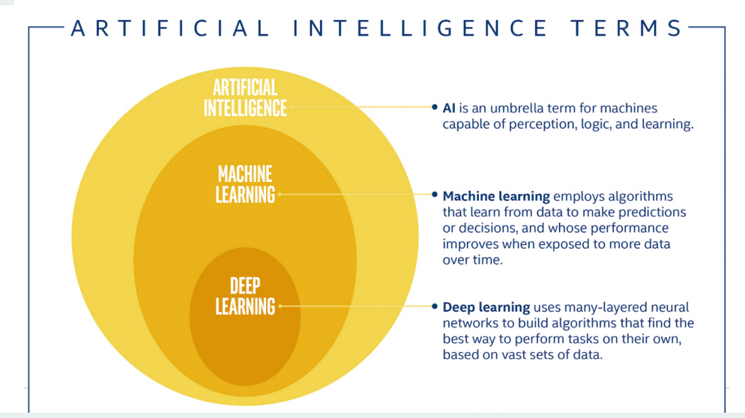
SOME DEFINITIONS
Modern
AI
Data Squad | Intro to AI

Slide 3
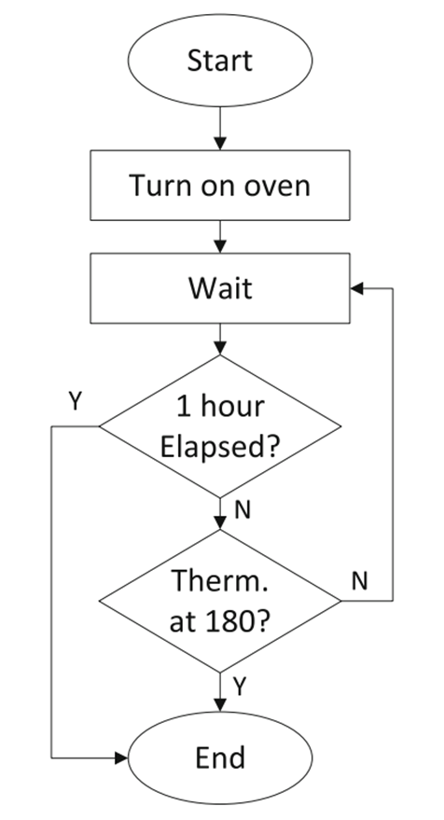
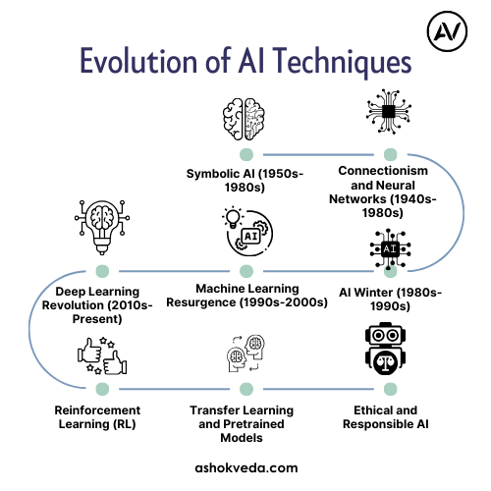
AI IS NOT NEW
THEN WHY IS IT FAMOUS NOW?
Data Squad | Intro to AI

Slide 4
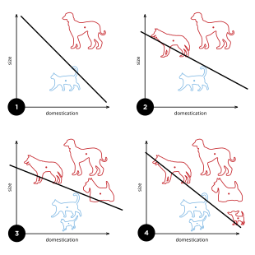
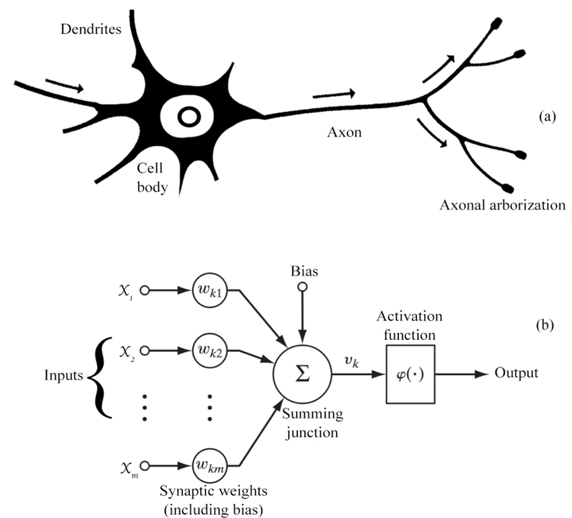
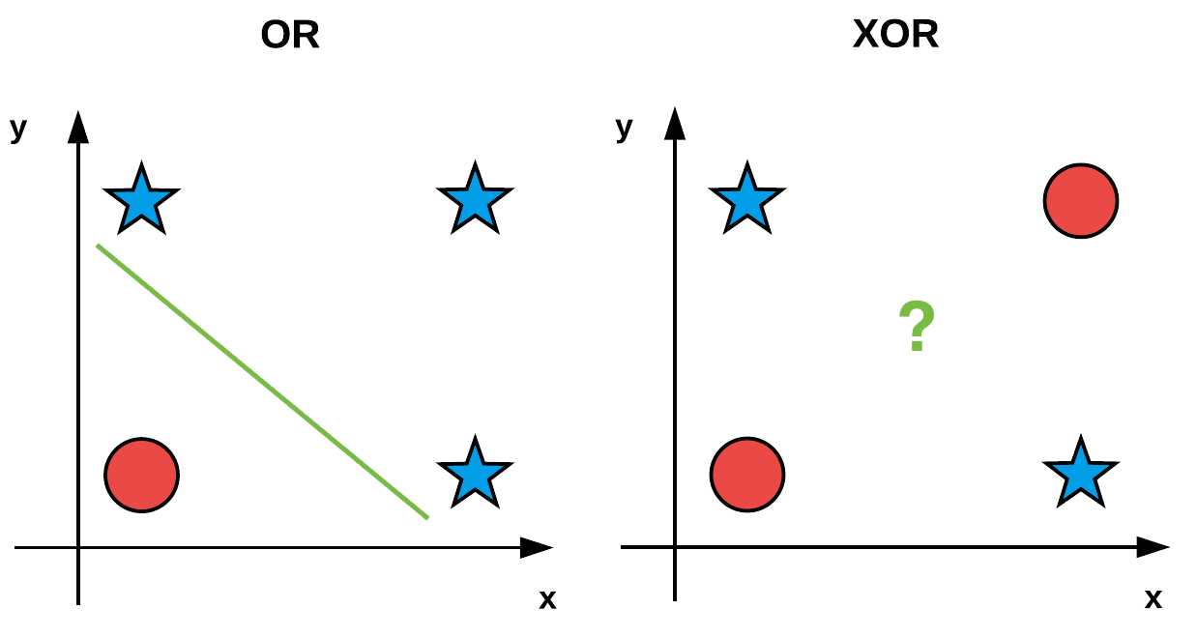
AI IS NOT NEW
THEN WHY IS IT FAMOUS NOW?
Data Squad | Intro to AI

Slide 5
AI IS NOT NEW
THEN WHY IS IT FAMOUS NOW?
Statistical Learning Theory
- being right according to reason
-> being right ‘on average’
- SVM Computational Power
Data Squad | Intro to AI

Slide 6
AI IS NOT NEW
THEN WHY IS IT FAMOUS NOW?
AlexNet winning ImageNet - proved deep CNNs superior for computer vision
GPU computing making training feasible
Large labeled datasets becoming available
Data Squad | Intro to AI

Slide 7
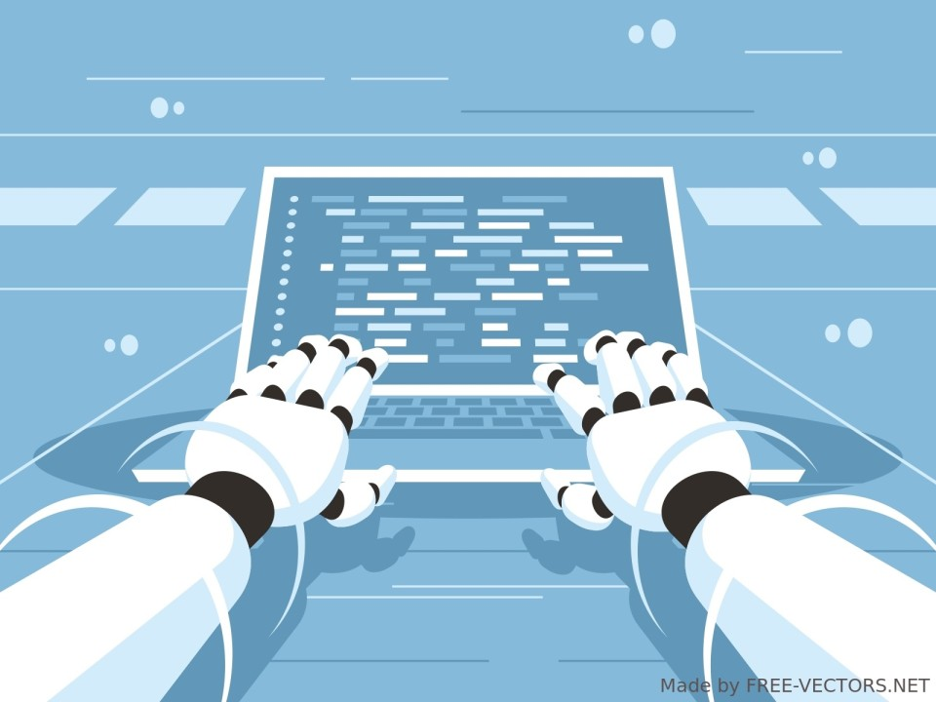
AI IS NOT NEW
THEN WHY IS IT FAMOUS NOW?
Data Squad | Intro to AI

Slide 8
AI IS NOT NEW
THEN WHY IS IT FAMOUS NOW?
Computational power
+
Algorithmic Innovations
=
Finally, we can do AI “properly”
Data Squad | Intro to AI

Slide 9
What we are going to teach you
Python, Bash & Git
How to work with data
Computer Vision and CNN
NLP and transformers
OpenAI API and chatbots
RAG
Langchain
Agents
Intro to ML/AI deployment and MLOps

Slide 10
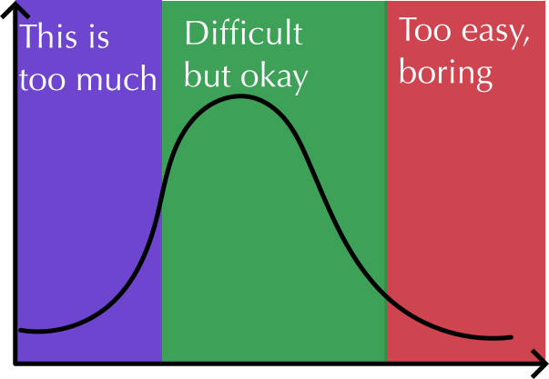
Easy = f(time doing similar things)
Python, Bash & Git
How to work with data
Computer Vision and CNN
NLP and transformers
Ask questions. Ask for help!
Ask for extra
challenge

Slide 11
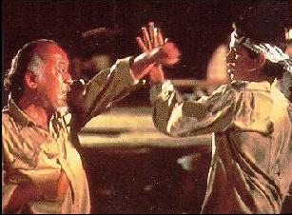
Bash: Command line tools

Slide 12
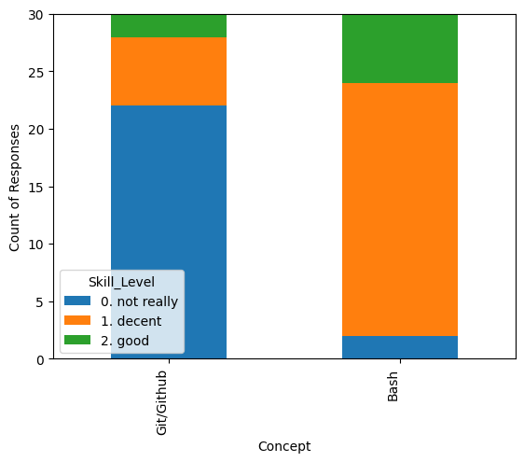
Git and Bash

Slide 13

It works on my machine → It works on everyone's machine

Slide 14
Learning Benefits
When we all see the same error messages, we can help each other more effectively
Screen sharing and code sharing just work, without version compatibility headaches
Following along with live coding is smoother when everyone's Python behaves the same way
+ Most tech companies enforce specific development environments

Slide 15
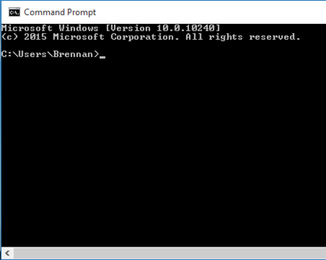
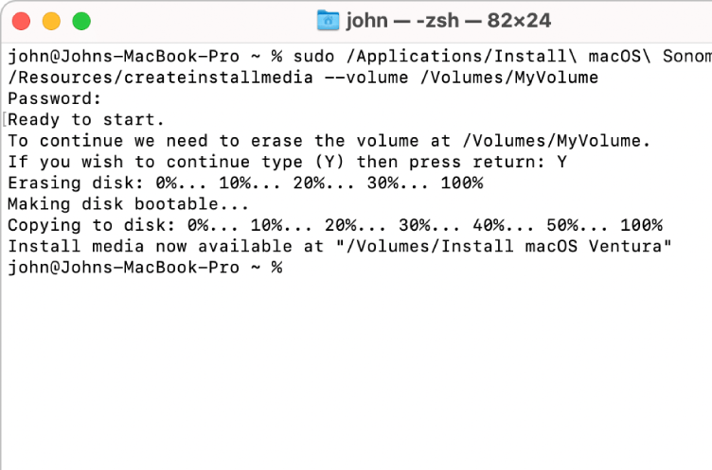
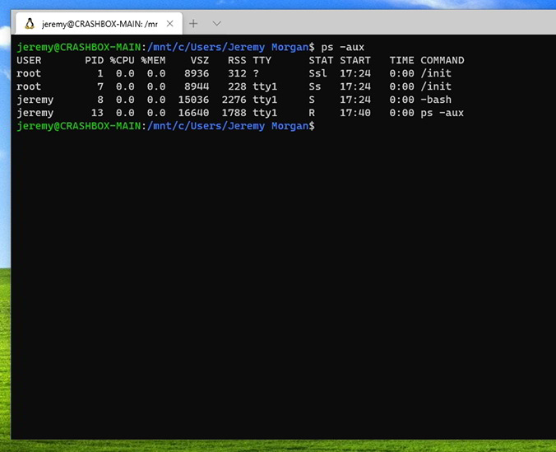
3 types of command lines
1. cmd
2.Bash
3. Powershell

Slide 16
Let’s begin with windows Folk
wsl
If wsl doesn’t work: cmd -> wsl –install
Then do bash class
When we reach python/git, Windows folk need special treatment
(git, python) – in cmd

