Slide 1


Vision Based Vehicle Detection in Traffic
Surveillance System
Under
Professor:Shivanjali Khare
Submitted By:
Harianth Kumar Kancharla
Trilok Kumar Pidikiti

Slide 2


Table of Contents
Introduction
Abstract
Proposed System
Implementation
Block Diagram
Conclusion

Slide 3
1.Introduction
Rising traffic congestion is an inescapable condition in large and growing metropolitan areas across the world.
Traffic signals are essential to guarantee safety at road intersections
The monitoring and controlling city traffic is becoming a major problem in many countries.
By using image processing we can control the traffic flow by 90 percent.

Slide 4
2.Abstract
Traffic analysis has been a problem that city planners were dealing for years. Consider road situation analysis tasks for traffic control and ensuring safety of people. Analysis of traffic may account for the number of vehicles in an area per some arbitrary time and the class of vehicles. The vehicles are counted and time for vehicles in a lane is allocated. Image processing algorithms like Detection Algorithm and Counting Algorithm are used here. Vehicles are detected using Haar Cascade Classifier and detected vehicles are counted. Based on the count of vehicles appropriate signalling time will be allotted for each lane.
Notes:
.Melanoma is the fastest

Slide 5
3.Proposed system
The main goal of the proposed system is to improve the Traffic Control by adding the necessary additional features and new technologies into the application
We propose a system for controlling the traffic light by image processing to prevent traffic congestion
The system will detect the density of vehicles and pedestrians through images instead of using electronic sensors embedded in the pavement.

Slide 6
Proposed system
Cameras will be placed alongside of the traffic street poles to capture image sources.
It will capture image sequences.
Image processing is a better technique to control the state change of the traffic light.
It shows that it can decrease the traffic congestion and avoids the time being wasted by a green light on an empty road
Input :vehicles in the lane
Processing : Time assigned to each lane=number of vehicles in the lane *time assigned to each vehicle + Base time
Output : Time allocated to that particular lane for the vehicles to move

Slide 7
Implementation
A video will be given as input ,which is further divide into frames
We are using image processing because it is a method to convert
an image into digital form and perform some operations on it,
in order to get an enhanced image or to extract some information.

Slide 8
Image Processing
Image processing is a method to convert an image into digital form and perform some operations on it, in order to get an enhanced image or to extract some useful information from it.
The two types of methods used for Image Processing are Analog and Digital Image Processing.
The analog image processing is applied on analog signals and it processes only two-dimensional signals.

Slide 9
Image Processing
Analog or visual techniques of image processing can be used for the hard copies like printouts and photographs.
A digital image is a picture that is stored on a computer. It has been digitilised, which means it has been changed into sequence of numbers that computers can understand
Digital Processing techniques help in manipulation of the digital images by using computers.

Slide 10
Implementation Haar Cascade Algorithm
We use HAAR CASCADE ALGORITHM the Cascade classifier gives the vehicle density count on the road .
Haar Cascade classifier is an effective object detection approach which was proposed by Paul Viola and Michael Jones in their paper, “Rapid Object Detection using a Boosted Cascade of Simple Features” in 2001.
Cascade classifier is used to detect the objects in the video stream.

Slide 11
Implementation
This algorithm is capable of differentiating vehicles from different objects.
Haar Cascade is a machine learning-based approach where a lot of positive and negative images are used to train the classifier.
Positive images – These images contain the images which we want our classifier to identify.
Negative Images – Images of everything else, which do not contain the object we want to detect.

Slide 12

OpenCV
OpenCV (Open Source Computer Vision Library) is an open source computer vision and machine learning software library.
The library has more than 2500 optimized algorithms ,these algorithms can be used to detect and recognize faces, identify objects, classify human actions in videos, track camera movements, track moving objects, extract 3D models of objects etc.

Slide 13
Implementation
The system includes a camera placed facing a lane that will record video of the road on which we want to control traffic.
Those video clippings efficiently processed to know the traffic density.
According to the processed data from OpenCV , a controller will send command to the traffic LED timer to show particular time on the signal to manage traffic
The basic idea of the project is to get count of vehicles in each lane and allocate timing for each Signal dynamically.

Slide 14
5. Architecture of System
nInput Video Clip or Live Camera
iDivide Video Into Frames
Foreground Detection
Image Enhancement
Image Analysis
Vehicle Detection
Vehicle Counting
Change Signal and Time Limit

Slide 15
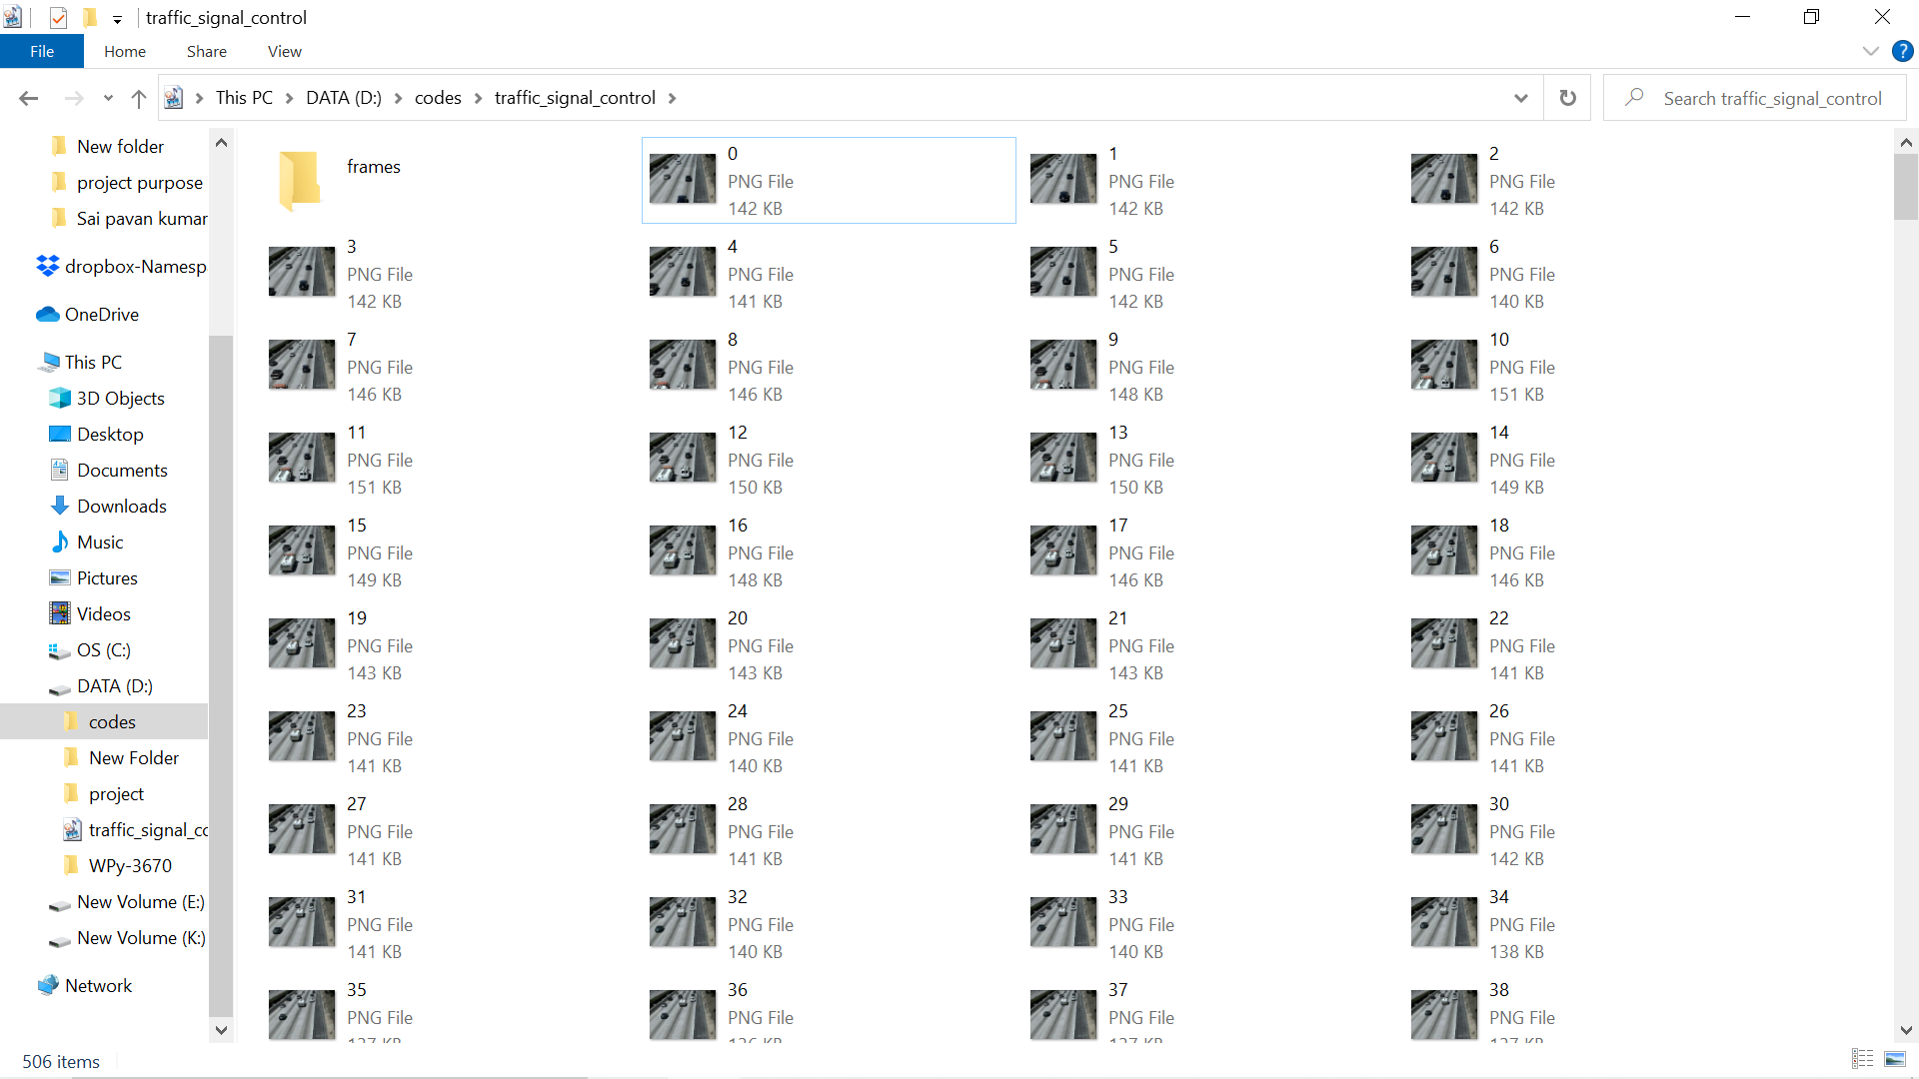
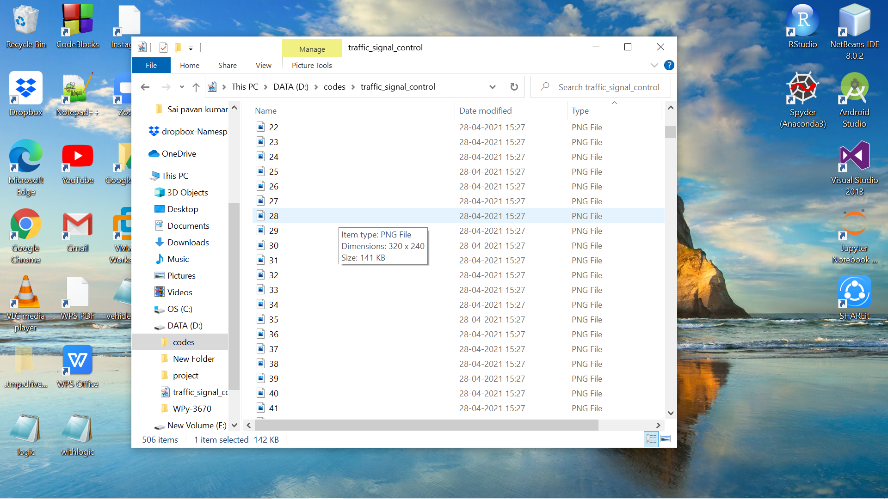
Video Divided into frames

Slide 16
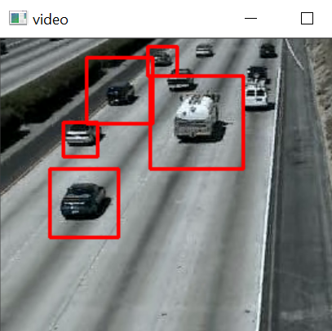
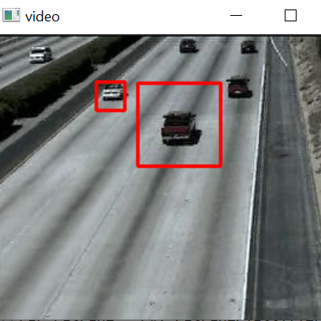
Vehicle Detection

Slide 17
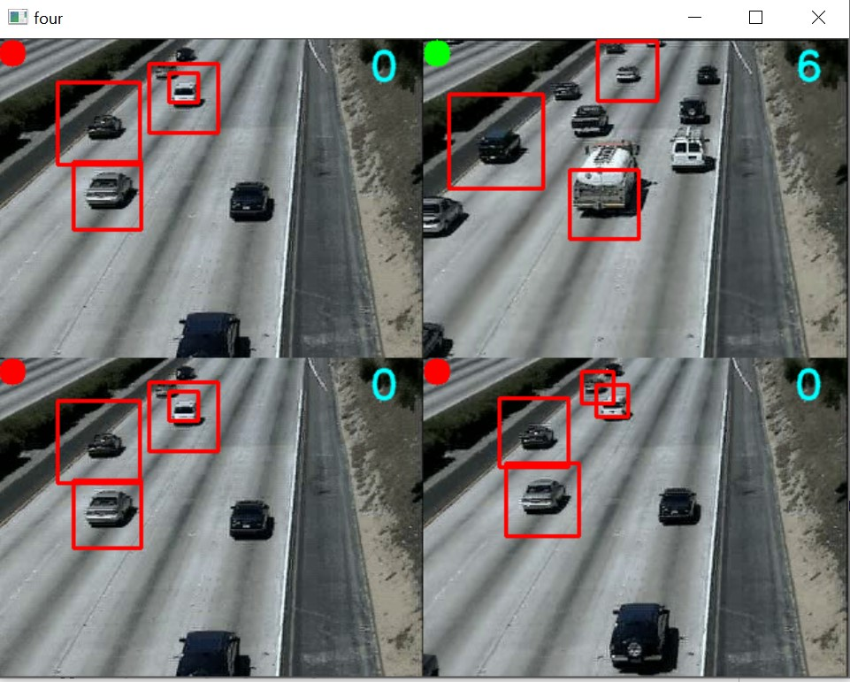
Output:

Slide 18
Conclusion
In this project, a method for estimating the traffic using OpenCV is presented.
This is done by using the camera images captured from the road lanes. Each image is processed separately and the number of cars has been counted.
This system guarantees that the average waiting time of the vehicle in front of traffic signal will be lesser than present traffic control systems, also the techniques and algorithms used in this project promises to be more effective as compared to the previous system.

Slide 19
References
Shi Y.Q. and Yang, X.G. (2013), The Public Transportation System of High Quality in Taiwan. 2013 IEEE Eleventh International Symposium on Autonomous Decentralized Systems (ISADS), Mexico City, 6-8 March 2013,1-6. https://doi.org/10.1109/ISADS 2013
Mingpei Liang, Xinyu Huang, Chung-Hao Chen, Xin Chen, and Alade Tokuta, ―Counting and Classification of Highway Vehicles by Regression Analysis‖, IEEE transactions on Intelligent Transportation Systems, Vol. 16, Issue:5, October 2015

Slide 20

Thank You

