Slide 1


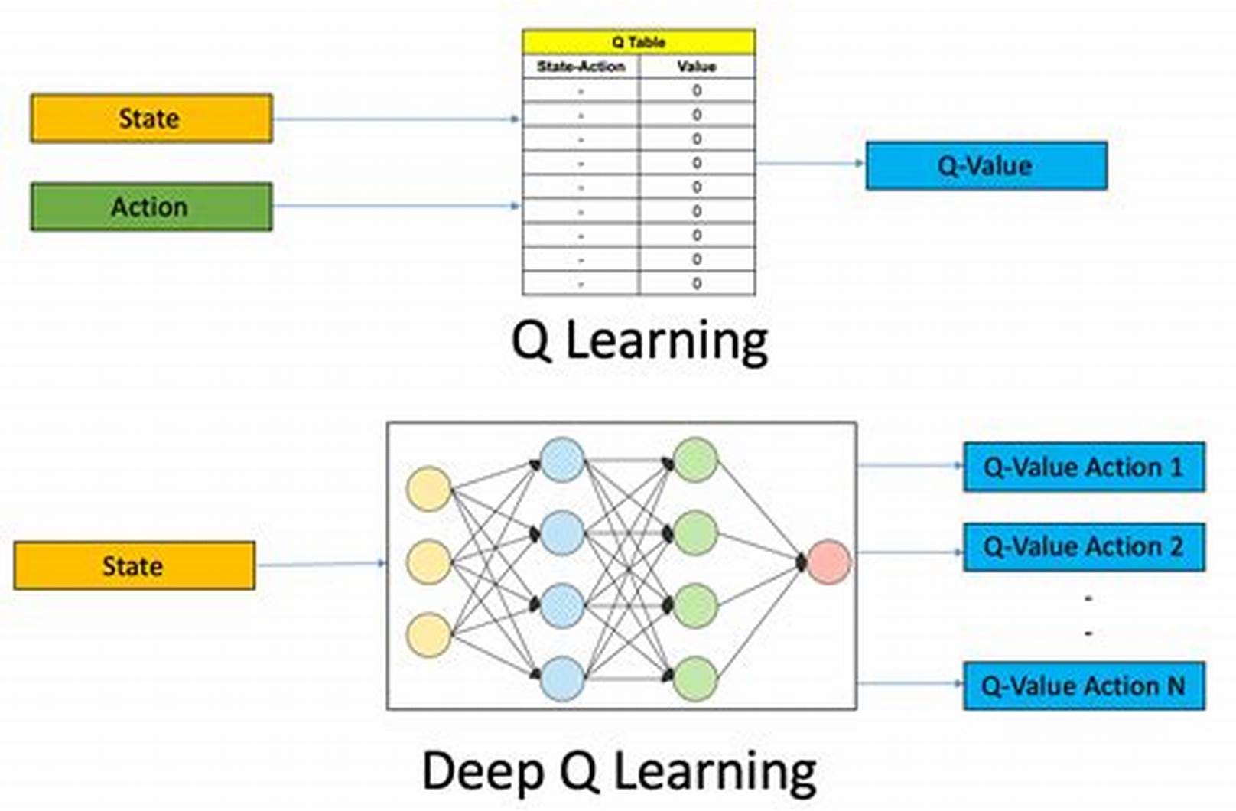
Deep Q-Networks: A Reinforcement Learning Approach
AI Forge Program 2025
Latrache Imane, Benali Samy, Berabah Selma, Bentchakal Mouloud
Kamar Abderhmane , Ketir Melissa , Taarabit Dalila
Abstract
Methods
Applications & Real-World Use Cases
Deep Q-Networks (DQNs) represent a major advancement in reinforcement learning by integrating deep neural networks to approximate the Q-function, enabling agents to make optimal decisions in complex, high-dimensional environments. Traditional Q-Learning, while foundational, struggles with large state spaces and memory inefficiencies. DQNs address these limitations by leveraging experience replay and target networks, leading to improved stability and scalability.
This poster explores the evolution from Q-Learning to DQNs, explaining their architecture, applications in fields like game AI, robotics, and autonomous systems, and the challenges they still face, such as sample inefficiency and instability. Finally, we discuss ongoing research efforts to enhance DQNs and push reinforcement learning toward more intelligent and adaptable systems.
Q-Learning & Deep Q-Networks (DQN)
What is Q-Learning?
A reinforcement learning method where an agent learns to take optimal actions to achieve a goal.
  States: Possible positions (e.g., cells in a maze).
  Actions: Moves (e.g., up, down, left, right).
  Rewards: Feedback (e.g., +10 for exit, -1 for wall, 0 for normal moves).
Uses a Q-table to store and update expected rewards for state-action pairs.
Formula:
New value=Old value+α×(Reward+γ×Best future move−Old value)New value=Old value+α×(Reward+γ×Best future move−Old value)
  α: Learning rate (speed of learning).
  γ: Discount factor (balance immediate vs. future rewards).
Improving Q-Learning: Deep Q-Networks (DQN)
Combines Q-Learning with Deep Neural Networks for complex tasks.
Structure:
  Input Layer: Processes raw data (e.g., game screen, sensor data).
  Hidden Layers: Detect features (e.g., edges, shapes, objects).
  Output Layer: Scores (Q-values) for each action.
  Memory: Stores experiences for replay.
  Loss Function: Measures performance and guides improvement.
  Optimization: Adjusts the network to improve decisions.
How DQN Works
Input: Receives the current state (e.g., game screen).
CNN (Brain): Breaks down input into meaningful features.
Output: Generates Q-values for actions; the highest score is chosen.
Learning: Improves by replaying experiences and minimizing loss.
Robotics: RL enables robots to learn complex tasks through trial and error, enhancing adaptability.
Autonomous Vehicles: Used for real-time decision-making, improving navigation and safety.
Healthcare: Helps personalize treatments, such as optimizing chemotherapy dosing.
NLP: Enhances chatbots and translation models by refining responses through interaction.
Finance: Optimizes trading strategies for dynamic market adaptation while managing risks.
Industrial Automation: Improves efficiency in manufacturing and energy management.
Gaming: Powers AI agents to surpass human performance in strategic games like Go and Dota 2.
Petroleum Engineering: Optimizes reservoir management, such as waterflooding strategies.
Introduction
Advantages | Disadvantages
Works with Complex Visual Inputs | Computational Hunger
More Scalable Solutions | Data Inefficiency:
Human-Level Performance | Black Box Decisions
Versatile Applications: | Brittle Performance
Reinforcement Learning (RL) is a subset of machine learning where an agent learns to make sequential decisions by interacting with an environment. Unlike supervised learning, RL relies on trial and error, using a reward-based system to optimize actions. One of the foundational algorithms in RL is Q-Learning, which computes an optimal action-selection policy using a Q-Function.
However, traditional Q-Learning struggles with high-dimensional state spaces due to memory constraints. To overcome these limitations, Deep Q-Networks (DQN) integrate deep learning with RL by using neural networks to approximate the Q-Function. This approach enables agents to learn complex policies from raw data, achieving breakthroughs in areas such as game playing, robotics, and autonomous systems. Despite its success, DQN faces challenges such as instability, high sample complexity, and the balance between exploration and exploitation. Addressing these challenges remains an active research area, pushing RL towards more efficient and scalable solutions
Challenges
Training Stability: Fine-tuning hyperparameters is complex and impacts performance.
Real-World Deployment: Effective in simulations but struggles with unpredictable real-world conditions.
Safety Risks: Poorly designed rewards can lead to harmful behaviors.
Knowledge Transfer: Difficulty in applying learned strategies to new tasks.
Data Inefficiency: Requires vast amounts of training data.
Exploration vs. Exploitation: Balancing discovery and optimization remains challenging
Conclusions
Deep Q-Networks have significantly advanced reinforcement learning by enabling agents to learn effective strategies in complex environments. By integrating deep neural networks with traditional Q-Learning methods, DQNs have overcome previous limitations, leading to applications in areas such as game AI, robotics, and autonomous systems. However, challenges like sample inefficiency and training instability persist. Current research focuses on addressing these issues to develop more robust and adaptive systems. Looking ahead, embracing future improvements is crucial. Innovations such as integrating Bayesian methods for efficient exploration and incorporating transformer architectures for dynamic decision-making are promising avenues. Additionally, adaptive action space techniques aim to balance exploration and exploitation more effectively, enhancing convergence speed and solution quality. In summary, while DQNs have transformed reinforcement learning, ongoing research and openness to future enhancements are essential to fully realize their potential across various domains..
References
Awan, A. A. (2022, October 27). Introduction to Q-learning: A beginner tutorial. DataCamp. https://www.datacamp.com/tutorial/introduction-q-learning-beginner-tutorial
Boppiniti, S. T. (2021). Evolution of Reinforcement Learning: From Q-Learning to Deep Q-Networks. SSRN.
Muqaddas. (2024, October 25). Policy gradients vs. Q-learning explained. Data Science AI. https://datascienceai.blog/policy-gradients-vs-q-learning-explained
Chanda, K. K. (2025, February 25). Q-learning in Python. GeeksforGeeks. https://www.geeksforgeeks.org/q-learning-in-python/
Poespas Blog. (2024, June 2). Using Deep Q-Networks for high-dimensional state-space problems. Poespas Blog. https://blog.poespas.me/posts/2024/06/02/Using-Deep-Q-Networks-for-High-Dimensional-State-Space-Problems
Murel, J., & Kavlakoglu, E. (2024, March 25). Reinforcement learning. IBM. https://www.ibm.com/think/topics/reinforcement-learning

