Slide 1


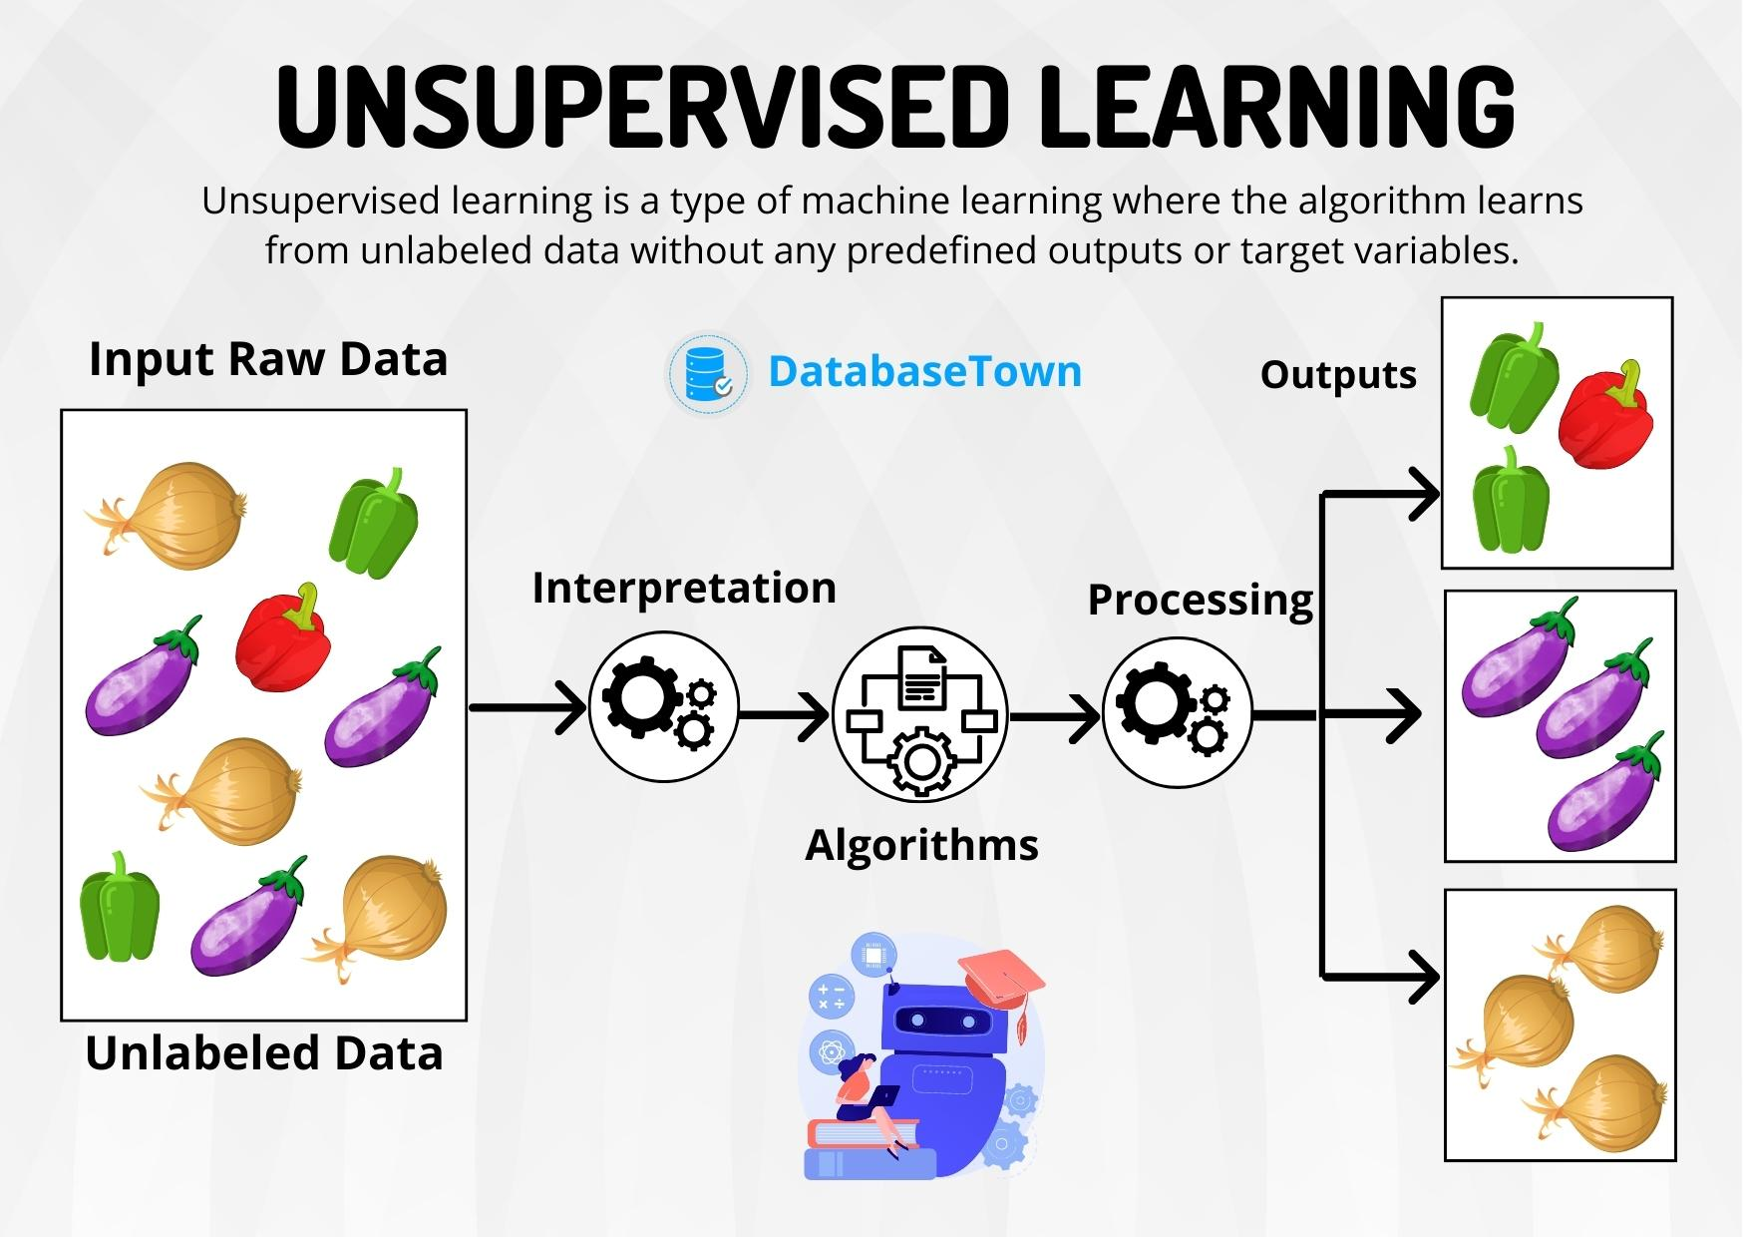
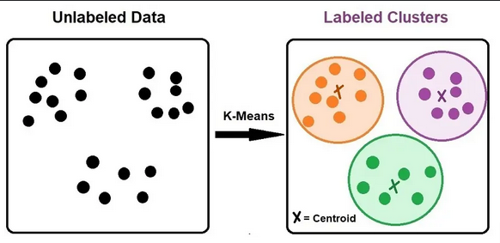
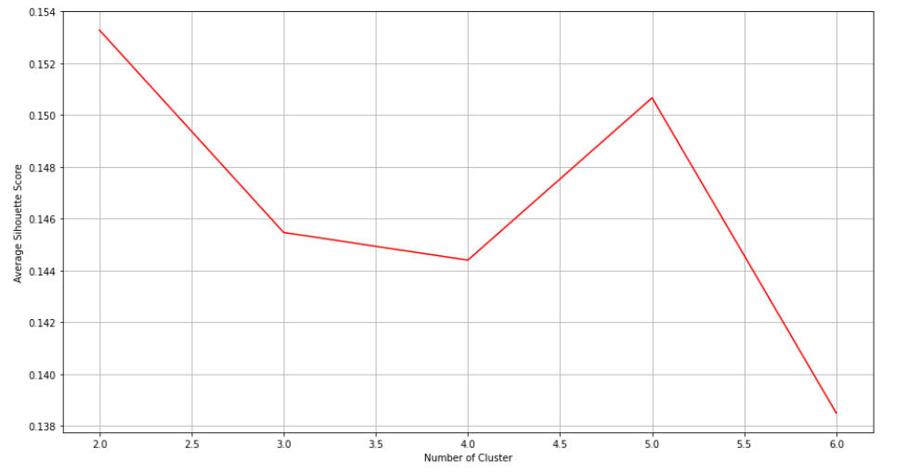
Unsupervised Learning
AI Forge Program 2025
Amina KHRAIMECH, Imane RAHAL, Lylia AZZOUZ, Nassim BERDAOUI, Ilyes ELFOUL
TEAM C
Motivation
How K-Means Works
Example
Imagine we have a puzzle, but there's a problem we don’t have the final picture to guide us So, how do we start solving it?
We begin by grouping pieces with similar colors maybe all the blue ones go together (sky), the green ones (grass), and so on.
Then, we look for edge pieces to form a border.
As we continue connecting similar pieces, the full image starts to appear naturally without anyone telling us what it should be.
This is exactly how unsupervised learning works The AI doesn’t have labels or instructions, but it finds patterns by grouping similar things together
Choose the Number of Clusters (K): we decide how many clusters (K) we want to create. For example, if K=3, the algorithm will group the data into 3 clusters only.
Initialize Cluster Centers: The algorithm randomly selects K data points ( for example k = 3) as the initial cluster centers.
Assign Data Points to Clusters: Each data point is assigned to the nearest centroid based on a distance.
Update Cluster Centers: The centroids are recalculated as the mean of all the data points assigned to that cluster.
Repeat Steps 3 and 4: The algorithm repeats the assignment and update steps until the centroids no longer change significantly.
Traveling is an essential part of life, allowing people to discover new places based on their interests. However, the problem is finding the best suitable destinations, often spending hours searching for recommendations. This project focuses on developing a travel recommendation system using Google Review ratings to group users based on similar interests. Google Reviews allow users to rate places (from 1 to 5 stars), Offering meaningful insights into their interests. The dataset for this project is sourced from the UC Irvine Machine Learning Repository and contains user ratings for 24 travel categories across Europe, including museums, restaurants, parks, beaches, and hotels.
The objective is to apply unsupervised machine learning to group users based on their travel preferences, enabling companies to offer recommendations. Here, we apply clustering algorithm K-means to analyze user behavior and enhance travel decision-making.
Method and Steps
To effectively group users based on their travel preferences, we implemented the K-Means clustering algorithm.
K-Means partitions data into K clusters, where each user is assigned to the nearest centroid based on their travel ratings.
Selecting the optimal number of clusters (K) is crucial for meaningful segmentation.
To determine the most suitable number of clusters, we applied the Elbow Method, which analyzes the variance within clusters (inertia) for different values of K.
The "elbow point" in the plot indicated where adding more clusters no longer significantly reduced variance.
To further validate this choice, we calculated the Silhouette Score, a metric that assesses how well-separated the clusters are by measuring cohesion within clusters and separation from others.
Based on these evaluations, K = 5 was chosen as the optimal number of clusters.
Introduction
Unsupervised learning is a type of machine learning where the model is trained on data without labeled responses, meaning there are no predefined categories or labels. Instead, unsupervised learning algorithms analyze the data to identify hidden patterns, structures, or relationships without any prior guidance.
One of the most widely used unsupervised learning algorithms is K-Means Clustering. This algorithm groups similar data points into clusters based on their features. By minimizing the variance within each cluster, K-Means effectively organizes data into meaningful group
Results
After clustering the data, we analyzed the distribution of users across these five clusters:
Cluster 0: Users with broad interests across all travel categories.
Cluster 1: Users who prefer cultural experiences, such as museums, parks, malls, and theatres.
Cluster 2: Users who frequently visit malls and restaurants.
Cluster 3: Users drawn to burger shops, hotels, and art galleries.
Cluster 4: Users interested in fitness and nightlife, including gyms, swimming pools, and dance clubs.
.
Pros and cons
Advantages of K-means
Generalization of clusters for different shapes and sizes.
Simple, easy to implement, and computationally efficient.
Scalable for different applications and domains.
Interpretable Results
Disadvantages of K-means
Sensitive to the outliers.
Requires pre-selection of K, which may be difficult to determine.
Not Suitable for Categorical Data because K-means works best with numerical data where distance can be calculated.
Conclusions
Unsupervised learning, especially K-Means clustering, is a powerful tool for finding patterns in data without labels. It is widely used in customer segmentation, helping businesses understand their audience, and in fraud detection, identifying unusual transactions. In document clustering, it groups similar articles to improve search results, while in healthcare, it helps classify patients for better treatment. Social media platforms also use it to segment users and improve content recommendations. As data continues to grow, K-Means remains a key method for making sense of complex information across different fields.
References
Data: https://archive.ics.uci.edu/ml/datasets/Tarvel%2BReview%2BRatings
https://medium.com/@kadambaripatel79/understanding-the-limitations-of-k-means-clustering-1fb5335f7859
Learning the k in k-means [University of California, San Diego La Jolla, California 92093-0114]02:43
Lecture 14: K-Means concluded; Survey of Clustering; PCA

