Slide 1







AI & INNOVATION
SPRINTS
2026
Team PID: AI-IS 04
Team Name: Mind-SafeIndia
Team Members: Sarvesh Patil, Sai Katkade, Avani Atram and Kaivalya Patil
Problem Statement Overview:

Slide 2
Solution Overview
The Problem:
• Data Risk: E-waste holds sensitive data; wiping is unsafe/delayed
• No Transparency: Users can’t track devices after handover
• Hidden Impact: Environmental effects of e-waste are invisible
• No Incentives: Few options to reuse, resell, or recycle
The Solution:
• AI Platform: Multi-agent system for secure e-waste management
• Doorstep Service: Military-grade on-site data wipe
• Proof: Cryptographic QR certificate of destruction
• Tracking: Real-time technician logistics via Mapbox SDK
• Smart Decisions: AI resale/recycle estimator
Who Benefits:
• Consumers & SMBs: Safe disposal of electronics
• Enterprises: Audit-ready compliance & certification
• Environment: Eco Impact Dashboard (CO₂ & water saved)
• Circular Economy: Promotes reuse/resale over landfill.

Slide 3
Key Features and workflow
  Key Features
  • AI Chatbot (Gemini API): Guides users, collects details
  • Multi-Agent System: Chat, Logistics, Security, Sustainability agents
  • Live Tracking: Mapbox SDK for technician movement & ETA
  • On-Site Data Wiping: Military-grade overwrite & verification
  • Resale Estimator: AI-driven value check for reuse/recycle
  • QR Certificate: Cryptographic proof of data destruction
  • Eco Dashboard: CO₂ & water savings displayed

Slide 4
Key Features and workflow
  Technical Feasibility
  • Frontend: React/Flutter + Mapbox SDK
  • Backend: Node.js/FastAPI with WebSockets, MongoDB/JSON storage
  • AI Layer: Gemini API + Agentic RAG for decision-making
  • Security: Cryptographic hashing, encrypted data at rest
  • Risk Mitigation: Offline technician mode + verification logs

Slide 5
Key Features and workflow
  Workflow
  1. User Input: Chatbot collects pickup/device info
  2. Evaluation: AI estimates resale/recycle value
  3. Assignment: Logistics Agent dispatches technician, live tracking
  4. On-Site Action: Military-grade wipe with progress bar
  5. Output:
  • QR certificate of destruction
  • Eco Impact Dashboard update
  • Automated user notification

Slide 6
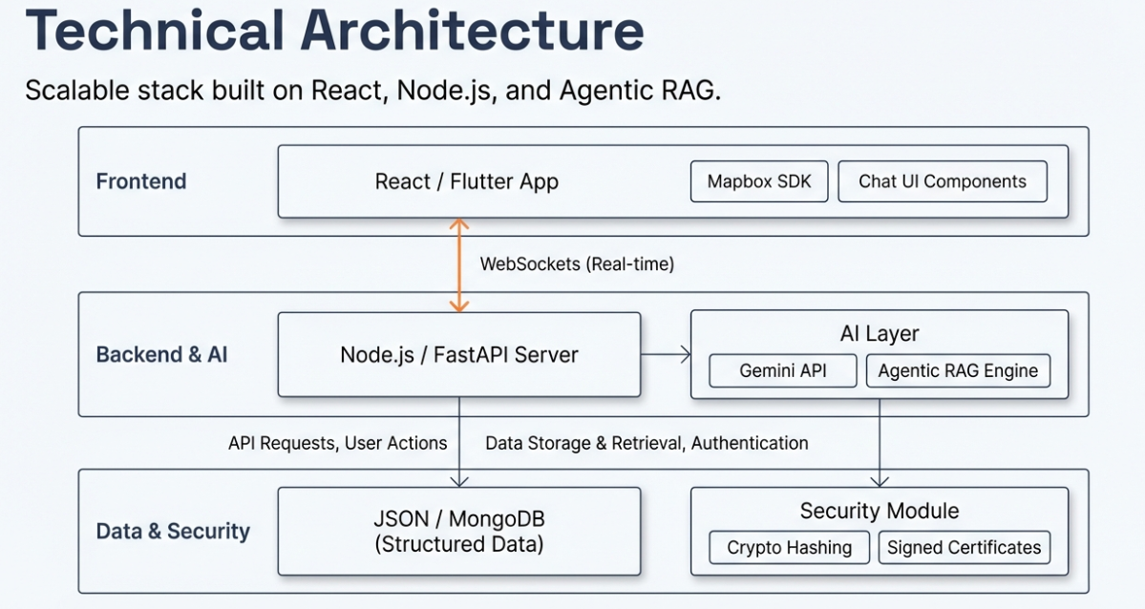
System Architecture

Slide 7
AI Integration
  AI Integration in this project - AI techniques used
Mind-Safe India integrates AI across decision-making, automation, and secure operations using the following techniques:
Large Language Models (LLMs)
→ Conversational chatbot for user guidance, device classification, and reasoning
Embeddings & Vector Databases
→ Contextual storage of device data, compliance rules, and operational history
Retrieval-Augmented Generation (RAG)
→ Context-aware responses using real operational and regulatory data
Agentic RAG (Multi-Agent AI)
→ Autonomous task execution for logistics assignment, technician routing, and workflow coordination
Model Context Protocol (MCP)
→ Structured and consistent context sharing across AI agents, tools, and APIs

Slide 8
AI Integration
  Why AI Is Needed in This Solution
AI is essential due to the complexity, scale, and sensitivity of e-waste and data-security operations:
High risk of human error in data wiping and certification
Dynamic logistics and routing for device pickup and technician assignment
Need for real-time decision-making across multiple workflows
Handling large volumes of contextual data (devices, locations, compliance)
Ensuring secure, auditable, and scalable operations
Without AI, the system would be manual, error-prone, and non-scalable.

Slide 9
AI Integration
  How AI Improves Accuracy, Automation, and Decision-Making
Accuracy
RAG ensures responses are based on verified operational data
AI validates device status and data-wipe completion
Cryptographically signed QR certificates prevent tampering
Automation
Agentic AI automatically assigns logistics and technicians
Event-driven backend with WebSockets enables real-time updates
Automated sustainability and carbon-impact calculation
Decision-Making
AI selects optimal disposal, resale, or recycling paths
Context-aware reasoning using MCP across all system components
Live dashboards enable informed user and enterprise decisions
.

Slide 10
Financial Analysis
  Estimated development/operational cost
Annual Cost Structure (Pilot Scale):
Technology & Infrastructure: ₹7–8 lakh
(AI models, APIs, servers, data security systems, platform maintenance)
Operations & Manpower: ₹8–9 lakh
(Technicians, logistics, device handling, compliance, support)
🔻 Total Estimated Annual Cost:
₹16–17 lakh / year

Slide 11
Financial Analysis
Revenue Model
Mind-Safe India follows a B2B + B2C + Service-based revenue model, monetizing data security, device reuse, and environmental impact.
Revenue Streams:
B2C Revenue: ₹24–25 lakh / year
(Data wiping, optional backups, resale commissions, refurbished sales, carbon credits)
B2B Revenue: ₹32–35 lakh / year
(Bulk data destruction, enterprise backups, AMC/SLA contracts, material resale, carbon credits)
Service-Based Revenue (Platform as a Service): ₹12–15 lakh / year
(Data destruction as a service, ESG & compliance reports, white-label solutions)
Carbon Credit Revenue: ₹6–8 lakh / year
(Voluntary credits via verified environmental impact)
💰 Total Annual Revenue:
₹74–83 lakh / annum

Slide 12
Financial Analysis
Target Users / Market
B2C (Individual Users):
Households disposing old phones, laptops, storage devices
Users seeking secure data deletion & eco-friendly recycling
Approx. 3,600 devices/year
B2B (Organizations):
IT companies & startups
Banks, fintechs, hospitals
Corporates upgrading hardware
Government & institutions
Approx. 2,400 devices/year
Market Positioning:
A trusted data-security + sustainability platform addressing India’s growing e-waste and data-privacy gap.

Slide 13
Financial Analysis
Profitability & Sustainability Approach
Financial Profitability:
High-margin service-based model
Low fixed costs with scalable operations
Net Profit (before tax): ₹58–65 lakh / year
Strong unit economics even at pilot scale
Sustainability & Long-Term Growth:
Promotes reuse and extended device lifecycle
Prevents illegal dumping and data breaches
Generates carbon credits through measurable impact
Aligns with ESG goals for enterprises
Scalable across cities with minimal cost increase

