Slide 1

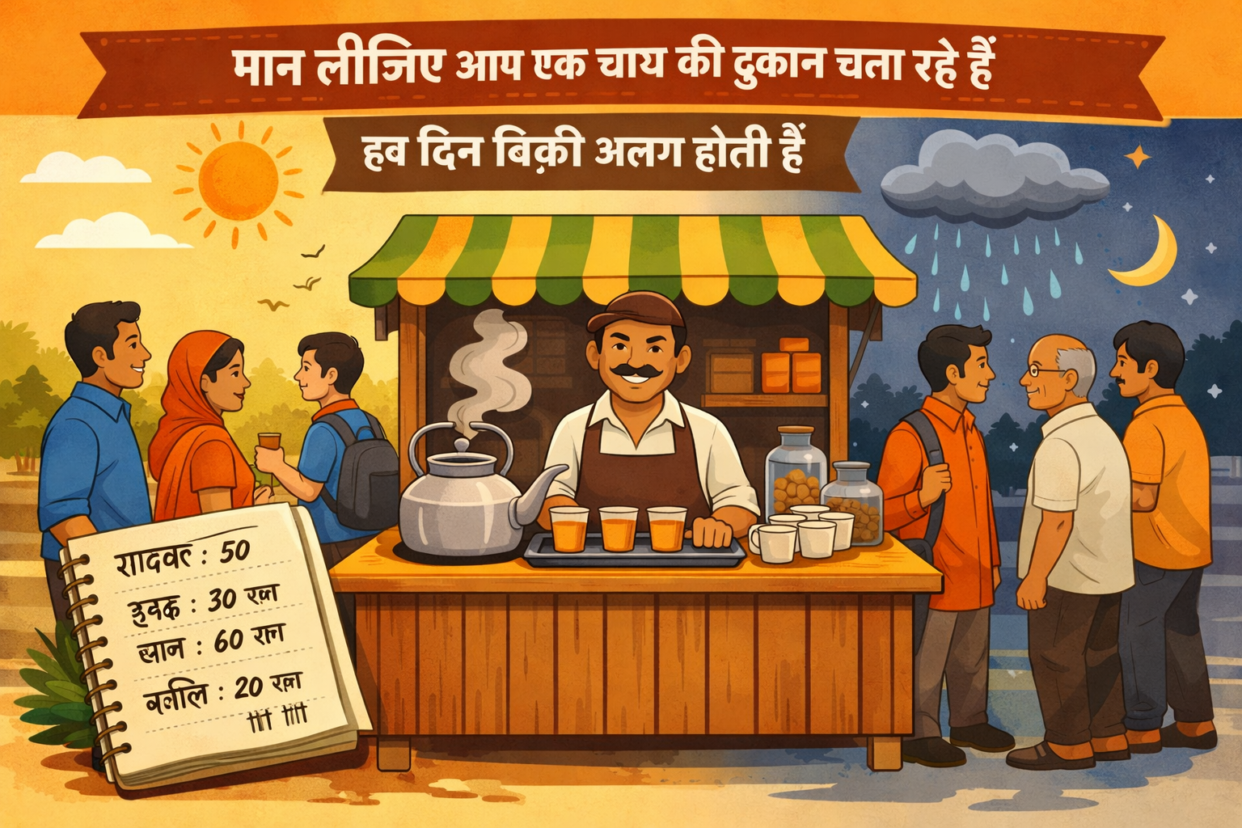
घंटा (X) | कमाई (y)
0 | ₹0
1 | ₹50
2 | ₹100
3 | ₹150
4 | ?

