Slide 1
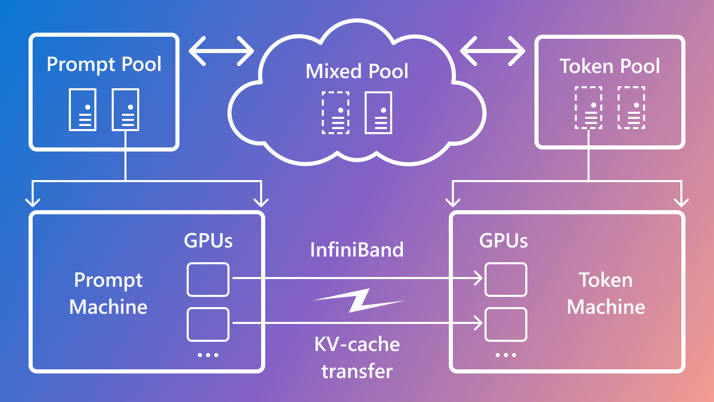

vLLM 架构剖析
ZOMI

Slide 2
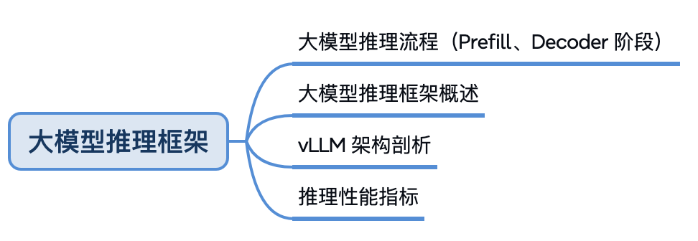
大模型推理

Slide 3
目录
业界大模型推理框架
Huggingface TGI
vLLM
SGLang
LMDeploy
性能对比
小结与思考

Slide 4
01
有哪些大模型推理框架

Slide 6
https://mp.weixin.qq.com/s/-5EniAmFf1v9RdxI5-CwiQ
https://mp.weixin.qq.com/s/tus1S_GuXLHH_FU1pWg3jg

