Slide 1
Word Embeddings
Nils Reimers
Course-Website: www.deeplearning4nlp.com

Slide 2
Possible Representations for Words
Many NLP systems regards words as atomic symbols
In vector terms, this is a vector with one 1 and a lot of zeros:
Its problem:
Machine learning systems cannot derive useful information from this 1-hot representation
Impossible to keep-up with synonyms and new words
Hotel [1 0 0 0] Dog [0 0 1 0]
Motel [0 1 0 0] Cat [0 0 0 1]
Hotel [1 0 0 0] AND
Motel [0 1 0 0] = 0

Slide 3
Distributional Hypothesis
Words that occur in the same contexts tend to have similar meanings (Harris, 1954)
One of the most successful ideas in modern NLP
Hugely boost the performance if used correctly
Idea: Count the co-occurrence of tokens:
rich
Warren Buffet
Bill Gates
Ethiopia
Sierra Leone
poor

Slide 4
Co-occurence Matrix
Create a matrix of the co-occurences for all words
Problems:
Increases with the size of vocabulary
High dimensional – requires a lot memory
Subsequent steps have sparsity issues
Solution:
Use dimensionality reduction to store only the most important information
 | word1 | word2 | word3 | word4 | word5 | word6 | word7
word1 | 0 | 2 | 0 | 3 | 5 | 0 | 1
word2 |  | 0 | 1 | 5 | 2 | 0 | 3
word3 |  |  | 0 | 1 | 0 | 0 | 1
word4 |  |  |  | 0 | 6 | 0 | 1

Slide 5
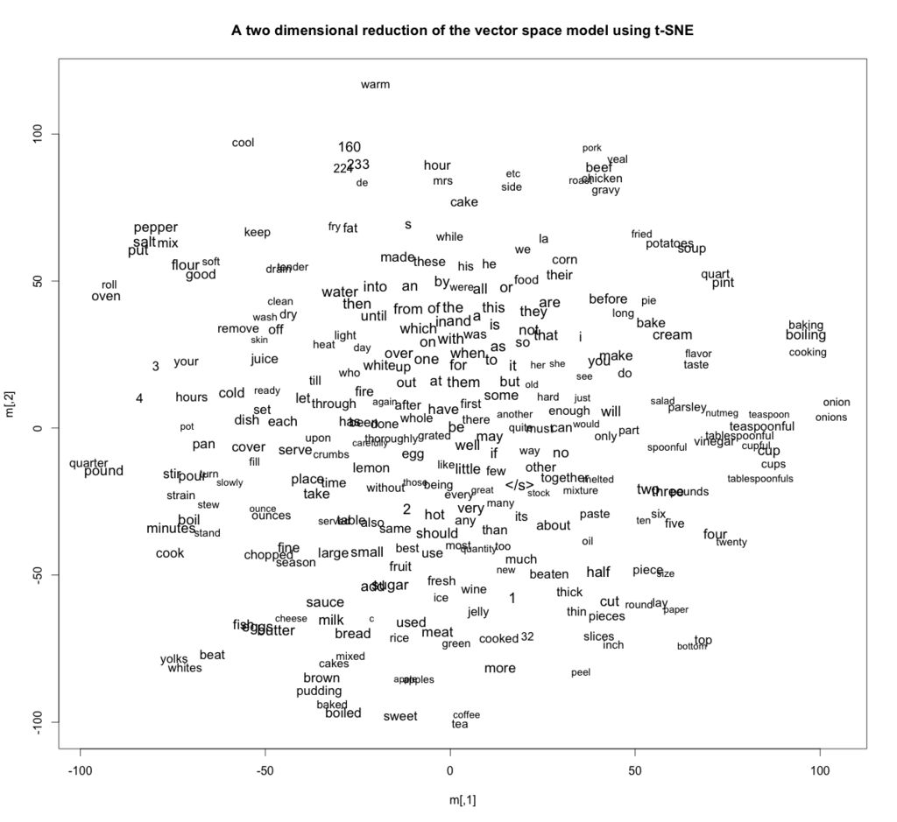
Low Dimensionality Representation of Words

Slide 6
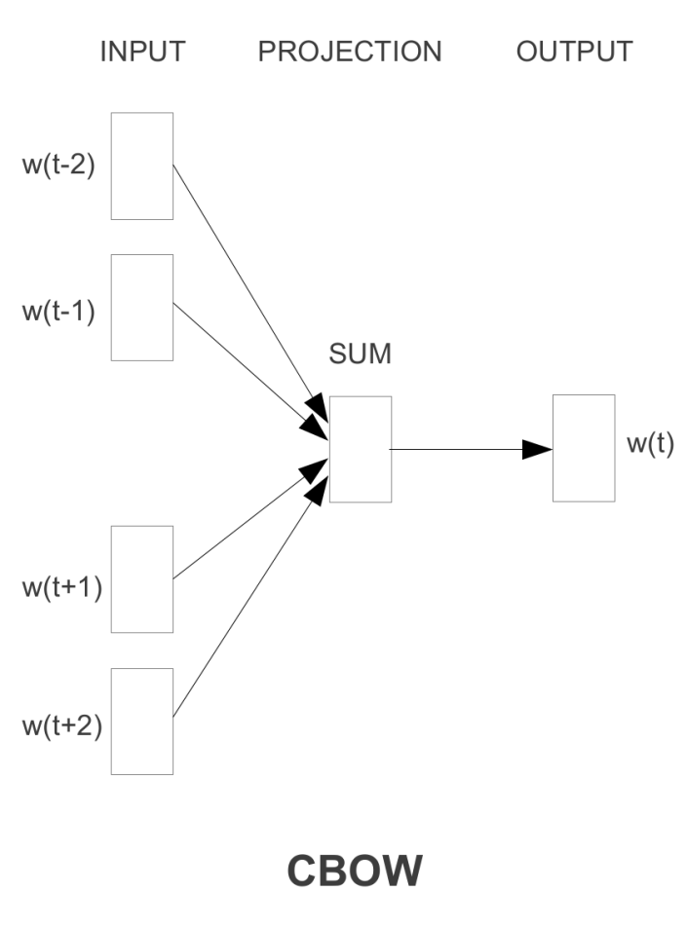
Representation Learning for Words Word2vec - CBOW
Word2vec (Mikolov et al.): Instead of creating co-occurrence matrix, create low-dimensional vectors directly
Highly efficient for large corpora (>100 TB)
CBOW-Model:
Given the surrounding words, try to predict word: w(t)
Idea: score(cat chills on a mat) > score(cat chills French a mat)
Maximize the distance between on and French for the given phrase
Result: Similar words are close, dissimilar words are far apart in vector space
Mikolov et al., 2013

Slide 7
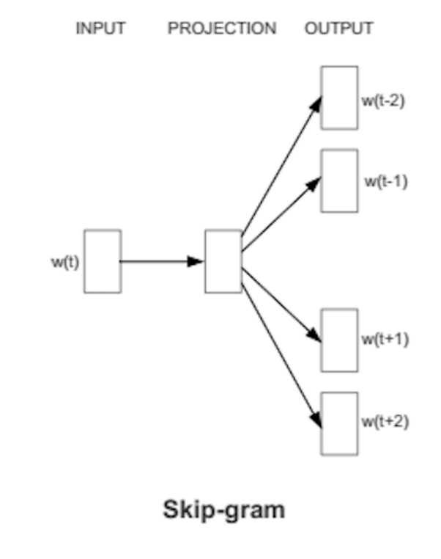
Representation Learning for Words Word2vec – Skip-Gram
Given center word w(t), try to predict context words w(t-2), …, w(t+2)
Usually works better than CBOW
What a context word is, can be quite arbitrarily:
Words to the left & right of the word
Dependency relations
Relations in FreeBase / WikiData etc.
Different contexts create different embeddings
Which is most suitable depends on the task
Mikolov et al., 2013

Slide 8
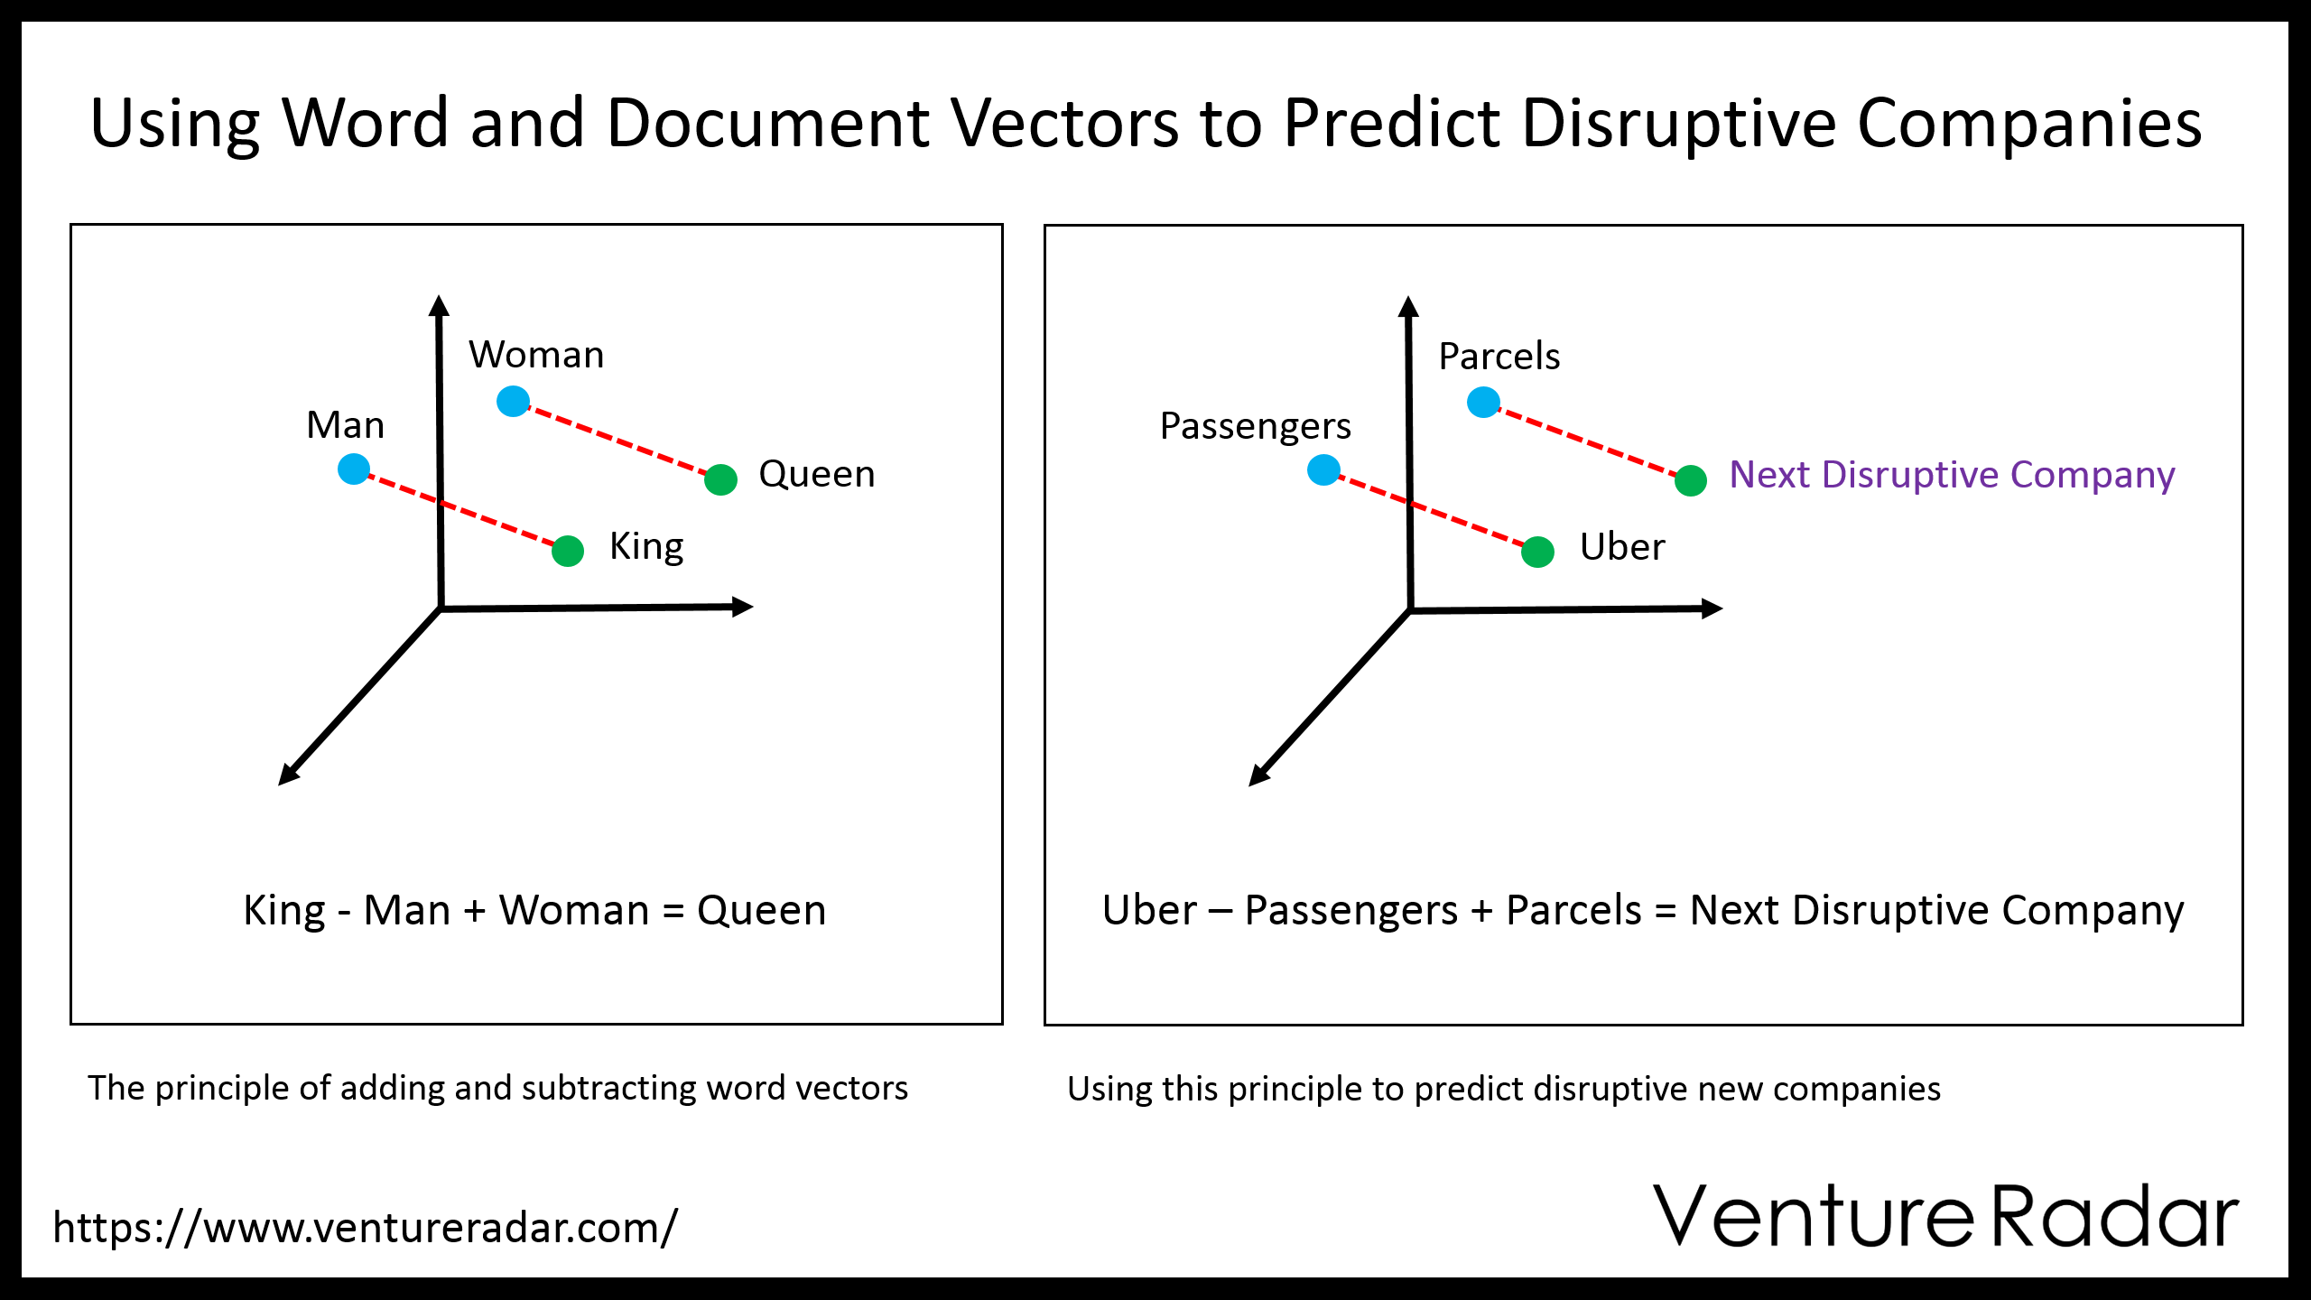
Representation of Words
Syntactic and semantic properties are captured in this vector space

Slide 9
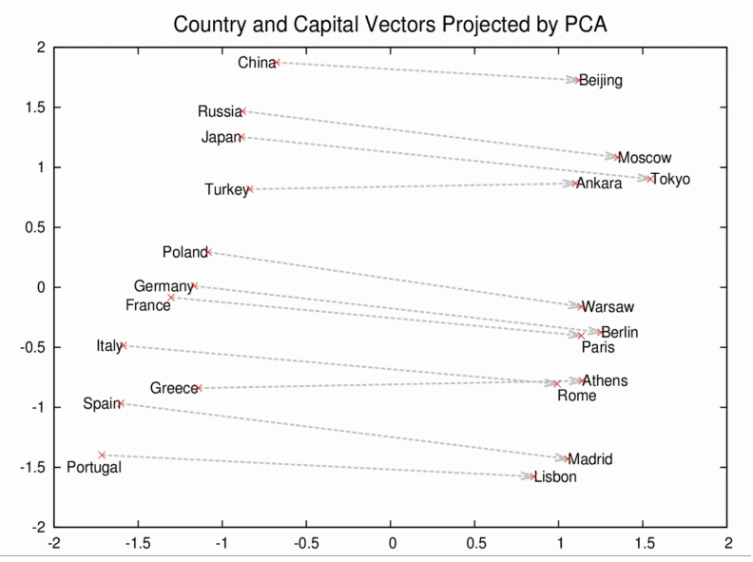
Representation of Words

Slide 10
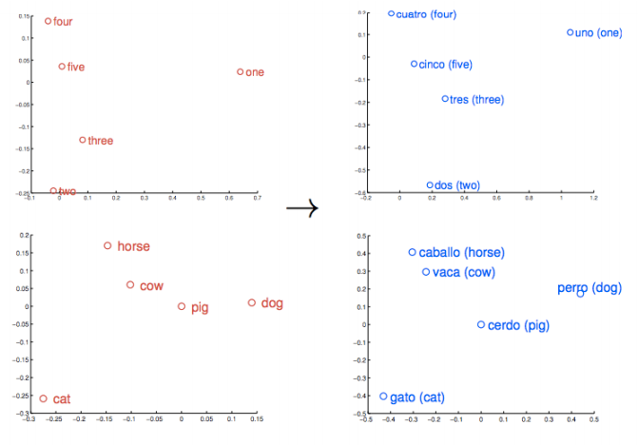
Representation of Words

Slide 11
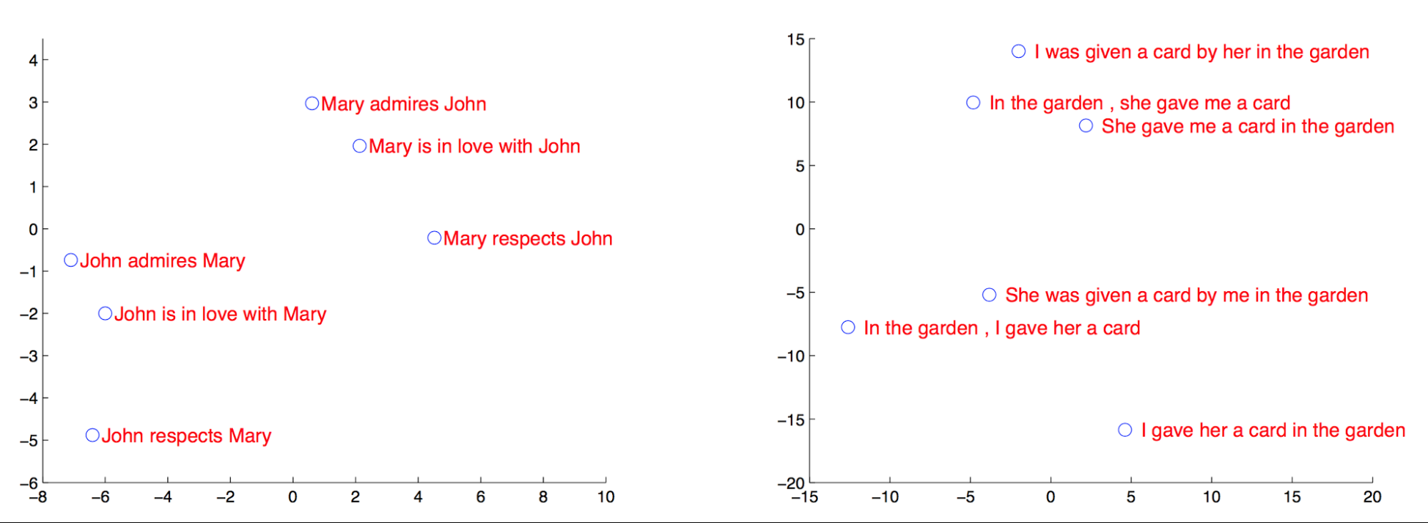
Representation of Sentences
Sentences can be represented as well as a dense vector space

Slide 12
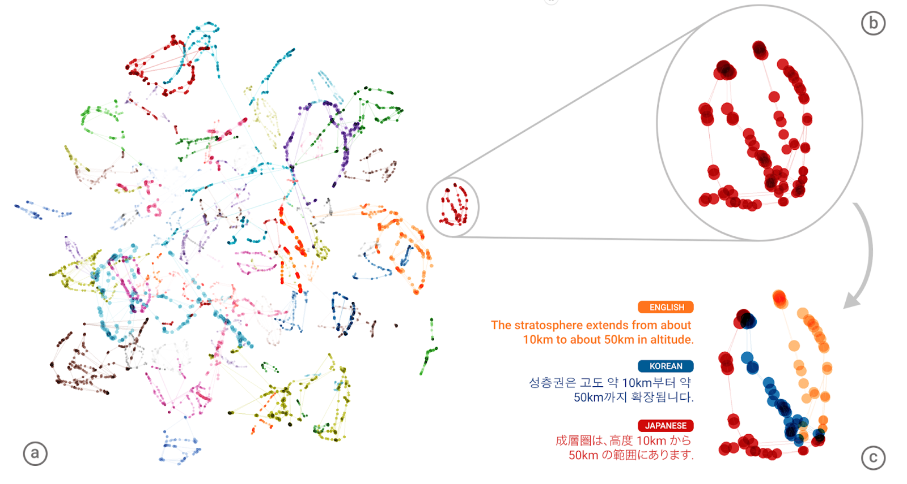
How Powerful are Dense Representations?
Google Neural Machine Translation system learned a lingua franca
Similar sentences are mapped to the same area independent of the language
Allows translating between unseen language pairs!
Otherwise 10.000 bilingual corpora would be need for supporting 103 languages
Source: https://research.googleblog.com/2016/11/zero-shot-translation-with-googles.html

Slide 13
Embeddings & Deep Learning
Word vectors form the basis of most deep learning approaches
They provide basic knowledge about the meaning
Neural Networks are able to propagate information into them
Linear models like naïve bayes / SVM cannot do that
The quality of the embeddings has huge effect on the performance
Quality of embeddings depends on:
Dataset (quality & quantity)
Pre-processing & cleaning of the dataset
Definition of the context words
Hyperparameters
The algorithm (word2vec, GloVe) is often of minor importance

