Slide 1
Deep Learning Frameworks
Nils Reimers
Course-Website: www.deeplearning4nlp.com
Please have your Python environment up and running

Slide 2
Requirements for a Framework
To train Deep Neural Networks requires billions of operations
Google had trained some systems on up to 16.000 cores
Performance in training time is crucial
More data = better results = your paper get published
Some times: Larger network = better results = your paper get published
Slow computation is not acceptable => Choose the framework that is the fastest
Nearly all operations are matrix operations (multiplications, additions)
Easy syntax for matrices desired
Optimizing matrix multiplication for speed is hard, simple “two loop solution” is way too slow
Must be runnable on a GPU
Nice to have: Easy computation of gradients

Slide 3
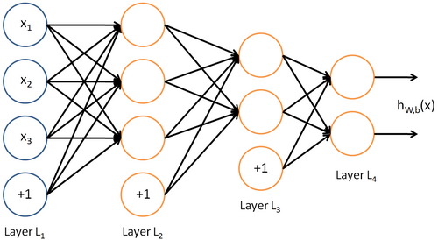
Neural Network as One Long Function
Neural Networks can be expressed as one long function of vector and matrix operations
Img-Source: http://ufldl.stanford.edu/wiki/

Slide 4
Common Frameworks
Outdated: C/C++, Matlab, Caffe
Torch (Lua)
DeepLearning4j (Java)
Most used frameworks:
Theano
One of the oldest deep learning frameworks
Python based framework
Largely used in the research community
TensorFlow
Deep Learning framework by Google
Written in C/C++, wrapper exists for various languages
Most people use the Python wrapper for TensorFlow
My recommendation for starters in deep learning – learn TF

Slide 5
Introduction to Theano
TensorFlow uses similar concepts and porting code is not too difficult

Slide 6
Theano
Advantages
Python library with tight integration of NumPy
Easy syntax for matrix operations ü
Transparent use of GPU (speed-up of up to 140x) ü
Efficient symbolic differentiation (Theano computes the gradient) ü
Speed and stability optimizations ü
Calculations are dynamically mapped to C code
We do our computations as fast as we would have written it in C
Great performance (>10 faster than Java in my experiments) ü
Disadvantages
Debugging is really hard

Slide 7
Some note on the installation of Theano
Theano utilizes BLAS (Basic Linear Algebra Subprograms)
Building blocks for fast vector and matrix operations
Often written in Fortran, sometimes in Assembler
For performance optimization install a BLAS package
Benchmark different BLAS packages
I use a manually compiled OpenBlas implementation
Installation notes: http://deeplearning.net/software/theano/install_ubuntu.html

Slide 8
Theano – Flow
The execution of a Theano script is a bit different
Python: Define a computation graph
Python: Tell Theano to compile the graph
Theano: Optimize the graph, generate C-Code and compile it
Python: Pass input data to the compiled graph
C: Compute the output, compute updates of weights, maybe run on GPU
Python: Get the final output

Slide 9
Theano – Computation Graph
You write symbolic expression to define the computation graph
a
vector
float
b
vector
float
c
matrix
float
import theano
import theano.tensor as T
a = T.fvector()
b = T.fvector()
c = T.fmatrix()
res1 = a+b
res2 = T.dot(res1,c)
+
res1
vector
float
*
res2
matrix
float

Slide 10
Introduction to Keras
One of the most popular Deep Learning Framewokrs

Slide 11
Keras
Builds on top of Theano and TensorFlow
You can easily switch the backend without needing to change your code
As of Keras 1.1.1, TensorFlow the default backend
Keras implements tons of useful Neuronal Network Moduls:
Feed Fordward Layers, Convolutional Layers, Recurrent Layers
Different optimization functions
Different loss functions
Storage and loading of models
….
Building your deep learning models becomes quite easy with Keras
… at least as long as it is already implemented in Keras

