Slide 1
Deep Learning for NLP Convolutional Neural Networks
Nils Reimers
Course-Website: www.deeplearning4nlp.com

Slide 2
Recommended Readings
https://www.youtube.com/watch?v=EevTPpQvxiU
Kim, 2014, Convolutional Neural Networks for Sentence Classification

Slide 3
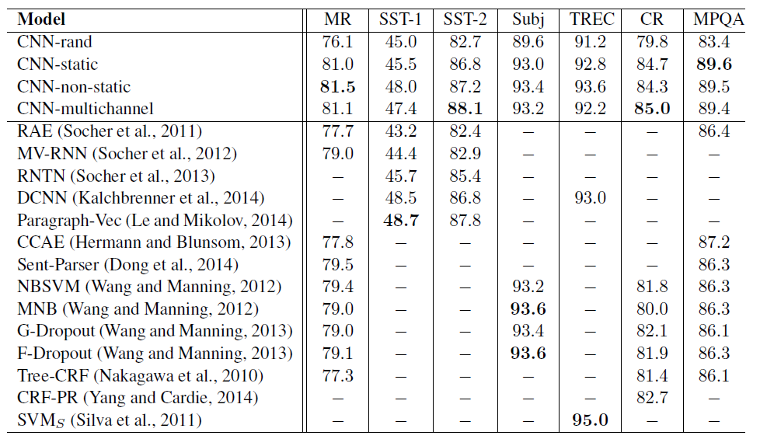
Convolutional Neural Network
Universal architecture achieving state-of-the-art
Kim, 2014. Performance on Sentence Classification Tasks

Slide 4
Some notes on Conv. Neural Networks
Convolutional Neural Networks are dominating computer vision
For NLP, they became popular in ~2014
Understanding the notation is quite difficult in computer vision
Images are typically 3 dimensional (width x height x color)
In NLP, we mainly deal with 1 dimensional data (our sentence / document)
Notation for 1 dimensional data is much simpler

Slide 5
Convolutional Neural Networks solve 2 crucial Challenges
First Challenge:
In a lot of cases, we have variable sized input data, e.g. length of sentence / length of document.
Our network / our hidden layers are of fixed sizes
Solution 1: Window Approach (Collobert et al.), but we don’t capture information outside of the window
Solution 2: Recursive & Recurrent Neural Networks
Second Challenge:
Increasing the window in the window approach allows us to capture more context information, but increases dramatically the number of parameters
Often the position in the context window is of minor importance:
Jim [sells]_{Pred} his car for [$5,000]???
Jim [sells]_{Pred} his car, which he inherited from his dad, for [$5,000]???

Slide 6



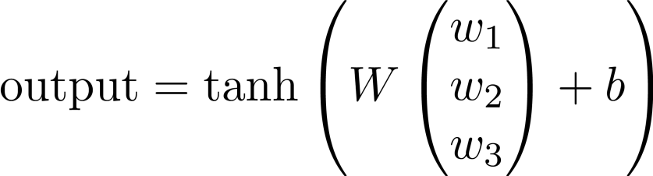







Single Layer CNN – Single Filter
We compute a single filter for a window size of n (here n=3): Word Vectors: Weight Matrix: Bias:
$$\left(0.8\right)$$
$$\left(\begin{matrix}1 \\ 1\end{matrix}\right)$$
$$\left(\begin{matrix}7 \\ 3\end{matrix}\right)$$
$$\left(\begin{matrix}2 \\ 5\end{matrix}\right)$$
$$\left(\begin{matrix}1 \\ 9\end{matrix}\right)$$
$$\left(\begin{matrix}3 \\ 3\end{matrix}\right)$$
$$\left(\begin{matrix}1 \\ 1\end{matrix}\right)$$
PAD The movie was awesome PAD

Slide 7










Single Layer CNN – Single Filter
Compute the output for all windows of size n (in our case n=3)
For each window use the same weight and bias matrix (shared weights)
This gives us the same number of digits as the length of the sentence
$$\left(0.5\right)$$
$$\left(0.2\right)$$
$$\left(0.6\right)$$
$$\left(0.9\right)$$
$$\left(\begin{matrix}1 \\ 1\end{matrix}\right)$$
$$\left(\begin{matrix}7 \\ 3\end{matrix}\right)$$
$$\left(\begin{matrix}2 \\ 5\end{matrix}\right)$$
$$\left(\begin{matrix}1 \\ 9\end{matrix}\right)$$
$$\left(\begin{matrix}3 \\ 3\end{matrix}\right)$$
$$\left(\begin{matrix}1 \\ 1\end{matrix}\right)$$
PAD The movie was awesome PAD

Slide 8


Single Layer CNN – Pooling Layer
New building block: Pooling
Idea: Capture the most important activation
Let denote the output values for our filter
Compute a max-over-time pooling layer:
Because of max-over-time pooling, length of input sequence is irrelevant.
We could use the output c and forward it to a softmax classifier and derive a sentiment class for the sentence
Max-pooling most common in NLP. In Computer Vision, min-pooling and mean-pooling also common.

Slide 9
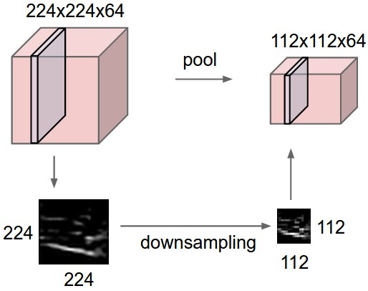
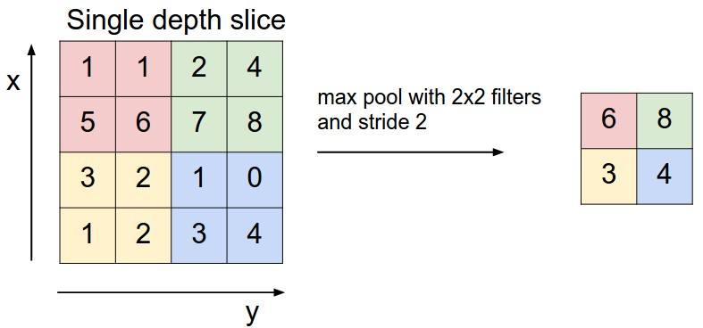
Excursion: Max Pooling in Computer Vision
In computer vision, pooling is often applied over fixed windows (e.g. 2x2)
Example:
224x224 pixel gray scale images, 64 images / batch
2x2 max-pooling reduces each image it to 112 x 112 dimensions
Img-Source: http://cs231n.github.io/convolutional-networks/

Slide 10
Max Pooling vs. Max-over-Time
Max pool with 2x2 filters on variable sized input generates variable sized output
Max-over-time generates fixed-sized output
In NLP, mostly max-over-time is used (as presented by Collobert et al., NLP almost from scratch, section 3.2.2)
A lot of literature on max pooling originated from Computer Vision
Be careful with different terminology and hyper parameters for those pooling layers
Most libraries (Lasagne, Keras) are optimized for computer vision and only support window sized max pooling
Using the existent layers for 1-dimensional max-over-time can be a bottleneck
Implementation of max-over-time quite easy in Theano: T.max(matrix, axis=1)

Slide 11

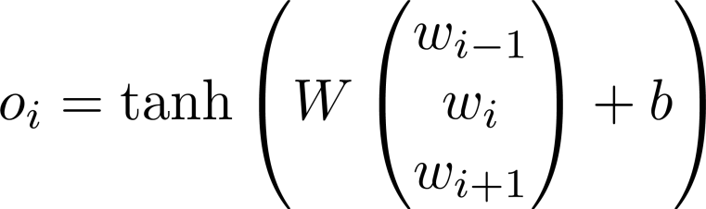











Single Layer CNN + Classification
Negative / Positive
You can train this like any other Neural Network
Softmax-Classifer
$$\left(0.9\right)$$
$$\left(0.5\right)$$
$$\left(0.2\right)$$
$$\left(0.6\right)$$
$$\left(0.9\right)$$
$$\left(\begin{matrix}1 \\ 1\end{matrix}\right)$$
$$\left(\begin{matrix}7 \\ 3\end{matrix}\right)$$
$$\left(\begin{matrix}2 \\ 5\end{matrix}\right)$$
$$\left(\begin{matrix}1 \\ 9\end{matrix}\right)$$
$$\left(\begin{matrix}3 \\ 3\end{matrix}\right)$$
$$\left(\begin{matrix}1 \\ 1\end{matrix}\right)$$
PAD The movie was awesome PAD

Slide 12




1 Dimension – not enough information
Negative / Positive
With only a single filter our possibilities are limited
Softmax-Classifer
$$\left(0.5\right)$$
$$\left(0.5\right)$$
$$\left(0.2\right)$$
$$\left(−0.2\right)$$
$$\left(−0.9\right)$$
$$\left(\begin{matrix}1 \\ 1\end{matrix}\right)$$
$$\left(\begin{matrix}7 \\ 3\end{matrix}\right)$$
$$\left(\begin{matrix}2 \\ 5\end{matrix}\right)$$
$$\left(\begin{matrix}1 \\ 9\end{matrix}\right)$$
$$\left(\begin{matrix}−3 \\ −3\end{matrix}\right)$$
$$\left(\begin{matrix}1 \\ 1\end{matrix}\right)$$
PAD The movie was horrible PAD

Slide 13

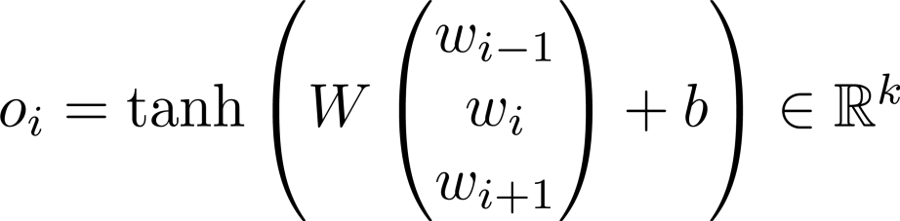





Single Layer CNN – Multiple Filters
Negative / Positive
By changing the dimensionality of the weight matrix, we can add further filters:
Softmax-Classifer
$$\left(\begin{aligned}0.5 \\ 0.8\end{aligned}\right)$$
$$\left(\begin{aligned}0.5 \\ 0.7\end{aligned}\right)$$
$$\left(\begin{aligned}0.2 \\ 0.1\end{aligned}\right)$$
$$\left(\begin{aligned}−0.2 \\ 0.7\end{aligned}\right)$$
$$\left(\begin{aligned}−0.9 \\ 0.8\end{aligned}\right)$$
$$\left(\begin{matrix}1 \\ 1\end{matrix}\right)$$
$$\left(\begin{matrix}7 \\ 3\end{matrix}\right)$$
$$\left(\begin{matrix}2 \\ 5\end{matrix}\right)$$
$$\left(\begin{matrix}1 \\ 9\end{matrix}\right)$$
$$\left(\begin{matrix}−3 \\ −3\end{matrix}\right)$$
$$\left(\begin{matrix}1 \\ 1\end{matrix}\right)$$
PAD The movie was horrible PAD

Slide 14




















Going further with Filters
We can create convolutional layers working on unigrams, bigrams, trigrams etc. and combine their output
Softmax-Classifer
$$\left(\begin{aligned}0.1 \\ 0.7\end{aligned}\right)$$
$$\left(\begin{aligned}0.5 \\ 0.8\end{aligned}\right)$$
$$\left(\begin{aligned}0.1 \\ 0.1\end{aligned}\right)$$
$$\left(\begin{aligned}0.0 \\ 0.1\end{aligned}\right)$$
$$\left(\begin{aligned}0.1 \\ 0.1\end{aligned}\right)$$
$$\left(\begin{aligned}−0.8 \\ 0.7\end{aligned}\right)$$
$$\left(\begin{aligned}0.5 \\ 0.7\end{aligned}\right)$$
$$\left(\begin{aligned}0.2 \\ 0.1\end{aligned}\right)$$
$$\left(\begin{aligned}−0.2 \\ 0.7\end{aligned}\right)$$
$$\left(\begin{aligned}−0.9 \\ 0.8\end{aligned}\right)$$
$$\left(\begin{matrix}7 \\ 3\end{matrix}\right)$$
$$\left(\begin{matrix}2 \\ 5\end{matrix}\right)$$
$$\left(\begin{matrix}1 \\ 9\end{matrix}\right)$$
$$\left(\begin{matrix}−3 \\ −3\end{matrix}\right)$$
$$\left(\begin{matrix}1 \\ 1\end{matrix}\right)$$
$$\left(\begin{matrix}7 \\ 3\end{matrix}\right)$$
$$\left(\begin{matrix}2 \\ 5\end{matrix}\right)$$
$$\left(\begin{matrix}1 \\ 9\end{matrix}\right)$$
$$\left(\begin{matrix}−3 \\ −3\end{matrix}\right)$$
$$\left(\begin{matrix}1 \\ 1\end{matrix}\right)$$
The movie was horrible
PAD The movie was horrible PAD

Slide 15


























Or work on a different granularity
Softmax-Classifer
$$\left(\begin{aligned}0.7 \\ 0.9\end{aligned}\right)$$
$$\left(\begin{aligned}0.5 \\ 0.8\end{aligned}\right)$$
$$\left(\begin{aligned}0.1 \\ 0.1\end{aligned}\right)$$
$$\left(\begin{aligned}0.0 \\ 0.1\end{aligned}\right)$$
$$\left(\begin{aligned}0.1 \\ 0.1\end{aligned}\right)$$
$$\left(\begin{aligned}0.2 \\ 0.2\end{aligned}\right)$$
$$\left(\begin{aligned}0.6 \\ 0.0\end{aligned}\right)$$
$$\left(\begin{aligned}0.1 \\ 0.9\end{aligned}\right)$$
$$\left(\begin{aligned}0.7 \\ 0.9\end{aligned}\right)$$
$$\left(\begin{aligned}0.5 \\ 0.7\end{aligned}\right)$$
$$\left(\begin{aligned}0.2 \\ 0.1\end{aligned}\right)$$
$$\left(\begin{aligned}−0.2 \\ 0.7\end{aligned}\right)$$
$$\left(\begin{aligned}−0.9 \\ 0.8\end{aligned}\right)$$
$$\left(\begin{matrix}7 \\ 3\end{matrix}\right)$$
$$\left(\begin{matrix}2 \\ 5\end{matrix}\right)$$
$$\left(\begin{matrix}1 \\ 9\end{matrix}\right)$$
$$\left(\begin{matrix}3 \\ 3\end{matrix}\right)$$
$$\left(\begin{matrix}4 \\ 2\end{matrix}\right)$$
$$\left(\begin{matrix}2 \\ 3\end{matrix}\right)$$
$$\left(\begin{matrix}2 \\ 3\end{matrix}\right)$$
$$\left(\begin{matrix}1 \\ 1\end{matrix}\right)$$
$$\left(\begin{matrix}7 \\ 3\end{matrix}\right)$$
$$\left(\begin{matrix}2 \\ 5\end{matrix}\right)$$
$$\left(\begin{matrix}1 \\ 9\end{matrix}\right)$$
$$\left(\begin{matrix}−3 \\ −3\end{matrix}\right)$$
$$\left(\begin{matrix}1 \\ 1\end{matrix}\right)$$
The mov ie was hor rib le
PAD The movie was horrible PAD
Conv. Layer on character trigrams
Conv. Layer on word trigrams

Slide 16



















Stacking Convolutional Layers
From character n-grams we could derive vectors for words and then a vector for the sentence
$$\left(\begin{aligned}0.9 \\ 0.4\end{aligned}\right)$$
$$\left(\begin{aligned}0.2 \\ 0.4\end{aligned}\right)$$
$$\left(\begin{aligned}0.9 \\ 0.2\end{aligned}\right)$$
$$\left(\begin{aligned}0.0 \\ 0.3\end{aligned}\right)$$
$$\left(\begin{aligned}0.1 \\ 0.2\end{aligned}\right)$$
$$\left(\begin{aligned}0.2 \\ 0.4\end{aligned}\right)$$
$$\left(\begin{aligned}0.9 \\ 0.1\end{aligned}\right)$$
$$\left(\begin{aligned}0.0 \\ 0.1\end{aligned}\right)$$
$$\left(\begin{aligned}0.1 \\ 0.1\end{aligned}\right)$$
$$\left(\begin{aligned}0.2 \\ 0.2\end{aligned}\right)$$
$$\left(\begin{aligned}0.6 \\ 0.0\end{aligned}\right)$$
$$\left(\begin{matrix}7 \\ 3\end{matrix}\right)$$
$$\left(\begin{matrix}5 \\ 4\end{matrix}\right)$$
$$\left(\begin{matrix}2 \\ 1\end{matrix}\right)$$
$$\left(\begin{matrix}7 \\ 3\end{matrix}\right)$$
$$\left(\begin{matrix}2 \\ 5\end{matrix}\right)$$
$$\left(\begin{matrix}1 \\ 9\end{matrix}\right)$$
$$\left(\begin{matrix}3 \\ 3\end{matrix}\right)$$
$$\left(\begin{matrix}4 \\ 2\end{matrix}\right)$$
#St arW ars
#Aw eso meM ovi e
#StarWars
#AwesomeMovie

Slide 17
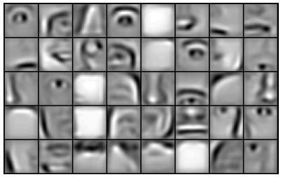
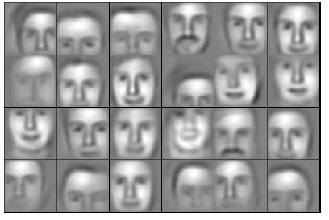
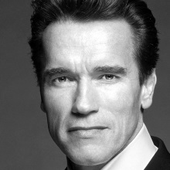
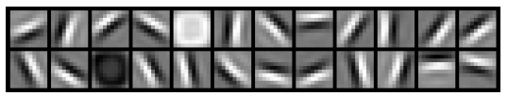
Stacked Convolutional Layers
Computer vision uses stacked convolutional layers to derive from simple representations high level representations
Source: Lee et al. (ICML 2009)
Input
e.g. 40 000 dim
Layer 1
9 600 dim
Layer 2
3800 dim
Layer 3
900 dim

Slide 18


















Terminology: Filter Length
The filter length is the extension of each filter
Mainly inspired by Computer Vision where we work on spatial close pixels
In NLP we are more flexible:
Use a context window of size n
Use dependency links / syntax tree
Filter Length: 1
$$\left(\begin{aligned}0.5 \\ 0.7\end{aligned}\right)$$
$$\left(\begin{aligned}0.2 \\ 0.1\end{aligned}\right)$$
$$\left(\begin{aligned}−0.2 \\ 0.7\end{aligned}\right)$$
$$\left(\begin{aligned}−0.9 \\ 0.8\end{aligned}\right)$$
$$\left(\begin{matrix}7 \\ 3\end{matrix}\right)$$
$$\left(\begin{matrix}2 \\ 5\end{matrix}\right)$$
$$\left(\begin{matrix}1 \\ 9\end{matrix}\right)$$
$$\left(\begin{matrix}−3 \\ −3\end{matrix}\right)$$
The movie was horrible
Filter Length: 3
$$\left(\begin{aligned}0.5 \\ 0.7\end{aligned}\right)$$
$$\left(\begin{aligned}0.2 \\ 0.1\end{aligned}\right)$$
$$\left(\begin{aligned}−0.2 \\ 0.7\end{aligned}\right)$$
$$\left(\begin{aligned}−0.9 \\ 0.8\end{aligned}\right)$$
$$\left(\begin{matrix}1 \\ 1\end{matrix}\right)$$
$$\left(\begin{matrix}7 \\ 3\end{matrix}\right)$$
$$\left(\begin{matrix}2 \\ 5\end{matrix}\right)$$
$$\left(\begin{matrix}1 \\ 9\end{matrix}\right)$$
$$\left(\begin{matrix}−3 \\ −3\end{matrix}\right)$$
$$\left(\begin{matrix}1 \\ 1\end{matrix}\right)$$
PAD The movie was horrible PAD

Slide 19










Terminology: Stride
The stride specifies the steps size we move across a sentence
In NLP: Typically stride=1
In computer vision: Other values can be used
Stride: 1
$$\left(\begin{aligned}0.5 \\ 0.7\end{aligned}\right)$$
$$\left(\begin{aligned}0.2 \\ 0.1\end{aligned}\right)$$
$$\left(\begin{aligned}−0.2 \\ 0.7\end{aligned}\right)$$
$$\left(\begin{aligned}−0.9 \\ 0.8\end{aligned}\right)$$
$$\left(\begin{matrix}1 \\ 1\end{matrix}\right)$$
$$\left(\begin{matrix}7 \\ 3\end{matrix}\right)$$
$$\left(\begin{matrix}2 \\ 5\end{matrix}\right)$$
$$\left(\begin{matrix}1 \\ 9\end{matrix}\right)$$
$$\left(\begin{matrix}−3 \\ −3\end{matrix}\right)$$
$$\left(\begin{matrix}1 \\ 1\end{matrix}\right)$$
PAD The movie was horrible PAD
Stride: 2
$$\left(\begin{aligned}0.5 \\ 0.7\end{aligned}\right)$$
$$\left(\begin{aligned}−0.2 \\ 0.7\end{aligned}\right)$$
$$\left(\begin{matrix}1 \\ 1\end{matrix}\right)$$
$$\left(\begin{matrix}7 \\ 3\end{matrix}\right)$$
$$\left(\begin{matrix}2 \\ 5\end{matrix}\right)$$
$$\left(\begin{matrix}1 \\ 9\end{matrix}\right)$$
$$\left(\begin{matrix}−3 \\ −3\end{matrix}\right)$$
$$\left(\begin{matrix}1 \\ 1\end{matrix}\right)$$
PAD The movie was horrible PAD

Slide 20
How to choose the embeddings?
When we use words, how should we initialize the embeddings?
Rand: Random initialization
Static: word2vec, no updates during training
Non-static: word2vec with updates
Multichannel: next slide
Source: Kim, 2014. Performance on Sentence Classification Tasks

Slide 21
Multi-Channel Idea
We start with 2 copies for the word vectors, both initialized with word2vec/GloVe etc.
Only one version of them is updated, the other is static
We apply the same filters to both channels before we apply the pooling
The one channel can learn task specific embeddings
E.g. for sentiment, good and bad should be far away in vector space
So far mixed results
Different Idea: Use differently pre-trained word embeddings
E.g. based on local context, on dependency trees, on relations from knowledge bases etc.
Reference: Kim, 2014. Performance on Sentence Classification Tasks

Slide 22
Hints on the Implementation
Numpy and Theano cannot work with variable sized rows
How to model a dataset like this? [ [This is my first sentence .] [This is my second , longer sentence .] [Super short ]]
2 Approaches:
Ignore minibatches, just input 1 sentence at a time for training / testing
Bad for performance
Pad the sentences with 0 to make them of the same length
Be careful with the padding, that the max-pooling does not choose your padded values
Be careful with the runtime, that a single super long sentence does not create too much padding for all other sentences.
Great to run on GPU (convolutions can be computed easily in parallel)

Slide 23
Hints on the Implementation II
Most implementation for convolutional layers are targeted for computer vision
They introduce a lot more hyper parameters.
Keras.Convolution1D:
nb_filter: dimensionality of the output
filter_length: The extension (spatial or temporal) of each filter.
border_mode: How are vales at the border handled. ‘valid' or 'full'.
subsample_length: The stride value for the filter
Keras.MaxPooling1D:
pool_length: factor by which to downscale. 2 will halve the input.
stride: Stride value.
ignore_border: boolean
Note: Existent Convolution1D and MaxPooling1D not suitable for max-over-time implementation

