Slide 1
Deep Learning for NLP When Big Data hits Machine Learning
Nils Reimers
Course-Website: www.deeplearning4nlp.com

Slide 2
Organization of this Course
This course will not give a long motivation on deep learning
This course will focus on hands-on exercise, less on theory
There are tons of good introductions and lectures that cover all the math
We approach this topic more like an engineer:
Use the things that work
Deep knowledge only needed when something doesn’t work
Weekly meeting, Monday at 11am
Please read the preparation for class papers– it will be assumed that you know the content
Theoretical input, clarification of questions for the papers etc.
Practice tasks (programming)
For a given task (NER, Genre Classification, Sentiment Classification) we develop a deep neural network using Python / Theano / Lasagne

Slide 3
Recommended Readings
Recommended Readings for this lecture:
From the 2009 Yoshua Bengio Book:
1 Introduction - Good introduction into the terminology and the basic concept of deep learning
2 Theoretical Advantages of Deep Architectures - In case you are interested why deep architectures are better than shallow
Chapter 1 - Using neural nets to recognize handwritten digits
Chapter 2 - How the backpropagation algorithm works
From the 2015 Yoshua Bengio Book:
1 Introduction - if you are interested in the historical development of neural networks
Part I: Applied Math and Machine Learning Basics - As a refresher for linear algebra and machine learning basics (if needed)
6 Feedforward Deep Networks - Read on feedforward networks, the most simple type of neural networks

Slide 4
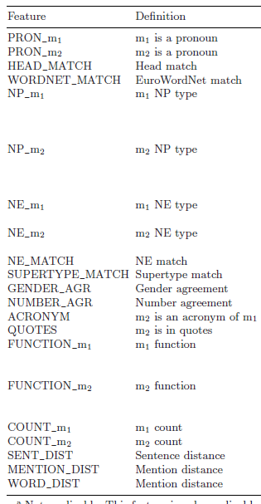
What is Deep Learning?
Deep Learning is a subfield of Machine Learning
Most machine learning methods work well because of human-designed features
Recasens et al. (2009) lists >30 features for event coreference resolution
Most time spent on engineering features
Machine learning becomes optimizing weights to make a final prediction given the features

Slide 5
Machine Learning vs. Deep Learning
Traditional Machine Learning
Feature Engineering: Describe your data with features a computer can understand
Machine Learning: Some hyper-parameter tuning
Task, language and text-domain specific
Requires high domain expertise (Ph.D.-level)
Often requires other tools and resources (POS-tagger, Wordnet …)
Deep Learning Approach
Getting Domain Expertise
Design / select a suitable network architecture
Optimize architecture & fine-tune parameters

Slide 6

Deep Learning
Deep Learning
Representation Learning attempts to automatically learn good features or representations
Deep Learning attempts to learn multiple levels of representation from raw input
Instead of modeling the problem by the design of features, deep learning attempts to learn by itself a good representation (i.e. features).
Large amounts of data are typically needed
They must not necessarily be labeled (see autoencoders, word embeddings)
For small datasets: Hand-designed features can still be included

Slide 7
The Deep Learning Dream
Input the pure characters and output the desired label (sentiment, genre, translated version, QA)
No hassle with preprocessing:
No error propagation
No inconsistencies between pipeline components (different segmentations, tagsets etc.)
No ‘component not available in your language’
This makes models easily adaptable to new text domains and languages
Just take existent network architecture and train on new dataset
Dream not yet achieved, but we are on a good way
See: Zang et al., 2015, Text Understanding from Scratch
Zang et al., 2015, Character-level Convolutional Networks for Text Classification will be published on NIPS 2015

Slide 8
What is New?
Deep Neural Networks are nothing new (started ~1960)
Until 2006 training of deep neural networks wasn‘t successful
Hinton et al. (2006) presented a new, stacked training method which applies the concept of pre-training
Successful training of deep networks (from scratch) requires large amounts of data
Training requires lots of computation power
GPUs are perfect to train deep neural networks
Training is complex, but at inference time deep neural networks are often superior

Slide 9

Neural Network Basics

Slide 10

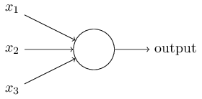




Neural Network Basics
Given several inputs: and several weights: and a bias value:
A neuron produces a single output:
This sum is called the activation of the neuron
The function s is called the activation function for the neuron
The weights and bias values are typically initialized randomly and learned during training

Slide 11
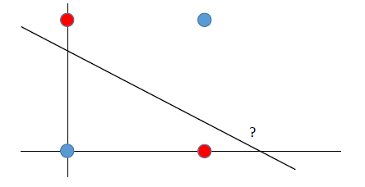
Activation Function & Non-linearity
The critical part is the non-linearity
Example: Create a classifier, that learns the XOR function
No linear classifier can solve this problem
“not bad” != “not” + “bad”
not good
not bad
very good
very bad

Slide 12
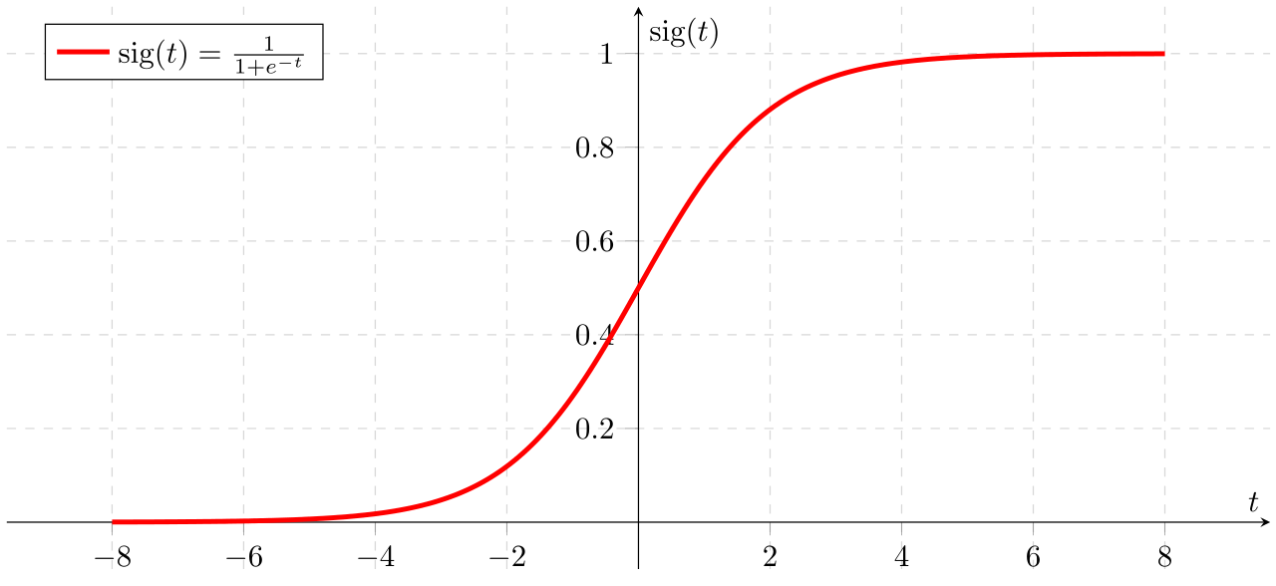
Activation Function
The non-linearity is a crucial concept that gives neural networks more representational power compared to some other techniques (linear SVM, logistic regression)
Without the non-linearity, it is impossible to model certain combinations of features (like Boolean XOR function), unless we do manual feature engineering
Typical non-linear activation functions for neural nets are the sigmoid function, the hyperbolic tangent or a step function
Img-Source: Wikipedia

Slide 13
Typical Activation Function
Sigmoid Function scales between 0 and 1
Img-Source: Wikipedia

Slide 14
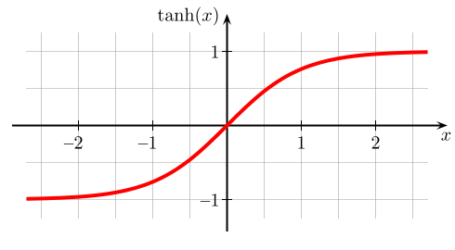
Typical Activation Function
hyperbolic tangent scales between -1 and 1
Img-Source: Wikipedia

Slide 15

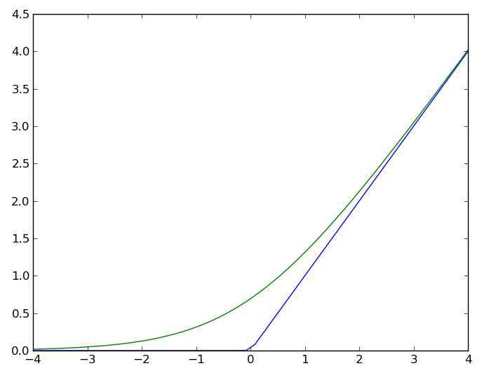

Typical Activation Function
Rectifier (blue):
Smooth approximation (green):
A unit using the rectifier function is called rectified linear unit (ReLU)
Img-Source: Wikipedia

Slide 16
Which Activation Function to use?
Most papers use the tanh or a mathematically easier to compute version of it (due to performance increases)
For certain problems the rectifier can be useful, especially for convolutional neural networks
Be careful with your input data, the activation can become arbitrarily large -> “one input dimension could rule them all”
Rule of Thumb
Use tanh for all your hidden layers
Changing the activation function has only minor effect

Slide 17
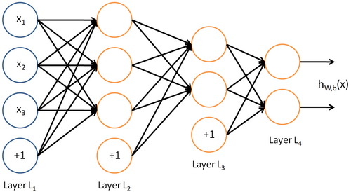
Feed Forward Neural Networks
Img-Source: http://ufldl.stanford.edu/wiki/
Feed Forward Networks
The most simple network architecture
Information flows only in one direction
Input Layer: Represents my data
Output layer: Represents possible labels

Slide 18
Hidden-Layer
The hidden layer (L₂, L₃) represent learned non-linear combination of input data
For solving the XOR problem, we need a hidden layer
some neurons in the hidden layer will activate only for some combination of input features
the output layer can represent combination of the activations of the hidden neurons
Neural network with one hidden layer is a universal approximator
Every function can be modeled as a shallow feed forward network
Not all functions can be represented efficiently with a single hidden layer ⇒ we still need deep neural networks

Slide 19









Matrix Notation
Given 3-dimensional input
Given first weight matrix:
Given first bias vector:
Given second weight matrix:
Given second bias vector:
Given third weight matrix:
Given third bias vector:
Computation L₂ :
Computation L₃ :
Computation L₄ :
Img-Source: http://ufldl.stanford.edu/wiki/

Slide 20
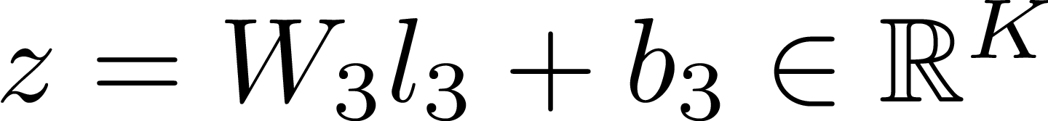
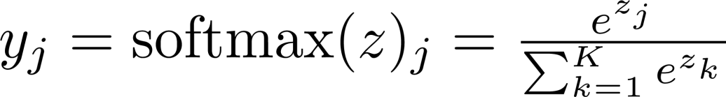
Softmax-Classifier
For classification, most networks apply a softmax-classifier as final layer
Softmax regression is a generalization of logistic regression to the case of multiple classes
Given we have K classes (K = number of output units). Compute the activation z for the last layer: Compute the final output y:
y_{j} can have values between 0 and 1
y_{j} sums up to 1 -> It can be interpreted as probability distribution

Slide 21
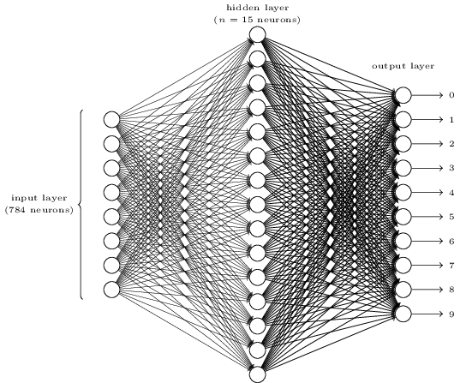
Feed-Forward Network for Handwritten Digit Recognition
Img-Source: http://neuralnetworksanddeeplearning.com

Slide 22
Hidden Layers
Rule of Thumb
The number and the size of the hidden layers can have a large impact on the performance
More hidden layers ⇒ more parameters to learn ⇒ more data needed
Start with a small number of hidden layers, i.e. with 1
Increase number of hidden layers stepwise until you find an optimum
Typically decreasing sizes for the hidden layers, for example 2000 dim ⇒ 1500 dim ⇒ 750 dim ⇒ 100 dim ⇒ 10 dim

Slide 23
Initialization of Weights and Bias
The weights and bias vectors are the parameters that we learn during training
The bias is typically initialized to 0
The weights are randomly initialized – Use Glorot-style uniform initialization
Xavier Glorot & Yoshua Bengio, Understanding the difficulty of training deep feedforward neural networks (http://jmlr.org/proceedings/papers/v9/glorot10a/glorot10a.pdf)
Explanation of the algorithm: http://andyljones.tumblr.com/post/110998971763/an-explanation-of-xavier-initialization
Implementation / Usage in Theano & Lasagne is straight forward
Be careful: The maximal size of the weights is different for the tanh and the sigmoid activation function.

Slide 24

Training Neural Networks
Img-Source: https://www.flickr.com/photos/jakerust/

Slide 25


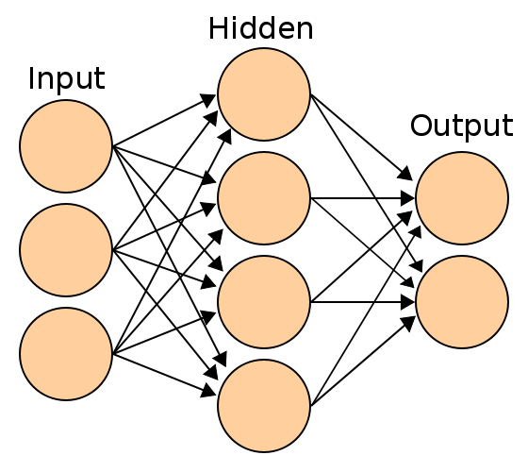
Back Propagation
Defining an Error Function
First we need an error function which computes the difference between the output of the network and the expected output (true label)
In case of single label classification, we can use the negative log-likelihood: with y denoting the expected label and o the output vector.
In case of a distributional classification, we can use the mean squared error: with y_{i} denoting the expected value for node i
We then want to minimize the error function
Defining the error function is an important aspect in designing a deep neural network
Changing the error function changes what our network learns
Img-Source: Wikipedia

Slide 26
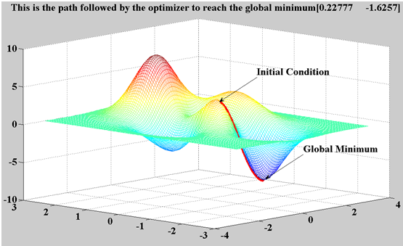
Back Propagation – Gradient Descent
Source: mathworks.de
Gradient Descent
We want to minimize the error function by tuning the trainable parameters (weights and biases)
The gradient (the derivative of a multi dim. function) points us torwards a local minima
We follow the gradient by a certain step length. This length is called learning rate

Slide 27
Computation of Gradients in Theano
Computation of the gradient (the derivative of a multi dimensional function) can be cumbersome
Especially as the computation must be computationally efficient, as we will perform billions of such computations
Theano is great, as it provides us automatic gradient computation
We don’t need to compute the derivative
And we don’t need to implement it into our program code
-> Awesome!
Next slides look a bit complicated, but doing back propagation via stochastic gradient descent (SGD) is quite simple in Theano

Slide 28
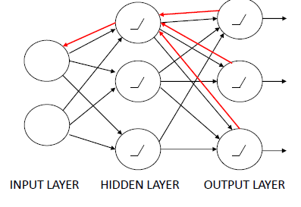

Back Propagation – Gradient Descent
Training with back propagation:
Given the input data, we compute the values for the output neurons
Compare the output to the gold labels – compute error function
Compute the derivative for all tunable parameters (weights and parameters)
Update the parameters: is denoting the learning rate
Each iteration is called an epoch. With each epoch, the error function decreases, converging to a local minima
Source: Mikolov, 2014

Slide 29
Motivation for Deep Learning
Feed forward networks with a single hidden layer can compute any function ⇒ in theory, no need for deep architectures
However, learning shallow architectures is not always efficient
To learn the parity function (N bits at input, output is 1 if the number of active input bits is odd) requires an exponential number of hidden units ⇒ requires exponentially more training data
See the 2009 Yoshua Bengio Book – Chapter 2 Theoretical Advantages of Deep Architectures for more information
http://www.iro.umontreal.ca/%7Ebengioy/papers/ftml_book.pdf

Slide 30
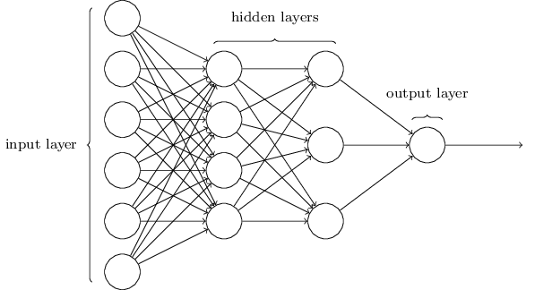
Going from Shallow to Deep Neural Networks
Neural Networks can have several hidden layers
Initializing the weights randomly and training all layers at once does hardly work
Instead we train layerwise on unannotated data (a.k.a. pre-training):
Train the first hidden layer
Fix the parameters for the first layer and train the second layer.
Fix the parameters for the first & second layer, train the third layer
…
After the pre-training, train all layers using your annotated data
The pre-training on your unannotated data creates a high-level abstractions of the input data
The final training with annotated data fine tunes all parameters in the network

Slide 31
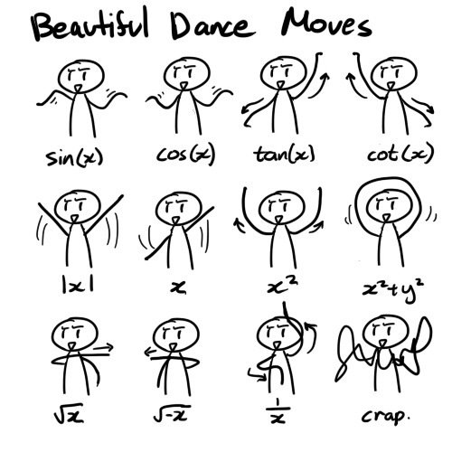
Everything is a Vector
Source: https://www.flickr.com/photos/dylanng/

Slide 32
Vectors in Deep Learning
Deep Learning loves dense vectors
Everything is represented and understood as a vector
Vectors allows an end-to-end-training
No more in-between mapping to tag sets etc.
No problem with modeling hard cases and ambiguities
No problem with error propagation between pipeline components
Dense Vector
In a dense vector most values are non-zero

Slide 33
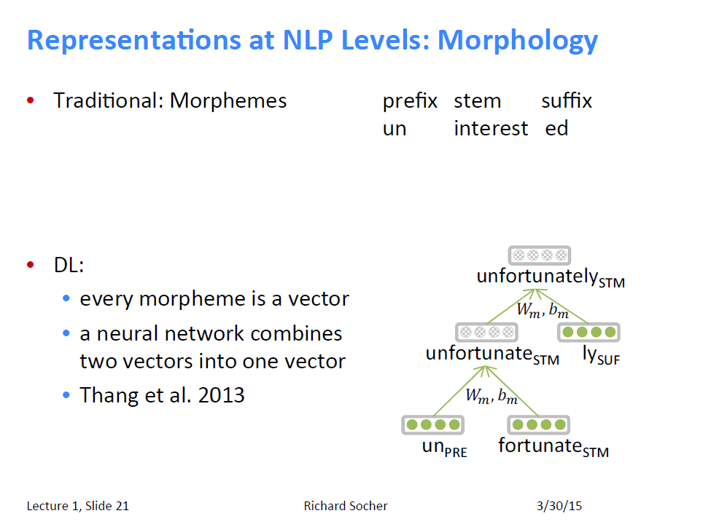
Source: Richard Socher, CS224d, http://cs224d.stanford.edu/syllabus.html

Slide 34
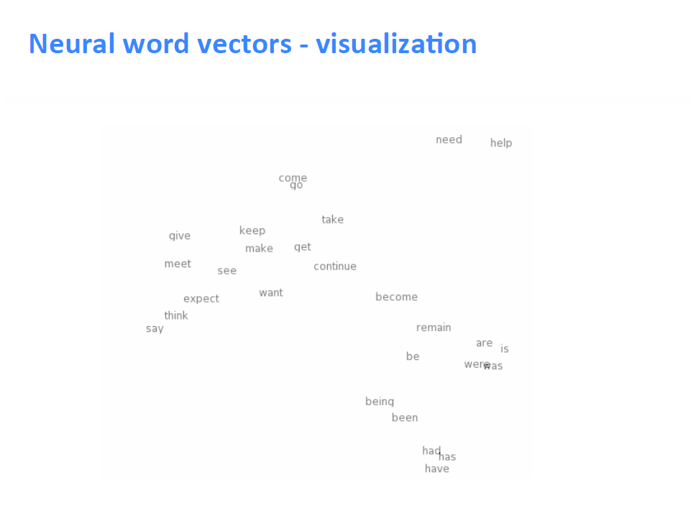
Source: Richard Socher, CS224d, http://cs224d.stanford.edu/syllabus.html

Slide 35
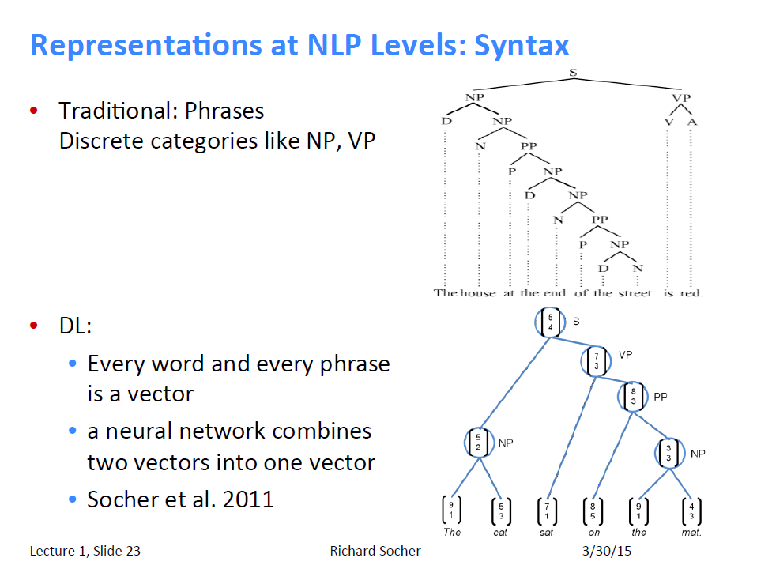
Source: Richard Socher, CS224d, http://cs224d.stanford.edu/syllabus.html

Slide 36
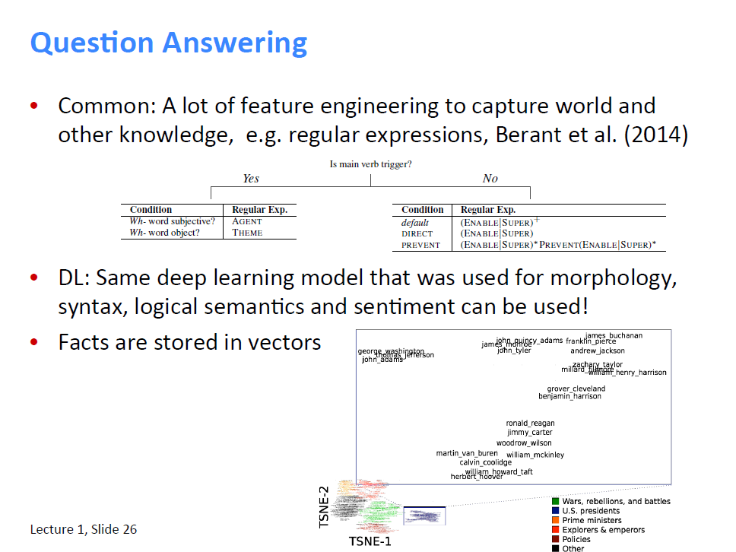
Source: Richard Socher, CS224d, http://cs224d.stanford.edu/syllabus.html

Slide 37
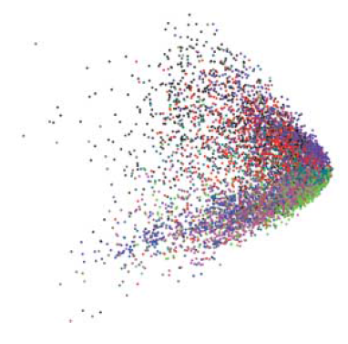
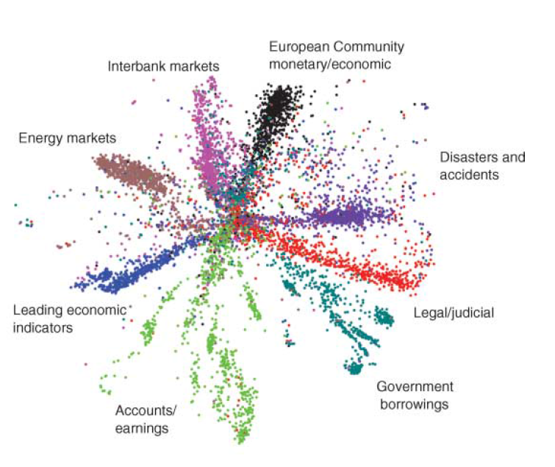
Learning Multiple Levels of Representation
Biologically inspired: The brain has a deep architecture
Instead of solving a task directly, we learn intermediate representations
Highly non-linear properties can be captured this way
Insufficient model depth can be exponentially inefficient
LSA
Deep Autoencoder
Source: Hinton et al., 2006

Slide 38
Next Lecture
Preparation before class:
Install Python (2.7), NumPy, SciPy and Theano (Installing Theano for Ubuntu)
Install Lasagne
Refresh your knowledge on Python and Numpy:
Python and Numpy Tutorial
Python-Tutorial and Numpy refresher from the Theano website
Hint: You can install Python, Theano etc. on you local desktop machine and log into it via SSH or via IPython Notebook during class

