Slide 1
Deep Learning for NLP
Nils Reimers
Course-Website: www.deeplearning4nlp.com

Slide 2
Last Week Exercise
Adapt the Keras NER implementation and include capitalization information

Slide 3
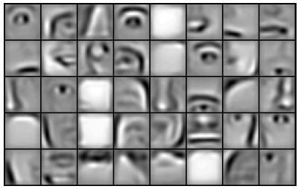
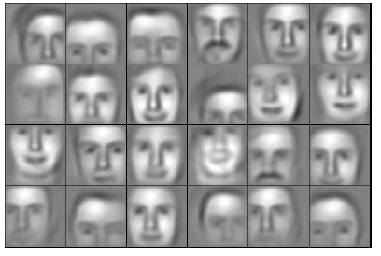
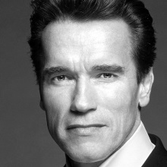
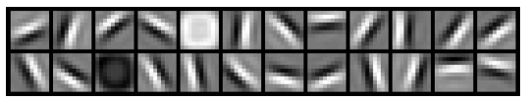
What does the intermediate Layers learn?
Lee et al. (ICML 2009) learned automatically different feature detectors
Input
e.g. 40 000 dim
Layer 1
9 600 dim
Layer 2
3800 dim
Layer 3
900 dim

Slide 4
Warm-Up Question
How to use a feed forward network for coreference resolution?
Hint: We can model this as a binary classification task: does two mention refer to the same entity?

Slide 5
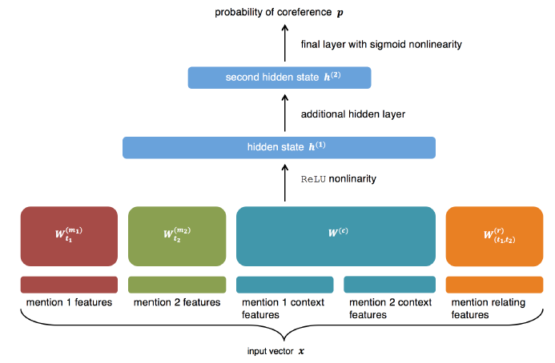
Solution
Kevin Clark, 2014, Neural Coreference Resolution

Slide 6
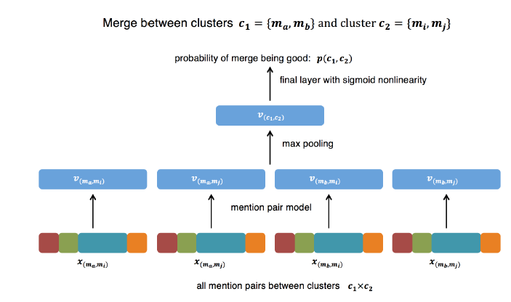
Solution II
Kevin Clark, 2014, Neural Coreference Resolution

Slide 7
Recommended Readings
Autoencoders:
http://ufldl.stanford.edu/tutorial/unsupervised/Autoencoders/
http://ufldl.stanford.edu/wiki/index.php/Stacked_Autoencoders
http://ufldl.stanford.edu/wiki/index.php/Fine-tuning_Stacked_AEs
Recursive Neural Networks:
Socher et al., 2011, Semi-supervised recurisve autoencoders for predicting sentiment distributions http://dl.acm.org/citation.cfm?id=2145450
Socher et al., 2013, Recursive Deep Models for Semantic Compositionality over a Sentiment Treebank http://nlp.stanford.edu/%7Esocherr/EMNLP2013_RNTN.pdf
Good video from Hinton on autoencoders and pretraining
https://www.youtube.com/watch?v=vShMxxqtDDs

Slide 8
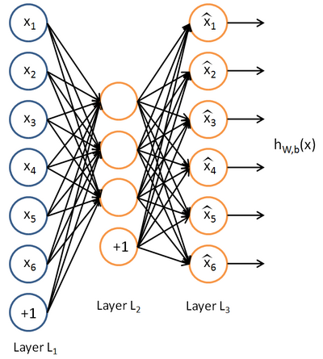


Autoencoders
Autoencoders
Unsupervised Learning Algorithm
Given an input x, we learn a compressed representation of the input, which we then try to reconstruct
In the simpliest form: Feed forward network with hidden size < input size.
We then search for parameters such that: for all training examples
The error function is:
Once we finished training, we are interested in the compressed representation, i.e. the values of the hidden units
Source: http://ufldl.stanford.edu/wiki/index.php/Autoencoders_and_Sparsity

Slide 9
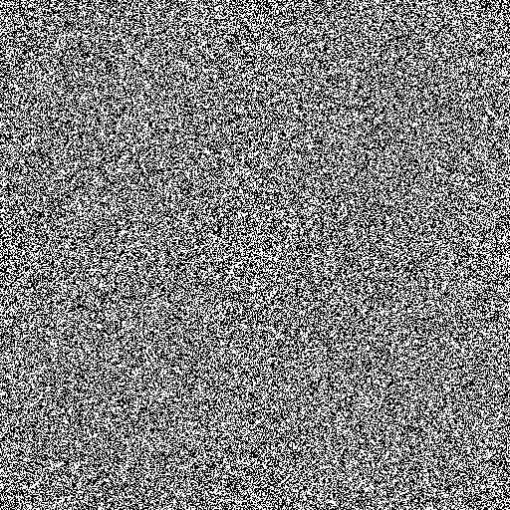
Why would we use autoencoders?
How does a randomly generated image look like?

Slide 10
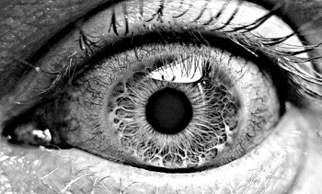
Why would we use autoencoders?
What would be the probability to get an image like this from random sampling?

Slide 11
Why would we use autoencoders?
Produce a compressed representation of a high-dimensional input (for example images)
The compression is lossy. Learning drives the encoder to be a good compression in particular for training examples
For random input, the reconstruction error will be high
The autoencoder learns to abstract properties from the input. What defines a natural image? Color gradients, straight lines, edges etc.
The abstract representation of the input can make a further classification task much easier

Slide 12
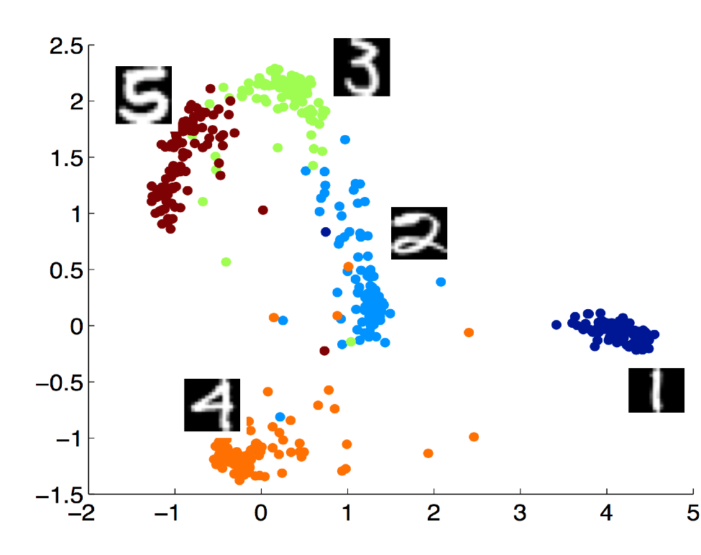
Dimension-Reduction can simplify classifcation tasks – MNIST Task

Slide 13
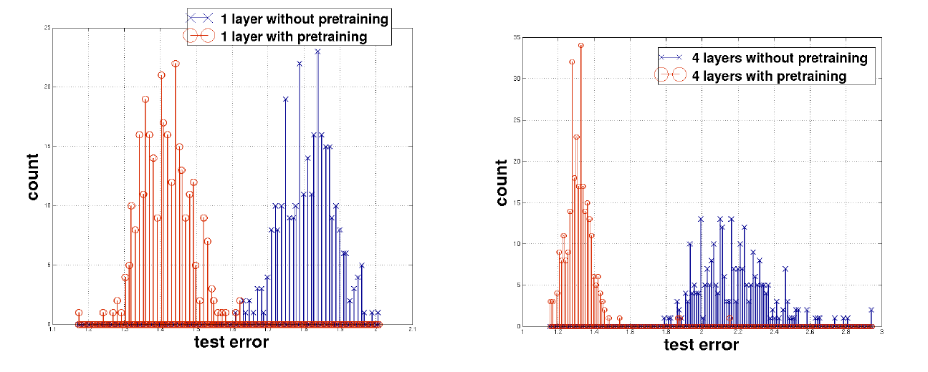
Dimension-Reduction can simplify classifcation tasks – MNIST Task
Histogram-plot of test error on the MNIST hand written digit recognition.
Comparison of neural network with and without pretraining
Source: Erhan et al, 2010, Why Does Unsupervised Pre-training Help Deep Learning?

Slide 14
Autoencoders vs. PCA
Principle component analysis (PCA) converts a set of correlated variables to a set of linearly uncorrelated variables called principle components
PCA is a standard method to break down high-dimensional vector spaces, e.g. for information extraction or visualization
However, PCA can only capture linear correlations

Slide 15
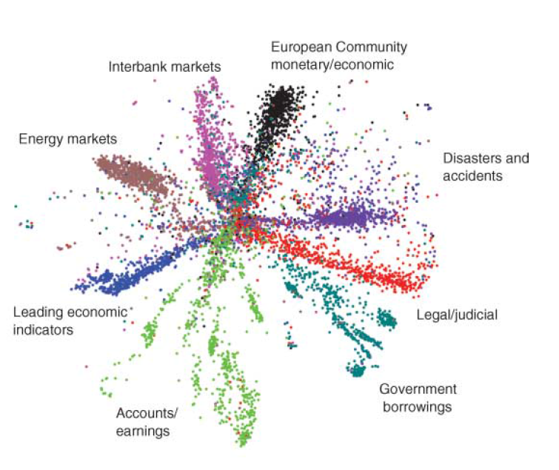
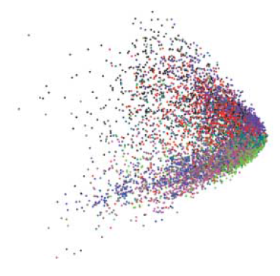
Autoencoders vs. PCA - Example
Articles from Reuter corpus were mapped to a 2000 dimensional vector, using the 2000 most common word stems
LSA
Deep Autoencoder
Source: Hinton et al., Reducing the Dimensionality of Data with Neural Networks

Slide 16


How to ensure the encodes does not learn the identity function?
Identify Function
Learning the identity function would not be helpful
Different approaches to ensure this:
Bottleneck constraint: The hidden layer is (much) smaller than the input layer
Sparse coding: Forcing many hidden units to be zero or near zero
Denoising encoder: Add randomness to the input and/or the hidden values
Denoising Encoder
Create some random noise
Compute
Reconstruction Error:
Alternatively: Set some of the neurons (e.g. 50%) to zero
The noise forces the hidden layer to learn more robust features

Slide 17
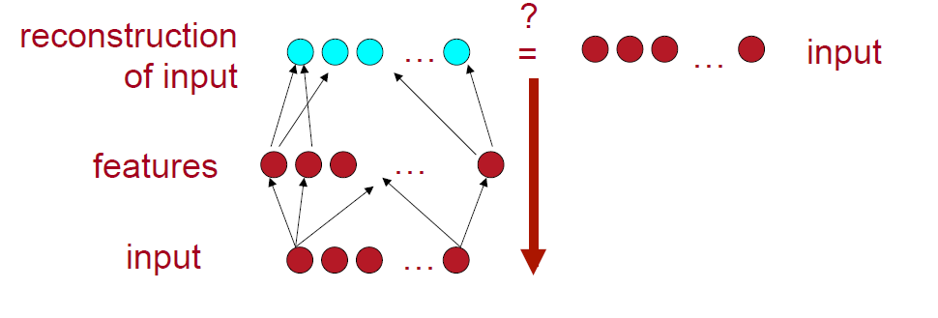
Stacking Autoencoders
We can stack multiple hidden layers to create a deep autoencoder
These are especially suitable for highly non-linear tasks
The layers are trained layer-wise – one at a time
Step 1: Train single layer autoencoder until convergence

Slide 18
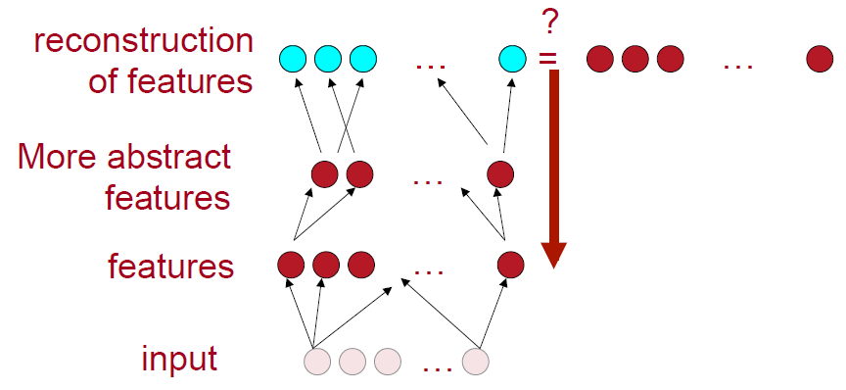

Stacking Autoencoders
Step 2: Add additional hidden layer and train this layer by trying to reconstruct the output of the previous hidden layer. Previous layers are will not be changed. Error function: .

Slide 19
Stacking Autoencoders – Fine-tuning
After pretraining all hidden layers, the deep autoencoder is fine-tuned
Unsupervised Fine-Tuning:
Apply back propagation to the complete deep autoencoder
Error-Function:
Further details, see Hinton et al.
(It appears that supervised fine-tuning is more common nowadays)
Supervised Fine-Tuning:
Use your classification task to fine-tune your autoencoders
A softmax-layer is added after the last hidden layer
Weights are tuned by using back prograpagtion.
See next slides for an example or http://ufldl.stanford. edu/wiki/index.php/Stacked_Autoencoders

Slide 20
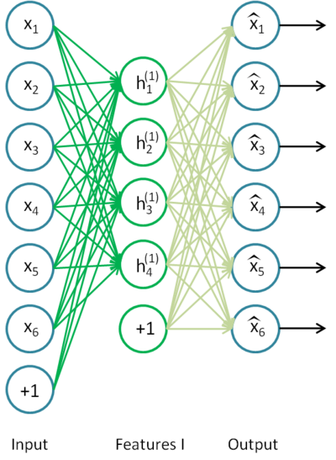


Stacking Autoencoders - Example
Pretrain first autoencoder
Train an autoencoder to get the first weight matrix and first bias vector
The second weight matrix, connecting the hidden and the output units, will be disregarded after the first pretraining step
Stop after a certain number of iterations
Source: http://ufldl.stanford. edu/wiki/

Slide 21
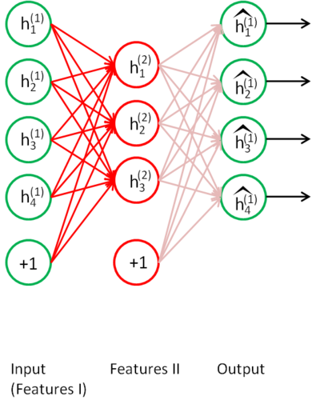
Stacking Autoencoders - Example
Pretrain second autoencoder
Use the values of the previous hidden units as input for the next autoencoder.
Train as before
Source: http://ufldl.stanford. edu/wiki/

Slide 22
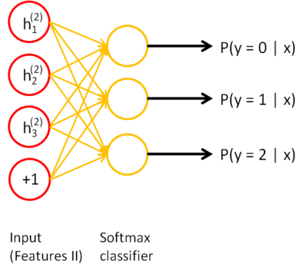
Stacking Autoencoders - Example
Pretrain softmax layer
After second pretraining finishes, add a softmax layer for your classification task
Pretrain this layer using back propagation
Source: http://ufldl.stanford. edu/wiki/

Slide 23
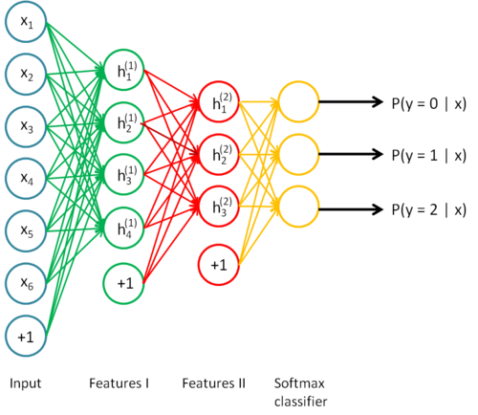
Stacking Autoencoders - Example
Fine-tuning
Plug all layers together
Compute the costs based on the actual input
Update all weights using backpropagation
Source: http://ufldl.stanford. edu/wiki/

Slide 24
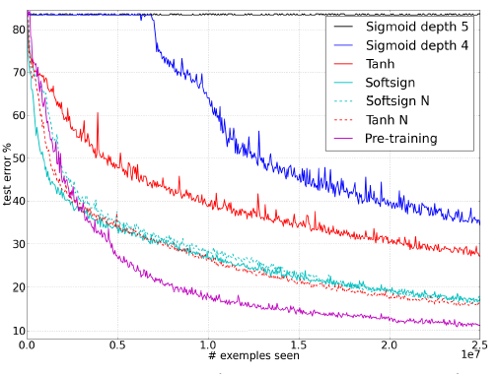
Is pre-training really necessary?
Xavier Glorot and Yoshua Bengio, 2010, Understanding the difficulty of training deep feedforward neural networks
With the right activation function and initialization, the importance of pre-training decreases

Slide 25
Is pre-training really necessary?
Pre-training achieves two things:
It makes optimization easier
It reduces overfitting
Pre-training is not required to make optimization work, if you have enough data
Mainly due to a better understanding how initialization works
Pre-training is still very effective on small datasets
More information: https://www.youtube.com/watch?v=vShMxxqtDDs

Slide 26
Recursive Neural Networks
Socher et al., 2011, Semi-supervised recursive autoencoders for predicting sentiment distributions
Socher et al., 2013, Recursive Deep Models for Semantic Compositionality over a Sentiment Treebank

Slide 27
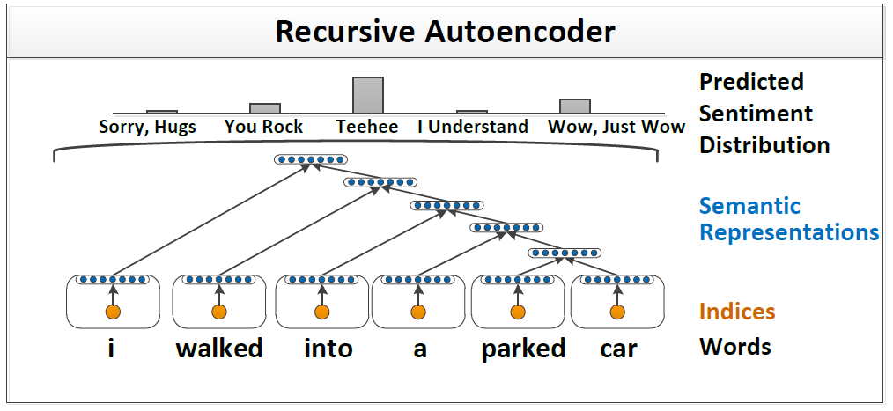
Recursive Autoencoders
In a first step, words are mapped to dense vectors (word embeddings)
Iteratively they are combined and reduced to form a single compact representation of the sentence

Slide 28



Recursive Autoencoders (RAE)
Given two embeddings each with length n
The autoencoder takes as input and maps it to a hidden layer of size n:
The function is repeatedly applied for the whole sentence until we receive a single vector of size n, representing the semantic of this sentence

Slide 29

Selecting the nodes that should be combined
The previous slides showed a joining of the vectors from right to left
However, we can define any tree structure for the combination of two vectors, for example a parse tree
Socher et al. present a greedy approach for the combination of vectors
Compute the reconstruction error for all neighboring vectors.
The two neighbors with the lowest error are selected and their nodes are replaced by the compressed representation.
Repeat the previous two steps until we end up with a single vector representing the semantics of the sentence
The output of the recursive autoencoder can be used for a classification task by adding a final softmax layer:

Slide 30
Dropout in Neural Networks
Inspired by Hinton https://www.youtube.com/watch?v=vShMxxqtDDs
For details:
Srivastava, Hinton et al., 2014, Dropout: A Simple Way to Prevent Neural Networks from Overtting

Slide 31
Ensemble Learning
Create many different models and combine them at test time to make prediction
Averaging over different models is very effective against overfitting
Random Forest
A single decision trees is not very powerful
Creating hundreds of different trees and combine them
Random forests works really well
Several Kaggle competitions, e.g. Netflix, were won by random forests

Slide 32
Model Averaging with Neural Nets
We would like to do massive model averaging
Average over 100, 1.000, 10.000 or 100.000 models
Each net takes a long time to train
We don’t have enough time to learn so many models
At test time, we don’t want to run lots of large neural nets
We need something that is more efficient
Use dropouts!

Slide 33
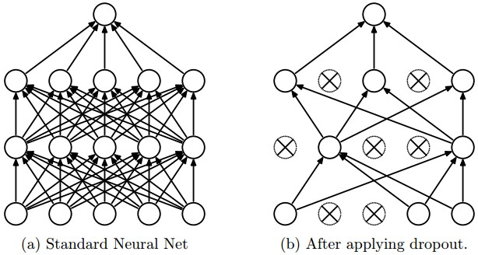
Dropout
Each time present a training example, we dropout 50% of the hidden units
With this, we randomly sample over 2^{H} different architectures
H: Number of hidden units
All architectures share the same weights
Img source: http://cs231n.github.io/

Slide 34
Dropout
With H hidden units, we sample from 2^{H} different models
Only few of the models get ever trained and they only get 1 training example
Sharing of weights means that every model is strongly regularized
Much better than L1 and L2 regularization, which pulls weights towards zero
It pulls weights towards what other models need
Weights are pulled towards sensible values
This works in experiments extremely well

Slide 35
Dropout – at test time
We could sample many different architectures and average the output
This would be way too slow
Instead: Use all hidden units and half their outgoing weights
Computes the geometric mean of the prediction of all 2^{H} models
Using this trick, we train and use trillions of “different” models
For the input layer:
We could apply dropout also to the input layer
The probability should be then smaller than 0.5
This is known as denoising autoencoder
Currently this cannot be implemented in out-of-the-box Keras

Slide 36
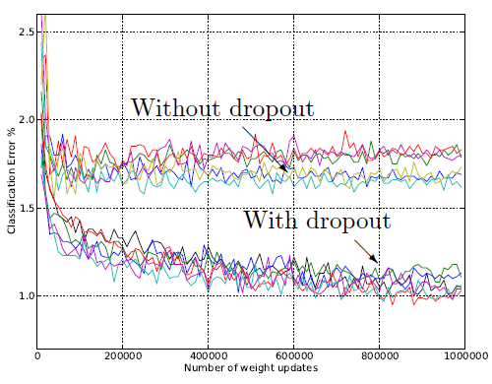
How well does dropout work?
Classification error on MNIST dataset
Source: Srivastava et al, 2014, Drouput A Simple Way to Prevent Neural Networks from Overtting

Slide 37
How well does dropout work?
If your deep neural network is significantly overfitting, dropout will reduce the number of errors a lot
If your deep neural network is not overfitting, you should be using a bigger one
Our brain: #parameters >> #experiences
Synapses are much cheaper then experiences

Slide 38
Another way to think about Dropout
In a fully connected neural network, a hidden unit knows which other hidden units are present
The hidden unit co-adapt with them for the training data
But big, complex conspiracies are not robust -> they fail at test time
In the dropout scenario, each unit has to work with different sets of co-workers
It is likely that the hidden unit does something individually useful
It still tries to be from its co-workers

