Slide 1

WINE QUALITY EDA
- MEGHA SINGHAL

Slide 2
Problem Statement
The dataset is related to red and white variants of the Portuguese "Vinho Verde" wine. Due to privacy and logistic issues, only physicochemical (inputs) and sensory (the output) variables are available .
Purpose:
To analyze the dataset to summarize the main characteristics in order to determine the quality of wine.
Approach:
Performed basic EDA.

Slide 3
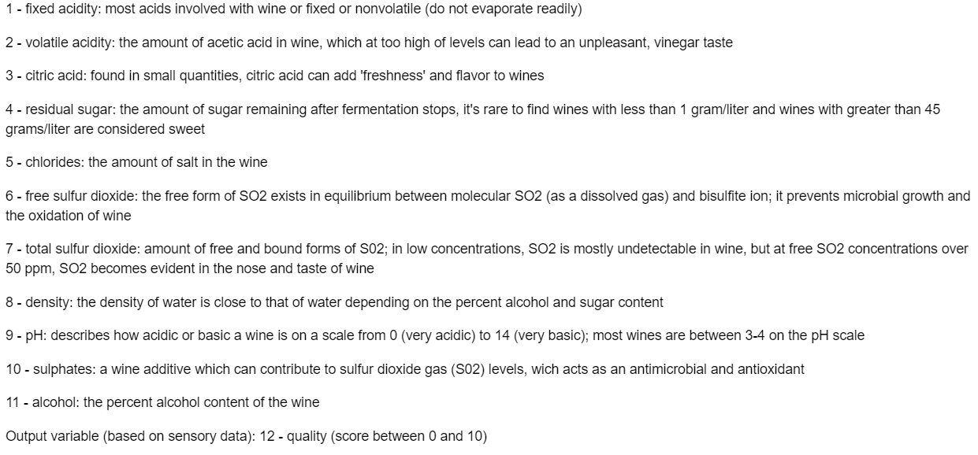
Data Description

Slide 4
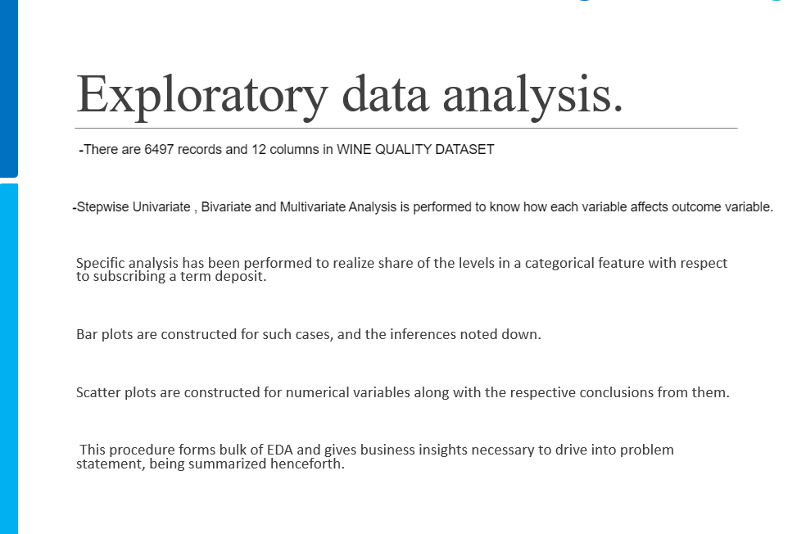

Slide 5

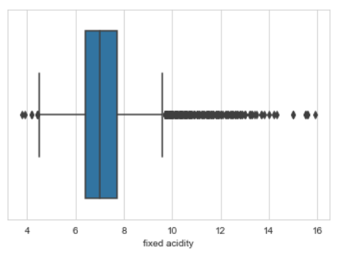
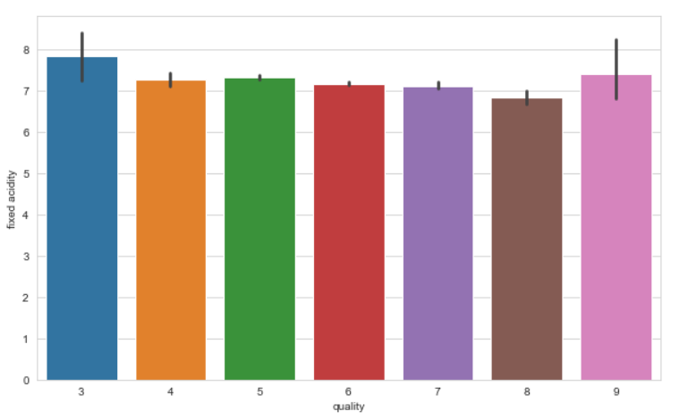
The distribution of fixed.acidity data is lightly right skewed with minimum value of 3.80, maximum of 15 and median of 7 and mean of 7.215.
Here we see that fixed acidity does not give any specification to classify the quality.

Slide 6

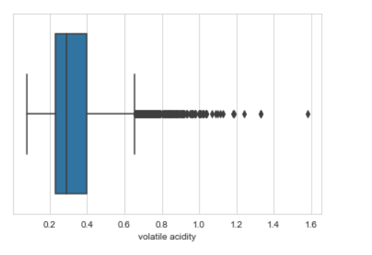
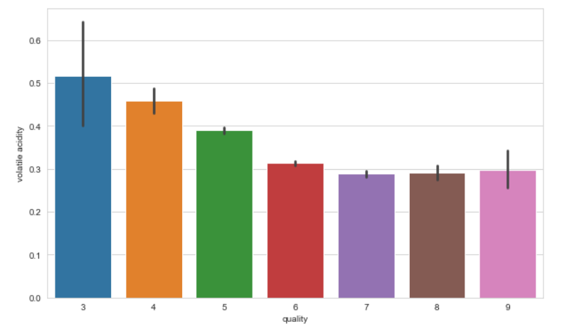
The distribution of volatile.acidity data is right skewed ,with minimum value of 0.08, maximum of 1.58 and median of 0.29 and mean of 0.33.
Here we see that its quite a downing trend in the volatile acidity as we go higher the quality.

Slide 7

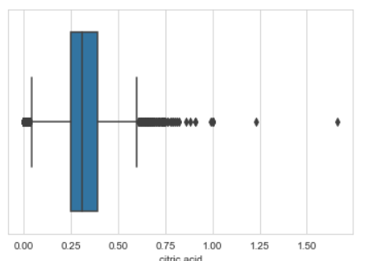
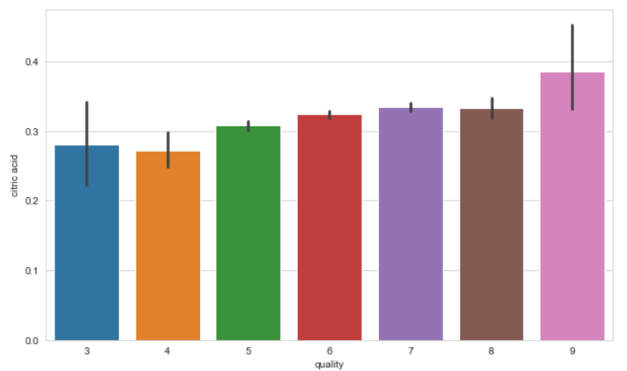
The distribution of citric.acid data is right skewed.
Here we see that its quite a upward trend in the citric acid as we go higher the quality.

Slide 8

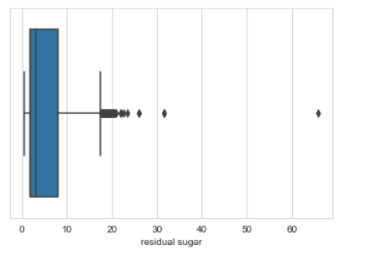
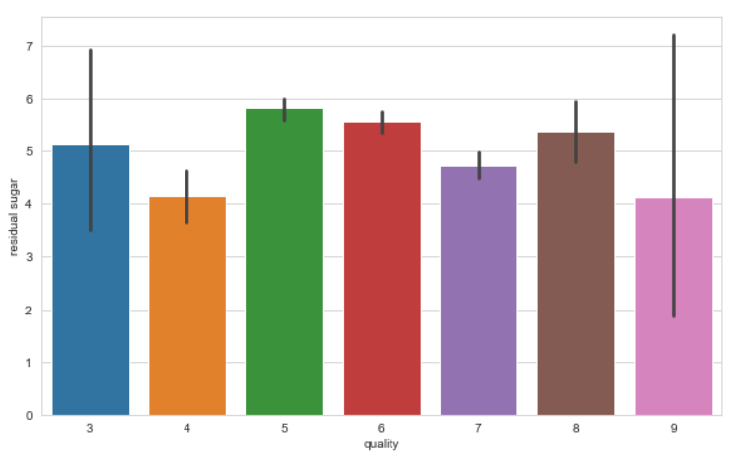
The distribution of residual sugar data is right skewed (long-tailed) with minimum value of 0.6, maximum of 65 (many outlayers) and median of 3 and mean of 5.44.
Here we see that residual sugar does not give any specification to classify the quality.

Slide 9

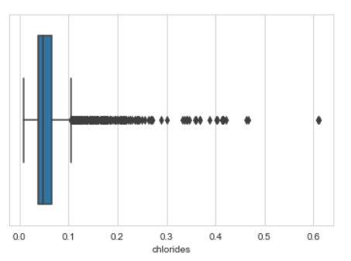
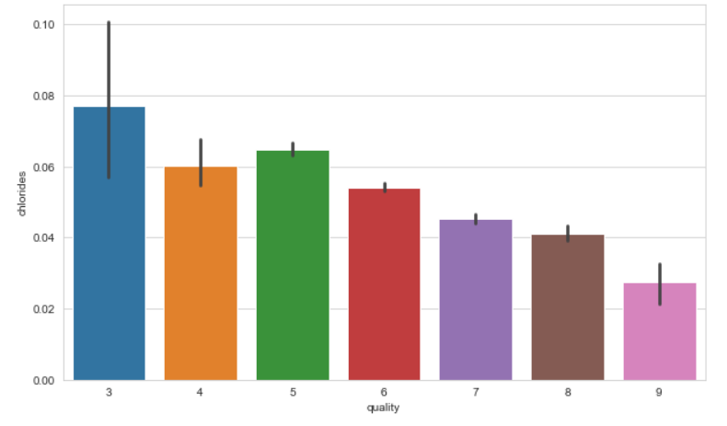
The distribution of chlorides data is also right skewed (long-tailed) and very similar to distribution of residual.sugar with minimum value of 0.009, maximum of 0.611 (many outlayers) and median of 0.047 and mean of 0.005.
Composition of chloride also go down as we go higher in the quality of the wine

Slide 10

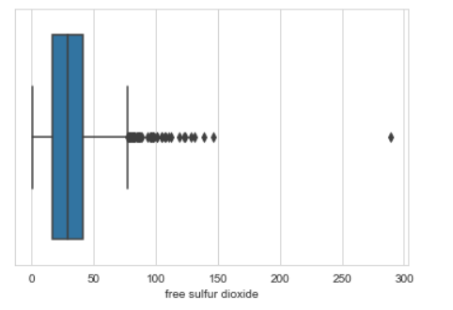
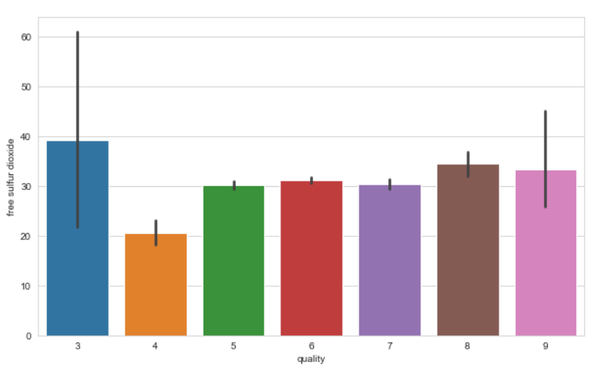
The distribution of sulpher dioxide data is also right skewed (long-tailed) with minimum value of 1, maximum of 289 (many outlayers) and median of 29 and mean of 30.5.
Here we see that residual sugar does not give any specification to classify the quality.

Slide 11

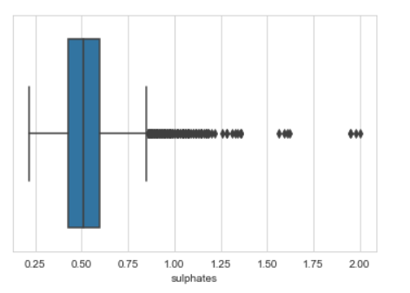
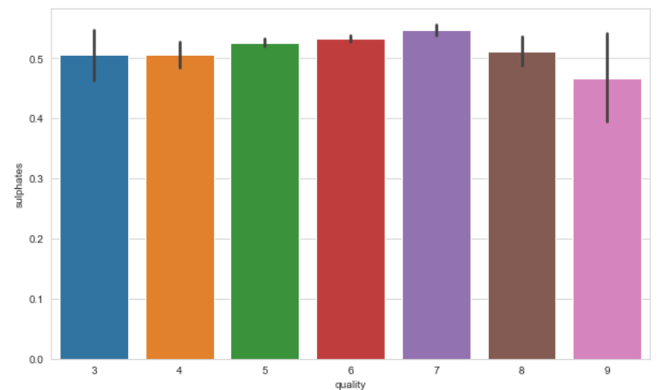
The distribution of sulphates data is right skewed (long-tailed) with minimum value of 0.22, maximum of 2 and median of 0.51 and mean of 0.53.
-The average sulphates value decreases as the quality level increases.

Slide 12

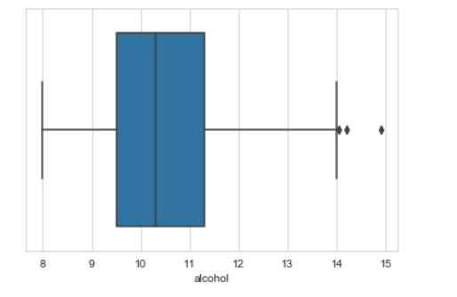
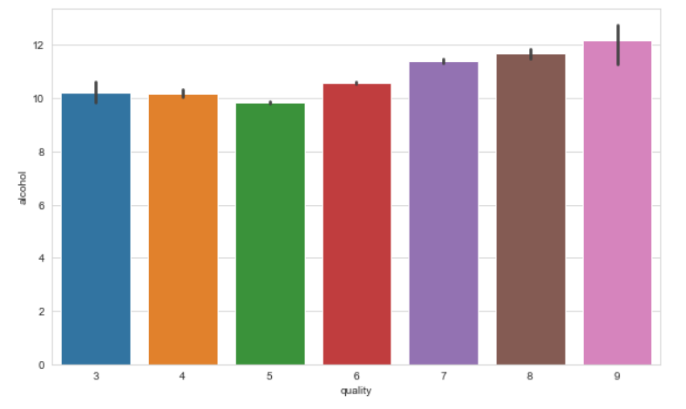
The distribution of alcohol data is right skewed but does not have many outliers with minimum value of 8.0, maximum of 14.9 and median of 10.3 and mean of 10.49.
Alcohol level also goes higher as the quality of wine increases

Slide 13
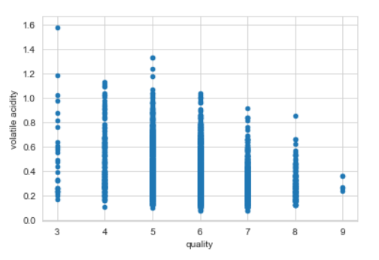
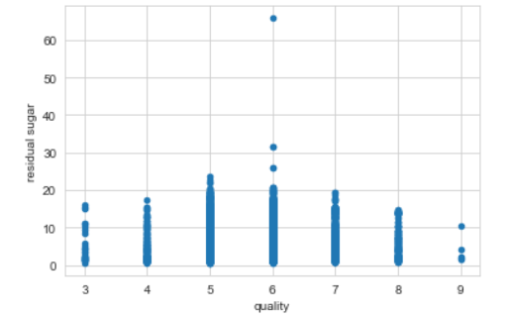

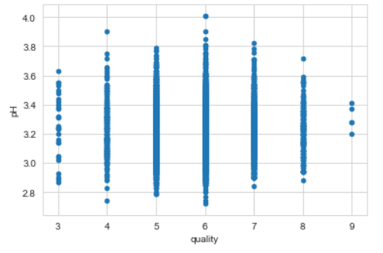
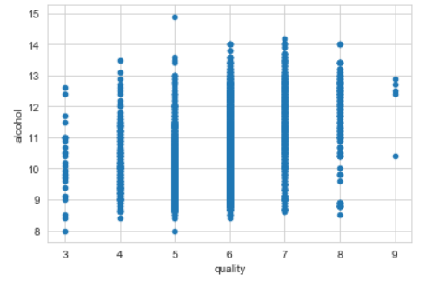
Based on scatterplots of quality against different feature variables, which of the following is most likely to have a positive impact on quality?
- ALCOHOL is most likely to have a positive impact on quality.

Slide 14
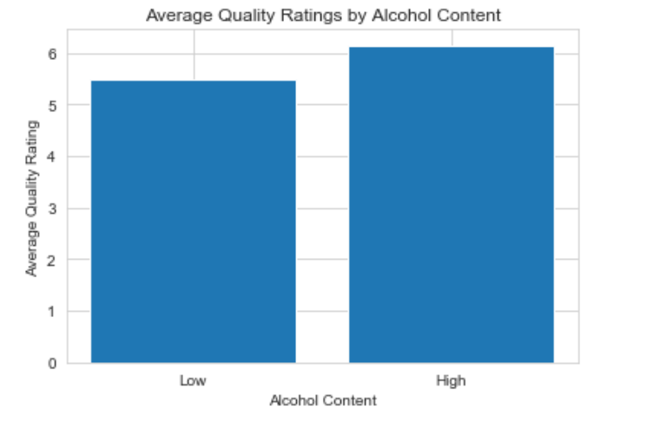
Do wines with higher alcoholic content receive better ratings?
- Yes, Wines with higher alcoholic content generally receive better ratings

Slide 15
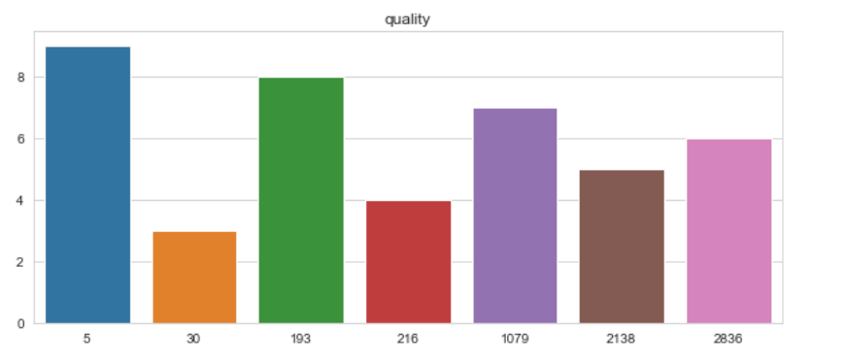
How many wines with particular quality ?
All features in the data set contain numerical values 8 different quality levels have been determined for wines; 3, 4, 5, 6, 7, 8,9 The lowest value is 3 and the highest value is 9.
Class distribution of the samples in the data set is unstable. Unbalanced class distribution is undesirable for machine learning models. Considering this imbalance, the 'stratify' feature will be used when leaving the data set for training and testing.
To cope with the unbalanced distribution of classes, classes with few samples are replicated to have the same number of samples as classes with multiple samples.

Slide 16
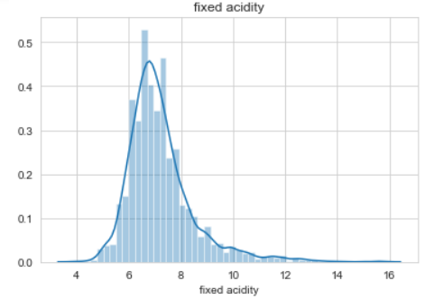
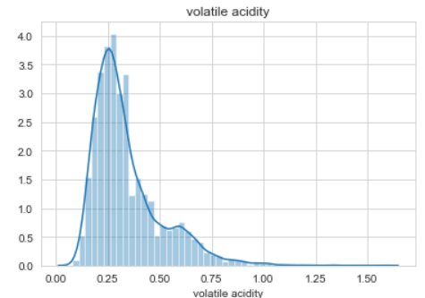
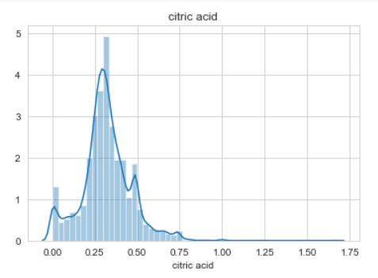
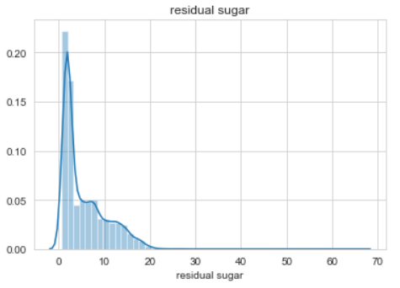
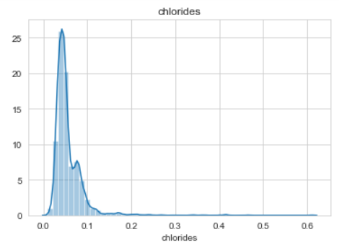
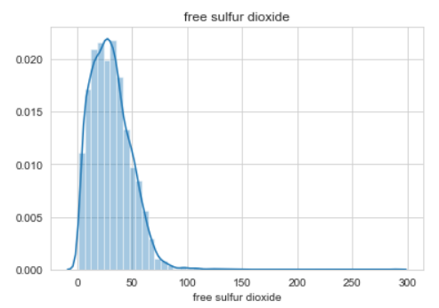
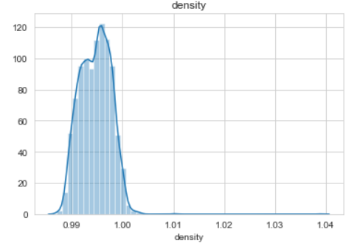
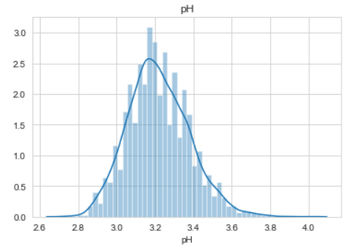
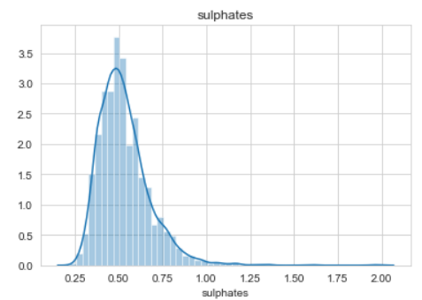
Density plot to check linearity
“pH” column appears to be normally distributed remaining all independent variables are right skewed/positively skewed.

Slide 17
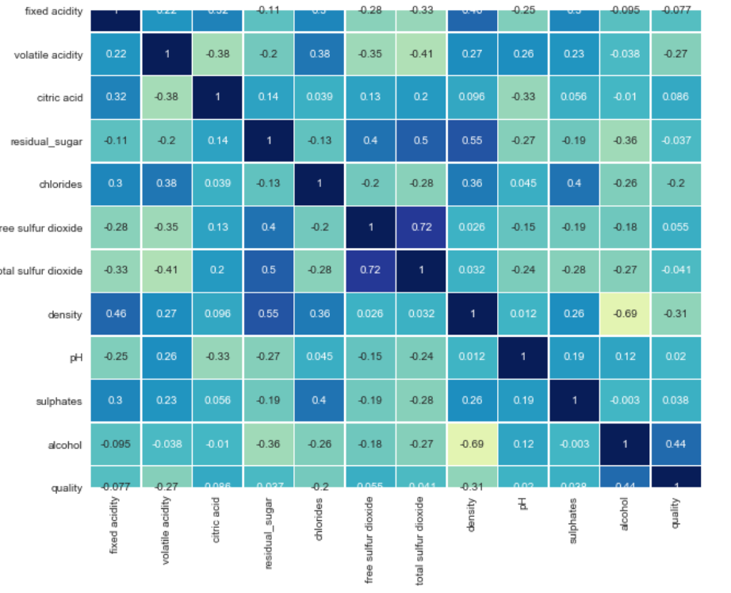
As can be seen from the above heat-map, there is a positive correlation between residual sugar and density, also there is a negative correlation between alcohol and density.

Slide 18
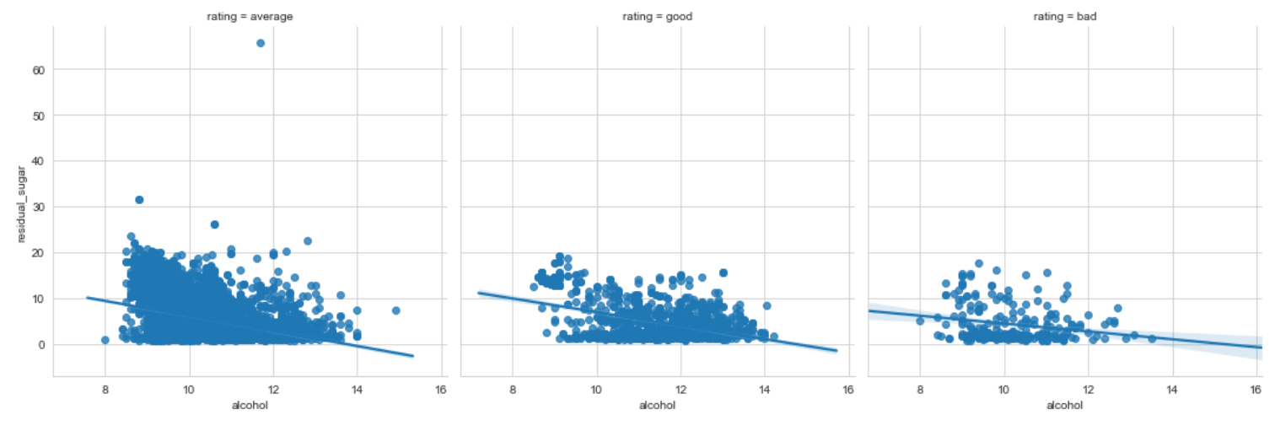
-The linear regression plots above for different wine quality ratings (bad, average & good) shows the regression between alcohol and residual sugar content of the red wine.
-We can observe from the trendline that, for good and average wine types the residual sugar content remains almost constant irrespective of alcohol content value. Whereas for bad quality wine, the residual sugar content increases gradually with the increase in alcohol content.
-This analysis can help in manufacturing the good quality wine with continuous monitoring and controlling the alcohol and residual sugar content.

Slide 19
Conclusion
-We observed the key factors that determine and affects the quality of the red wine. Wine quality is ultimately a subjective measure. The ordered factor 'quality' was not very helpful and to overcome this, so we created another variable called 'rating'.
-Our analysis showed that high quality wines typically have high alcohol content (b/w 10 to 14%) and lower residual sugar (0-20 units).
-This new information suggests that higher quality wines uses moderately sweet grapes and longer fermentation process.
-Too much S02 or volatile acidity means lower quality of wine.
-A right amount of citric acid is a correct balance of a quality wine.
-The usage of this analysis will help to understand whether by modifying the variables, it is possible to increase the quality of the wine on the market. If you can control your variables, then you can predict the quality of your wine and obtain more profits.

Slide 20

Thank You!

