Slide 1

SUMMIX
(An Automated Text Summarizer)
FYP Mid Evaluation Presentation
Supervisor:
Dr. Omer Beg
Team Members:
M. Muneeb Raza (16i-0128)
M. Shahzaib Ali (16i-0246)

Slide 2
CONTENTS
FYP Poster.
Work done up till now and the difficulties we faced.
Work we are up to.

Slide 3
FYP Poster

Slide 4
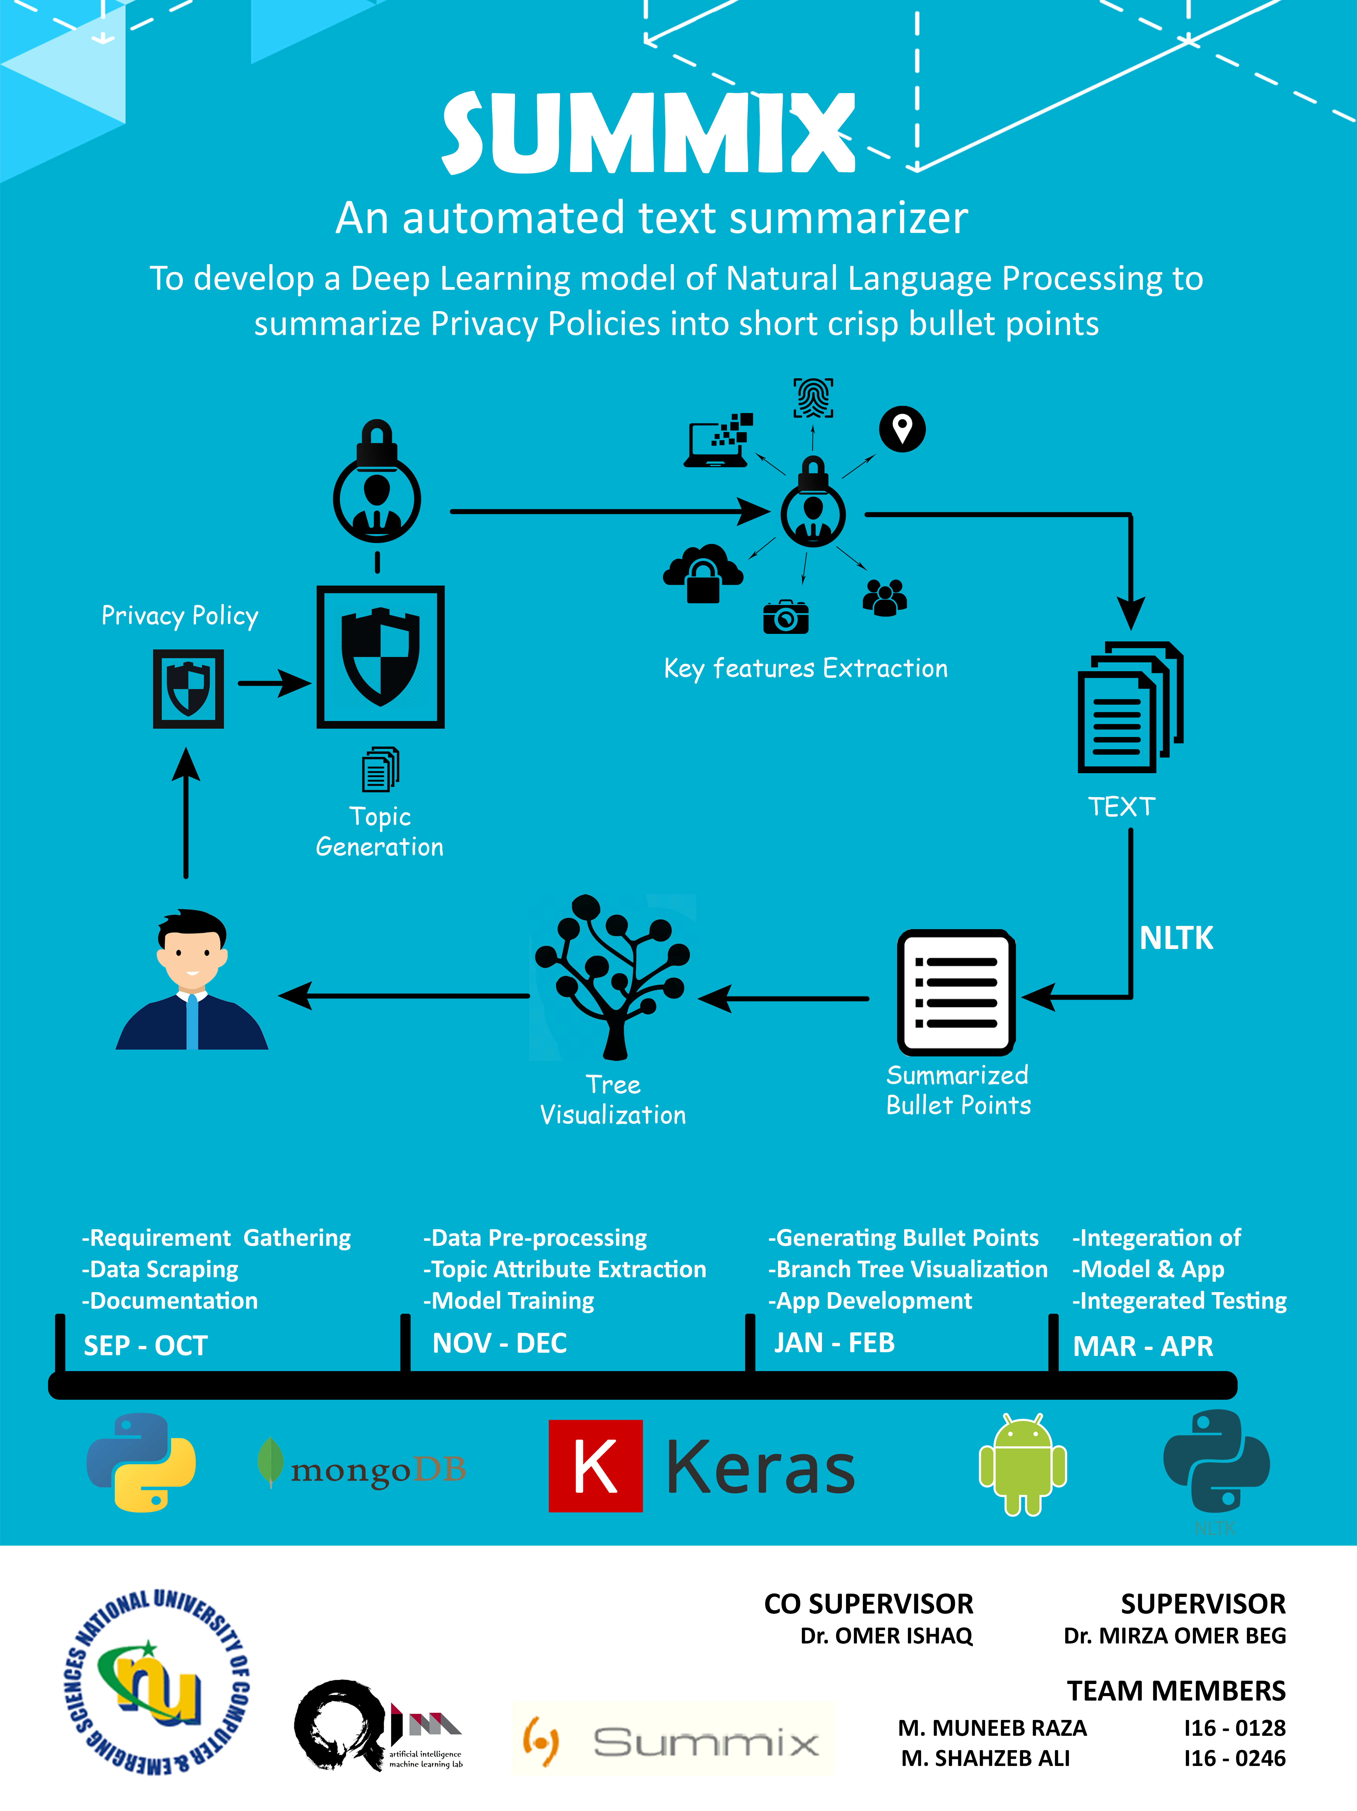
+
Deep Learning model

Slide 5
Work Done

Slide 6
Data Collection
No open source large dataset of privacy policies available.
Made our own scraper
Used Selenium (framework for testing web applications).
Scraped around 10,000 policies.

Slide 7
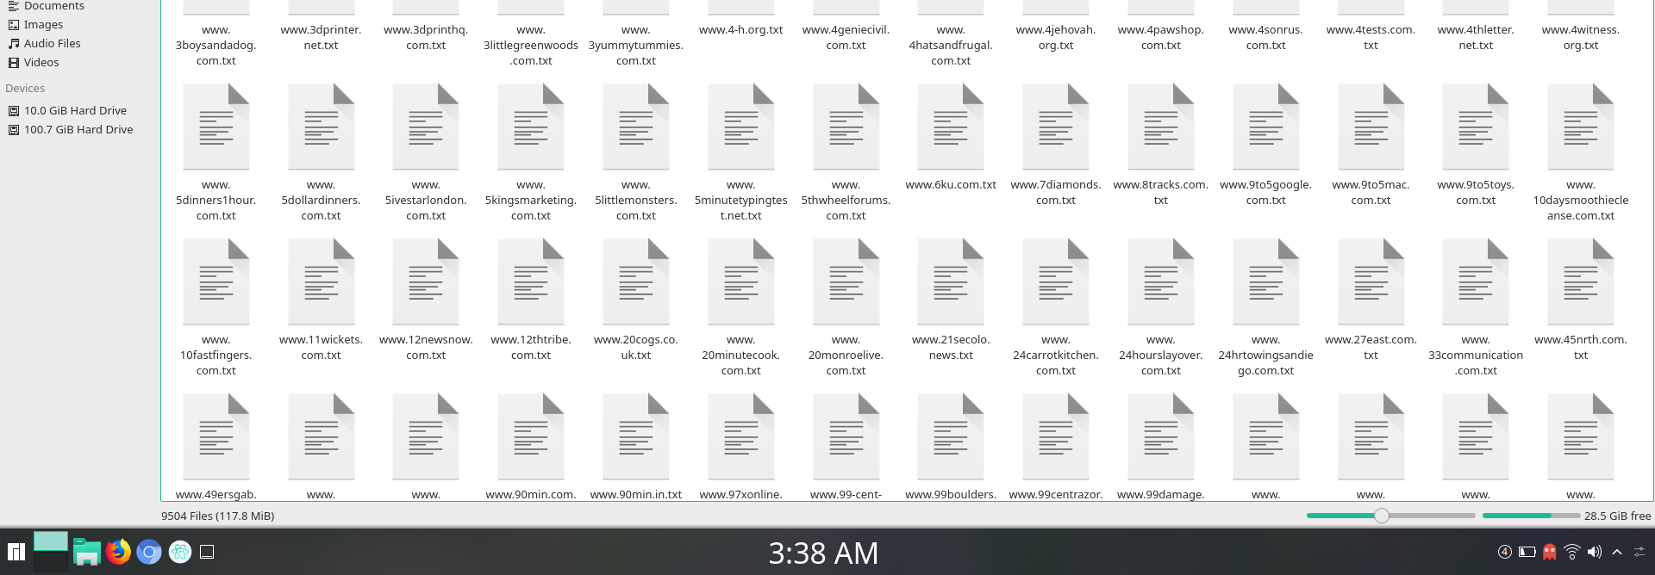
Screenshot of the files collected.

Slide 8
Implementation of Summarization
Have implemented a simple machine learning technique.
Using NLTK (Natural Language Tool Kit).
Data Pre-processing.
Calculating sentence frequency to occur in summary.

Slide 9
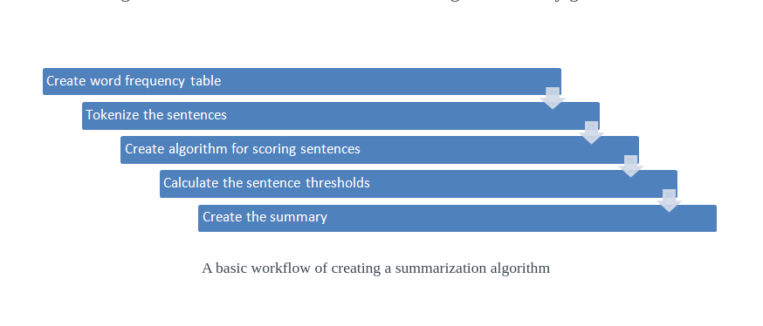
Implemented Algorithm Workflow

Slide 10
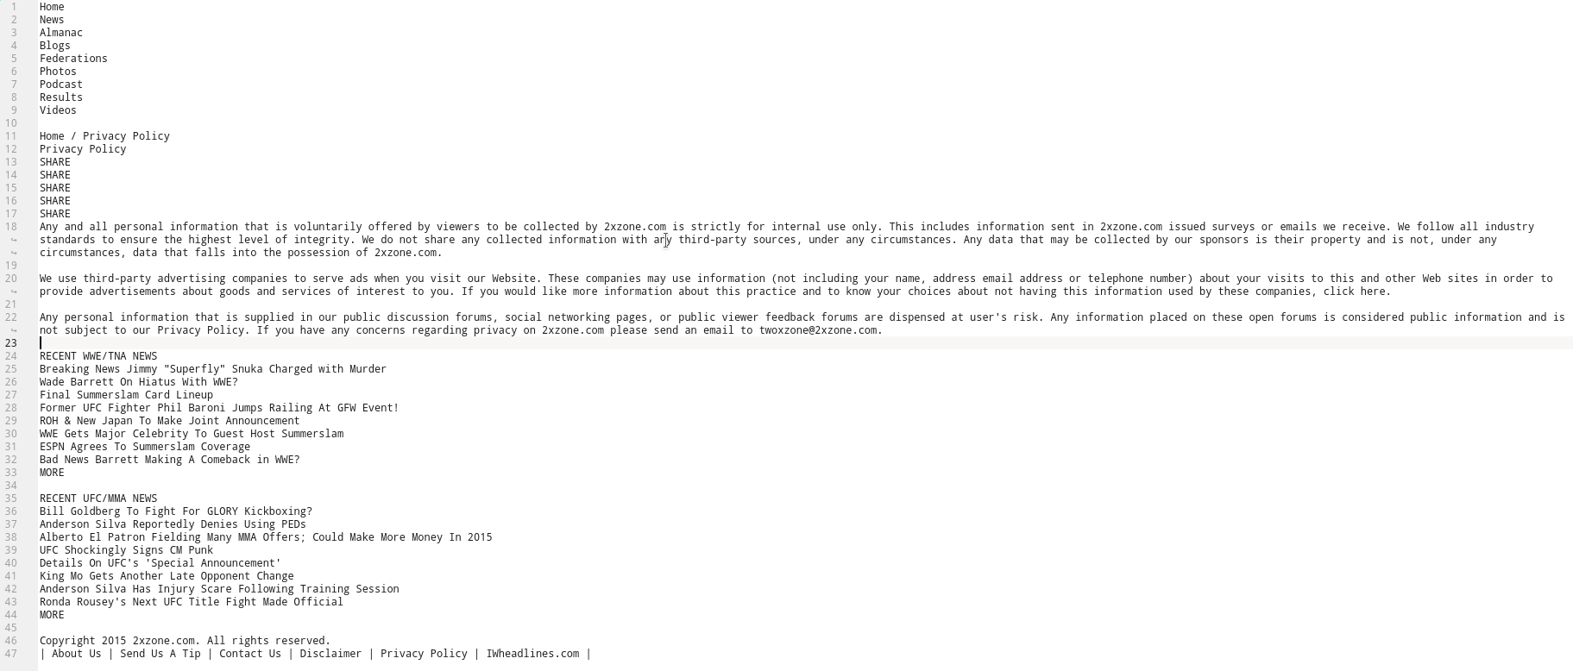
Privacy Policy

Slide 11
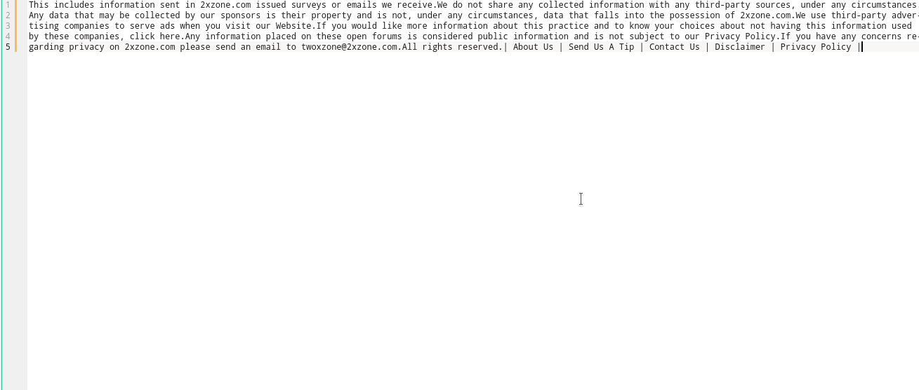
Summary

Slide 12
Limitations
Summaries produced were not precise.
Sentences don’t give their literal meaning properly.
Long summaries comprising of paragraphs.

Slide 13
App Protype
Have built a simple front-end of app.
Using Android Studio.

Slide 14
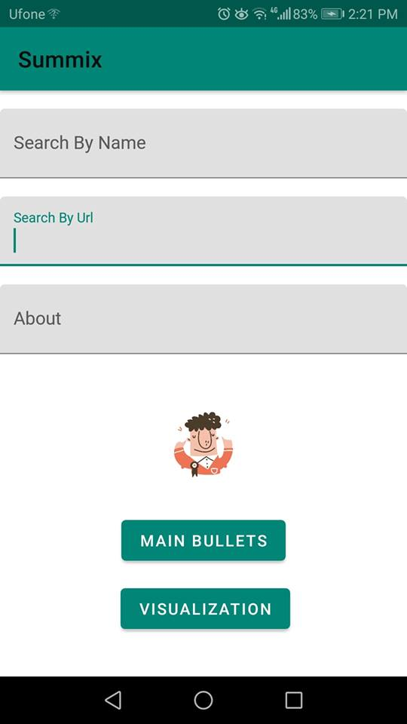
App Front Page

Slide 15
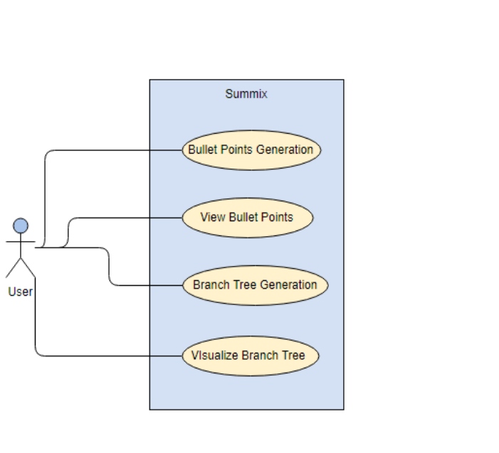
Use Case Diagram

Slide 16
Future Work

Slide 17
Machine Learning Techniques
Unsupervised Learning using Sentence Embedding.
Sequence-to-sequence model by defining the encoder-decoder RNN architecture.
Query-Oriented summarization via Unsupervised Deep Learning.

Slide 18
References
https://www.aaai.org/ocs/index.php/AAAI/AAAI12/paper/view/5058/5322
https://hackernoon.com/text-summarization-using-keras-models-366b002408d9
https://medium.com/jatana/unsupervised-text-summarization-using-sentence-embeddings-adb15ce83db1

Slide 19
Thank You
Any Questions?

