Slide 1
ORC Deep Dive
Owen O’Malley omalley@apache.org
January 2020 @owen_omalley

Slide 2
OverView

Slide 3
Requirements
Files had to be completely self describing
Schema
File version
Tight compression ⇒ Run Length Encoding (RLE) & compression
Column projection ⇒ segregate column data
Predicate pushdown ⇒ understand & index user’s types
Files had to be easy & fast to divide
Compatible with a write once file systems

Slide 4
File Structure
The file footer contains:
Metadata – schema, file statistics
Stripe information – metadata and location of stripes
Postscript with the compression, buffer size, & file version
ORC file data is divided into stripes.
Stripes are self contained sets of rows organized by columns.
Stripes are the smallest unit of work for tasks.
Default is ~64MB, but often configured larger.

Slide 5
Stripe Structure
Within a stripe, the metadata data is in the stripe footer.
List of streams
Column encoding information (eg. direct or dictionary)
Columns are written as a set of streams. There are 3 kinds:
Index streams
Data streams
Dictionary streams

Slide 6
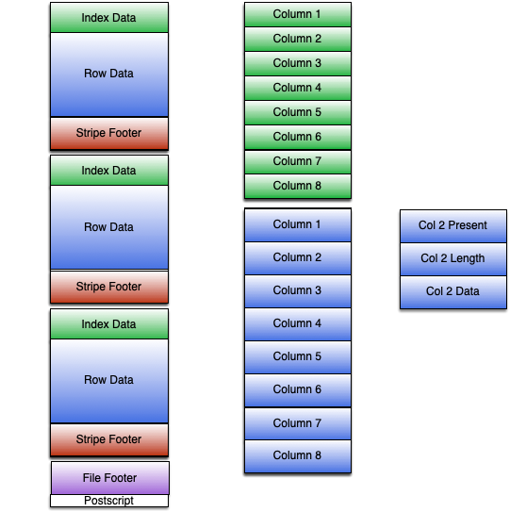
File Structure

Slide 7
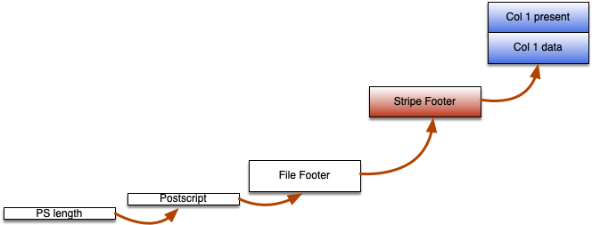
Read Path
The Reader reads last 16k of file, extra as needed
The RowReader reads
Stripe footer
Required streams

Slide 8
Streams
Streams are an independent sequence of bytes
Serialization into streams depends on column type & encoding
Optional pipeline stages:
Run Length Encoding (RLE) – first pass integer compression
Generic compression – Zlib, Snappy, LZO, Zstd
Encryption – AES/CTR

Slide 9
Data Encoding

Slide 10
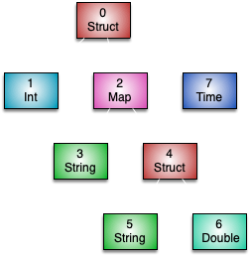
Compound types
Compound types are serialized as trees of columns.
struct, list, map, uniontype all have child columns
Types are numbered in a preorder traversal
The column reading classes are called TreeReader
a: int,
b: map<string,
struct<c: string,
d: double>>,
e: timestamp

Slide 11
Encoding columns
To interpret a stream, you need three pieces of information:
Column type
Column encoding (direct, dictionary)
Stream kind (present, data, length, etc.)
All columns, if they have nulls, will have a present stream
Serialized using a boolean RLE
Integer columns are serialized with
A data stream using integer RLE

Slide 12
Encoding columns
Binary columns are serialized with:
Length stream of integer RLE
Data stream of raw sequence of bytes
String columns may be direct or dictionary encoded
Direct looks like binary column, but dictionary is different
Dictionary_data is raw sequence of dictionary bytes
Length is an integer RLE stream of the dictionary lengths
Data is an integer RLE stream of indexes into dictionary

Slide 13
Encoding columns
Lists and maps record the number of child elements
Length is an integer RLE stream
Structs only have the present stream
Timestamps need nanosecond resolution (ouch!)
Data is an integer RLE of seconds from Jan 2015
Secondary is an integer RLE of nanoseconds with 0 suppress

Slide 14
Run Length Encoding
Goal is to get some cheap quick compression
Handles repeating/incrementing values
Handles integer byte packing
Two versions
Version 1 – relative simple repeat/literal encoding
Version 2 – complex encoding with 4 variants
Column encoding of *_V2 means use RLE version 2
Can typically treat these a black box

Slide 15
Compression & Indexes

Slide 16
Row pruning
Three levels of indexing/row pruning
File – uses file statistics in file footer
Stripe – uses stripe statistics before file footer
Row group (default of 10k rows) – uses index stream
The index stream for each column includes for each row group
Column statistics (min, max, count, sum)
The start positions of each stream

Slide 17
Search Arguments
Engines can pass Search Arguments (SArgs) to the RowReader.
Limited set of operations (=, <=>, <, <=, in, between, is null)
Compare one column to literal(s)
Can only eliminate entire row groups, stripes, or files.
Engine must still filter the individual rows afterwards
For Hive, ensure hive.optimize.index.filter is true.

Slide 18
Compression
All of the generic compression is done in chunks
Codec is reinitialized at start of chunk
Each chunk is compressed separately
Each uncompressed chunk is at most the buffer size
Each chunk has a 3 byte header giving:
Compressed size of chunk
Whether it is the original or compressed

Slide 19
Indexes
Wanted ability to seek to each row group
Allows fine grain seeking & row pruning
Could have flushed stream compression pipeline
Would have dramatically lowered compression
Instead treat compression & RLE has gray boxes
Use our knowledge of compression & RLE
Always start fresh at beginning of chunk or run

Slide 20
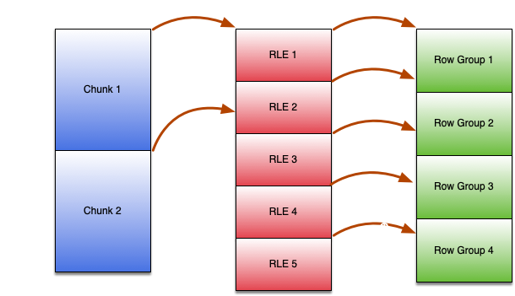
Index positions
Records information to seek to a given row in all of a column’s streams
Includes:
C Compressed bytes
U Uncompressed bytes
V RLE values
C, U, & V jump to RG 4

Slide 21
Bloom Filters
For use cases where you need to find particular values
Sorting by that column allows min/max filtering
But you can only sort on one column effectively
Bloom filters are probabilistic data structures
Only useful for equality, not less than or greater than
Need ~10 bits/distinct value ⇒ opt in
ORC uses a bloom_filter_utf8 stream to record a bloom filter per a row group

Slide 22
Row Pruning Example
TPC-DS
from tpch1000.lineitem where l_orderkey = 1212000001;
Index | Rows Read | Time
Nothing | 5,999,989,709 | 74 sec
Min/Max | 540,000 | 4.5 sec
Bloom | 10,000 | 1.3 sec

Slide 23
Versioning

Slide 24
Compatibility
Within a file version, old readers must be able to read all files.
A few exceptions (eg. new codecs, types)
Version 0 (from Hive 0.11)
Only RLE V1 & string dictionary encoding
Version 1 (from Hive 0.12 forward)
Version 2 (under development)
The library includes ability to write any file version.
Enables smooth upgrades across clusters

Slide 25
Writer Version
When fixes or feature additions are made to the writer, we bump the writer version.
Allows reader to work around bugs, especially in index
Does not affect reader compatibility
We should require each minor version adds a new one.
We also record which writer wrote the file:
Java, C++, Presto, Go

Slide 26
EXAMPLE workaround for HIVE-8746
Timestamps suck!
ORC uses an epoch of 01-01-2015 00:00:00.
Timestamp columns record seconds offset from epoch
Unfortunately, the original code use local time zone.
If reader and writer were in time zones with the same rules, it worked.
Fix involved writing the writer time zone into file.
Forwards and backwards compatible

Slide 27
Additional Features

Slide 28
Schema Evolution
User passes desired schema to RecordReader factory.
SchemaEvolution class maps between file & reader schemas.
The mapping can be positional or name based.
Conversions based on legacy Hive behavior…
The RecordReader uses the mapping to translate
Choosing streams uses the file schema column ids
Type translation is done by ConvertTreeReaderFactory.
Adds an additional TreeReader that does conversion.

Slide 29
Stripe concatenation & Flush
ORC has a special operator to concatenate files
Requires consistent options & schema
Concatenates stripes without reserialization
ORC can flush the current contents including a file footer while still writing to the file.
Writes a side file with the current offset of the file tail
When the file closes the intermediate file footers are ignored

Slide 30
Column encryption
Released in ORC 1.6
Allows consistent column level access control across engines
Writes two variants of data
Encrypted original
Unencrypted statically masked
Each variant has its own streams & encodings
Each column has a unique local key, which is encrypted by KMS

Slide 31
Other developer tools
Benchmarks
Hive & Spark
Avro, Json, ORC, and Parquet
Three data sets (taxi, sales, github)
Docker
Allows automated builds on all supported Linux variants
Site source code is with C++ & Java

Slide 32
UsiNG ORC

Slide 33
Which Version is IT?
Engine | Version | ORC Version
Hive | 0.11 to 2.2 | Hive ORC 0.11 to 2.2
 | 2.3 | ORC 1.3
 | 3.0 | ORC 1.4
 | 3.1 | ORC 1.5
Spark hive | * | Hive ORC 1.2
Spark native | 2.3 | ORC 1.4
 | 2.4 to 3.0 | ORC 1.5

Slide 34
From SQL
Hive:
Add “stored as orc” to table definition
Table properties override configuration for ORC
Spark’s “spark.sql.orc.impl” controls implementation
native – Use ORC 1.5
hive – Use ORC from Hive 1.2

Slide 35
From Java
Use the ORC project rather than Hive’s ORC.
Maven group id: org.apache.orc version: 1.6.2
nohive classifier avoids interfering with Hive’s packages
Two levels of access
orc-core – Faster access, but uses Hive’s vectorized API
orc-mapreduce – Row by row access, simpler OrcStruct API
MapReduce API implements WritableComparable
Can be shuffled
Need to specify type information in configuration for shuffle or output

Slide 36
From C++
Pure C++ client library
No JNI or JDK so client can estimate and control memory
Uses pure C++ HDFS client from HDFS-8707
Reader and writer are stable and in production use.
Runs on Linux, Mac OS, and Windows.
Docker scripts for CentOS 6-8, Debian 8-10, Ubuntu 14-18
CI builds on Mac OS, Ubuntu, and Windows

Slide 37
From Command LINE
Using hive –orcfiledump from Hive
-j -p – pretty prints the metadata as JSON
-d – prints data as JSON
Using java -jar orc-tools-*-uber.jar from ORC
meta -j -p – print the metadata as JSON
data – print data as JSON
convert – convert CSV, JSON, or ORC to ORC
json-schema – scan a set of JSON documents to find schema

Slide 38
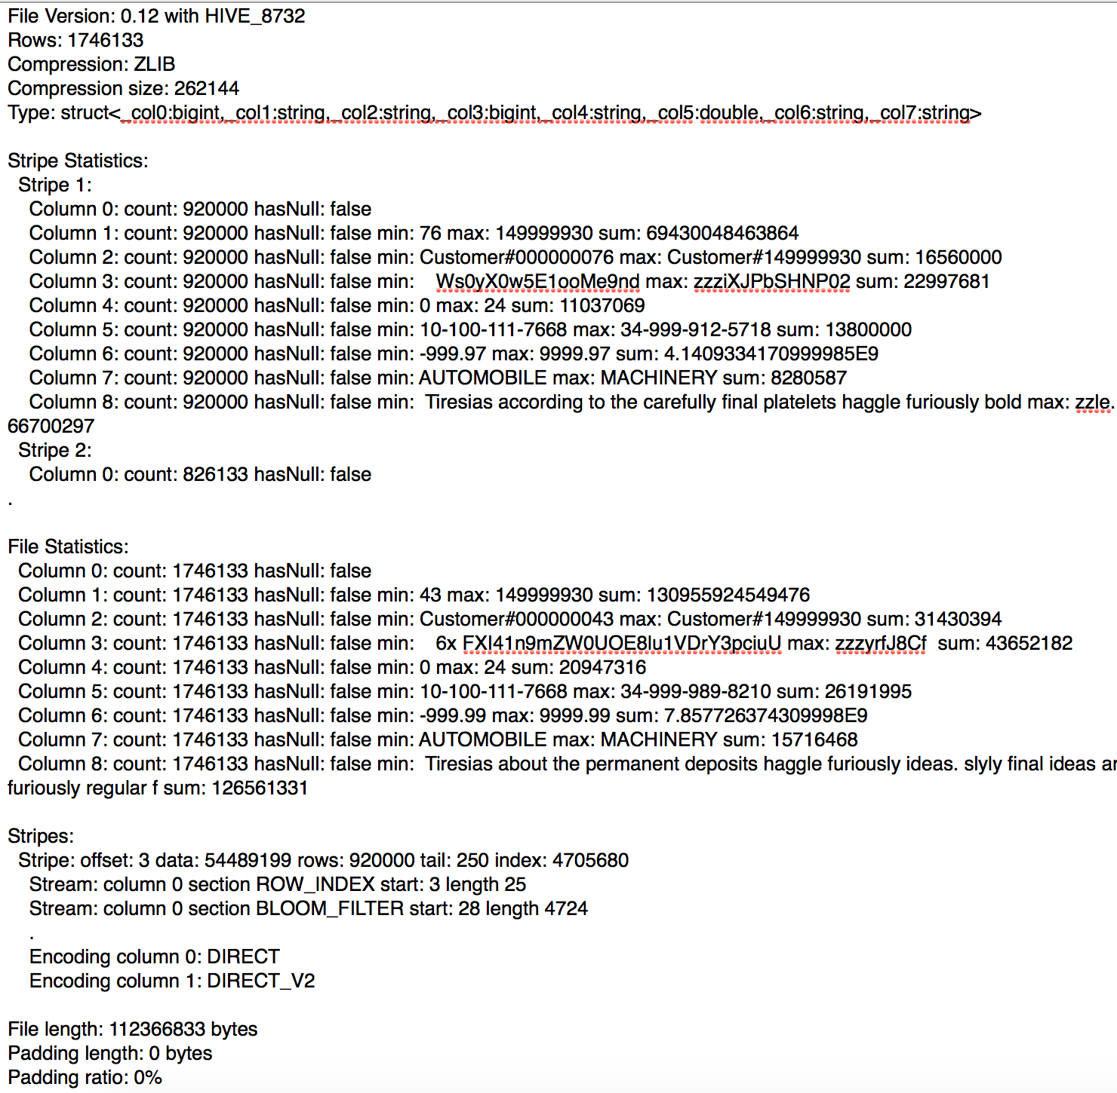
Debugging
Things to look for:
Stripe size
Rows/Stripe
File version
Writer version
Width of schema
Sanity of statistics
Column encoding
Size of dictionaries

Slide 39
Optimization

Slide 40
Stripe Size
Makes a huge difference in performance
orc.stripe.size or hive.exec.orc.default.stripe.size
Controls the amount of buffer in writer. Default is 64MB
Trade off
Large = Large more efficient reads
Small = Less memory and more granular processing splits
Multiple files written at the same time will shrink stripes
Use Hive’s hive.optimize.sort.dynamic.partition

Slide 41
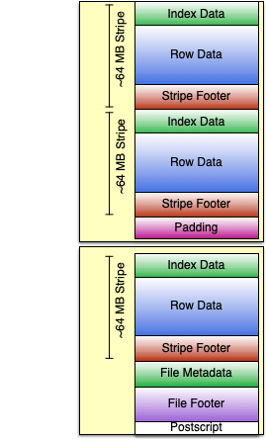
HDFS Block Padding
The stripes don’t align exactly with HDFS blocks
Unless orc.write.variable.length.blocks
HDFS scatters blocks around cluster
Often want to pad to block boundaries
Costs space, but improves performance
orc.default.block.padding
orc.block.padding.tolerance

Slide 42
Split Calculation
BI
Small fast queries
Splits based on HDFS blocks
ETL
Large queries
Read file footer and apply SearchArg to stripes
Can include footer in splits (hive.orc.splits.include.file.footer)
Hybrid
If small files or lots of files, use BI

Slide 43
Conclusion

Slide 44
For More Information
The orc_proto.proto defines the ORC metadata
Read code and especially OrcConf, which has all of the knobs
Website on https://orc.apache.org/
/bugs ⇒ jira repository
/src ⇒ github repository
/specification ⇒ format specification
Apache email list dev@orc.apache.org

Slide 45
THANK YOU
Owen O’Malley
omalley@apache.org
@owen_omalley

