Slide 1
Work 1
Properties compared prediction
Background & Motivation
Combining with the spCLM model, working as an ADMET or activity prediction model

Slide 2
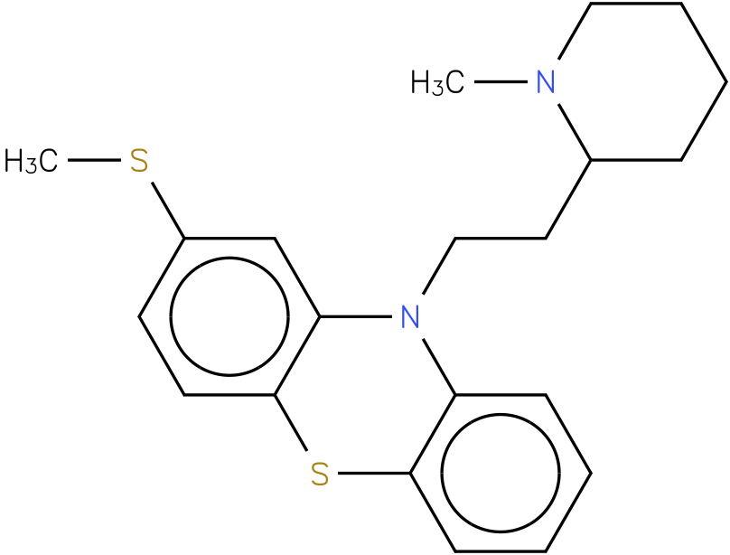
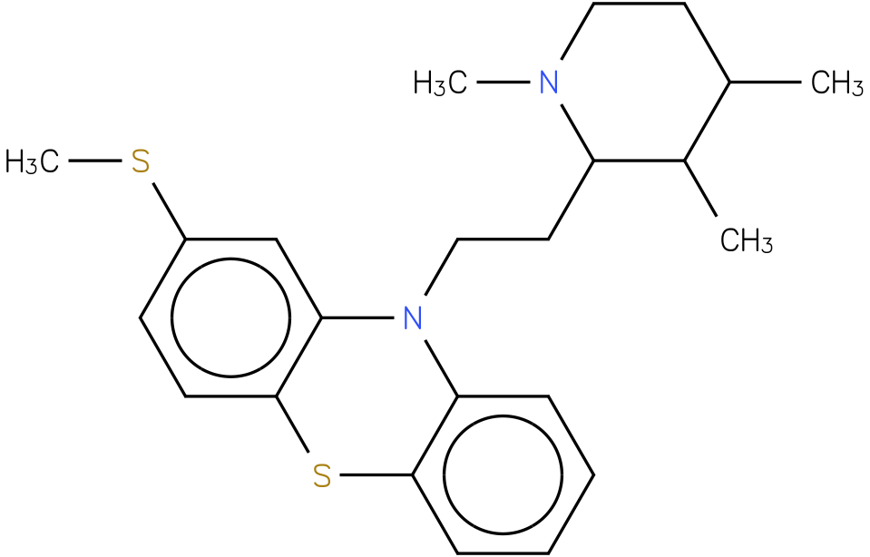
CSc1ccc2c(c1)N(CCC1CCCCN1C)c1ccccc1S2
CSc1cc2N(c3c(Sc2cc1)cccc3)CCC1N(C)CCC(C)C1C
HERG 95.5 nM
HERG 1300 nM
Prediction:
Direction: Value increase or decrease
Change range: 10X 100X ........

Slide 4
Work 2
Target information embedding
Background & Motivation
What is the way to embedding the target information in the lignad based generation models.

Slide 5
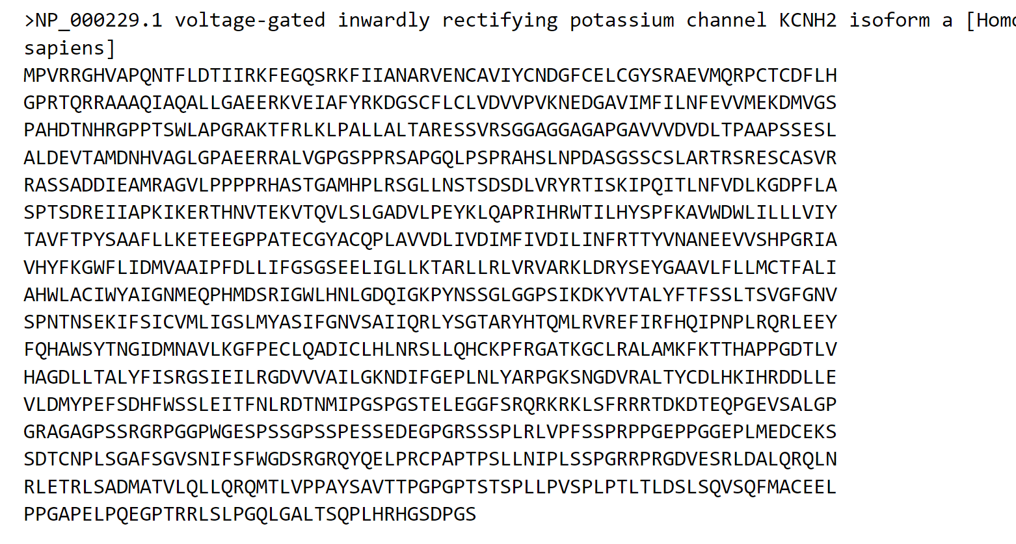
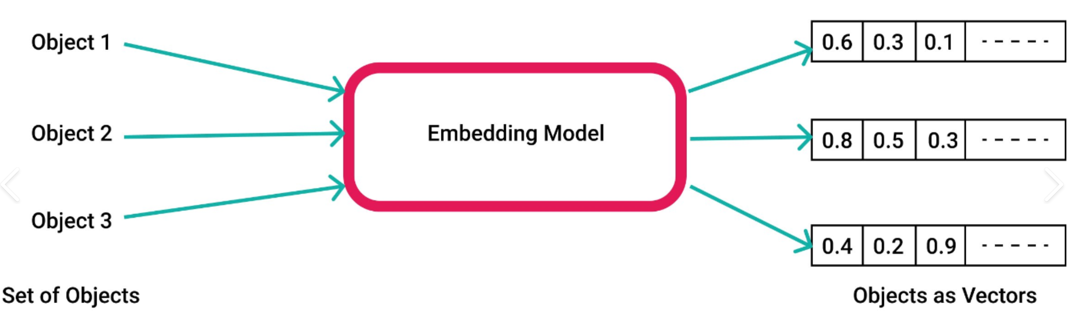
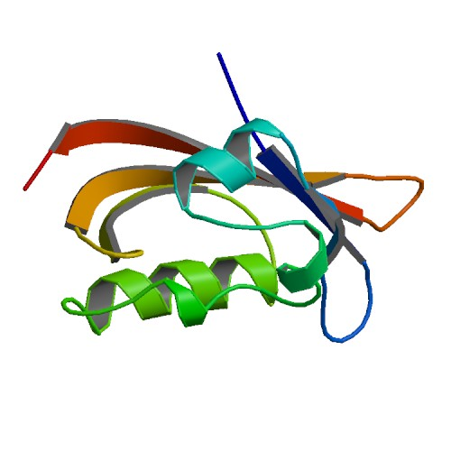
hERG

Slide 7
Work 3
Pocket and hetero/water/ligand atom distribution prediction

Slide 8
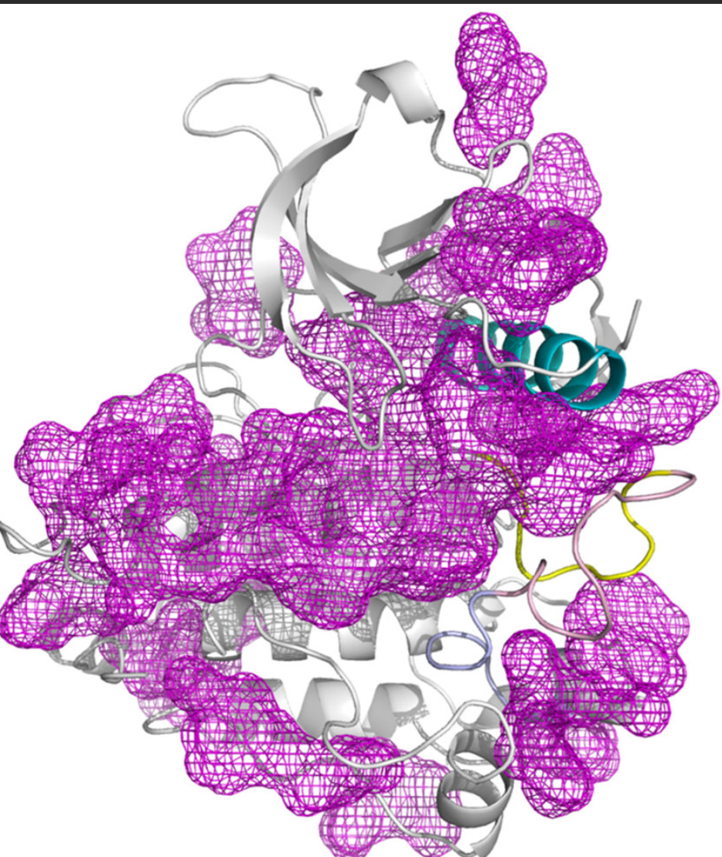
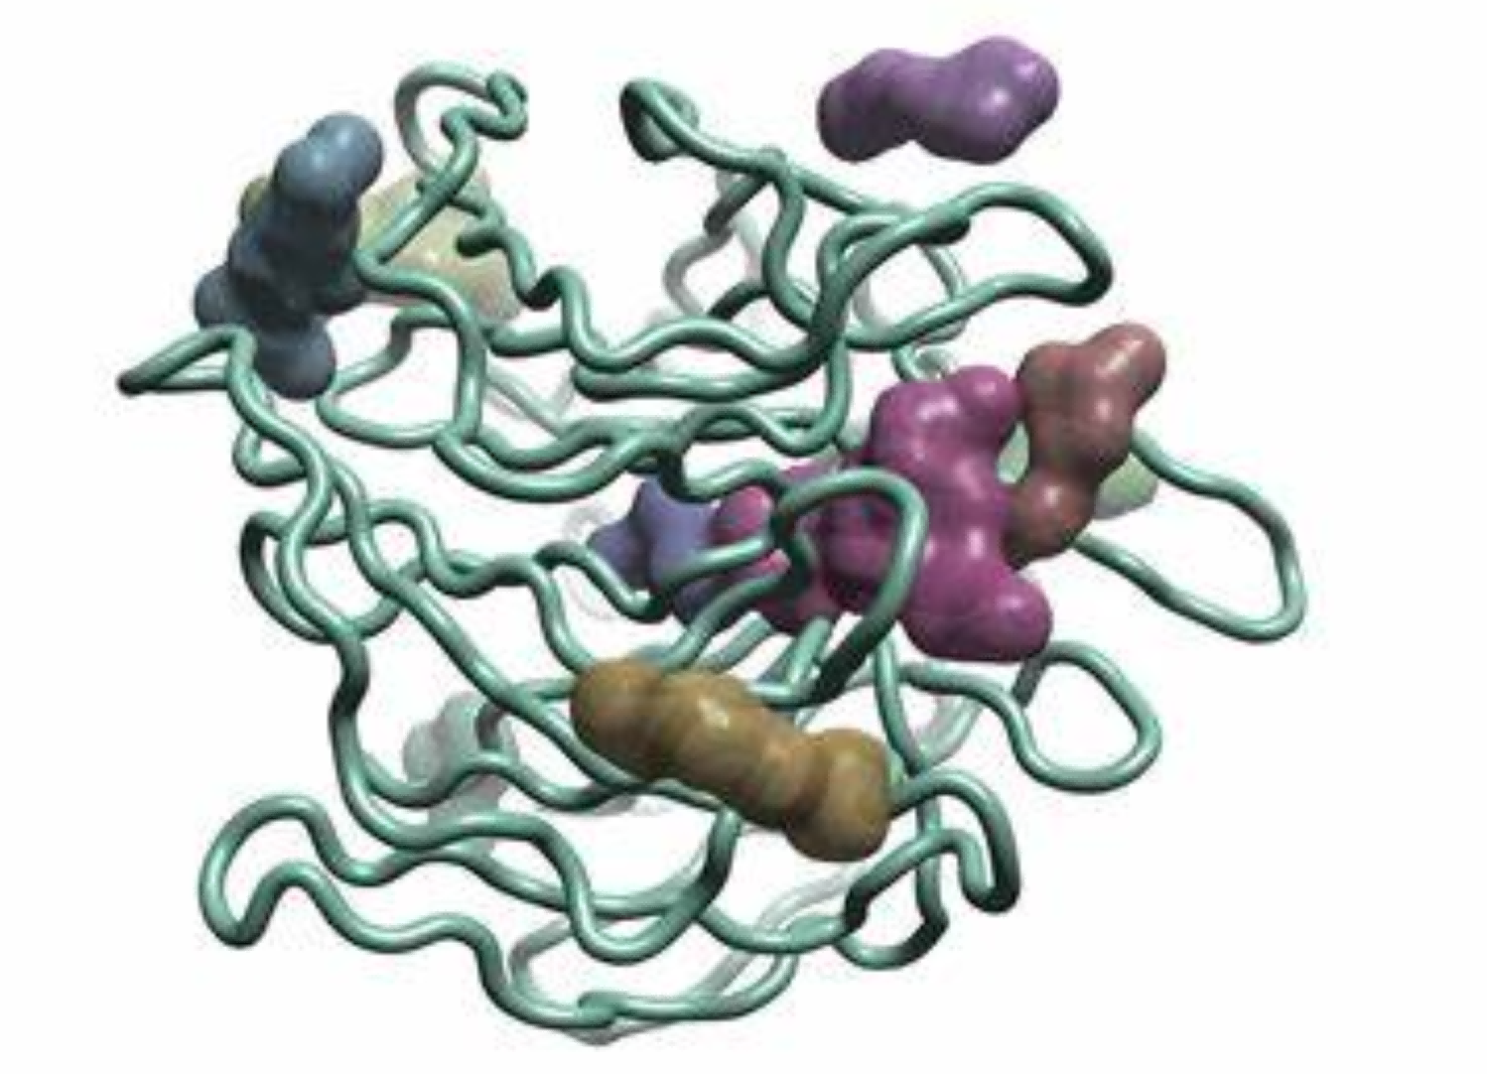
Prediction:
Probability of atoms in the grid point
Probability of water/hetero/ligand atom type

Slide 10
Work 4
Pose generation/substructure pose generation
Background & Motivation
Generate the pose of the molecules (whole molecule and part of the molecule) combining with the SPCLM model

Slide 11
