Slide 1

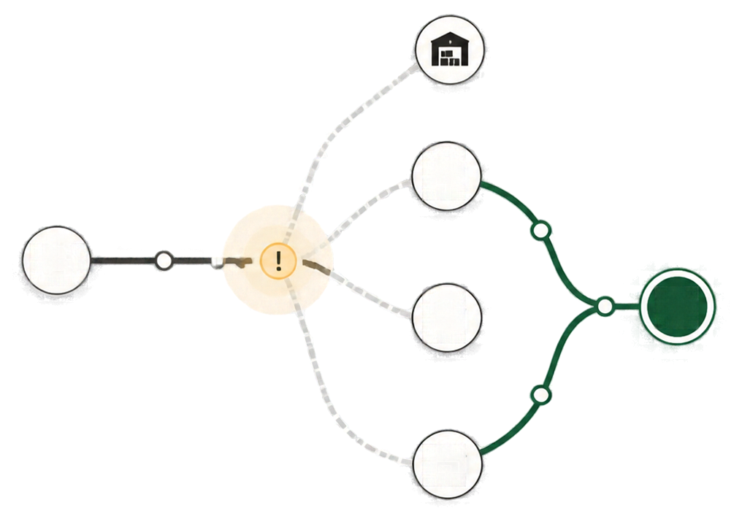








by
SUPPLY LINK
OCEAN PRIDE
The real operational gap
isn’t the truck breaking down.
It’s the slow, manual process of finding replacement stock across separate branches.
AI11 AquaMind
1

Slide 2









Oceanpride
Ocean Pride
Team Members
Mr. Kaung Htike San
Mr. Aung Kaung Myat
UI Designer
UX Designer
Mr. Kyaw Zin Hein
Ms. Hsu Myat Noe Thant
Frontend Developer
Frontend Developer
Mr. Myat Min Khant
Mr. Thaw Linn Htet
Ms. Thant Kyi Phyu Nwe
Project Manager
Backend Developer
Backend Developer

Slide 3
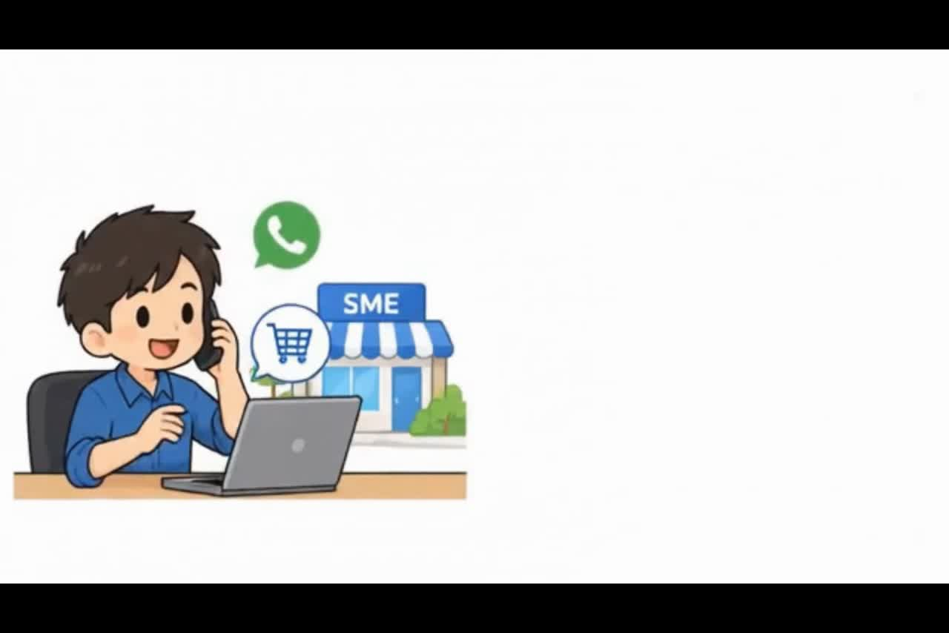

Slide 4











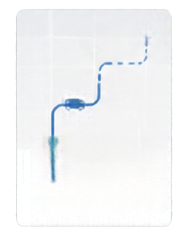




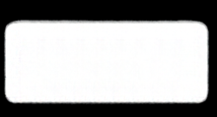









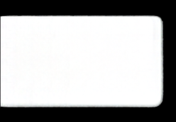




Solution & Demo
SupplyLink coordinates recovery, stock fulfilment, and visibility when delivery fails.
Breakdown reported
AI reroute suggestion
People confirm
New route sent
SL-2026-1052
❌ AI reroute suggestion
Branch accepts
C2 Refresh status
Best match
Stock reserved
Breakdown reported
Yangon Central
HQ confirms
Truck breakdown. Unable to continue.
Can supply all fourteen
Plan confirmed
Status
Available stock
Driver confirms
Rerouted
On Hold
14 / 14 boxes
Assignment accepted
* On the way
14 / 14 boxes
Driver reports the truck breakdown; order goes On Hold.
Checks branch backup stock and suggests Yangon Central, which can supply all fourteen.
Branch accepts and reserves stock. HQ confirms the plan. Driver confirms the assignment.
Delivery continues
and everyone follows
the new route.
User : Driver
User : HQ
2

Slide 5
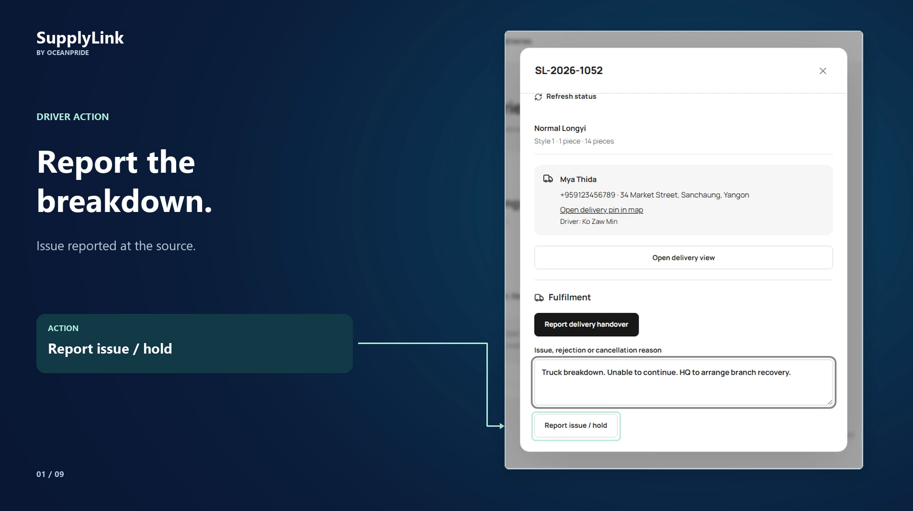

3

Slide 6
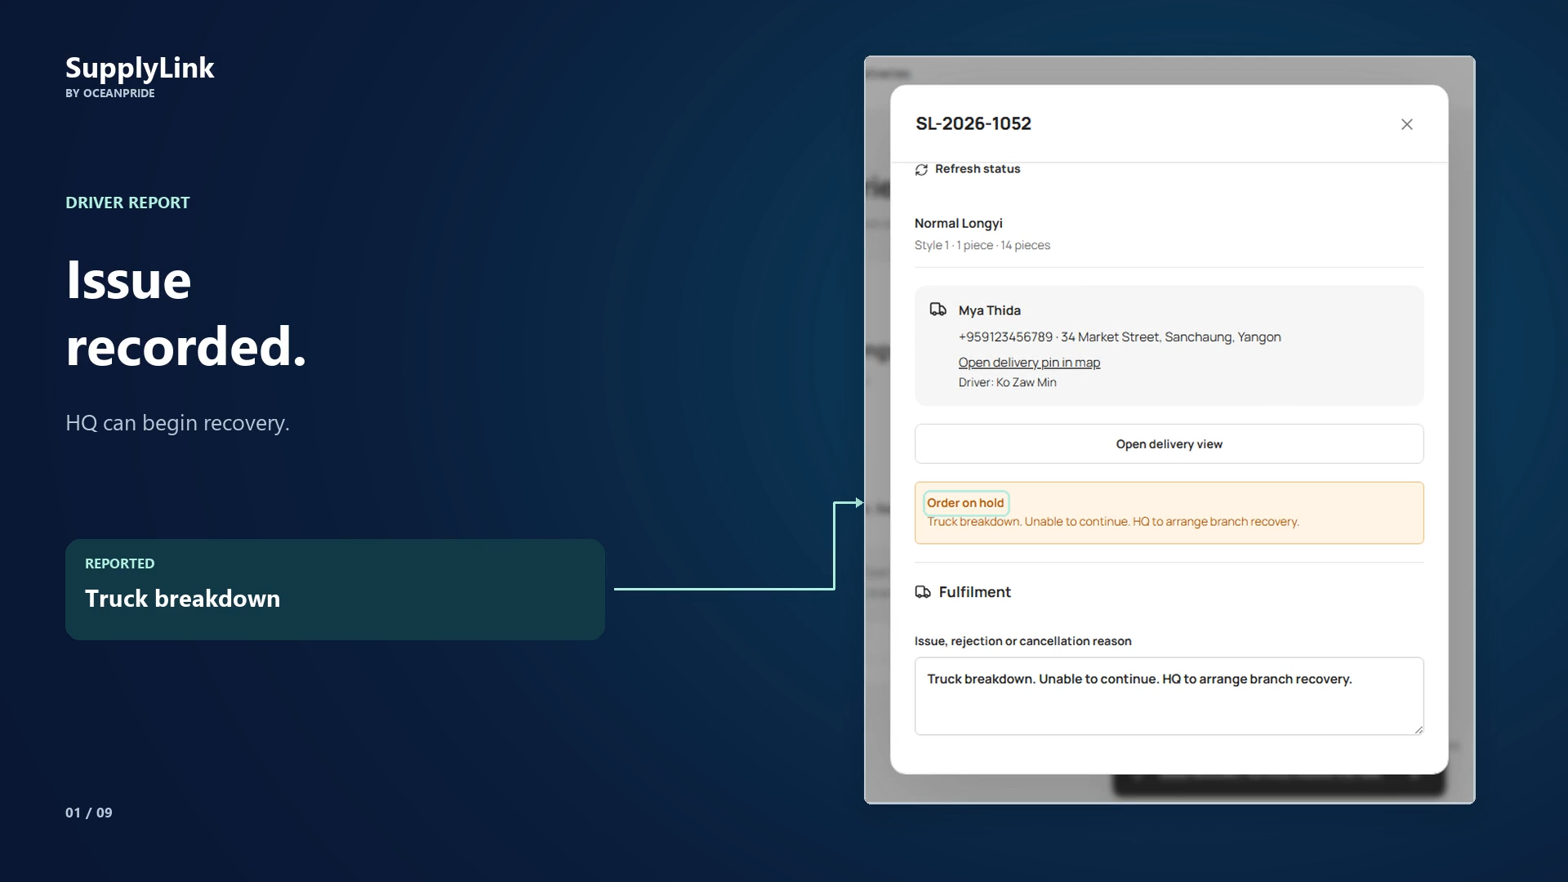
4

Slide 7
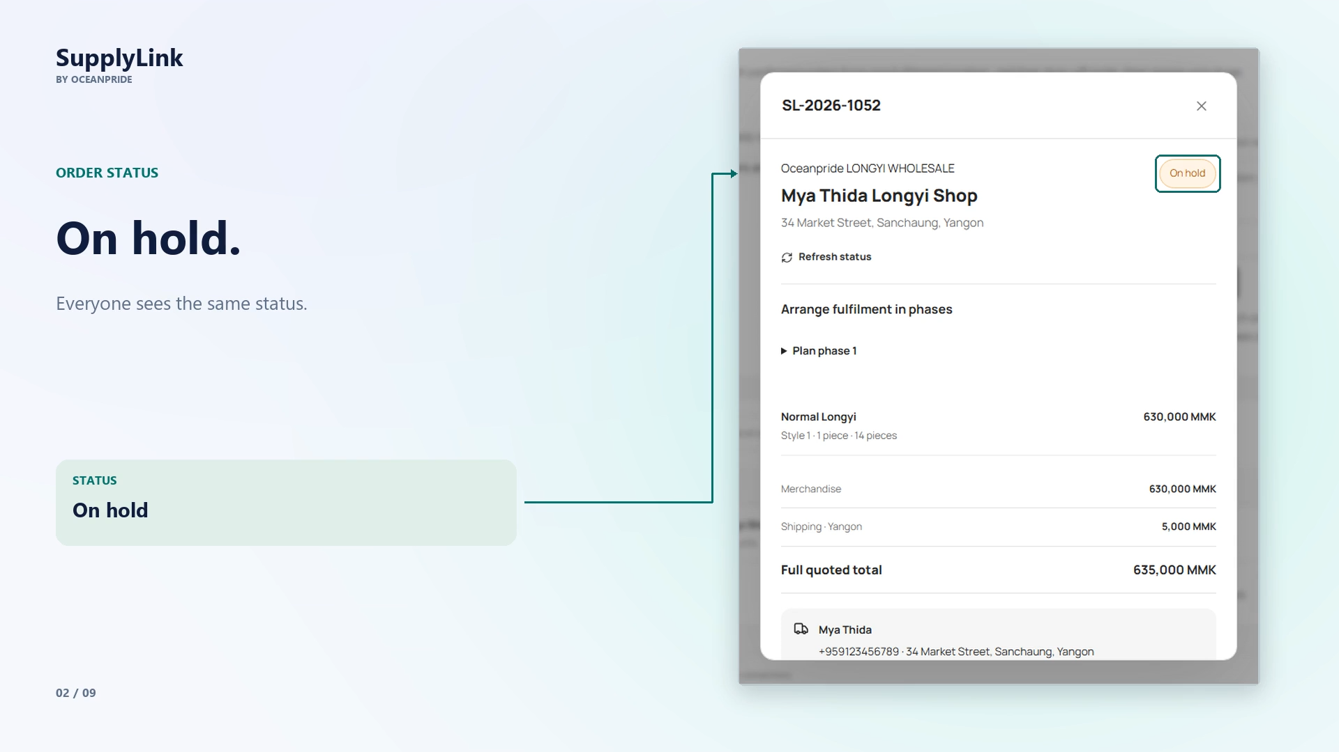
5

Slide 8
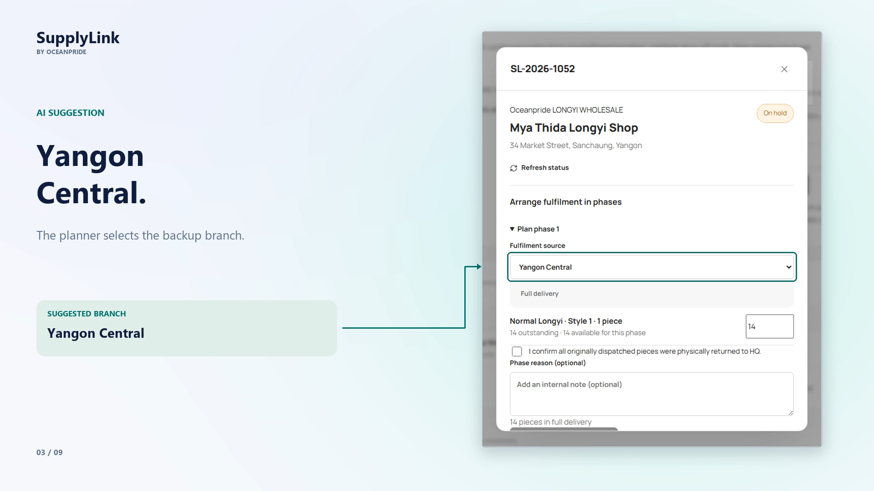
6

Slide 9
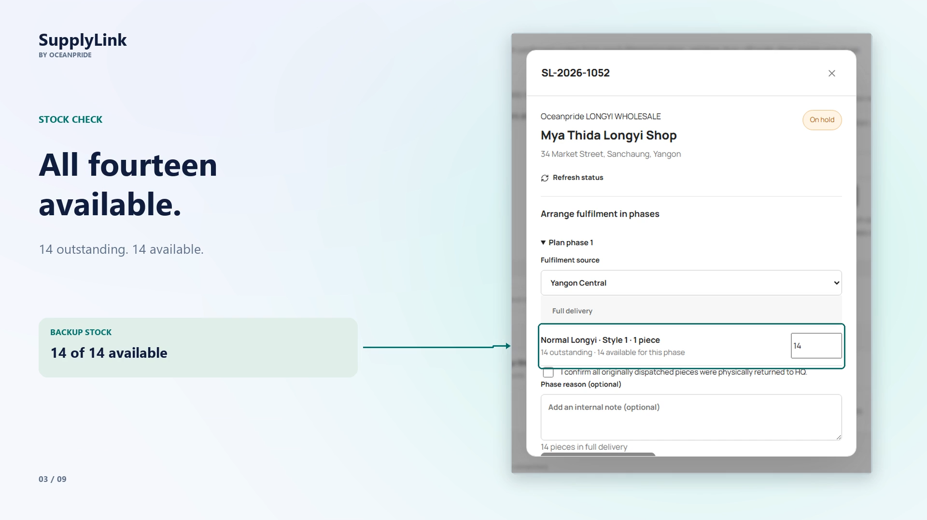
7

Slide 10
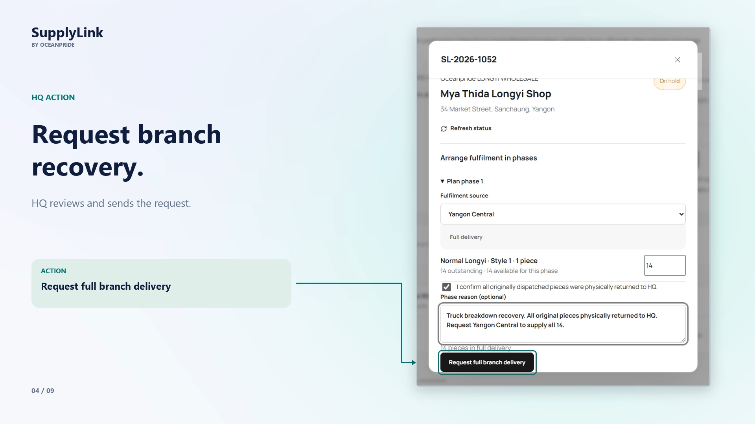
8

Slide 11
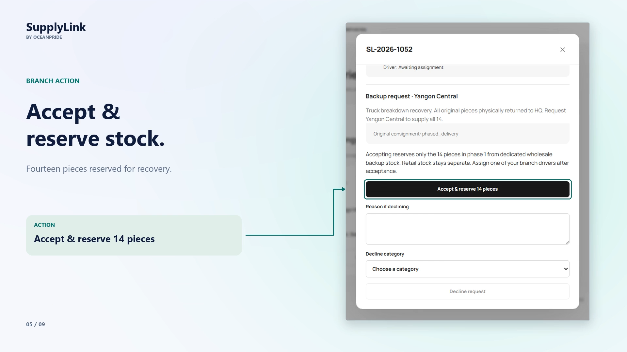
9

Slide 12
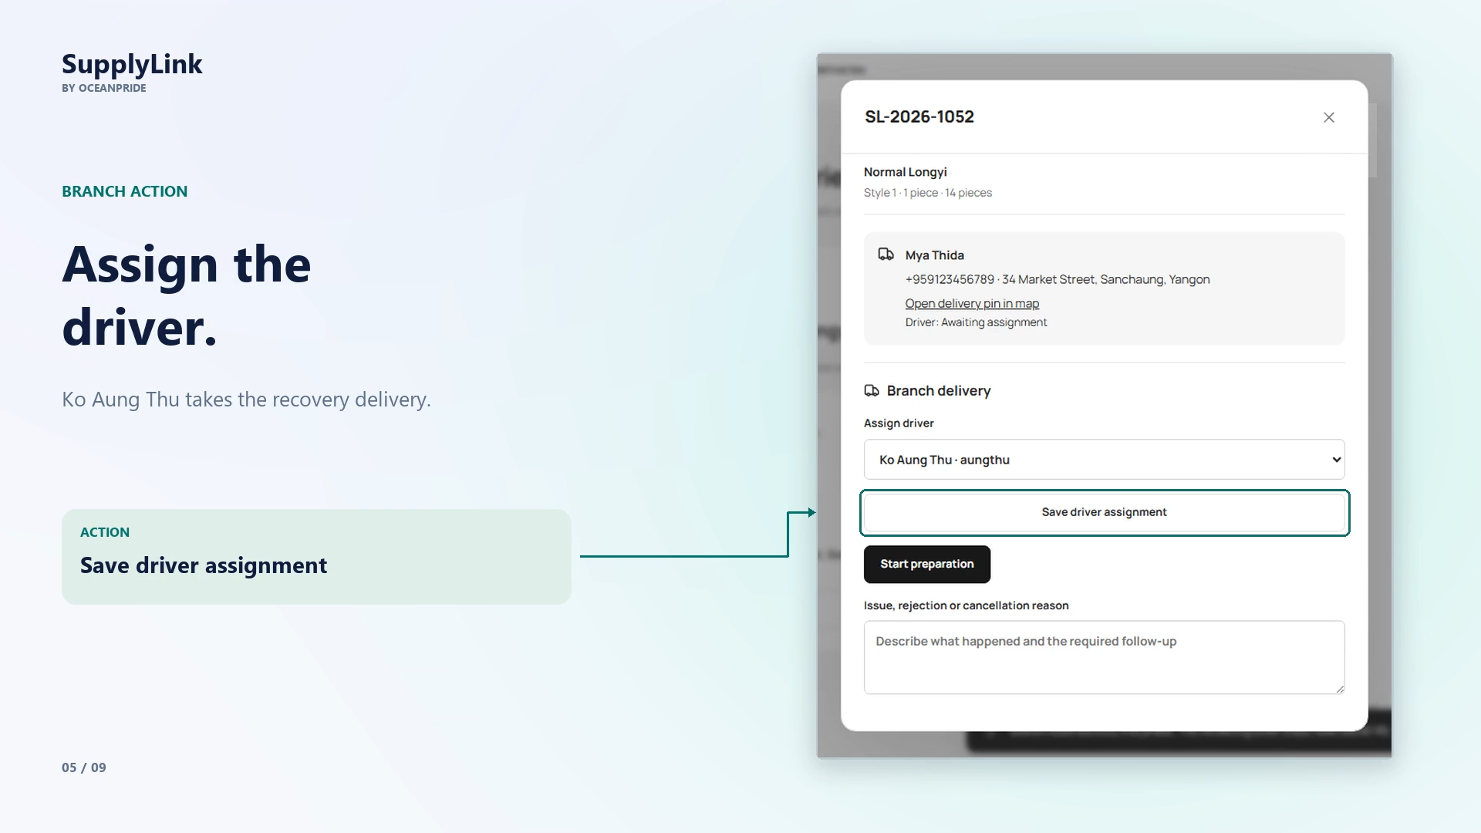
10

Slide 13
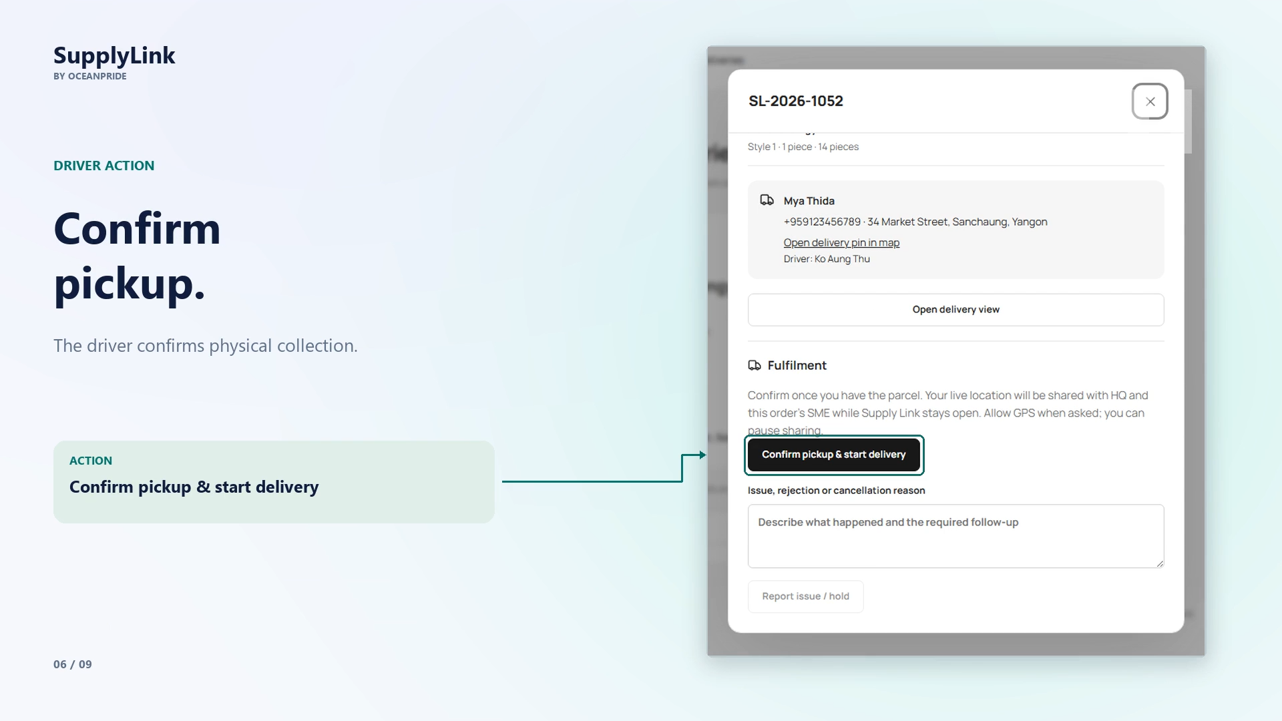
11

Slide 14
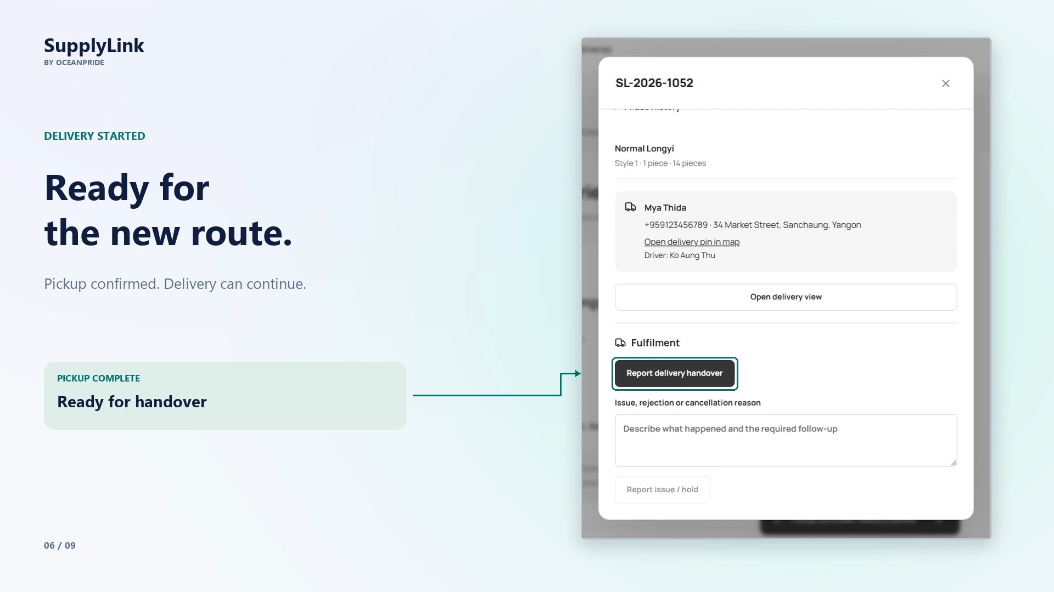
12

Slide 15
13

Slide 16
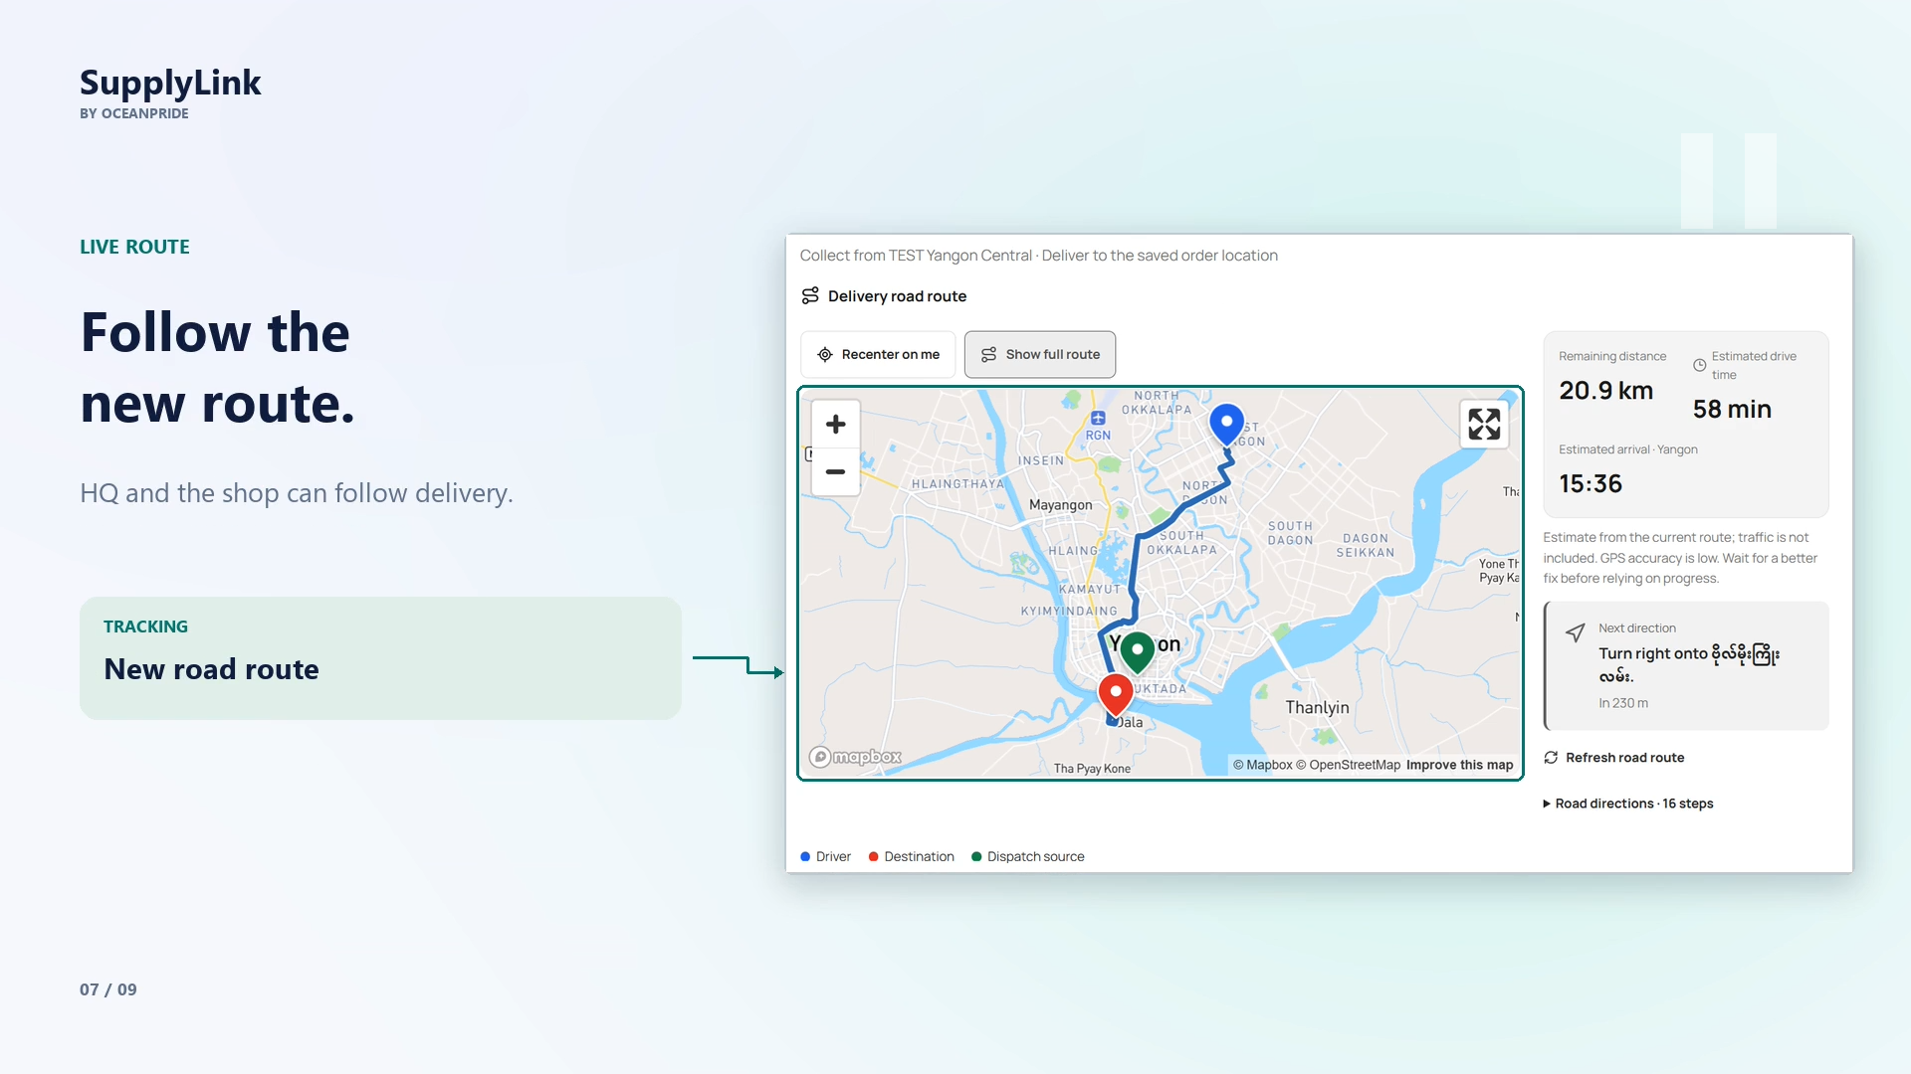
14

Slide 17
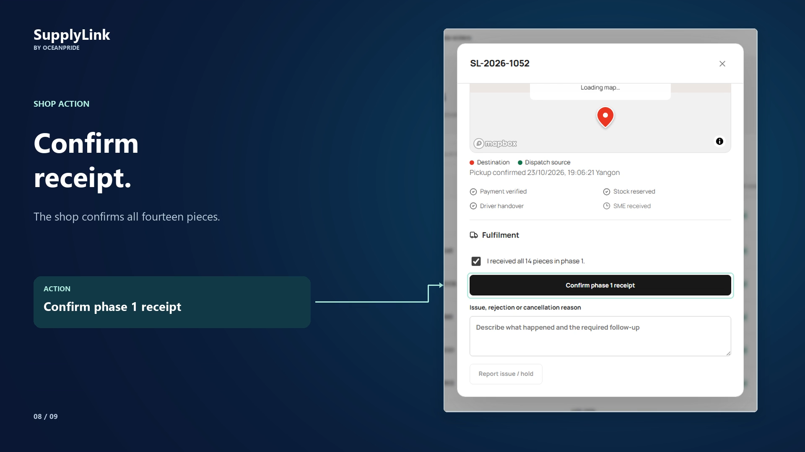
15

Slide 18
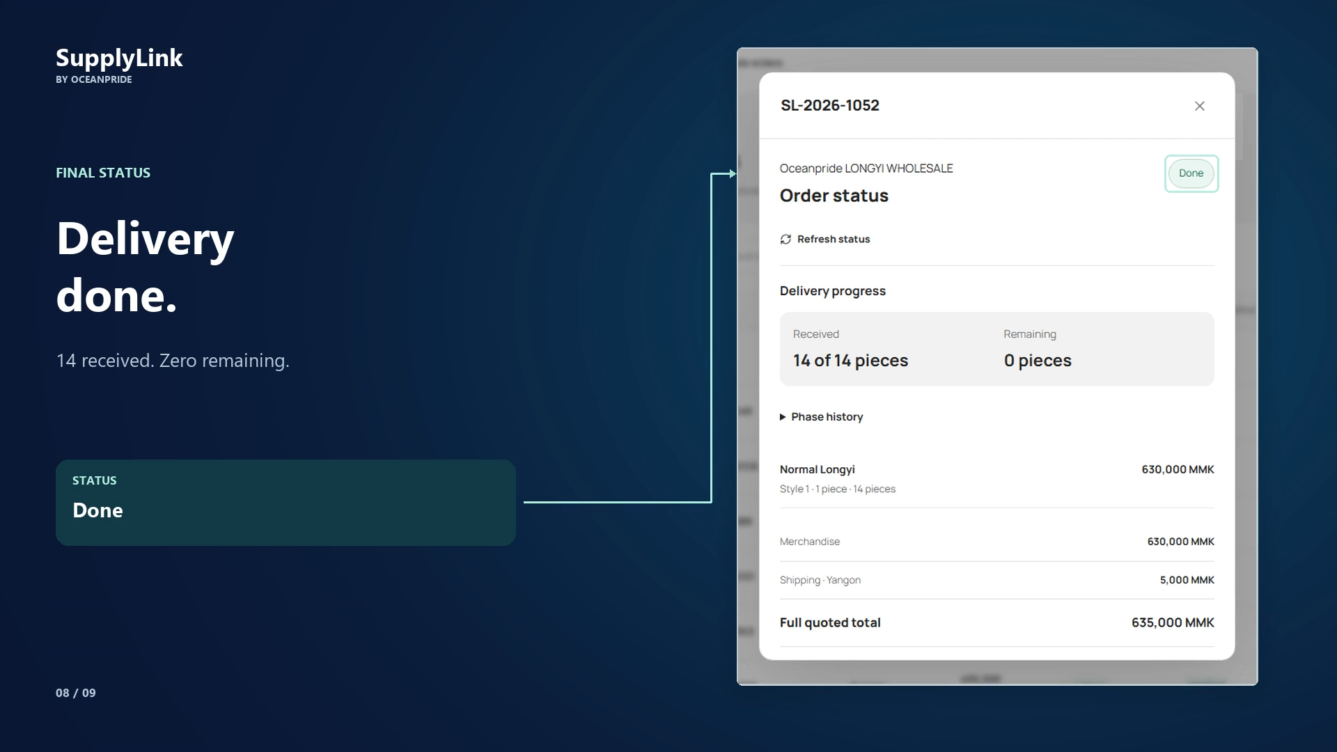
16

Slide 19
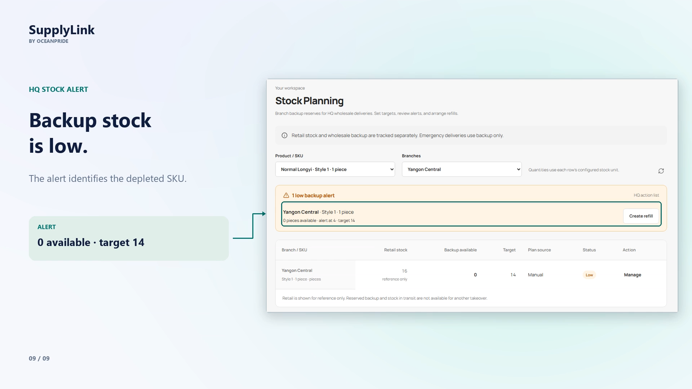
17

Slide 20
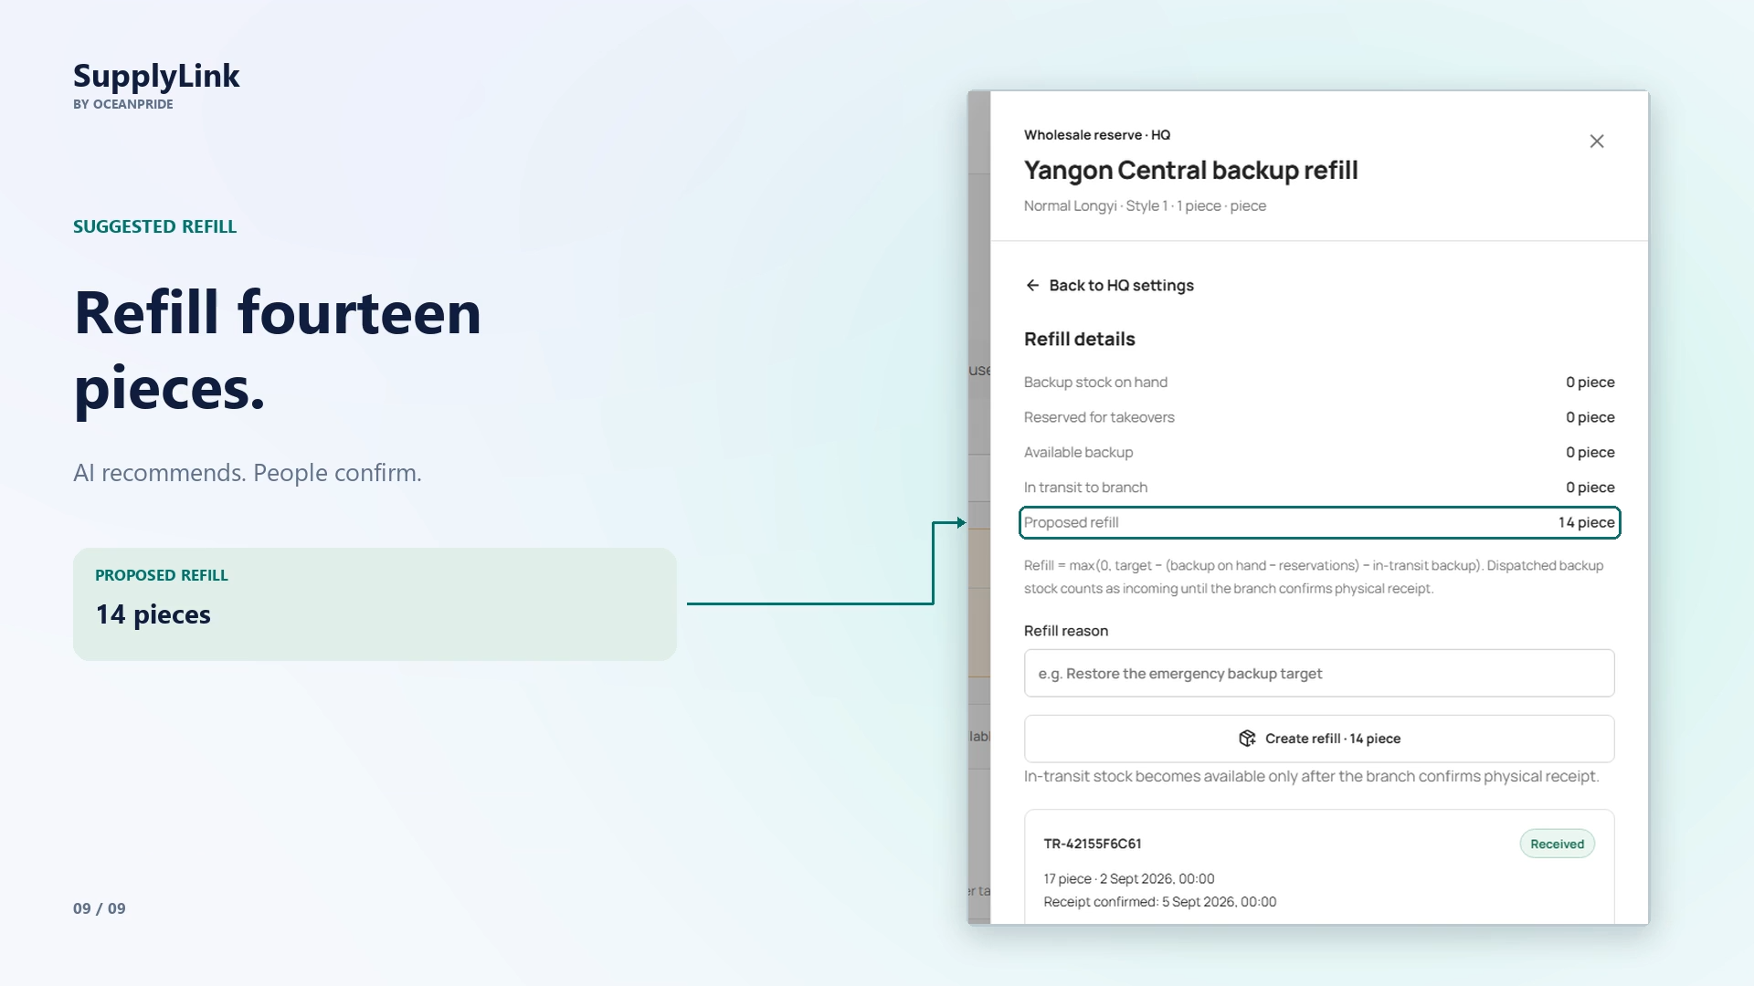
18

Slide 21
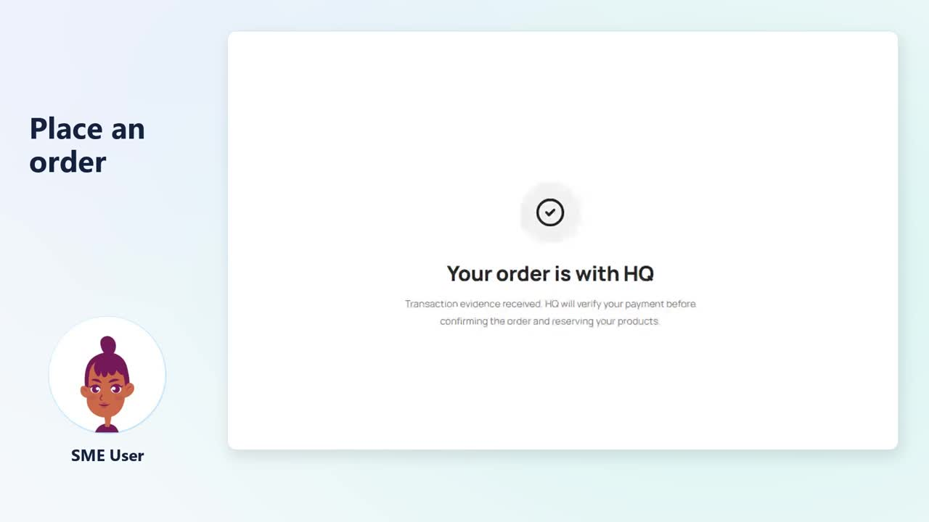

Slide 22
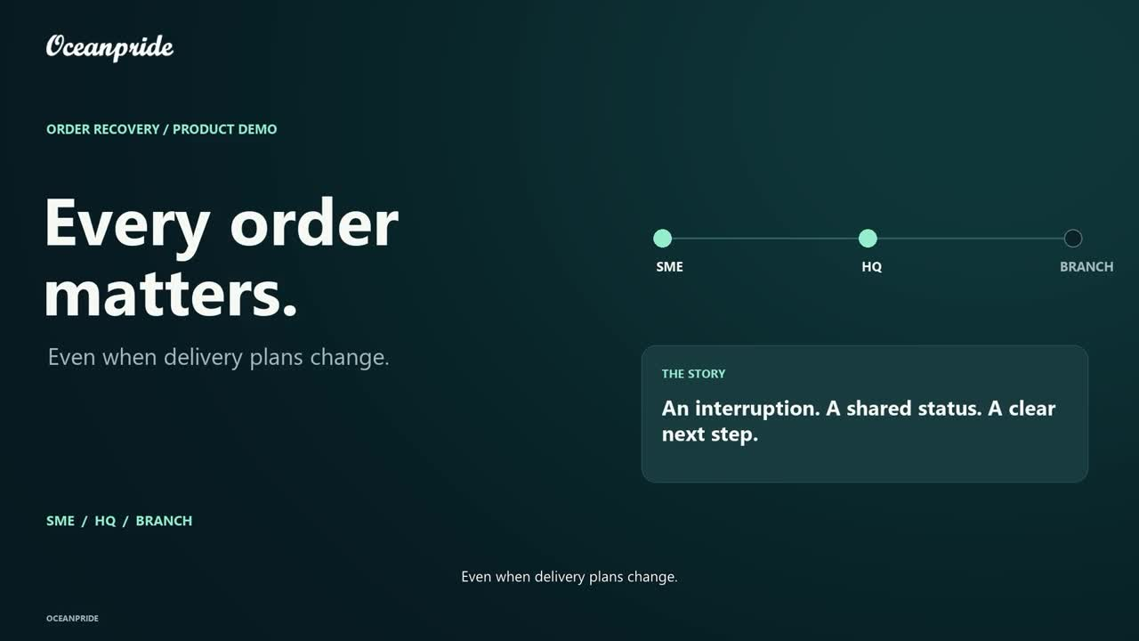

Slide 23
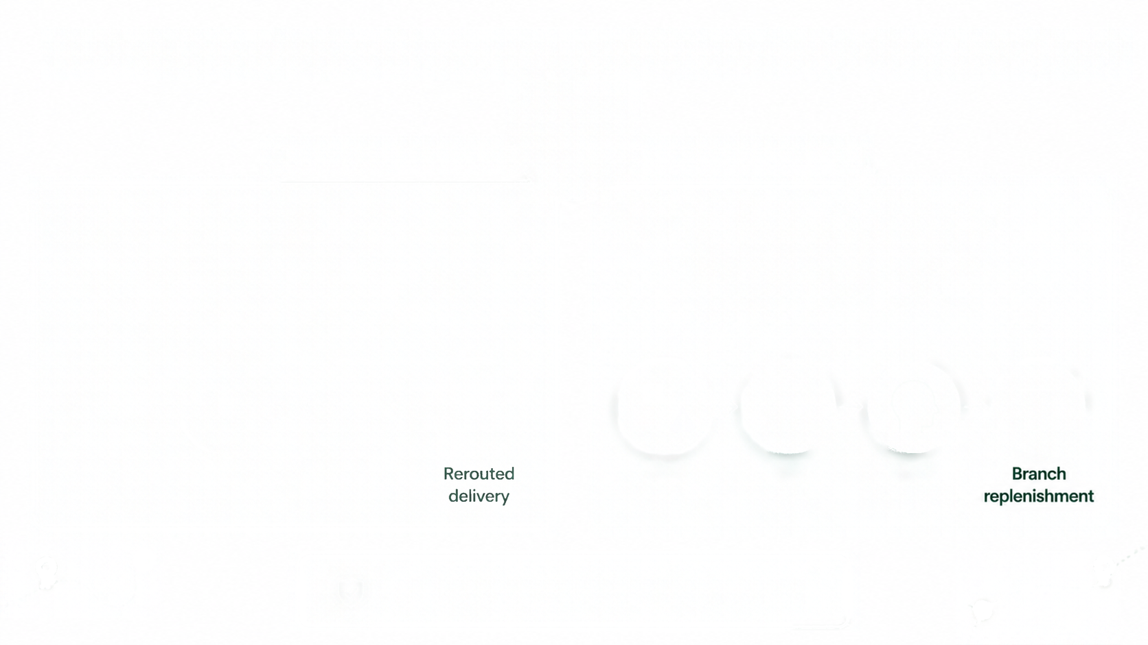


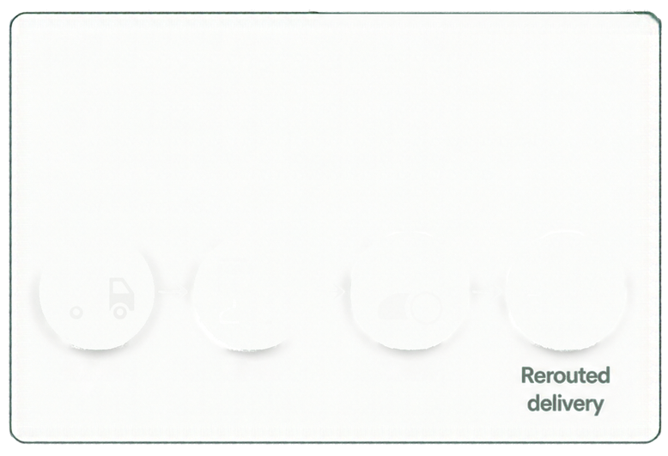



























AI That Coordinates Recovery and
Prevents the Next Stockout
SUPPLYLINK
BY
OCEANPRIDE
1.
Recover the failed delivery
2.
Refill before stock runs low
When a delivery fails, SupplyLink finds a stock available branch and the nearest practical route. People confirm every step before the order moves.
SupplyLink warns HQ when a branch's backup stock is low and suggests what to refill.
Delivery failure
Branch + route suggestion
Human confirmation
Low backup stock
HQ
alert
AI refill suggestion
AI suggests. People stay in control.

Slide 24










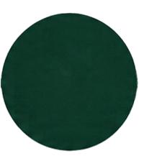

















Target Buyers, Value & Business Model
BRANCHES
SME CUSTOMERS
BRANCH
BRANCH
HEADQUARTERS
SUPPLYLINK
BY OCEANFRIDE
BRANCH
1
Who it's for
2
Why it matters
3
How it works commercially

Slide 25




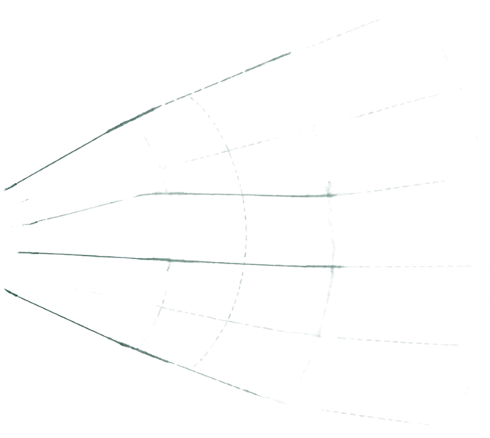










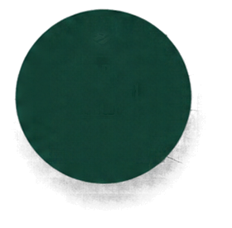




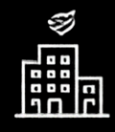








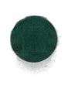
















A model that scales with your network
Our model would be a monthly subscription that grows with the number of branches a supplier connects, plus a one-time onboarding fee.
Monthly subscription
One-time onboarding fee
SUPPLIER HEADQUARTERS
More connected branches. More operational coverage.

Slide 26




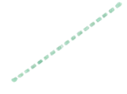



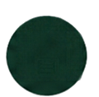






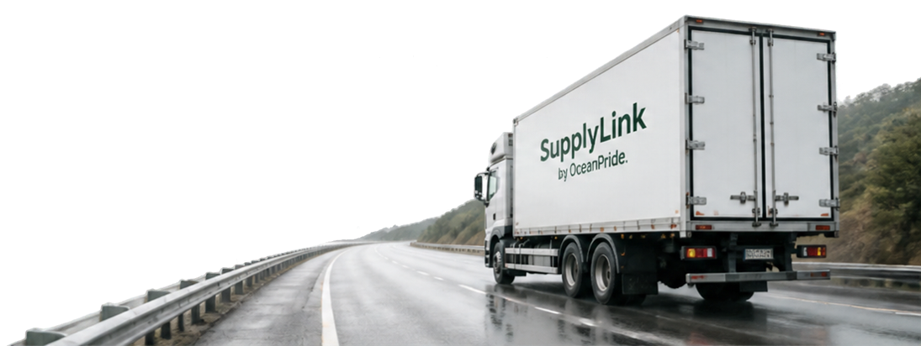

SUPPLY LINK by
Oceanpride
HQ
This is a working prototype on test data.
BRANCH
BRANCH
SME CUSTOMER
When deliveries fail,
customer trust shouldn’t have to.
RECOVERED DELIVERY ROUTE
Schedule a pilot discussion

Slide 27


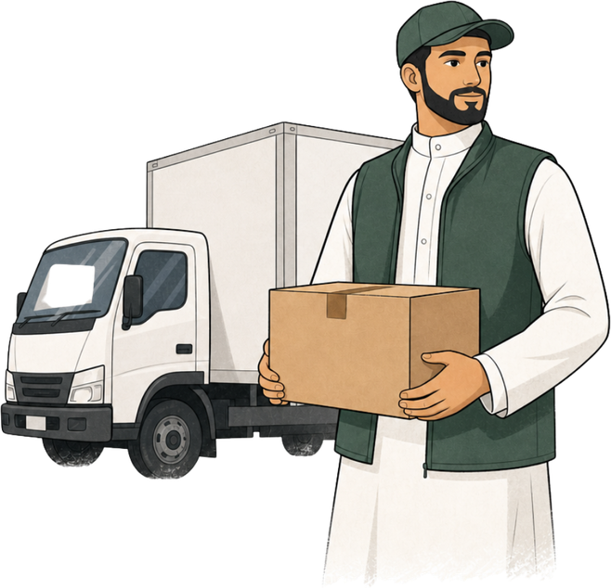

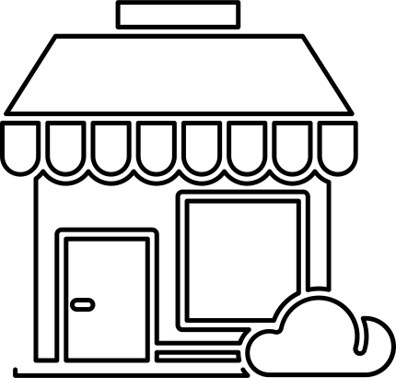
Thank You

