Slide 1




ResolveMate
Smarter Logistics Support, Faster Case Resolution
One Workspace for Delivery Complaints
Presented by: Aquaholics
October, 2026

Slide 2
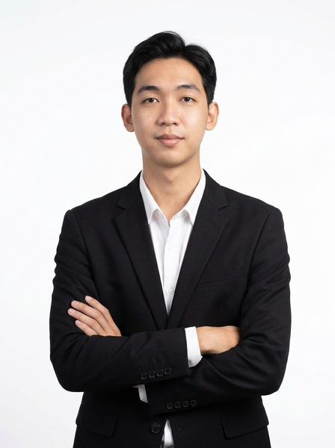






BROUGHT TO YOU BY AQUAHOLICS
Kaung Set Thar
Pan Myo Phyu
Aye Nandar Win
Aung Khant Min
Ye Htet Naing
Myat Thetlyar Min
Thaw Thaw Tun

Slide 3


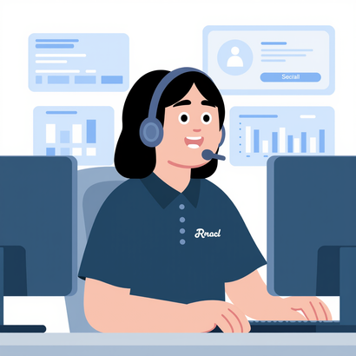

The operational problem behind the complaint
Customer
Seller
Operation staff
Driver
Ask the seller
Contacts Operations
Looks up the order
Explains the disruption
"Why is my parcel delayed?"
Waits then relays replies
Calls driver/ Writes replies
Answers the next call
Replies travel back through the chain
  Another enquiry? The work starts again.
One enquiry. Four actors. The next enquiry restarts the loop.
Notes:
TARGET 0:25–0:55 · 30 seconds. Scene 2.
NARRATION: Before, the customer asks the seller. The seller contacts operations. Aye searches for the order, calls the driver, and writes a reply. The seller passes it back. Then another enquiry arrives, and much of that investigation starts again. Coral marks the repeated lookup, chasing and reply work. This is an illustrative workflow, not a measured process audit. Keep these four actors in mind: customer, seller, operations and driver. We will return to the same arrangement after the demo.
REVEAL: actors left to right, then forward steps, then coral return loop. Transition: fade to the customer impact.
## Before: the same investigation starts again.
TARGET 0:25–0:55. Scene 2. Large editable manual workflow diagram: customer asks seller, seller contacts operations, operations searches order and calls driver, writes reply, another enquiry restarts loop. Mark repeated lookup/chasing/reply steps with coral. Actor colours and positions must recur on after slide.

Slide 4
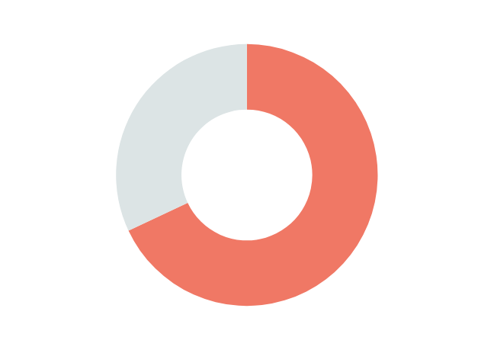

Staff workload becomes
a reputation risk.
Financial Times reports that shoppers cancel orders after learning Evri or Yodel would deliver them, because of previous bad experiences in exception handlings.
  Evri and Yodels are delivery companies in the UK.
68 / 100
46 / 100
UK recipients experienced any delivery
issue in the previous SIX MONTHS
Complaints-handling satisfaction
Separate measure, not a funnel
Ofcom UK · 22 Oct 2025 | International evidence, not Myanmar estimates
Notes:
TARGET 0:55–1:20 · 25 seconds. Scene 3.
NARRATION: Delivery problems can become a customer-care problem. Ofcom's UK evidence reports that 68 in 100 recipients experienced any delivery issue in the previous six months. Separately, complaints-handling satisfaction was 46 in 100. These are different measures: not parcel failure rates and not a conversion funnel. They are international evidence, not Myanmar estimates. May's fictional question captures the risk we want to explore: can repeated frustration also affect the seller's reputation?
REVEAL: show the two independent graphics separately, then May's illustrative quote. Transition: cut to the workspace concept.
## Staff workload becomes a reputation risk.
TARGET 0:55–1:20. Scene 3. Separate accurate data graphics: 68/100 pictogram grid or doughnut for UK recipients experiencing any delivery issue in previous SIX MONTHS; 46/100 independent bar for complaints-handling satisfaction. NOT parcel failure rate or conversion funnel. Small Ofcom UK 2025 source and 'International evidence, not Myanmar estimates'. Beside or below: fictional May quote 'Can you use another delivery company next time?' with 'Illustrative scenario'.

Slide 5

Meet ResolveMate
Solution?
A centralized workspace for delivery exceptions.
Target buyer = Delivery company
Primary User = Operation employee
Notes:
TARGET 1:20–1:45 · 25 seconds. Scene 4.
NARRATION: This is one delivery company's internal exception workflow. The company is the buyer, and Aye in operations is the primary user. Drivers submit structured reports through a portal; customers submit questions or complaints through another. Operations reviews the context, investigates, publishes customer updates and sends relevant findings to sellers. We are demonstrating with demo data. A connection to existing delivery management is a future integration, not something this prototype claims to have live today.
REVEAL: company boundary and Aye first, then portal inputs, reviewed outputs and dashed future integration. Transition: zoom into the driver portal.
## One company. One operations workspace.
TARGET 1:20–1:45. Scene 4. Operations user Aye central, driver reports and customer complaints incoming, reviewed updates and relevant seller handoffs outgoing. Label company buyer, operations primary user; customer and driver use portals. Existing delivery management below with dashed FUTURE integration, demo-data badge. This is ONE company's internal exception workflow.

Slide 6
Centralizing Multi-Channel Exception Intake
ONE COMPANY'S INTERNAL EXCEPTION WORKFLOW
Driver portal
Structured reports
Operations
Review • investigate • publish
Reviewed
customer updates
Customer portal
Complaints
Relevant
seller handoffs
Existing delivery management
FUTURE integration · not connected in this demo
Notes:
TARGET 1:20–1:45 · 25 seconds. Scene 4.
NARRATION: This is one delivery company's internal exception workflow. The company is the buyer, and Aye in operations is the primary user. Drivers submit structured reports through a portal; customers submit questions or complaints through another. Operations reviews the context, investigates, publishes customer updates and sends relevant findings to sellers. We are demonstrating with demo data. A connection to existing delivery management is a future integration, not something this prototype claims to have live today.
REVEAL: company boundary and Aye first, then portal inputs, reviewed outputs and dashed future integration. Transition: zoom into the driver portal.
## One company. One operations workspace.
TARGET 1:20–1:45. Scene 4. Operations user Aye central, driver reports and customer complaints incoming, reviewed updates and relevant seller handoffs outgoing. Label company buyer, operations primary user; customer and driver use portals. Existing delivery management below with dashed FUTURE integration, demo-data badge. This is ONE company's internal exception workflow.

Slide 7

How shared context helps each role?
May · Customer
Before: Repeated enquiries
After: Visible response
RESULT
Less manual coordination
Shared context
Visible owner
replaces scattered coordination
Driver A
Before: Repeated calls
After: One structured report
Seller
Before: Calls + relays
After: Relevant handoff
Clearer responses
Less frustration
Aye · Operations
Before: Lookup + chasing
After: Shared workspace,
Aye owns
Stronger trust / brand reputation
Notes:
TARGET 3:15–3:40 · 25 seconds. Scene 7.
NARRATION: Return to the same actors, in the same positions and colours. Before, information is scattered across calls and repeated enquiries. After, a shared workspace gives operations a visible owner, the driver a structured reporting path, the customer a response history and the seller a relevant handoff. Our intended chain is less manual coordination, clearer responses, less frustration and stronger trust or brand reputation. These are intended benefits, not proven outcomes. A pilot must validate every link, rather than assuming a nicer interface automatically creates loyalty.
REVEAL: before row, after row, then causal chain left to right. Transition: fade to positioning.
## Better operations. A better customer experience.
TARGET 3:15–3:40. Scene 7. Compelling BEFORE vs AFTER paired diagram using same actor positions/colours as slide 2. Before scattered calls and repeated enquiries; after shared workspace and visible owner. Lower causal diagram: less manual coordination, clearer responses, less frustration, stronger trust/brand reputation. 'Intended benefits; pilot validation required.' Avoid fake savings chart.

Slide 8
Business strategy
AREA
STRATEGY
Target customer
Myanmar courier companies with dedicated support teams
Value proposition
One workspace for complaints, AI-assisted triage, and seller escalation
Revenue model
Monthly company subscription plus a one-time setup fee
Market entry
Pilot with one courier team, measure results, then expand across branches
Competitive focus
Courier-specific workflows, local onboarding, and company-specific policies
Success measures
Less handling time, faster responses, and conversion to a paid subscription
Next milestone: Secure one pilot partner and prove measurable value
Notes:
Proposed B2B strategy. Pricing and willingness to pay require pilot validation. Start with one courier team, then expand across branches within that company's deployment.

Slide 9
Future implementation and expansion
1
2
3
Connect
Improve operations
Scale securely
Live system integration
SLA and escalation rules
Enterprise access controls
Connect shipment and order data to the courier’s systems.
Configure service deadlines and company escalation policies.
Strengthen staff permissions and isolate each company’s data.
Verified notifications
Trend analytics
Support future deployments with role-based access and multi-tenancy.
Keep customers informed through SMS or messaging.
Identify recurring delivery issues using verified case history.
Notes:
Based on Section 8.3 Phase 2 roadmap of ResolveMate Mentor Review Documentation Pack: Courier and Order API Integration; Verified customer notifications; Configurable SLA and Escalation; Trend and Root-cause analytics; Enterprise RBAC and Multi-Tenancy. The three groups organize the roadmap for presentation and do not commit implementation dates. Dependencies include partner API access, notification provider setup and consent, agreed operational policies, historical cases with verified root-cause labels, and security review.

Slide 10
How ResolveMate compares on key features?
Feature | ResolveMate | AfterShip | Freshdesk | Narvar
Seller Escalation
AI Triage & Inbox
Multi-Portal Access
✓
✗
✗
✗
✓
✗
✓
✗
✓
✗
✓
✗

Slide 11
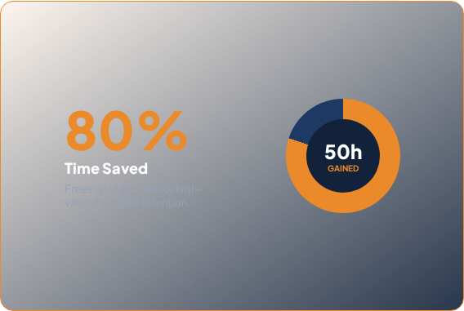
QUANTIFIABLE BUSINESS CASE
Measuring the Pilot Impact: 50 Hours Saved / Month
Pilot Validation Model
Monthly Staff Workload per 1,000 Cases
Pilot ROI & Workload Reduction
Comparison of manual follow-up time vs. automated resolution
Direct capacity reclaimed for merchant support teams
Manual Handling (Status Quo)
50 Hours / Month
1,000 cases × 3 mins = 3,000 mins
With ResolveMate Automated Pilot
10 Hours / Month
-80%
Staff Hours
Repeat Enquiries
Based on 1,000 monthly cases at 3 mins per follow-up enquiry.
CSAT Score
Merchant Retention
COMMERCIAL MODEL:
Delivery Company Buyer
Monthly Subscription
Integration / Onboarding Fee
Expansion: Multi-branch deployment under identical software architecture

Slide 12
BEFORE
AFTER
Chasing answers.
Managing
exceptions.
"Where is my parcel?"
Seller calls operations
✓
Driver reports once
Repeat lookup
Rules find who is affected
✓
➔
Ops calls Driver A
✓
Aye reviews and publishes
Repeat call
Reply relayed back...
May sees the answer
✓
Repeat explanation
✓
Seller gets a relevant handoff

Slide 13
Sources and
demonstration boundaries
Unspoken appendix · Reference for judges
What this demonstration does not claim
Ofcom · 22 Oct 2025 ↗
Best and worst parcel firms for customer
satisfaction revealed 2025
UK measures are separate; not Myanmar estimates.
Personas are fictional. Every UI is simulated.
Commercial ROI assumptions and reputation benefits remain unproven.
Existing-system integration is future work.
No refund or payment approval.
Zendesk · Ticketing system ↗
Official reference: unified support ticketing
AfterShip · Exception-handling settings ↗
Official reference: exception management
Notes:
UNSPOKEN APPENDIX — excluded from 5:00 main presentation. No automatic advance. Use only for questions and source verification.
SOURCE LINKS (preserved exactly):
Ofcom (22 Oct 2025) https://www.ofcom.org.uk/post/deliveries-and-charges/best-and-worst-parcel-firms-for-customer-satisfaction-revealed-2025
Zendesk https://www.zendesk.com/service/ticketing-system/
AfterShip https://support.aftership.com/en/tracking/articles/17126856-set-up-exception-handling-settings
BOUNDARIES: UK delivery-issue experience over the previous SIX MONTHS and complaints-handling satisfaction are separate measures, not a parcel failure rate or funnel and not Myanmar estimates. Personas are fictional. UI is simulated with demo data. Commercial ROI inputs are illustrative assumptions, not observed results; pricing, willingness to pay and reputation benefits are unproven. Pilot validation is required. Existing-system integration is future work. Seller handoff conveys findings, not refund/payment approval.
## Sources and demonstration boundaries
TARGET Unspoken appendix. Exact source blocks MUST include these actual URLs, not generic homepages or missing-source disclaimers: Ofcom (22 Oct 2025) https://www.ofcom.org.uk/post/deliveries-and-charges/best-and-worst-parcel-firms-for-customer-satisfaction-revealed-2025 ; Zendesk https://www.zendesk.com/service/ticketing-system/ ; AfterShip https://support.aftership.com/en/tracking/articles/17126856-set-up-exception-handling-settings . Use clickable descriptive titles linked to exact URLs if full links crowd. State UK measures separate, fictional personas, UI simulated, commercial ROI assumptions and reputation benefits unproven, future integration, no refund/payment approval. Source URLs ARE supplied here.

Slide 14

Thank You For Your Time
Deliver Better, Resolve Faster
Notes:
UNSPOKEN APPENDIX — excluded from 5:00 main presentation. No automatic advance. Use only for questions and source verification.
SOURCE LINKS (preserved exactly):
Ofcom (22 Oct 2025) https://www.ofcom.org.uk/post/deliveries-and-charges/best-and-worst-parcel-firms-for-customer-satisfaction-revealed-2025
Zendesk https://www.zendesk.com/service/ticketing-system/
AfterShip https://support.aftership.com/en/tracking/articles/17126856-set-up-exception-handling-settings
BOUNDARIES: UK delivery-issue experience over the previous SIX MONTHS and complaints-handling satisfaction are separate measures, not a parcel failure rate or funnel and not Myanmar estimates. Personas are fictional. UI is simulated with demo data. Commercial ROI inputs are illustrative assumptions, not observed results; pricing, willingness to pay and reputation benefits are unproven. Pilot validation is required. Existing-system integration is future work. Seller handoff conveys findings, not refund/payment approval.
## Sources and demonstration boundaries
TARGET Unspoken appendix. Exact source blocks MUST include these actual URLs, not generic homepages or missing-source disclaimers: Ofcom (22 Oct 2025) https://www.ofcom.org.uk/post/deliveries-and-charges/best-and-worst-parcel-firms-for-customer-satisfaction-revealed-2025 ; Zendesk https://www.zendesk.com/service/ticketing-system/ ; AfterShip https://support.aftership.com/en/tracking/articles/17126856-set-up-exception-handling-settings . Use clickable descriptive titles linked to exact URLs if full links crowd. State UK measures separate, fictional personas, UI simulated, commercial ROI assumptions and reputation benefits unproven, future integration, no refund/payment approval. Source URLs ARE supplied here.

