Slide 1


The Citadel
Learning that leads
to real opportunities
Team 404
A learning platform connecting education to real jobs
01
Notes:
[15 seconds]
Hello everyone. We are Team 404, and this is the Citadel. We connect learning to real work. Let us show you the idea through two stories, and then through our product.
Sources: Team 404 pitch script supplied by the user. Brand assets and product screenshots from the local Citadel project. Illustrations depict fictional characters. No market-size or traction figures are asserted.

Slide 2

Meet ZinYaw
A big dream.
No clear way to begin.
Cidi helps her find a place
to learn the skills she needs.
02
Notes:
[35 seconds]
ZinYaw is a young seagull with a big dream: she wants to fly across the ocean. But she cannot fly yet. Then she meets Cidi, who introduces her to the Citadel. There she finds crabs, octopuses, sharks and turtles learning alongside her. Each has a different goal. They represent learners like us: people with ambition who need a clear place to begin.
Sources: Team 404 pitch script supplied by the user. Brand assets and product screenshots from the local Citadel project. Illustrations depict fictional characters. No market-size or traction figures are asserted.

Slide 3

The gap between learning and work
Young learners in Myanmar
“Which skills do I need,
and how do I prove them?”
Our first audience
Aspiring IT talent seeking an affordable path
to work, and companies hiring junior talent.
03
Notes:
[25 seconds]
The gap is the same outside our story. Young learners need to know what to learn and how to show that they can do the work. Companies need evidence of ability before they hire. We begin with aspiring IT talent in Myanmar and companies seeking junior talent.
Sources: Team 404 pitch script supplied by the user. Brand assets and product screenshots from the local Citadel project. Illustrations depict fictional characters. No market-size or traction figures are asserted.

Slide 4
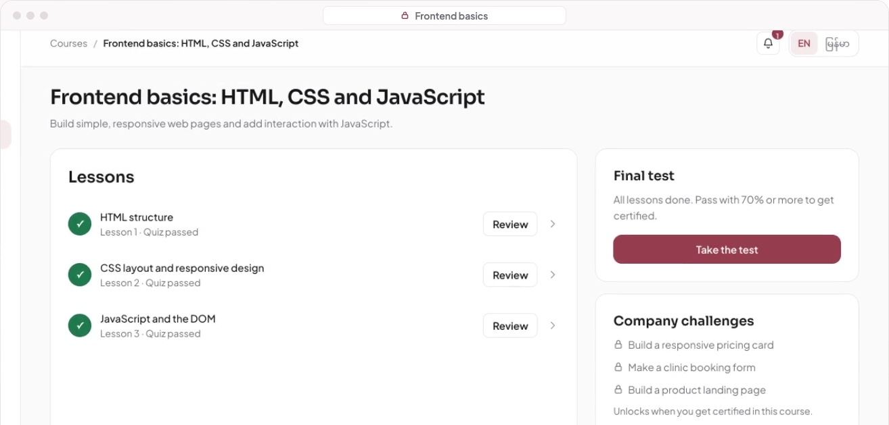
The learner journey
Choose a goal. Learn. Pass the course test. Prove your skills.
A personal roadmap
Short lessons
and practice
A certificate unlocks
company challenges
Learner demo
04
Notes:
[40 seconds including a 20-second demo]
Learners choose a goal and get a personal roadmap. They take short courses, complete practice and pass the course assessment to earn a certificate. That certificate unlocks related company challenges, where learners can show what they can do.
Demo cue: play a 20-second excerpt showing the roadmap, lessons and certificate. Local video: /Users/PROM1/Downloads/hackathon(uxmm)/Team-5/output/walkthrough/the-citadel-learner-walkthrough.mp4
The image is a still from that existing demo. In the current product, a course assessment awards the certificate. A company challenge is a separate step toward an interview.
Sources: Team 404 pitch script supplied by the user. Brand assets and product screenshots from the local Citadel project. Illustrations depict fictional characters. No market-size or traction figures are asserted.

Slide 5

Meet Cone Cone
He has a job
that needs doing.
ZinYaw can now show
that she can do it.
05
Notes:
[30 seconds]
Now meet Cone Cone, an older turtle. He wants to send a love letter across the ocean, so he needs someone who can fly. At the Citadel, ZinYaw has learned, earned a certificate and can demonstrate her ability. Cone Cone gives her the delivery job. She gets paid to do what she loves. Cone Cone represents the companies looking for proven talent.
Sources: Team 404 pitch script supplied by the user. Brand assets and product screenshots from the local Citadel project. Illustrations depict fictional characters. No market-size or traction figures are asserted.

Slide 6
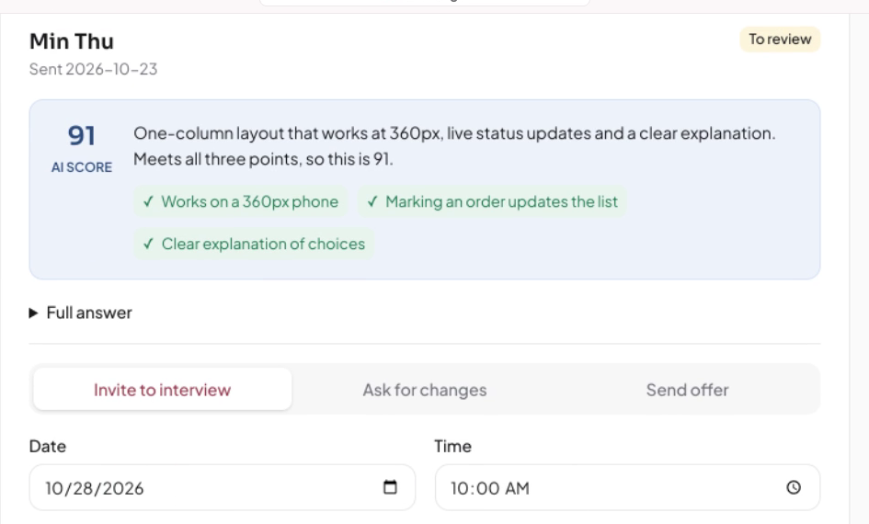
The company journey
Real work gives companies something concrete to review.
Get verified
Post a real challenge
and review submissions
Shortlist and interview
the people behind the work
Company demo
06
Notes:
[40 seconds including a 20-second demo]
Verified companies create real challenges and review learner submissions. AI helps organise feedback, while the company makes the decision. Companies can shortlist people and invite them to interview. This is designed to reduce the effort of finding suitable junior talent. Learners never pay to apply or interview. An interview or job is not guaranteed.
Demo cue: play a 20-second excerpt showing challenge posting, reviewing work and inviting a candidate. Local video: /Users/PROM1/Downloads/hackathon(uxmm)/Team-5/output/walkthrough/the-citadel-company-walkthrough.mp4
The image is a still from that existing demo. Company names and scores shown are demo data, not traction.
Sources: Team 404 pitch script supplied by the user. Brand assets and product screenshots from the local Citadel project. Illustrations depict fictional characters. No market-size or traction figures are asserted.

Slide 7

Why learners can start with Citadel
25%
Always free
Internship applications
and interviews
of every paid course
is free to try
AI helps draft lessons.
Human experts review them.
07
Notes:
[25 seconds]
Learning starts free. The first quarter of every paid course is free to try, and internship applications and interviews stay free. Our content approach uses AI to help draft lessons, followed by human expert review. The aim is to build courses faster while keeping people responsible for quality.
Sources: Team 404 pitch script supplied by the user. Brand assets and product screenshots from the local Citadel project. Illustrations depict fictional characters. No market-size or traction figures are asserted.

Slide 8
The proposed revenue model
Learners
Companies
Pay to unlock the
remaining 75%
Challenge posting fee
Fee for a successful hire
Only for paid courses
Planned revenue streams
08
Notes:
[25 seconds]
The proposed model begins with course purchases. Learners pay to unlock the remaining seventy-five percent of paid courses. Later, companies would pay a challenge-posting fee and a fee when they hire an intern through Citadel. These are proposed revenue streams, not reported revenue. We keep learner applications and interviews free.
Sources: Team 404 pitch script supplied by the user. Brand assets and product screenshots from the local Citadel project. Illustrations depict fictional characters. No market-size or traction figures are asserted.

Slide 9

Trust is the hardest part
Verify every company
Check registration, contacts and internship terms.
Keep opportunities real
Review company behaviour and learner reports.
Grow both sides together
Match learner pathways with enough relevant challenges.
09
Notes:
[25 seconds]
Our biggest challenge is trust. We must verify companies carefully and make sure internship opportunities are genuine. We also need enough relevant challenges for the learners we serve. That means growing both sides carefully, checking internship terms and reviewing reports, rather than opening the doors faster than we can support.
Sources: Team 404 pitch script supplied by the user. Brand assets and product screenshots from the local Citadel project. Illustrations depict fictional characters. No market-size or traction figures are asserted.

Slide 10

We were ZinYaw, too
Big dreams deserve
a clear first step
Team 404
We’re looking for pilot partners and supporters
to connect learning with real opportunities.
Thank you. See you on November 1st!
10
Notes:
[25 seconds]
Why us? Because we know what it feels like to have a big dream without a clear path. That is why Team 404 is building the Citadel. We are looking for pilot partners, mentors and supporters who want to connect learning to real opportunity. Thank you for listening. See you on November first!
Suggested total timing: approximately 4 minutes 45 seconds, including two 20-second demo excerpts. The closing asks for pilot support rather than inventing a funding amount or claiming signed partners.
Sources: Team 404 pitch script supplied by the user. Brand assets and product screenshots from the local Citadel project. Illustrations depict fictional characters. No market-size or traction figures are asserted.

