Slide 1


fom.
BUILT FOR EVERYDAY ACCESS
Two people.
One clearer transaction.
FOM — Future of Myanmar
Hlaing Myint Myat
Thurein Hein
Nyein Zaw Lin
Product Designer
Business Owner
Full Stack Developer
P Sai Naung
Lin Khant Tun
Shin Khant
Project Manager
Business Analyst
Business Owner
FOM / FUTURE OF MYANMAR
01
Notes:
FOM | everyday transactions
10 seconds. Timed pitch.

Slide 2
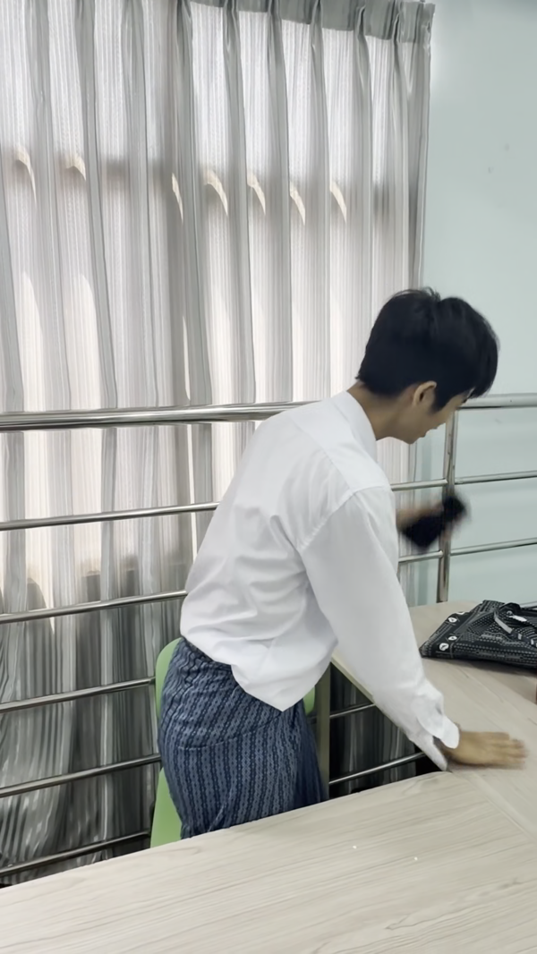
01
THE TRUST
PROBLEM
An everyday moment.
A familiar frustration.
Notes:
Scenario 1
69 seconds. Timed pitch.

Slide 3
fom.
INTENDED ESCROW MODEL
Turn “Can I trust this?”
into a clear next step.
AGREE
PARTNER HOLDS
CHECK
RELEASE
→
→
→
Item + amount
Delivery + checking
Approved financial
partner required
Buyer receives
and checks the item
Partner-backed
release or resolution
Prototype: agreement, receipts and delivery. Live holding/release: planned.
FOM / FUTURE OF MYANMAR
03
Notes:
Trust becomes a visible journey
8 seconds. Timed pitch.

Slide 4
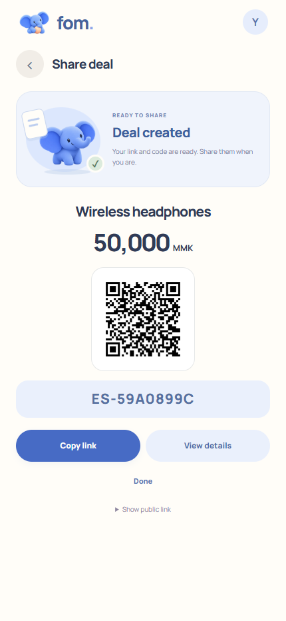
fom.
CURRENT PRODUCT FLOW
Create a deal.
Make it clear.
01 Describe
Item, amount and receiving details
02 Agree
Delivery and checking terms
03 Create & share
One code, link or browser QR
FOM / FUTURE OF MYANMAR
04
Notes:
Product | create deal
20 seconds. Timed pitch.
Static screen from the actual current app. Seller creates item, amount, receiving information, delivery/checking terms and a share code. Replace this section with a recording synchronized to narration after voice is received.

Slide 5
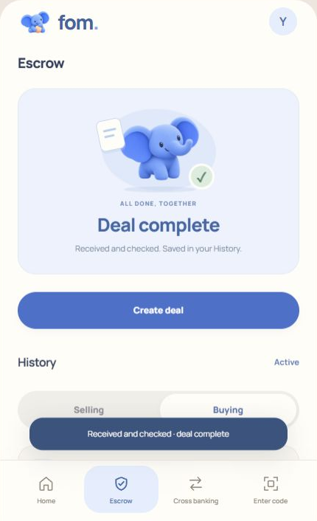
fom.
CURRENT PROTOTYPE · TWO-SIDED WORKFLOW
Both sides know
what happens next.
BUYER
Reviews the agreement and submits a receipt
SELLER
Adds a package photo and confirms arrival
BUYER
Receives, checks and confirms; saved in History
FOM / FUTURE OF MYANMAR
05
Notes:
Product | buyer and delivery
24 seconds. Timed pitch.
Static current product state. Receipt upload does not independently verify payment. Real fund holding/release remains planned. Record the buyer/seller actions after narration arrives; do not treat this slide as completed motion footage.

Slide 6

02
THE PAYMENT
PROBLEM
An everyday moment.
A familiar frustration.
Notes:
Scenario 2
48 seconds. Timed pitch.

Slide 7
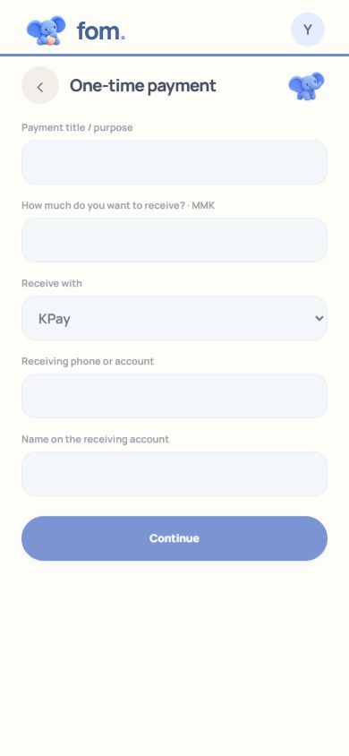
fom.
CURRENT PRODUCT FLOW
Create. Share.
Keep the record.
CREATE
Purpose, amount and receiving details
SHARE
The customer opens a code, link or browser QR
FOLLOW
Instructions, receipt submission and History
FOM / FUTURE OF MYANMAR
07
Notes:
Product | payment request
34 seconds. Timed pitch.
Current receipt workflow; no cross-wallet transfer is performed. This is the static presentation. Capture and synchronize actual button presses after narration is received.

Slide 8
fom.
PUBLISHED OFFERS VS OUR PROTOTYPE / PROPOSAL
Payment collection exists.
Our focus is the whole deal.
COMPARE
Dinger
MyanMyanPay
FOM
Product today
Merchant collection
MMQR collection
Receipt / deal prototype
Link / QR entry
Published links
Published links / QR
Browser code / link / QR
Bank-verified payment
Published collection
Published verification
Planned integration
Delivery + buyer check
Not documented¹
Not documented¹
Implemented workflow
Recurring fixed fee
100,000 MMK / month²
120,000 MMK / year;
waived through 2026
0 monthly proposed
Transaction charge
KBZPay: 1.9% + 100²
Storefront: 500 / order³
2% FOM proposed
+ provider charges
¹ Not documented in reviewed pages; not proof of absence. ² Dinger Standard / published route. ³ Current Storefront fee.
FOM / FUTURE OF MYANMAR
08
Notes:
Competitive feature matrix
13 seconds. Timed pitch.
Sources checked 23 October 2026: https://dinger.asia/social/eng ; https://dinger.asia/pricing/eng ; https://myanmyanpay.com/ ; https://myanmyanpay.com/faqs . MMP fee becomes 1% + 500 on 1 Jan 2027. Its annual fee is currently waived. FOM charges and partner capability are proposals; no live fee is collected by the demo.

Slide 9
fom.
ENTRY-COST HYPOTHESIS · MONTHLY EQUIVALENT, MMK
Start without a monthly plan.
Fixed charges only; transaction fees excluded. MMP annual fee waived through 2026. FOM is a proposal.
100,000
100,000
75,000
50,000
25,000
0
0
0
Dinger Standard
MyanMyanPay
FOM proposal
Published monthly plan
Annual fee currently waived
No monthly subscription
FOM / FUTURE OF MYANMAR
09
Notes:
Fixed-charge comparison chart
12 seconds. Timed pitch.
This graph compares fixed platform charges only, not total payment cost and not escrow capabilities. Dinger Standard is not every possible Dinger offer. MyanMyanPay annual fee is waived through 31 Dec 2026. No pricing advantage over every competitor is claimed. https://dinger.asia/pricing/eng ; https://myanmyanpay.com/faqs

Slide 10
fom.
BUSINESS MODEL CANVAS · PROPOSED OPERATING MODEL
How FOM creates and captures value.
KEY PARTNERS
KEY ACTIVITIES
VALUE PROPOSITION
CUSTOMER RELATIONS
CUSTOMER SEGMENTS
Needed:
Approved payment partner
Phase 2:
Delivery partners
Guided deal flows
Verification + exceptions
Support and disputes
Easy to open and follow
Both sides see next steps
Planned partner-backed
protected deals
Self-service guidance
Private saved history
Reports + human help
Start:
Chat-based small sellers
and their buyers
Expand:
Occasional everyday users
KEY RESOURCES
CHANNELS
Browser product
Transaction evidence
Partner rails + team
Browser links + QR
Chat and social sharing
Seller referrals
COST STRUCTURE
REVENUE STREAMS
Processing charges · verification · hosting
Support / disputes · loss exposure
Proposed: 2% FOM service fee per completed transaction
Provider charges separate · no monthly subscription
FOM / FUTURE OF MYANMAR
10
Notes:
FOM business model canvas
10 seconds. Timed pitch.
Business Model Canvas is the requested nine-block framework, completed for FOM. All partner arrangements, pricing, revenue and market assumptions are proposed, not validated outcomes. Approved provider eligibility still applies to real payments. No partner has been secured by this work.

Slide 11
fom.
ILLUSTRATIVE ARITHMETIC · PRICING HYPOTHESIS, NOT RESULTS
50,000 MMK deal.
1,000 MMK gross FOM fee.
Proposed 2% FOM fee; provider charges disclosed separately.
2,000
REVENUE ≠ PROFIT
1,000
Gross fee
− verification
− support / disputes
− hosting + losses
= contribution margin
500
25,000 deal
50,000 deal
100,000 deal
GROSS FOM SERVICE FEE (MMK)
Pilot: social sellers → shared links / referrals → repeat use + measured support cost
FOM / FUTURE OF MYANMAR
11
Notes:
Revenue mechanics and unit economics
17 seconds. Timed pitch.
Calculated: service fee = transaction amount × 0.02. 25,000×.02=500; 50,000×.02=1,000; 100,000×.02=2,000. These are arithmetic examples of a proposed fee, not actual revenue, profit, demand or forecasts. Provider charges remain separately disclosed; actual cost allocation and pricing require partner agreement and a pilot.

Slide 12
fom.
AI LEVERAGE + EXECUTION EVIDENCE
From references to a working flow.
MOBBIN
CHATGPT
BROWSER
TESTS
Study patterns
→
Plan and implement
→
Exercise the flow
→
Check state and access
Design references
Product + code iterations
Buyer / seller walkthroughs
Backend validation
Project evidence: local app walkthroughs and saved validation reports.
FOM / FUTURE OF MYANMAR
12
Notes:
AI-assisted build with verification
12 seconds. Timed pitch.
User confirmed Mobbin and ChatGPT. Sources: FOM/README.md; outputs/receipt-mvp/HANDOFF.md; actual recording-events.json from this rebuild. Do not portray Mobbin as the coding AI or claim these local tests validate a live financial provider.

Slide 13
fom.
NEXT STEPS
Everyday transactions.
Easier to start and follow.
NOW
Working receipt / deal prototype
NEXT
Approved partner + limited pilot
PHASE 2
Explore delivery verification
FOM / FUTURE OF MYANMAR
13
Notes:
Roadmap and closing
8 seconds. Timed pitch.
Phase 2 delivery infrastructure is a short exploratory direction, not a current capability or a promise to authenticate every product.

Slide 14
fom.
APPENDIX · EXCLUDED FROM TIMED VIDEO
The FOM team.
Hlaing Myint Myat
Thurein Hein
Product Designer
Business Owner
hlaingmyintmyat111@gmail.com
mgthureinhein123@gmail.com
Nyein Zaw Lin
P Sai Naung
Full Stack Developer
Project Manager
nzaw39165@gmail.com
psainaung2009@gmail.com
Lin Khant Tun
Shin Khant
Business Analyst
Business Owner
linzwe90@gmail.com
shinkhanttun0@gmail.com
FOM / FUTURE OF MYANMAR
14
Notes:
Team contacts
0 seconds. Hidden reference appendix.

Slide 15
fom.
APPENDIX · EXCLUDED FROM TIMED VIDEO
Evidence behind the pitch.
COMPETITORS
dinger.asia/social/eng · dinger.asia/pricing/eng
myanmyanpay.com · myanmyanpay.com/faqs · kbzpay.com/en/products/mmqr
PRODUCT
Actual current app: handshake/app/ · FOM/README.md
Flow inspection: actual-flow-inspection.json · prior browser validation reports
ASSUMPTIONS
2% service fee, no subscription, target segment and delivery roadmap are proposals.
No traction, live bank integration, secured partnership or profit is claimed.
CHECKED
23 October 2026. Fixed-charge graph excludes transaction fees.
Current receipt upload does not independently verify or transfer money.
FOM / FUTURE OF MYANMAR
15
Notes:
Evidence and assumptions
0 seconds. Hidden reference appendix.

