Slide 1
IT Batch Management
Austin Okechukwu
Notes:
Good afternoon/ morning everyone, my name is Austin Okechukwu and I am a data consultant with FDM group and have been attached to the HSBC Global Audit Analytics team for 1 year. Today, I will be discussing a data project I recently delivered, which is the IT Batch Management Audit.

Slide 2
Introduction
Overview of the Presentation:
Project Structure
Architecture and Implementation
Results
Conclusion
Objective:
Assess and mitigate the key risks relating to process of payments.
Scope:
Digital Business Service
Audit Period was 3 months
Regions Covered
Key Stakeholders:
Audit Analytics Lead
Audit Manager
Accountable Executive
Notes:
Provide an overview of the project, including the objective, scope, and key stakeholders.
The objective of the audit was to assess the adequacy of key business automated controls and IT general controls implemented in HSBC shared application, mitigating the key risks relating to process of payments.
The audit scope was covering Digital Business Services, across 3 months and covered three regions UK, US AND HK. The field work was between 3 weeks.
The key stakeholders are
Audit Analytics Lead
Audit Manager
Accountable Executive

Slide 3
Project Structure
Data sources and methods used for collecting.
Control - Log files
EIM Dashboards - CSV
Service Desk Manager - Database
Project phase:
Gather and clean
Dashboard Tool
Developed 7 Tests related to:
Alert
Dependency
Critical Jobs
Incident
Failed Jobs
Manual Job
Notes:
The data sources are broking down into three core systems, which are interconnected in some form. They control the following information about the data. They are stored across different formats and systems but the predominant file formats were log files and CSV.
Control - Job Logs, Job Configurations, Job Alerts,
Dashboards - Application Data
Service Desk Manger - Incident Data.
•Present key findings and insights from the data analysis.
Process The project itself was completed in two phases. The first phase was to gather and clean the data, which included understanding the data structure, and using data engineering techniques to transform the data into a usable format. The second phase was to develop a dashboard using bespoke tool called Celonis which used process mining
•Explain how the insights were used to inform the project objectives.
The objectives were focused around 7 tests which are based on the information gathered in the data such as
Alert
Dependancy
Critical Jobs
Incident
Failed Jobs
Manual Job
and using the celonis tool to map the process flow.

Slide 4
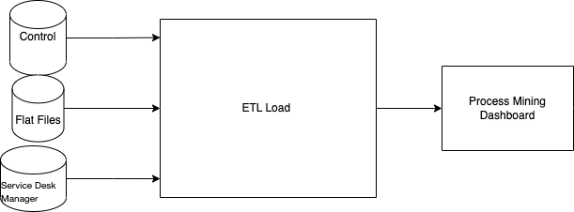
Architecture and Implementation
Source systems from global applications.
Bash script - unzipped Bzip files, into Log files.
Python(pandas) - Data extraction and Data cleaning.
MS SQL Server - Store Data.
Celonis – Perform Test, Visualize Result.

Slide 5
Results
Metric | Evaluation | Comment
Dashboard | The 7 tests were delivered and the Audit team were able to investigate and look at the process flow of incidents. Over 400 million incidents reported. | The dashboard was completed on time within the fieldwork period. Saved the Audit team hours of manual checks.
Quality Control Document(QC) | Repeatable, Scalable and within the Data governance of the internal Data access requirements. (Data Visa) | The Audit followed all data requirements set by the data visa. Repeatable, it was repeatable as the documentation on how to run the script was also created. Scalability was a potential issue as the data architecture was rigid and could fail to be completed with a larger time scope than 3 months.
Stakeholders | Managing stakeholder expectation and communicating throughout the period. | The stakeholders also complete their part of the QC which evaluates the dashboard and the tests developed.

Slide 6
Conclusion
Summary
Project Structure - Data formats, Project phase , Test development
Architecture and Implementation
Results
Notes:
Summary
Introduction
Project Structure - Data formats, Project phase , test development
Architecture and Implementation
Results
I am proud of my work on this project, I was able to effectively complete the data project within the allocated time and budget, and was able to provide the client with a dashboard that they can use to make informed decisions. I am confident that my technical experience and stakeholder interaction/ management capabilities are well suited for a data consultant role. Thank you for your time and I look forward to your questions.

