Slide 1

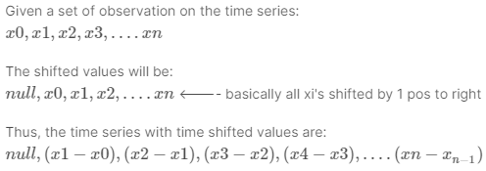
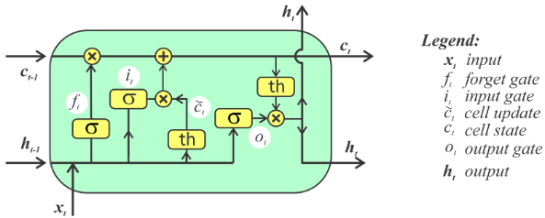
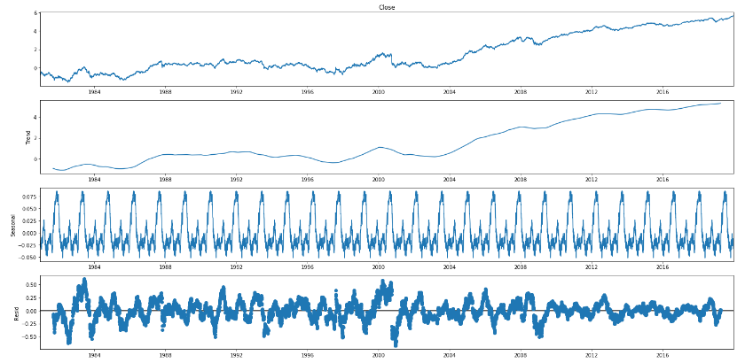
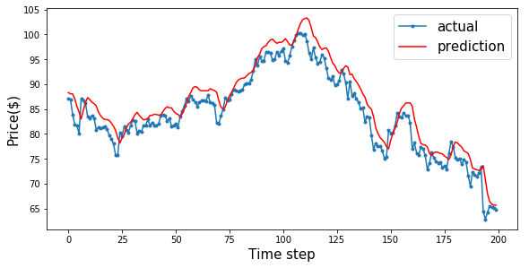
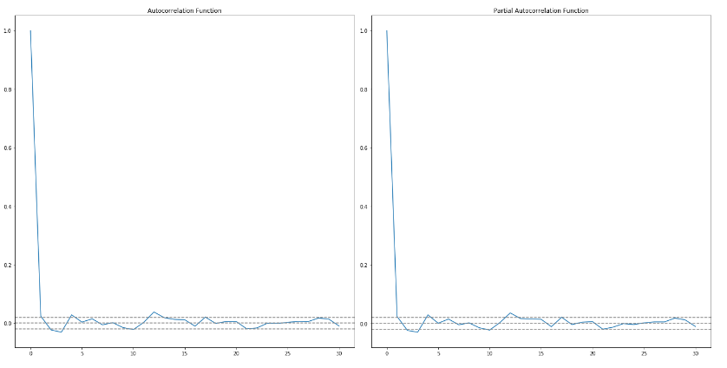
Time Series Analysis and Forecasting
Dušan Stević SW10-2016
Problem
Techniques for making time series stationary
Machine learning models
Comparison between algorithms for time series forecasting. The main focus of the project is to study performance of statistical models (AR, MA, ARIMA) and machine learning models (LSTM).
Differencing (Time Shift Transformation)
Decomposition (Time series = Trend + Seasonality + Noise)
Long short-term memory (LSTM) is an artificial recurrent neural network (RNN) architecture.
Capable of handling sequential data (time series)
A common LSTM unit is composed of a cell, an input gate, an output gate and a forget gate. The cell remembers values over arbitrary time intervals and the three gates regulate the flow of information into and out of the cell.
LSTMs were developed to deal with the exploding and vanishing gradient problems that can be encountered when training traditional RNNs.
Differencing
Motivation
A time series is a series of data points indexed in time order.
Time series forecasting is the use of a model to predict future values based on previously observed values.
The motivation for this study is to present performance evaluation for state-of-the-art algorithms for time series forecasting.
Objectives
Decomposition
Data collection (Data acquisition)
Data preprocessing
Develop models
Evaluate algorithmic performance
Tuning Models
Grid search method (AR, MA, ARIMA)
Trial and error method (LSTM)
Data collection and preprocessing
Evaluation
Historical stock prices
Stock market API
Handling NA values
Feature engineering and scaling
ARIMA Root Mean Square Error (RMSE): 23.2218
LSTM Root Mean Square Error (RMSE): 9.4728
Detecting stationarity in time series
Statistical Models
Rolling (moving) statistics
Additive time series
Augmented Dickey Fuller Test
Additive time series
Kwiatkowski–Phillips–Schmidt–Shin Test
Multiplicative time series
Multiplicative time series
Visual Test
Statistical Tests
Statistical Tests
p-value threshold 5%
p-value threshold 5%
Rolling Mean
Rolling Standard Deviation
(H1): Time series is stationary
(H0): Time series is non-stationary. It has some time dependent structure.
(H0): Time series is non-stationary. It has some time dependent structure.
(H1): Time series is stationary
The Autoregressive AR(p) Part of ARIMA : describes relationship between a current observation and previous observations.
The Integrated I(d) Part of ARIMA: describes number of lags (shifts) until time series becomes stationary.
The Moving Average MA(q) Part of ARIMA: describes relationship between an observation and a residual error from previous observations.

