Slide 1

Science Project Title
Your name | Teacher’s name | School
Problem / Question
Materials
Results
Enter your question here (statement of the problem)
Materials (detailed list) | Quantity (be specific)
Item | Amount
Item | Amount
Item | Amount
Item | Amount
Item | Amount
Item | Amount
Item | Amount
Hypothesis
Add your answer / solution here
Write hypothesis before you begin the experiment
This should be your best educated guess based on your research
Project Overview
Procedure
Include results based on your experiments
Result 2
Result 3
Step 1
Describe this step in your experiment
Step 2
Describe this step in your experiment
Step 3
Describe this step in your experiment
Step 4
Describe this step in your experiment
Add a brief overview or summary of your project. (Use the Bullets button on the Home tab to remove the bullets.)
Conclusion
Brief summary of what you discovered based on results
Indicate and explain whether or not the data supports your hypothesis
Variables / Research
Data / Observations
Controlled variables
These are kept the same throughout your experiments
Independent variable
The one variable you purposely change and test
Dependent variable
The measure of change observed because of independent variable
Decide how you will measure the change
Observation 1
Observation 2
Observation 3
Works Cited
Include print and electronic sources in alphabetical order
Notes:
To change this poster, replace our sample content with your own. Or, if you'd rather start from a clean slate, press the New Slide button on the Home tab to insert a new page. Now enter your text and pictures in the empty placeholders. If you need more placeholders for titles, subtitles or body text, copy any of the existing placeholders, then drag the new one into place.

Slide 2

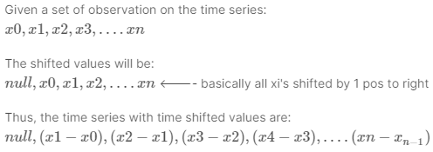
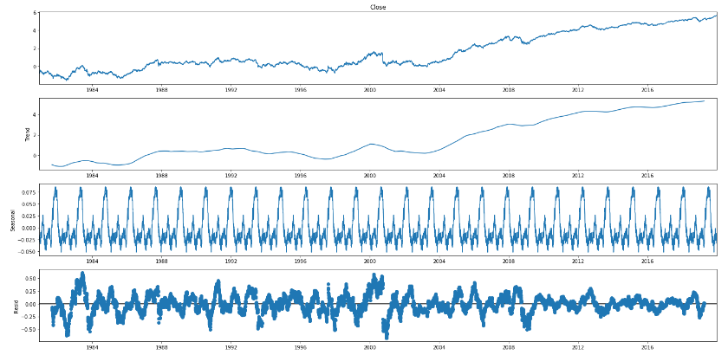
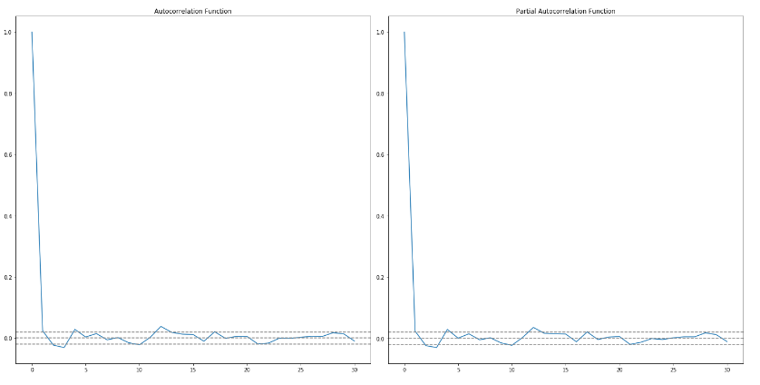
Time Series Analysis and Forecasting
Dušan Stević SW10-2016
Problem
Techniques for making time series stationary
Comparison between algorithms for time series forecasting. The main focus of the project is to study performance of statistical models (AR, MA, ARIMA) and machine learning models (LSTM).
Differencing (Time Shift Transformation)
Decomposition (Time series = Trend + Seasonality + Noise)
Differencing
Motivation
A time series is a series of data points indexed in time order.
Time series forecasting is the use of a model to predict future values based on previously observed values.
The motivation for this study is to present performance evaluation for state-of-the-art algorithms for time series forecasting.
Objectives
Decomposition
Data collection (Data acquisition)
Data preprocessing
Develop models
Evaluate algorithmic performance
Data collection and preprocessing
Historical stock prices
Stock market API
Handling NA values
Feature engineering and scaling
Detecting stationarity in time series
Statistical Models
Rolling (moving) statistics
Additive time series
Augmented Dickey Fuller Test
Additive time series
Kwiatkowski–Phillips–Schmidt–Shin Test
Multiplicative time series
Multiplicative time series
Visual Test
Statistical Tests
Statistical Tests
p-value threshold 5%
p-value threshold 5%
Rolling Mean
Rolling Standard Deviation
(H1): Time series is stationary
(H0): Time series is non-stationary. It has some time dependent structure.
(H0): Time series is non-stationary. It has some time dependent structure.
(H1): Time series is stationary
The Autoregressive AR(p) Part of ARIMA : describes relationship between a current observation and previous observations.
The Integrated I(d) Part of ARIMA: describes number of lags (shifts) until time series becomes stationary.
The Moving Average MA(q) Part of ARIMA: describes relationship between an observation and a residual error from previous observations.

