Slide 1
ACP-GINI
Ancestor-correlation penalties
for less redundant decision trees
ΔG
×
path penalty
Huynh Khang Lam • Tuan Dat Phan • Trong Nhan Nguyen
FPT University
01

Slide 2
PROBLEM
Trees avoid coefficient failure — not redundant evidence
Near-equal gains make representatives interchangeable
X₁
≈
X₂
Several members of one correlated block can reappear downstream
Accuracy can stay strong while the explanation repeats itself
02

Slide 3
CONSEQUENCES
The practical cost is interpretability, not only prediction
Unstable structure
Diluted importance
Redundant paths
small sample changes alter downstream branches
one signal is divided across substitutes
different nodes reuse the same evidence block
03

Slide 4
RESEARCH GAP
Existing methods regulate features globally; ACP-Gini is path-local
VIF pruning
drops variables before training
information loss
RRF-style
fixed penalty for new features
not pairwise
Conditional importance
post-hoc diagnostic
does not change the tree
ACP-Gini
correlation with path ancestors
single-tree construction
04

Slide 5
RESEARCH QUESTIONS
Four questions separate redundancy, stability, accuracy, and size
RQ1 — Does bootstrap structure become more stable?
RQ2 — Are selected features less redundant and importance more reliable?
RQ3 — What accuracy–penalty tradeoff does α create?
RQ4 — Do trees become smaller under the same depth budget?
05

Slide 6
ACP-GINI IDEA
Penalize correlation with distinct features already on the path
Penalty(Xⱼ,T) = ∏ [1 − α |r(Xⱼ,Xₚ)|]
root: no penalty
Xₚ ∈ ancestors(T), Xₚ ≠ Xⱼ
child: compare to root
deeper: accumulate
No self-penalty • raw gain controls stopping • α=0 is exactly CART
06

Slide 7
FORMAL BEHAVIOR
The criterion changes ordering — never whether information exists
Backward compatible
Monotone
Accumulating
α=0 gives CART
higher |r| lowers score
several ancestors compound
No hard exclusion
Repeat-safe
Raw-gain stopping
positive factors for α<1
same feature is excluded from its own penalty
penalty cannot create an artificial leaf
07

Slide 8
ALGORITHM AND SELECTION
A conservative selection rule biases disagreements toward CART
Scan thresholds with cumulative class counts
Cost
Score each best raw gain × ancestor penalty
O(nd²)
one-time correlation
+ path lookups
Tie-break by score, raw gain, then lowest feature index
Keep α values within 1 SD of CART macro-F1
Aggregate fold choices by lower quartile; RRF λ uses upper quartile
08

Slide 9
EXPERIMENTAL SETUP
The benchmark isolates the split criterion under one complexity budget
5 real binary datasets + controlled synthetic groups
Headline metrics
CART, VIF+CART, RRF-style, ACP-Gini
Accuracy / macro-F1 / AUC
Weighted selected-set redundancy
Importance rank correlation
Top-5 Jaccard
Split-composition distance
5-fold CV × 3 seeds = 15 held-out observations
B=50 bootstrap trees per training fold
max_depth=6; min_samples_leaf=5; paired Wilcoxon tests
09

Slide 10
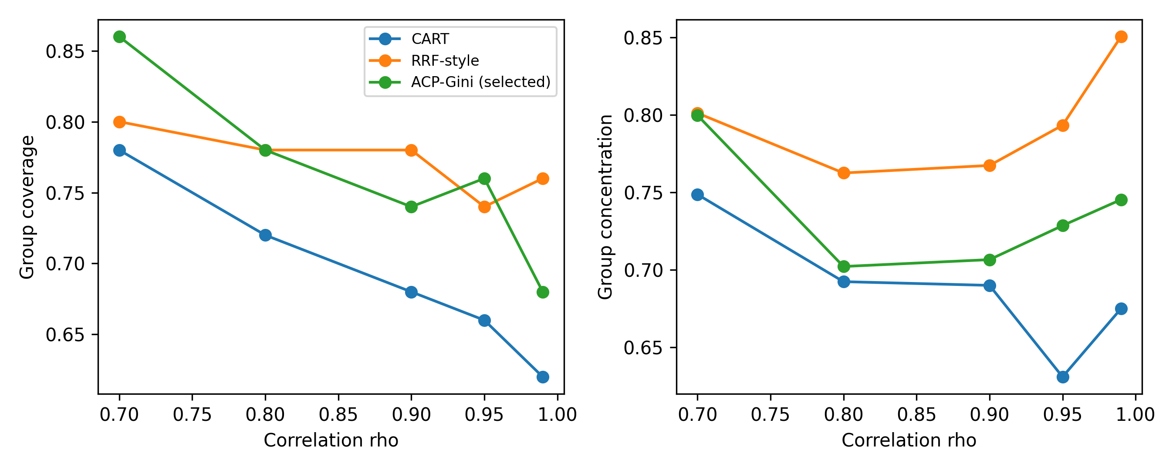
CONTROLLED EVIDENCE
Synthetic groups recover broader signal coverage as α increases
10

Slide 11
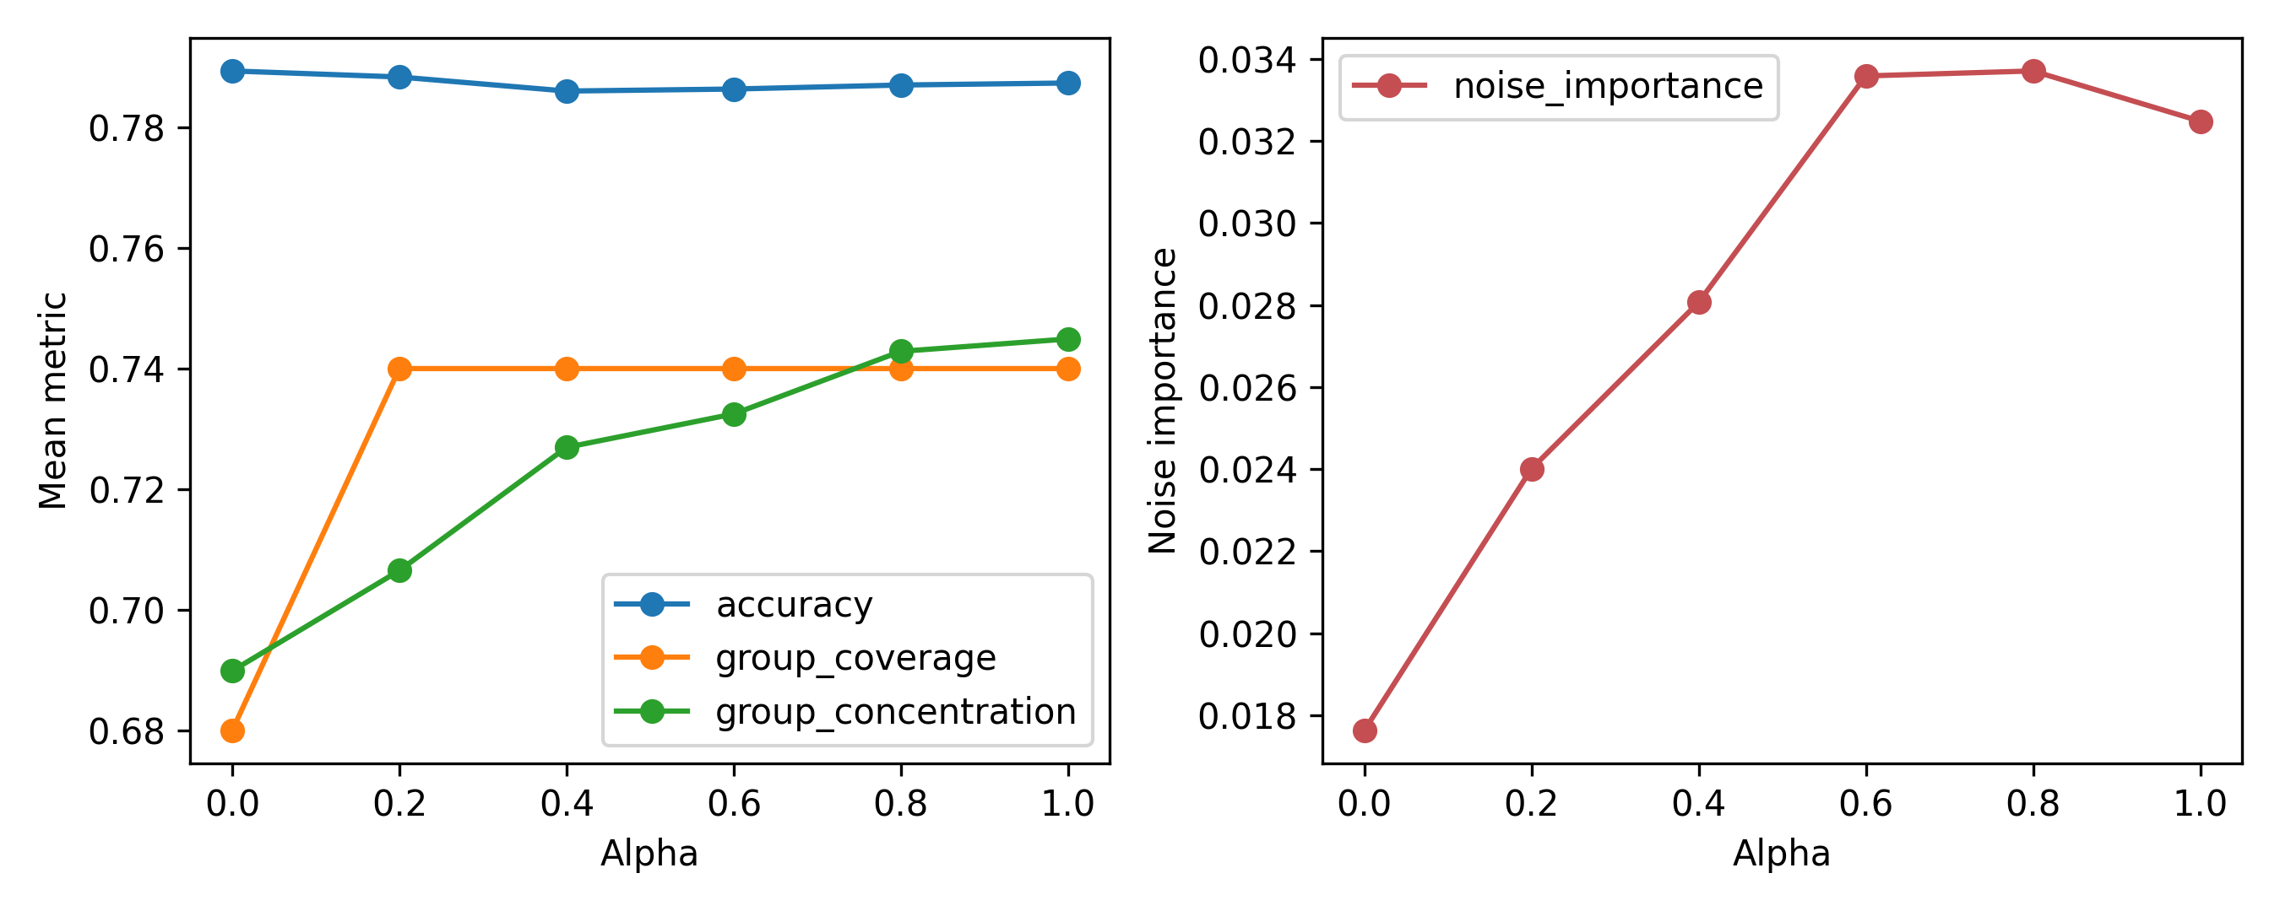
ALPHA SENSITIVITY
Accuracy stays flat while concentration improves — with a small noise cost
11

Slide 12
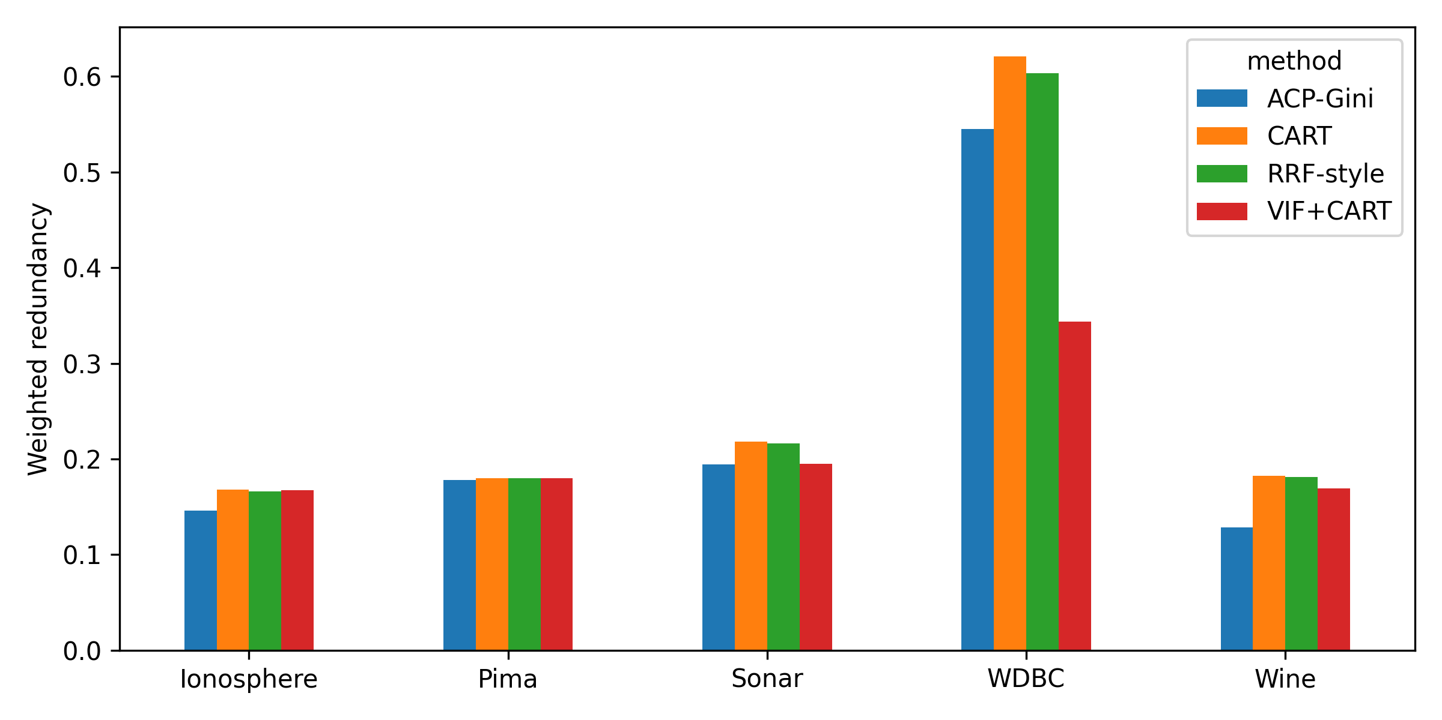
MAIN RESULT
ACP-Gini lowers internal correlation on every collinear real dataset
What changes
Wine: strongest selected-setting reduction
WDBC: conservative α keeps accuracy unchanged
Sonar gap shrinks after lower-quartile refinement
Pima control remains practically flat
12

Slide 13
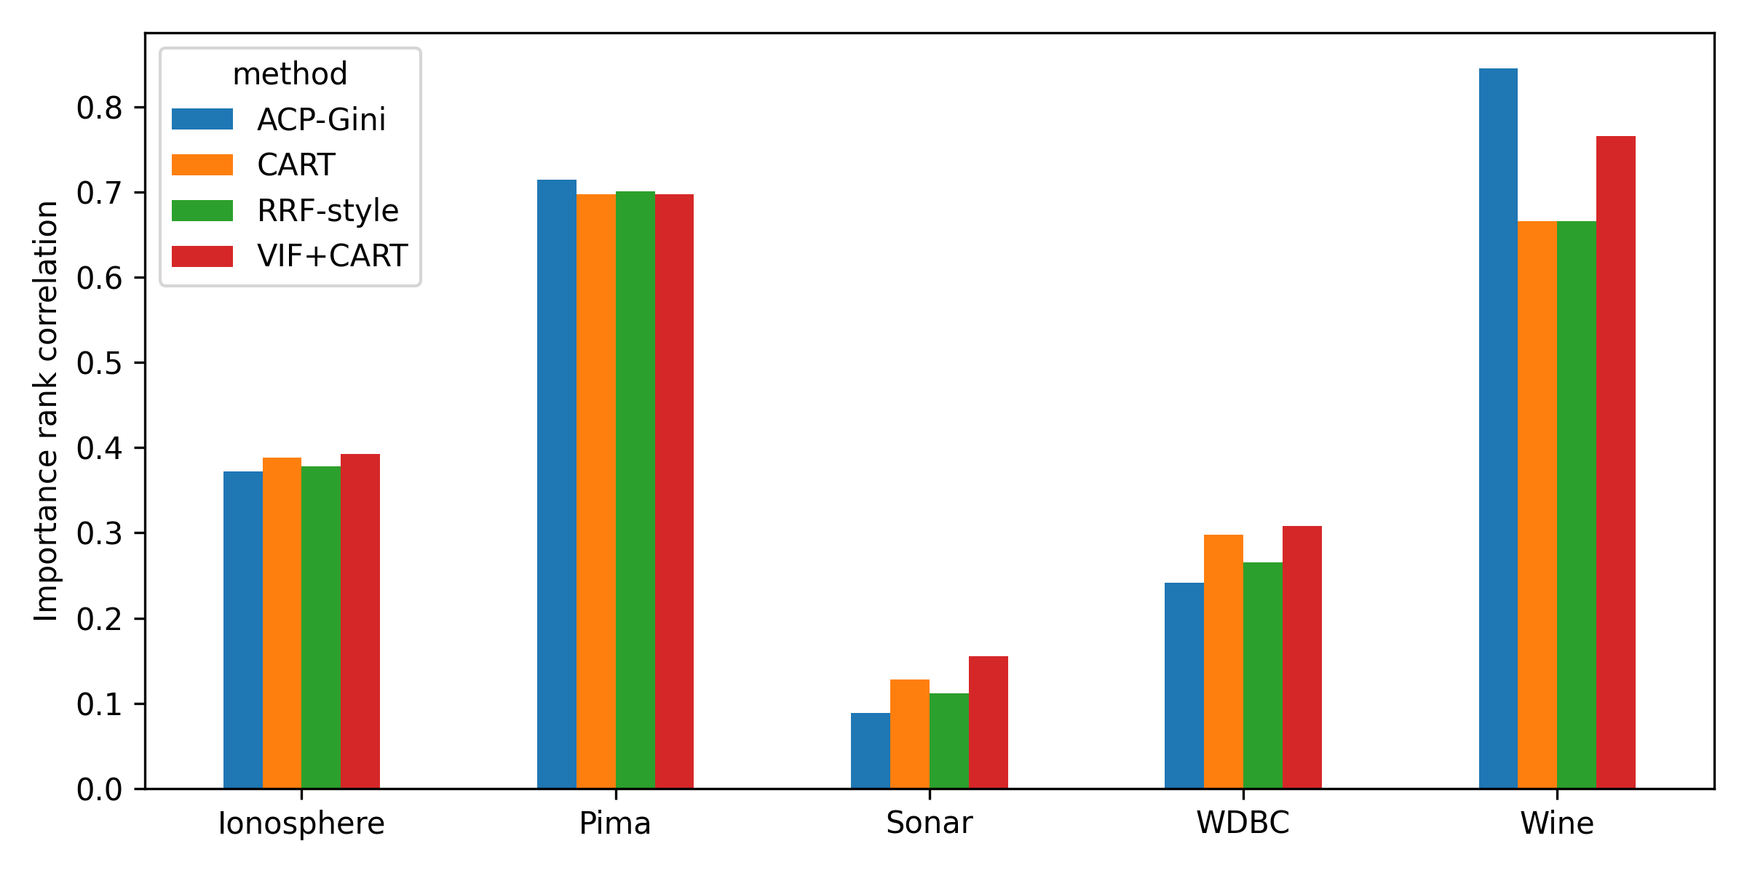
TRADEOFF
Stability is conditional: redundancy reduction can diversify rankings
Wine
redundancy ↓
stability ↑
WDBC / Sonar
redundancy ↓
rank stability ↓
13

Slide 14
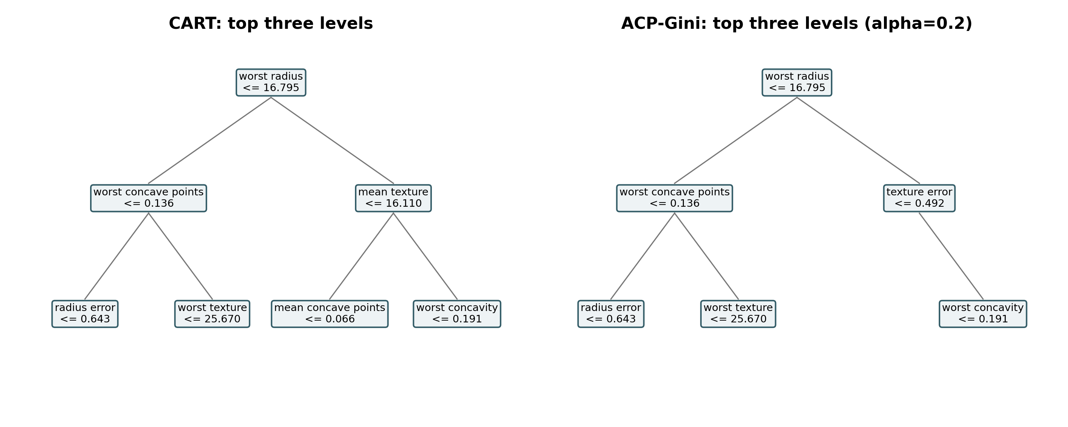
QUALITATIVE COMPARISON
The path changes below an identical root
14

Slide 15
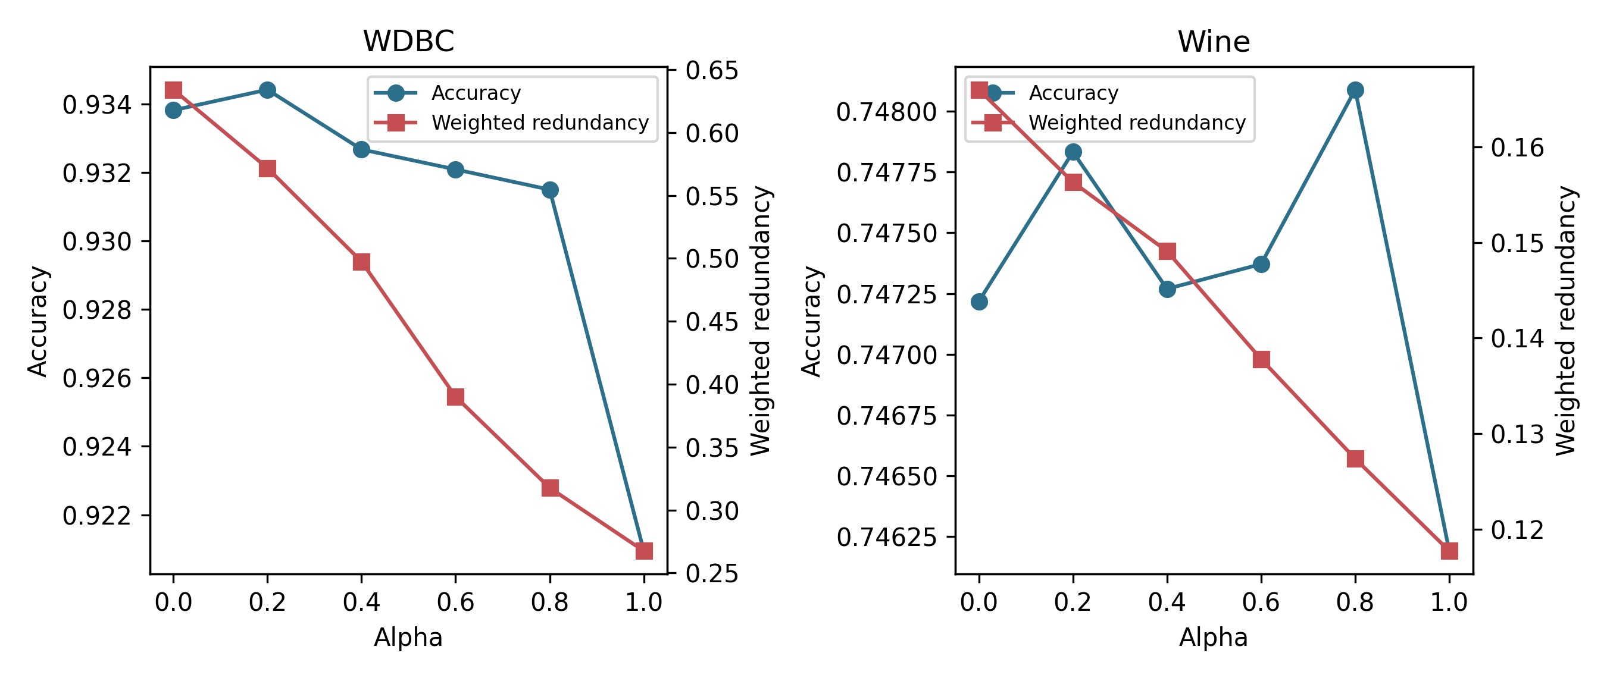
OPERATING CHARACTERISTICS
α is an operating control, not a universal optimum
WDBC spot check
α=0.6
46.5% less redundancy
accuracy unchanged
Three-seed average: 38.5% reduction with a 0.17 pp accuracy change
15

Slide 16
CONCLUSION
ACP-Gini is a redundancy control with an honest stability tradeoff
Primary: less internally correlated selected evidence
Takeaway
Synthetic: better group coverage and concentration
Accuracy alone
does not measure
explanation quality
Predictive performance: statistically indistinguishable at selected α
Stability: improves on Wine/Pima, decreases on WDBC/Sonar
Next: categorical association, regression, ensembles, theory
References: Breiman et al. (1984); Deng & Runger (2012, 2013); Strobl et al. (2008); Dormann et al. (2013); Rudin (2019).
16

