Slide 1
Modelling Exercise
Relational Dynamic Influence Diagram Language (RDDL)

Slide 2
Recommended Editor:
VSCode + PDDL Plugin
Recommended Planner:
pyRDDL + PROST

Slide 4
Mega wild-fire walkthrough
Fire out when no fuel
Extra column of forest
Longer burn
Water drop

Slide 5

Summary
Task: Model a forest fire scenario
Types: x-pos, y-pos
Fluents: burning, out-of-fuel, target, neighbor
Actions: put-out, cut-out
Initial State / Goal: Some fire configuration / protect the targets

Slide 7
1. Wildfire
We’re going to walk through this base encoding together
http://editor.planning.domains/planning-course/rddl/starter

Slide 8
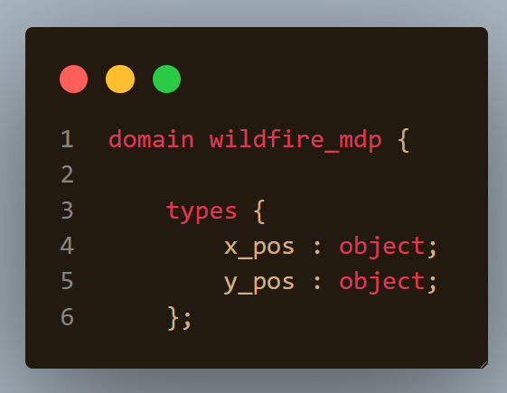

Slide 9
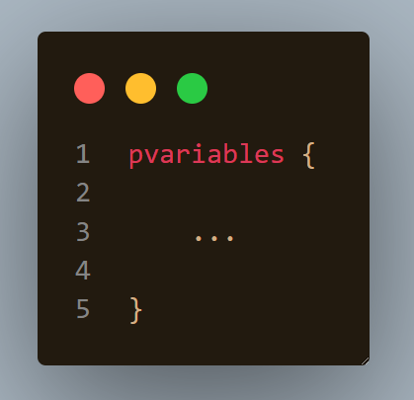

Slide 10
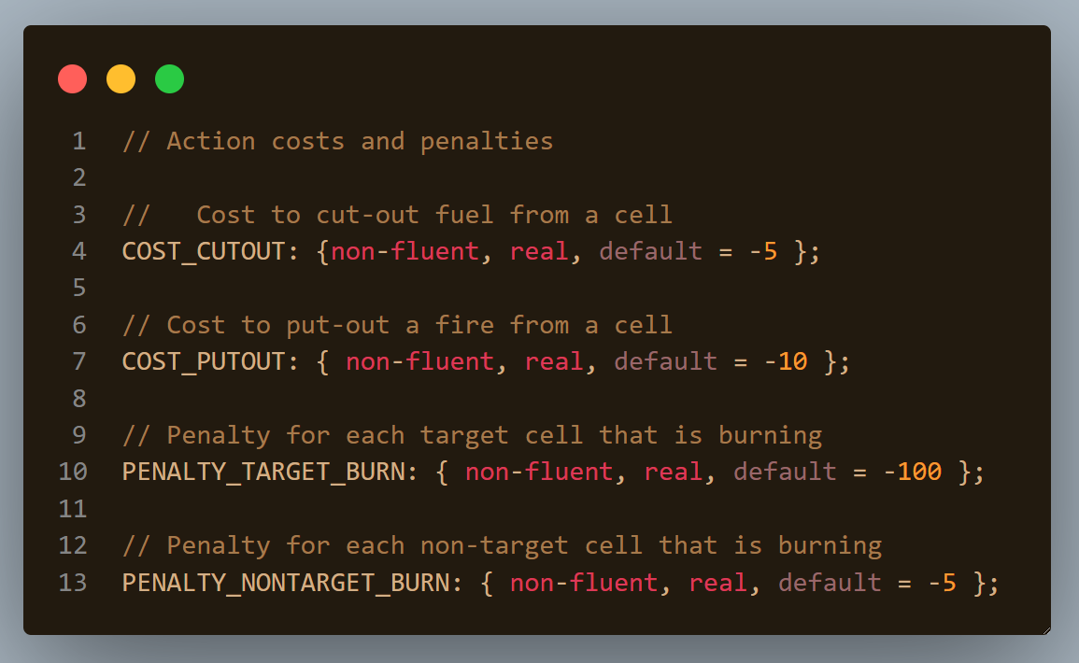

Slide 11
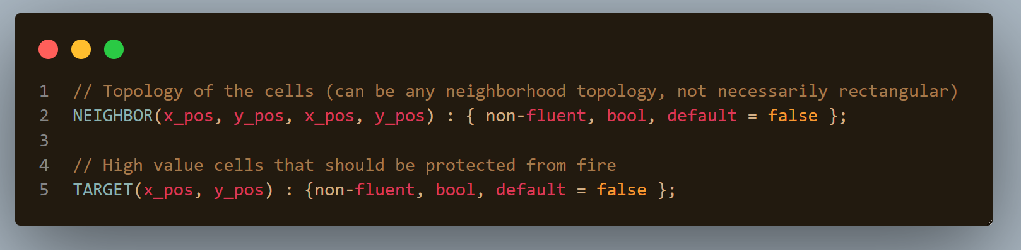

Slide 12
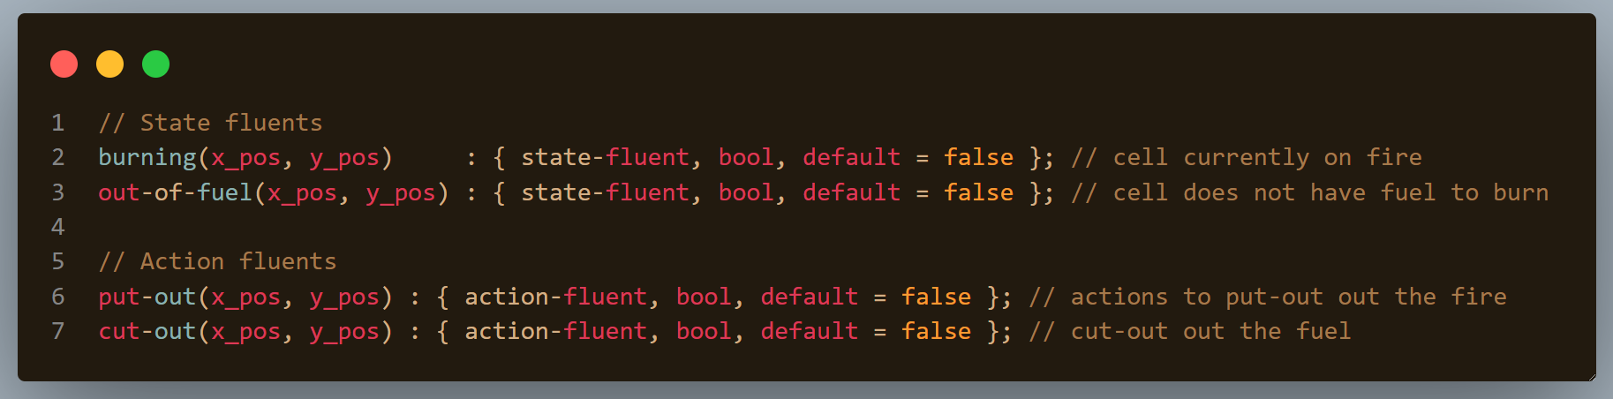

Slide 13
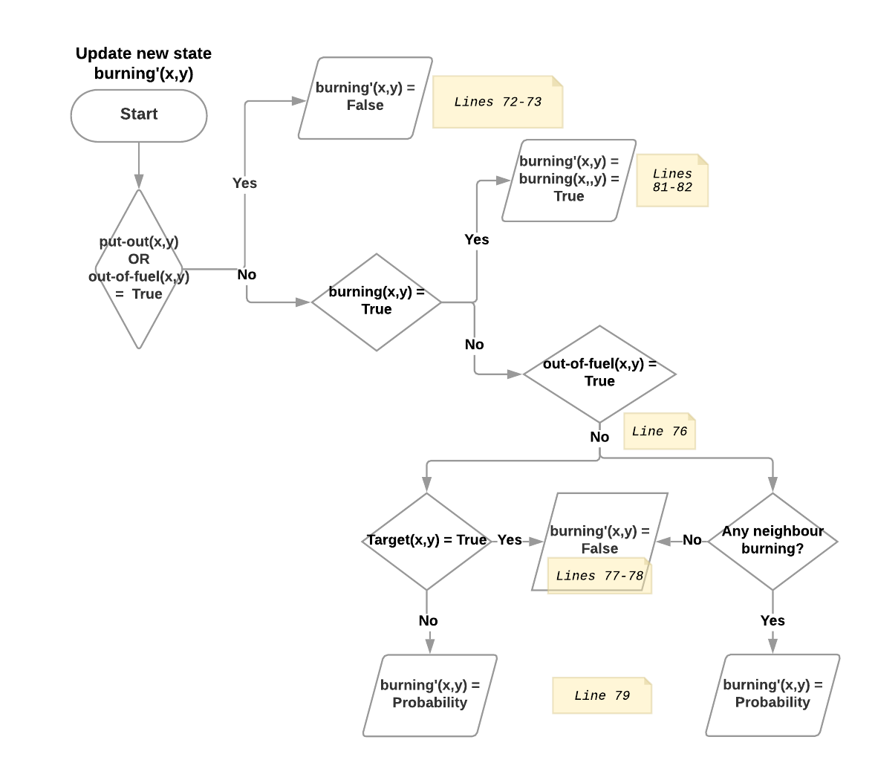

Slide 14
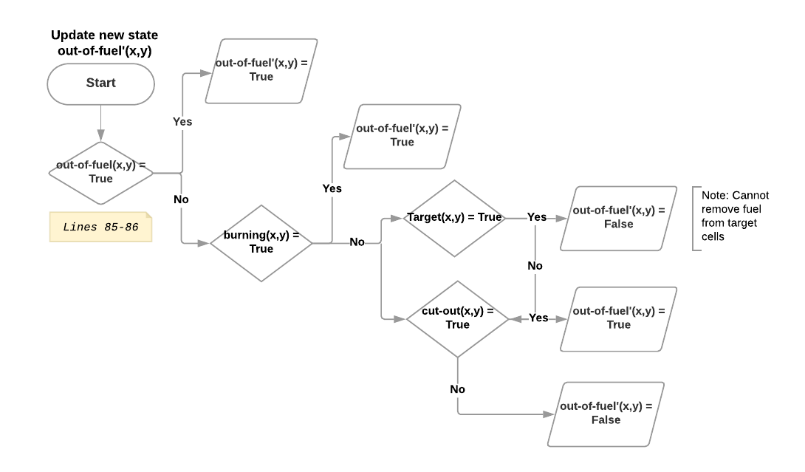

Slide 15
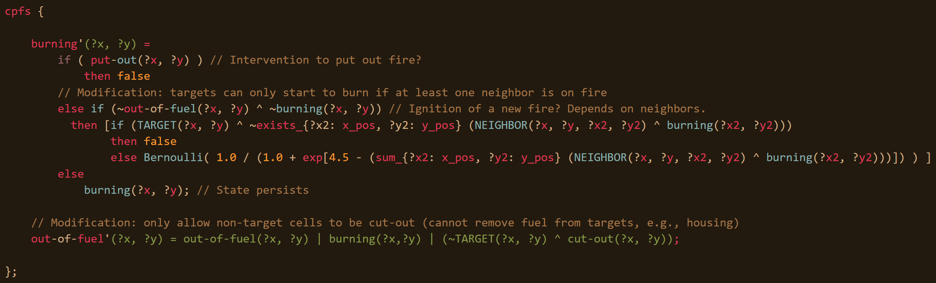

Slide 16
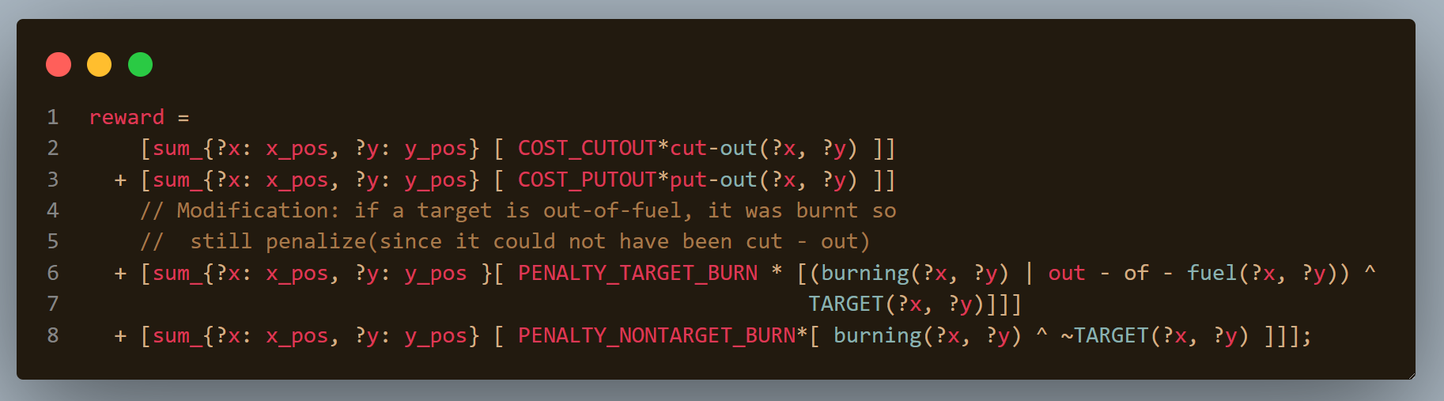

Slide 17
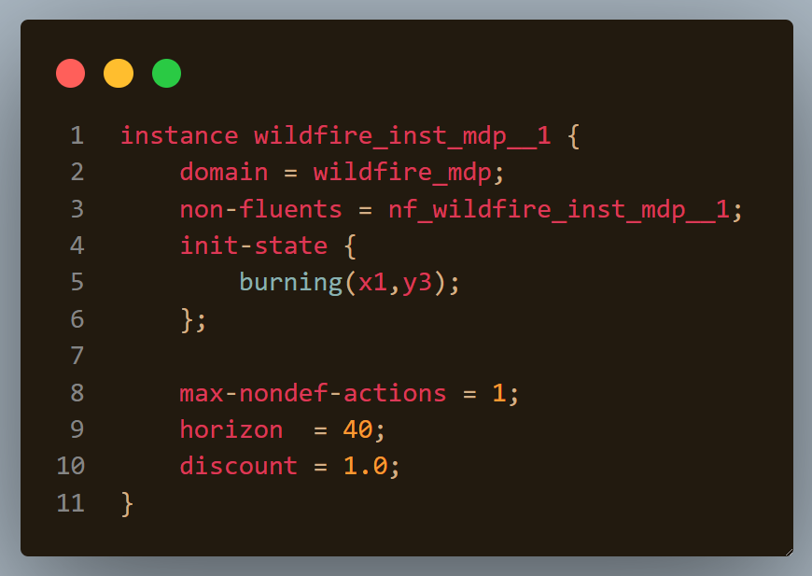

Slide 18
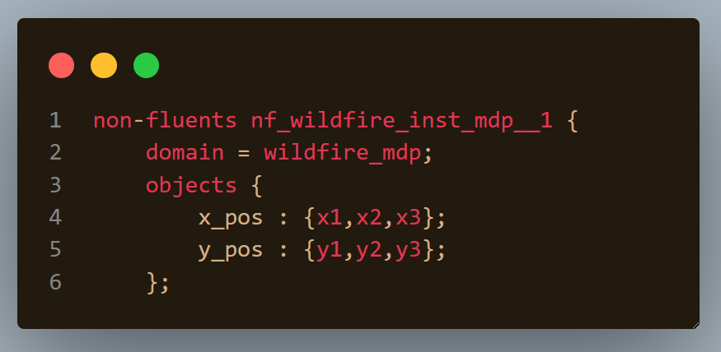

Slide 19
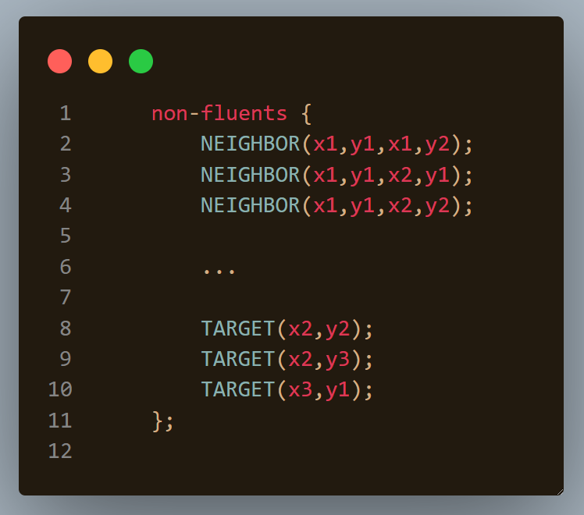

Slide 20
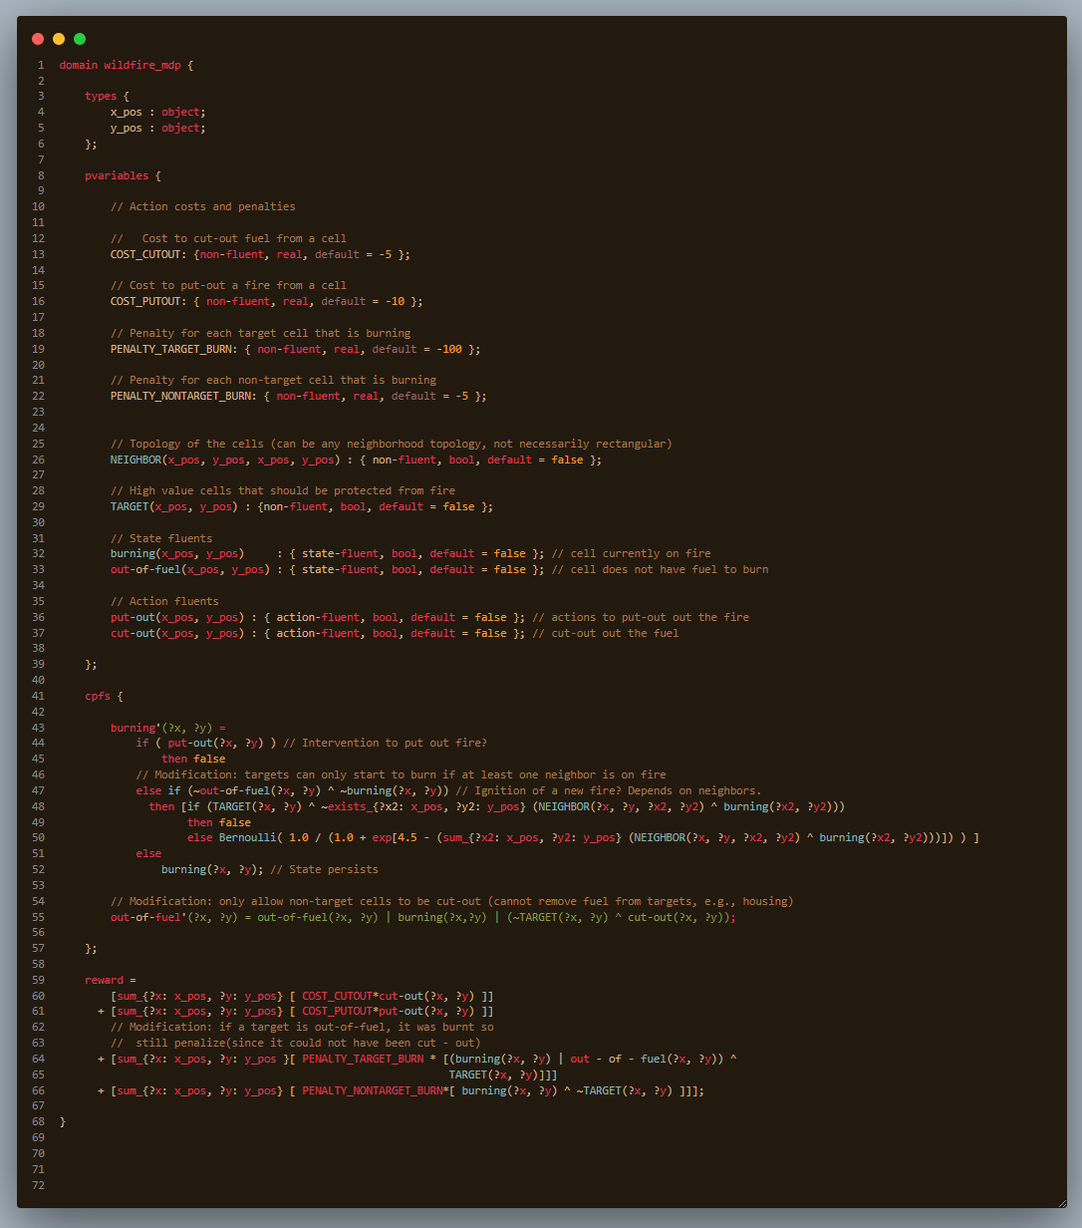
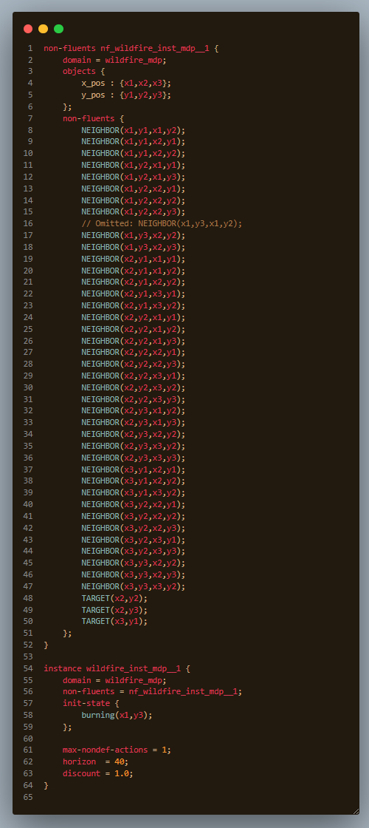

Slide 21
Let’s put out some fires!!!

Slide 24
2. Getting everyone to their destination
Load and drive passengers and get them all there
http://editor.planning.domains/planning-course/adl/passengers

Slide 25
http://editor.planning.domains/planning-course/adl/passenged

Slide 26
3. Moving an autonomous car around
Put the shuttles on the circuit!
http://editor.planning.domains/planning-course/adl/circuit

Slide 27
http://editor.planning.domains/planning-course/adl/circed

Slide 28
4. Picking up / dropping off passengers
Everyone aboard! Either that, or get outa here…
http://editor.planning.domains/planning-course/adl/all-aboard

Slide 29
http://editor.planning.domains/planning-course/adl/boarded

Slide 30
5. Safe manual moves
Let’s just avoid all those Tesla shuttles…
http://editor.planning.domains/planning-course/adl/safe

Slide 31
http://editor.planning.domains/planning-course/adl/safetied

