Slide 1
Modelling Exercise
Epistemic Planning

Slide 2
Recommended Editor:
VSCode + PDDL Plugin
Recommended Planner:
rpmep

Slide 3
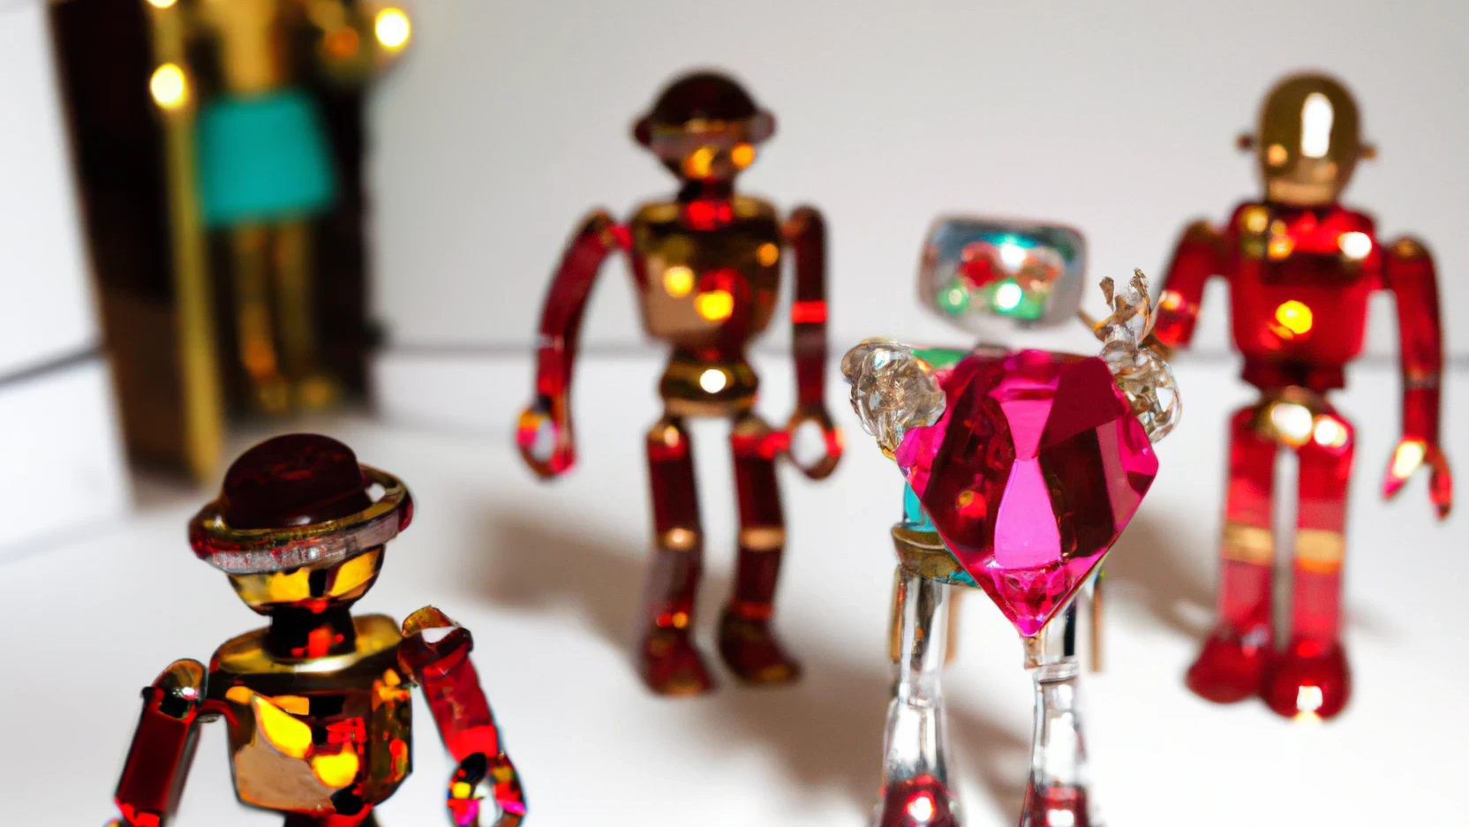
Deceptive Robots Rushing for Rubies

Slide 4
Get that treasure!
Who’s got it?
Nosy neighbours.
The art of suspicion.
The perfect logician.

Slide 5

Summary
Task: Create a planning model that orchestrates several agents trying to find a treasure, and tell each other all about it
Types: loc, agent*
Predicates: has-treasure, treasure-at, at, connected, …
Actions: move, take, drop, ask, infer, …
Initial State / Goal: Initial belief, and goal of deception

Slide 6


l3
l2
l0
l4
l1

Slide 7
Running Tips
Regular run: rpmep problem.pdkddl
To keep the generated files: … --keep-files
To find an optimal plan afterwards: lama pdkb-domain.pddl pdkb-problem.pddl

Slide 8
1. Get the treasure!
Warm-up: let’s have agents move around and take/drop the treasure.
move: (always known) Moves agent from one loc to another
take: (seen in room) Agent takes the treasure
drop: (seen in room) Agent drops the treasure
Goal: ‘a’ thinks ‘b’ has it, and ‘c’ thinks ‘d’ has it
epistemic / treasure

Slide 9
epistemic / wererich

Slide 10
2. Who’s got it?
Introduce an ask action letting agent ?a1 ask ?a2 if ?a3 has the treasure
It should never have its condition derived.
Precondition is that the agents are co-located.
Effect is that when ?a2 believes ?a3 has it (or doesn’t), then ?a1 will come to believe the same thing.
Goal: ‘c’ thinks ‘a’ has the treasure / ‘d’ thinks it’s possible ‘a’ doesn’t
epistemic / tellmethis

Slide 11
epistemic / youllneverguesswhatiheard

Slide 12
3. Nosy neighbours.
Modify ask so others can eavesdrop
Change the derive-condition to capture agents in the room
Precondition stays the same, but the effect now includes the asking agent to believe the telling agent believes what they say
Wasn’t it weird that we didn’t consider this before?
Goal:
‘a’ has the treasure
‘b’ and ‘c’ both think ‘a’ has the treasure
‘c’ thinks ‘b’ thinks ‘a’ doesn’t have the treasure (similar for ‘b’ and ‘c’)
epistemic / whatsthatnow

Slide 13
epistemic / mindyourbusiness

Slide 14
4. The art of suspicion.
Let’s harden up the beliefs on these agents (they’ll believe anything!)
Start with a goal of ‘a’ having the treasure, and both ‘b’ and ‘c’ thinking it’s at ‘l0’ and ‘l1’ respectively.
Modify move so that the moving agent thinks:
it’s possible for the treasure to either be (or not) at the source location
when the treasure is at (or not) the destination, the agent believes this
Try solving it again.
epistemic / sus

Slide 15
epistemic / idontbelieveawordyousay

Slide 16
5. The perfect logician.
We know RP-MEP can’t handle disjunction natively. But what if we encode the notion of logical reasoning?
Add a diff predicate (always known) to indicate if agents differ
Add a can-infer predicate to let us infer just once.
Add the infer action:
Should have a derive condition of always.
Parameters: 3 agents and a location
Precondition: the agents all differ, are all at the location, and can-infer
Effect: (1) we can’t infer; and (2) when all the locations don’t have the treasure, plus ?a1 and ?a2 don’t have it, then ?a3 must have it.
epistemic / theydontexist

Slide 17
epistemic / mybrainhurts

Slide 19
PDKBDDL

Slide 20
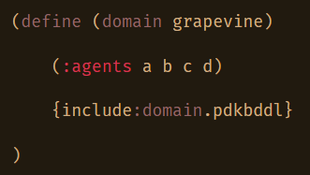
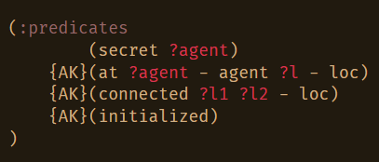
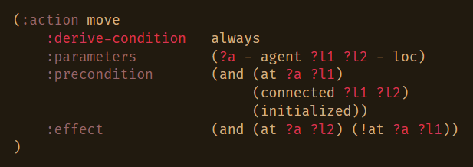
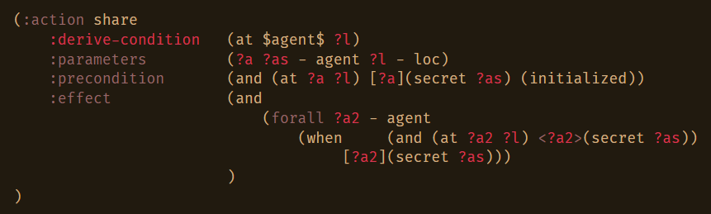

Slide 21
