Slide 1
Modelling Exercise
Advanced Deterministic Planning
ADL

Slide 2
Recommended Editor:
VSCode + PDDL Plugin

Slide 4
Moving a manual car around
Moving an autonomous car around
Picking up / dropping off passengers
Pausing to stop for drop-off / pickup
Safe manual moves

Slide 5

Summary
Task: Create a planning model that orchestrates the movement of cars, shuttles, and people
Types: locatable, location, car, person, mv, av
Predicates: at, in, link, destination, hub, path
Actions: move, getin, getout, step
Initial State / Goal: Get people where they need to be

Slide 6
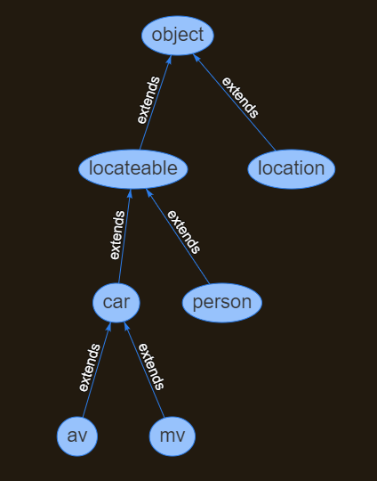
Types

Slide 7
l2
l4
l1
l3
l5

