Slide 1
Modelling Exercise
Fully Observable Non-Deterministic Planning
FOND

Slide 2
Recommended Editor:
VSCode + PDDL Plugin
Recommended Planner:
PRP++ (shhhh!)

Slide 3
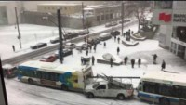

Slide 4
Moving around snow-free roads
Observing the snowy status
Better snow analysis
Going home to bed
2-way streets
Getting a job

Slide 5

Summary
Task: Create a planning model that orchestrates the movement of cars, shuttles, and people
Types: locatable, location, car, person, mv, av
Predicates: at, in, link, destination, hub, path
Actions: move, getin, getout, step
Initial State / Goal: Get people where they need to be

Slide 6



l2
l4
l1
l3
l5

Slide 7
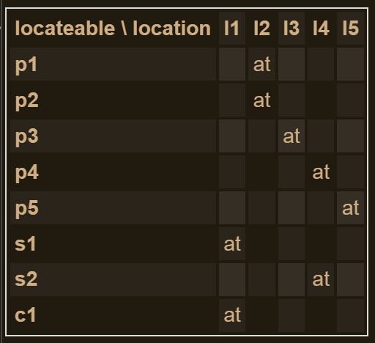
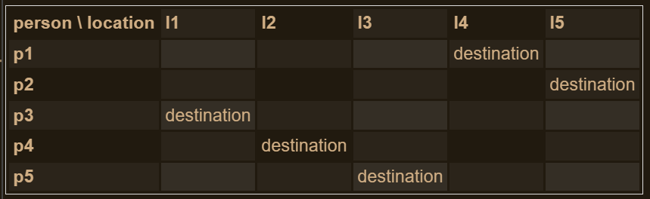
l2
l4
l1
l3
l5

Slide 8
1. Moving a manual car around
Just a warm-up. Let’s get this car to where it wants to go…
http://editor.planning.domains/planning-course/adl/moving-mv

Slide 9
http://editor.planning.domains/planning-course/adl/moved-mv

Slide 10
2. Getting everyone to their destination
Load and drive passengers and get them all there
http://editor.planning.domains/planning-course/adl/passengers

Slide 11
http://editor.planning.domains/planning-course/adl/passenged

Slide 12
3. Moving an autonomous car around
Put the shuttles on the circuit!
http://editor.planning.domains/planning-course/adl/circuit

Slide 13
http://editor.planning.domains/planning-course/adl/circed

Slide 14
4. Picking up / dropping off passengers
Everyone aboard! Either that, or get outa here…
http://editor.planning.domains/planning-course/adl/all-aboard

Slide 15
http://editor.planning.domains/planning-course/adl/boarded

Slide 16
5. Safe manual moves
Let’s just avoid all those Tesla shuttles…
http://editor.planning.domains/planning-course/adl/safe

Slide 17


Slide 18
http://editor.planning.domains/planning-course/adl/safetied

