Slide 1
Modelling Exercise
Relational Dynamic Influence Diagram Language (RDDL)

Slide 2
Recommended Editor:
VSCode + PDDL Plugin
Recommended Planner:
pyRDDL + PROST

Slide 4
Mega wild-fire walkthrough
Fire out when no fuel
Extra column of forest
Longer burn
Water drop

Slide 5
Gotchas!!
Careful with brackets:
Good: func(?x, ?y)
Bad: func(?x,?y)
Careful with multi-line equality:
Need to have a space after the “=” sign
Depth of trial is given in the instance (# of trials on the cmd-line)
If pyRDDL states “Address already in use”, restart the docker

Slide 6
Gotchas!!
Careful with brackets:
Good: func(?x, ?y)
Bad: func(?x,?y)
Careful with multi-line equality:
Need to have a space after the “=” sign
Depth of trial is given in the instance (# of trials on the cmd-line)
If pyRDDL states “Address already in use”, restart the docker

Slide 7

Summary
Task: Model a forest fire scenario
Types: x-pos, y-pos
Fluents: burning, out-of-fuel, target, neighbor
Actions: put-out, cut-out
Initial State / Goal: Some fire configuration / protect the targets

Slide 9
1. Wildfire
We’re going to walk through this base encoding together
http://editor.planning.domains/planning-course/rddl/starter
fetch-exercise rddl starter

Slide 10
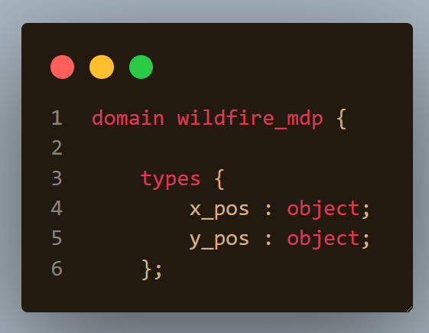

Slide 11
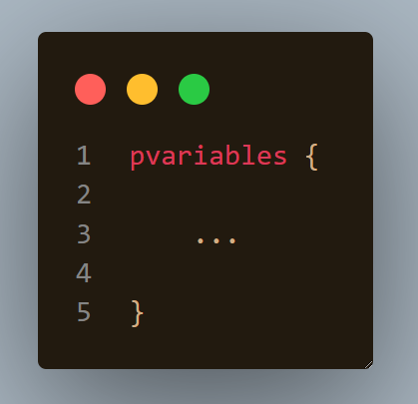

Slide 12
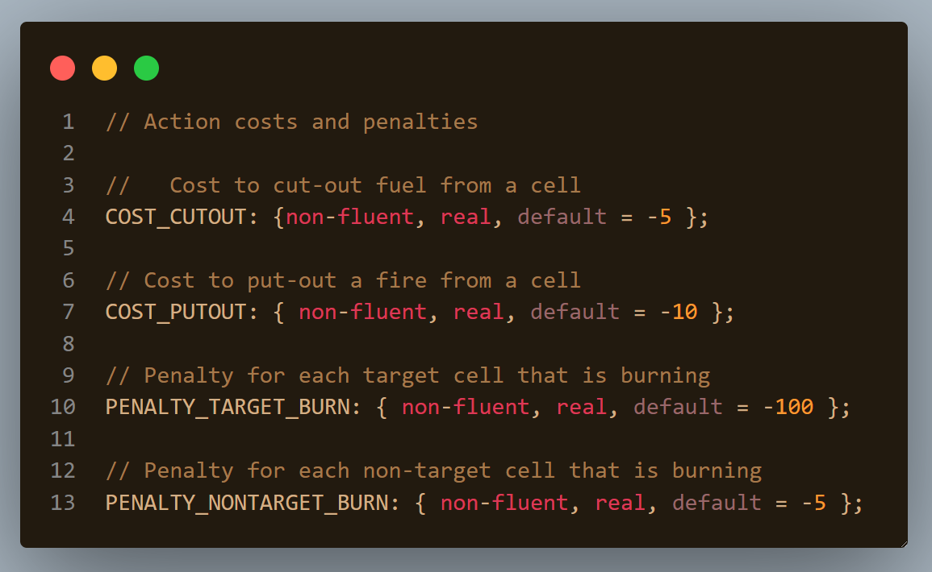

Slide 13
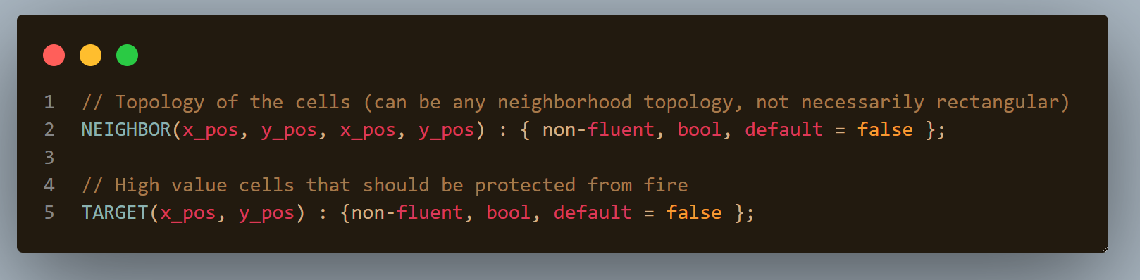

Slide 14
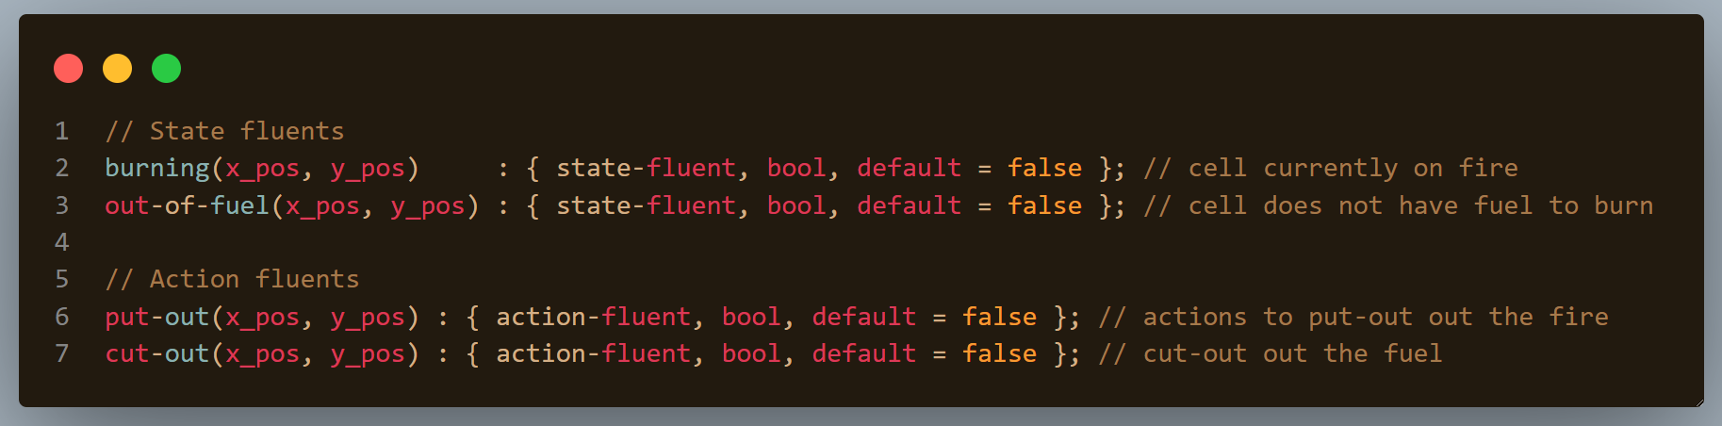

Slide 15
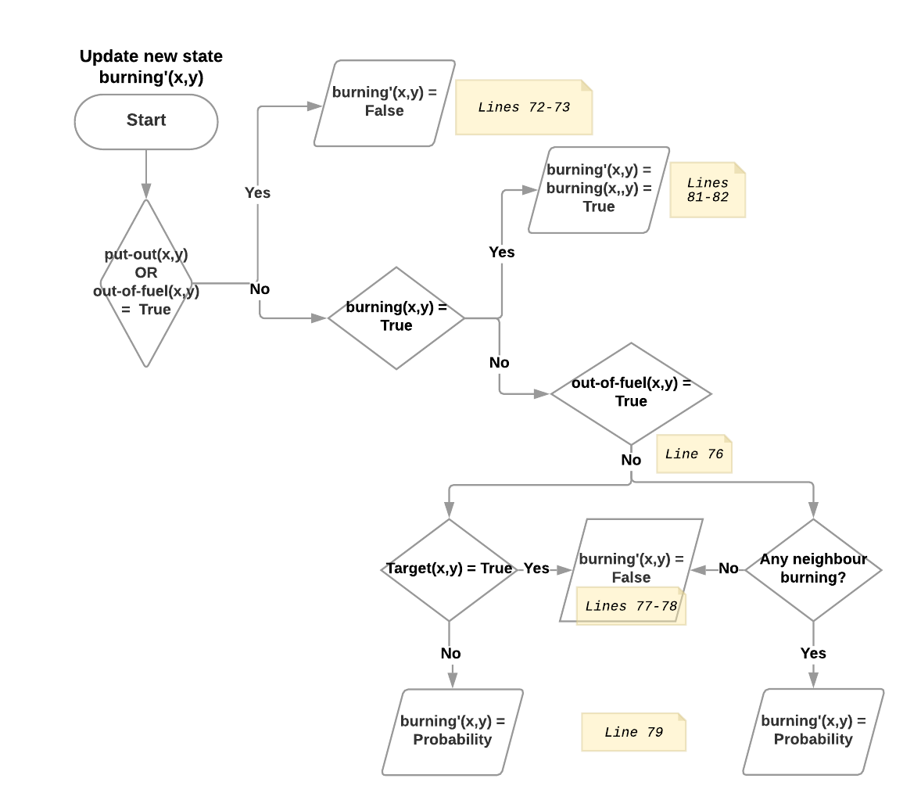

Slide 16
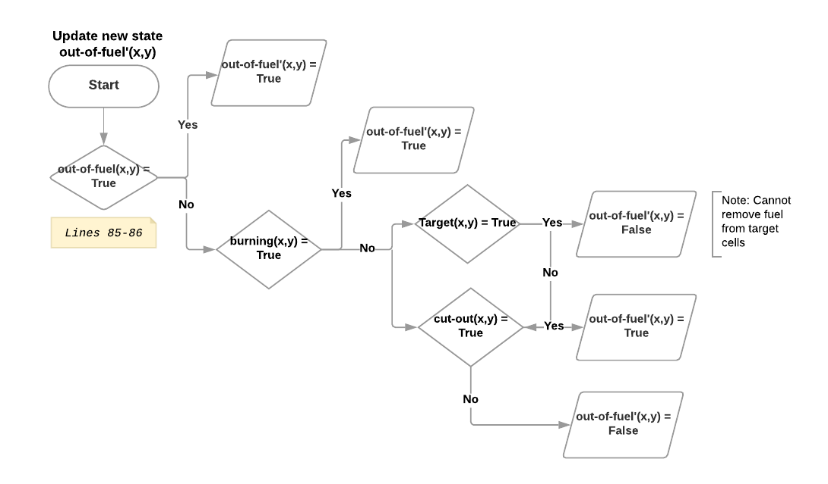

Slide 17
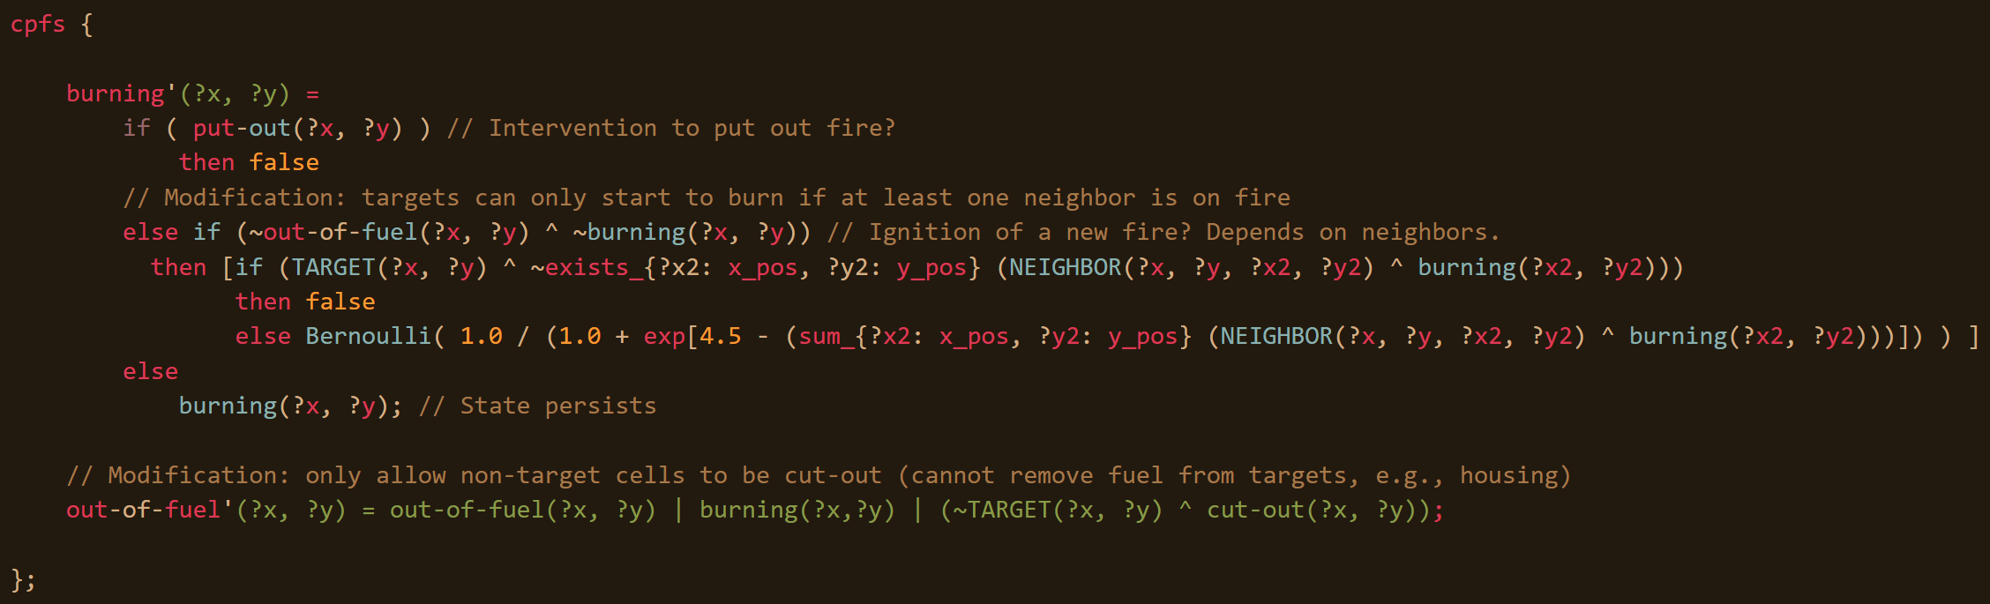

Slide 18
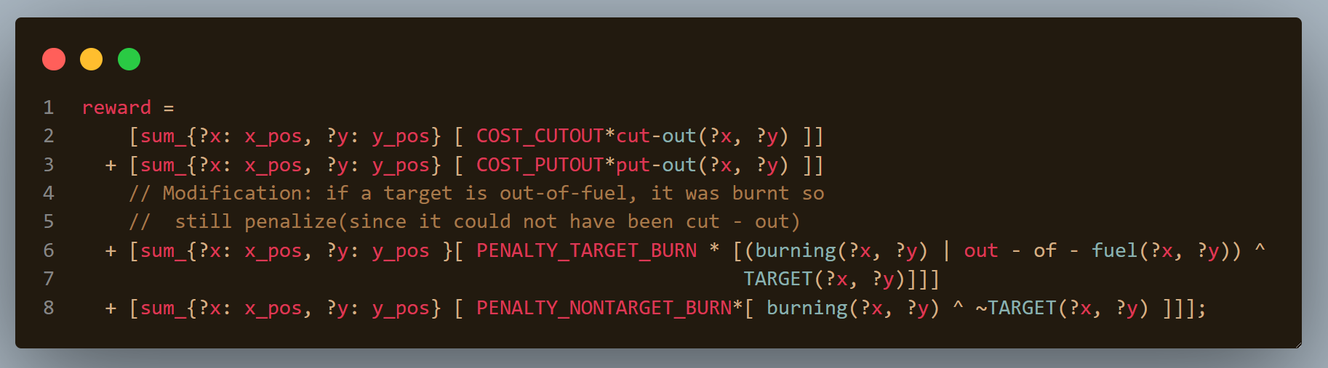

Slide 19
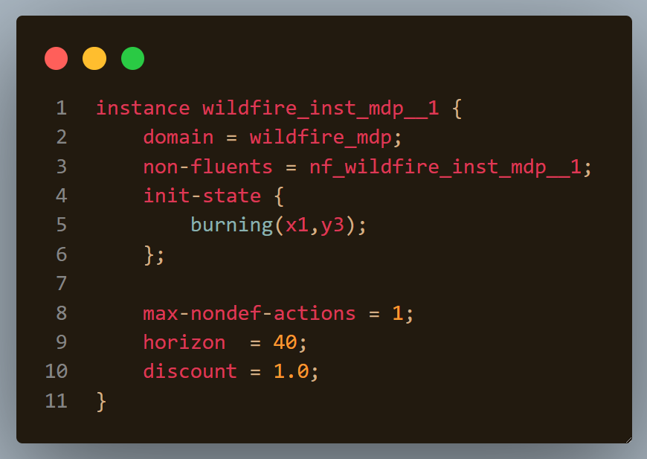

Slide 20
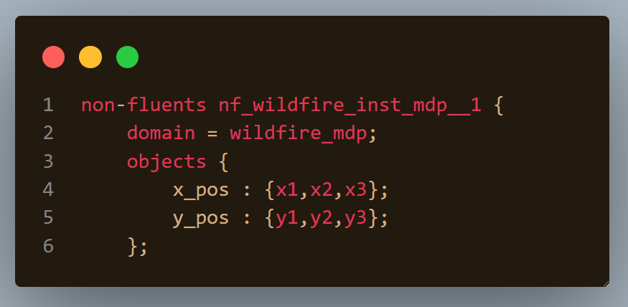

Slide 21
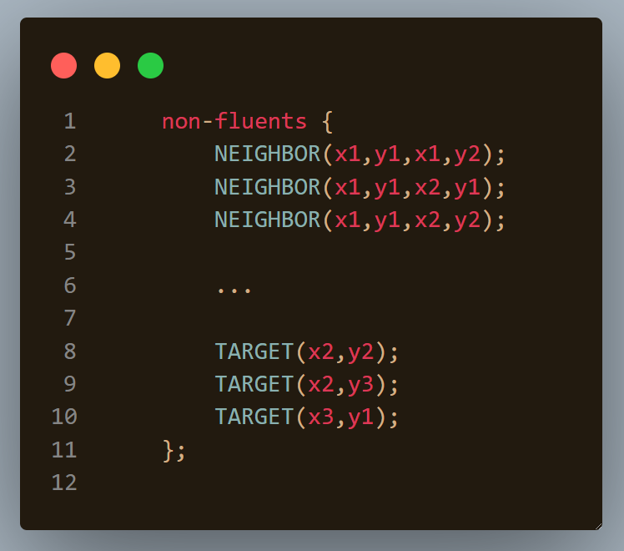

Slide 22
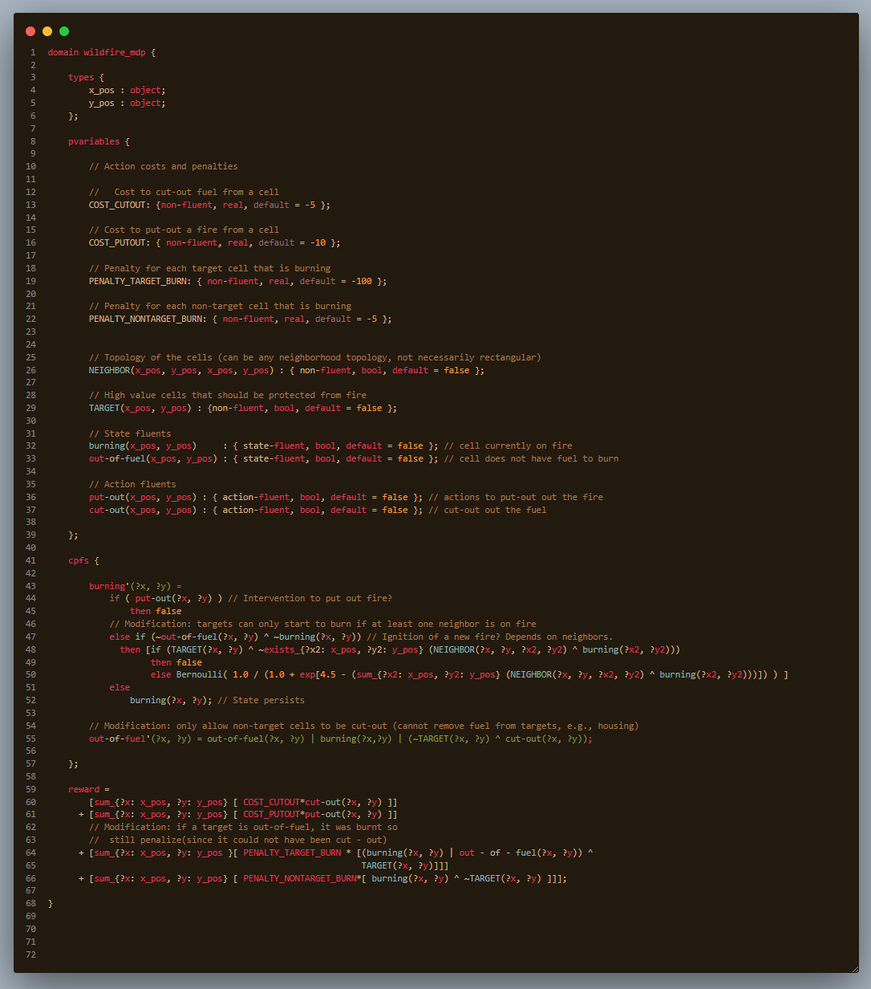
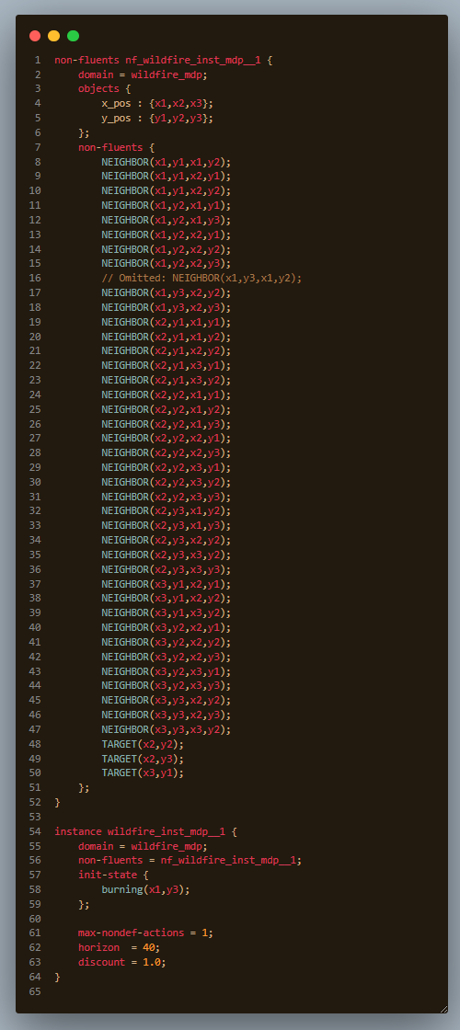

Slide 23
Let’s put out some fires!!!
Get the docker container up and going
Fire it up (aha!): docker run -it --privileged -v $(pwd):/PROJECT cjmuise/cisc813-rddlprost rddlprost domain.rddl instance.rddl 1 10
Check the data.json: viz data.json

Slide 24
2. Fire out when no fuel
In the original, note that a fire only stops burning when it is put-out.
Modify it so that a cell stops burning as soon as it is out of fuel.
http://editor.planning.domains/planning-course/rddl/v2
fetch-exercise rddl v2

Slide 25
http://editor.planning.domains/planning-course/rddl/v2fin

Slide 26
3. Extra Column of Forest
Originally, there are 3 x positions and 3 y positions for a total of 9 cells
Modify the instance to expand with an extra column x_pos “x4” (12 cells)
However, connect only horizontally (no vertical edges), and bidirectional
http://editor.planning.domains/planning-course/rddl/v3

Slide 27
http://editor.planning.domains/planning-course/rddl/v3nif

Slide 28
4. Longer burn
So far, a Wildfire will burn for at most two time steps (once the cell is out-of-fuel, the fire can no longer burn)
Add a new fluent almost-out-of-fuel that allows a fire to burn for three time steps.
I.e., a burning cell progresses to almost-out-of-fuel then out-of-fuel
http://editor.planning.domains/planning-course/rddl/v4

Slide 29
http://editor.planning.domains/planning-course/rddl/v4ed

Slide 30
5. Water drop
So far, the domain only allows two actions: put-out and cut-out
Add a third action to allow a single aerial water drop which has high cost and puts out a fire in all cells neighboring where the water is dropped.
Note that this change requires addition of an action fluent and changes to the cpfs, rewards, and state-action-constraints (max of one drop).
http://editor.planning.domains/planning-course/rddl/v5

Slide 31
http://editor.planning.domains/planning-course/rddl/v5set

