Slide 1
Modelling Exercise
Deterministic Planning: PDDL

Slide 2
Online Editor ( your IDE )
Hello World ( domain, problem, actions, predicates)
Moving Crates ( types, parameters, objects )
Stacking Setarc ( combinatorial conundrums )
Merging Things

Slide 3
http://editor.planning.domains/

Slide 4
Hello World
Task
Create a planning model that executes the actions (hello) and (world)

Slide 5
http://editor.planning.domains/planning-course/fod/hello-world

Slide 6

Moving Crates
Task: Create a planning model that orchestrates the movement of crates in a warehouse via robots
Types: room, locatable, crate, robot
Predicates: holding, in, hands-free, connected
Actions: move, drop, pickup
Initial State / Goal: Move crates to their targets

Slide 7
Moving Crates: Types
(:types
room locatable - object
robot crate - locatable
)

Slide 8
Moving Crates: Predicates
(holding ?r - robot ?c - crate)
(in ?obj - locatable ?r - room)
(hands-free ?r - robot)
(connected ?r1 ?r2 - room)

Slide 9
Moving Crates: Action
(move ?rob - robot ?r1 ?r2 - room)
Pre: Robot in right location, and rooms connected
Eff: Robot in new room
(drop ?rob - robot ?rm - room ?c - crate)
Pre: Robot in right room, and holding crate
Eff: Crate now in room, and hand is free
(pickup ?rob - robot ?rm - room ?c - crate)
Pre: Robot in right room, and hand is free
Eff: Crate now being held

Slide 10
Moving Crates: Action
(:action move
:parameters (?rob - robot ?r1 ?r2 - room)
:precondition (and (in ?rob ?r1)
(connected ?r1 ?r2))
:effect (and (in ?rob ?r2)
(not (in ?rob ?r1)))
)

Slide 11
http://editor.planning.domains/planning-course/fod/crate-start

Slide 12
Moving Crates: Action
(move ?rob - robot ?r1 ?r2 - room)
Pre: Robot in right location, and rooms connected
Eff: Robot in new room
(drop ?rob - robot ?rm - room ?c - crate)
Pre: Robot in right room, and holding crate
Eff: Crate now in room, and hand is free
(pickup ?rob - robot ?rm - room ?c - crate)
Pre: Robot and crate in right room, and hand is free
Eff: Crate now being held (and no longer in the room)

Slide 13
http://editor.planning.domains/planning-course/fod/crate-fin

Slide 14
Stacking Setarc
Task: Shift the elusive Setarc in such a way that the desired configuration is achieved
Types: none
Predicates: on, top
Actions: shift
Move a Setarc from the top of one stack to another
Initial State / Goal: Shift the Setarc!

Slide 15
http://editor.planning.domains/planning-course/fod/setarc

Slide 16
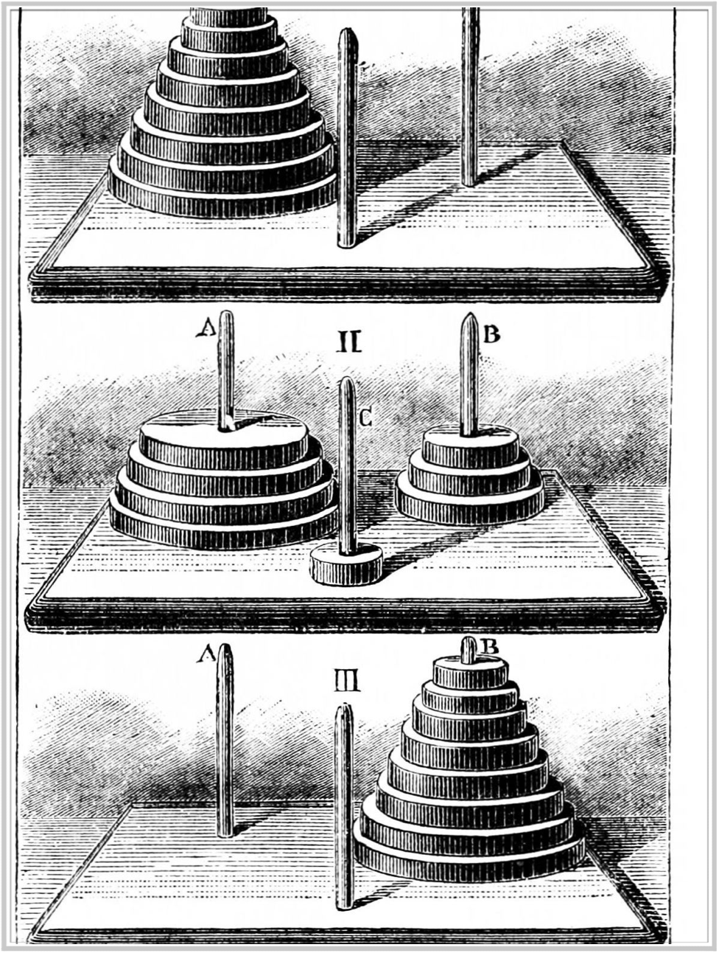
Setarc??
“Crates”.reverse( )

Slide 17
http://editor.planning.domains/planning-course/fod/setarc-nif

Slide 18
Merging Things
Task:
Merge the Crates and Setarc domains so that the robots have limited space they can place crates

Slide 19
http://editor.planning.domains/planning-course/fod/merge

Slide 20
http://editor.planning.domains/planning-course/fod/all-merged

Slide 21
http://editor.planning.domains/planning-course/fod/all-domains

