Slide 1
Modelling Exercise
Hybrid Planning
PDDL+

Slide 2
Recommended Editor:
VSCode + PDDL Plugin
Recommended Planner:
enhsp

Slide 3
Traffic Revisited!!

Slide 4
Moving a manual car around
Getting everyone to their destination
Moving an autonomous car around
Picking up / dropping off passengers
Safe manual moves

Slide 5

Summary
Task: Create a planning model that orchestrates the movement of cars, shuttles, and people
Types: locatable, location, car, person, mv, av
Predicates: at, in, link, destination, hub, path
Actions: move, getin, getout, step
Initial State / Goal: Get people where they need to be

Slide 6
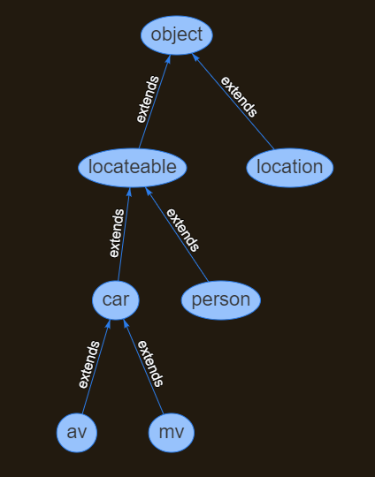
Types

Slide 7



l2
l4
l1
l3
l5

Slide 8
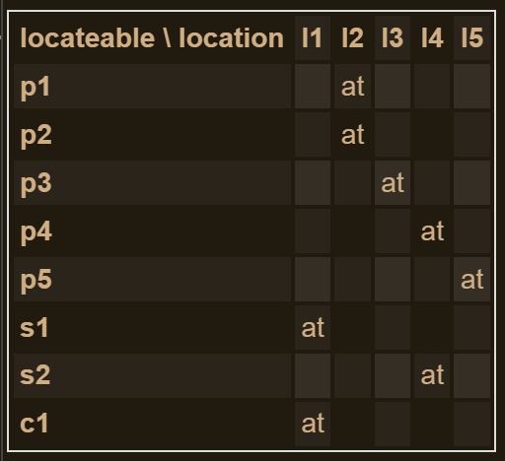
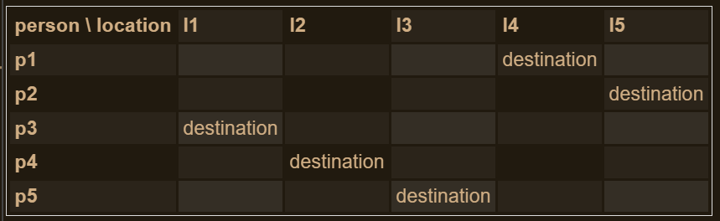
l2
l4
l1
l3
l5

Slide 9
1. Moving a manual car around
Just a warm-up. Let’s get this car to where it wants to go…
http://editor.planning.domains/planning-course/adl/moving-mv

Slide 10
http://editor.planning.domains/planning-course/adl/moved-mv

Slide 11
2. Getting everyone to their destination
Load and drive passengers and get them all there
http://editor.planning.domains/planning-course/adl/passengers

Slide 12
http://editor.planning.domains/planning-course/adl/passenged

Slide 13
3. Moving an autonomous car around
Put the shuttles on the circuit!
http://editor.planning.domains/planning-course/adl/circuit

Slide 14
http://editor.planning.domains/planning-course/adl/circed

Slide 15
4. Picking up / dropping off passengers
Everyone aboard! Either that, or get outa here…
http://editor.planning.domains/planning-course/adl/all-aboard

Slide 16
http://editor.planning.domains/planning-course/adl/boarded

Slide 17
5. Safe manual moves
Let’s just avoid all those Tesla shuttles…
http://editor.planning.domains/planning-course/adl/safe

Slide 18
http://editor.planning.domains/planning-course/adl/safetied

