Slide 1
Modelling Exercise
Advanced Deterministic Planning
ADL

Slide 2
Recommended Editor:
VSCode + PDDL Plugin

Slide 4
Moving a manual car around
Getting everyone to their destination
Moving an autonomous car around
Picking up / dropping off passengers
Safe manual moves

Slide 5

Summary
Task: Create a planning model that orchestrates the movement of cars, shuttles, and people
Types: locatable, location, car, person, mv, av
Predicates: at, in, link, destination, hub, path
Actions: move, getin, getout, step
Initial State / Goal: Get people where they need to be

Slide 6
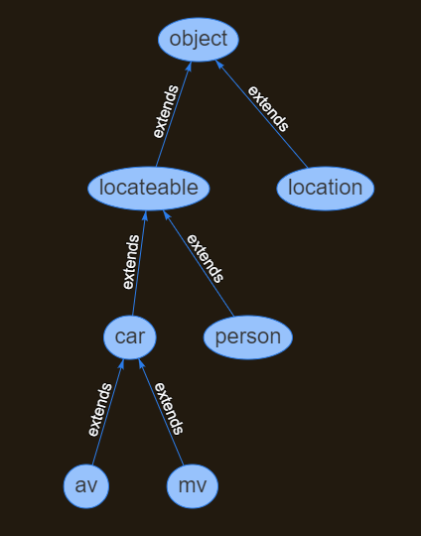
Types

Slide 7



l2
l4
l1
l3
l5

Slide 8
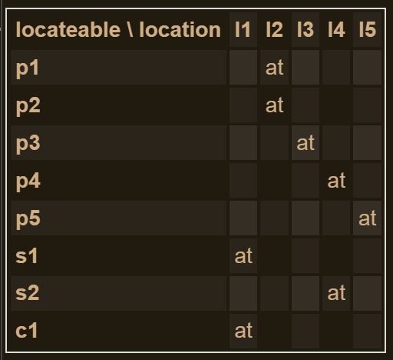
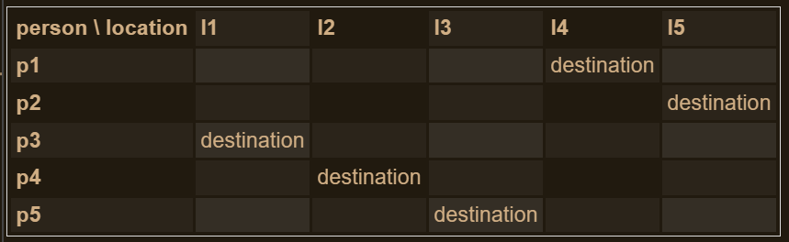
l2
l4
l1
l3
l5

Slide 9
1. Moving a manual car around
Just a warm-up. Let’s get this car to where it wants to go…
adl / moving-mv

Slide 10
adl / moved-mv

Slide 11
2. Getting everyone to their destination
Load and drive passengers and get them all there
adl / passengers

Slide 12
adl / passenged

Slide 13
3. Moving an autonomous car around
Put the shuttles on the circuit!
adl / circuit

Slide 14
adl / circed

Slide 15
4. Picking up / dropping off passengers
Everyone aboard! Either that, or get outa here…
adl / all-aboard

Slide 16
adl / boarded

Slide 17
5. Safe manual moves
Let’s just avoid all those Tesla shuttles…
adl / safe

Slide 18
adl / safetied

