Slide 1
Modelling Exercise
Relational Dynamic Influence Diagram Language (RDDL)

Slide 2
Recommended Editor:
VSCode + PDDL Plugin
Recommended Planner:
pyRDDL + PROST

Slide 4
Mega wild-fire walkthrough
Fire out when no fuel
Extra column of forest
Longer burn
Water drop

Slide 5
Gotchas!!
Careful with brackets:
Good: func(?x, ?y)
Bad: func(?x,?y)
Careful with multi-line equality:
Need to have a space after the “=” sign
Depth of trial is given in the instance (# of trials on the cmd-line)
If pyRDDL states “Address already in use”, restart the docker

Slide 6

Summary
Task: Model a forest fire scenario
Types: x-pos, y-pos
Fluents: burning, out-of-fuel, target, neighbor
Actions: put-out, cut-out
Initial State / Goal: Some fire configuration / protect the targets

Slide 8
1. Wildfire
We’re going to walk through this base encoding together
http://editor.planning.domains/planning-course/rddl/starter

Slide 9
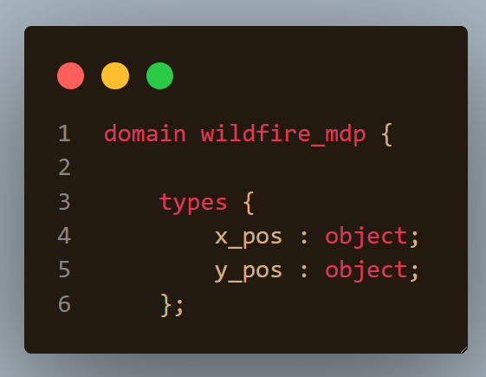

Slide 10
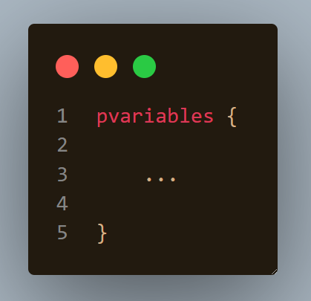

Slide 11
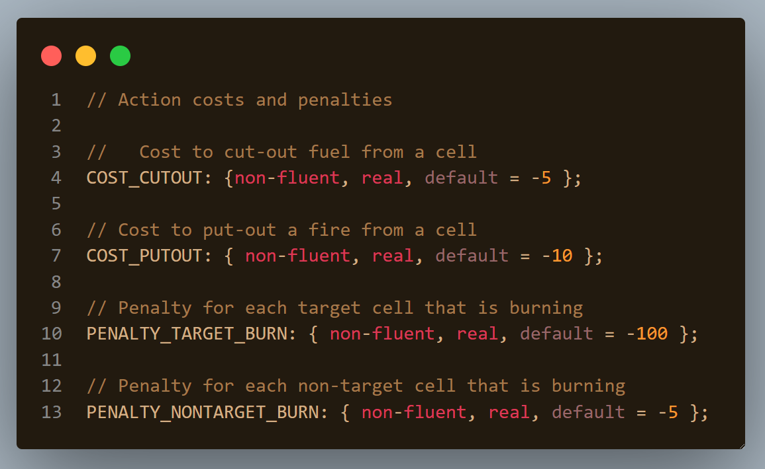

Slide 12
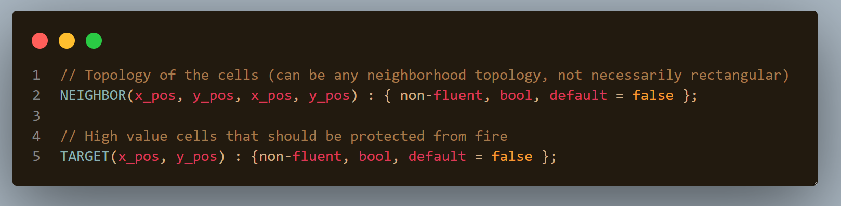

Slide 13
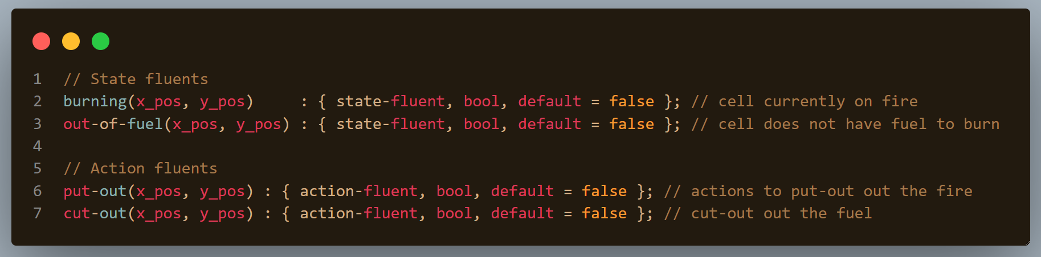

Slide 14
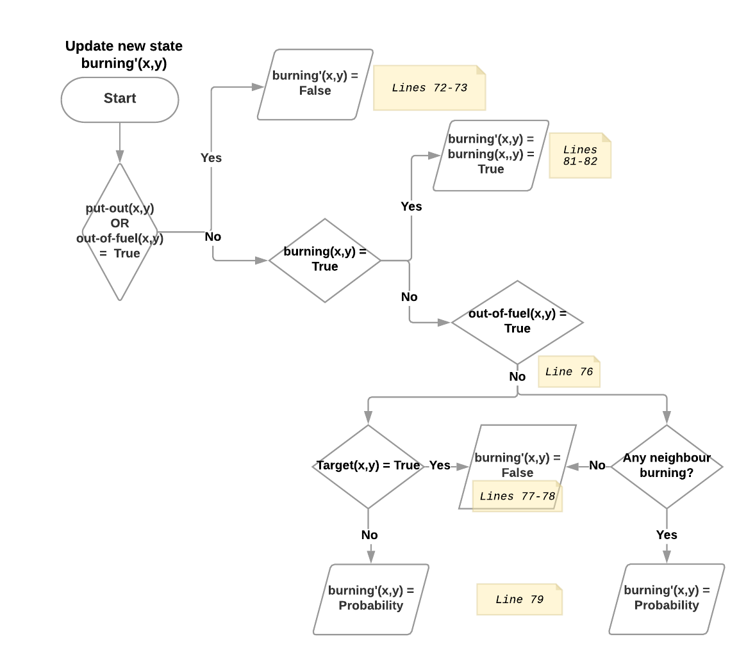

Slide 15
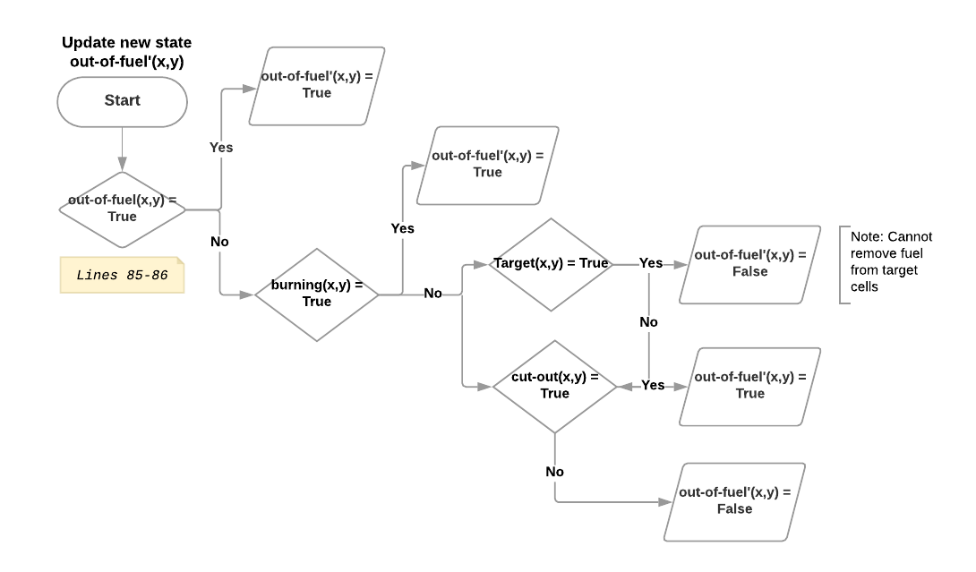

Slide 16
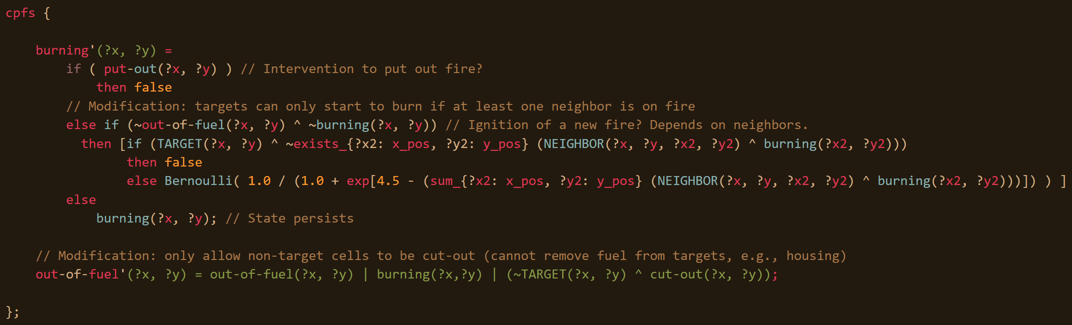

Slide 17
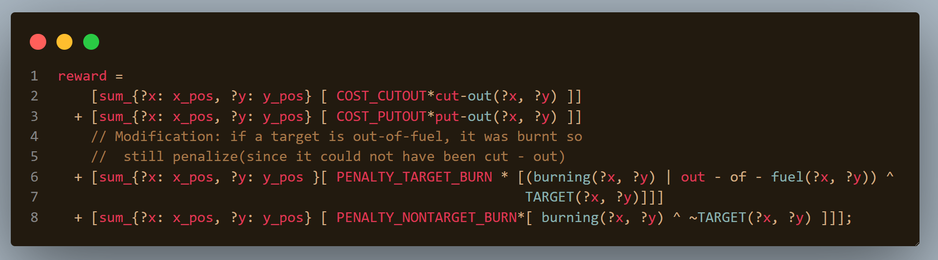

Slide 18
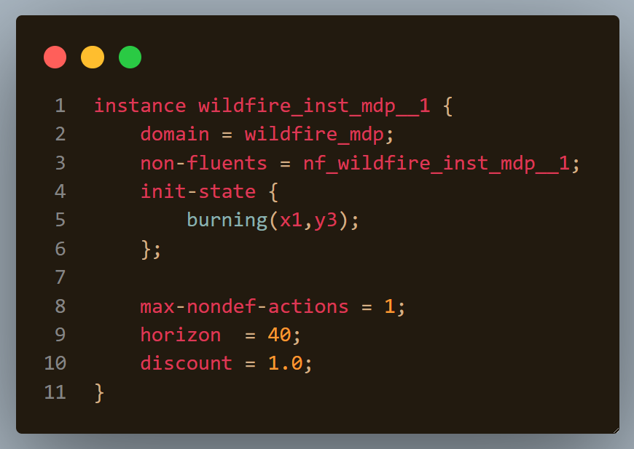

Slide 19
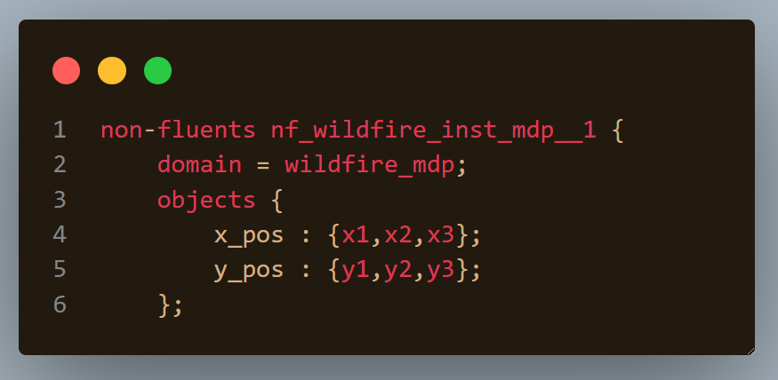

Slide 20
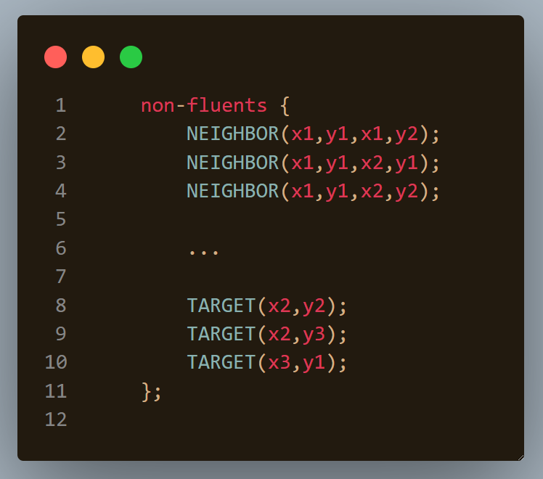

Slide 21
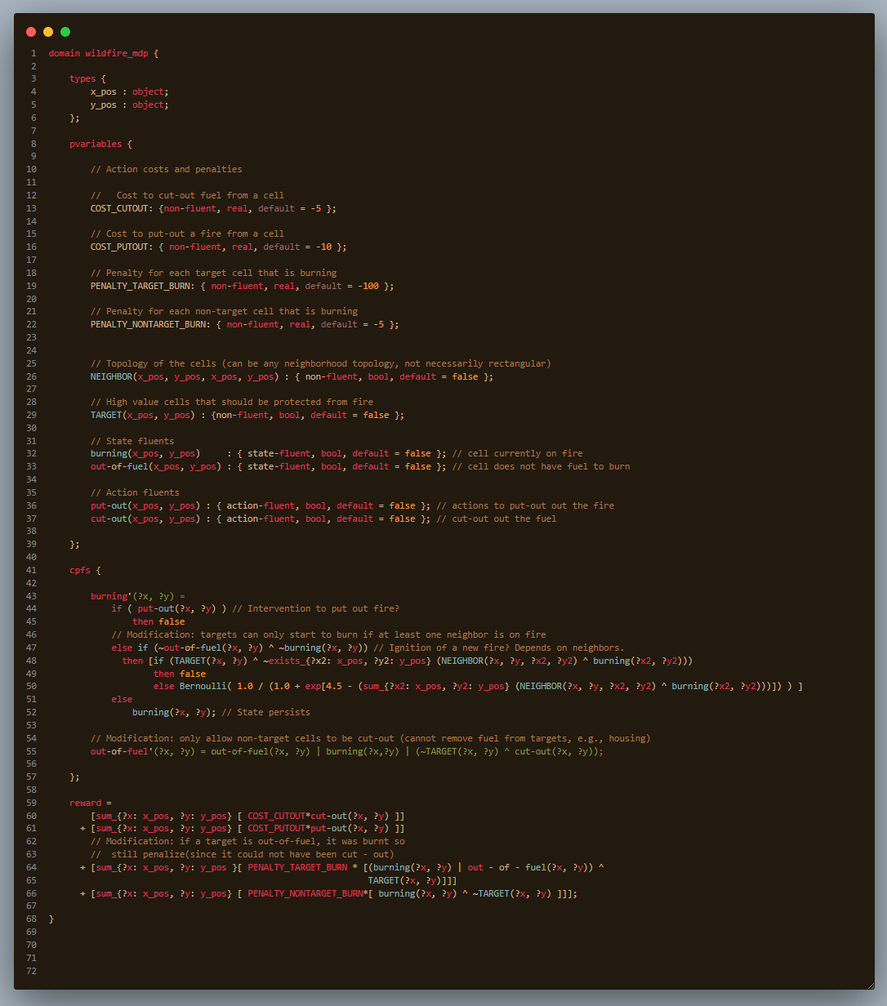
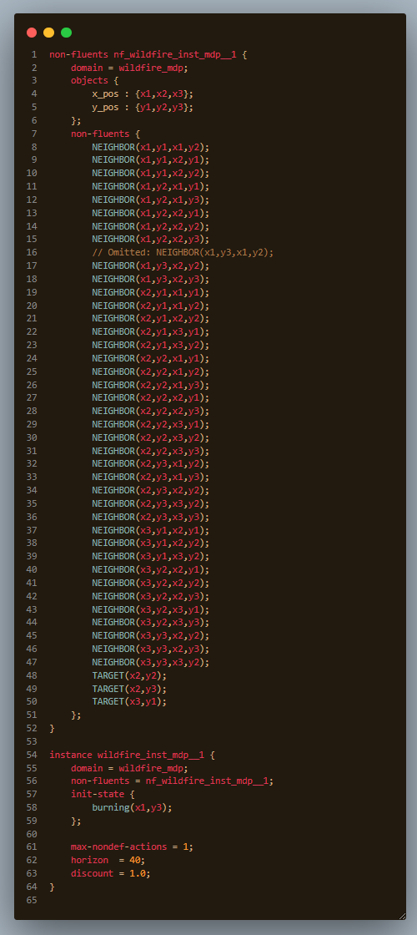

Slide 22
Let’s put out some fires!!!

Slide 25
2. Getting everyone to their destination
Load and drive passengers and get them all there
http://editor.planning.domains/planning-course/adl/passengers

Slide 26
http://editor.planning.domains/planning-course/adl/passenged

Slide 27
3. Moving an autonomous car around
Put the shuttles on the circuit!
http://editor.planning.domains/planning-course/adl/circuit

Slide 28
http://editor.planning.domains/planning-course/adl/circed

Slide 29
4. Picking up / dropping off passengers
Everyone aboard! Either that, or get outa here…
http://editor.planning.domains/planning-course/adl/all-aboard

Slide 30
http://editor.planning.domains/planning-course/adl/boarded

Slide 31
5. Safe manual moves
Let’s just avoid all those Tesla shuttles…
http://editor.planning.domains/planning-course/adl/safe

Slide 32
http://editor.planning.domains/planning-course/adl/safetied

