Slide 1


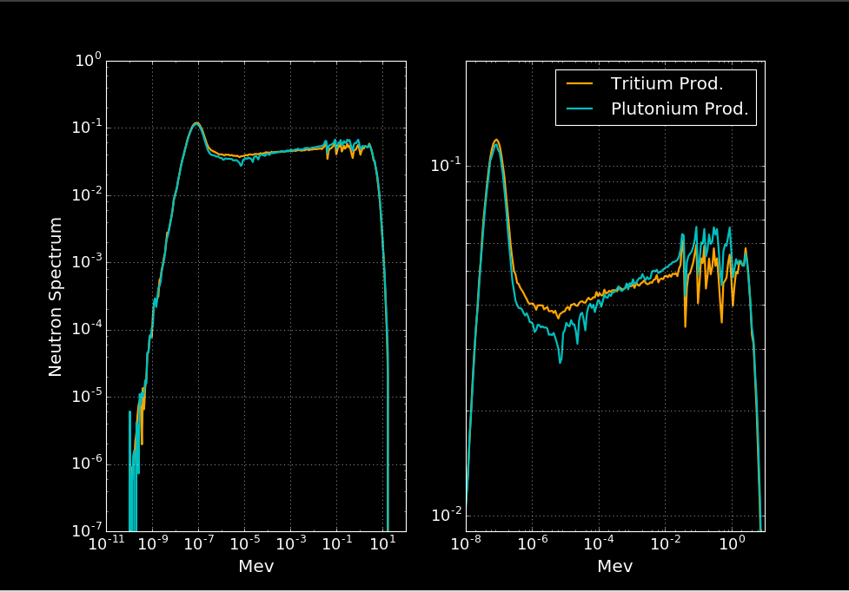






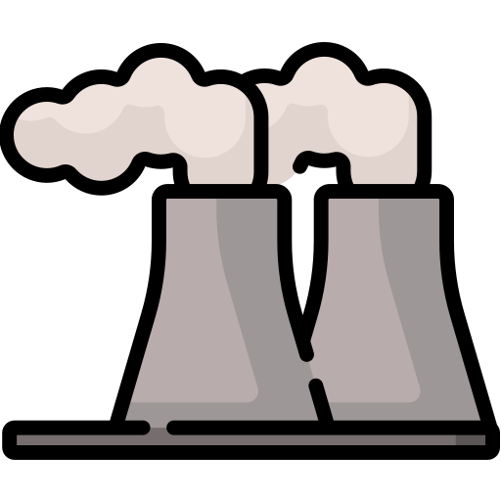




Estimating plutonium and tritium production in China and North Korea without relying on their collaboration
²³⁹Pu
Reactor design & operation
³H
Collecting information on nuclear reactors’ past operation and simulating their plutonium and tritium production with advanced physics software
Undertaking reactor physics analysis to understand how and in which reactors plutonium and tritium could have been produced
Reviewing potential applications of dual-use technologies and projects on production capabilities for nuclear weapons
Ex: North Korean tritium production in 5 MWe or IRT?
Guangyuan
Jiuquan
5 MWe
IRT
Closed fuel cycle
ELWR

Slide 2
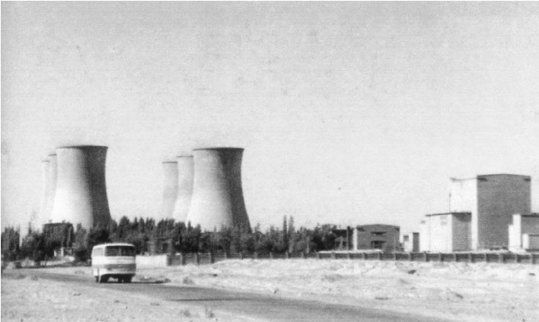
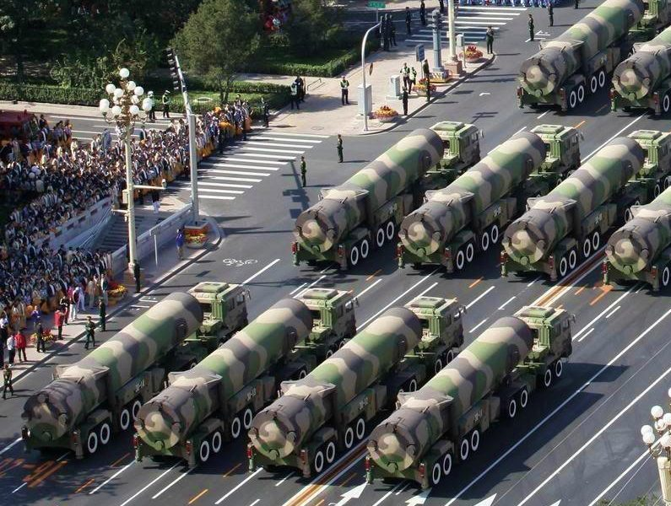
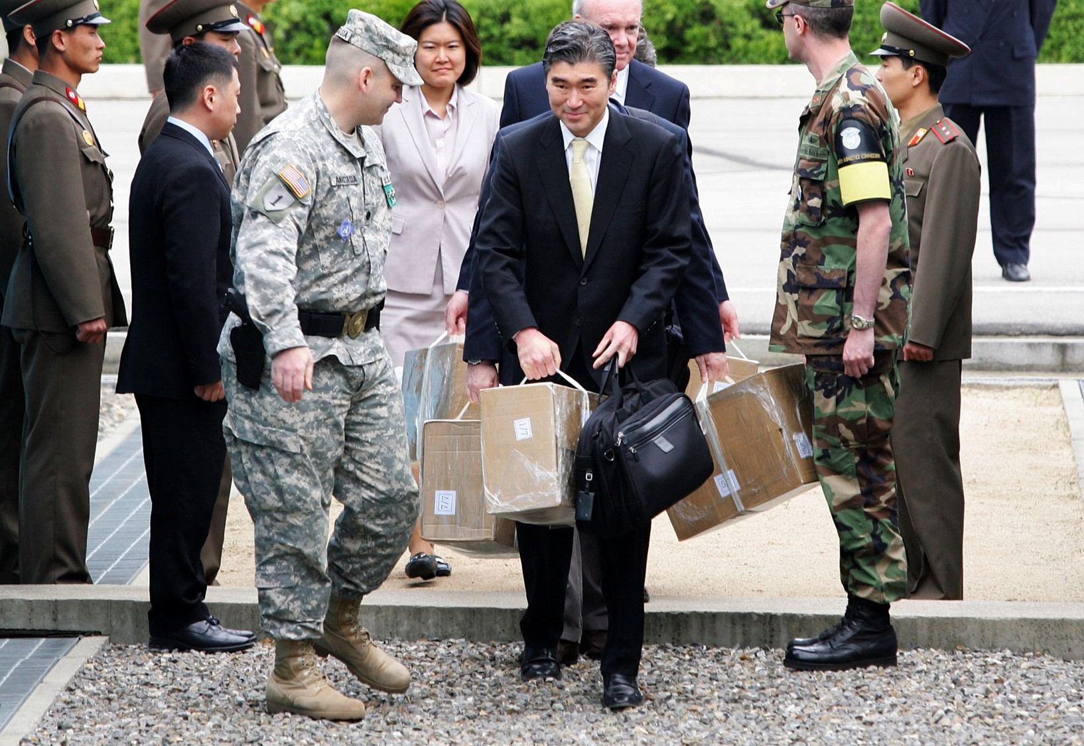
Expected achievements and policy implications
Better understanding of past production and current production capabilities in China and North Korea
Informing policymakers on China nuclear capabilities and possible future evolution (avoid extravagant speculations)
Formulating appropriate verification measures on plutonium and tritium for arms control efforts in North Korea
Ex: How is China currently producing tritium?
Ex: How big can Chinese arsenal grow if closed-fuel cycle used for military capabilities?
Ex: How to verify non-production of plutonium or tritium in denuclearization scenario?

