Slide 1
Seaborn

Slide 2
Why use Python Seaborn?
Python Seaborn library is used to ease the challenging task of data visualization and it’s based on Matplotlib.
Seaborn allows the creation of statistical graphics through the following functionalities:
An API that is based on datasets allowing comparison between multiple variables
Supports multi-plot grids that in turn ease building complex visualizations
Univariate and bivariate visualizations available to compare between subsets of data
Availability of different colour palettes to reveal various kinds of patterns
Estimates and plots linear regression automatically

Slide 3
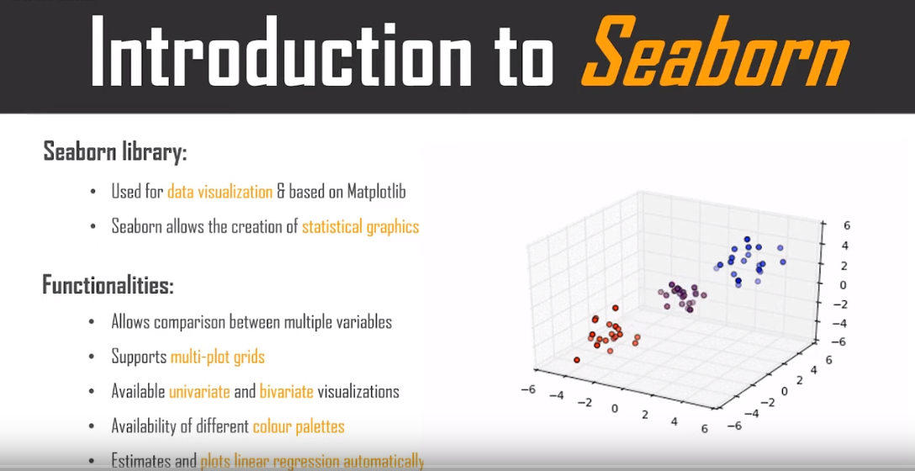

Slide 4
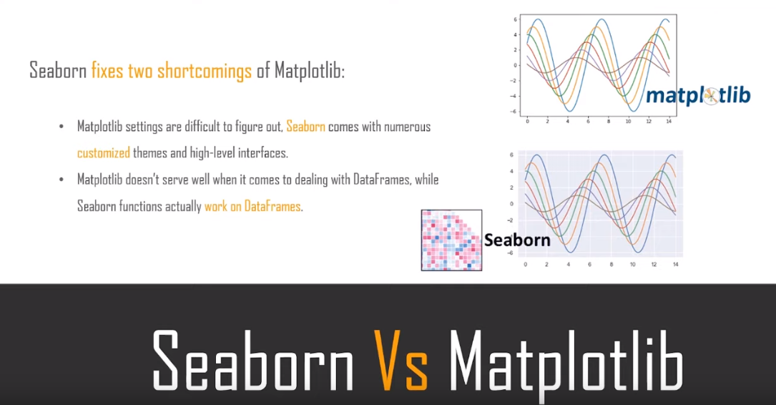

Slide 5
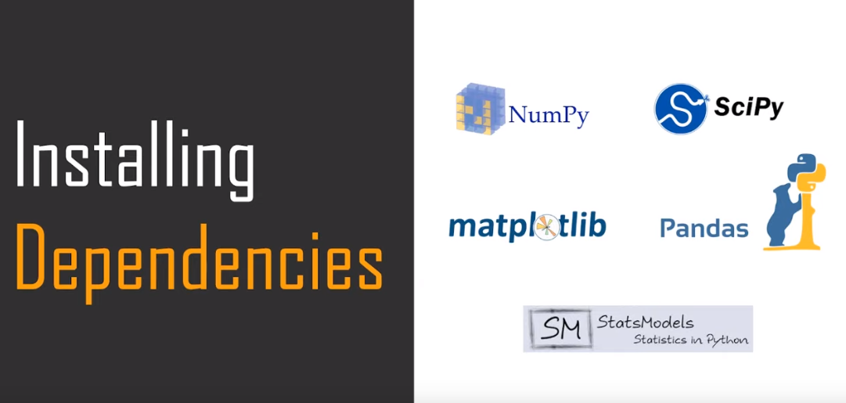

Slide 6
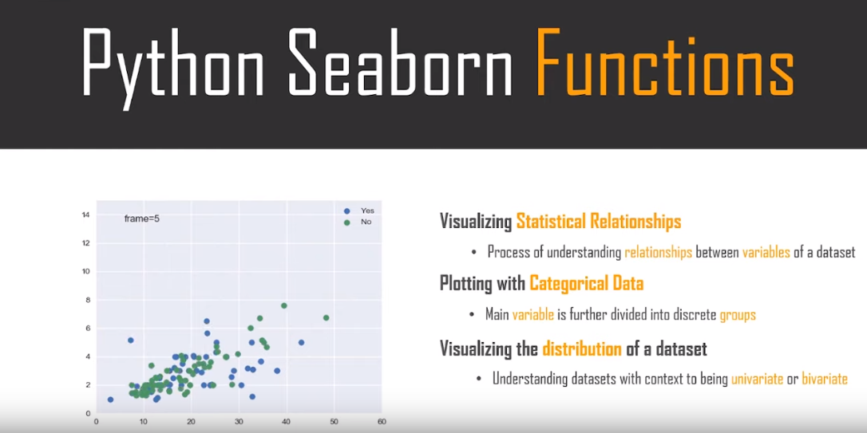

Slide 7
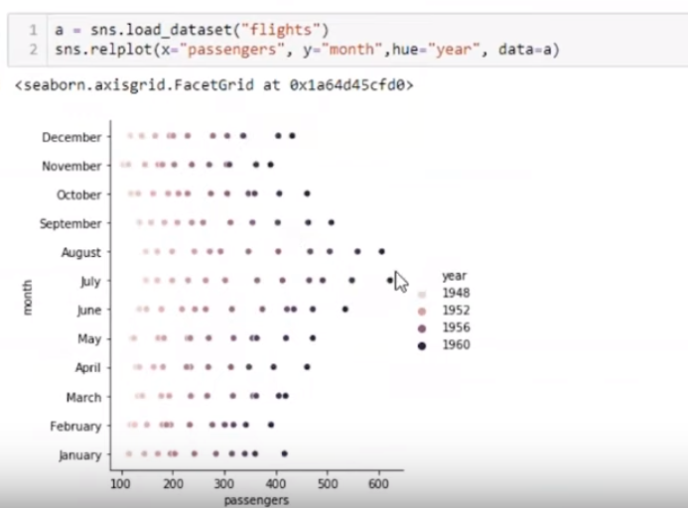
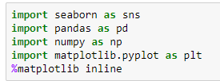
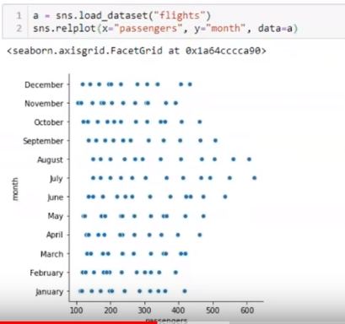
Relplot

Slide 8

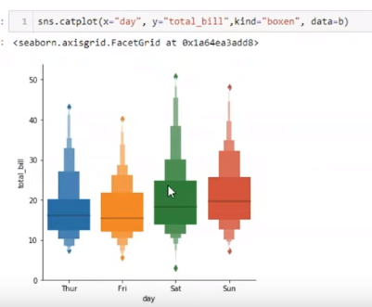
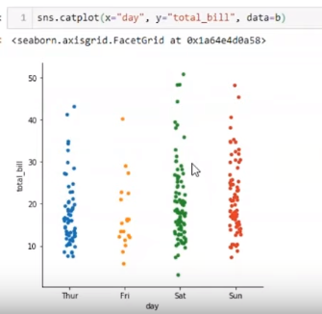
Catplot

Slide 9
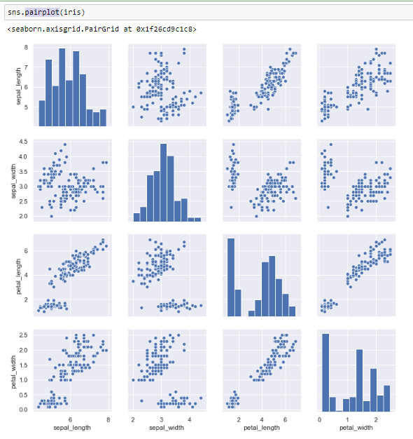
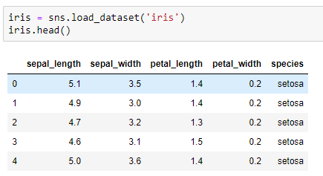
Pairplot

Slide 10
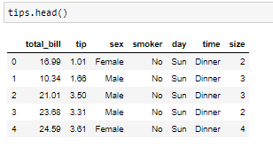
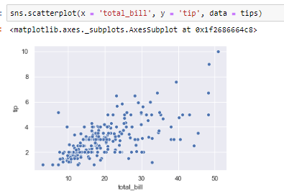
Scatterplot

Slide 11
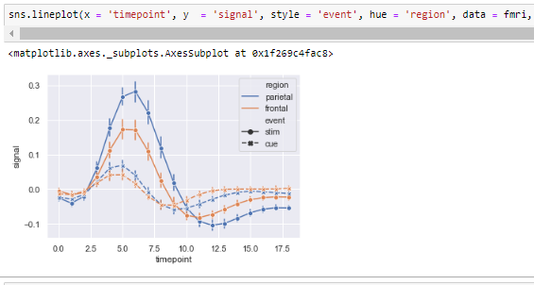
Lineplot

Slide 12
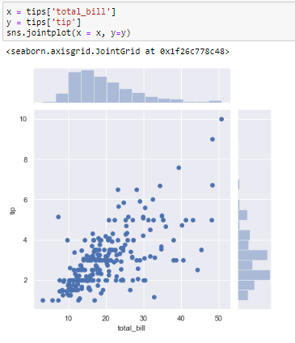
Jointplot

