Slide 1


z
PA movement
Waveguide 1
Waveguide 2
……
L_{z}
BS
Waveguide M
x
User 1
……
User K
L_{y}
y
User 2
L_{x}

Slide 2
z
N PAs
Waveguide 1
Waveguide 2
……
L_{z}
BS
Waveguide M
x
User 1
……
User K
L_{y}
y
User 2
L_{x}

Slide 3
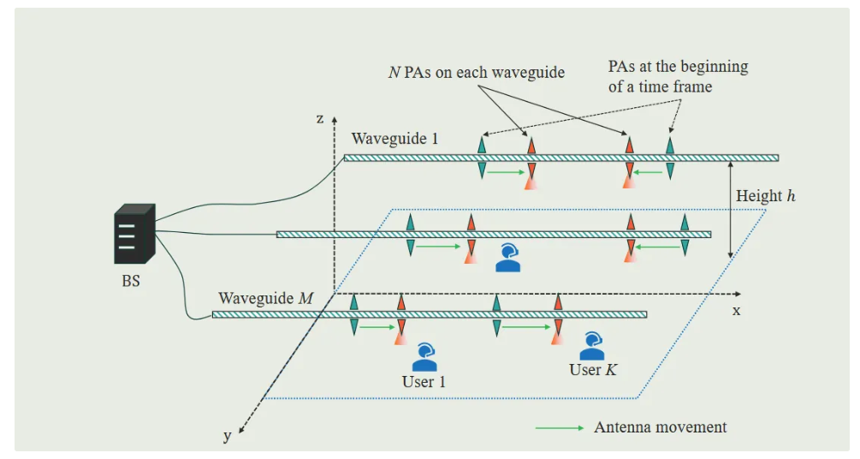


Slide 4
