Slide 1


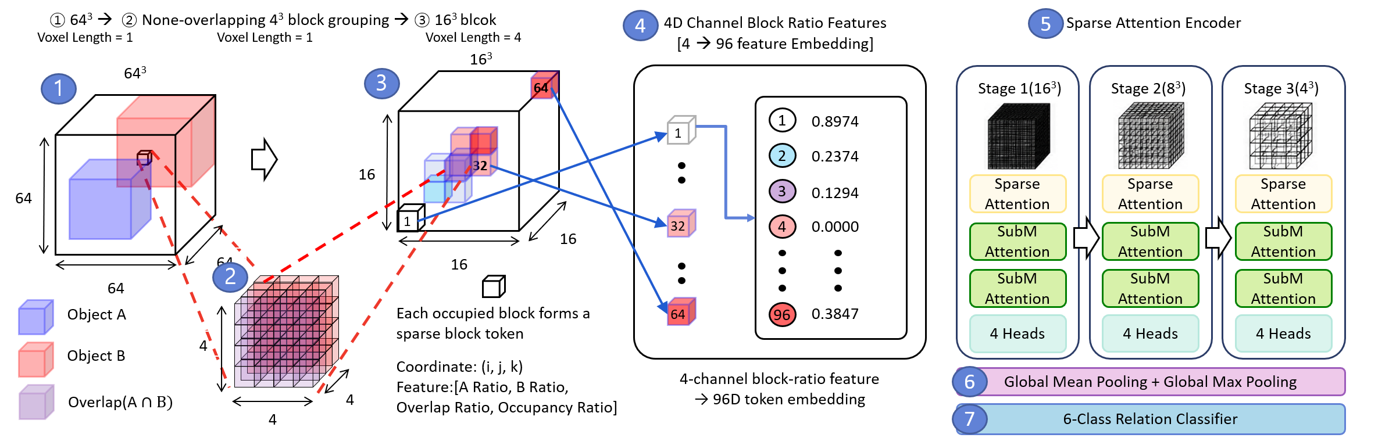
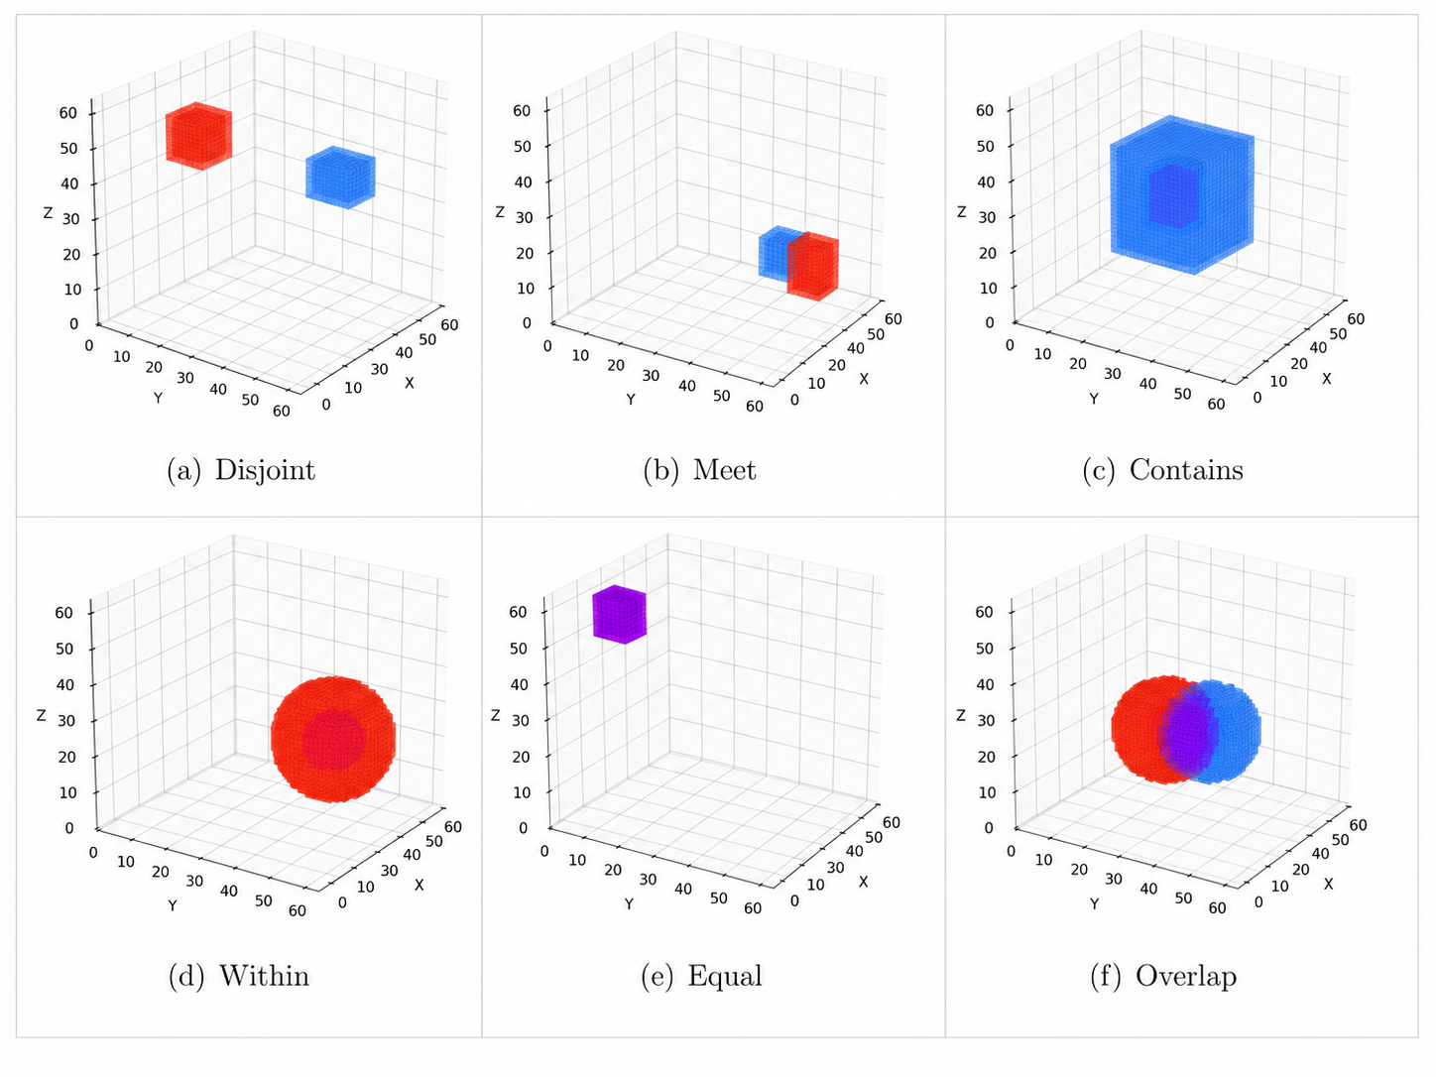
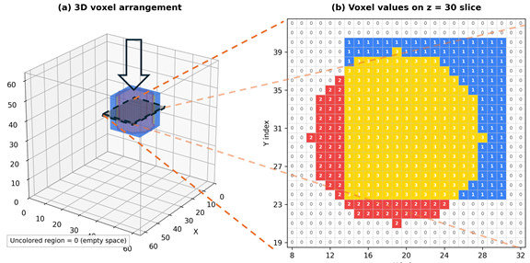
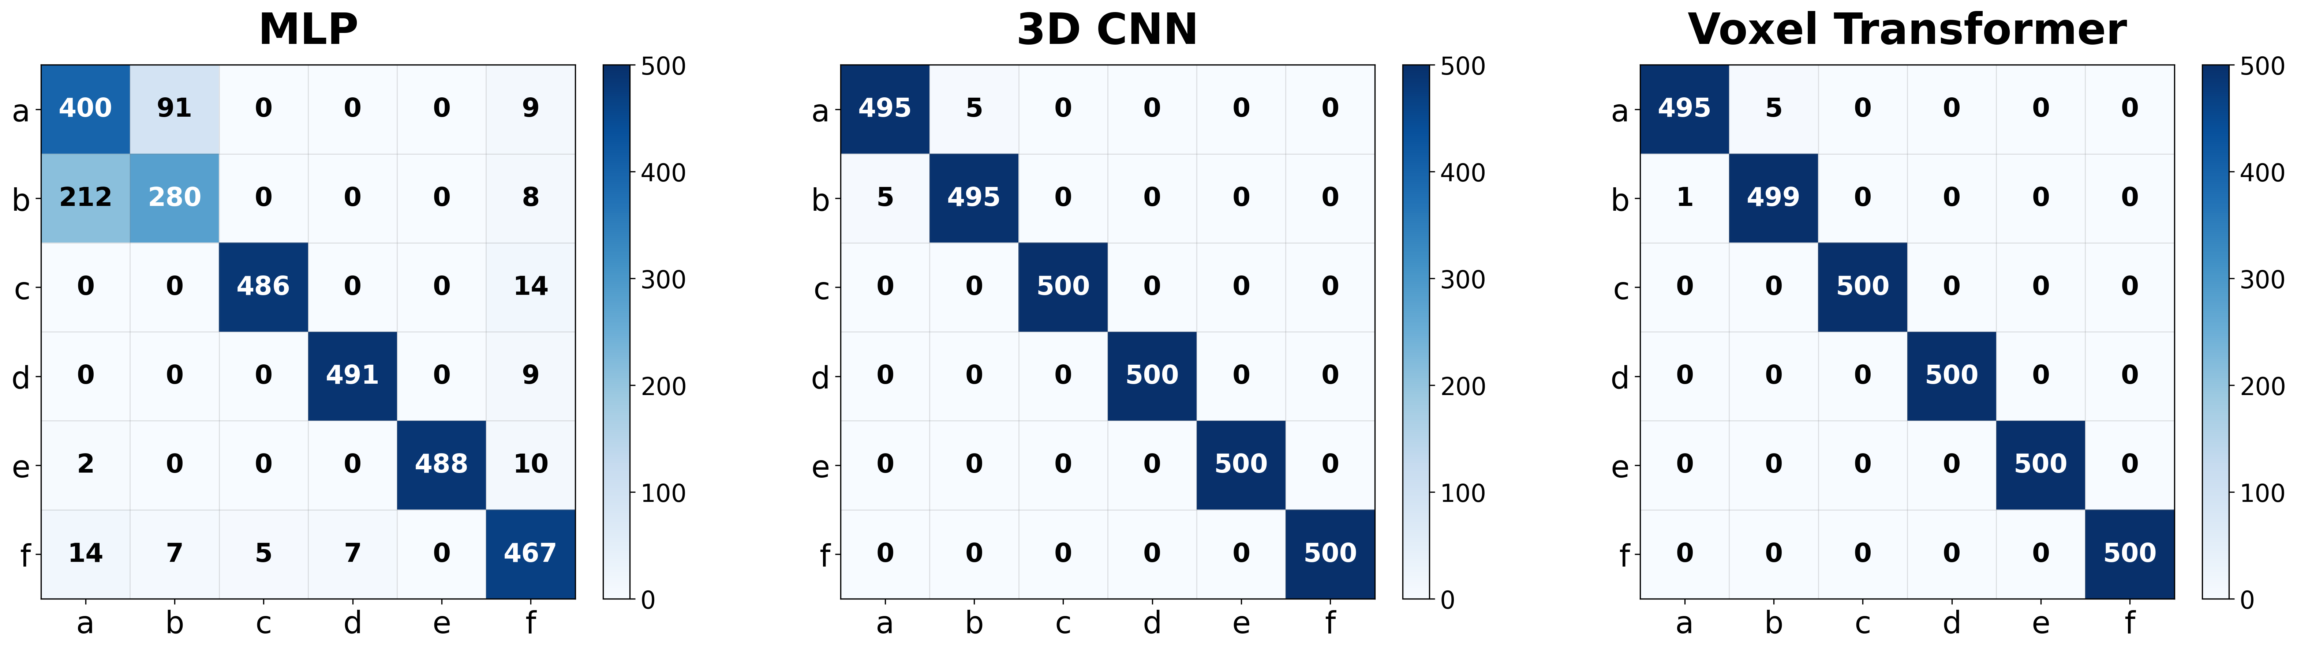
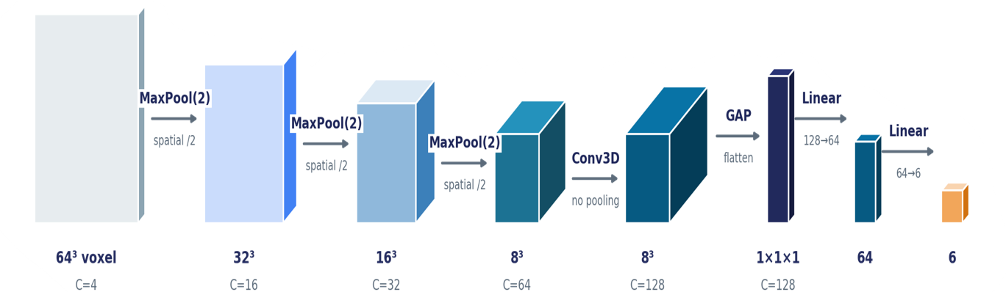
Comparative Analysis of Deep Learning Models for Voxel-Based 3D Spatial Relation Operations
Jaeseok Seo ^{1, 4}
Jaehong Kim^{2,4}
Kiwook Park^{3,4}
Kihoon Lee⁴
Kwangsoo Kim⁴
¹ Konyang University/Department of Artificial Intelligence, Daejeon, Korea, vhvj1398@gmail.com
² Dongguk University/Department of Computer Science and Artificial Intelligence, Seoul, Korea, imjahk@dgu.ac.kr
³ University of Ulsan/Department of IT Convergence, Ulsan, Korea, kmj977284@gmail.com
⁴ Electronics and Telecommunications Research Institute, Daejeon, Korea, {hoony, enoch}@etri.re.kr
INTRODUCTION
  c. VT (Voxel Transformer)
Background
  The demand for 3D spatial information analysis is increasing in fields such as digital twins, autonomous driving, and robot navigation.
  Voxels represent space as regular grids and can be used for various 3D spatial operations.
  However, rule-based methods have limitations in handling complex spatial structures and diverse spatial relations.
Object of this study
  Fig 4. Voxel Transformer flowchart
  Formulate voxel-based 3D spatial operations as a spatial relation classification problem between two objects.
  Compare the performance of MLP(Multi Layer Perceptron), 3D CNN(3D Convolution Neural Network), and VT(Voxel Transformer) models.
  Evaluate the potential of learning-based intelligent voxel spatial operations.
RESULTS
  a. Table of DE-9IM data based Voxel classification performance
  VT achieved the best performance among all evaluated models.
  Models that explicitly learn 3D spatial structures significantly outperformed the MLP baseline.
METHODS & MATERIALS
  Table 2. Performance comparison of MLP, 3D CNN, and Voxel Transformer models.
Model | Methods | Accuracy | Precision | Recall | F1-Score
MLP | (a) | 0.8707 | 0.6369 | 0.8000 | 0.7092
 | (b) |  | 0.7407 | 0.5600 | 0.6378
 | (c) |  | 0.9898 | 0.9720 | 0.9808
 | (d) |  | 0.9859 | 0.9820 | 0.9840
 | (e) |  | 1.0000 | 0.9760 | 0.9879
 | (f) |  | 0.9033 | 0.9340 | 0.9184
3D CNN | (a) | 0.9967 | 0.9900 | 0.9900 | 0.9900
 | (b) |  | 0.9900 | 0.9900 | 0.9900
 | (c) |  | 1.000 | 1.000 | 1.000
 | (d) |  | 1.000 | 1.000 | 1.000
 | (e) |  | 1.000 | 1.000 | 1.000
 | (f) |  | 1.000 | 1.000 | 1.000
Voxel Transformer | (a) | 0.9983 | 0.9979 | 0.992 | 0.9949
 | (b) |  | 0.9920 | 0.998 | 0.9950
 | (c) |  | 1.000 | 1.000 | 1.000
 | (d) |  | 1.000 | 1.000 | 1.000
 | (e) |  | 1.000 | 1.000 | 1.000
 | (f) |  | 1.000 | 1.000 | 1.000
(1). DE - 9IM based Voxel Train-set Construction
  DE-9IM defines spatial relations based on intersections among the interior, boundary, and exterior of two objects.
  Two 3D objects were generated in a 64 × 64 × 64 voxel grid, where empty space was labeled as 0, object A as 1, object B as 2, and the overlapping region as 3.
  Six spatial relation classes were defined: Disjoint(a), Meet(b), Contains(c), Within(d), Equal(e), and Overlap(f), with class-index and one-hot labels.
  The dataset consisted of 18,000 training, 3,000 validation, and 3,000 test samples, balanced across all six classes.
  (a) 3D Voxel Arrangement
  (b) Voxel values on z = 30 slice
  b. Confusion Matrix
  Most classification errors occurred between classes (a) and (b).
  During training, the sparse boundary-contact signal between adjacent A–B voxels can be weakened or lost.
(a) Disjoint
(b) Meet
(c) Contains
  MLP
  3D CNN
  Voxel Transformer
(d) Within
(e) Equal
(f) Overlap
Empty Space
Object B
Object A
Overlap Space
  Fig 1. Six voxel-based 3D spatial relation classes and a 64 × 64 × 64 input data encoding example.
(2). Deep Learning Methods
  Table 1. Optuna based tuning
  Fig 5. Confusion matrices of MLP, 3D CNN, and Voxel Transformer models.
  a. MLP (Multi Layer Perceptron)
  c. Discussion
  MLP : Flattening voxel data weakens explicit 3D spatial relationships, the lowest performance.
  3D CNN : 3D convolution preserves local voxel adjacency and learns hierarchical spatial features, resulting in high performance.
  VT : Local and dilated attention capture both short- and long-range voxel relationships, resulting in the best performance.
Input layer
64x64x64
Hidden Layer 1
Hidden Layer 2
…
Hidden Layer L
Output layer
6-Class
Class | Item | Value
Detail Of Optuna | Best trial number | 13
 | Best validation macro f1 | 0.8789
 | Number of trials | 30
 | Parameter count | 1,844,230
Parameters Of MLP | Number of layers | 4
 | Pooled size | 8
 | Hidden dimension | 512
 | Dropout | 0.1
 | Activation function | GELU
 | Batch normalization | True
 | Optimizer | AdamW
 | Scheduler | Cosine annealing
 | Learning rate | 0.0009
 | Weight decay | 1.10 x 10⁻⁷
 | Gradient clip norm | 0.5
x₁
h¹₁
h^{L}₁
y₁
Disjoint
x₂
h²₁
…
y₂
Meet
x₃
h¹₂
h²₁
h^{L}₂
y₃
Contains
…
…
…
…
y₄
Within
x_{N}
h¹_{N}
h²_{N}
h^{L}_{N}
y₅
Equal
CONCLUSIONS
Activation
Activation
Activation
y₆
Overlap
  Voxel-based 3D spatial operations were formulated as a learning-based spatial relation classification problem.
  The results demonstrated that deep learning models can classify spatial relations between voxel objects with high performance.
  The model effectively learned complex 3D spatial patterns from voxel data.
  The proposed approach can support intelligent voxel operations for digital twins, autonomous driving, and robot navigation.
  Fig 2. MLP flowchart
Softmax
  b. 3D CNN (3D Demension Convolution Neural Network)
ACKNOWLEDGEMENT
(b) Meet
(b) Meet
(b) Meet
(b) Meet
64
FC Layer +
Dropout
(b) Meet
6
Output
(6 relations)
64³ voxel
C=4
Input
32³
C=16
Conv Block 1
16³
C=32
Conv Block 2
8³
C=64
Conv Block 3
8³
C=128
Conv Block 3
1³
C=128
Global Average
Pooling
(b) Meet
  This work is supported by the Korea Agency for Infrastructure Technology Advancement (KAIA) grant funded by the Ministry of Land, Infrastructure and Transport (RS-2025-02317649, Implementation and Application of 3D Grid System for Advanced National Spatial Information).
  Fig 3. 3D CNN flowchart

Slide 2
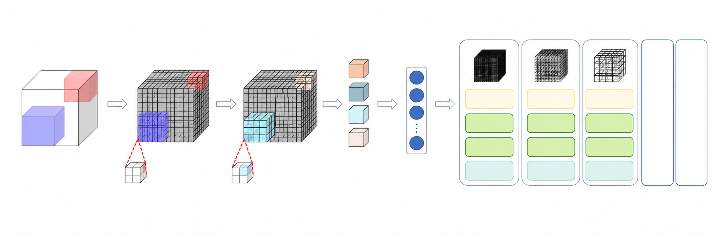
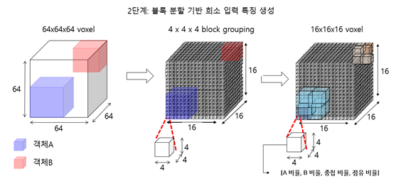
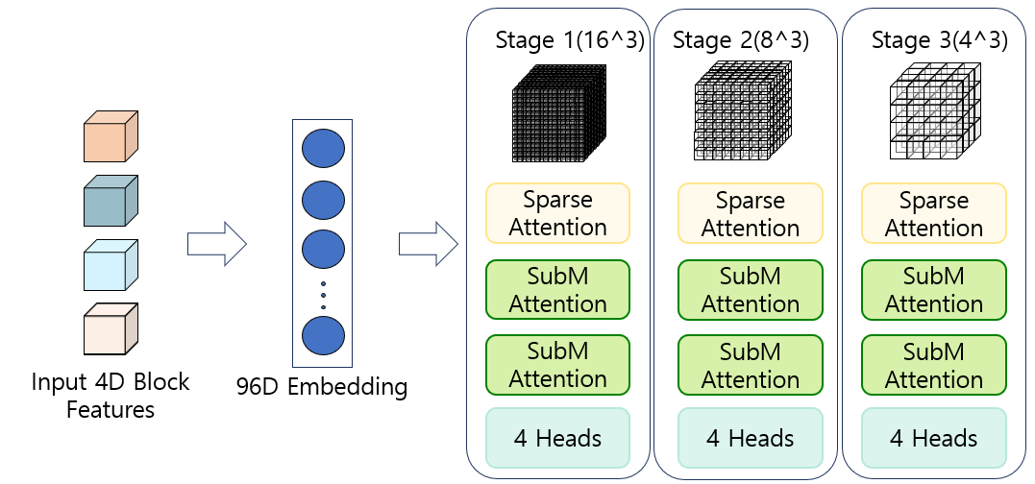
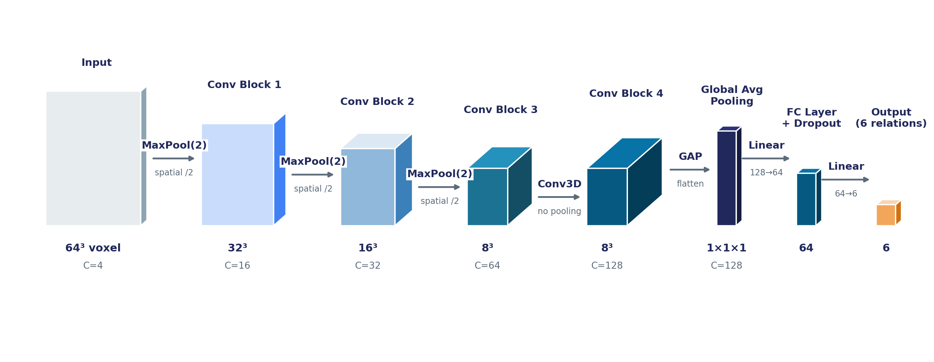
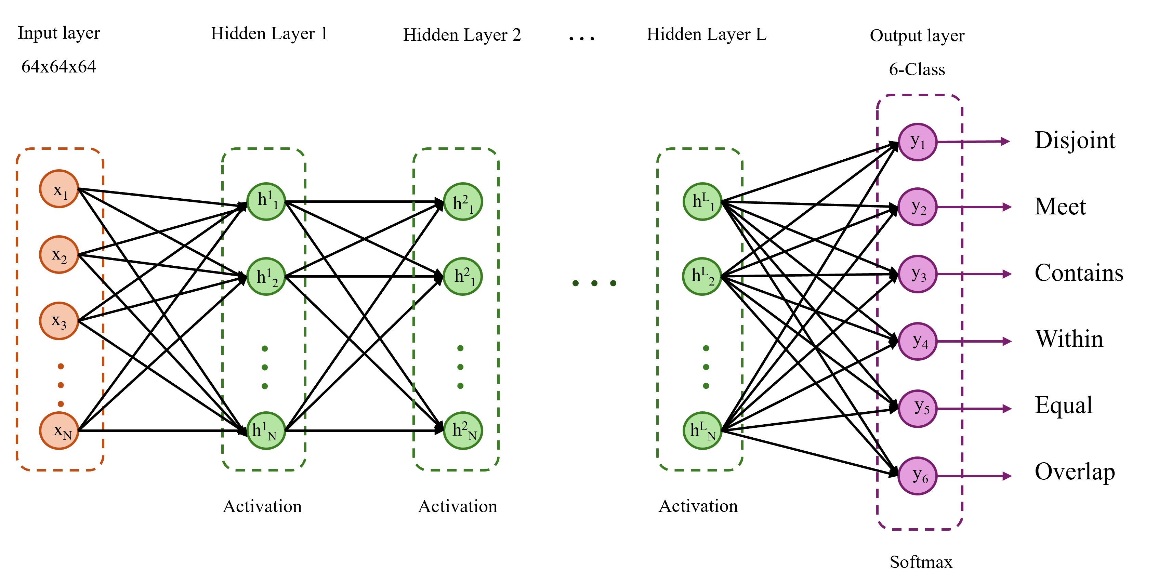
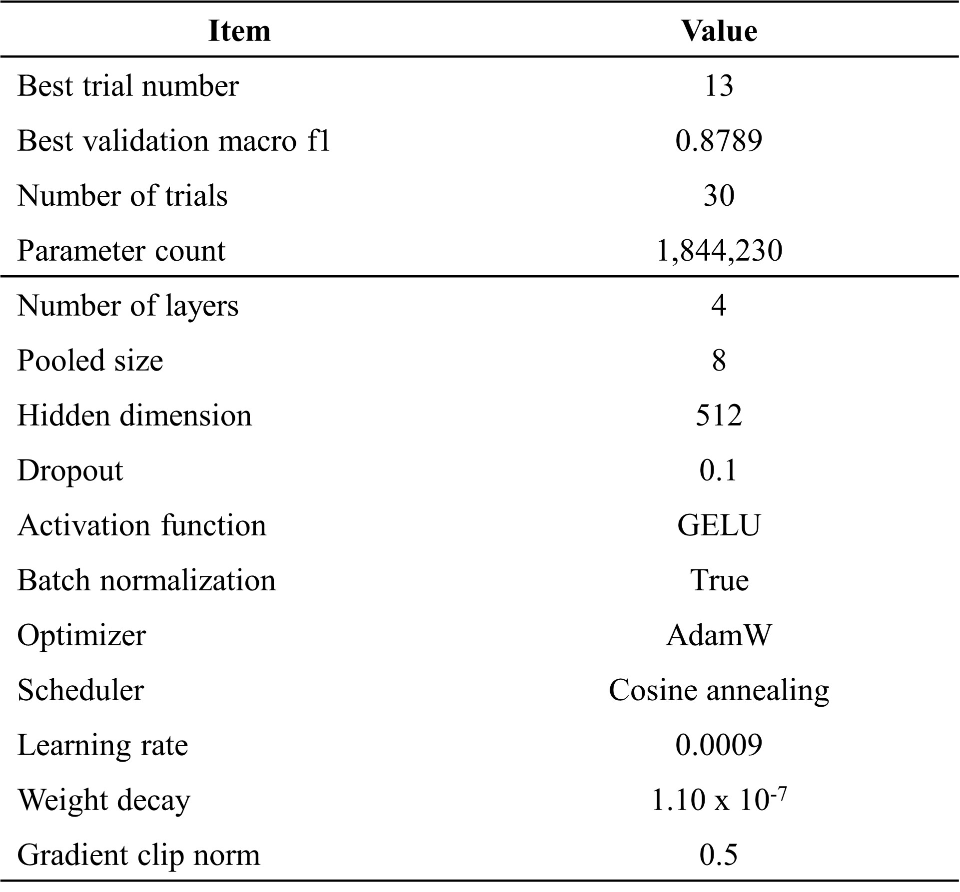
Input layer
64x64x64
Hidden Layer 1
Hidden Layer 2
…
Hidden Layer L
Output layer
6-Class
Item | Value
Best trial number | 13
Best validation macro f1 | 0.8789
Number of trials | 30
Parameter count | 1,844,230
Number of layers | 4
Pooled size | 8
Hidden dimension | 512
Dropout | 0.1
Activation function | GELU
Batch normalization | True
Optimizer | AdamW
Scheduler | Cosine annealing
Learning rate | 0.0009
Weight decay | 1.10 x 10⁻⁷
Gradient clip norm | 0.5
x₁
h¹₁
h^{L}₁
y₁
Disjoint
x₂
h²₁
…
y₂
Meet
x₃
h¹₂
h²₁
h^{L}₂
y₃
Contains
…
…
…
…
y₄
Within
x_{N}
h¹_{N}
h²_{N}
h^{L}_{N}
y₅
Equal
Activation
Activation
Activation
y₆
Overlap
Softmax
Global Mean Pooling + Global Max Pooling
6-class classification
(f) Overlap
(f) Overlap
(f) Overlap
(f) Overlap
(f) Overlap
(f) Overlap
(f) Overlap
(f) Overlap
(f) Overlap
(f) Overlap
  Optuna based Tuning

